Slide 1
Why do we need this?
This is the so-called “synthesis”, which converts arithmetics to silicon gates
This is the matter base of binaries
O₀
O₁
A₀
B₀
A₁
B₁
1 2 8
^
^
+
1 2 8
&
Carry
^
1
2 5 6
&
Carry
|
&
|
&

Slide 2
Why do we need this? (CORRECTED)
This is the so-called “synthesis”, which converts arithmetics to silicon gates
If you do a+b in Verilog, the synthesizer will take all the for you
O₀
O₁
A₀
B₀
A₁
B₁
1 2 8
c[i], o[i] =
full_adder(a[i], b[i], c[i-1])
^
^
+
1 2 8
&
Carry
^
1
2 5 6
&
Carry
|
&
|
&

Slide 3
What if I want something different?
Let’s start with a trivial solution.
Repeat this block next 31 times
O₀
O₁
O₂
c[i], o[i] =
full_adder(a[i], b[i], c[i-1])
A₀
B₀
A₁
B₁
A₂
B₂
^
^
^
c[i], o[i] =
(kbit_adder(32))(
a[i],
b[i],
c[i-1])
&
Carry
^
^
&
Carry
&
Carry
|
|
…
&
&
|
|
&
&

Slide 4

Wait... What is something different?
Or how good or bad is this solution?
Repeat this block next 31 times
O₀
O₁
O₂
A₀
B₀
A₁
B₁
A₂
B₂
Pros: It works, and it is simple!
Cons: Slow... The longest path is linear to the bit width.
^
^
^
&
Carry
^
^
&
Carry
&
Carry
|
|
…
&
&
|
|
&
&

Slide 5
What is system about?
Create a feeling of “it was all the same”
AB
c[i], o[i] =
(kbit_adder(32))(
a[i],
b[i],
c[i-1])
C
O₀
O₁
O₂
A₀
B₀
A₁
B₁
A₂
B₂
^
^
^
OK. Let’s view this problem in a higher view.
Why do I bother to wait?
&
Carry
^
^
&
Carry
&
Carry
|
|
…
&
&
|
|
&
&

Slide 6
What is system about?
Why do I bother to wait?
Waiting for the carry bit
What if I cannot know it earlier?
Do both!
c[i], o0[i] =
(kbit_adder(k))(
a[i], b[i], 0)
AB
0
AB
1
c[i], o1[i] =
(kbit_adder(k))(
a[i], b[i], 1)

Slide 7
Why is it useful to do both?
Either is useful! Select the useful one!
adder l..r
=
=
+
+
+0
+1
o[l:r] = carry[l-1] ? : ;
c[r] = carry[l-1] ? : ;

Slide 8
Summary: Hierarchical Synthesis
AB
=
Building the h/w is all about the levels and levels
C
+
O₁
+0
A₁
B₁
^
^
&
Carry
|
&
|
&

Slide 9
Summary: Hardware Synthesis
Why do we call it hierarchical synthesis not recursive function call?
What makes s/w h/w essentially different?
// bit-level
c[i], o[i] = full_adder(a[i], b[i], c[i-1])
// chunk-level
c[i], o[l:l+4] = (kbit_adder(5))(a[i], b[i], c[i-1])
// put it all together
o[l:r] = c[l-1] ? o1[l:r] : o0[l:r]
c[r] = c[l-1] ? c1[l:r] : c0[l:r]

Slide 10
Homework: A Carry Ripple Adder
Implement what I taught you just now in gate level
All the usage of +/- operator will be regarded as invalid
This is an co-operational homework for PPCA
Please do this independently
The REAL homework of this class will be postponed

Slide 11
An Intro to Computer System
W2D1: A Deeper Tour to C/C++ Language
Jian Weng
Computer Science
CEMSE, KAUST

Slide 12
Roadmap
How much do you know C?
Memory layouts
Toolchains
How do you work with others?
What are the differences b/t C & C++?

Slide 13
Where did you get the C compiler?
Quick question: Where did you get `gcc`, assuming you are using Ubuntu?
OK. Now you have a compiler.
Let’s write some C code.
> sudo apt update
> sudo apt install gcc

Slide 14
Arrays
What are arrays?
Arrays are a range of continuous memory allocated
Dude, there are no higher-dimension arrays.
All the higher-dimension arrays are syntactical sugars
int a[100]; // 1d array
long b[200][100]; // 2d array

Slide 15
Alignment
Typically arrays are aligned by its scalar element
If unaligned, imaging each element may look like this:
How can we write a program to verify this?
uint8_t c[101]; // 101 bytes [7]
uint64_t d[5]; // but d is still aligned!

Slide 16
Flatten Arrays
Dude, there is no high-dimensional arrays
int b[200][100]; // 2d array
// use array
b[i][j]
// flattened array use
((int*)b)[i*100+j];

Slide 17
Global v.s. Local Arrays
Global Arrays
Local Arrays
// N has to be constant
int a[N];
void foo() {
int b = rand();
// This is allowed,
// but not recommended.
int a[b]; }

Slide 18
Flatten Arrays? Hint to pointer access!
In C, if you do this three. The function signature should be the same.
Wait, what is function signature?
Let me explain it later
void foo(int *a) { }
void foo(int a[]) { }
void foo(int a[100]) { }

Slide 19
Hint to pointer access (CONT’D)
Actually, the compiler does not care about the 1st dimension.
void foo(int a[][100]) { } // GOOD!
void foo(int a[10000][100]) { } // GOOD!
void foo(int a[10000][]) { } // BAD!

Slide 20
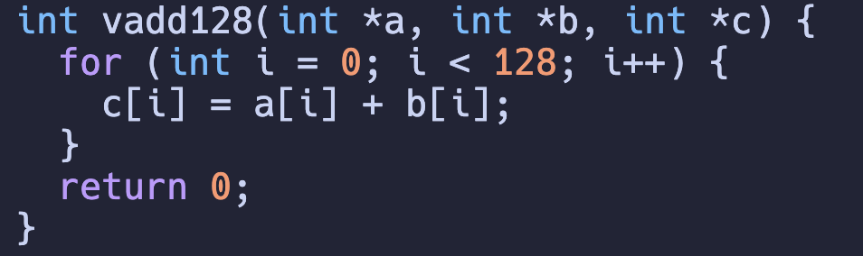
Even more hints to array access
clang array4.c –S –emit-llvm –O3
The generated code is a mess, why?

Slide 21
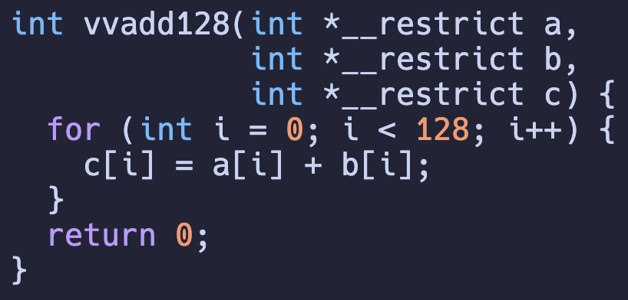
Even more hints to array access
clang array4.c –S –emit-llvm –O3
Why does it help?

Slide 22
Summary: Arrays
Arrays are continuous memory allocated
All the arrays are essentially 1-d
pointer=(∑(idx*stride))*sizeof(elem)
In C, all the array passing are pointer passing
Question: What if you want to pass a array by copying the array?

Slide 23
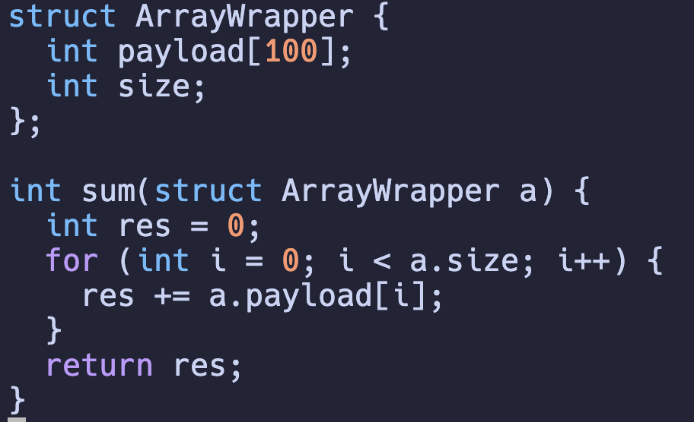
Struct of Array
Any argument passed to this function will be copied to the target function
What are structs?

Slide 24
Ad: Rust is a user-enforced C++
Rust uses its syntax to enforce the mistakes you may make in C++
struct A {
// ... }
fn foo(a: A);
fn goo(a: &A);
fn main() {
let a = A { ... };
foo(a);
// Error! a’s lifetime ends.
goo(&a);
}
struct A {
// ... };
// Bad!
void foo(A a);
// Good!
void goo(const A &a);

Slide 25
Struct: What is a struct?
Struct: A bundle of attributes
Question: What is the offset of each attribute?
Hint: Alignment
#include <stdint.h>
struct A {
int32_t i32;
int8_t i8;
int8_t another;
int64_t i64; };

Slide 26
Struct (CONT’D)
A struct should be biggest attribute aligned.
(+8) – (+5) = 3, 3 bytes wasted by padding
#include <stdint.h>
struct A {
int32_t i32; // +0
int8_t i8; // +4
int8_t another; // +5
int64_t i64; // +8 };
Alignment
CPU is byte-addressable
Each k-byte element should have %k==0

Slide 27
Union
What is a union?
How is the union below aligned?
Assuming we have a 64-bit machine
#include <stdint.h>
union A {
char *ptr,
char ch,
};

Slide 28
Union (Advanced Usage)
What is a union?
How to understand the union below’s usage?
#include <stdint.h>
union A {
int i,
float f,
};
int main() {
union A a;
a.f = 1.0;
printf("%0x%x\n", a.i); }
int main() {
float f;
int i = *((int*)(&f));
printf("0x%x\n", i);
}
int main() {
float f;
printf("0x%x\n",
reinterpret_cast<int>(f));
}

Slide 29
Quiz: How to optimize the memory layout?
Reorder the attributes below to minimize the memory occupancy.
#include <stdint.h>
struct A {
int32_t i32; // +0
int8_t i8; // +4
int8_t another; // +5
int64_t i64; // +8 };

Slide 30
Summary: Arrays, and Structs
Both arrays and structs are essentially “pointer offsets”
struct A {
int32_t i32; // +0
int8_t i8; // +4
int8_t another; // +5
int64_t i64; // +8 };
struct A a;
a.i64;
ptr = (int64_t*)(((uint8_t*)&a) + 8);
*ptr;

Slide 31
Summary: Arrays, and Structs
Both arrays and structs are essentially “pointer offsets”
To conclude, I would rather call struct a “heterogeneous array”
uint32_t a[100];
// Normally
a[i] = 0;
// Break it down!
ptr = (((int8_t*)a) + i*4)
*ptr = 0;

Slide 32
Summary: Arrays, and Structs
What are the differences between these two?
uint32_t a[100];
// Be careful about left and
// right values
c = a[i] * 2;
a[i] = c + d;

Slide 33
Function Signature
An "Identifier" to the function
In C, this identifier is not ambiguous
The parsed identifier token is also the only identifier to the function
But…
int foo();

Slide 34
Function Signature (CONT’D)
I did not talk about this syntactical sugar in last class
Because I think it is evil 🤦🏻‍♀️
This implicit signature style is explicitly disabled in modern languages because error-prone
clang main.c –S –emit-llvm -c
int foo();
int foo(int x);
int foo(float x);
_Z3foov
_Z3fooi
_Z3foof
Function argument list
C++ mangling padding
Function identifier string length is 3

Slide 35
Function Signature (CONT’D)
Any problem in computer system can be solve by another level of indirection
This introduces a new syntactical feature, while retaining backward compatibility
clang main.c –S –emit-llvm -c
int foo();
int foo(int x);
int foo(float x);
_Z3foov
_Z3fooi
_Z3foof
Function argument list
C++ mangling padding
Function identifier string length is 3

Slide 36
Recap: How should I deal with overloaded visitors in languages with overload disabled?
Visitor pattern is a visitor to traverse each node in depth first
class VisitorBase {
virtual void visit(CompoundStmt *s) {
for (auto &stmt : s->stmts) {
this->visit(s); } }
virtual void visit(DeclStmt *s) {
this->visit(s->var);
if (s->init) this->visit(s->init); }
virtual void visit(RefVar *r) {
/*It is a leaf*/ }
}

Slide 37
Recap: How should I deal with overloaded visitors in languages with overload disabled?
Answer: Manually rename the functions
class VisitorBase {
void visit_compound_stmt(CompoundStmt *s) {
for (auto &stmt : s->stmts) {
this->visit(s); } }
void visit_decl_stmt(DeclStmt *s) {
this->visit(s->var);
if (s->init) this->visit(s->init); }
void visit_var(RefVar *r) {
/*It is a leaf*/ }
}

Slide 38
Function Signature (CONT’D)
What if I do not want the mangling?
Spoiler: This will be useful for your homework.
extern "C" {
// within this scope
// functions will not
// be mangled
int foo();
int foo(float x); // NOT GOOD!
}

Slide 39
What is next?
How many people still remember this?
In LLVM, Assembler and Linker are separated
In GCC, Linker is separated
Anyways, the compiler is just an “invoker”.
PP
Tokenizer
Parser
IR CodeGen
Optimizer
Inst Select
Register Allocation
Machine Rel. Opt.
Assembler
Link Lib
Frontend
Backend

Slide 40
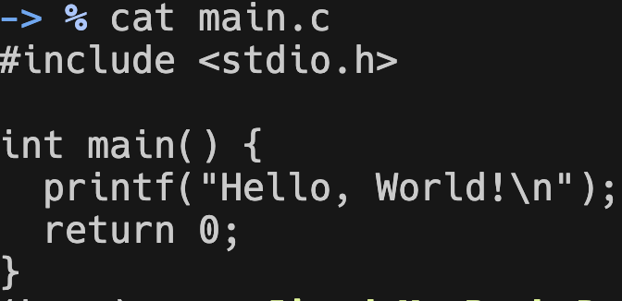
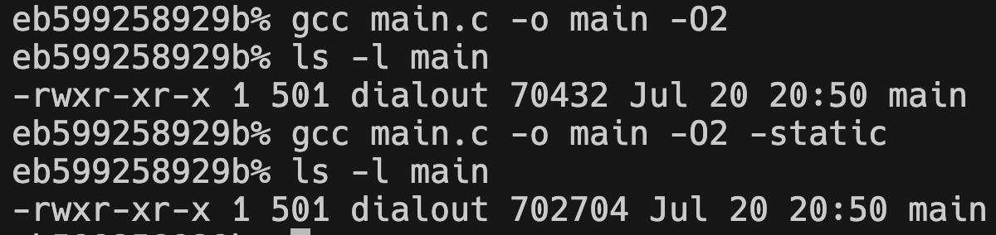
Link the libraries
Compile the program with different linkages
Non-static is 10x larger than static
Why?

Slide 41

Library Linkage (CONT’D)
How many people are playing games on Steam especially on Windows?
Before installing in a game did you see what were installed?
Actually, these three are the same thing:
Linux: .so
MacOS: .dylib
Windows: .dll
An executable w/o main entrance
Then, who drives the execution?
Source: https://en.wikipedia.org/wiki/DLL_hell

Slide 42

Dynamic/Static Linkage
Metaphor: I want a reference to a file in Linux in my project
Option 1: Just copy it!
Option 2: Link, a soft link.
You may just regard soft link like a short cut
cp source dest # static linkage
ln –s source dest # dynamic linkage

Slide 43
Where did you get the C toolchain?
Quick question: Where did you get `gcc`, assuming you are using ubuntu?
Gcc is just a tool of the chain, what are else trying to help?
sudo apt update
sudo apt install gcc
sudo apt install build-essential

Slide 44
What are “others” trying to help?
Work on larger projects
Give your code for others’ use
Use others’ code
Separate works into pieces
Put back separated pieces into one

Slide 45
What is Makefile?
You can do this even without a Makefile, but who will?
A basic entry of Makefile shall be:
The target is main, which depends on main.c
When main.c is changed, use the command below to recompile
> make main.c
cc main.c –o main
main: main.c
cc $^ -o $@ -O3

Slide 46
Makefile: More complicated
(1)
(4)
// main.c
#include "hello.h"
int main() {
helloworld(); }
hello.o main.o: %.o: %.c
cc $^ -o $@ -O3 -c
hello: main.o hello.o
cc $^ -o $@ -O3
(2)
// hello.h
#include <stdio.h>
void hello();
> make hello
> ./hello
(3)
Did you notice the problem?
// hello.c
#include <stdio.h>
void hello() {
puts("Hello, world!"); }

Slide 47
What is NOT decl-impl decoupled in C++?
Hint: Did you learn data structure?

Slide 48
Rustup! Rust unifies generic types and subclasses
For performance consideration, Rust nearly removes subclasses.

Slide 49
Summary
Only changing header is not captured.
What’s more?
File organization is more complicated
I want to use external code

Slide 50
How can I organize a project?
Did you try to setup a open-source project before?
|
|-- {src/lib}: for compilational code
|-- include/xxx: for header files
|-- python/xxx: for Python frontend
|-- tests: for unit tests
|-- build-system: for build invocation
`-- build: built by build

Slide 51
What are we trying to deliver?
Something usable.
How to use it?
|
|-- {src/lib}: for compilational code
|-- include/xxx: for header files
|-- python/xxx: for Python frontend
|-- tests: for unit tests
|-- build-system: for build invocation
`-- build: built by build

Slide 52
Rustup! Cargo package manager.
Installation
This installs both rust compiler and package manager
Package manager
curl --proto '=https' --tlsv1.2 \
-sSf https://sh.rustup.rs | sh
cargo init # initialize a hello world project for u

Slide 53
Recap: What was our goal?
Give our code for others to use
(Or use others)
How? What is exposed?
> ls /usr
lib include share

Slide 54
In include
Header files
There are only declarations
Where are the implementations?
In libs
Or, what if I have a function without implementation?
We talked about too much good and correct things in our education.
Which seems everything should be magically just good and correct.

Slide 55
Let’s look at a toy example.
Understanding several additional flags
-I<dir>: find headers from the given <dir>
-L<dir>: will find libs from the given <dir>
-l<lib-name>: link the libxxx.{a/so} from the <dir> given by -L
No body teaches you how to read documents before, I do

Slide 56
Summary: What to expose?
In C/C++ family programming, .h are exposed for function interfaces.
.so/.a are accompanied with .h for linking the binaries.

Slide 57
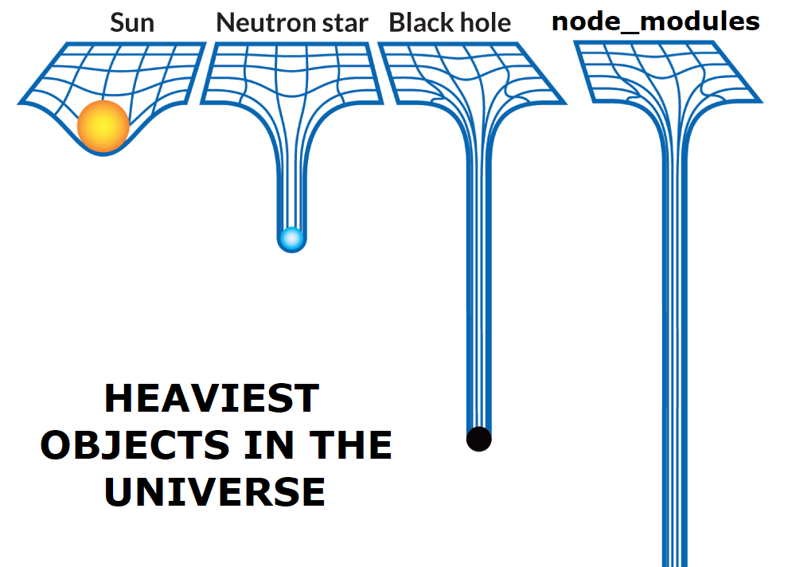
Summary: Design Tradeoffs
This is already a system standard
Pros: Save the binary sizes
Cons: DLL hell
apt install libxxx-dev

