Slide 1
Computer Architecture W3D2: Modeling and Implementation
Jian Weng
Computer Science
CEMSE, KAUST

Slide 2
Roadmap
What is modeling?
What is implementation?
What is the gap b/t?

Slide 3





A Typical Architecture Design & Impl. Process
I have a good architecture idea!
I don’t want to waste my engineering effort.
HARDware implementation is too HARD
A problem is solved by introducing another
Separate implementation, separate teams

Slide 4
Characterizing the Modeling Methods
Higher-level Performance Estimation
Analytical Model
Lower Impl Difficulties
Shorter time to estimate
Functional Sim.
RTL Simulation
Verilator
More low-level insights
Gate-level
Higher Impl Difficulties
Longer time to simulate

Slide 5
Characterizing the Modeling Methods
Functional Simulation
Execution-based: Simulate binary executable
Feed the binaries to a simulator simulates what the hardware does
add t1, t2, t3
sub t3, t1, t2

Slide 6
Characterizing the Modeling Methods
Functional Simulation
Trace-based: Instrument before every inst.
Execute the raw program to generate the trace
Simulate the traces
# before instrument
print "add t1 t2 t3"
add t1, t2, t3
print "sub t3, t1, t2"
sub t3, t1, t2
# before instrument
add t1, t2, t3
sub t3, t1, t2

Slide 7
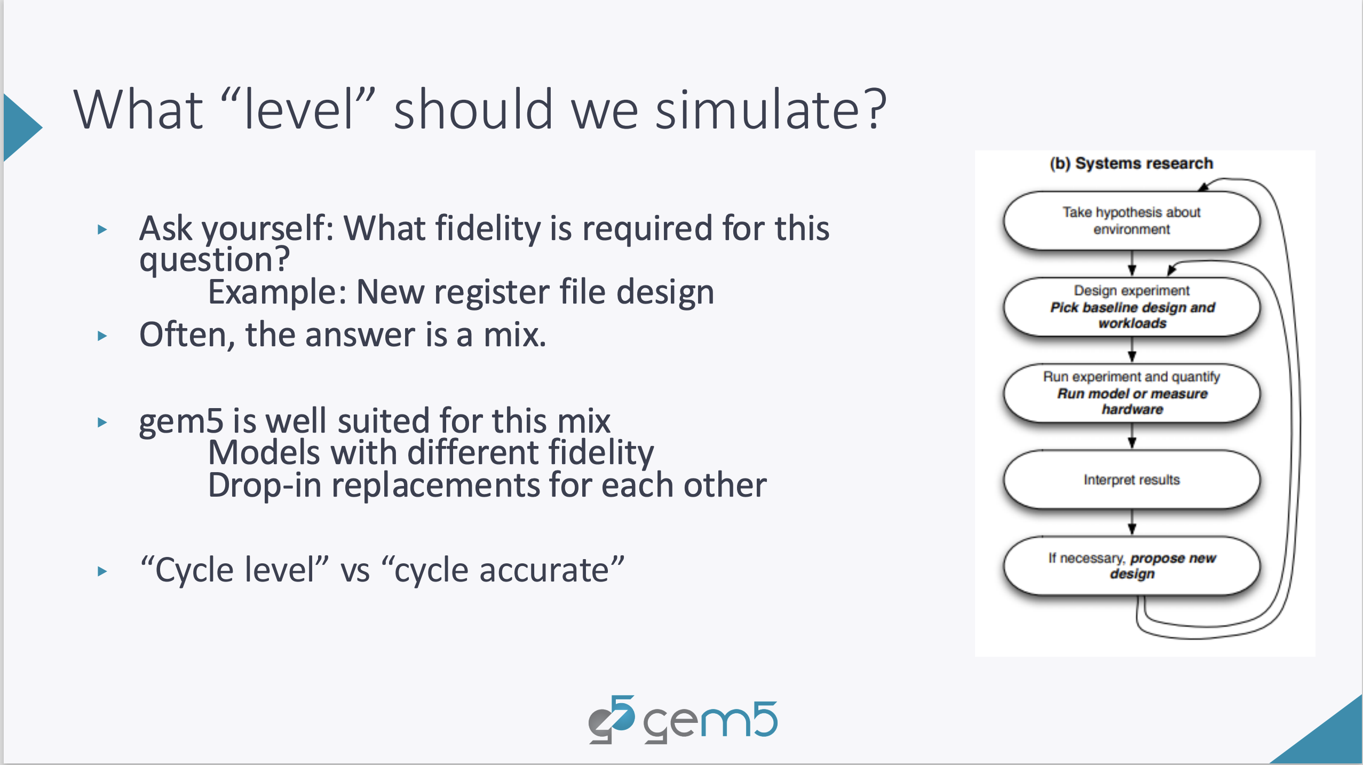

Slide 8
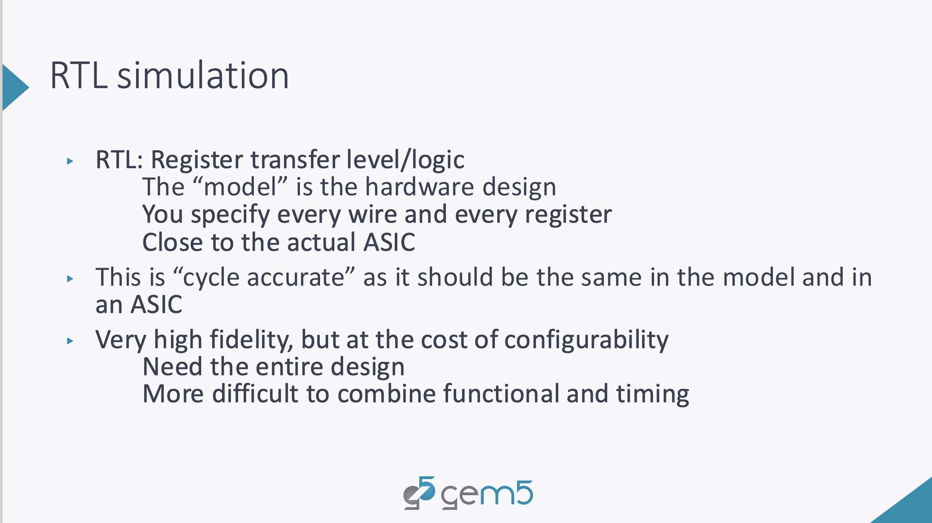

Slide 9
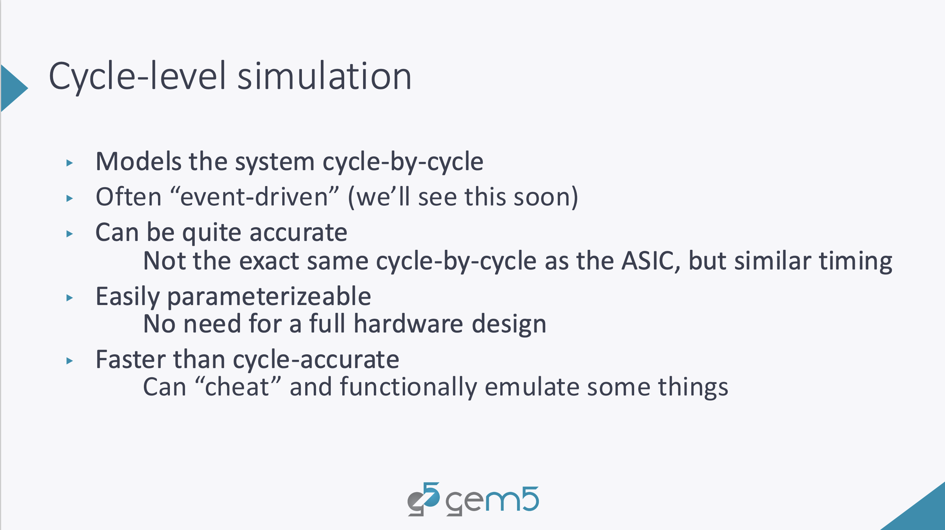

Slide 10
Sw/hw Co-designs
Performance: Cycle-Accurate Simulator
Power/Area: RTL Synthesis
Alignment: Who cares?

Slide 11


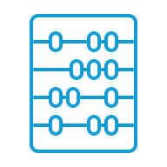


Insights and Principles
Ideal Solution: A unified and easy programming interface for both simulation & implementation
def engine():
while !q.empty():
e = q.front()
e.sim(q)
Unified: Some commonality b/t sim and impl.
Easy: Better behavior-oriented abstraction
class IF():
def sim(q: Queue):
inst = icache[self.pc]
q.enqueue(ID(inst))
IF
ID
EX
MA
WB
Simulation Trace:
class ID():
def sim(q: Queue):
opcode,a,b =
decode(self.inst)
q.enqueue(EX(opcode,a,b))
Cycle 1
Cycle 2
Cycle 3
IF
IF
ID
IF
ID
EX
……
Notes:
I think a very first insight I would like to emphasize is that application domain does not necessarily define a domain-specific accelerator. Application behaviors of interests do, and herein will be referred as computing idioms.
If we would like to have a design automation, we first need a well-defined design space. The principle of having such a design space is that many hardware specialization mechanisms can be approximated by composing a set of simple and common primitives, and all these mechanisms can be modularly integrated to a target hardware.
Though we are automating domain-specific accelerator design, the domain itself is agnostic. Therefore, the universal space of accelerator design should be general purpose, while getting rid of the VN overheads. In this case, we adopt the decoupled-spatial paradigm.

Slide 12
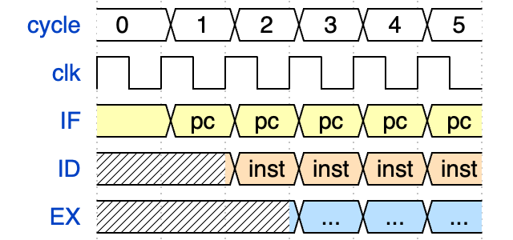
Insights and Principles (CONT’D)
What if I rearrange it a little bit?
Simulation Trace:
RTL Waveform:
Cycle 1
Cycle 2
Cycle 3
IF
IF
IF
ID
ID
……
EX
In principle, we can have a 1-1 correspondence
But we don’t achieve it for many reasons [1]…
[1] https://research.cs.wisc.edu/vertical/papers/2014/wddd-sim-harmful.pdf
Notes:
I think a very first insight I would like to emphasize is that application domain does not necessarily define a domain-specific accelerator. Application behaviors of interests do, and herein will be referred as computing idioms.
If we would like to have a design automation, we first need a well-defined design space. The principle of having such a design space is that many hardware specialization mechanisms can be approximated by composing a set of simple and common primitives, and all these mechanisms can be modularly integrated to a target hardware.
Though we are automating domain-specific accelerator design, the domain itself is agnostic. Therefore, the universal space of accelerator design should be general purpose, while getting rid of the VN overheads. In this case, we adopt the decoupled-spatial paradigm.

Slide 13
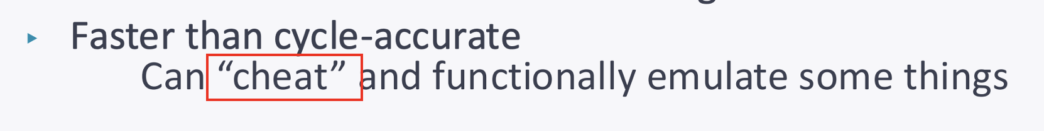
Why is RTL implementation hard?
Or, why simulation is easier?
😭 C++ does not enforce you only write a reg once a cycle
😠 vector<T>::push_back does not enforce your buffer size
🤔 Some data structure manipulation/state machine is too hard
These are part of the problem.
Execution model

Slide 14
Write every register only once!
Each register can only be written once every cycle
☹ Manually gather all the sources of deltas
☺ Concurrency are fake!
// In C++
// Site 1.
if (cond0) { reg++; }
// Site 2.
if (cond1) { reg--; }
// In Verilog
delta0 = cond ? 1 : 0;
delta1 = cond ? 1 : 0;
reg <= reg + delta0 – delta1;

Slide 15
Buffer Overwhelming
Even a simple code can construct a super long chain of RAW.
What is wrong with this?
😠 In simulator, you can simply do
😭 In RTL, you will overwhelm the inter-stage register
// In C
b[a[i]]++;
# r2 is i
load r1, a(r2)
shli r1, r1, 4
load r3, b(r1)
addi r3, r3, 1
sw r3, b(r1)
id.push_back(inst)

Slide 16
Diverged: Initial Interval
Initial Interval: The interval b/t two launches of execution
II=1: Fully pipelined, the ideal performance
What is the II here?
Question: Can we have a 500-stage pipeline?
// In C
b[a[i]]++;
# r2 is i
load r1, a(r2)
shli r1, r1, 4
load r3, b(r1)
addi r3, r3, 1
sw r3, b(r1)

Slide 17
Data Structure Manipulation
Find an instruction that can be issued for execution in reservation station
foreach reservation station {
if rs1.valid && rs2.valid {
issue for execution }
}

Slide 18
Why is RTL implementation hard? (CONT’D)
Or, why simulation is easier?
😭 C++ does not enforce you only write a reg once a cycle
😠 vector<T>::push_back does not enforce your buffer size
🤔 Some data structure manipulation/state machine is too hard
These are part of the problem.
A Gap of Execution model

Slide 19





How pipelined architectures are taught?
IF: “I read the manual for instructions!”
A stage finishes its duty and pushes remaining jobs to the next ones
ID: “I check the data availability!”
EX: “I do the computation!”
MA: “I am the warehouse keeper!”
WB: “I check in the results!”

Slide 20
Asynchronized Event Handling
Decode my fetched instruction, please.
OK. I promise it will be decoded, but not now
IF
ID
Why this happens?
A too long critical path may hurt the timing
What do we need?
A clear boundary between the “current” and “next” cycle
What is async?
x = async foo(1, 2) // A Promise returned
x.when(function (result) {
// use the returned value here.
})
foo will be done, but not immediately;
a promise is returned to use the result when ready

Slide 21
What is “async” function call?
What is sync?
What is async?
function foo(a, b) {
// do something here
}
foo(1, 2) // a sync call
When calling foo, the program counter immediately move to foo: tag.
x = async foo(1, 2) // A Promise returned
x.when(function (result) {
// use the returned value here.
})
foo will be done, but not immediately;
a promise is returned to use the result when ready

Slide 22
How are pipelined architectures implemented?
# Instruction Decoder
if inst.valid {
inst.pop_valid = true
opcode, operand = decode(inst)
if all operands available {
if EX resource available {
EX.push_valid = true
EX.data1 = rs1
EX.data2 = rs2
# ...
} }
}
Every stage listens to the valid signal
When enabled acts its functionality
Remember this!
Will be explained later!

Slide 23
Mis-alignment: Push? Pull?
Architectural design
OK. I finished my job this stage, and I push it to the next.
Architectural implementation
Carefully listen to my related signal. When enabled pull the data in.
Let me further make an example in algorithm implementation

Slide 24
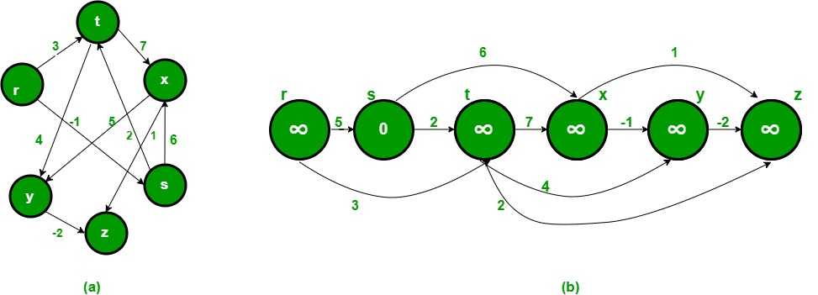
How do you do a shortest path on DAG?
Push?

Slide 25
How do you do a shortest path on DAG?
Pull?

Slide 26
How do you do a shortest path on DAG?
They are anyways Turing-equivalent, which suggests a possible conversion

Slide 27
How are pipelined architectures implemented?
# Instruction Decoder
if inst.valid {
inst.pop_valid = true
opcode, operand = decode(inst)
if all operands available {
if EX resource available {
EX.push_valid = true
EX.data1 = rs1
EX.data2 = rs2
# ...
} }
}
RTL: Register-level Transfer
Every stage listens to the valid signal
When enabled acts its functionality

Slide 28
An Analogy: Event-listening
Did you write anything w/ UI before?
How is it implemented?
The browser arranges something like a thread (co-routine) listens to this button
Once clicked the PC will jump to functionToExecute()
<element onclick="functionToExecute()"> Click </element>

Slide 29
Event-listening (CONT’D)
Did you write anything w/ UI before?
What is something like a thread, but not a thread?
Let’s look at an example (of a bad demo of web frontend development)
<element onclick="functionToExecute()"> Click </element>

Slide 30

Why? What is a co-routine then?
Do you have a driver’s lic?
Did you use yield in Python?
Returned, but not fully returned.

Slide 31
Yielded Co-routine (CONT’D)
“Returned, but not fully returned”
Decode my fetched instruction, please.
OK. I promise it will be decoded, but not now
IF
ID

Slide 32
Yielded Co-routine (CONT’D)
“Returned, but not fully returned”
Yield: ID stopped execution, but not finished
Return: ID finished execution, and ready for the next
OK. I am backlogged. I should pause now.
Sorry. I am decoding, but data is not available
IF
ID

Slide 33
Summary
A gap between design and implementation
Design: Pushed
Impl: Pulled
A opportunity of Turing Equivalence
Push and pull are doing exactly the same thing

Slide 34
Assassyn: A Unified Abstraction for both Simulation and Synthesis
The Asynchronicity: Something will for sure happen but not know
What is asynchronized?
The state, the side effect.
Decode my fetched instruction, please.
OK. I promise it will be decoded, but not now
IF
ID

Slide 35
Assassyn: A Unified Abstraction for both Simulation and Synthesis
Source: https://github.com/Synthesys-Lab/assassyn
Set everything up
I strongly recommend not to use M-series MacBook 🤦🏻‍♀️
Use Docker to setup the environment dependencies
docker build -t assassyn:latest .

Slide 36
Assassyn: Getting Started.
And then mount the repo to execute
Mount the folder
docker run --rm -tid -v `pwd`:/app \
--user root \
--name assassyn \
assassyn:latest
Name of the container
Image
Physical Machine
VM
Repo

Slide 37
Assassyn: Getting Started.
Attach to this docker container
docker attach assassyn # attach to shell
$ <in side the container>
$ <C-p><C-q> # detach the container w/o exiting

Slide 38
Assassyn: Getting Started.
Attach to this docker container
Self-exemplified code development
docker attach assassyn # attach to shell
$ <in side the container>
$ cd python/unit-tests/
$ python unit-tests/test_async_call.py

Slide 39
A Simple Example: 2-Stage Pipeline
Driver stage
Self-increases cnt every cycle
Pushes cnt to Adder stage
Adder
Adds up value from Driver
++cnt
Driver
Adder

Slide 40
2-Stage Pipeline (CONT’D)
Driver stage
Driver invokes adder async-ly
Adder
Processes driver’s data from last cycle
++cnt
Driver
Adder

Slide 41
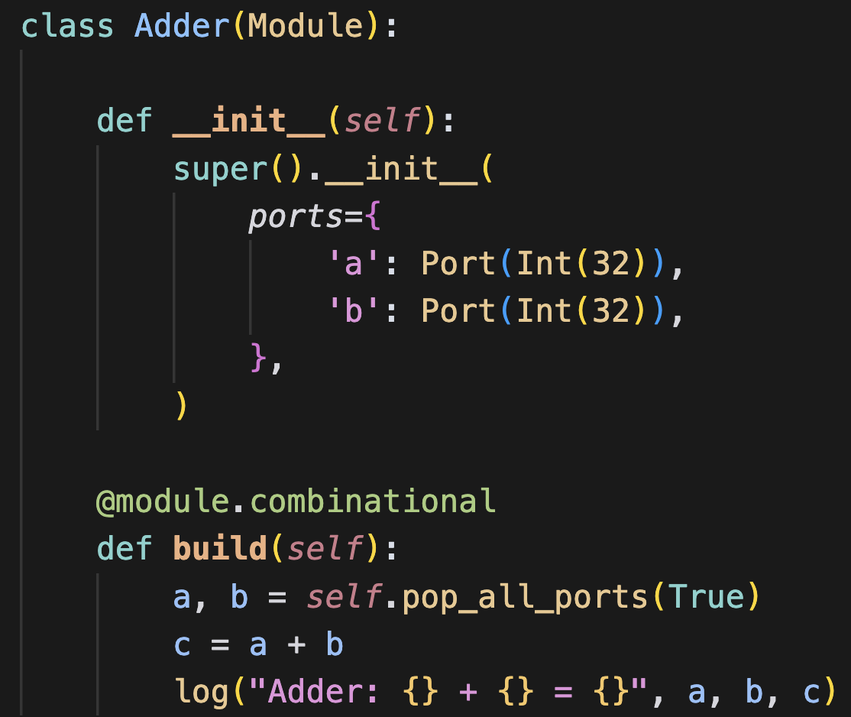
Understanding Each Stage
The logic of each stage: Adder

Slide 42
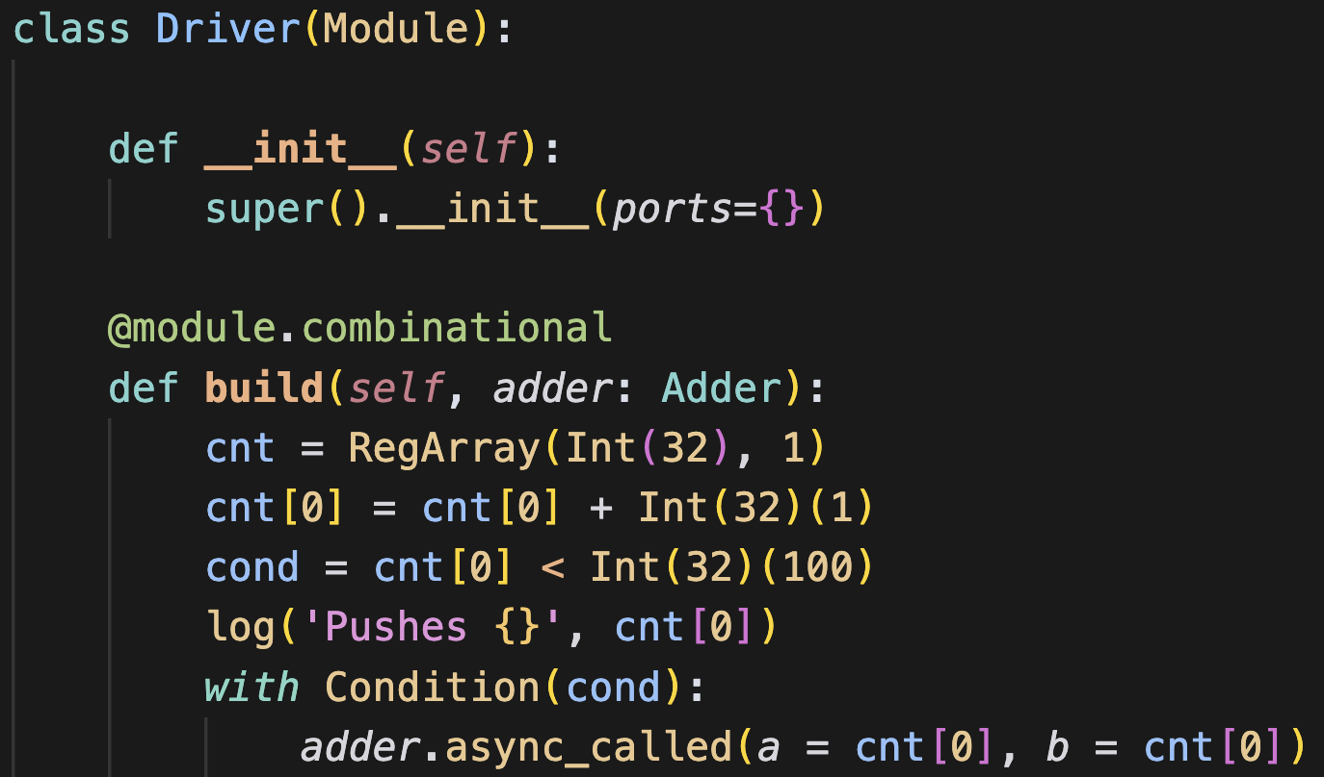
Understanding Each Stage (CONT’D)
The logic of each stage: Driver

Slide 43
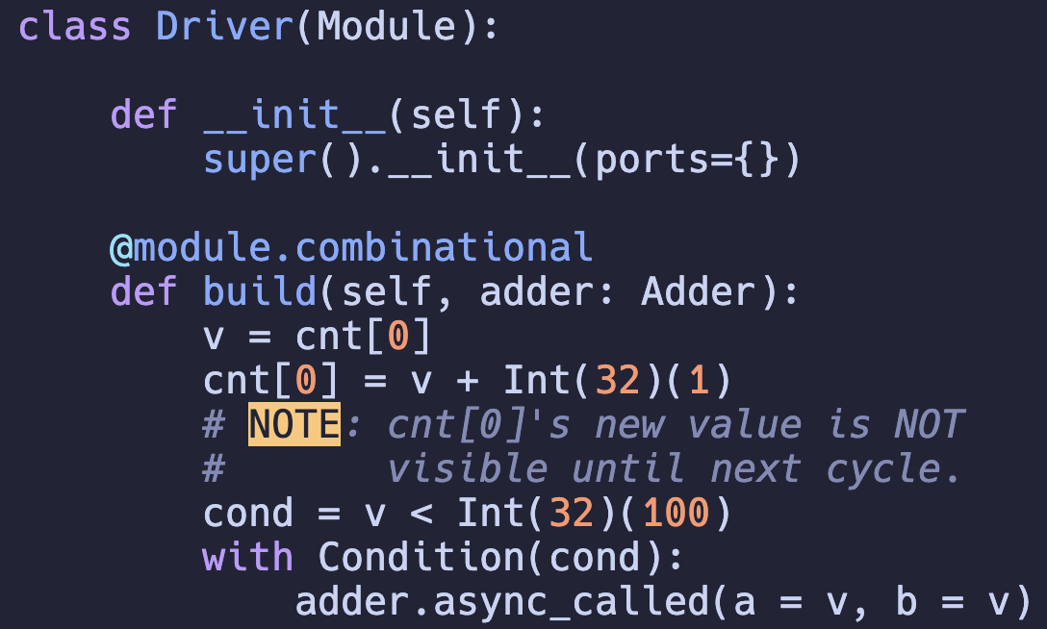
Understanding Each Stage
Sequential logic is not committed until next cycle.

Slide 44
Understanding the DSL
Trace-based DSL
Did you know what is operator overloading?
Did you know that operator overloading can be used to build DSL frontend?

Slide 45
Trace-based DSL Implementation
Did you know how to overload a function in Python?
__xx__
Did you know with in Python?

Slide 46
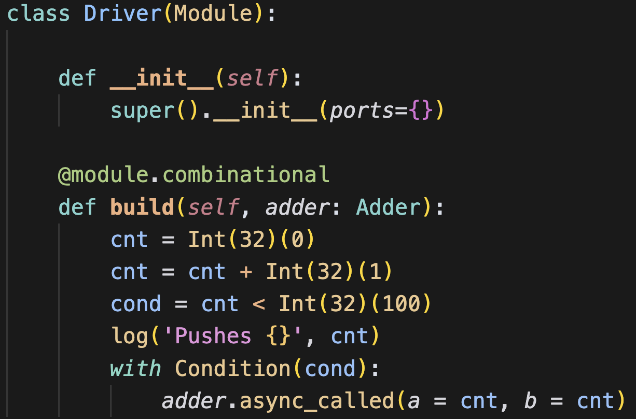
Therefore, it is wrong to do this…
You cannot overload = in Python
You can only overload a[b] = c in python

Slide 47
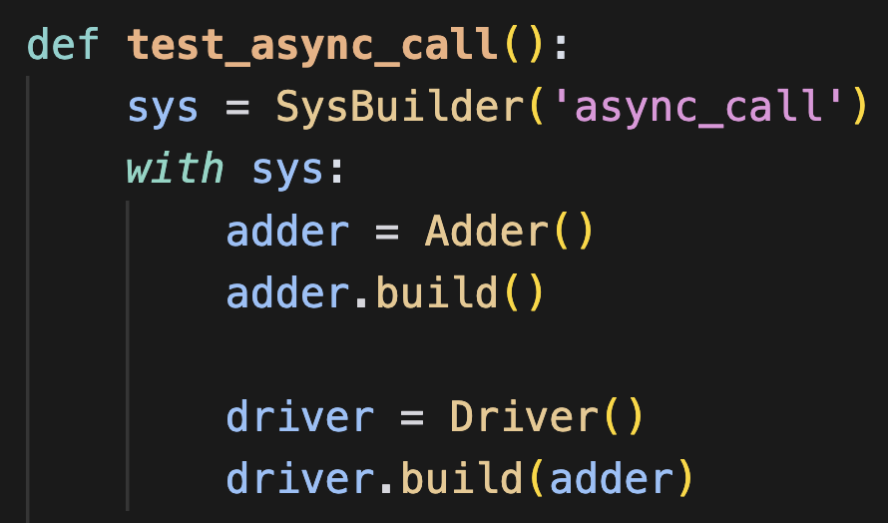
Understanding the Top Function
sys is the data structure of AST
with sets sys to the current AST
Every move within the recursively called function will be appended to the AST

Slide 48
Understanding the Top Function (CONT’D)
Decoupled interface and implementation
Function signature of each function is fixed
build is a function implements function

Slide 49
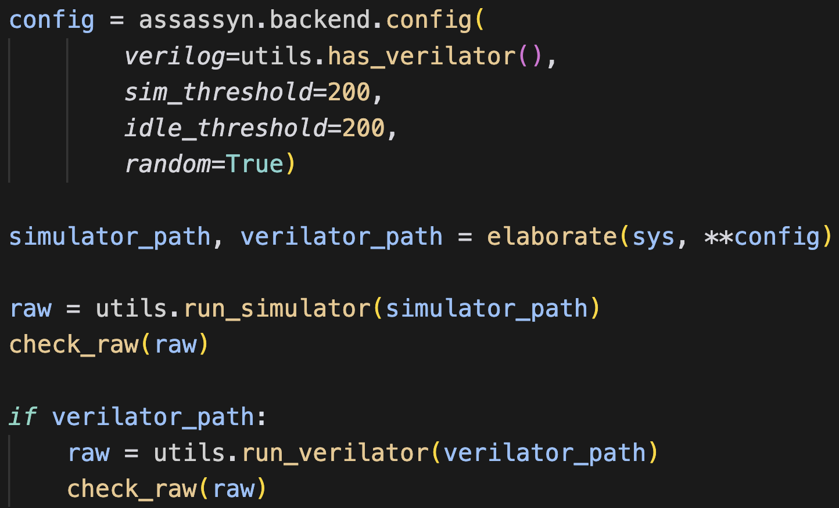
Elaborate the System
Elaborator traverses the AST for codegen
Simulator in Rust
RTL implementation in PyCDE
A Python-ized Verilog Generator

Slide 50
Code Generation: Simulator
Cycle 1
Cycle 2
Cycle 3
IF
IF
ID
IF
ID
EX
……
Combinational Logic
Sequential Logic
A Cycle is separated into 2 halves
1st Half: Executing the Combinational Logic Functions
2nd Half: Commit the side effect registers

Slide 51
Code Generation: Simulator Runtime (CONT’D)
class Fetcher:
@constructor
def __init__(self):
self.pc = Reg(int32)
@combinational
def build(self, decoder, inst_buffer):
inst = inst_buffer[self.pc]
decoder.async_call(inst)
self.pc += 4
# 1st-half
tmp = self.pc + 4
self.pc.write(tmp)
Bookkeep a pending write in runtime
# 2nd-half
self.pc.commit()
Commit the result in runtime
Within cycle x, pc is not updated until the 2nd half of this cycle.
Rest of the combinational logic will still see self.pc rather than self.pc + 4
Essentially, this is the SAME as Verilog simulation, but it determines the active regions in a coarser-grain way. Thus speedup is achieved (see eval later).
Simulate Funcs
Commit Regs
Cycle 1
Cycle 2
Cycle 3
IF
IF
ID
IF
ID
EX
……

Slide 52
Before Hardware: Valid-Ready Protocol
Valid: Data is valid to use
Ready: The downstream is ready to accept data
Upstream
Valid
Downstream
Data
Ready

Slide 53
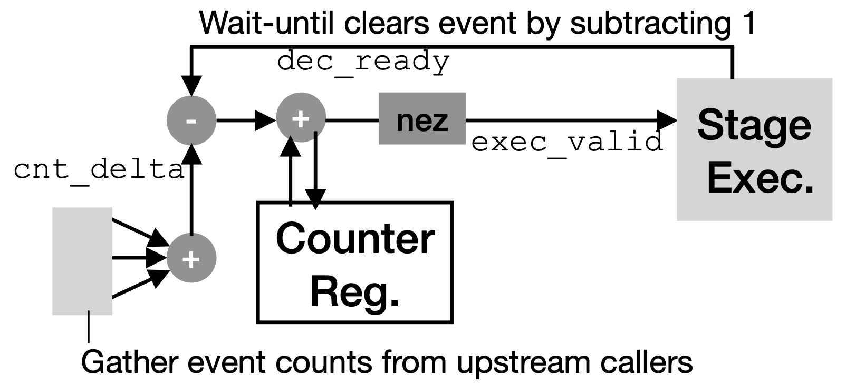
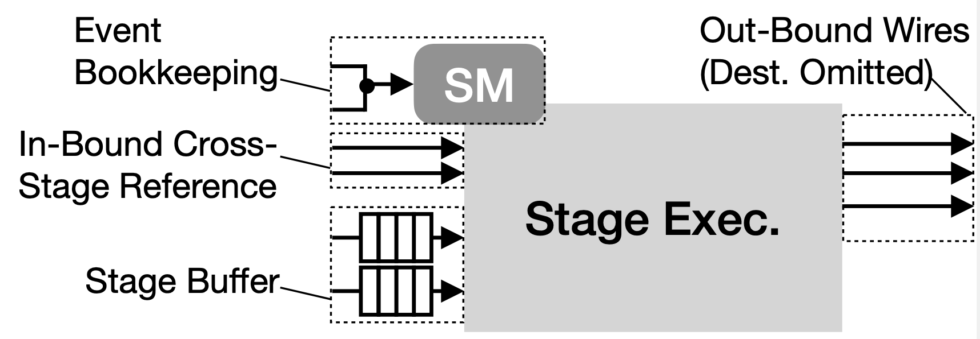
RTL Generation: Micro-architectural Support
Each function is a pipeline stage
Implicitly,
All the stage registers are FIFOs
A Counter SM is imposed to bookkeep executions
Counter State Machine
Each function call increases
Each execution decreases
Counter != 0 enables stage execution

Slide 54
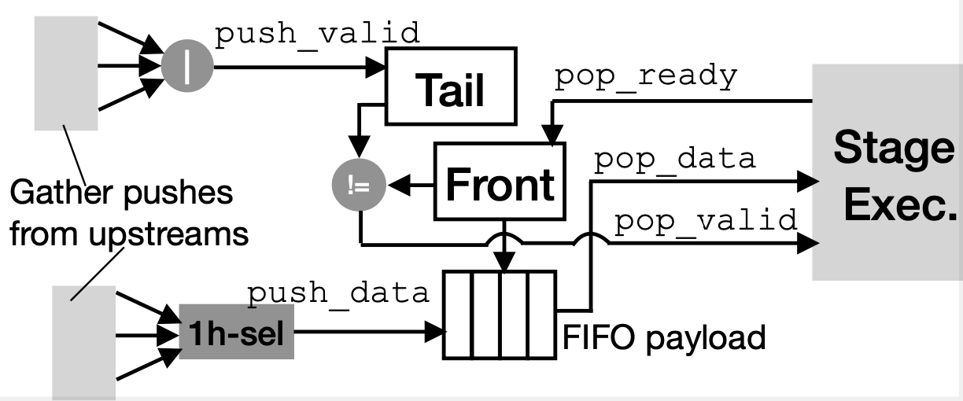
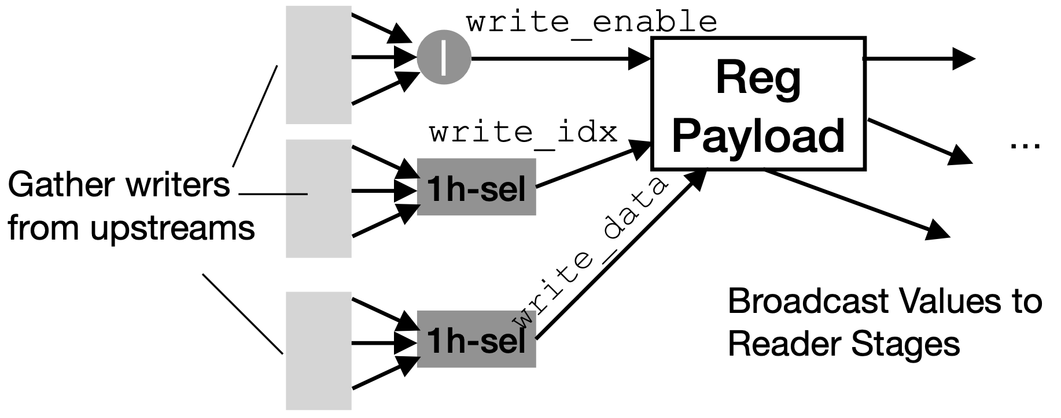
Micro-architectural Support (CONT’D)
Counter, Register and FIFO adopt a “gather and write” paradigm
A key difference is that counter uses “+” to gather, while other 2 use “|”
Registers are independent from each stage
FIFO will fall back to registers when depth=1

