Slide 1
Computer Architecture W4D1: A Deeper Tour to Assassyn
Jian Weng
Computer Science
CEMSE, KAUST

Slide 2
Resources
All the code demo are available at
https://github.com/were/sys-arch
TODO: Better documentation
TODO: Add a better .gitignore

Slide 3
Roadmap
Recap: A simplest 2-stage pipeline
Do we really understand every line?

Slide 4
Recap: 2-Stage Pipeline
Driver stage
Self-increases cnt every cycle
Pushes cnt to Adder stage
Adder
Adds up value from Driver
++cnt
Driver
Adder

Slide 5
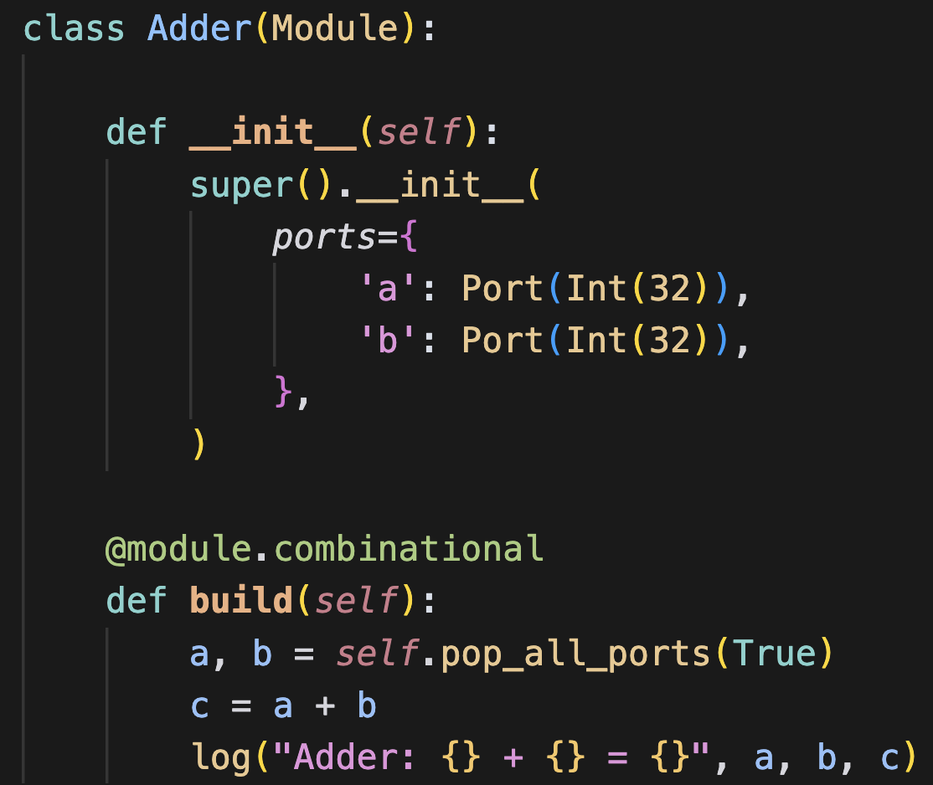
Recap: Understanding Each Stage
The logic of each stage: Adder

Slide 6
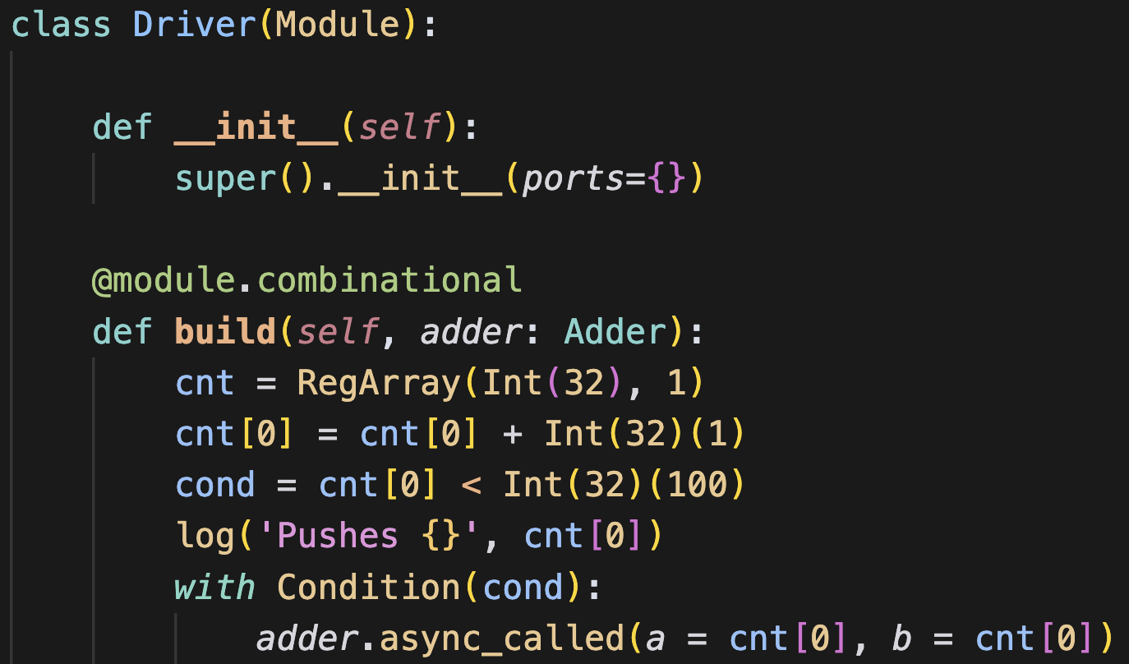
Understanding Each Stage (CONT’D)
The logic of each stage: Driver

Slide 7
Roadmap
Recap: A simplest 2-stage pipeline
Do we really understand every line?
Decorator
Partial

Slide 8
Recap: Trace-based DSL
Execute the code to grow the AST
AST appended to its corresponding AST node
What happened behind the frontend?

Slide 9
Recap: Trace-based DSL (CONT’D)
Create IR node in __add__
Append it to AST

Slide 10
Recap: Trace-based DSL
Create AST node in __add__
Append created node to AST
What if I have another 5-10 AST nodes?
Do I need to copy-paste the append code 5-10x?
Where to append?
def __add__(self, b):
node = AddNode(self, b)
ast.func.block.append(node)

Slide 11
decorator/
A function that returns a function that hooks a functions
wrapper.py
The decorator module: package.py
An abusive usage (?)
init.py
pip --user install decorator

Slide 12
Recap: Trace-based DSL
Create AST node in __add__
Append created node to AST
What if I have another 5-10 AST nodes?
Decorator hooks each function
@ir_builder
def __add__(self, b):
return AddNode(self, b)

Slide 13
Understanding Each Stage (CONT’D)
Decorator changes the “current” module to append

Slide 14
Roadmap
Recap: A simplest 2-stage pipeline
Do we really understand every line?
Decorator
Partial
Hardwar-ized Software Pipelining
Bind the dataflow

Slide 15
Recap: Understanding Each Stage
The logic of each stage: Adder

Slide 16
Understanding Each Stage (CONT’D)
The logic of each stage: Driver

Slide 17
Partially Bind Arguments
partial.py
Fixes function arguments one by one

Slide 18
Understanding Each Stage (CONT’D)
We only have void-call in Assassyn
adder0 = bind adder.a = cnt[0]
adder1 = bind adder0.b = cnt[0]
call adder1

Slide 19
Understanding Each Stage (CONT’D)
I only have void-call in my IR
adder.a.push(cnt[0]) // %1
adder.b.push(cnt[0]) // %2
call adder [%1, %2]

Slide 20
Question
How can we have a FIFO?
Why do you design void-call with binds?

Slide 21
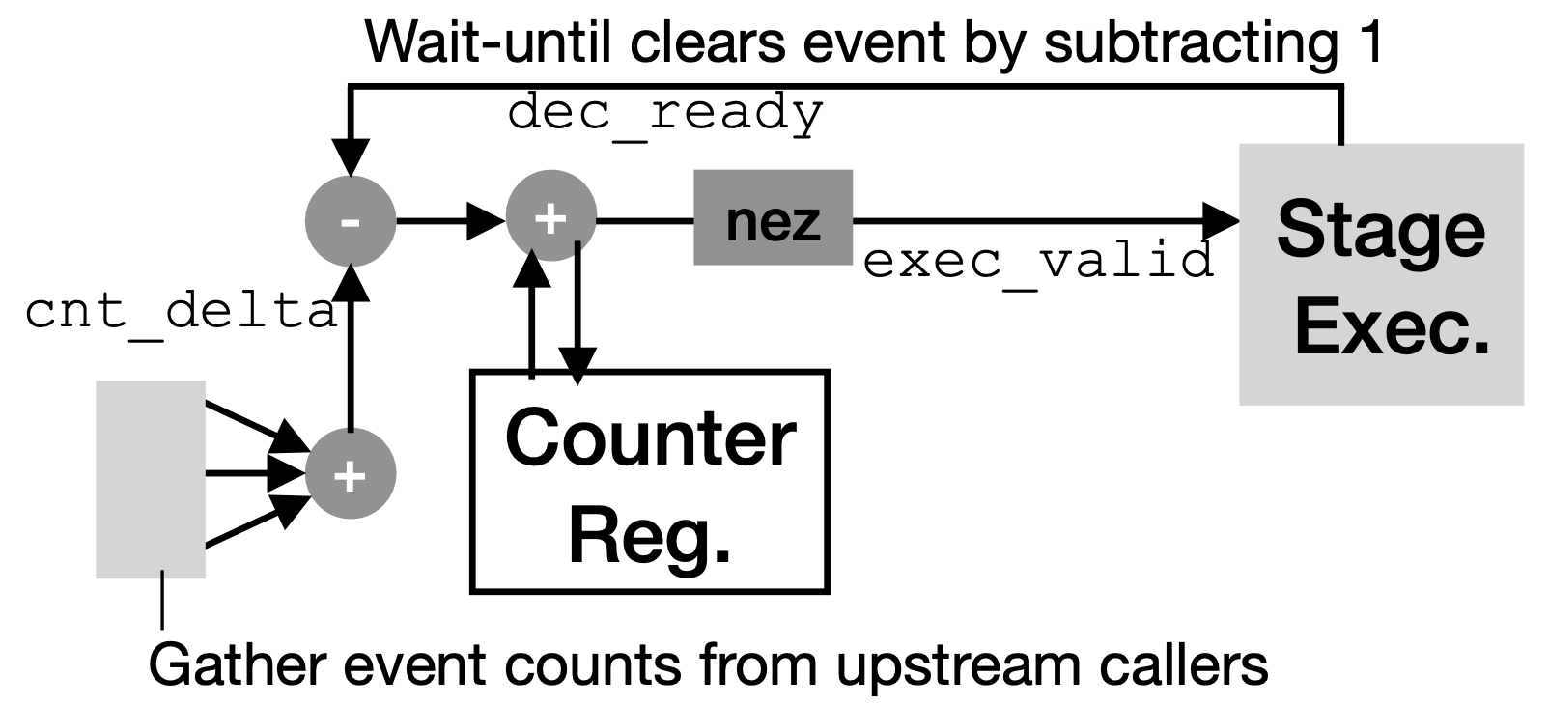
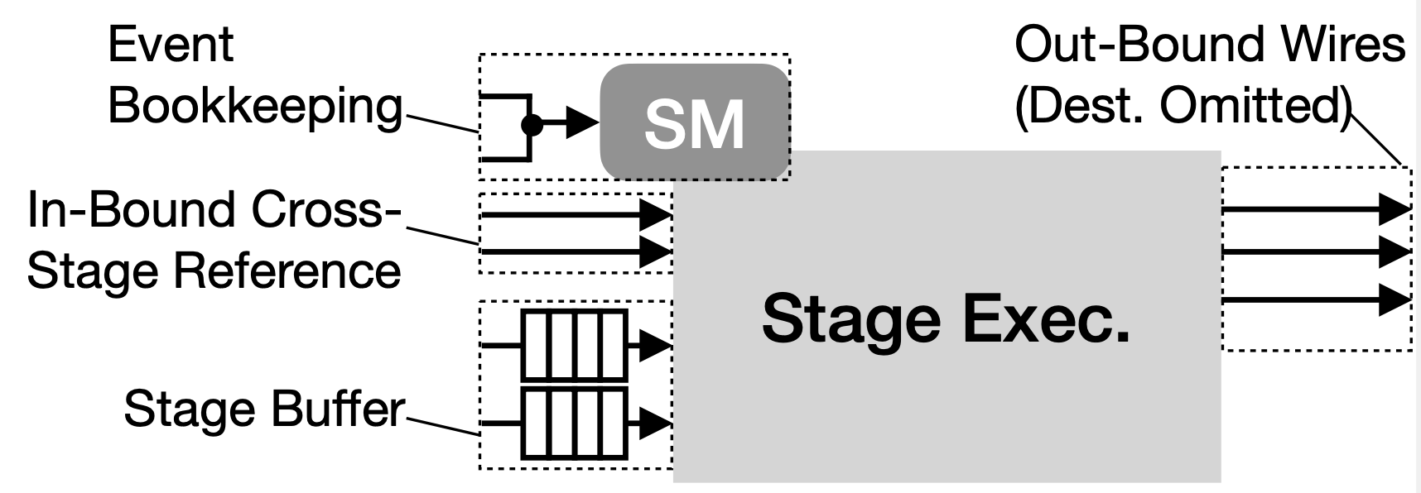
Recap: Micro-architectural Support
Each function is a pipeline stage
Implicitly,
All the stage registers are FIFOs
A Counter SM is imposed to bookkeep executions
Counter State Machine
Each function call increases
Each execution decreases
Counter != 0 enables stage execution

Slide 22
Verilog: How to manage a FIFO?
push_data
pop_data
User
Pusher
Pushee
push_valid
pop_valid
FIFO_ready
pop_ready
Why is Verilog so hard to write?
3×3=9
3 Valid/Ready/Payload
In/Out/Wire

Slide 23
Verilog: Fake it until you make it.
push_data
pop_data
Pusher
Pushee
User
push_valid
pop_valid
FIFO_ready
pop_ready
logic [WIDTH - 1:0] q[$];
always @(posedge clk or negedge rst_n) begin
if (!rst_n) begin
pop_valid <= 1'b0;
pop_data <= 'x;
end else begin
if (pop_ready) q.pop_front();
if (push_valid) q.push_back(push_data);
if (q.size() == 0) begin
pop_valid <= 1'b0;
pop_data <= 'x;
end else begin
pop_valid <= 1'b1;
pop_data <= q[0];
end end end
Initialization
pop_ready
q.pop()
push_valid
q.push(data)

Slide 24
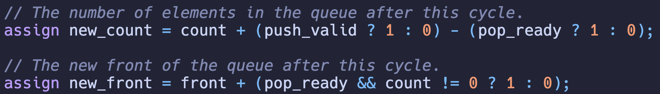
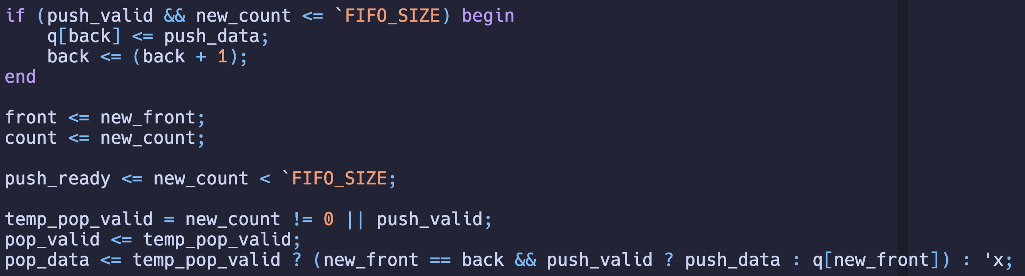
FIFO: A Penetrable Design
back++

Slide 25
Summary: Why do we call it RTL?
Software engineering is imperative
a.push(x)
a.pop(x)
Architecture description is graph connection
Connection transfers register data from upstream to downstream based on state machine controls
push_valid/pop_valid
Transfers data from FIFO buffer to pop_data reg

Slide 26
Question
How can we have a FIFO?
Why do you design void-call with binds?

Slide 27
Systolic Array: A Simplest Dataflow Arch.
4 3 2 1
4 3 2 1
4 3 2 1
4 3 2 1
4 3 2 1
4 3 2 1
4 3 2 1
4 3 2 1

Slide 28
Systolic Processing Element (PE)
A
B
A
B
A microarchitectural zoom-in
×
×
+
+
Reg
Reg
A
B
×
+
Reg

Slide 29
Summary
N³ v.s. 2N²
Exec. Time = (Amount of work) / (Comp. Power)
What is the source of acceleration?
Instruction Parallelism

Slide 30
Be careful about the timing!
1
1
1
1
A
B
A
B
C
2
2
×
×
How many C should be buffered?
Assuming we have back pressure
3
3
+
+
4
4
+
Reg
A friendly case
Reg

Slide 31
What if I do not have enough buffer?
1
1
1
1
A
B
A
B
C
2
2
×
×
3
3
+
+
Buffer filled. Then back pressured. C stops.
4
4
+
Reg
A friendly case
Reg

Slide 32
What if I do not have enough buffer?
1
1
1
1
A
B
A
B
C
2
2
×
×
3
3
+
+
4
4
+
Reg
A friendly case
Reg

Slide 33
Wait… Is there something missing?
3
Software Programming
foo(*args): args are all in caller
Hardware Design/Impl.
Data from A & B flow to C
PE1 cannot call PE2 alone because it has one argument input from PE3
1
2
from functools import partial
def foo(a, b):
return a + b
goo = partial(foo, 5)
# equivalent to foo(5, 10)
goo(10)
Bind the dataflow
There are too many “bind”s in Python, which one?

Slide 34
Bind the dataflow (CONT’D)
3
# module
class PE:
def __init__(self):
self.north = Port(8)
self.west = Port(8)
def build(south, east):
bind south(north=self.north)
async east(west=self.west)
PE1 can call PE2’s bound handle with argument from PE3 fed
1
2
Higher-order Function
A function that returns a function
Constructing pipeline stage is constructing a parameterized function
# init pe[i][j] w/ PE()
# top function
for i in 1..5:
for j in 1..5:
pe[i][j].build(pe[i+1][j],
pe[i][j+1].bound)

Slide 35
Homework: Weight-Stationary Systolic Array
This systolic array is called psum stationary, which buffers the accumulator in each PE
Based on examples/systolic_array.py
Implement a weight stationary systolic array, which buffers weight in each PE

Slide 36
Roadmap
Recap: A simplest 2-stage pipeline
Do we really understand every line?
Decorator
Partial
Return

Slide 37

Recap: What is this sign for?
Do you have a driver’s lic?
Did you use yield in Python?
Returned, but not fully returned.

Slide 38
Recap: Understanding Each Stage
The logic of each stage: Adder
valid = self.a.valid() & \
self.b.valid()
wait_until(valid)

Slide 39
Recap: Micro-architectural Support
√
Each function is a pipeline stage
Implicitly,
All the stage registers are FIFOs
A Counter SM is imposed to bookkeep executions
Counter State Machine
Each function call increases
Each execution decreases
Counter != 0 enables stage execution

Slide 40
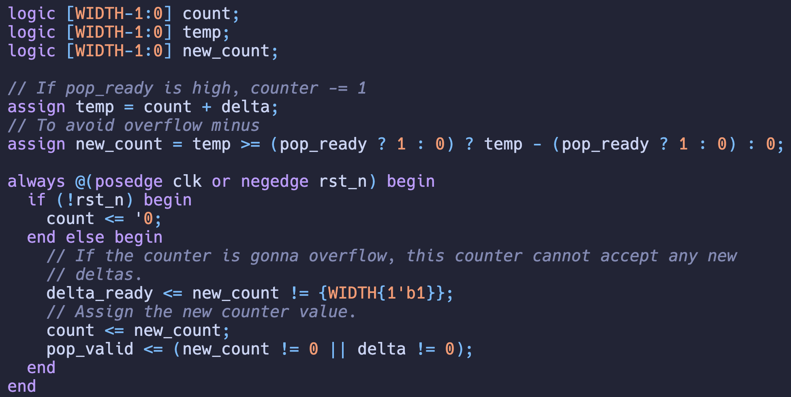
Counter: A “FIFO” w/o Payload

Slide 41
Recap: Micro-architectural Support
√
√
Each function is a pipeline stage
Implicitly,
All the stage registers are FIFOs
A Counter SM is imposed to bookkeep executions
Counter State Machine
Each function call increases
Each execution decreases
Counter != 0 enables stage execution

Slide 42
One last thing. What are these for?
IF
ID
EX
In Use
These are unexplained yet.
What are those?
Cross stage combinational logics
MA
WB
Decoder checks availability
Set the in use to true
Write back releases availability

Slide 43
Combinational pins across modules
if !in_use[rs1:rs1] && !in_use[rs2:rs2]
# ...
return rs1, rs2
IF
ID
return rd
Key demand: Expose data across modules within a same cycle.
EX
MA
In Use
in_use <= in_use ^
(1 << id.rd) ^
(1 << wb.rd);
WB

Slide 44
Recap: Trace-based DSL
Expose the handle to values using return
Use these values in an aggregated module
if !in_use[rs1:rs1] && !in_use[rs2:rs2]
return rs1, rs2
return rd
Something like a global value, but defined locally
in_use = in_use ^
(1 << id.rd) ^
(1 << wb.rd);

Slide 45
FIFO: A Penetrable Design
back++

Slide 46
Summary: Why do we call it RTL?
Recap the FIFO case
a.push(x)
a.pop(x)
Transfers data from last stage register to the next
Through combinational logics
All the registers are exclusive
Thus, no order is enforced among pipeline stages
Theoretically, no order is enforced among stages

Slide 47
Downstream Module
What is downstream?
Module is upstream.
Why do we have downstream?
Downstream has a topology because of combinational logics
Let’s look at the simulator

Slide 48
Care! Downstream modules hurt timing!
What should you do to bypass a branch result?
Combinational?
Sequential?
IF
ID
EX
MA
WB

