Slide 1
Computer Architecture W6D1: Cache (2)
Jian Weng
Computer Science
CEMSE, KAUST

Slide 2
Roadmap
Recap: Where were we?
Conflict
Cache Write
Prefetching 🤦🏻‍♀️
Virtual Memory

Slide 3
Recap: Conflict (w5d1/transpose.c)
To my surprise, I can still replicate this on an laptop produced in 2023
Transpose an 1024x1024 array
100%
Transpose an 1023x1023 array
-2047: -2 less works
Transpose an 1025x1025 array
2049: 2% more works
How much execution time differences will we have?

Slide 4
Solution 1: Way-Skewed Cache
Each way we can use a different function to allocate different entries of cache
Index[14:5]
Index[14:5]
Index[14:5]
Skew Function 1
Skew Function 2
Skew Function 3
Cache Assoc. Way 1
Cache Assoc. Way 2
Cache Assoc. Way 3

Slide 5
Solution 2: Victim Buffer
Associativity is expensive
We can temporarily increase the associativity
When kicking out, kick to VB
VB is a fully associated 8-entry storage
If hit in VB, bring it back
Does this work for transpose?
CPU
L1
VB

Slide 6
Roadmap
Recap: Where were we?
Cache Write
Prefetching 🤦🏻‍♀️
Virtual Memory

Slide 7
Cache Write: What makes it different?
Data duplication and consistency
In memory and cache, we have copies
What if they are different?
Write it back
When to write it back?
How to deal with hit and miss?

Slide 8
Cache Write: When to write?
Write-thru
Bypass the cache, directly write to memory
Simple, but more memory traffic
Write back
Write to memory when coming back
Write Request
Write to cache
Write Request
Cache
Cache
Write to memory on replacement
Memory
Memory

Slide 9
Cache Write: Miss or Hit?
Write-thru
Bypass the cache, directly write to memory
Simple, but more memory traffic
Write Request
No matter miss or hit
Anyways bypassed
Cache
Memory

Slide 10
Miss or Hit: Write allocate (or not)?
Write allocate: Bring to cache when writing
Often adopted with write-back
☺: Better memory bandwidth usage
☹: Variant latency of write access
An optimization: dirty bit
A dirty bit is set when writing
No memory write upon eviction when clean
Write Request
Write to cache
Cache
Miss? Bring it to cache!
Memory

Slide 11
Summary: When to bring in and out the data for writes?
Write through is often accompanied with write non-allocate
Write allocate is often used along with write allocate
Write Request
Write Request
Write to cache
Cache
Cache
Miss? Bring it to cache!
Memory
Memory

Slide 12
Recap: Store Queue and Victim Buffer
CPU
Store uncommitted memory writes
SQ
Write Buffer
Store committed memory writes
L1
All can serve as a lightweight “cache” for further loads
It not only holds victims, but also holds memory writes going to main memory
VB
Mem

Slide 13
Roadmap
Recap: Where were we?
Cache Write
Prefetching 🤦🏻‍♀️
I personally dislike this
Virtual Memory

Slide 14
Ideal Case: Memory latency is fully hidden
The point of OoO is to hide the memory latency
Execute those instructions with operands valid
Ideally it is fully hidden
Time
Instruction
Memory

Slide 15
Realistic Case: Memory latency is NOT fully hidden
Memory latency stalls computation
Time
Instruction
Memory

Slide 16
New Idea: Prefetch the data
Memory latency stalls computation
Fetch it early?!
Time
Instruction
Actual use here!
Prefetch to cache here
Memory

Slide 17
Prefetch (CONT’D)
Not that early though
This even hurts the performance badly
More instructions (Software defined)
Wasted memory bandwidth
Time
Instruction
Actual use here!
Prefetch to cache here
Memory
Maybe already flushed somewhere between…

Slide 18
Prefetch (CONT’D)
Not that late either
It is too late to benefit
Time
Instruction
Actual use here!
Prefetch to cache here
Memory
The performance is not 100% unleashed… Still waits for memory response for a while

Slide 19
Prefetch: Techniques
Prefetching: Put the blocks into cache speculatively
Simple Solution: Prefetch next block
Timeliness
Early enough to hide the latency
Late enough not to flush
Coverage: Prefetch the blocks will be used
Accuracy
It wastes memory bandwidth
It evicts prior blocks

Slide 20
Prefetch: Software
You can actually use this built-in function to prefetch
But I never made this help the performance before
for (int i = 0; i < n; i += block) {
prefetch(&a[i + block]);
for (int j = 0; j < block; ++j) {
sum += a[i + j]; } }

Slide 21
Prefetch: Hardware
What to prefetch?
One block ahead
Address Prediction?
When to prefetch?
On every reference?
How much latency do we hide?
One approach: Predict a block to be dead
Avoid useful evictions

Slide 22
Address-based Stride Predictor
Match some msb of the address
If the address matches but you do not have a stride, compute the stride
If the address and the stride match, do a prefetch
Address: N * stride + Base
Address
Stride
Confidence

Slide 23
Load-based Stride Predictor
Match the instruction PC
If no stride, compute the stride
If stride is valid, prefetch
Check if prediction is correct, increase the confidence
O.w. decrese
Prefetch when confidence is high
Load PC
Last Addr
Stride
Confidence

Slide 24
Roadmap
Recap: Where were we?
Cache Write
Prefetching 🤦🏻‍♀️
Virtual Memory
Why?
How?

Slide 25
Recap: System is all about end-to-end.
All the application runs on operating system
A super application
Underlying hardware supports OS
Virtual memory
Translates address
TLB caches translation (More on this later)
OS: Something in advance
App
App
App
OS
Mem
CPU
Dev.

Slide 26
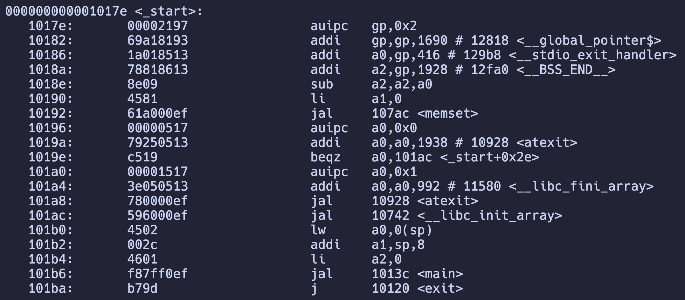
Recap: What we had on ELF structure
ELF is the data to be loaded to the memory

Slide 27
Recap: What are the assumptions of these addresses?
The program itself is unmodifiable
The program uses these hardcoded addresses to access data from CPU
What if I have two running instances of this program?
What if I have two programs using the same .so?
An illusion of occupying the whole machine

Slide 28
Requirement: Sharing and Isolation
Two programs cannot see each other
Two programs referencing the same dll shall be shared
Data are in memory
Share/isolation are done by data
What should we do on memory?
App
App
OS
.so
lib

Slide 29
Early Solution: Bound Register
Each application is bound by two registers
Base, bound
Memory access cannot be beyond this scope
App1
App2

Slide 30
Virtualizing the Memory
Goal: Create the illusion that each app:
Owns the whole machine
Has infinite memory
I actually do not know how much this is used nowadays because our memory is so big
If you go to your *nix shell to see the swap size, it is even smaller than your memory sometimes
sysctl vm.swapusage

Slide 31
Virtualizing the Memory (CONT’D)
What is virtualization?
Create the illusion that each app owns the whole machine, especially the memory
We only have one physical memory
But we have (relatively) infinite numbers of applications
Each memory assigned to each application is “virtualized” not “realized”
ps –A | wc -l

Slide 32
Virtual Space to Physical Space
Virtual Address (VA) seen by the program
Virtual Page Number
Physical Address (PA) allocated on memory
Physical Page Number
VA→PA: Address translation
In granularity of pages
VPN[31:12]
POFS[11:0]
PPN[31:12]
POFS[11:0]

Slide 33
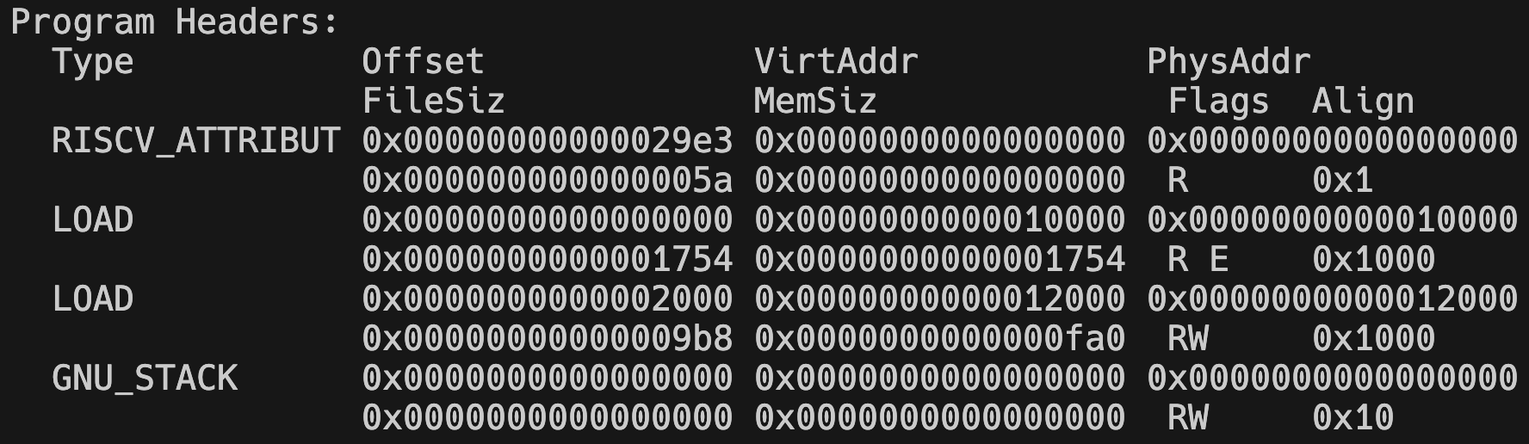
Address Translation
VA→PA: Address translation
In granularity of pages
Did you remember what are pages?
VPN[31:12]
POFS[11:0]
PPN[31:12]
POFS[11:0]

Slide 34
VA→PA: Address Translation
Pages are the granularity of alignment for proper translation by looking up a page table
Offsets (POFS) are not translated
VPN[31:12]
POFS[11:0]
PPN[31:12]
POFS[11:0]

Slide 35
Page Table (PT): Look up Translation
Wait, isn’t PT also a chunk of data?
Yes
How large is the page table below?
2⁽³¹⁻¹²⁺¹⁾=1m of entries
{ ppn: 32bit, valid: 1bit }: 4MB? 8MB?
Is it acceptable?
ps –A | wc -l
VPN[31:12]
POFS[11:0]
PPN[31:12]
POFS[11:0]

Slide 36
Look up Translation (CONT’D)
Each process has its own translation table
We have hundreds of threads
8MB * 100 = 800MB
2³²=4GB
800MB / 4GB = 25% memory for translation table?
ps –A | wc -l
VPN[31:12]
POFS[11:0]
PPN[31:12]
POFS[11:0]

Slide 37
Look up Translation (CONT’D)
800MB / 4GB = 25% memory for translation table?
This table can be exponentially larger
64-bit machine?
8-byte of each ppn entry
Larger page number?
2⁵² entries? I cannot even fit in one process 😭
VPN[64:12]
POFS[11:0]
PPN[64:12]
POFS[11:0]

Slide 38
Recap: Did you learn this in your ds/algo?
Essentially, it is a KV-indexing problem
An indexing with bound
Did you know what is a Trie?
CAT
CARD
CART
Chase the pointer to look-up
C
A
R
T
D
T

Slide 39
Leveled Look-up Table
VPN[31:22]
VPN[21:12]
Segment addresses
Translate each seg
The leaf holds the ppn result
…

Slide 40
How much memory did we save?
VPN[31:22]
VPN[21:12]
2-level lookup
Each entry is 4K
4K of root
Manage 4M
Example
2MB code
64KB stack
16MB heap
…

Slide 41
How much memory did we save?
2-level lookup
Each entry is 4K
4K of root
Manage 4M
Example
2MB code
64KB stack
16MB heap
2MB + 64KB + 16MB
×4KB + 4KB
4MB
24KB << 4MB

Slide 42
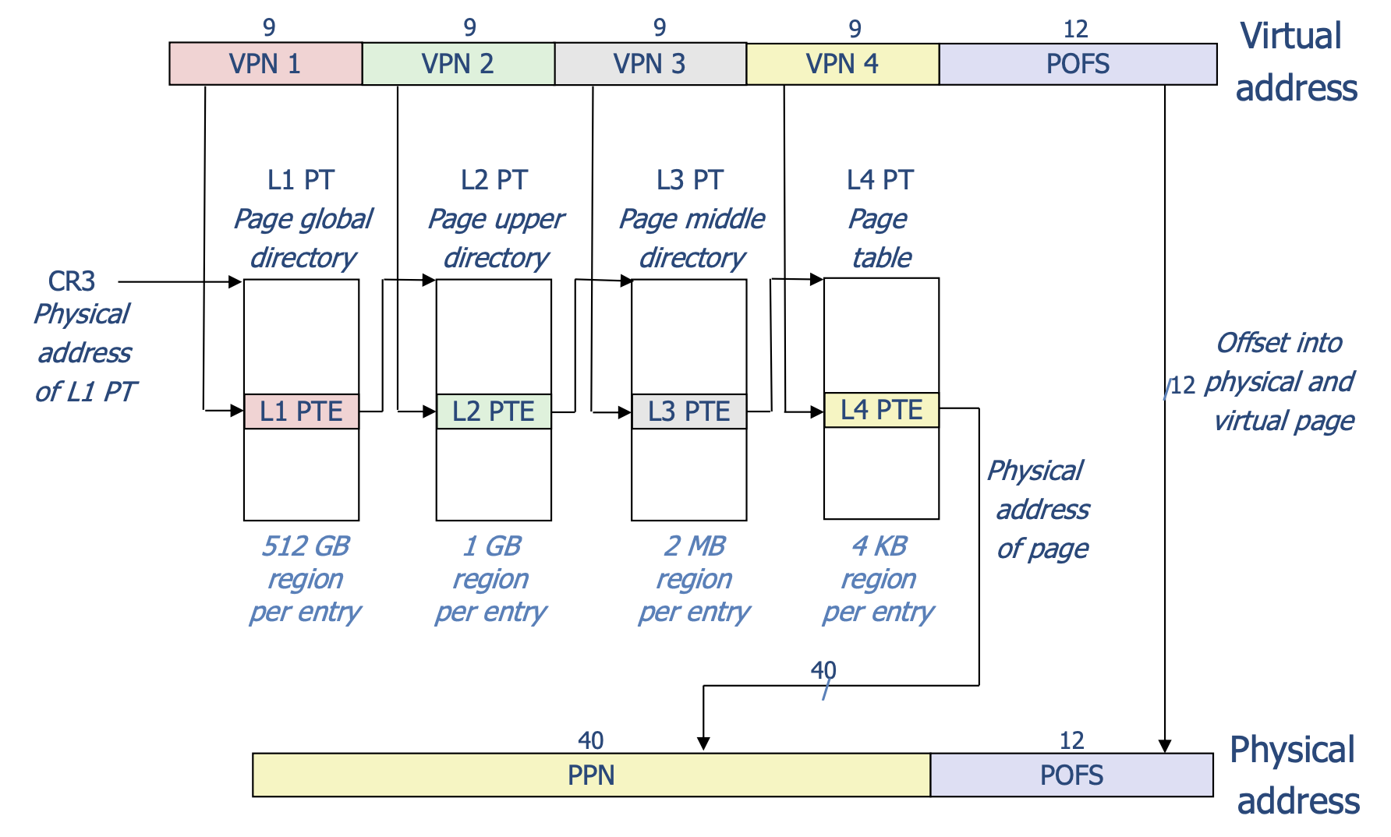
What if we have even larger memory space?

Slide 43
Summary: Virtual Memory
OS translates virtual address from application to memory physical address
Address is translated even before cache or memory access
A lookup table resides in the memory
We use leveled indexing to save memory
Problem
I need one memory access, but you need 5 associated?

Slide 44
A Cache for VM
Cache frequently accessed memory translation
TLB: Translation Lookaside Buffer
A really small cache with 16-512 entries
Small, so we can do fully associated access
TLB hit: return PPN
TLB miss: Walk through the page table
VPN
PPN

Slide 45
TLB Miss
Requested page not in TLB
X86: A specialized TLB walker
Saves OS software overhead
Walker can be active without blocking other insts
Wait, what if page table also misses?
No, we do not want a infinite recursion
Use physical address in PT address
Typically PT root is in a register

Slide 46
TLB Miss
Requested page not in TLB
X86: A specialized TLB walker
Saves OS software overhead
Walker can be active without blocking other insts
Wait, what if page table also misses?
No, we do not want a infinite recursion
Use physical address in PT address

Slide 47
TLB Un-Reach
TLB Reach: The biggest working set of virtual memory that can be translated by TLB
TLB Reach = #Entries × PageSize
4K * 512 = 2MB < LLC Size
4 memory access latency >>>>> LLC latency
Which invalidates the effort of LLC
What should we do?

Slide 48
TLB Reach!
TLB Reach << LLC Size
Solution 1: Large Page Table (e.g. 4MB? 1GB?)
Fewer levels for bigger pages
Many variants support self-adaptive entries
Larger table for more internal fragments
Solution 2: 2-level TLB
L1: 64 entries, L2: 512-2048 entries

Slide 49
Work with Cache
Functionality?
Any problem can be solved by indirect
PA Cache
Data locality is also TLB locality
☺: Simple solution for inter-process comm.
☹: Slow, at least one more cycle for TLB hit
What if the entry is not in TLB?
Invoke page fault process
CPU
VA
TLB
PA
L1

Slide 50
Page Table Miss? Page Fault!
If an entry is not in TLB and not even in page table, it is in the disk
OS will choose a physical page to replace
Just like cache associativity
Dirty bit? Write to disk
Read miss page from disk and bring it to memory
This is slow… Typically 10ms…

Slide 51
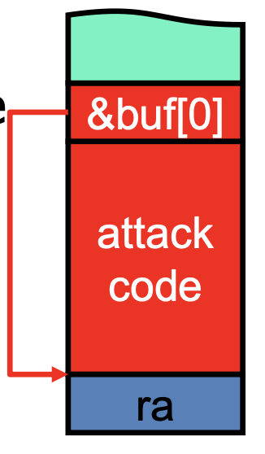
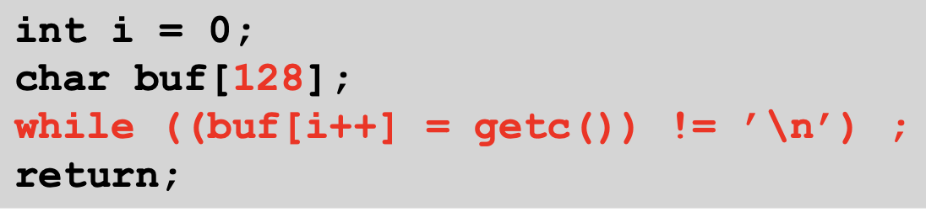
Page-level Permissions
Return-oriented attach
Bytes read are actually code, not data
Overflow buffer overwrites return address

Slide 52
Alternative: VA Cache
CPU
☺: Fast in access
☹: Applications can have same VA
What if processes switches?
Flushing is slow
Each tag has a PID
Many process w/ the same PA can have different VA
Duplicated entries
VA
L1
PA
TLB

Slide 53
TLB and L1 in Parallel
CPU
Anyways, page offset is not translated
So it is both VA and PA
Access TLB to translate VA to PA
Match PA tag with translated PA
Adopted in modern CPUs
PA
PA
L1
TLB
VPN[31:12]
POFS[11:0]
Tag is PA
Tag[31:12]
Index[11:5]
Offset[4:0]
Notes:
`

