Slide 1
An Intro to Computer System
W1D2: A Quick Tour to
PL & Compiler
Jian Weng
Computer Science
CEMSE, KAUST

Slide 2

Resources
https://1drv.ms/f/c/bedff36119963aae/EvWLYLwmhjJJpWqxT3UtL4kBpR-URbrArXSAFCja83hXbw?e=WsTb3s
All the slides will be released after instruction
Password: acm2025
Expiry: Jan 15, 2026
My office: Room322
Make an appointment first!
My email: jian.weng@kaust.edu.sa

Slide 3
Roadmap
Programming Language
Characterizing a programming language
Compiler Pipeline

Slide 4
Characterizing a Programming Lang.
Before starting a new project, what language do you choose? Why?
Characterizing a programing language
Target Application
Developer Experience
Performance
Libraries

Slide 5
Programming Language: Programmability
General-purpose
E.g. Java/Python/C/C++/Rust
Theoretically, for anything you want
Domain-specific
E.g. HTML/Markdown/PyTorch/TensorFlow
For only specific tasks, but easier to write

Slide 6
Performance: Managed & Unmanaged
If the language is managed by a virtual runtime environment
Unmanaged
C/C++/Rust(?)
Compiler compiles to a native environment
Managed
Java/JavaScript/C#/Python
Runs on a virtual interpreter

Slide 7
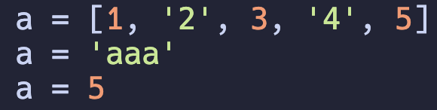
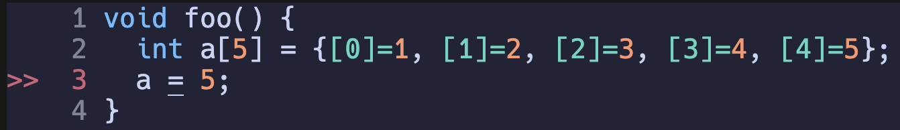
Tradeoff: Performance & Flexibility
Python: Dynamic-typed managed language can even do this ☺
C: Static-typed unmanaged language cannot ☹
But, at what cost?
A “left value identifier” is just a handle to the value, which can be anything
A “left value identifier” is represents its dedicated memory allocated

Slide 8
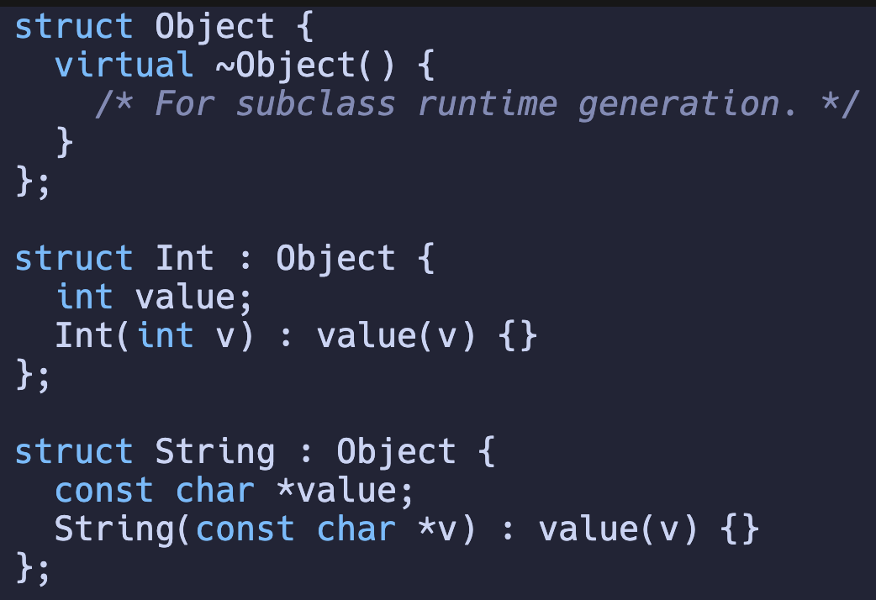
Performance & Flexibility: Heavier Runtime
There is no magic in this world
You need to declare a base object that is “array-able”
Do not mix this runtime with that runtime

Slide 9
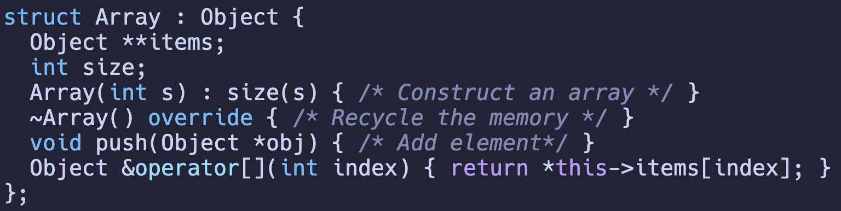
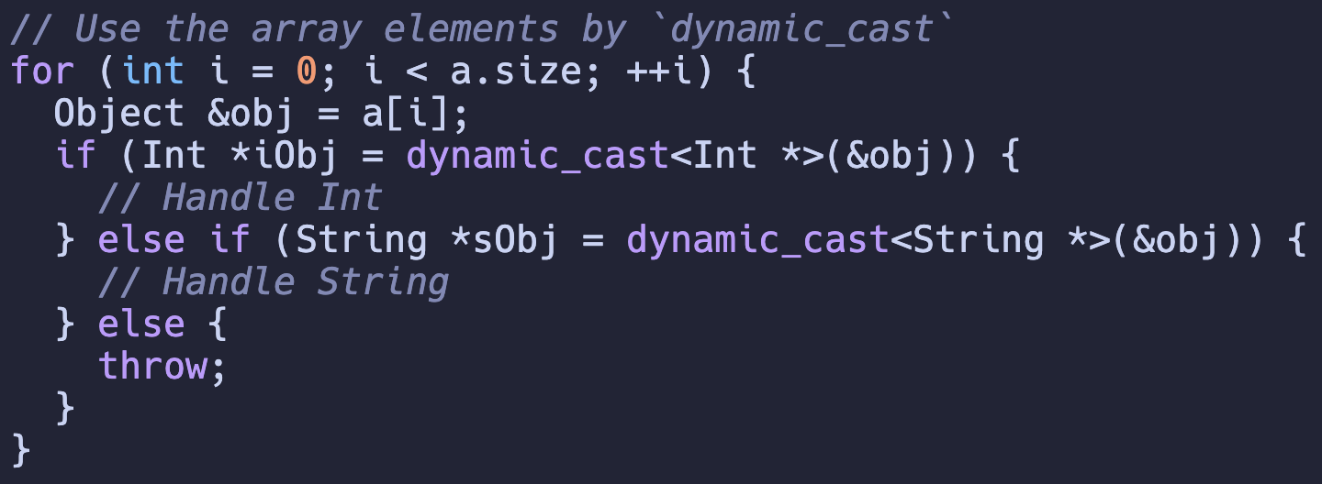
Managed Runtime (CONT’D)
Then we are have an array of Objects

Slide 10
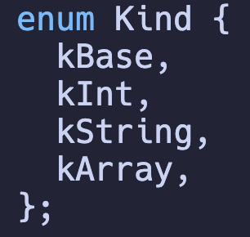
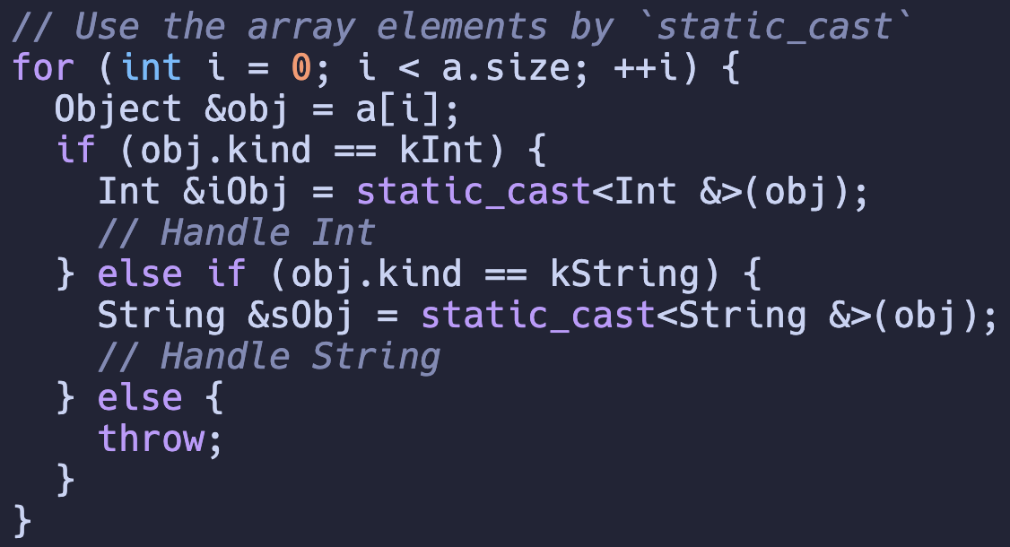
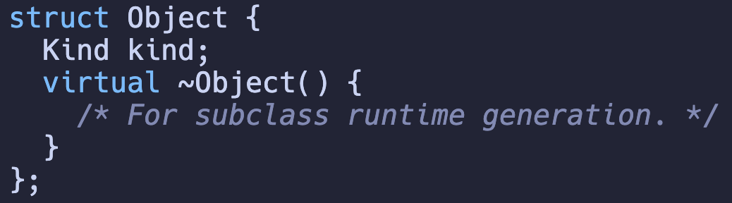
Unmanaged Runtime: Demystified
What if I do this?
Which performance is better?
Manually manage the subclass of each subclass.

Slide 11
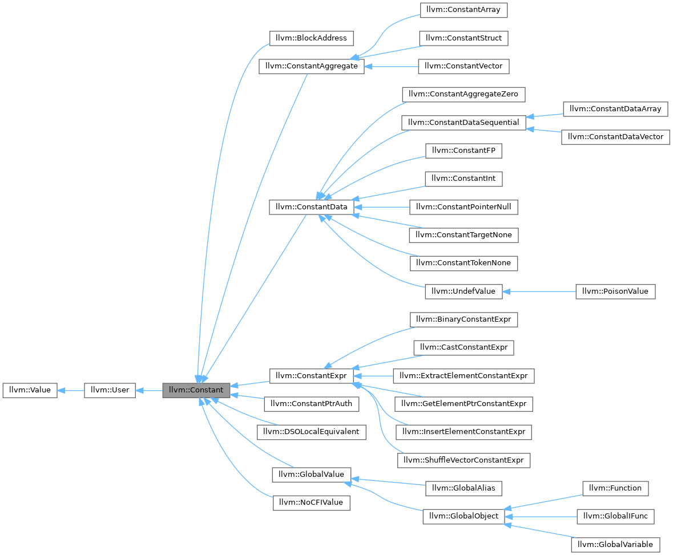
Unmanaged Runtime
Theoretically, there should be no difference between these two, but it will degrade the performance when over-complicated.
RTTI: -fno-rtti
Runtime type info
Source: https://stackoverflow.com/questions/22288347/dynamic-cast-vs-virtual-function-vs-member-enum

Slide 12

Unmanaged Runtime: Conclusion
Source: Age of Ultron (2015)

Slide 13
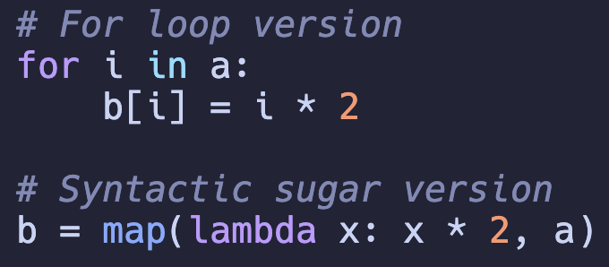
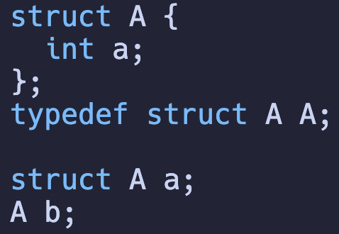
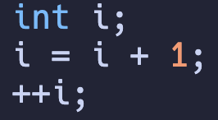
Syntactical Sugar: Oh! Sweet!
Python: Map or For-loop?
C: Self-increase
C: Type Decl
Exemplify the language features that makes you program more easily, while you can still program without them.

Slide 14
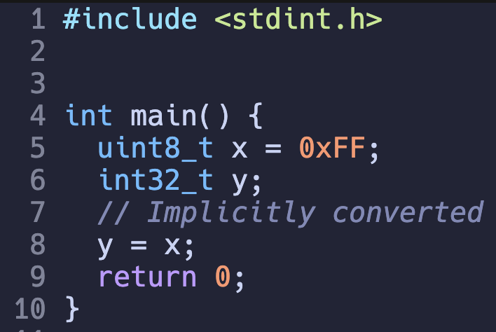
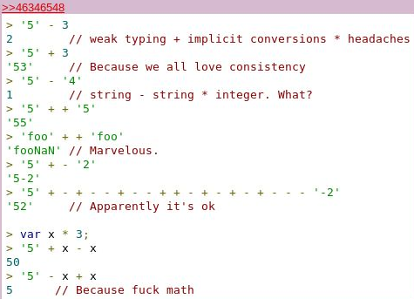
Syntactical Salt: Do (not) get addicted!
It is OK to do this in C
This makes code concise
You can even do this in JS!

Slide 15
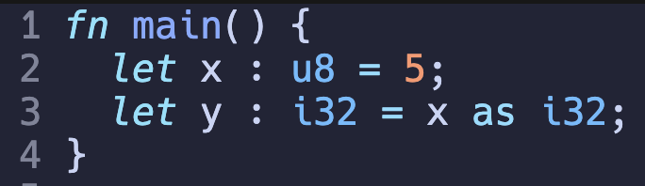
Syntactical Salt (CONT’D)
You are not allowed to do this in Rust (that freely).
Make you program harder to avoid unnecessary errors.

Slide 16
Dynamic/Static Type & Weak/Strong Type are orthogonal!
This is dynamic type in Python
This is weak type in C
This is both dynamic and weak typed in JS

Slide 17
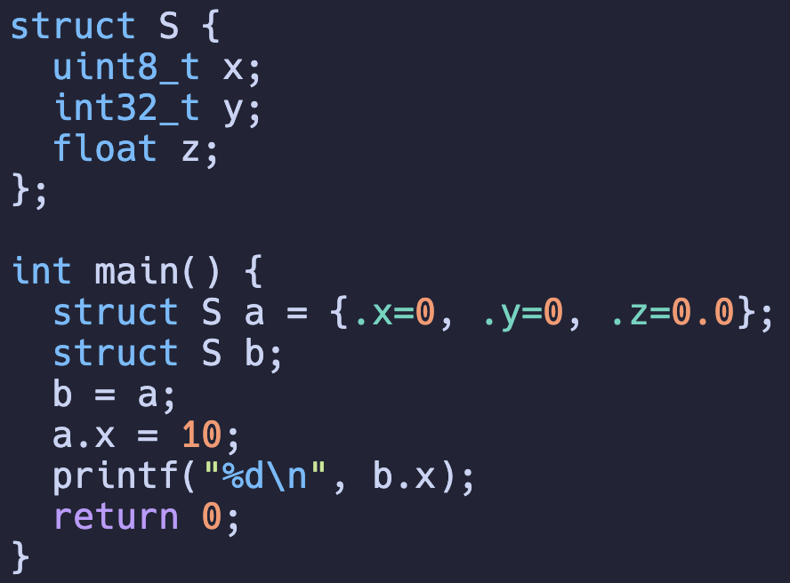
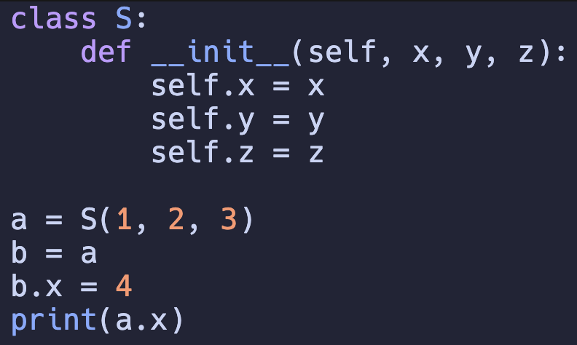
Structs
What are the key differences between C and Python/Java on structs?
Pointer references

Slide 18
Quiz: Characterizing a language.
 | C | Rust | Python | JavaScript
Dynamic?
Strong?

Slide 19
Summary
Tradeoffs
Performance vs Developer Experience
Performance vs Expressiveness
Characterization
Expressiveness
Managed/Unmanaged
Compiled/Interpreted

Slide 20
Summary: Compiler
Tradeoffs
Performance vs Developer Experience
Performance vs Expressiveness
Characterization
Expressiveness: General-purpose
Managed/Unmanaged
Compiled/Interpreted

Slide 21
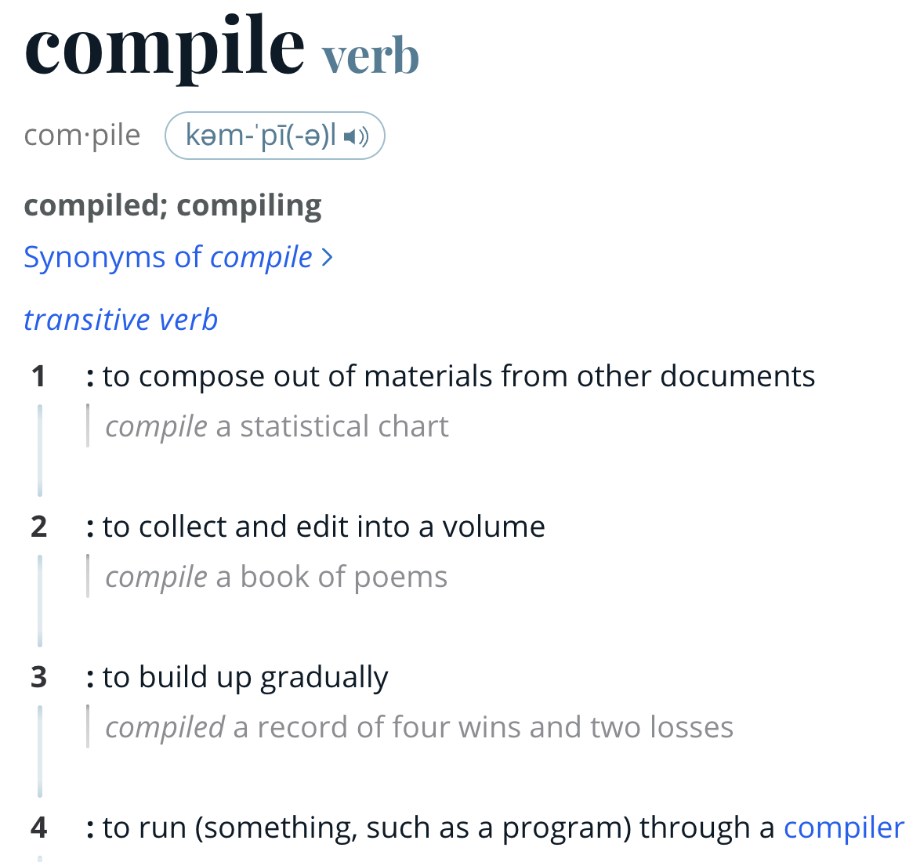

Roadmap
Programming Language
Compiler Pipeline
Frontend
Backend

Slide 22
LLVM: Compiler Infrastructure
LLVM: Low-level Virtual Machine
https://www.llvm.org/
https://releases.llvm.org/
Download one!
https://llvm.org/docs/GettingStarted.html
Build your own
It is high recommended to have LLVM infrastructure setup to run the examples
If you build it, be careful with the parallelism
-DLLVM_PARALLEL_{COMPILE,LINK,TABLEGEN}_JOBS=N

Slide 23

LLVM: Compiler Infrastructure
Spoiler: You need CMake to build LLVM, but I will talk about C build system next class…

Slide 24
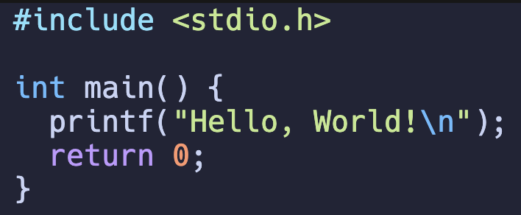
Compiler Pipeline
What happens after typing this?
> clang main.c -o main -O3
PP
Tokenizer
Parser
IR CodeGen
Optimizer
Inst Select
Register Allocation
Machine Rel. Opt.
Assembler
Link Lib
Frontend
Backend

Slide 25
Preprocessor
Resolve all the macros
> clang main.c -E
PP

Slide 26
Tokenizer: Split the program in "words"
Keyword int
Identifier main
LeftPran (
RightPran )
LeftBrace {
Identifier printf
LeftPran (
StringLiteral " Hello, World!\n ”
RightPran )
Semicolon ;
Keyword return
IntLiteral 0
Semicolon ;
RightBrace }
Sorry, we do not have a command here
PP
Tokenizer

Slide 27
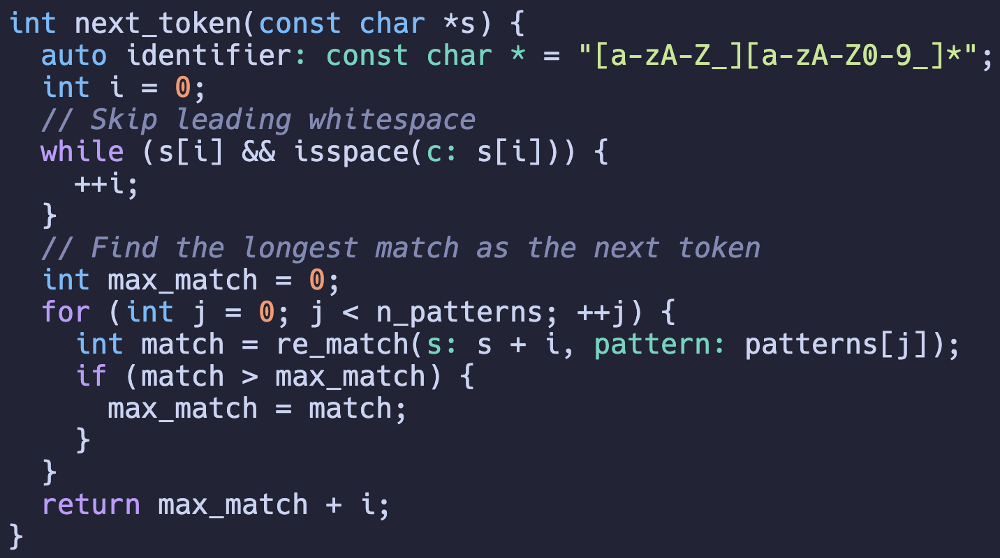
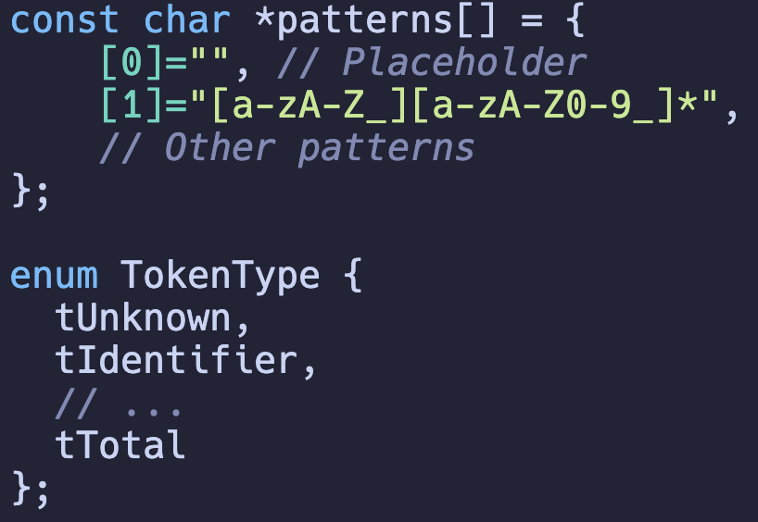
Tokenizer: Regex
Regex: Regular Expression
Skip all the white spaces and match the longest Regex
Notes:
Ask them if they already know Regex.

Slide 28
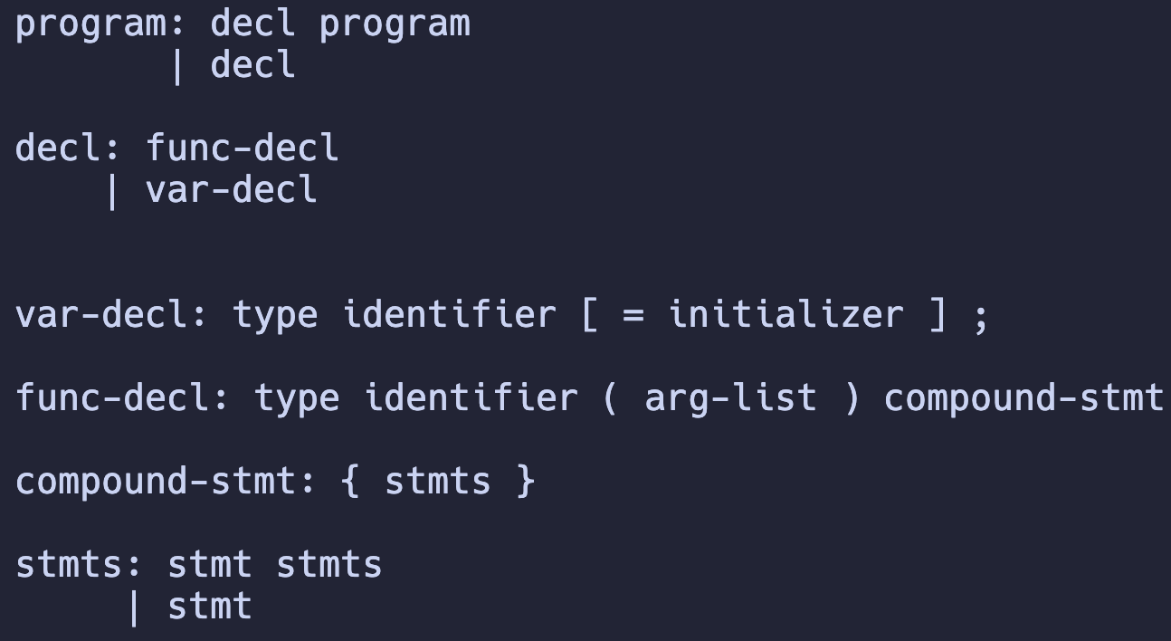
Parser: Organize the tokens
Formal Rule: Context Free Grammar

Slide 29
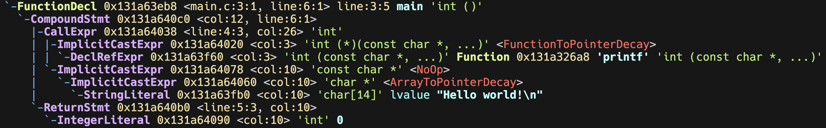
Tokenizer & Parser: A Demonstration
How it works in a commercial compiler?
clang –Xclang –ast-dump main.c
This is a sub-option to clang, not to the compiler itself
PP
Tokenizer
Parser
Frontend

Slide 30

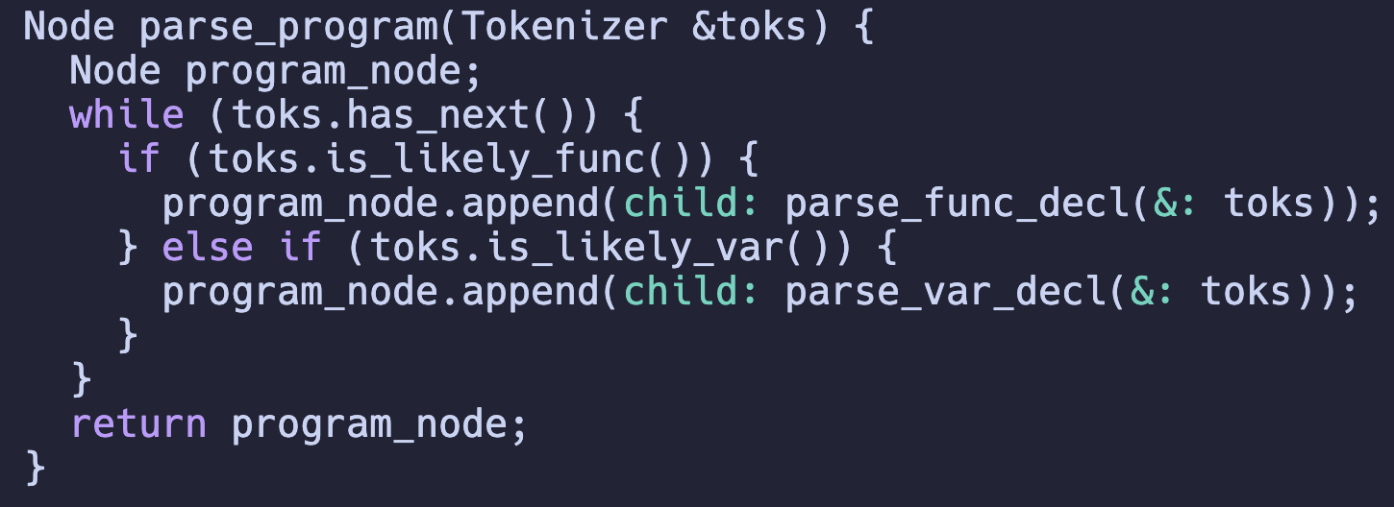
Tokenizer & Parser: Implementation
Generator (99% textbook will tell you to do this)
C-family: flex (regex+token) & bison (grammar)
Decedent Recursion
But actually 99% compiler projects does this

Slide 31
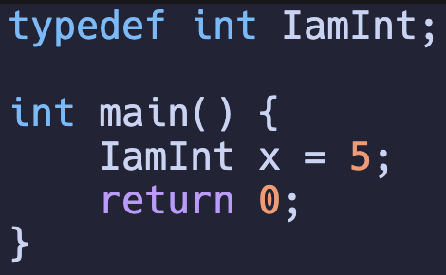
Why?
Modern languages are no long that context-free.
decl: type id = initializer
You can hardly know an Identifier is a type or a variable identifier w/o context knowledge.

Slide 32
Ad: Rust Variant is a good fit!
union Token {
char * id,
int64_t i,
... };
enum Token {
Identifier(String),
IntLiteral(i64),
...
};
enum kToken {
Identifier,
IntLiteral,
... };
match tok {
Identifier(id) => {}
IntLiteral(i) => {}
... }

Slide 33
Even worse! My vision is not that far ☹
C’s grammar is poorly designed
Why is it likely?

Slide 34
A bad “likely”
When it comes to int + identifier, what should I do?
int a;
typedef int int32_t;
int main() {
int32_t x;
x = 1; }

Slide 35
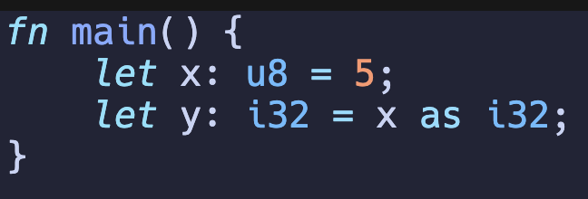
Parsers are simpler in modern languages
Recap: Keywords hint the parser

Slide 36
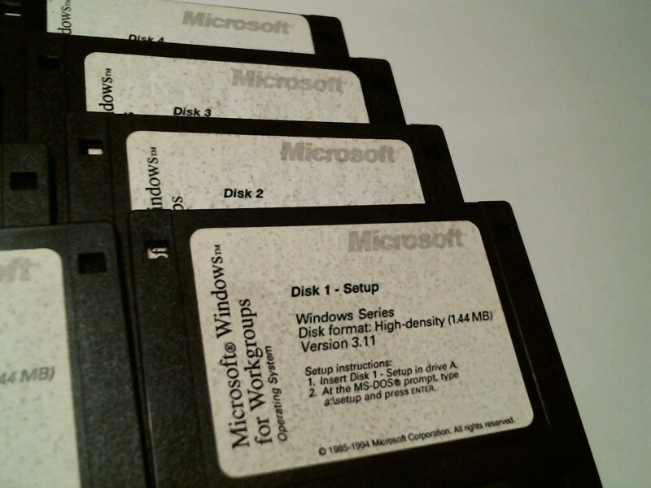
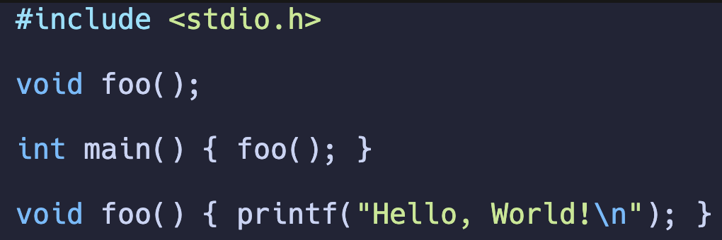
Another Historical Legacy: One-pass Compilation
Why do we bother to separate the declaration and implementation?

Slide 37
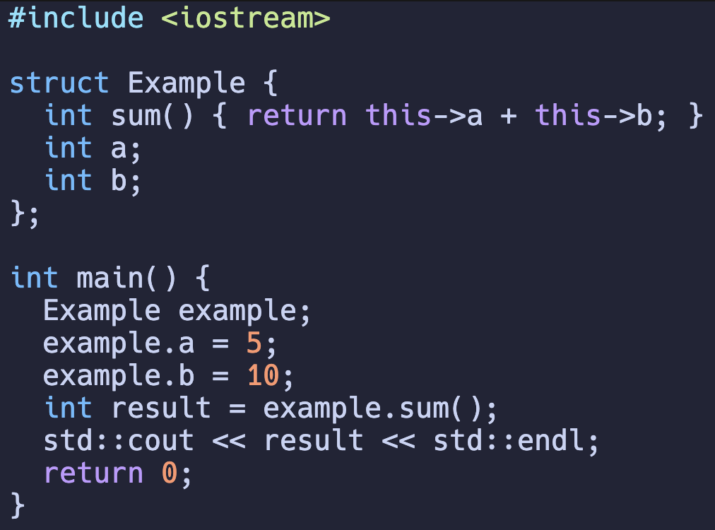
Compromise: I should scan it multiple times conditionally in C++ era.
Actually, within a struct, it is scanned more than once!
But still, other functions suffer from one-pass scan.

Slide 38
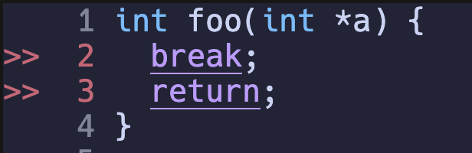
Semantics Check
The program below fits in the syntax of C, but semantically fails
PP
Tokenizer
Parser
Sema Check
Frontend

Slide 39
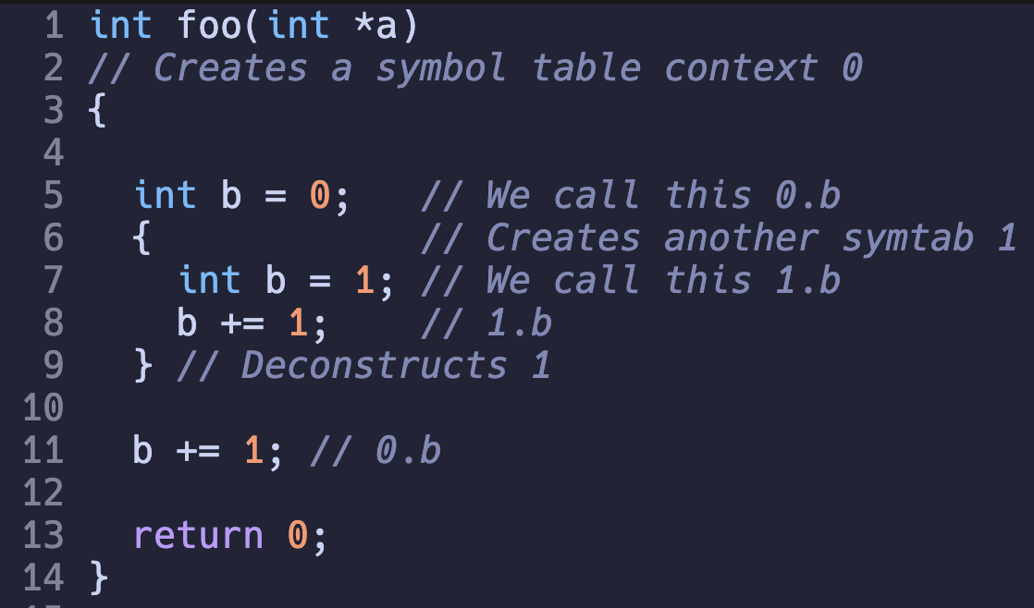
Semantics Check (Symbol Table)
Symbol table context scope

Slide 40
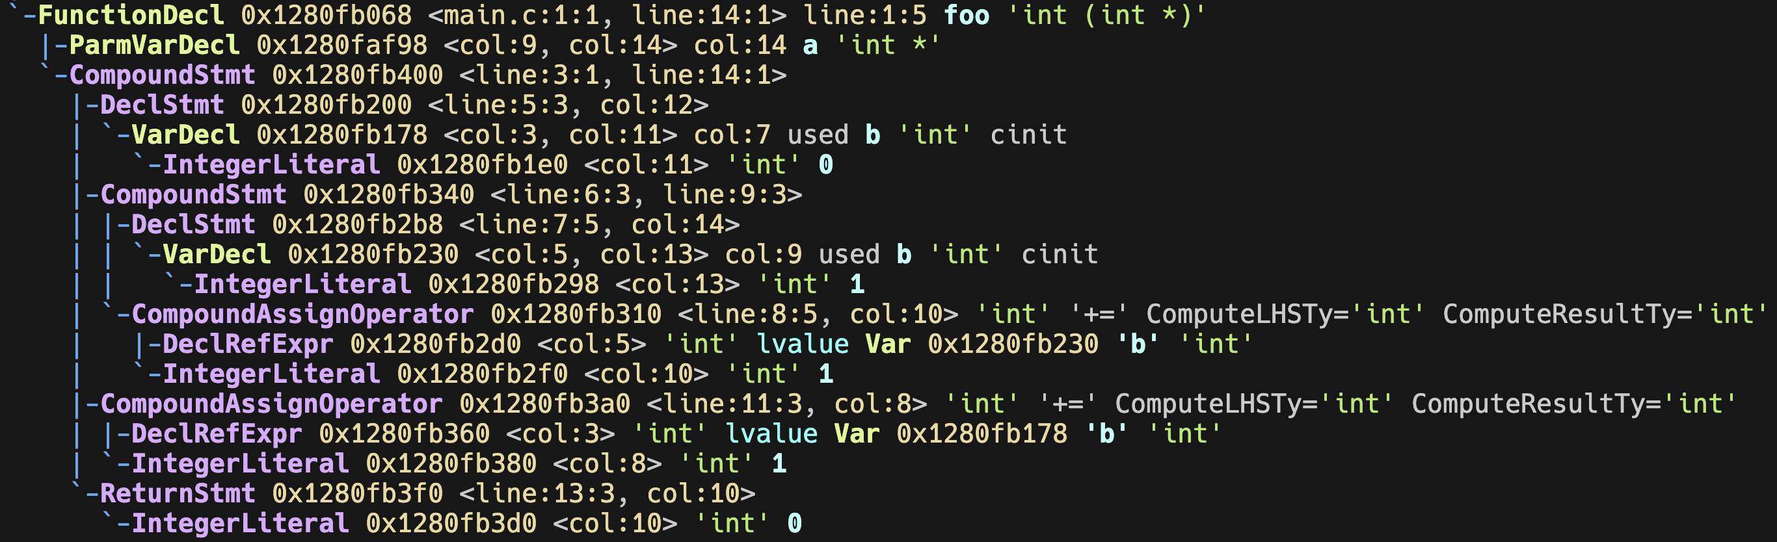
Implementation
Ideally, this can be summarized into three rules
When entering a CompoundStmt, create a new ctx
When leaving destroy
When entering a DeclStmt, put it into the ctx
When entering a reference, find it in ctx stack

Slide 41
Implementation
Key Behavior: We the behaviors on each AST node depends on its subclass
Trivial Solution: Virtual Function
Pros: Straightforward and effective
Cons: ?

Slide 42
Virtual Function: An invasive solution
Add a virtual method to each node for semantics check.
Pros: Straight forward
Cons: Invasive, very invasive.
Why is it bad?
Keep in ur mind: I am working on a big proj, and I am working w/ others
class CompoundStmt : ASTNode {
virtual void semanticsCheck(...) {
// create the context } }
class DeclStmt : ASTNode {
virtual void semanticsCheck(...) {
// add it to the context } }
class RefVar : ASTNode {
virtual void semanticsCheck(...) {
// find it from the context } }

Slide 43
Visitor Pattern is a Visitor
Visitor pattern is a visitor to traverse each node in depth first
class VisitorBase {
virtual void visit(CompoundStmt *s) {
for (auto &stmt : s->stmts) {
this->visit(s); } }
virtual void visit(DeclStmt *s) {
this->visit(s->var);
if (s->init) this->visit(s->init); }
virtual void visit(RefVar *r) {
/*It is a leaf*/ }
}

Slide 44
Visitor Pattern: Passive Voice
Visitor pattern is a visitor to traverse each node in depth first
class Sema : VisitorBase {
void visit(CompoundStmt *s) override {
this->ctx.push();
for (auto &stmt : s->stmts) {
this->visit(s); } this->ctx.pop(); }
void visit(DeclStmt *s) override {
this->ctx.add(s->var);
if (s->init) this->visit(s->init); }
virtual void visit(RefVar *r) {
this->ctx.find(r); }
}

Slide 45
Visitor Pattern: A Low-invasion Alternative
Before: Modify the `.h` node declaration
Will be discussed later. Modifying `.h` is evil.
After: Extend your related Visitor in each module
Only affects the module itself

Slide 46
IR CodeGen
Generate a near-ASM representation
It actually still works without -S
Compile w/o link
Text format
> clang main.c –c –O2 –S –emit-llvm
Optimize
Emit the LLVM IR
PP
Tokenizer
Parser
IR CodeGen
Frontend

Slide 47
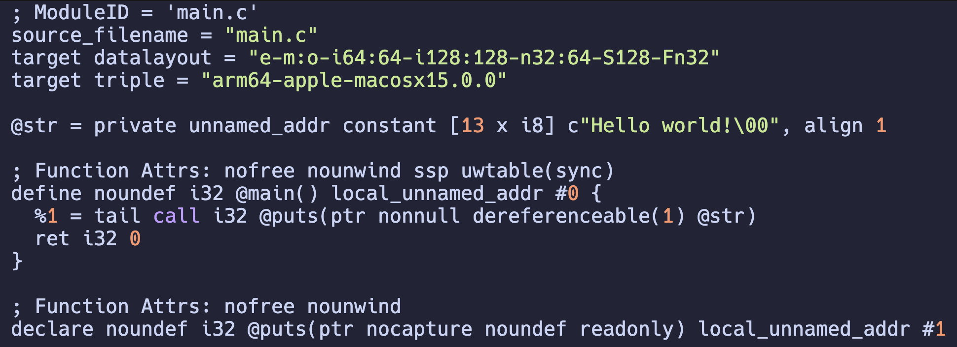
IR CodeGen
Generate a near-ASM representation
Compile w/o link
Text format
clang main.c –c –O2 –S –emit-llvm
Optimize
Emit the LLVM IR

Slide 48
Intermediate Representation
NxM-Effort
N+M-Effort
X86
X86
C
C
ARM
ARM
C++
C++
RISCV
IR
RISCV
Rust
Rust
PowerPC
PowerPC
Go
Go
Hexa
Hexa

Slide 49
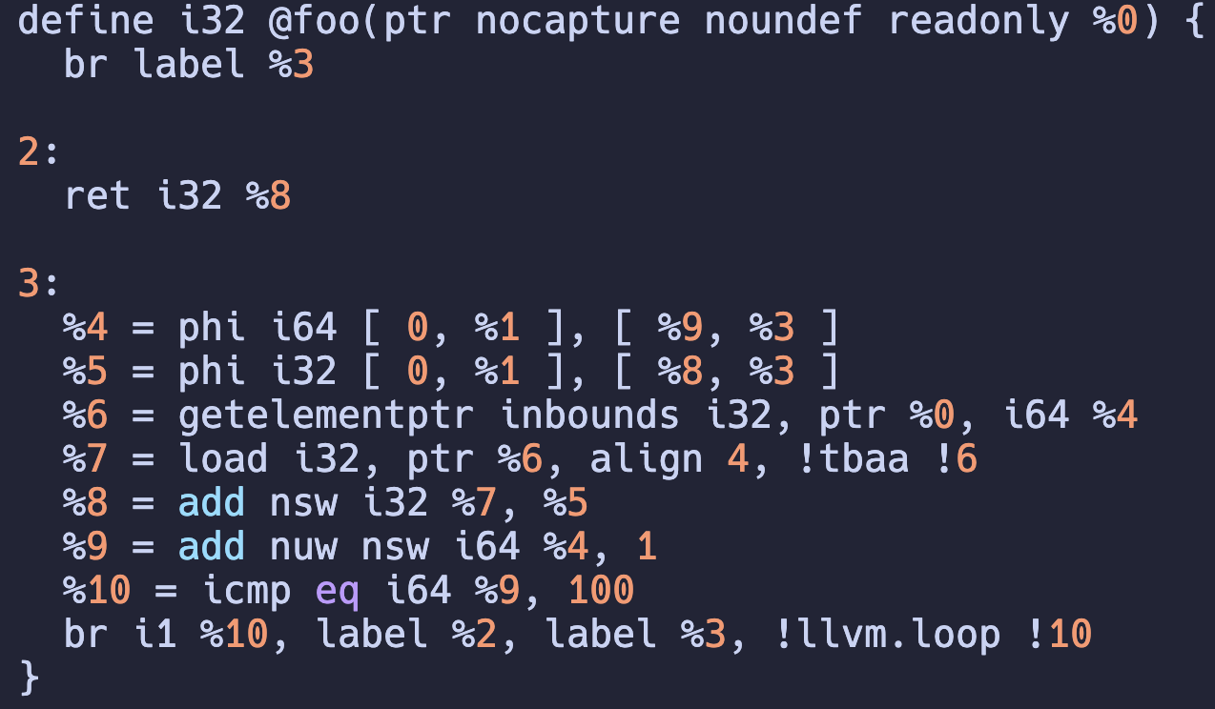
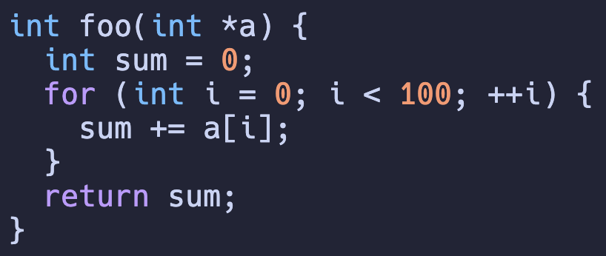
Intermediate Representation
Something nearer to assembly, but not an assembly
3-address instruction
Branches
Wait? What is PHI?

Slide 50
Machine-independent Optimizations
%3 = %1 + %2
%4 = %1 + %2
%5 = %3 + %4
%3 = %1 + %2
%4 = %3 + %3
%3 = %1 + %2
%4 = %3 << 1
CSE: %3 and %4 are the same, so we only compute it once!
Strength Reduction: A + A can be done by A * 2, which is simpler as A << 1
PP
Tokenizer
Parser
IR CodeGen
Optimizer
Frontend

Slide 51
Analyze first! Modify later.
You can easily make this mistake in C++
Why is it wrong?
// a is a vector
for (auto iter = a.begin(); i < a.end(); ++i) {
if (cond) a.erase(cond);
if (cond) a.push_back(/*something*/); }

Slide 52
Analyze first! Modify later! (CONT’D)
In language level, Rust ensures you should do this!
// Rust
// a is Vec<_>
let mut idx : Option<usize> = None;
for (i, v) in a.iter().enumerate() {
if cond { idx = Some(i) }; }
if Some(idx) = idx {
a.remove(idx);
}

Slide 53
Machine-independent Optimizations (CONT’D)
Hoisting loop invariant
for i in 0..n
// %invar = compute a[i]
for j in 0..n
// use %invar[j]
for i in 0..n
for j in 0..n
// use a[i][j]

Slide 54
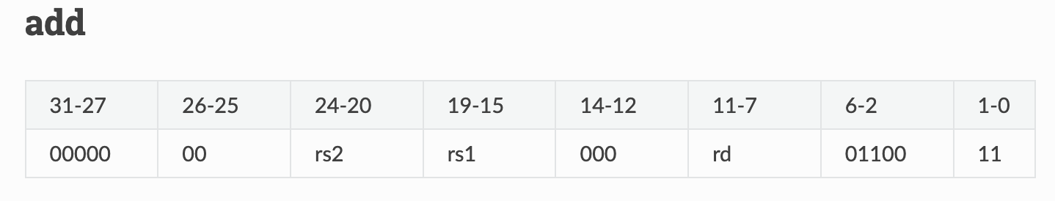
Backend: Target to a specific ISA
Code Selection
# %3 = %1 + %2
add a3, a1, a2
OK. It is as simple as expected.
PP
Tokenizer
Parser
IR CodeGen
Optimizer
Inst Select
Frontend

Slide 55
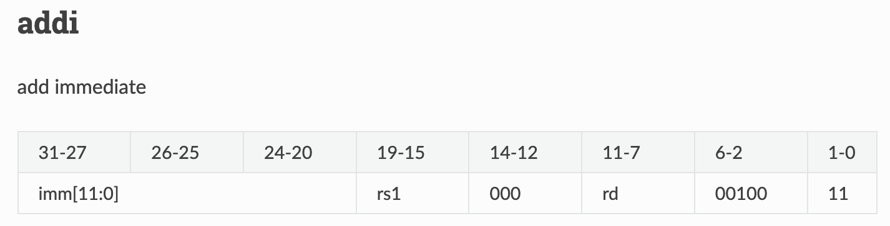
Code Selection (CONT’D)
# %2 = %1 + 2
addi a2, a1, 2
Phew~ It is as lucky as fitted.
PP
Tokenizer
Parser
IR CodeGen
Optimizer
Inst Select
Frontend

Slide 56
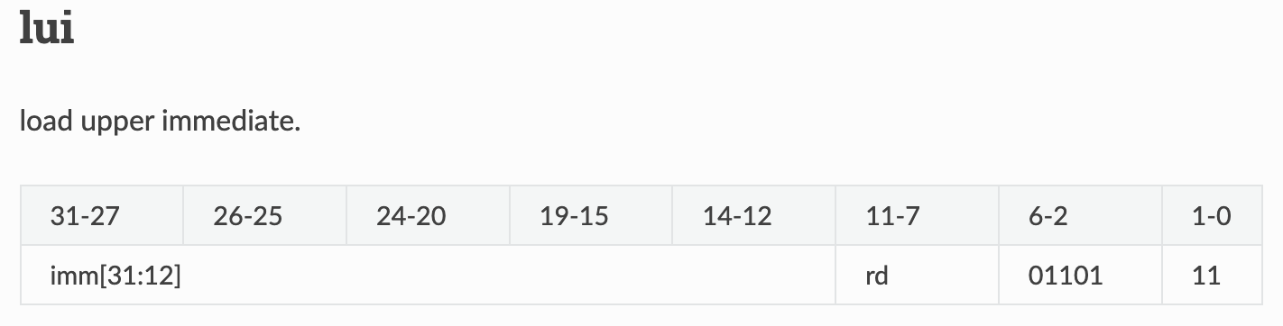
Code Selection (CONT’D)
# %2 = %1 + 1919810
lui a3, 468
xori a3, a3, 2882
addi a2, a1, a3
Wut? You do this?
468 << 12 | 2882 = 1919810
PP
Tokenizer
Parser
IR CodeGen
Optimizer
Inst Select
Frontend

Slide 57
Wait… What is the key differences b/t IR and ASM?
Infinite registers
llc main.ll –c –O1 –S
PP
Tokenizer
Parser
IR CodeGen
Optimizer
Inst Select
Register Allocation
Frontend
Backend

Slide 58
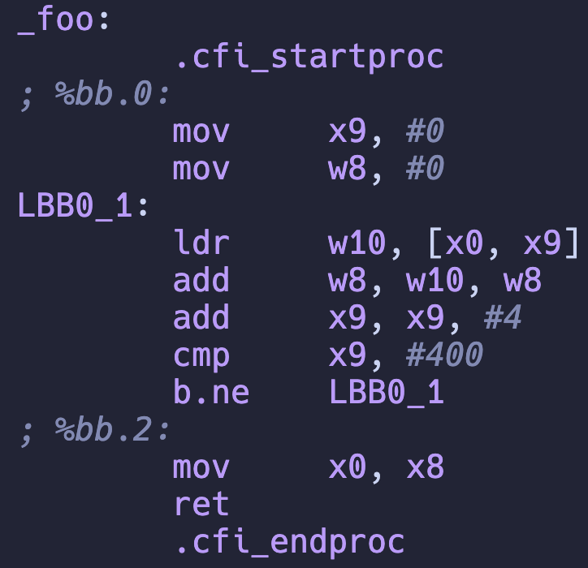
Code Select + Register Allocation
llc main.ll –o main.s

Slide 59
Still, it is far from executable yet…
> gcc main.s
> ls
... a.out ...
> a.out
Assembler and linkers are missing
Assembler: Encode instruction text format to binaries
Linker: Link runtime (?) libraries
PP
Tokenizer
Parser
IR CodeGen
Optimizer
Inst Select
Register Allocation
Machine Rel. Opt.
Assembler
Link Lib
Frontend
Backend

Slide 60
OK. A non-sense question.
What is the “entrance of a program”?
main function is NOT the correct answer
> objdump –d a.out

