Slide 1
An Intro to Computer System
W2D1: A Deeper Tour to Binaries
Jian Weng
Computer Science
CEMSE, KAUST

Slide 2
Roadmap
Cleanup what we had last class
How to use CMake
A deeper tour to binaries
What are in a binary executable?

Slide 3
Recap: Compiling a REAL C/C++ Project
Understanding several additional flags
-I<dir>: find headers from the given <dir>
-L<dir>: will find libs from the given <dir>
-l<lib-name>: link the libxxx.{a/so} from the <dir> given by -L
Essentially these three flags can handle 90% of building an external C/C++ project

Slide 4
Trouble shooting: Undefined Symbol
Find the paths inspected by the system
gcc -E -Wp,-v -
gcc -print-search-dirs

Slide 5
What are “others” trying to help?
Work on larger projects
What if the file organization is more complicated?
Give your code for others’ use
Use others’ code
Separate works into pieces
Put back separated pieces into one

Slide 6

LLVM: Compiler Infrastructure
Spoiler: You need CMake to build LLVM, but I will talk about C build system next class…
Did you know how to use it yet?

Slide 7
CMake: A Build Generator
What if the file organization is more complicated?
CMake is the answer
Automatically generate build system files
Mainly for Unix Makefiles and Ninja

Slide 8
CMake: A Domain-specific Language
Quiz: What is a Domain-specific Language (DSL)?
What is the key tradeoff of a language of being a DSL?
Tradeoff n. I trade something off/away to get something I want.

Slide 9
CMake: Basic Semantics
Function(<arg-name> <arg-value>)
It is something very Python-like
cmake_minimum_required(VERSION 3.20)
def foo(a=1, b=2):
return a + b
foo(1) # foo(1, 2)
Foo(b=114514) # foo(1, 114514)

Slide 10
CMake: Basic Semantics (CONT’D)
Let’s see the mini example in CMake version.

Slide 11
Three little games…
What if I modified the header file?
CMake “listens” header files
What if I move the shared object away?
Shared objects are searched from ENV
What if I magically know something I shouldn’t?
static hides dll exportation

Slide 12
Egg
Compilation database
-DCMAKE_EXPORT_COMPILE_COMMANDS=ON
Besides, modularly enable project options
My llvm build options
cmake ../llvm-project/llvm \
-DCMAKE_BUILD_TYPE=RelWithDebInfo \
-DCMAKE_EXPORT_COMPILE_COMMANDS=ON \
-DLLVM_ENABLE_EH=ON \
-DLLVM_ENABLE_RTTI=ON \
-DCMAKE_INSTALL_PREFIX=$HOME/repos/llvm-install \
-DLLVM_TARGETS_TO_BUILD="host" \
-DLLVM_ENABLE_PROJECTS="clang"

Slide 13

Homework
Just rename the class Demystifying Low-level Impl of PyTorch!
Fewer and fewer students are enrolling in C/C++ classes, because they love Python for ML research.

Slide 14
Motivation
What is the trade-off between C++ and Python?
Performance vs developer experience
Can we bypass this trade-off?
Glue on Python, but performance-critical on C++

Slide 15
Goal: Execute C++ code on upon Python invocation
What can we expose from C++ to Python?
Shared object
Hint: You still need extern C
How can Python invoke a C++ function?
ctypes (highly recommended)
PyBind (forbidden)
Cython (harder to use, as far as I know)

Slide 16
Homework: C-Python FFI
This homework is mandatory to be grouped by 2!
Only one lucky student can work on this alone 😠, iff |x∈enrolled| ≡ 1 (mod 2)
Part 1: Compile a shared object w/ a hello world function & a+b. Expose these functions in a header file.
Part 2: Use this shared object in Python for execution.
Part 2’: Integrate this shared object project as a 3rd party in your C++ project

Slide 17
Roadmap
Cleanup what we had last class
How to use CMake
A deeper tour to binaries
What are in a binary executable?

Slide 18
How do you have an binary executed?
./main
But how aspect contributes to the execution?
Did you mistakenly open a binary with text editor?

Slide 19
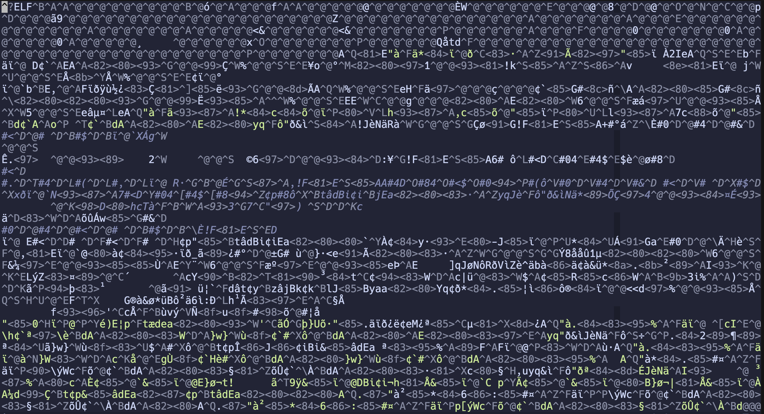
You may just see some non-sense like below.

Slide 20

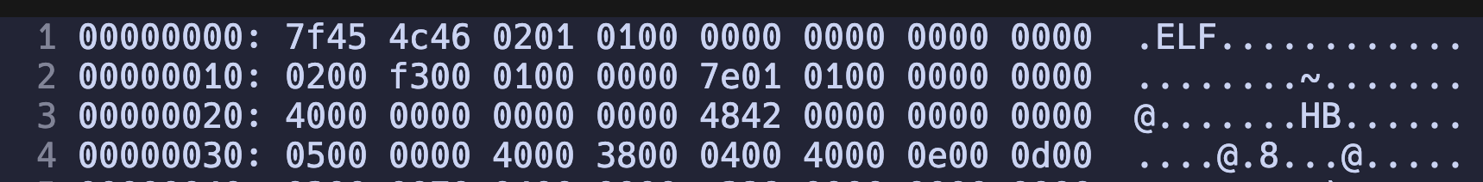
Understanding the hex format!
Why do we have hex format?
Binary 2¹
Hex 2⁴
_ _ _ _
vim main.riscv
:%!xxd

Slide 21
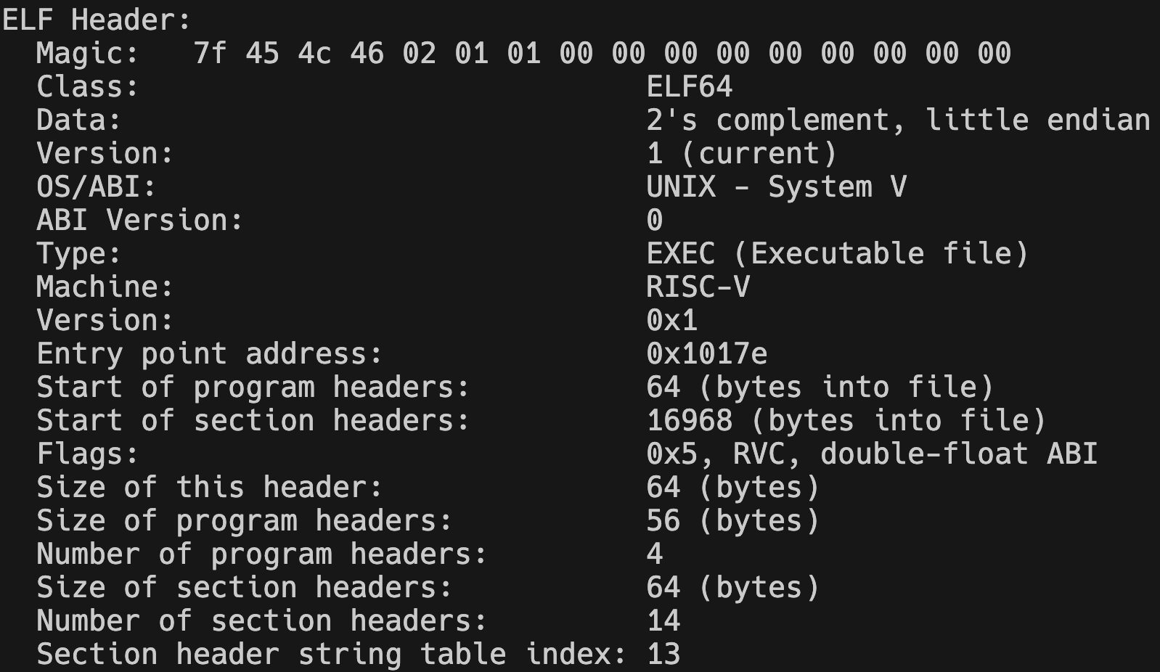
Read the header (CONT’D)
You need the help of readelf
riscv64-unknown-elf-readelf -h main.riscv

Slide 22
Read the header.
".ELF"
You need the help of readelf
riscv64-unknown-elf-readelf -h main.riscv

Slide 23
Read the header (CONT’D)
01:32-bit 02: 64-bit
You need the help of readelf
Questions: What is 32 or 64 for a 32/64-bit machine?
riscv64-unknown-elf-readelf -h main.riscv

Slide 24
Read the header (CONT’D)
01:little-endian 02:bit-endian
You need the help of readelf
What is the most normal endian contradiction you see everyday?
riscv64-unknown-elf-readelf -h main.riscv
a = 0b10101010101010
a = [0, 1, 0, 1, 0, 1, 0, 1, 0, 1, 0, 1, 0, 1]

Slide 25
Read the header (CONT’D)
OS/ABI
Paddings
You need the help of readelf
What is ABI?
What is API?
riscv64-unknown-elf-readelf -h main.riscv

Slide 26
ABI: Application Binary Interface
RISC-V Extensions: I/M/F/D/V/E/C
I: The most basic instruction set
M: Multiply
F: Float
D: Double
V: Vector
C: Compress
E: Extension

Slide 27
Why bother to have this much extensions?
Dude, there is no magic in this world
A multiplier is typically 3-stage pipeline, which is complicated
What if I do not have a multiplier while I have * in my app?
uint32_t multiply(uint32_t a, uint32_t b) {
uint32_t res = 0;
uint32_t (int i = 0; i < 32; ++i) {
if (b >> i & 1) {
res += a; }
a <<= 1; }
return res; }

Slide 28
Read the header (CONT’D)
EXEC
RISCV
You need the help of readelf
.exe/.o/.so and etc.
riscv64-unknown-elf-readelf -h main.riscv

Slide 29
Read the header (CONT’D)
Entry Point
You need the help of readelf
Did you still member big/little endian?
If so, what is the entry point?
riscv64-unknown-elf-readelf -h main.riscv

Slide 30
Read the header (CONT’D)
Section Offset
You need the help of readelf
Did you still member big/little endian?
If so, what is the entry point?
riscv64-unknown-elf-readelf -h main.riscv

Slide 31
Why? I do not know either.
My understanding is that 16968 is a physical address

Slide 32
Recap: OK. A non-sense question.
What is the “entrance of a program”?
main function is NOT the correct answer
> objdump –d a.out

Slide 33
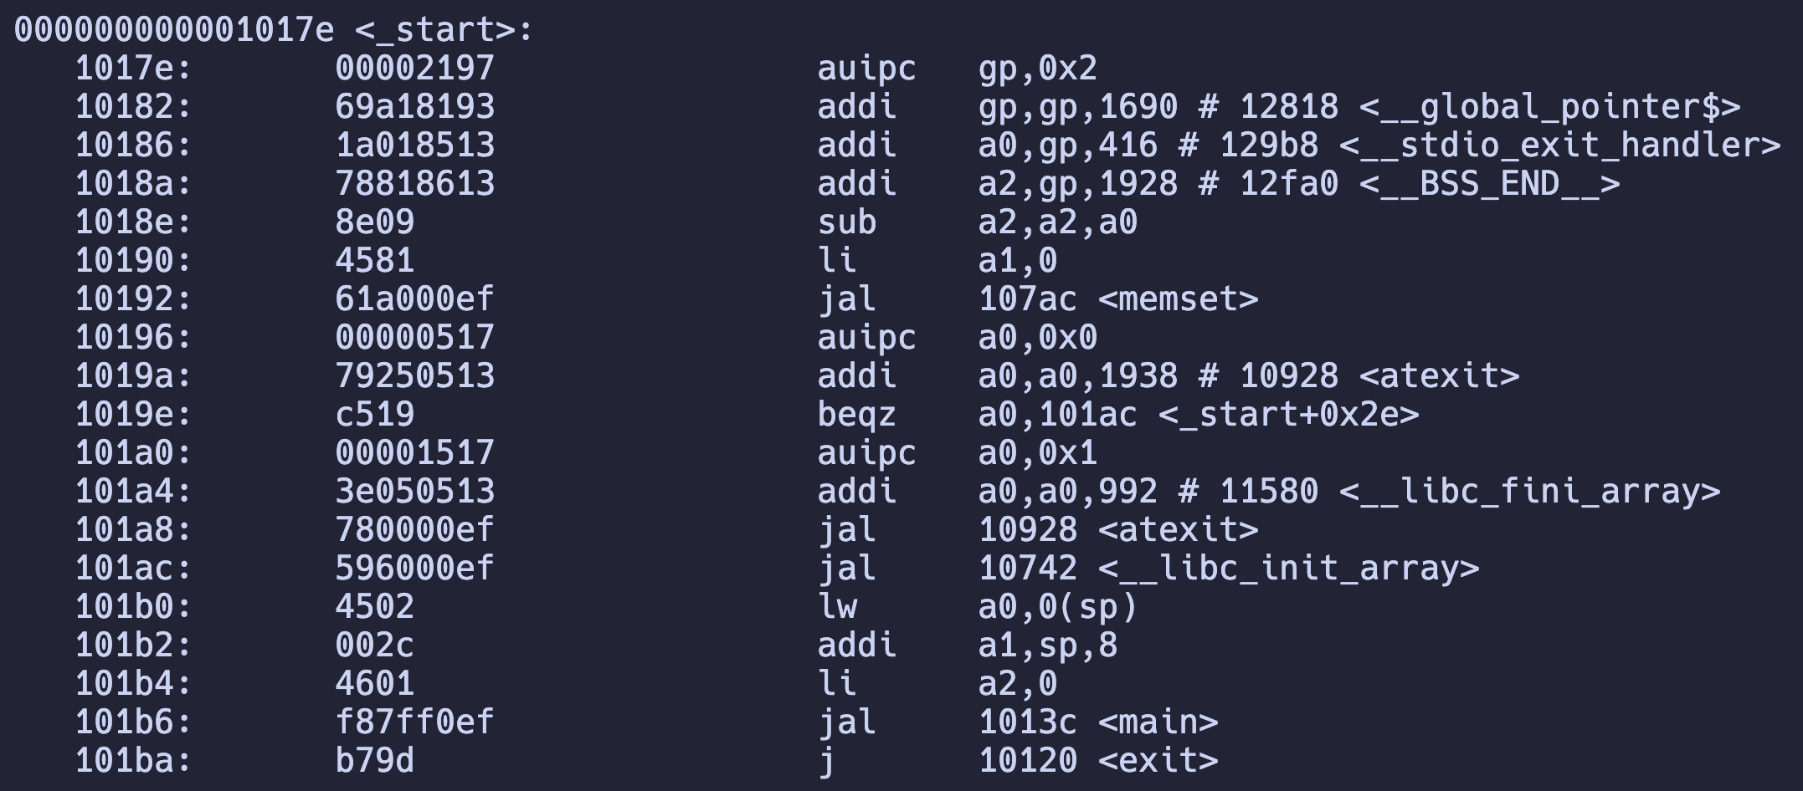
Fine, let me have this fixed…
> riscv-unknown-elf-objdump –d main.riscv

Slide 34
Question: How to find the correspondence?
It is logically at 0x1017e, but where is the physical location?
OK. It seems it is at 17e, but why?

Slide 35
Read the header (CONT’D)
This header is 64-byte
At 64-byte, we have program header.
You need the help of readelf
We are (nearly) done with the ELF header part
riscv64-unknown-elf-readelf -h main.riscv

Slide 36
Read the header (CONT’D)
Each entry is 56-byte
In total 4 entries
You need the help of readelf
We are (nearly) done with the ELF header part
riscv64-unknown-elf-readelf -h main.riscv

Slide 37
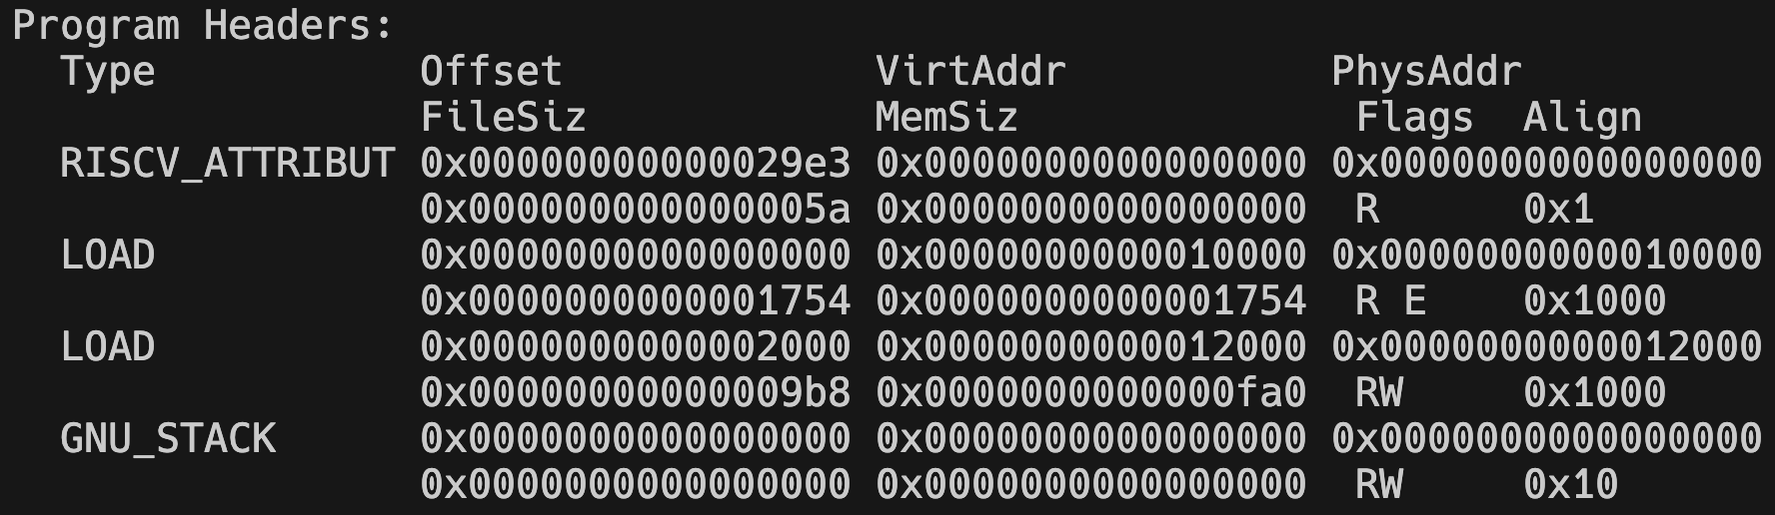
Read the header (CONT’D)
Each entry is 56-byte
In total 4 entries
You need the help of readelf
-l: means load.
riscv64-unknown-elf-readelf -l main.riscv

Slide 38
Read the header (CONT’D)
Each entry is 56-byte
In total 4 entries
You need the help of readelf
riscv64-unknown-elf-readelf -l main.riscv

Slide 39
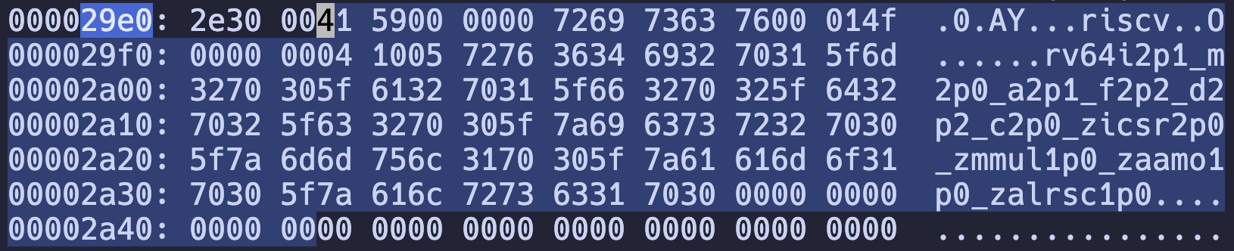
Load RISCV Attributes
From 0x29e3-th byte of this file, load 5a bytes of data as the RISCV attributes

Slide 40
Load RISCV Attributes
From the beginning (0x0) of the file, load 0x1754 bytes to the memory, mapping the virtual address at 0x10000
Each page is 0x1000 bytes
(look at the main.dump)
This is the executable code section.

Slide 41
Load Code
From the beginning (0x0) of the file, load 0x1754 bytes to the memory, mapping the virtual address at 0x10000
Each page is 0x1000 bytes
(look at the main.dump - It ends at EH_SEC)
This is the executable code section.

Slide 42
Load Data
From 0x2000 of the file, load 0x9b8 bytes to the memory, mapping the virtual address at 0x12000
Each page is 0x1000 bytes
(look at the main.dump – 0x12000)
This is the executable code section.

Slide 43
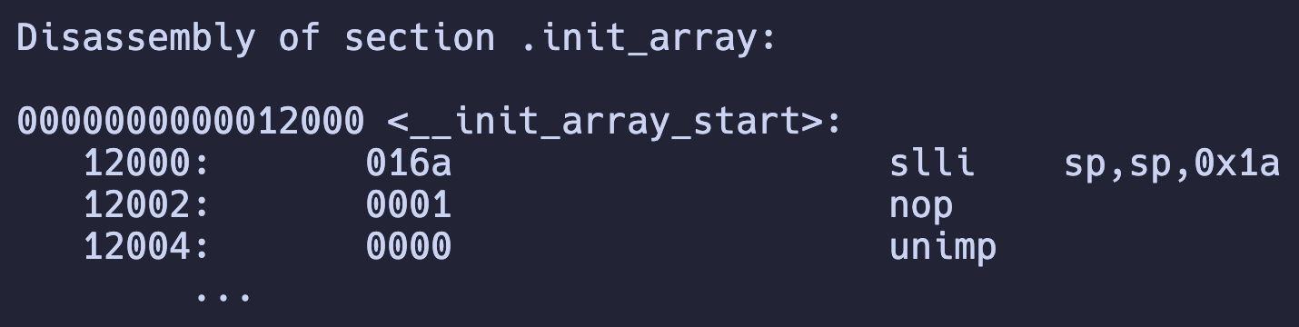
Egg: Oh buddy you got the wrong encoding…
All other sections’ instruction encodings are FAKE
These instructions have no actual meaning
They are just numbers happen to be those instructions

Slide 44
Why? I do not know either.
My understanding is that 16968 is a physical address
0x4248

Slide 45
Read the header (CONT’D)
64 Bytes Per Entry
14 Sections
You need the help of readelf
Sections
riscv64-unknown-elf-readelf -h main.riscv
riscv64-unknown-elf-readelf -S main.riscv

Slide 46
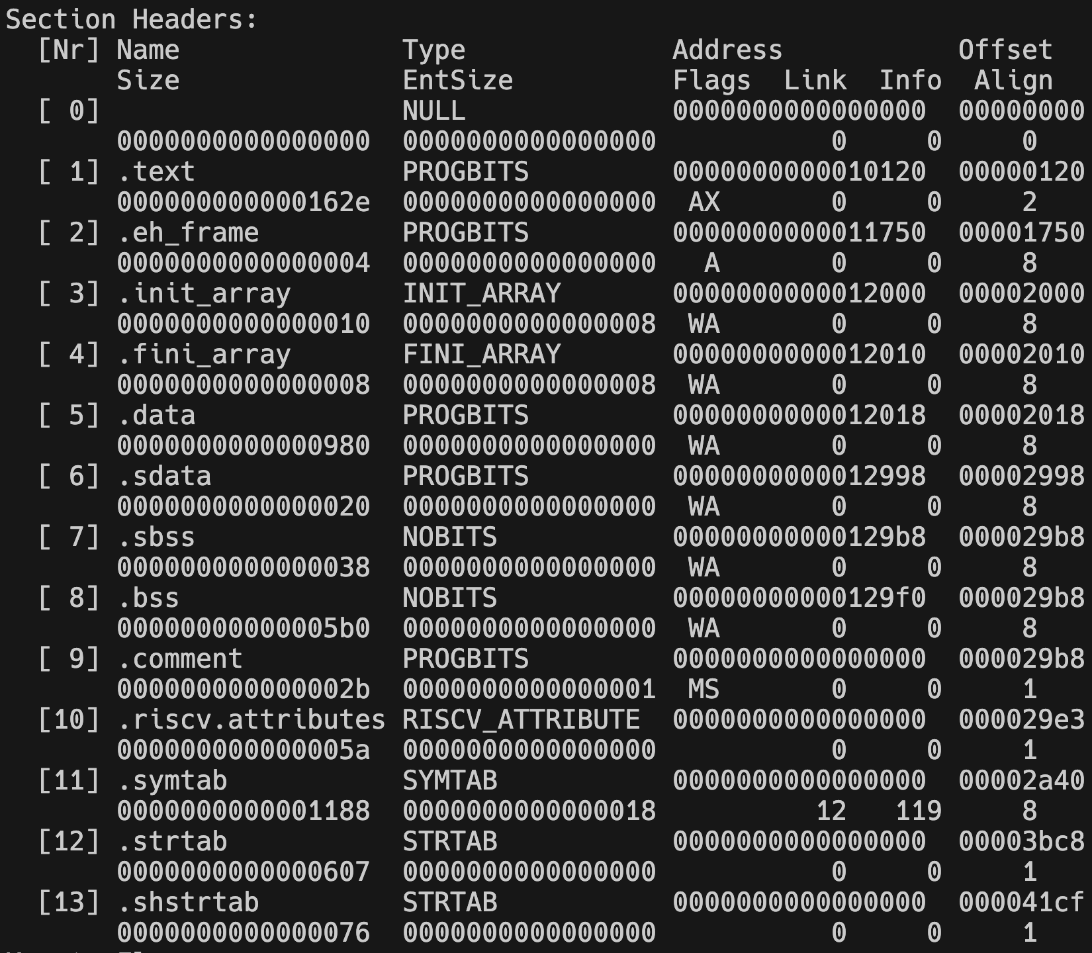
Sections

Slide 47
Sections (CONT’D)
0x1750+0x4 = 0x1754
Load both code and error handling

Slide 48
Sections
What symbol table did we talk about last time?
Do not get confused about that table.
But this table is also useful for linking and debugging.

Slide 49
Egg? Chicken-egg Paradox!
The program should be loaded for execution according to elf format
By whom? A loader.
The loader is also a program
Which should also be loaded

