Slide 1


Topic1: Buck Converter
Group 3: Li Fangchao
Tian Jiawei,
Wang Xingyi

Slide 2
Division of Work
Li Fangchao: Simulation Model
Wang Xingyi: Slide of Part1
Tian Jiawei: Slide of Part2
1

Slide 3
C
ONTENTS
01
Simulation Schematic
Theoretical Calculation and Comparison
02
Buck Converter with Variable Duty Cycle
03

Slide 4
01
Simulation Schematic

Slide 5
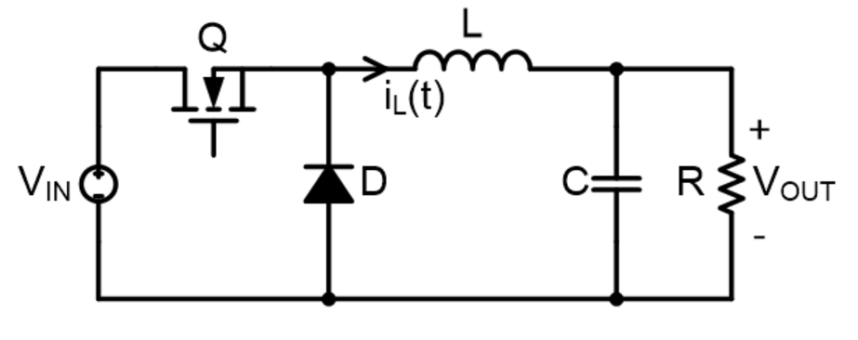
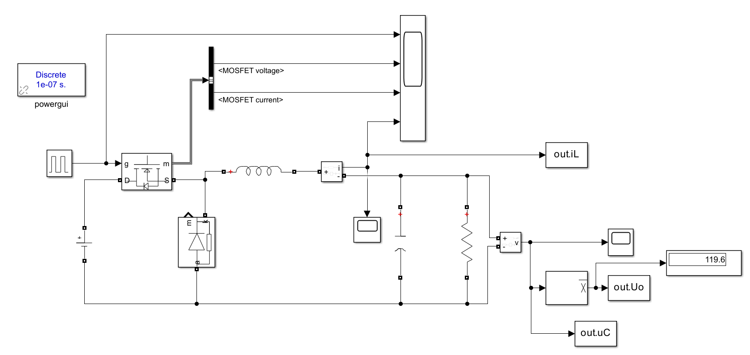
Simulation Model
Buck Converter
2

Slide 6
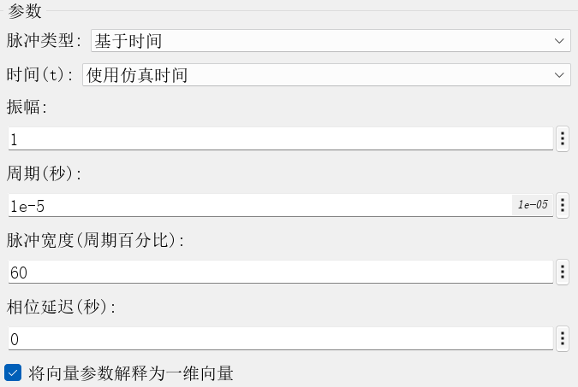
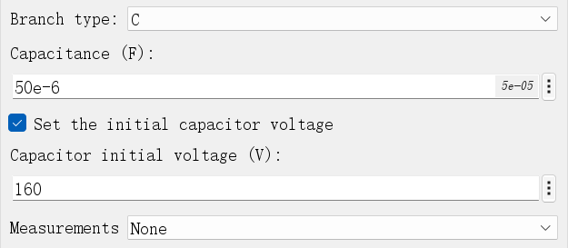
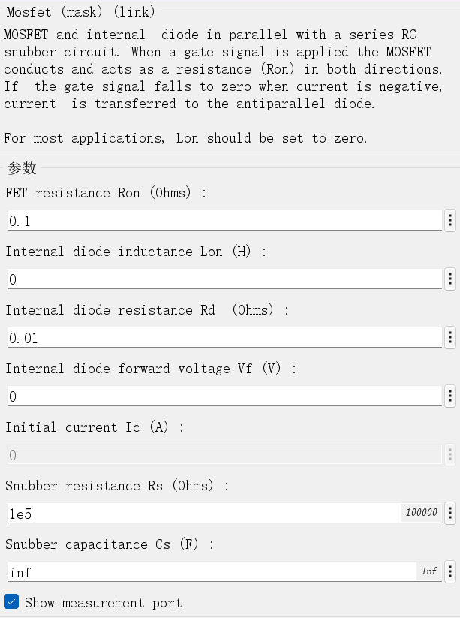
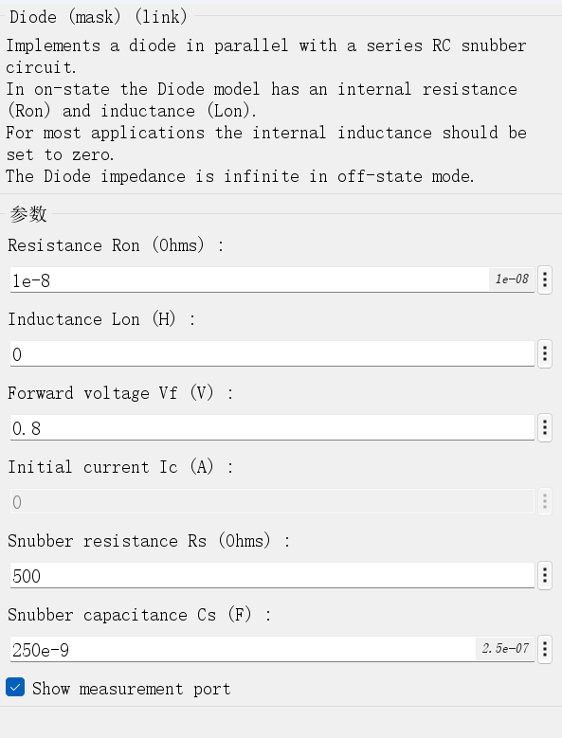
Parameter Setup
Converter Type | Vin | Vo | RL | fs | L | C
Buck | 200V | 120V | 60ohm | 100kHz | 4mH | 50
Parameters of Pulse Generator (L) and Capacitor (R)
CCM mode:
Parameters of Mosfet (L) and Diode (R)
3

Slide 7
02
Theoretical Calculation and Comparison

Slide 8
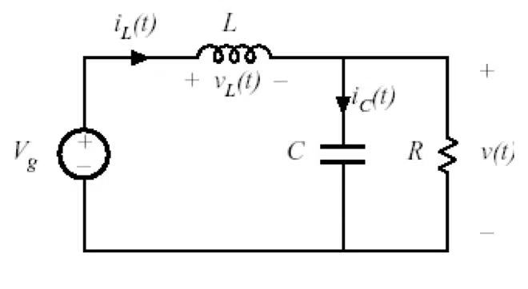
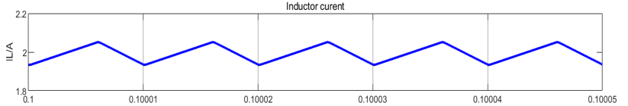
Inductor Current Ripple
Subinterval of Buck when the switch is on
Converter Type | Vin | Vo | RL | fs | L | C
Buck | 200V | 120V | 60ohm | 100kHz | 4mH | 50
4

Slide 9
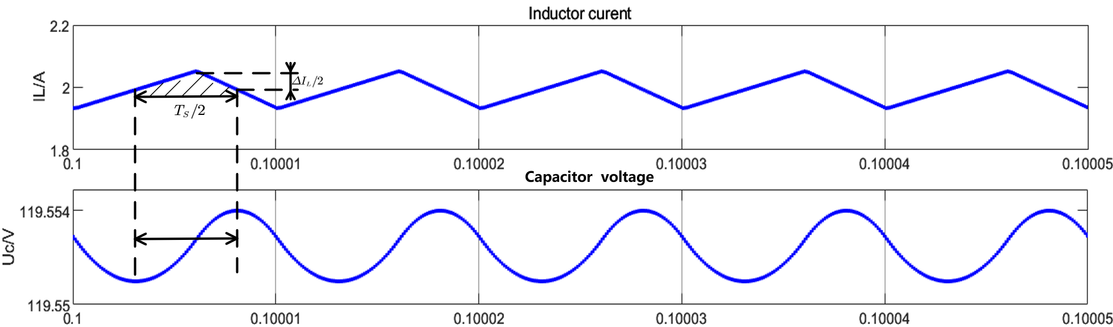
Capacitor Voltage Ripple
Converter Type | Vin | Vo | RL | fs | L | C
Buck | 200V | 120V | 60ohm | 100kHz | 4mH | 50
5

Slide 10
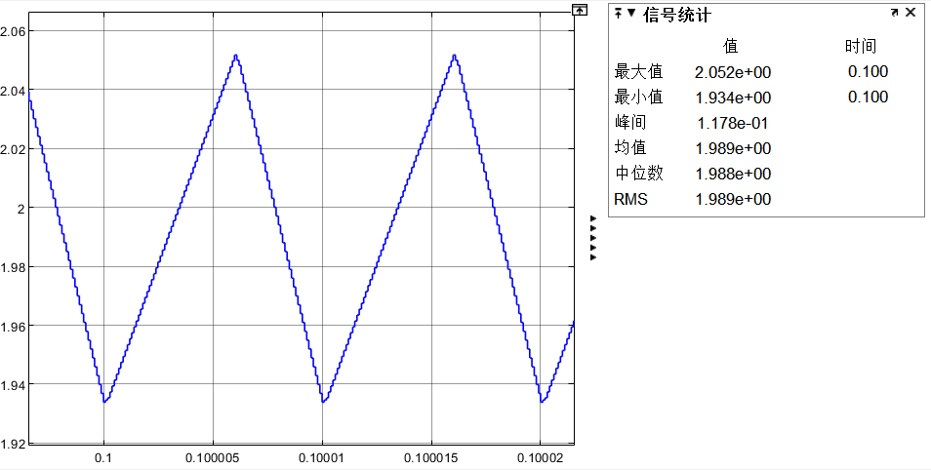
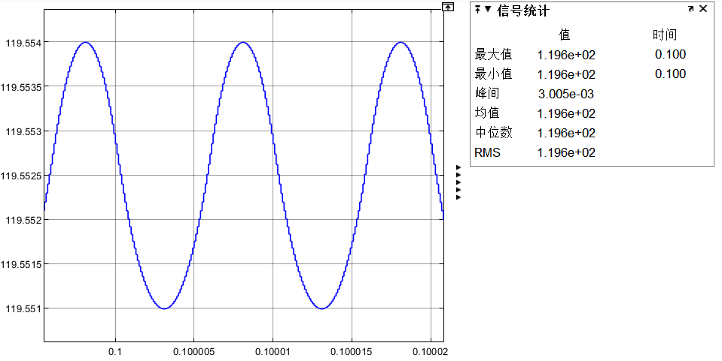
Comparison between Simulation results and theoretical results
 | Simulation | Theoretical Calculation | Error (%)
ΔI | 117.8mA | 120mA | 1.84
ΔU | 3.005mV | 3mV | 0.17
6

Slide 11
03
Buck Converter with Variable Duty Cycle

Slide 12
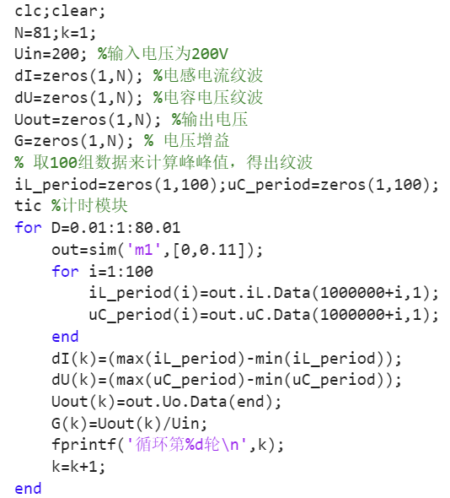
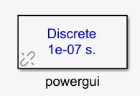
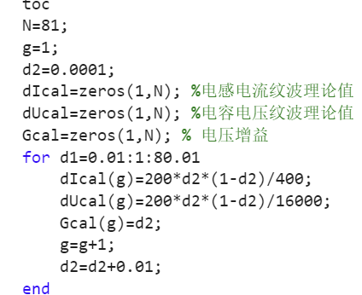
MATLAB Program
fs
100kHz
7

Slide 13
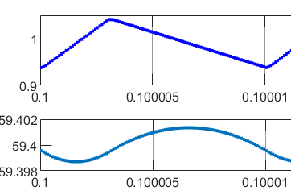
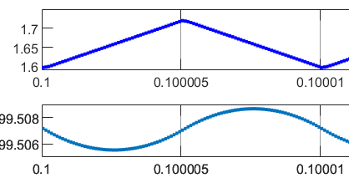
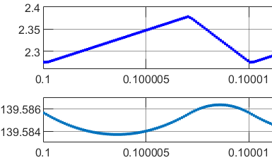
Ripple Component of Inductor and Capacitor
8
Inductor ripple current and capacitor ripple voltage (D=0.3, 0.5, 0.7)

Slide 14
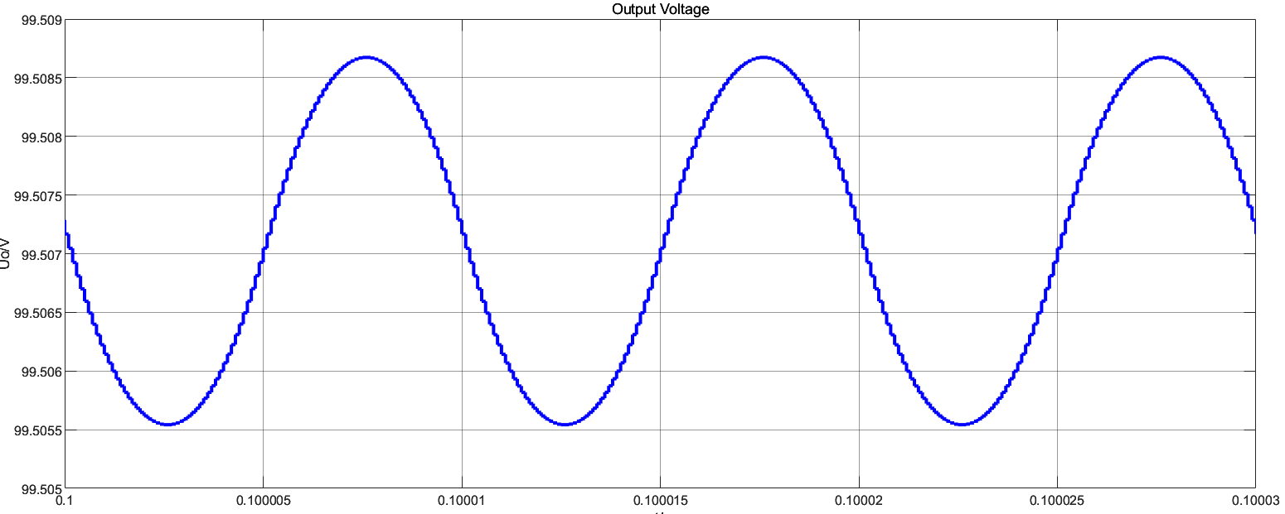
Voltage Gain
CCM mode:
9

Slide 15
Thanks！

Slide 16
Full-Bridge Inverter + Full-Wave Rectifier Structure
November 22,2024
Group 3: Wang Xingyi
Tian Jiawei,
Li Fangchao

Slide 17
C
ONTENTS
01
Introduction
02
Simulation Model
03
Parameter Setup
04
Result Analysis

Slide 18
01
Introduction

Slide 19
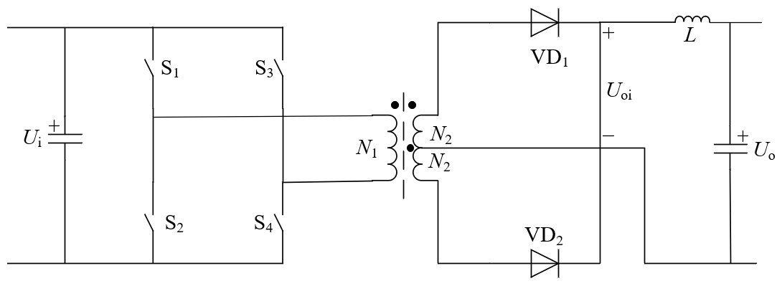
Introduction
Schematic diagram of the working principle: full-bridge inverter + full-wave rectifier structure
In order to analyze: its working principle and sequence,
continuous current mode (CCM) and discontinuous current mode (DCM),
the relationship between duty cycle and voltage gain when duty cycle changes
1

Slide 20
02
Simulation Model

Slide 21
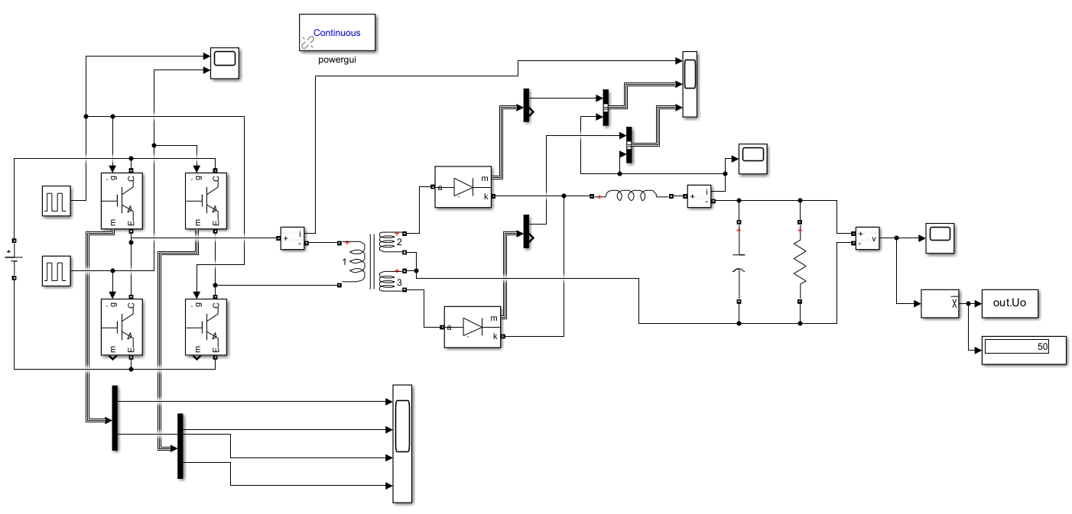
Simulation Model
Simulation model
2

Slide 22
03
Parameter Setup

Slide 23
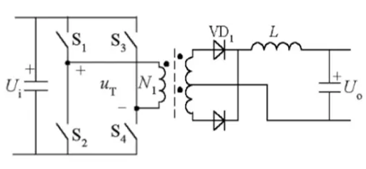
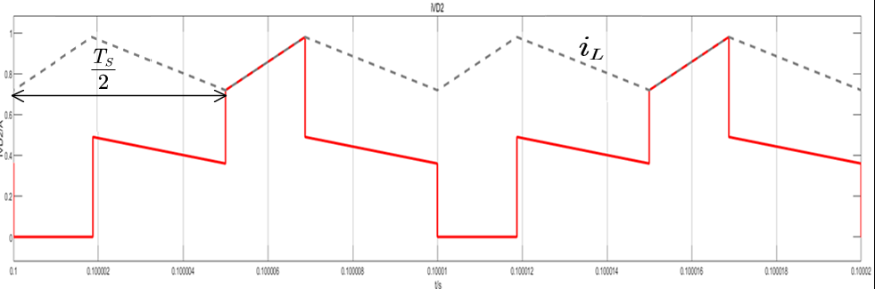
Parameter Setup
Vin | Vo | T | RL | fs | L | C
800V | 50V | 6:1:1 | 20 | 100kHz | 600uH | 200uF
3
(CCM Mode)

Slide 24
04
Result Analysis

Slide 25
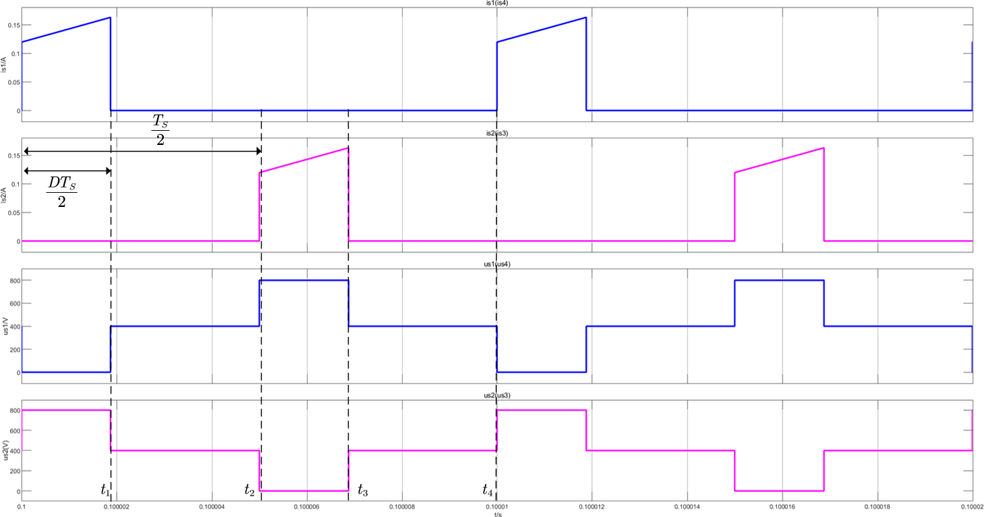
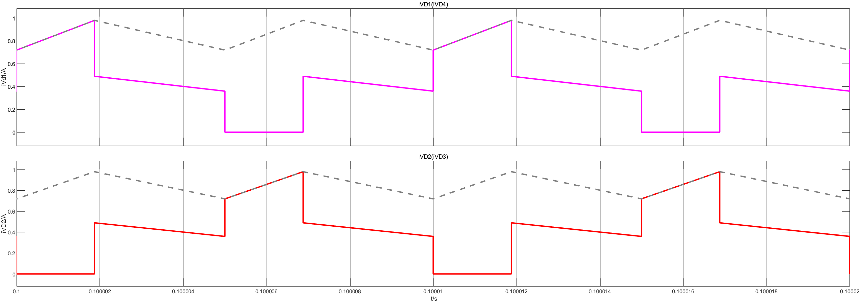
Operating Sequence
Current waveform of rectifier diodes
Current and voltage waveforms of switches $s1(s4)$ and $s2(s3)$
State | S1(S4) | S2(S3) | VD1 | VD2
t0-t1 | on | off | on | off
t1-t2 | off | off | on | on
t2-t3 | off | on | off | on
t3-t4 | off | off | on | on
4

Slide 26
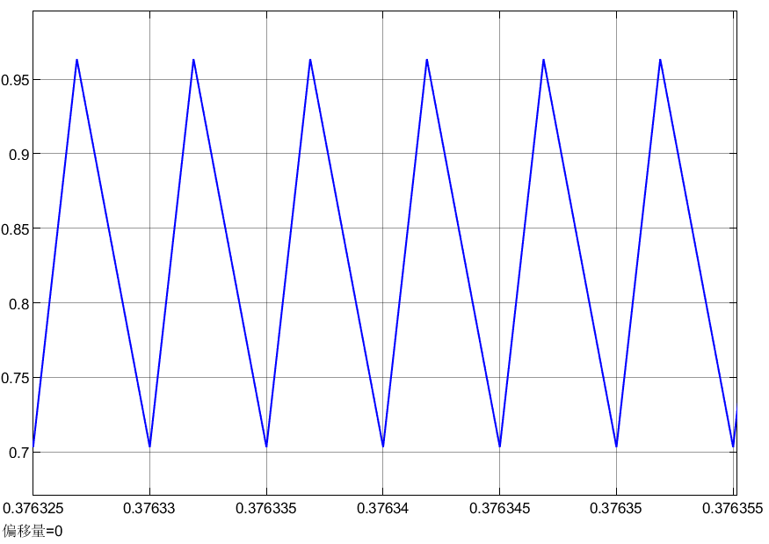
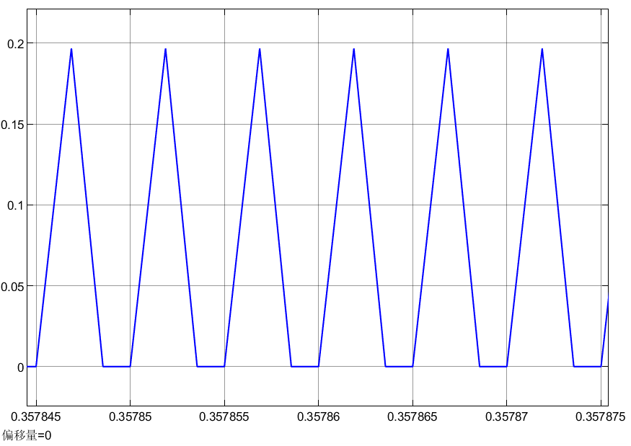

Relationship between CCM/DCM and load resistance
To ensure that the circuit parameter changes enter the steady state, the simulation time is extended to 0.1s.
CCM mode current
DCM mode current
when the load resistance $R=60Ω$
when the load resistance $R=1000Ω$
5

Slide 27
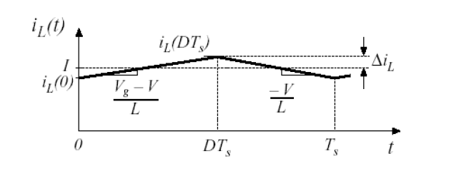
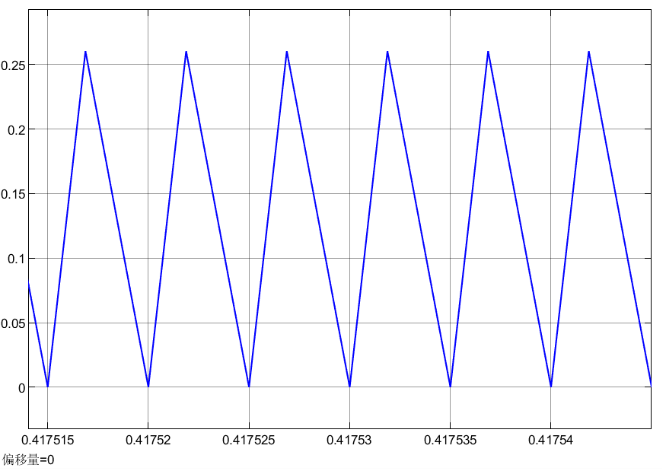



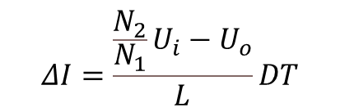

Relationship between CCM/DCM and load resistance
Calculation of critical resistance：
$$1）I_{L}=\frac{U_{o}}{R}$$
$$ΔI=\frac{\frac{N_{2}}{N_{1}}U_{i}−U_{o}}{L}DT$$
$$2）$$
$$3）$$
$$R=\frac{4Lf}{1−2D}$$
$$4）$$
The waveform of the current at critical load
6

Slide 28

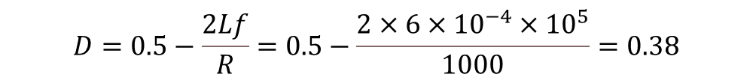
Relationships between D and voltage gain
$$\frac{U_{o}}{U_{i}}=2\frac{N_{2}}{N_{1}}D$$
$$D=0.5−\frac{2Lf}{R}=0.5−\frac{2×6×{10}^{−4}×{10}^{5}}{1000}=0.38$$
7

Slide 29
Thanks！

