Slide 1

Seminar 7
Wang Yuqi
Wang Xingyi
Wang Yusong
Class2213 Group 3
Notes:
添加设计方向、设计独特性、n应用要扩充；建设内容要扩充；李处建议：1、个人身份介绍，我是陕西高等教育大数据中心主任**，我代表教育厅汇报。。。设计情况 2、简单介绍书 ，很多做了拉页处理，大事记可以放到ppt，在省政务大数据局支持和指导下，投入多少人多少天完成项目3、

Slide 2
Division of Work
Wang Yuqi: Simulation of topic1, Analysis of the overshoot current
Wang Xingyi: Simulation of topic2, Slide of topic2
Wang Yusong: Analysis of the result, Slide of topic1

Slide 3
Topic1: Hard-Switching Buck Converter
Notes:
添加设计方向、设计独特性、n应用要扩充；建设内容要扩充；李处建议：1、个人身份介绍，我是陕西高等教育大数据中心主任**，我代表教育厅汇报。。。设计情况 2、简单介绍书 ，很多做了拉页处理，大事记可以放到ppt，在省政务大数据局支持和指导下，投入多少人多少天完成项目3、

Slide 4
PART. 01
Theoretical Analysis

Slide 5
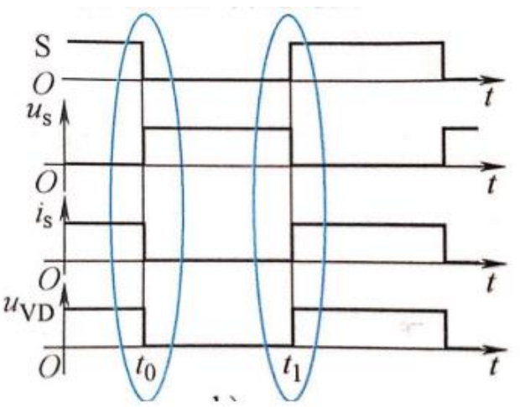
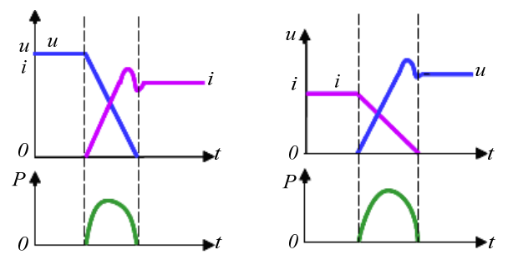
Theoretical Analysis
Fig.2.1: idealized turn-on and turn-off process
Fig.2.2: the voltage, current and power loss in switching process

Slide 6
PART. 02
Simulation Result

Slide 7
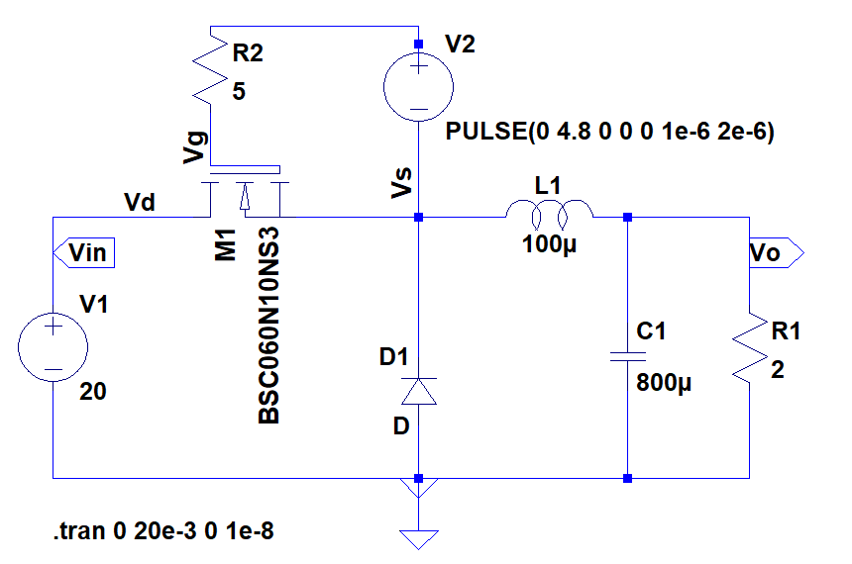
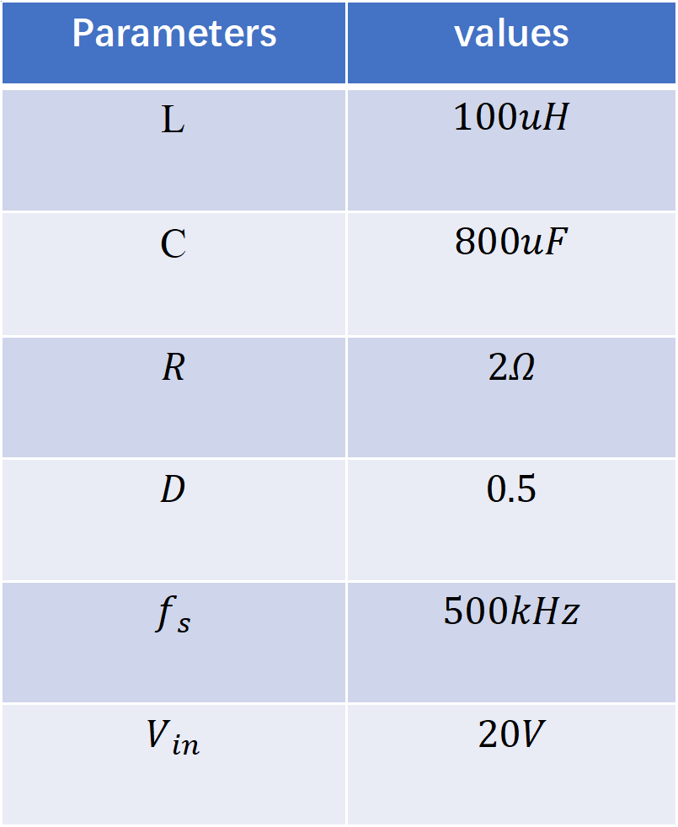
Simulation Model
Parameters | values
L | $$100uH$$
C | $$800uF$$
$$R$$ | $$2Ω$$
$$D$$ | $$0.5$$
$$f_{s}$$ | $$500kHz$$
$$V_{in}$$ | $$20V$$
Fig.2.3: simulation circuit
Table 2.1 Parameter Setup

Slide 8
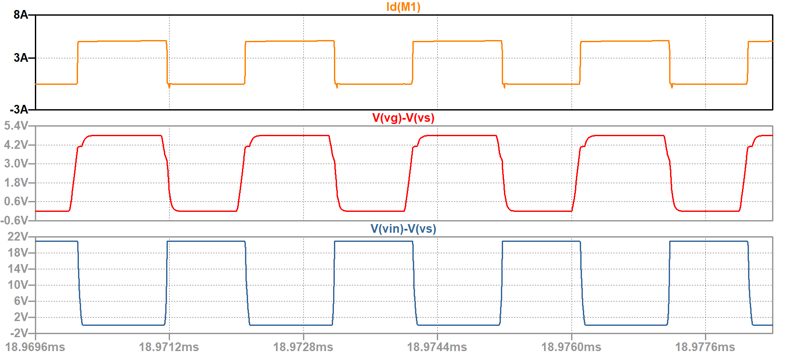
Simulation Result
After 18ms the circuit is in stead state. It can be easily seen that the
duty cycle is almost 50%
Fig. 2.4 Hard switching circuit output voltage

Slide 9

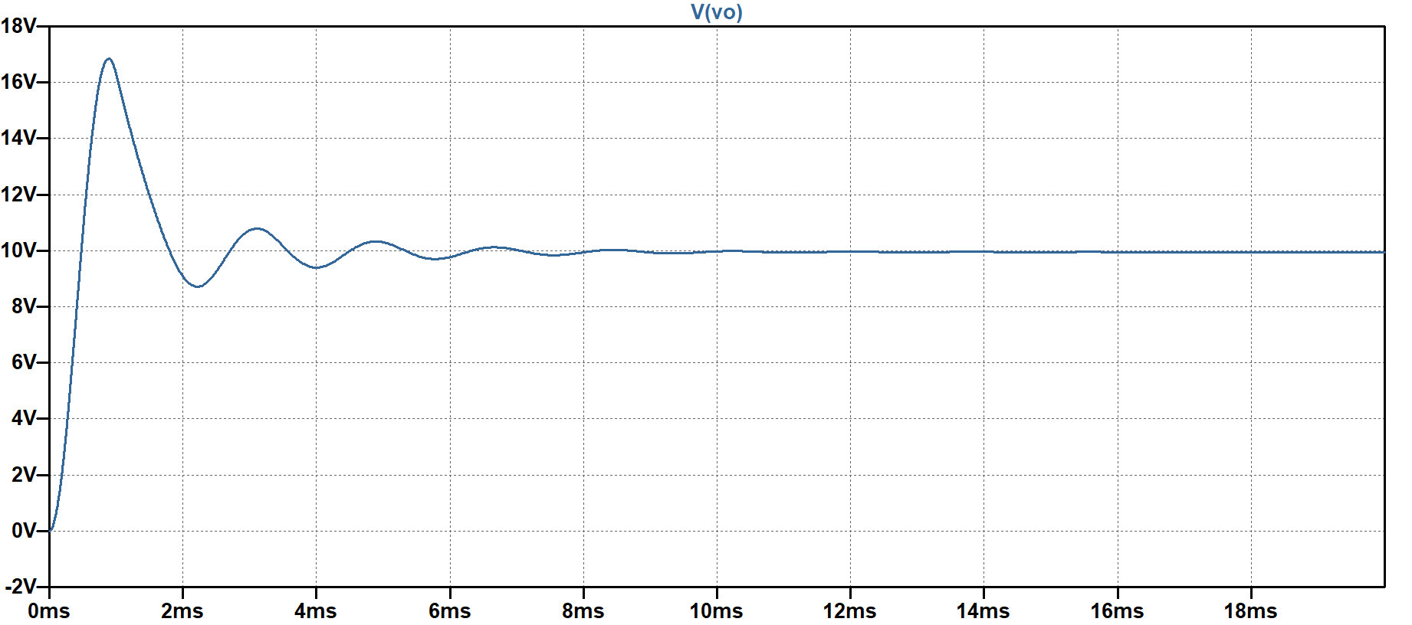
Simulation Result
Fig. 2.4 Hard switching circuit output voltage

Slide 10
PART. 03
Power Loss

Slide 11
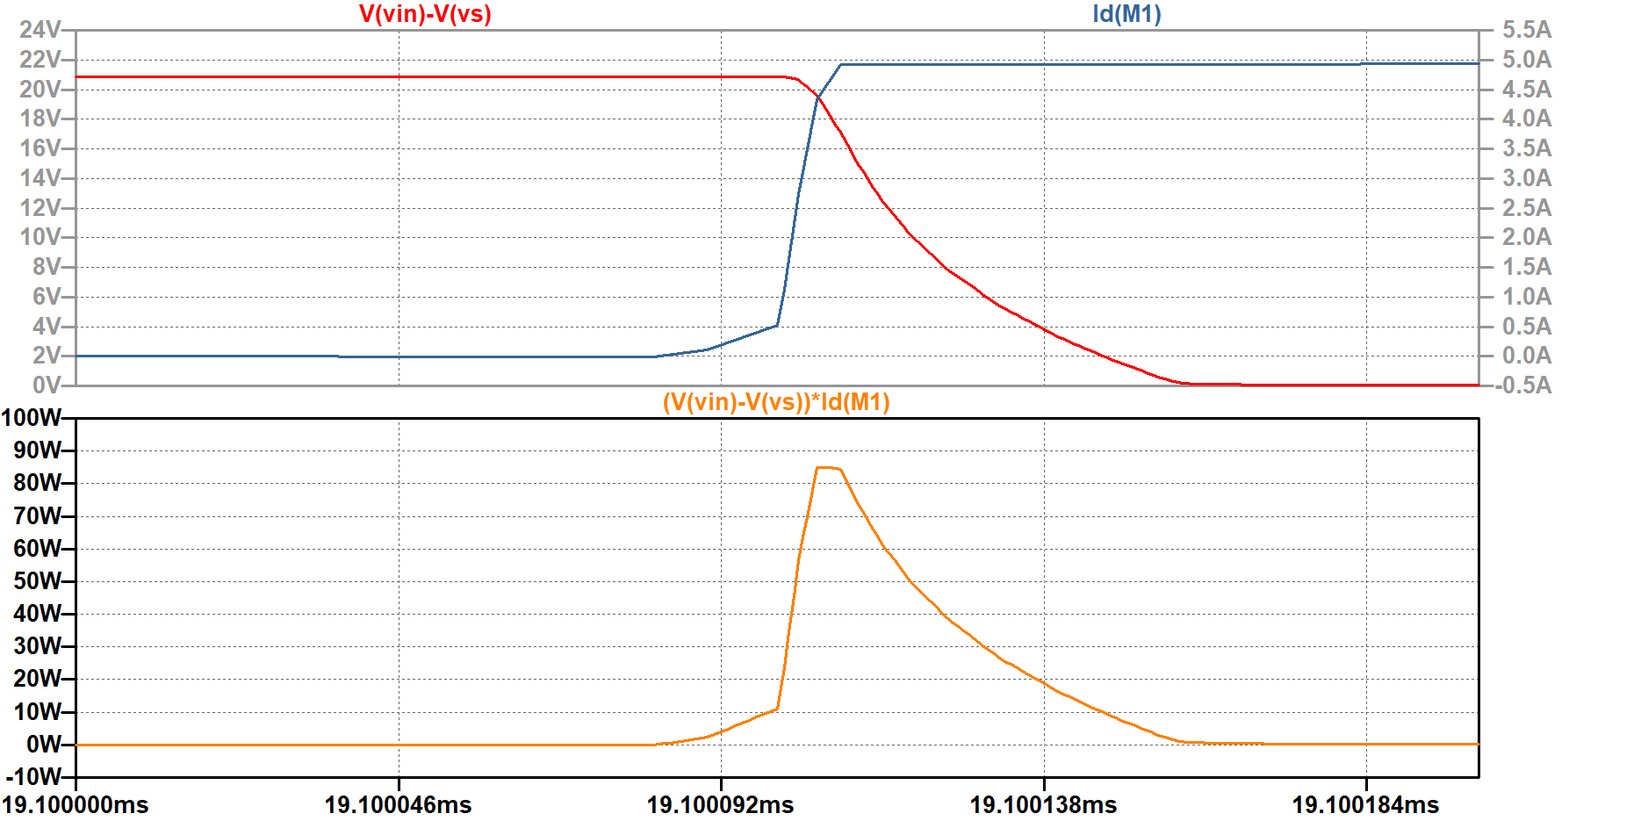
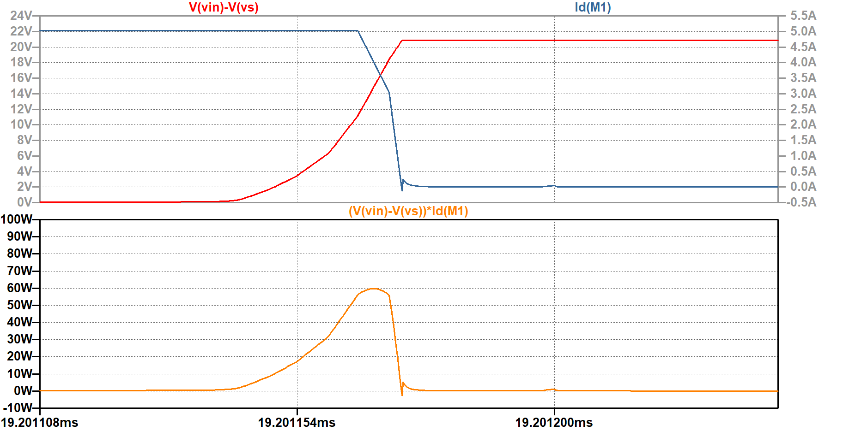
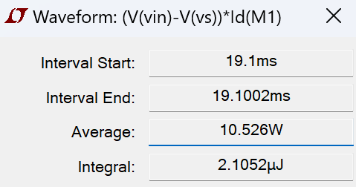
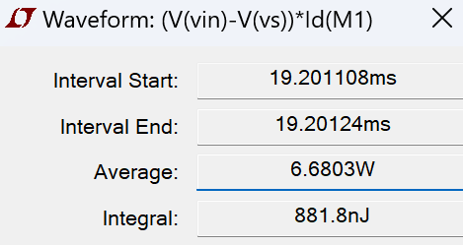
Power Loss
(a) turn on loss
(b) turn off loss

Slide 12
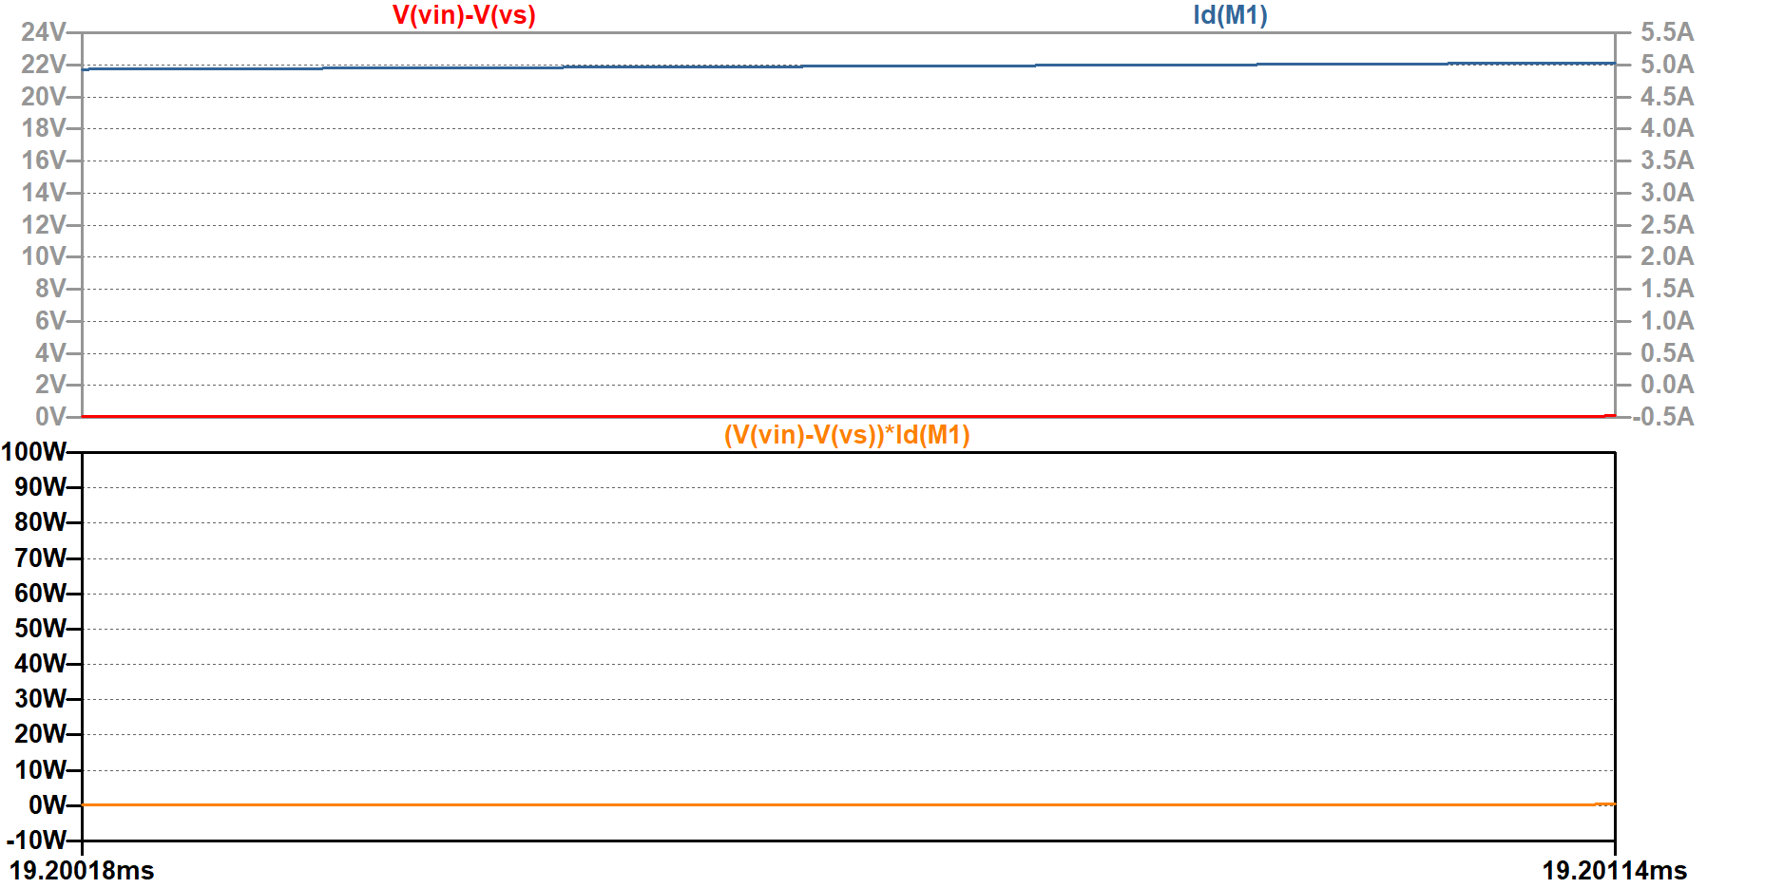
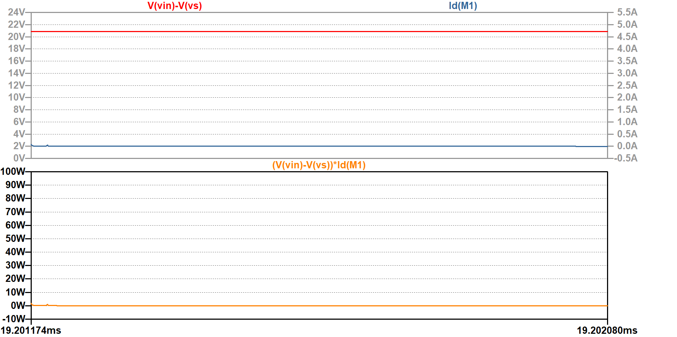
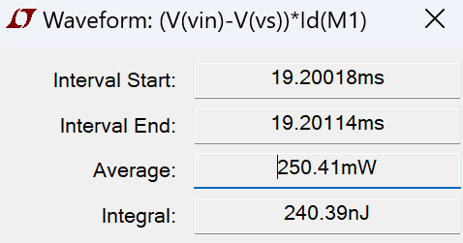
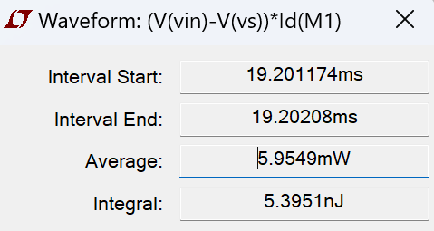
Power Loss
(c) on state loss
(d) off state loss

Slide 13
Power Loss
 | On Stage | Off Stage | Turning On | Turning Off | Total loss
Average | 250.41mW | 5.9549mW | 10.526W | 6.6803W | 1606.4mW
Integral | 240.39nJ | 5.3951nJ | 2105.2nJ | 881.8nJ | 3212.8nJ

Slide 14
Topic2: ZVS QRC Buck Converter
Notes:
添加设计方向、设计独特性、n应用要扩充；建设内容要扩充；李处建议：1、个人身份介绍，我是陕西高等教育大数据中心主任**，我代表教育厅汇报。。。设计情况 2、简单介绍书 ，很多做了拉页处理，大事记可以放到ppt，在省政务大数据局支持和指导下，投入多少人多少天完成项目3、

Slide 15
CONTENTS
01
Simulation Model
02
Switching Waveform
PART
PART
03
04
Loss Curve
Comparison
PART
PART
05
Analysis of the Peak Current
PART

Slide 16
PART. 01
Simulation Model

Slide 17
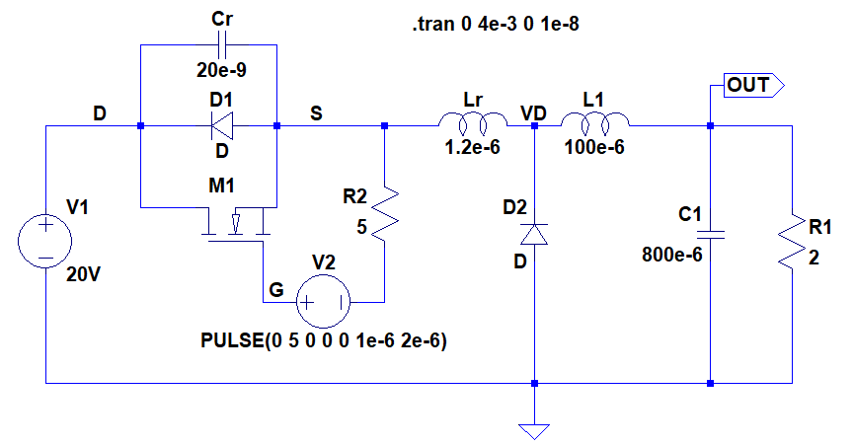
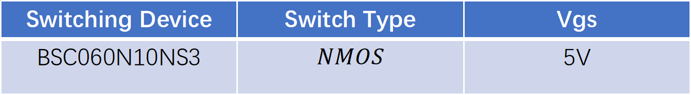
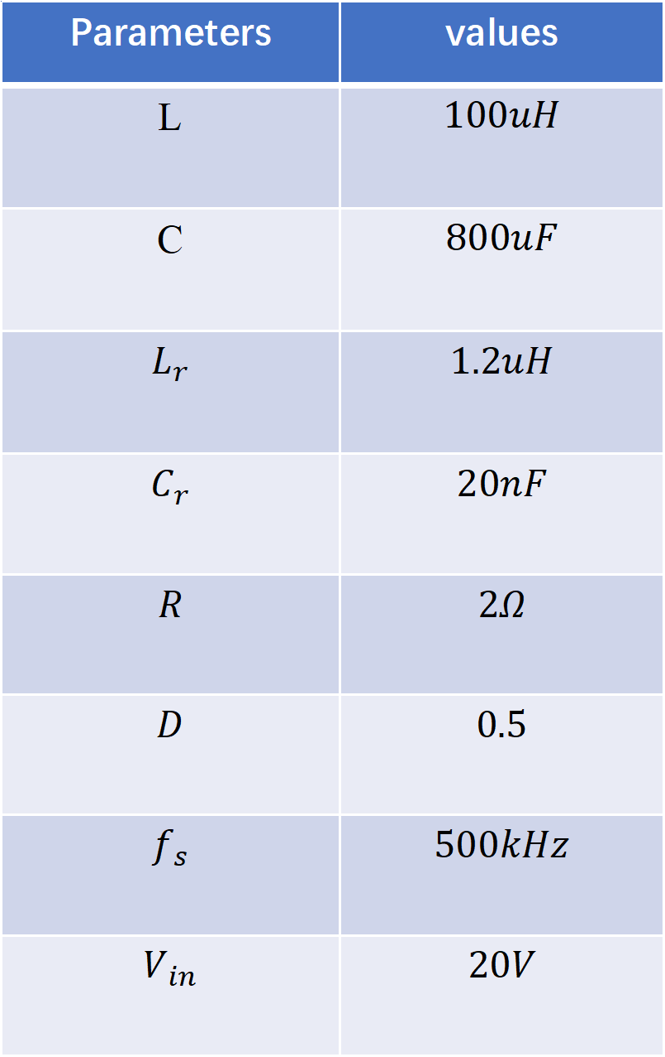
Simulation Model
Parameters | values
L | $$100uH$$
C | $$800uF$$
$$L_{r}$$ | $$1.2uH$$
$$C_{r}$$ | $$20nF$$
$$R$$ | $$2Ω$$
$$D$$ | $$0.5$$
$$f_{s}$$ | $$500kHz$$
$$V_{in}$$ | $$20V$$
Fig 2.1 ZVS QRC Simulation Model
Switching Device | Switch Type | Vgs
BSC060N10NS3 | $$NMOS$$ | 5V

Slide 18
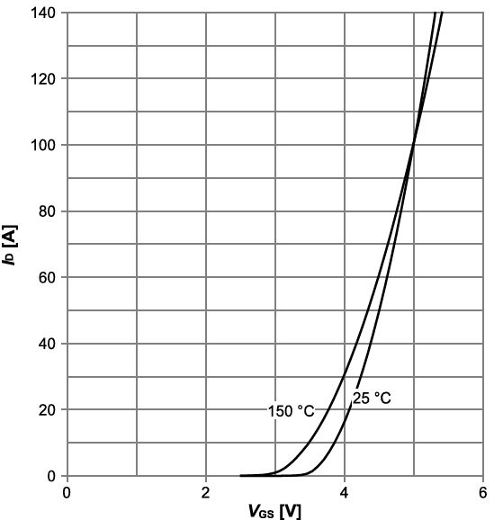
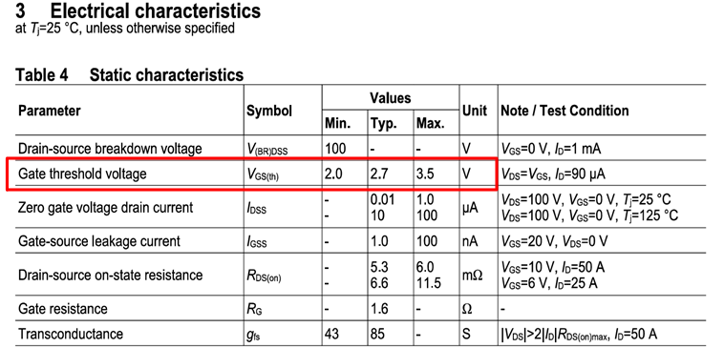
Simulation Model
Fig 2.2 Static Characteristics of BSC060N10NS3
Fig 2.3 Transfer Characteristic of BSC060N10NS3
Switching Device | Switch Type | Vgs
BSC060N10NS3 | $$NMOS$$ | 5V

Slide 19
Switching Waveform
PART. 02

Slide 20
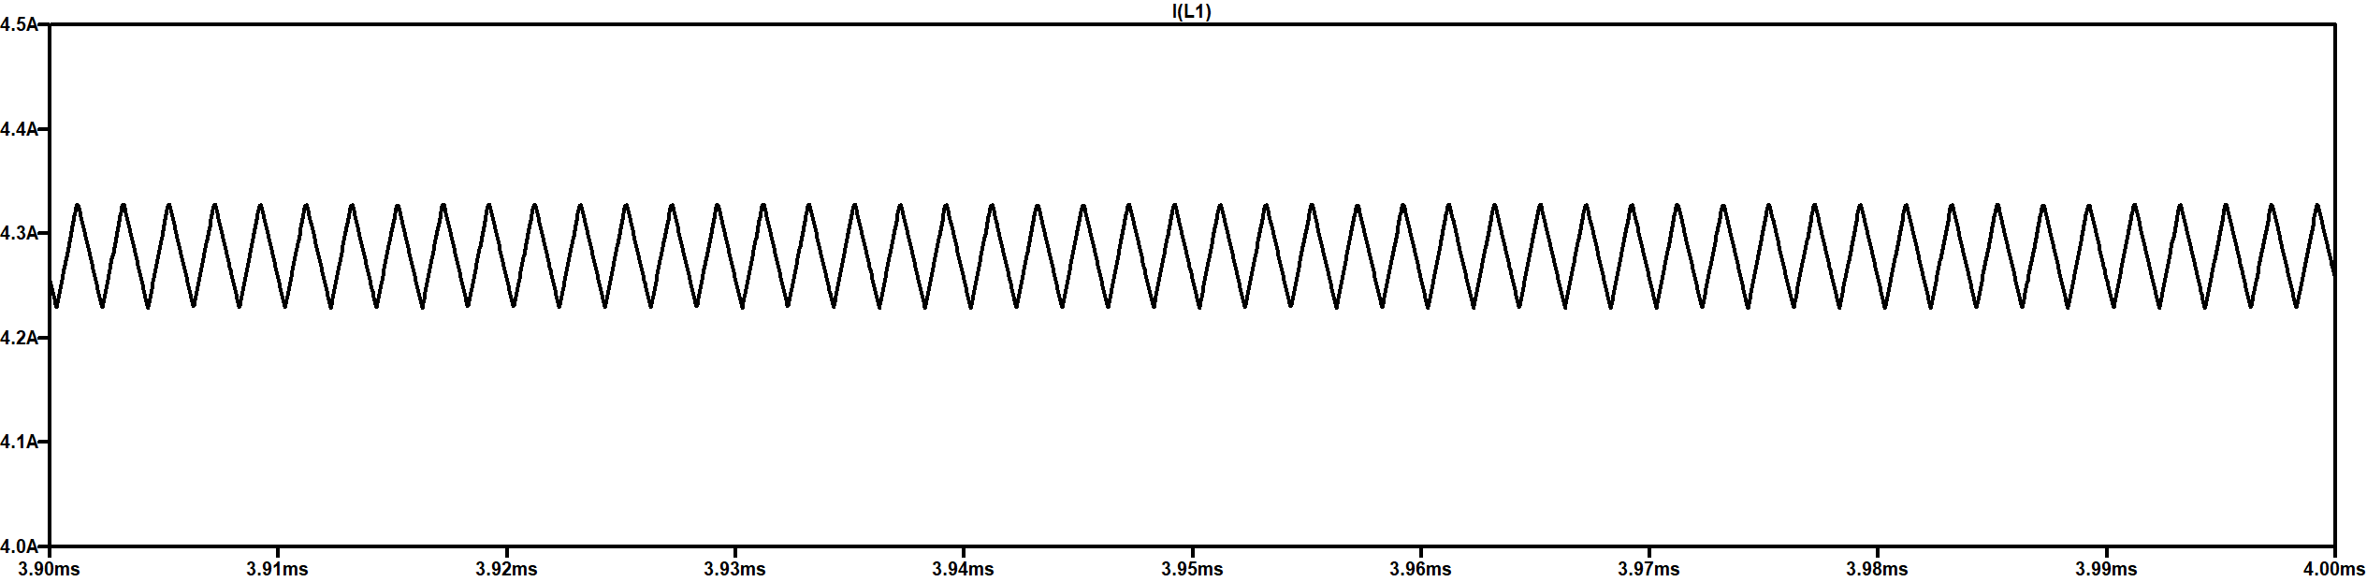
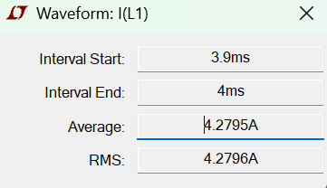
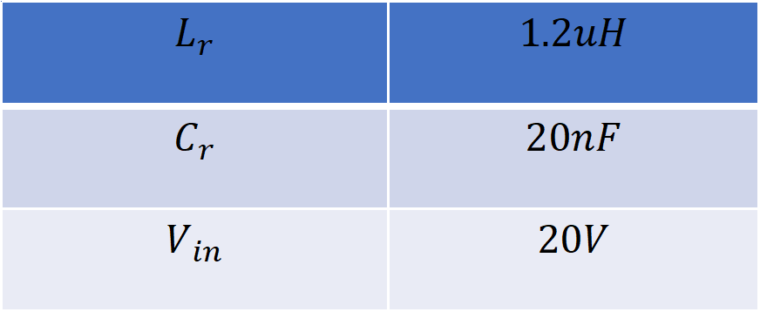
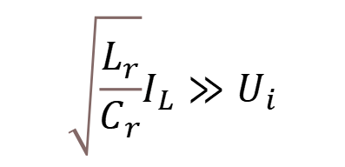
Output Waveform
Fig 2.4 Load Inductor Current of ZVS QRC
$$\sqrt{\frac{L_{r}}{C_{r}}}I_{L}≫U_{i}$$
$$L_{r}$$ | $$1.2uH$$
$$C_{r}$$ | $$20nF$$
$$V_{in}$$ | $$20V$$
Fig 2.5 Average Value of the Load Inductor Current

Slide 21
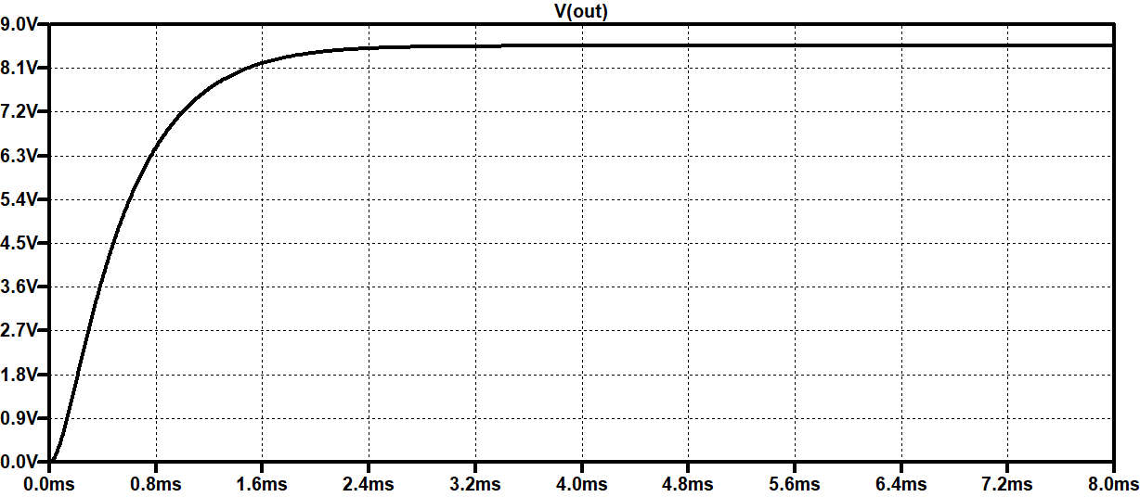
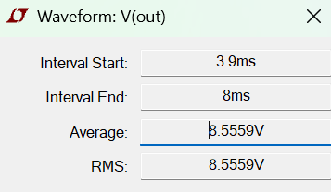
Output Waveform
Fig 2.6 Average Value of the Output Voltage
Fig 2.7 Output Voltage of ZVS QRC

Slide 22
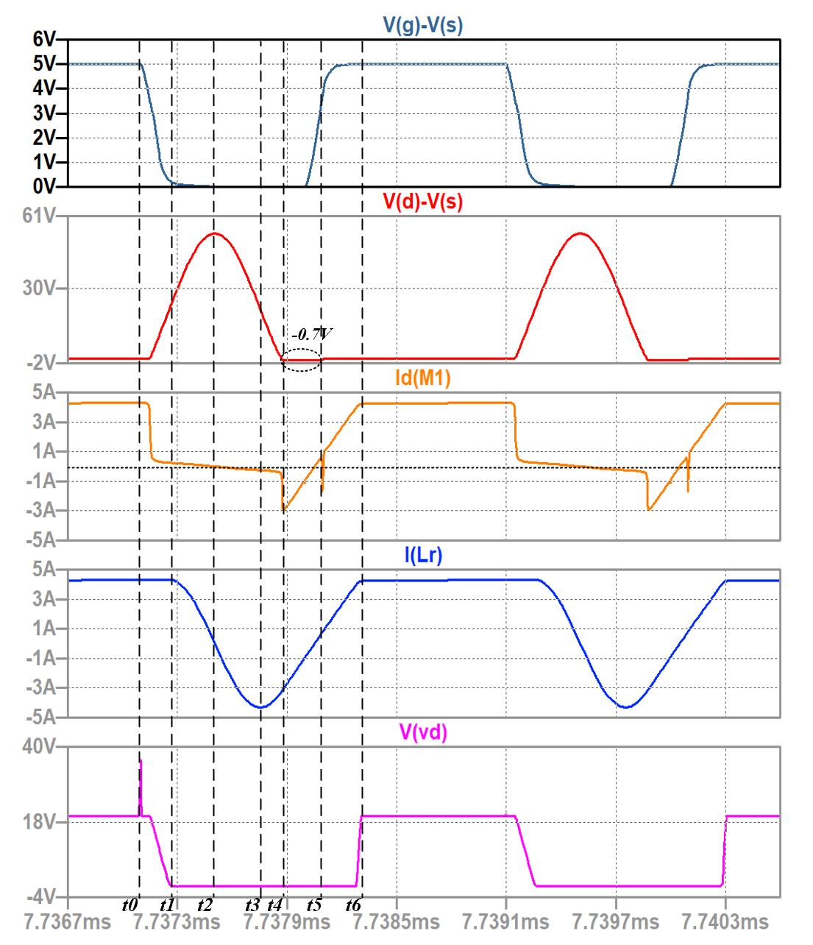
Switching Waveform
Fig 2.8 Switching Waveforms of ZVS QRC

Slide 23
PART. 03
Loss Curve

Slide 24
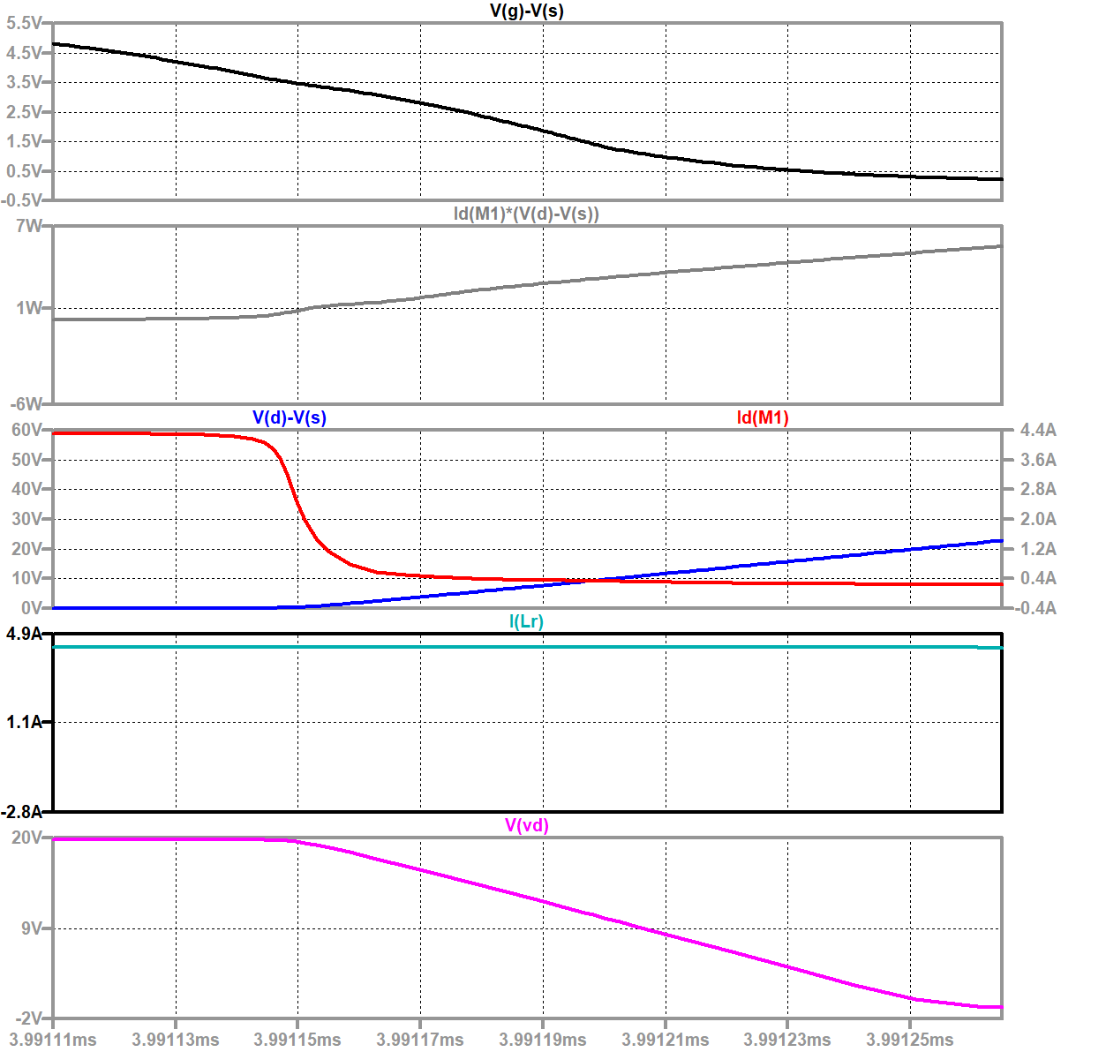
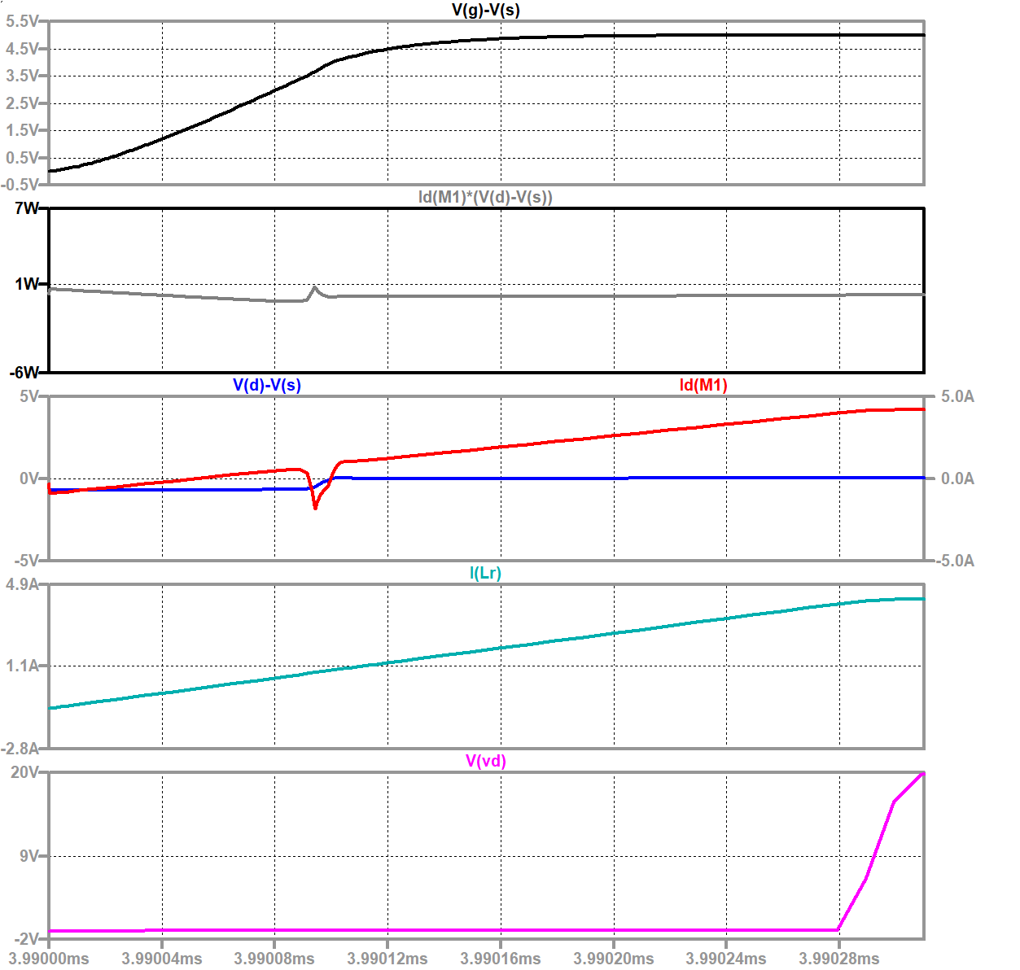
Loss Curve
Fig 2.9 Turning-Off Waveform of ZVS QRC
Fig 2.10 Turning-On Waveform of ZVS QRC

Slide 25
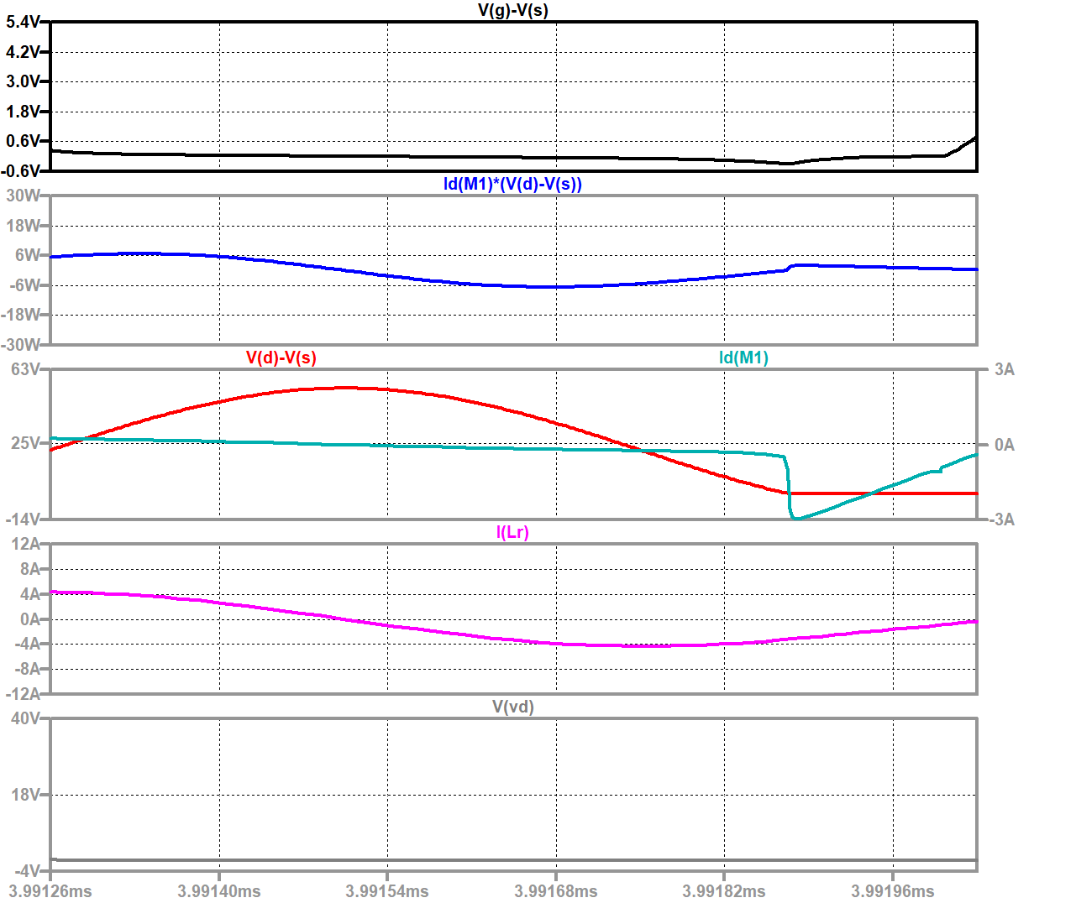
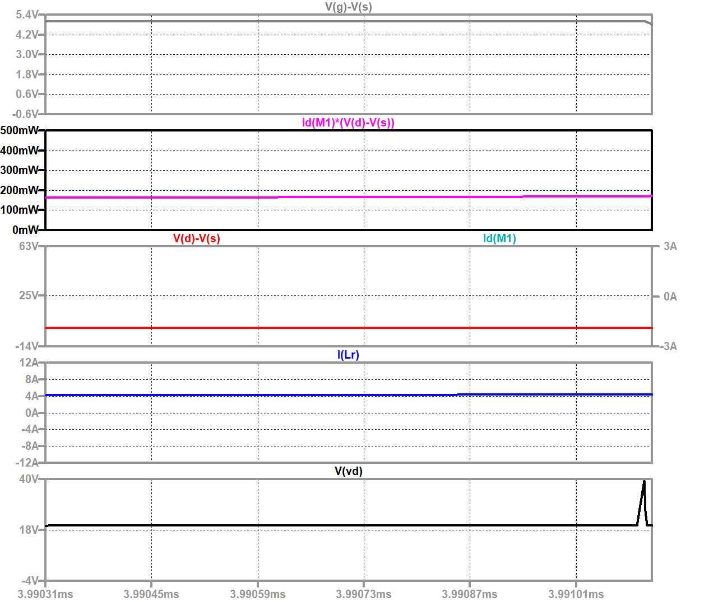
Loss Curve
Fig 2.11 Off-State Waveform of ZVS QRC
Fig 2.12 On-State Waveform of ZVS QRC

Slide 26
Loss Measure
 | On Stage | Off Stage | Turning On | Turning Off | Total loss
Average | 165.2mW | -256.87mW | 82.94mW | 2.6033W | 186.29mW
Integral | 132.16nJ | -188.8nJ | 25.711nJ | 403.52nJ | 372.59nJ

Slide 27
PART. 04
Comparison

Slide 28
Comparison
 | On Stage | Off stage | Turning On | Turning Off | Total Loss
Average for Hard-Switching | 250.41mW | 5.9549mW | 10.526W | 6.6803W | 1606.4mW
Integral for Hard -Switching | 240.39nJ | 5.3951nJ | 2105.2nJ | 881.8nJ | 3212.8nJ
Average for ZVS QRC | 165.2mW | -256.87mW | 82.94mW | 2.6033W | 186.29mW
Integral for ZVS QRC | 132.16nJ | -188.8nJ | 25.711nJ | 403.52nJ | 372.59nJ

Slide 29
Analysis of the peak current
PART. 05

Slide 30
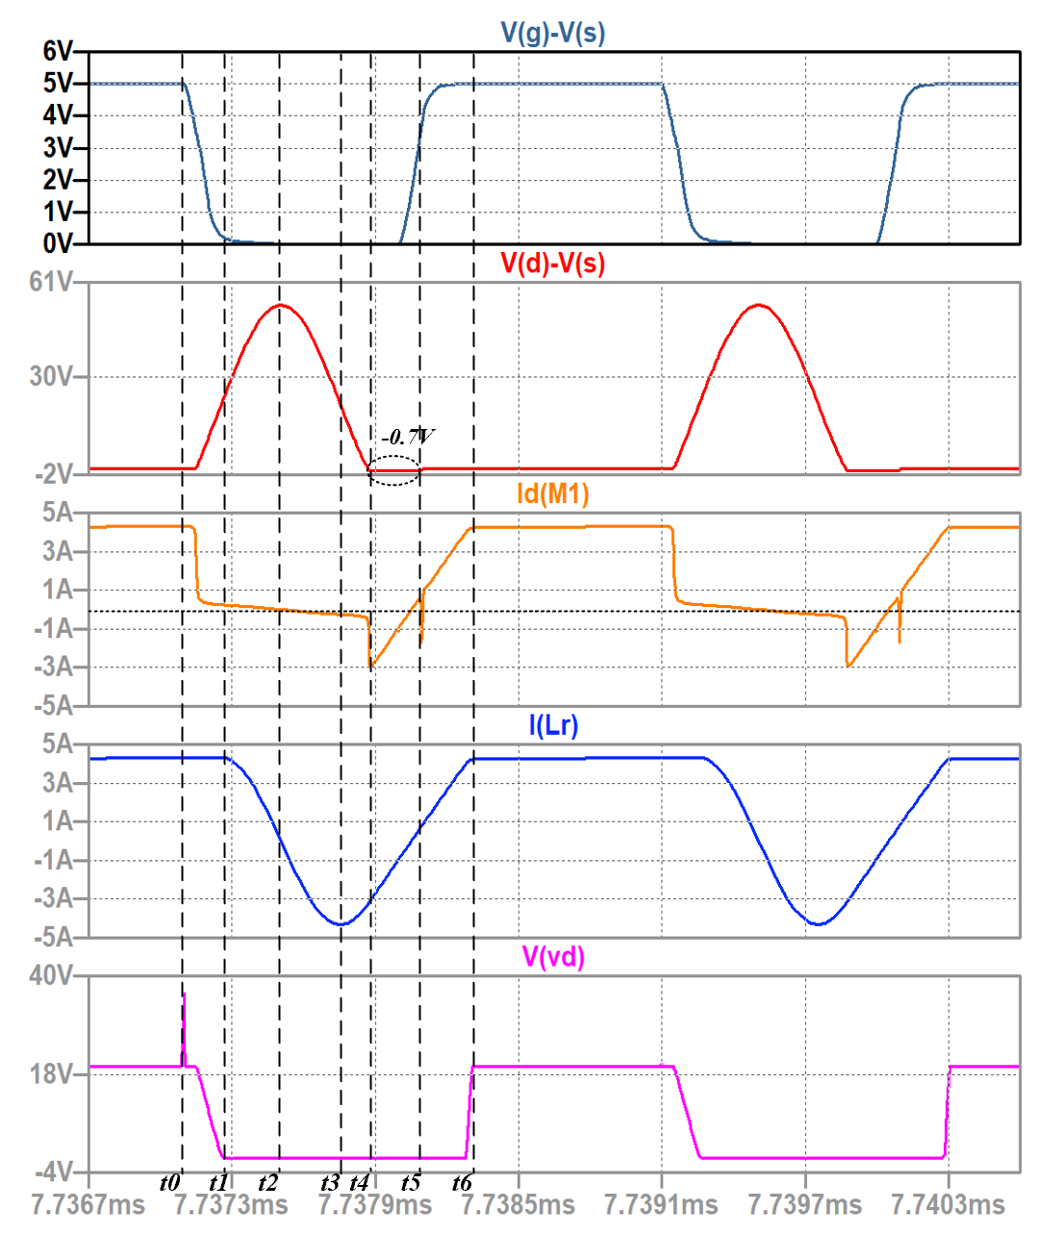
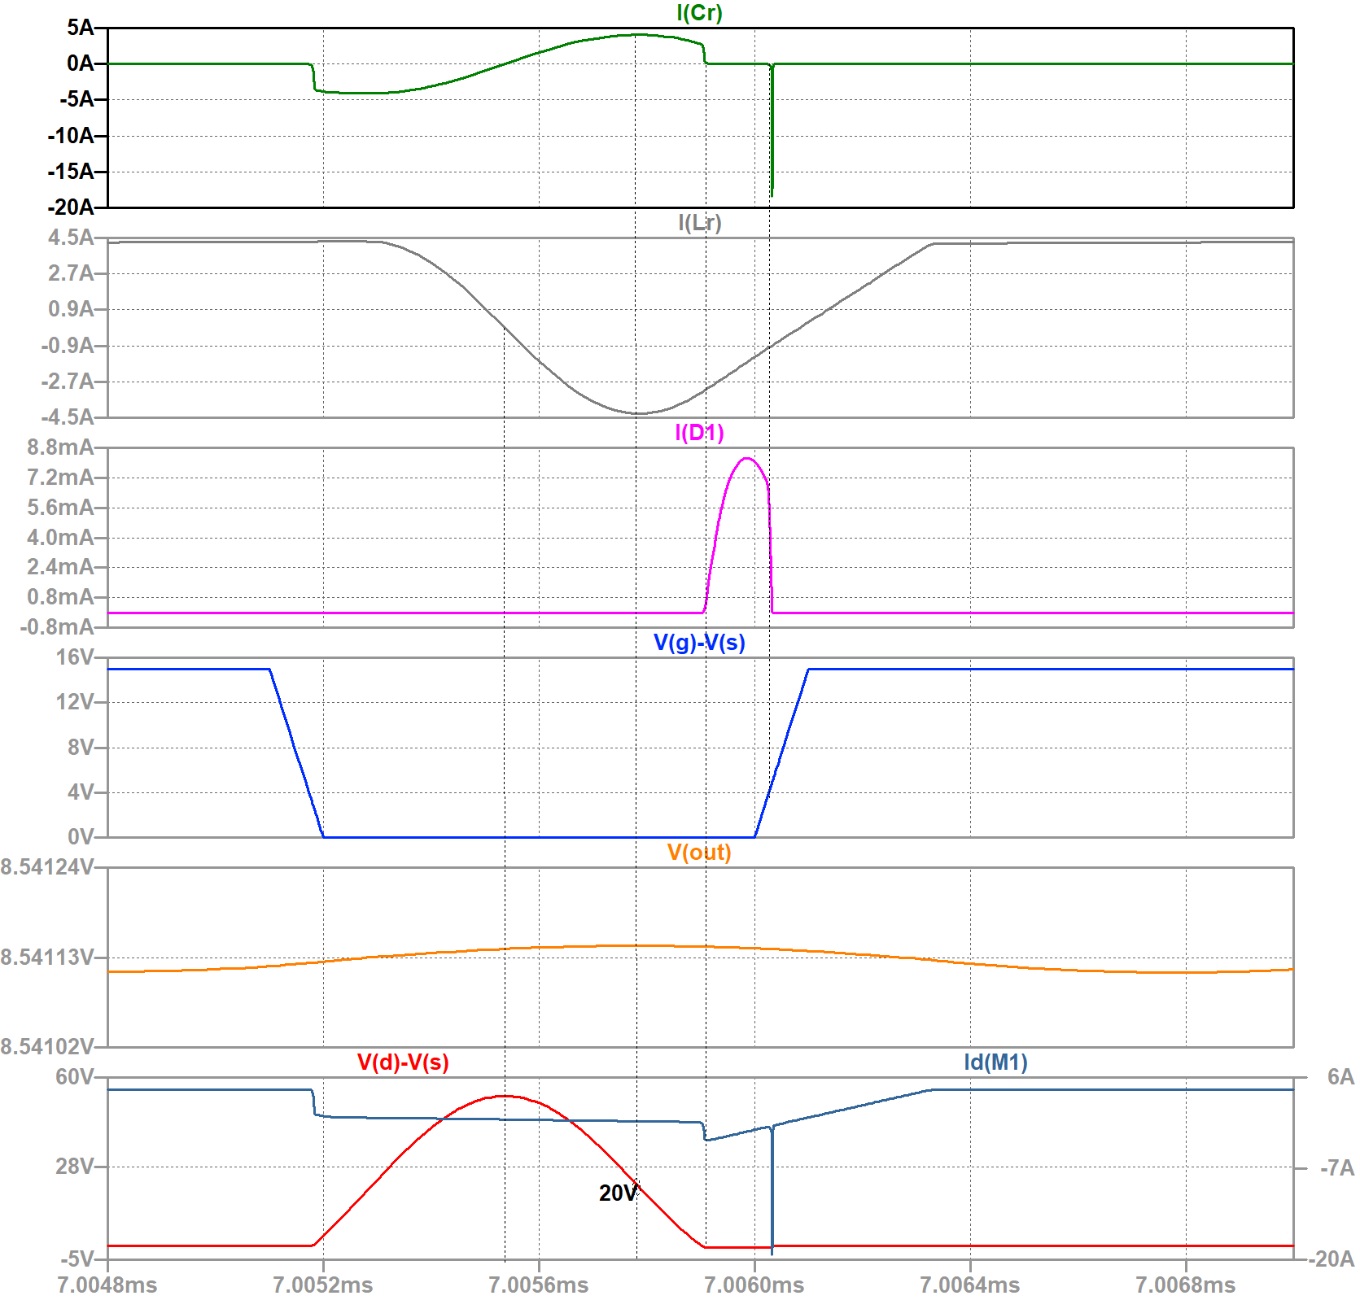
Peak Current of MOSFET
WHY?
So we draw all the current of the resonant device
REASON !!!
time t4~t5
Fig. Sequential Waveform
Fig. Current of the Resonant Device

Slide 31
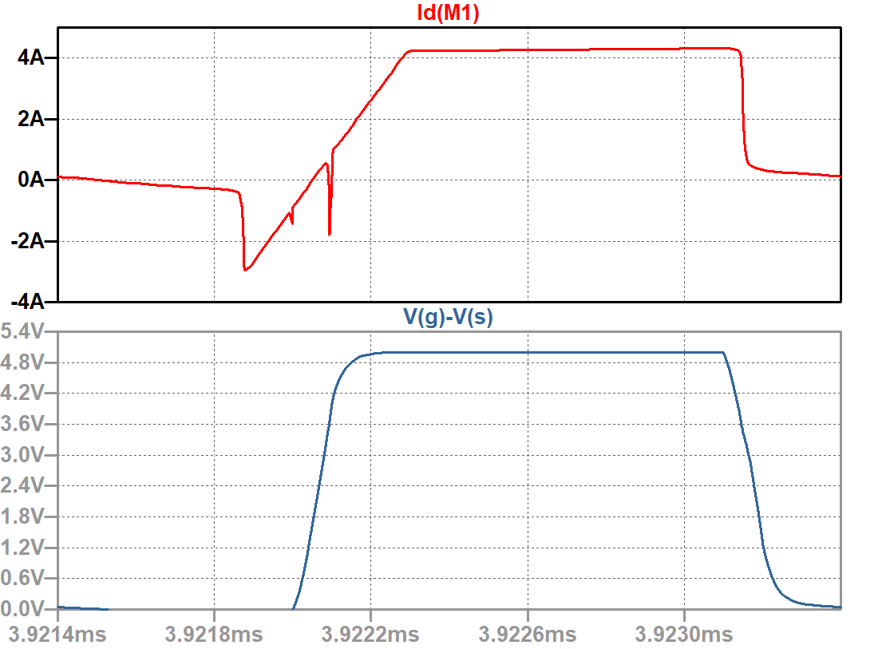
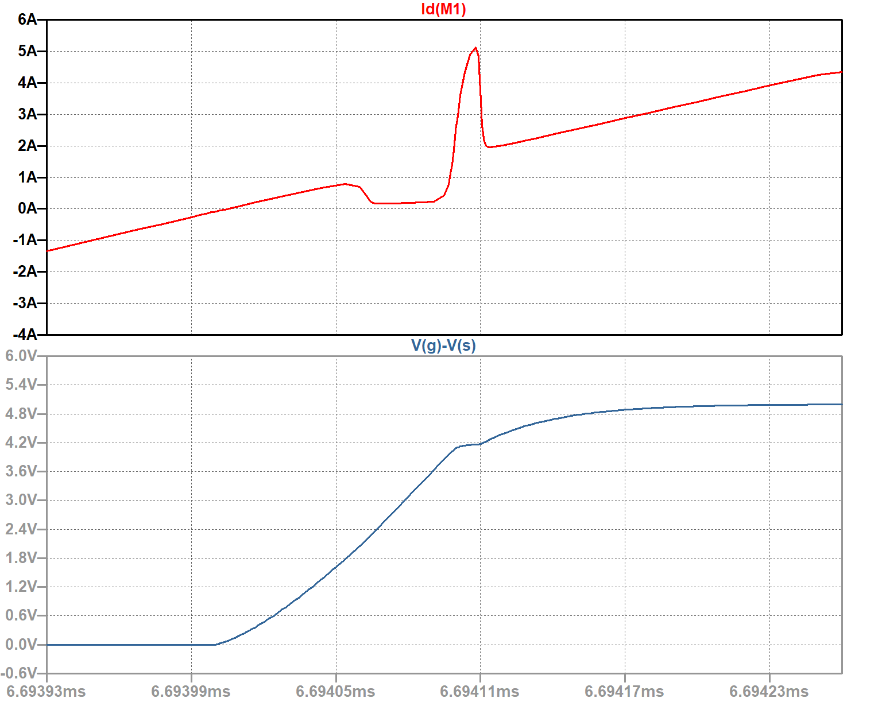
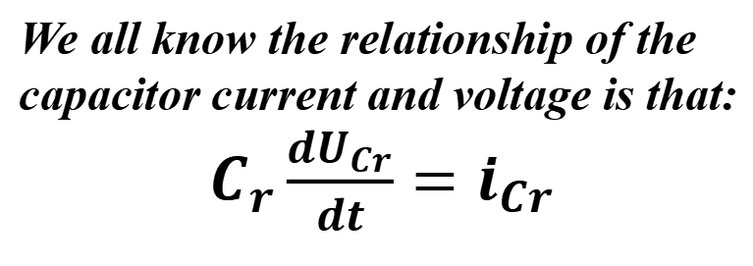
Analysis T4~T5 Period: Two Different Types of Commutation
During this period, you need to turn on the switch.
But the direction of the iLr makes the commutation process different.
When iLr is negative
When iLr is positive
Charging the capacitor Cr
-0.7V
0V
We all know the relationship of the
capacitor current and voltage is that:
$C_{r}\frac{dU_{Cr}}{dt}=i_{Cr}$
Fig. When Cr=20e-9, the peak current of Cr
Fig. When Cr=17.5e-9, the peak current of Cr
Different periods of MOSFET activation:
(1) When you turn on the MOSFET when iLr is negative, the voltage drop of -0.7V across it will generate a reverse overshoot current.
(2) When you turn on the MOSFET when is positive, at this time, because Cr has been charged for a short time, it releases forward overshoot current to the switch when the switch is closed.

Slide 32
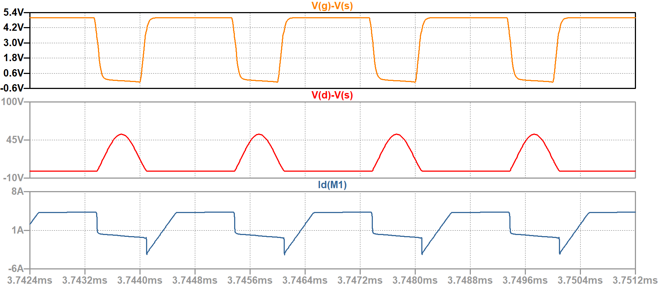
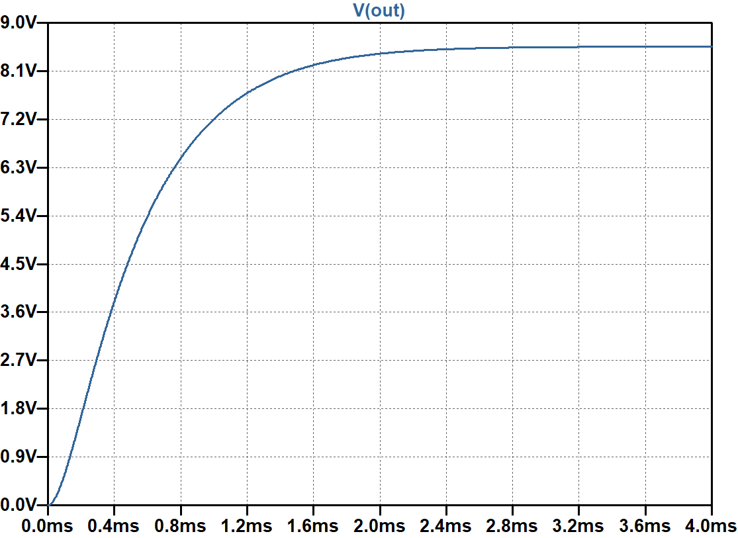
Some Way to Reduce the Overshoot Current
If you want to eliminate this spike current, you need to make the moment when the switch conducts exactly the moment when iLr crosses zero.
At this time, there is neither current flowing through the anti parallel diode nor current charging Cr, and the MOSFET is turned on at this moment, so there will be no overshoot current.
Fig. When Ton=1.26e-6, the waveform of switching current
Fig. When Ton=1.26e-6, the output voltage
Also we can see that duty cycle changing will not affect the output voltage, cause the output is controlled by the switching frequency.

Slide 33
Thanks！

