Slide 1

Seminar 6
Liu Ziyuan
Wang Xingyi
Wang Chenyao
Class2213 Group 3
Notes:
添加设计方向、设计独特性、n应用要扩充；建设内容要扩充；李处建议：1、个人身份介绍，我是陕西高等教育大数据中心主任**，我代表教育厅汇报。。。设计情况 2、简单介绍书 ，很多做了拉页处理，大事记可以放到ppt，在省政务大数据局支持和指导下，投入多少人多少天完成项目3、

Slide 2
Division of Work
Liu Ziyuan: Simulation of topic1, Slide of topic1
Wang Xingyi: Simulation of topic2, Slide of topic2
Wang Chenyao: Analysis of the result, Theoretical calculations

Slide 3
Topic1: Three-phase bridge PWM inverter
Notes:
添加设计方向、设计独特性、n应用要扩充；建设内容要扩充；李处建议：1、个人身份介绍，我是陕西高等教育大数据中心主任**，我代表教育厅汇报。。。设计情况 2、简单介绍书 ，很多做了拉页处理，大事记可以放到ppt，在省政务大数据局支持和指导下，投入多少人多少天完成项目3、

Slide 4
CONTENTS
Simulation model
Operating Principle
01
02
PART
PART
03
Harmonic analysis
PART

Slide 5
PART. 01
Simulation Model

Slide 6
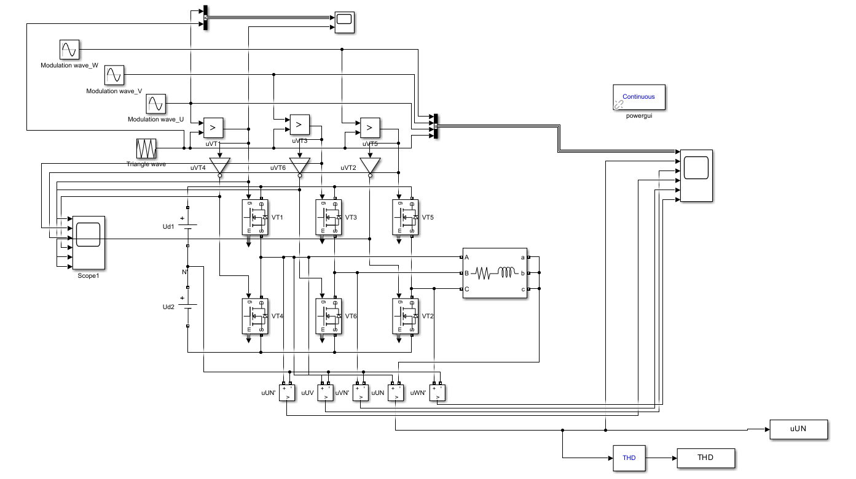
Simulation Model
Parameters | values
DC side voltage Uin | 900V
Modulation wave frequency fm | 50Hz
Switching frequency fs | 20kHz
Load resistance R | 10Ω
load inductance L | 3mH
Figure 1-1 : Three phase PWM inverter simulation model

Slide 7


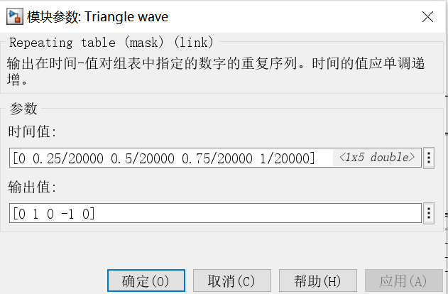
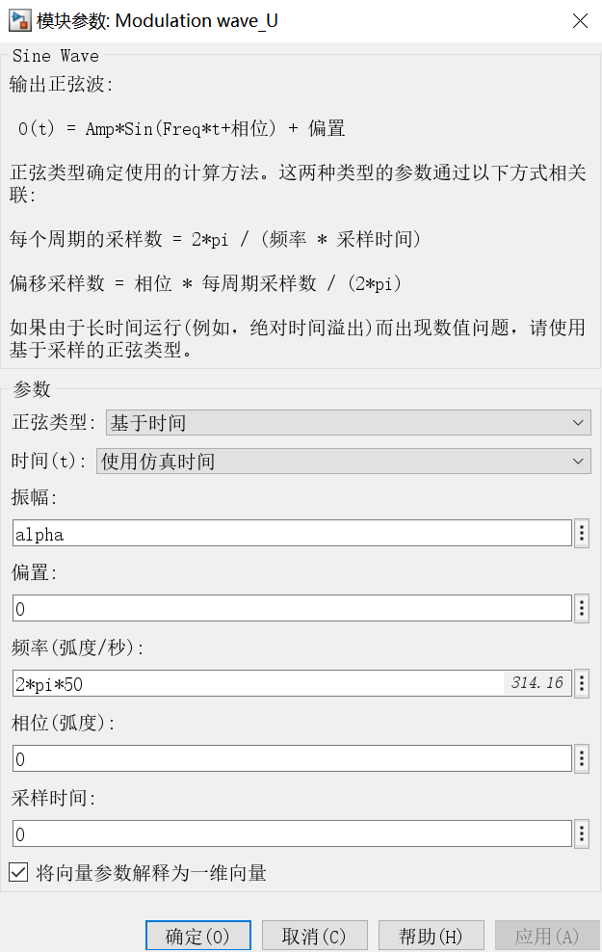
Parameters setting
(A) Carrier wave(triangle wave)
(B) Modulation wave(sine wave)
To change the switch frequency
To change the modulation depth

Slide 8
Circuit operating principle
PART. 02

Slide 9
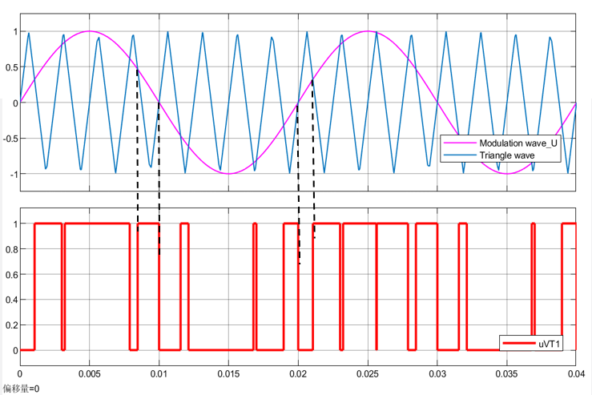
Modulation, carrier and PWM waveforms
In order to get clearly analysis and observation:
The carrier frequency was reduced to 400Hz
The working timing of the other two phases is consistent with U, and the phases are staggered by 120 degrees
Figure 1-2 :U-phase modulation , carrier and PWM waveforms
Notes:
circuit diagram
trigger signal of thyristor
The natural commutation point of the three-phase fully controlled bridge is set to 30 degree, and the delay angel α is 40 degree. VT1 conducts from 70 to130.VT2 conducts from 130 to 250.

Slide 10
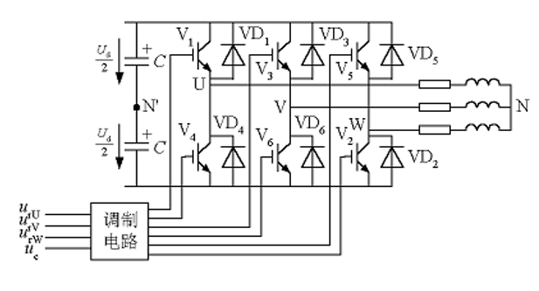
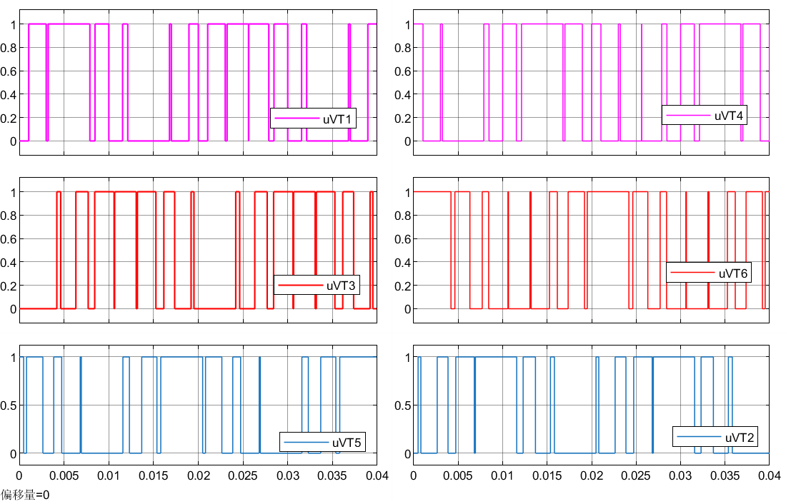
Circuit working sequence
Figure 1-3 :Three-phase PWM inverter
VT1 on; VT4 off
VT4 on; VT1 off
VT1 is complementary to VT4
Figure 1-4 : Driving signal (PWM wave)
Notes:
circuit diagram
trigger signal of thyristor
The natural commutation point of the three-phase fully controlled bridge is set to 30 degree, and the delay angel α is 40 degree. VT1 conducts from 70 to130.VT2 conducts from 130 to 250.

Slide 11
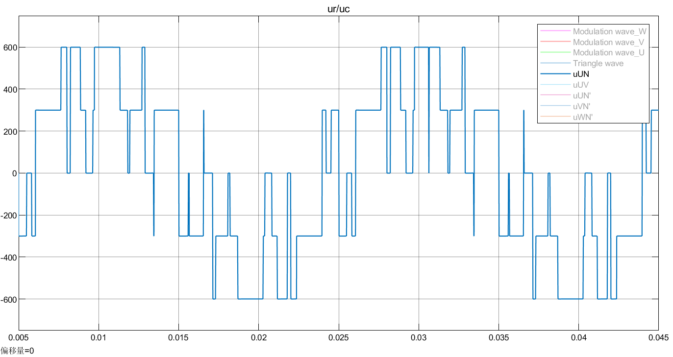
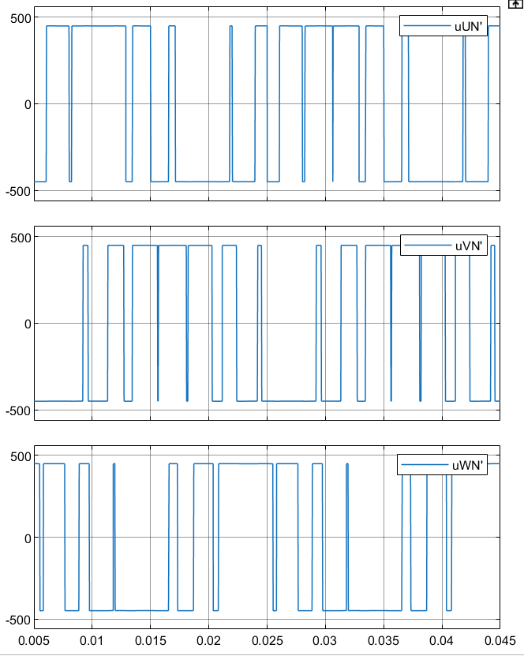
Output voltage
Figure 1-5 : Voltage for each phase (relative to N’)
Figure 1-6 : U-phase output voltage (relative to N)
Notes:
circuit diagram
trigger signal of thyristor
The natural commutation point of the three-phase fully controlled bridge is set to 30 degree, and the delay angel α is 40 degree. VT1 conducts from 70 to130.VT2 conducts from 130 to 250.

Slide 12
Harmonic analysis
PART. 03

Slide 13
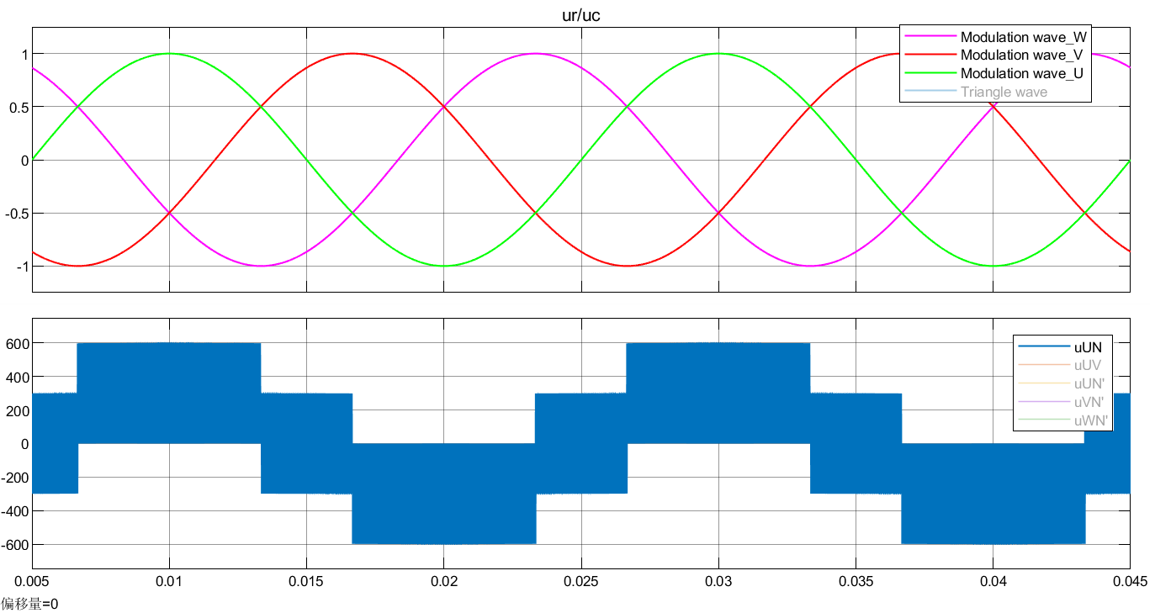
Conclusion:
contains only harmonics near carrier frequencies and its integer multiples
Figure 1-7 : Waveform of u_{UN} (fs=20kHz)
Notes:
circuit diagram
trigger signal of thyristor
The natural commutation point of the three-phase fully controlled bridge is set to 30 degree, and the delay angel α is 40 degree. VT1 conducts from 70 to130.VT2 conducts from 130 to 250.

Slide 14
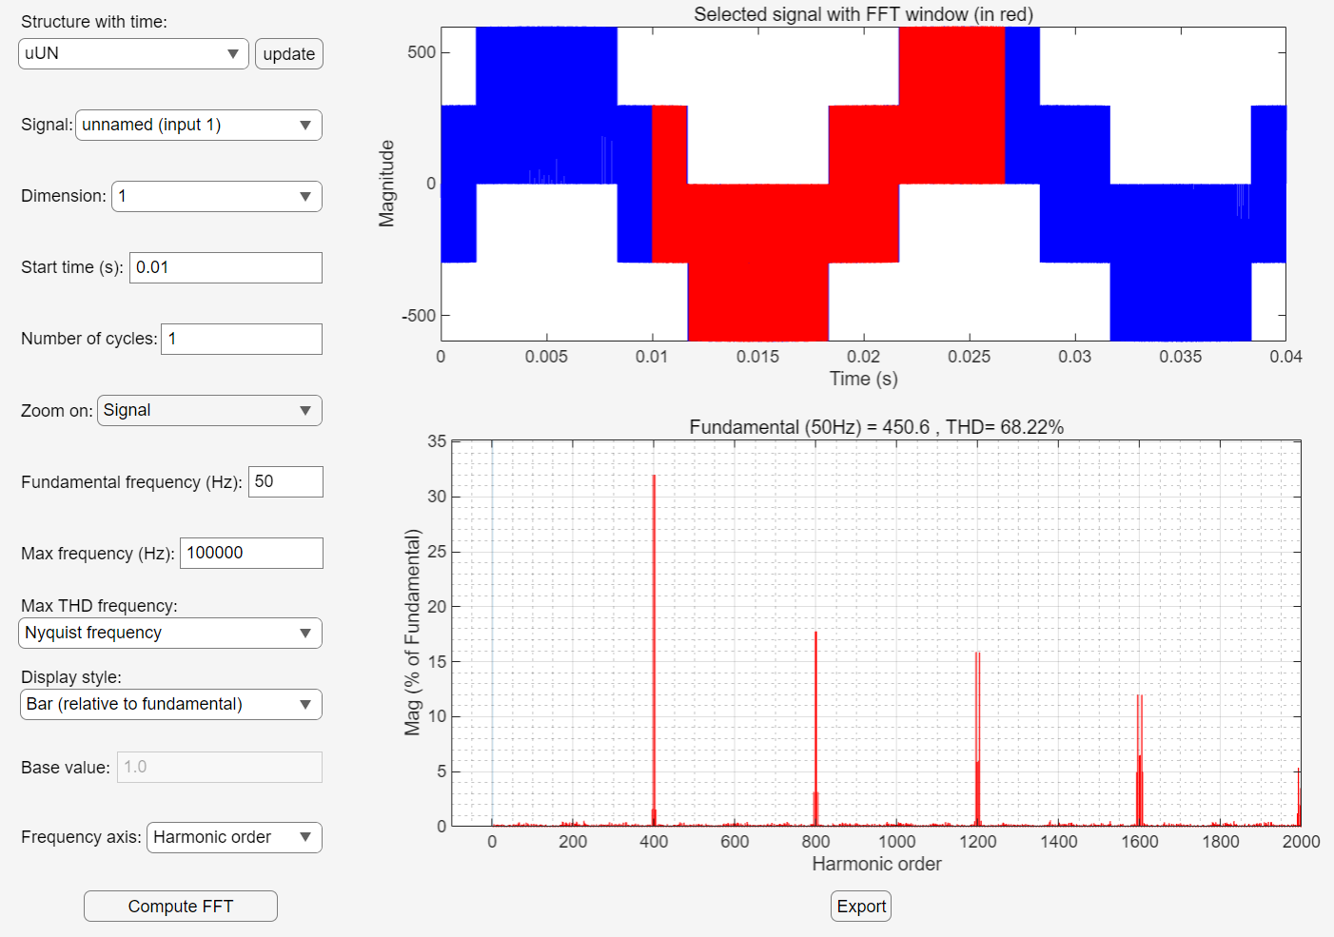
The carrier wave frequency is 20kHz and the fundamental frequency is 50Hz
The number of main harmonics is 400, 800, 1200, etc.
Figure 1-8 : Spectrum of u_{UN} (α=1)
Notes:
the voltage waveform of load the current wavefuorm of load
1)The thyristor will produce a voltage drop when it is turned on, which causes the analog value to be lower than the theoretical calculation value.
2)The inductance value is defined as infinite in theoretical calculation while is a finite value in simulation.
3)The theoretical calculation is actually a approximate calculation, for example, 根号6 ≈2.34，which have a influence on the results.
4)Essentially, MATLAB simulation calculation is Calculation of discrete points , which is also a approximate calculation.

Slide 15
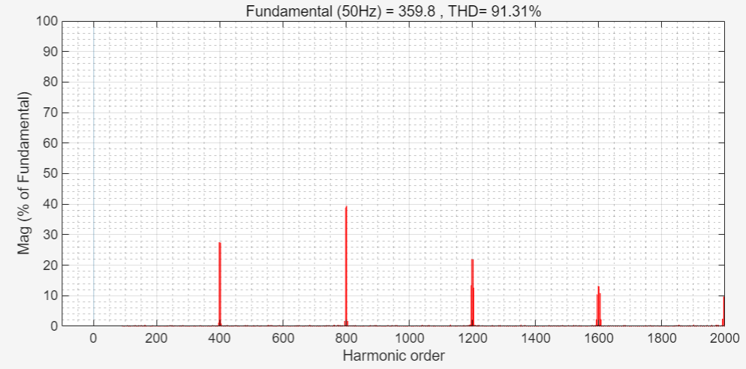
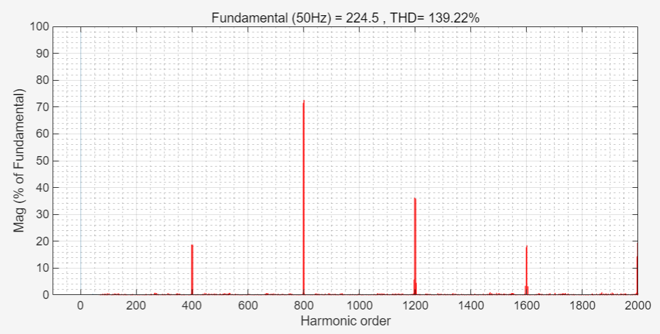
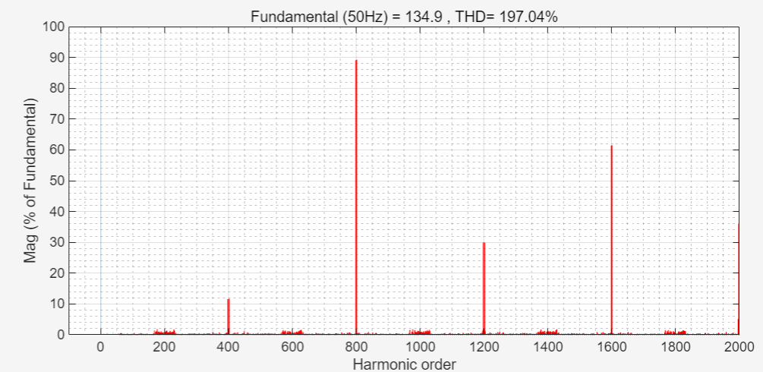
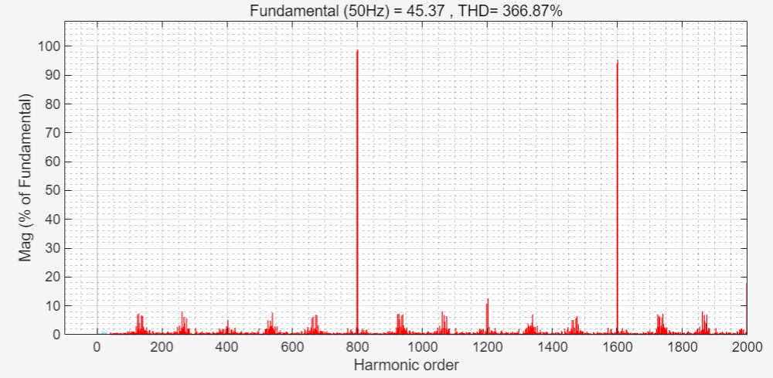
(a): α=0.8
(b): α=0.5
(c): α=0.3
(d): α=0.1
Figure 1-9 : Spectrum of u_{UN}
Notes:
the voltage waveform of load the current wavefuorm of load
1)The thyristor will produce a voltage drop when it is turned on, which causes the analog value to be lower than the theoretical calculation value.
2)The inductance value is defined as infinite in theoretical calculation while is a finite value in simulation.
3)The theoretical calculation is actually a approximate calculation, for example, 根号6 ≈2.34，which have a influence on the results.
4)Essentially, MATLAB simulation calculation is Calculation of discrete points , which is also a approximate calculation.

Slide 16
With the increase of the modulation system, the harmonic content of the output voltage decreases, so the modulation depth should be as close to 1 as possible.
Figure 1-9 : Spectrum of u_{UN}
Notes:
the voltage waveform of load the current wavefuorm of load
1)The thyristor will produce a voltage drop when it is turned on, which causes the analog value to be lower than the theoretical calculation value.
2)The inductance value is defined as infinite in theoretical calculation while is a finite value in simulation.
3)The theoretical calculation is actually a approximate calculation, for example, 根号6 ≈2.34，which have a influence on the results.
4)Essentially, MATLAB simulation calculation is Calculation of discrete points , which is also a approximate calculation.

Slide 17
Topic2: Single-Phase
PWM Full-Bridge VSC
Notes:
添加设计方向、设计独特性、n应用要扩充；建设内容要扩充；李处建议：1、个人身份介绍，我是陕西高等教育大数据中心主任**，我代表教育厅汇报。。。设计情况 2、简单介绍书 ，很多做了拉页处理，大事记可以放到ppt，在省政务大数据局支持和指导下，投入多少人多少天完成项目3、

Slide 18
CONTENTS
01
Simulation Model
02
Theoretical
Calculation
PART
PART
03
Simulation Results
PART

Slide 19
PART. 01
Simulation Model

Slide 20
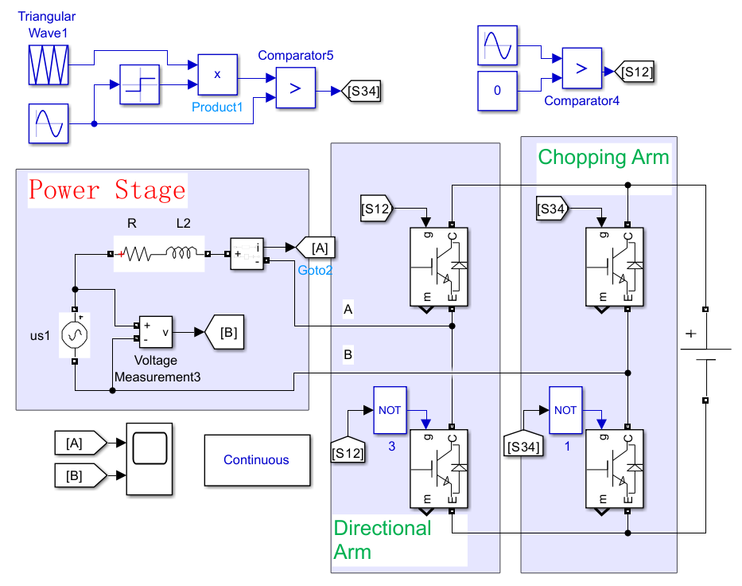
Triangular-Wave Natural Sampling
Parameters | values
Vac (RMS) | 220V
L | 4mH
Vdc | 540V
fline | 50Hz
fs | 20kHz
Iac(RMS) | 20A
φ(v,i) | -100°
R | 0.1ohm
Figure 2-1 : Single phase SPWM VSC with Modulation Method

Slide 21
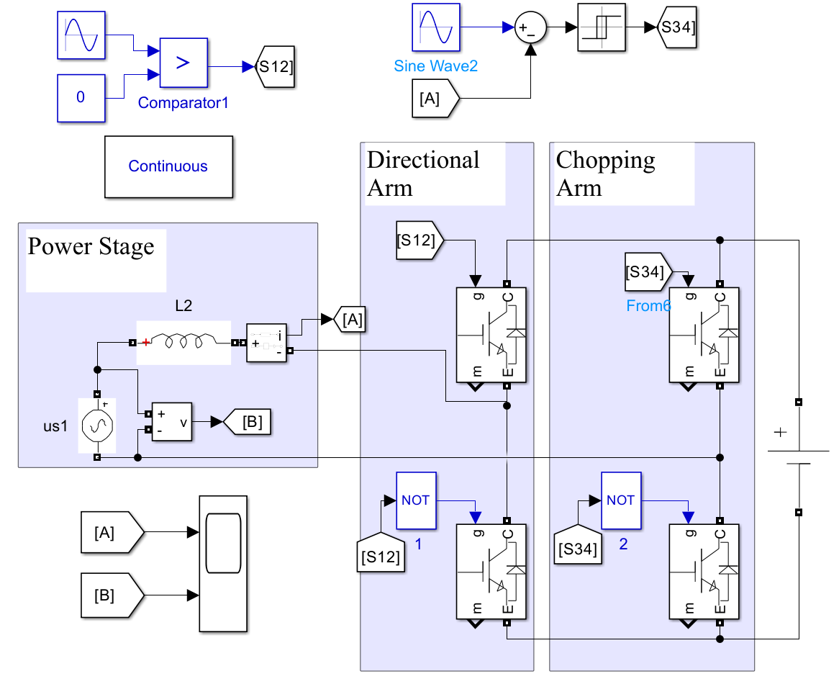
Current Hysteretic Control
Parameters | values
Vac (RMS) | 220V
L | 4mH
Vdc | 540V
fline | 50Hz
Iac(RMS) | 20A
φ(v,i) | -100°
Figure 2-2 : Single phase VSC with Current Hysteretic Control

Slide 22
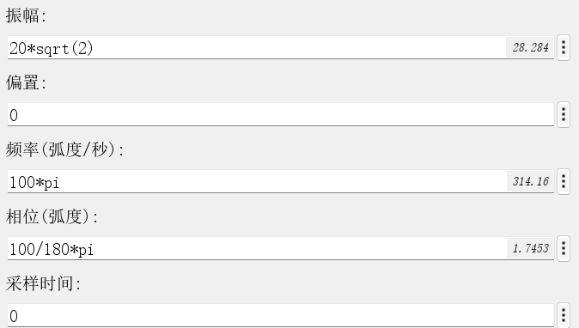
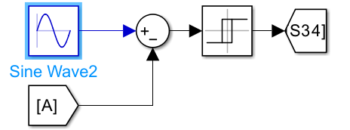

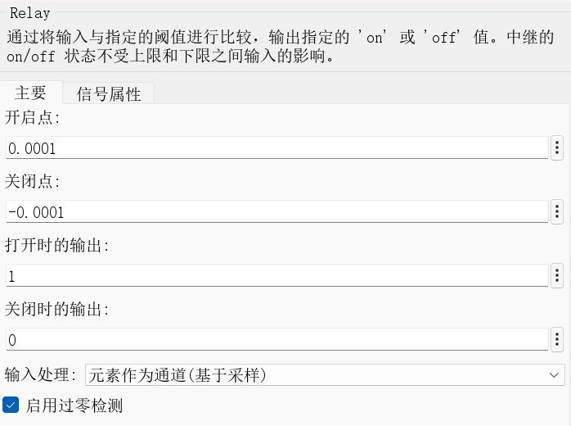
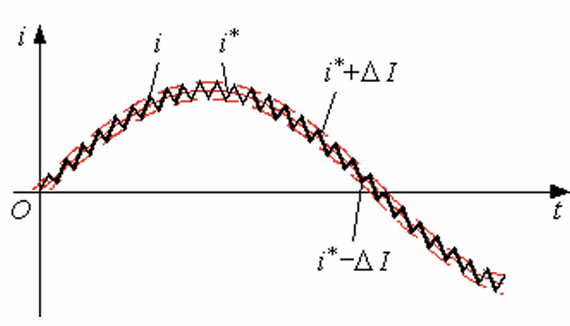
Current Hysteretic Control
Parameters | values
Vac (RMS) | 220V
L | 4mH
Vdc | 540V
fline | 50Hz
Iac(RMS) | 20A
φ(v,i) | -100°
Figure 2-3: Parameter of Commanding Signal
Figure 2-4: Parameter of Relay in the control circuit

Slide 23
Theoretical Calculation
PART. 02

Slide 24
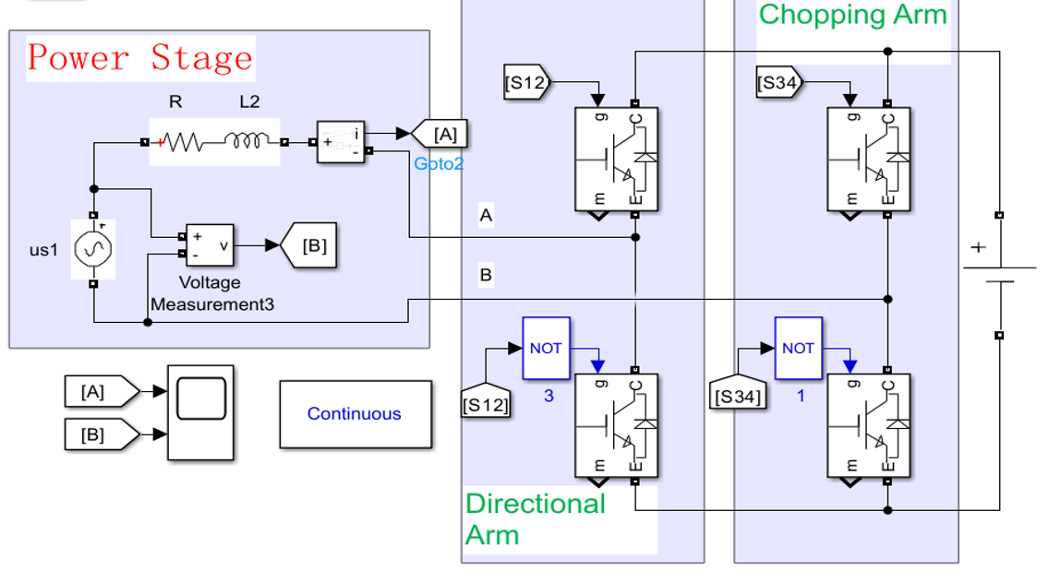
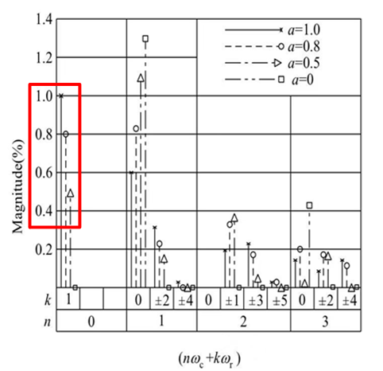
Theoretical Calculation
Figure 2-5: Spectrum of SPWM Wave Uab

Slide 25
Simulation Results
PART. 03

Slide 26
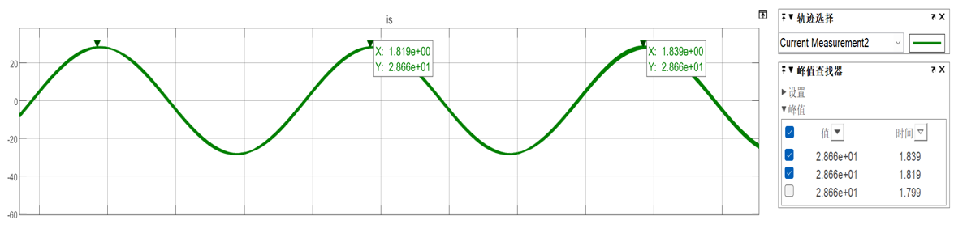
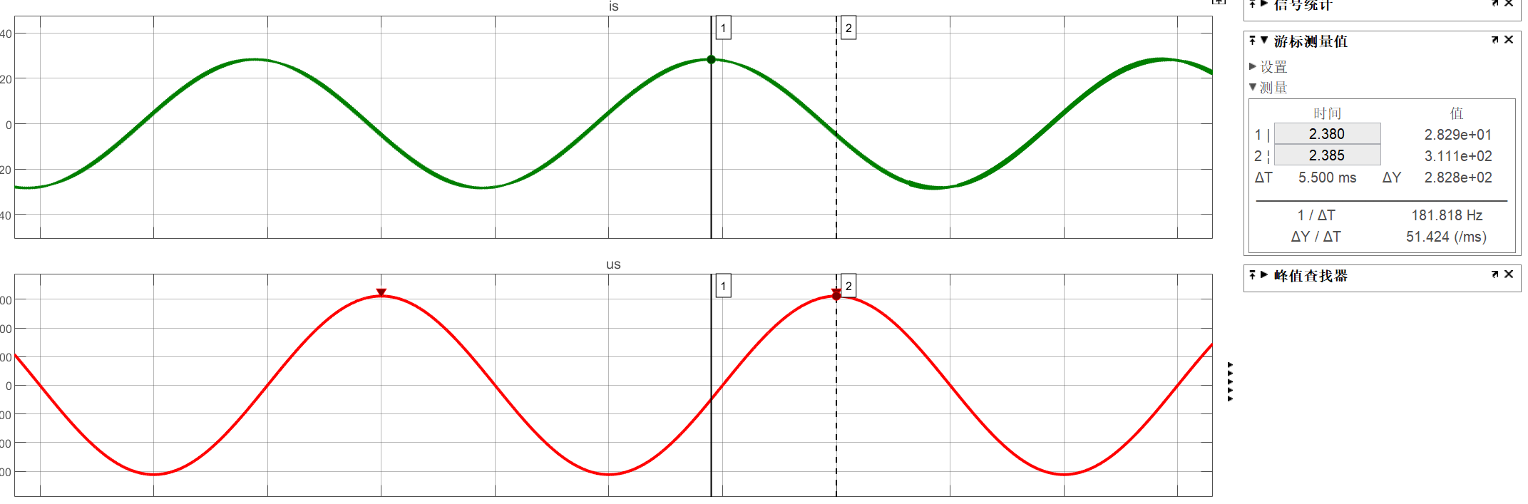
Triangular-Wave Natural Sampling

Slide 27
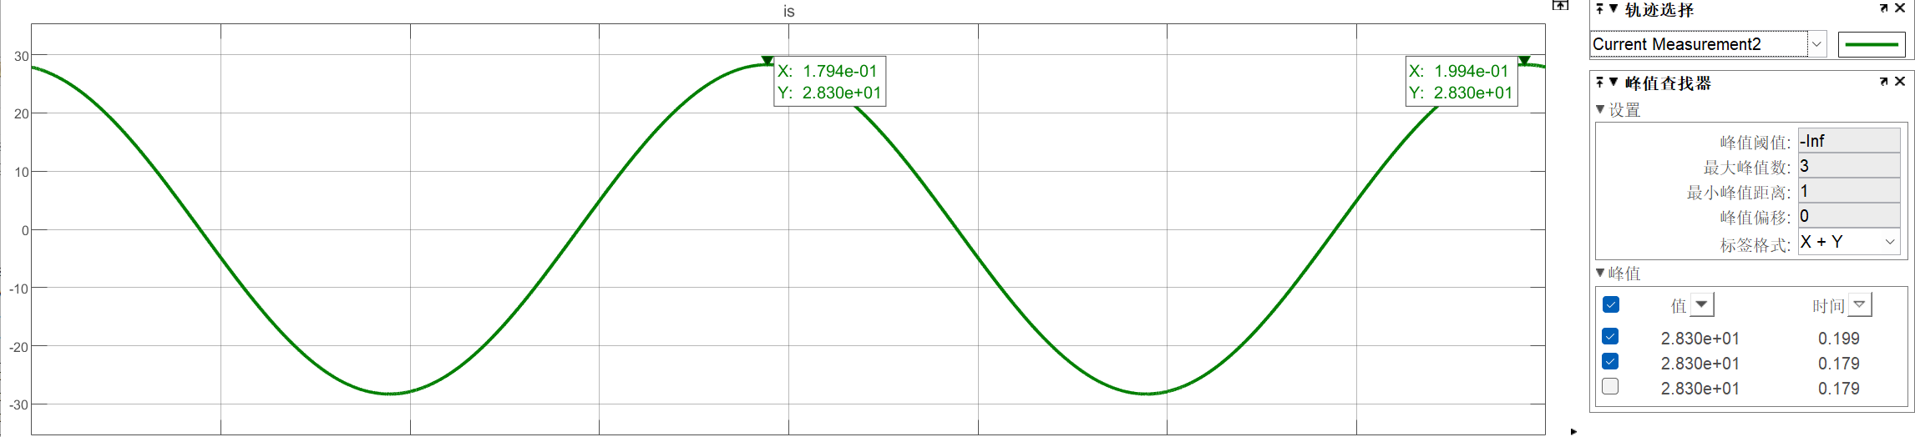
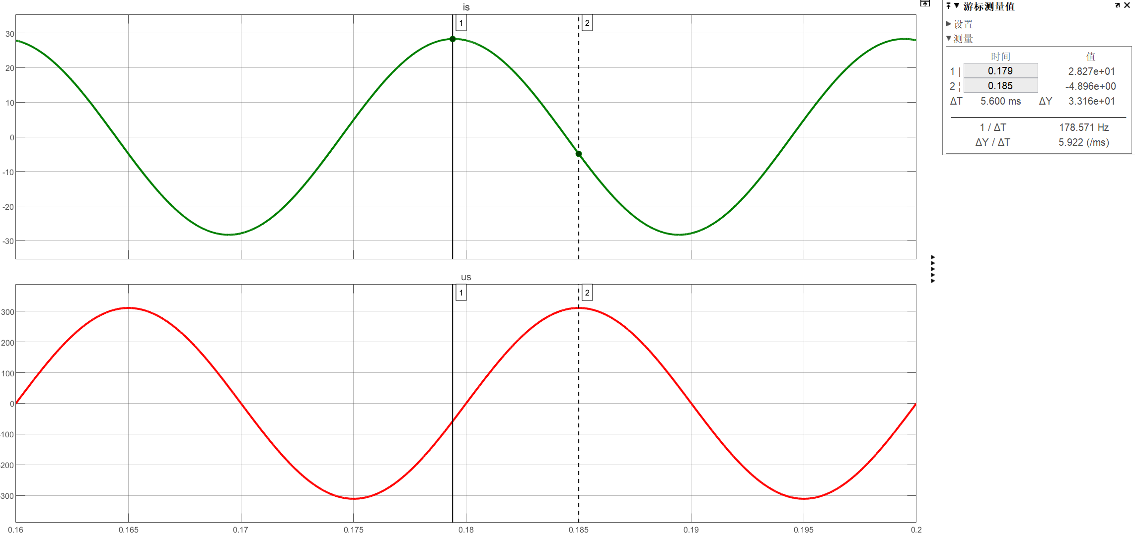
Current Hysteretic Control

Slide 28
Thanks！

