Slide 1

Topic1: Series connection of two single-phase full-bridge VSIs
Wang Xingyi
Mengtang Yunyu
Liu Ziyuan
Class3 _Group 2
Notes:
添加设计方向、设计独特性、n应用要扩充；建设内容要扩充；李处建议：1、个人身份介绍，我是陕西高等教育大数据中心主任**，我代表教育厅汇报。。。设计情况 2、简单介绍书 ，很多做了拉页处理，大事记可以放到ppt，在省政务大数据局支持和指导下，投入多少人多少天完成项目3、

Slide 2
Division of Work
Wang Xingyi: Simulation of part1, Slide of part1
Liu Ziyuan: Simulation of part2, Slide of part2
Mengtang Yunyu: Analysis of the result, Theoretical calculations

Slide 3
CONTENTS
01
Simulation Schematic
Single VSI
——Time sequence Waveform and I/O Voltage Relationship
02
PART
PART
03
Operating Principle
—— of Multiple Single-phase VSIs
04
External Phase-shifting Angle
PART
PART

Slide 4
Simulation Schematic
PART. 01

Slide 5
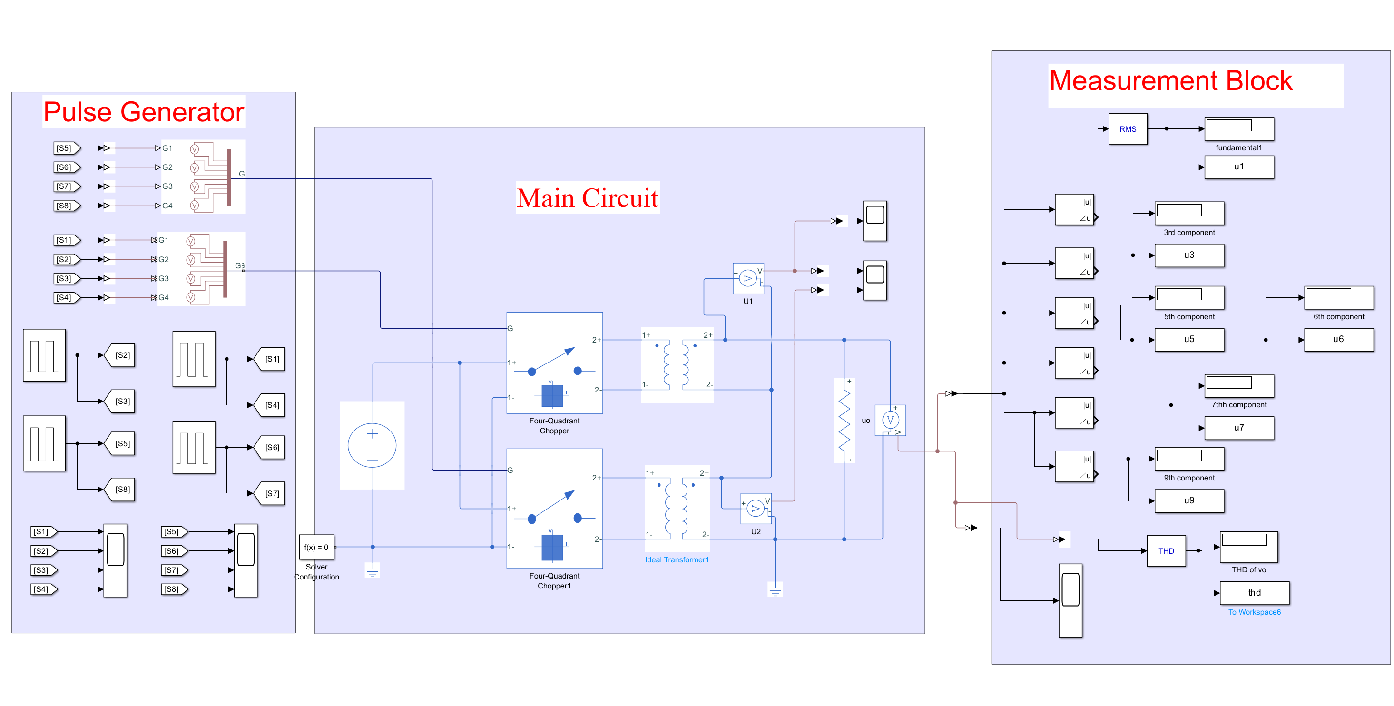
Simulation Model

Slide 6
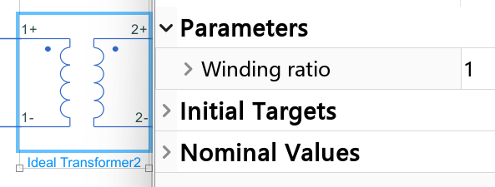
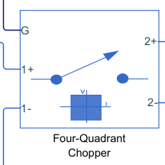
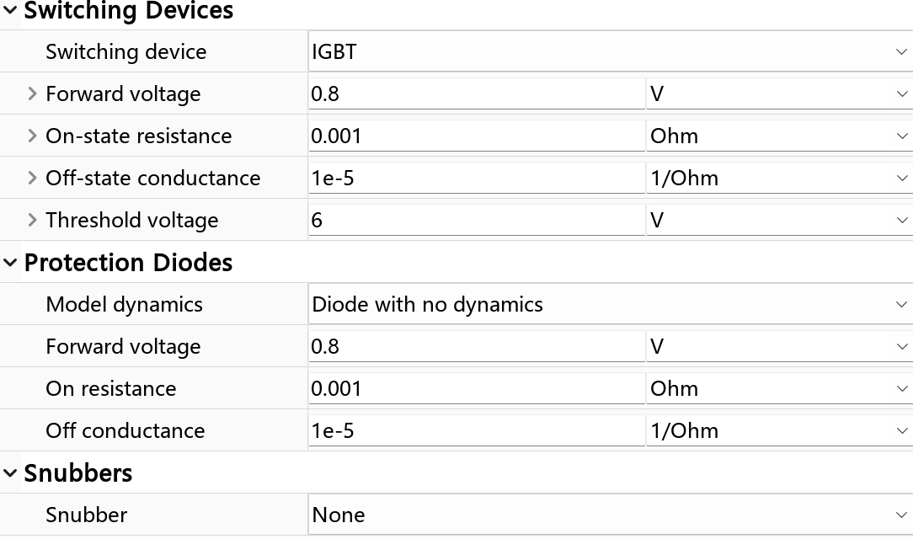
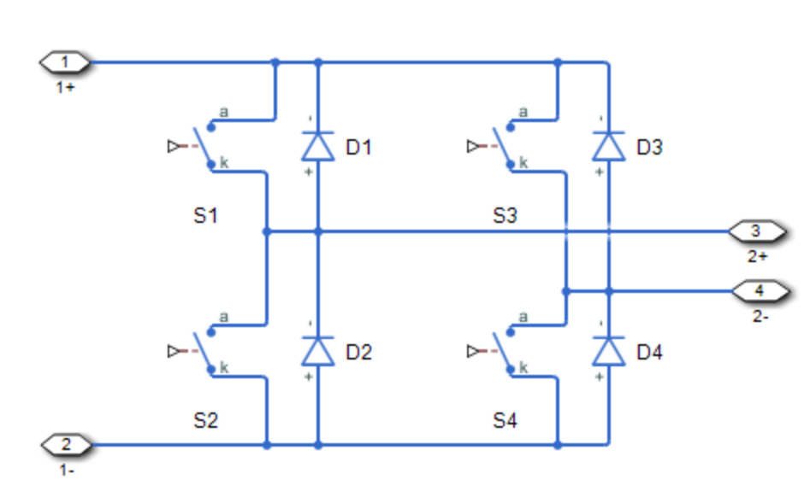
Main Circuit
Ideal Transformer
Parameters | values
R | 8Ω
Vdc | 400V
 | 180°
 | 0~360°
Inverter type | Full bridge
Equivalent Circuit
Parameters of switching device

Slide 7
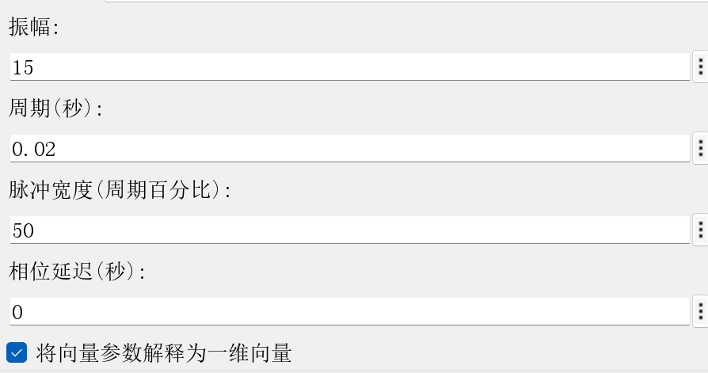
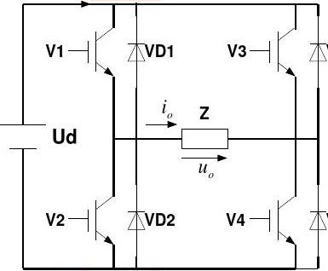
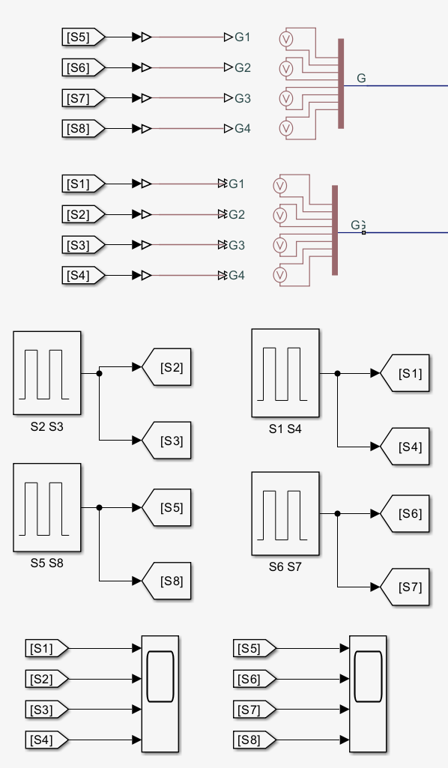
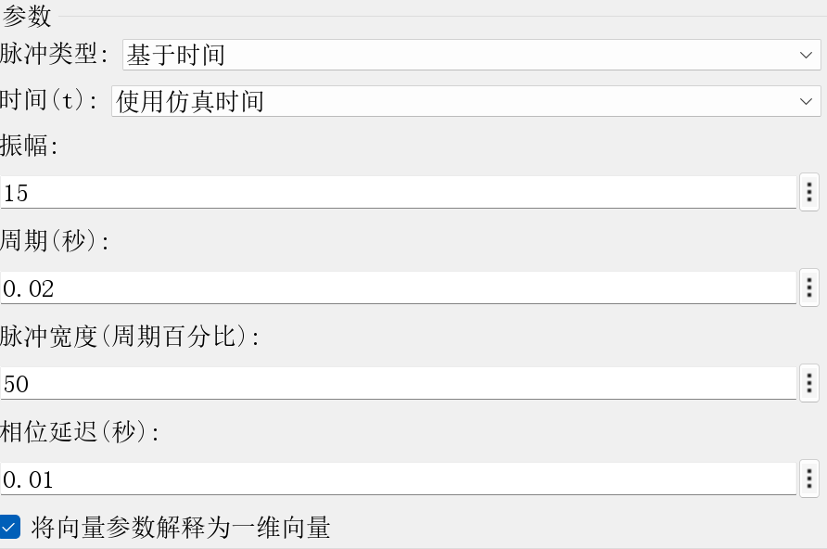
Pulse Generator
Parameters | values
R | 8Ω
Vdc | 400V
 | 180°
 | 0~360° (step size: 1°)
Inverter type | Full bridge
Parameters of pulses of S1 S4
Parameters of pulses of S2 S3

Slide 8
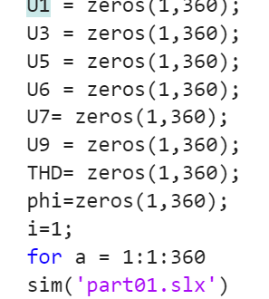
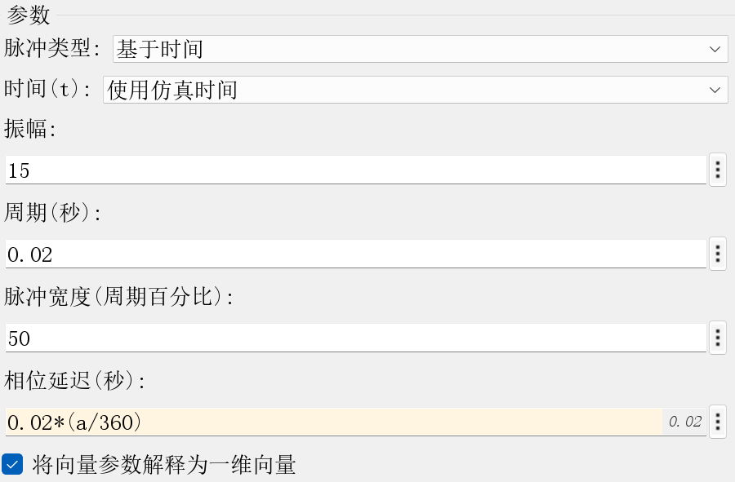
External Phase-Shifting angle
Parameters | values
R | 8Ω
Vdc | 400V
 | 180°
 | 0~360° (step size: 1°)
Inverter type | Full bridge
Parameters of pulses of S5 S8

Slide 9
Single VSI
——Time sequence Waveform and I/O Voltage Relationship
PART. 02

Slide 10
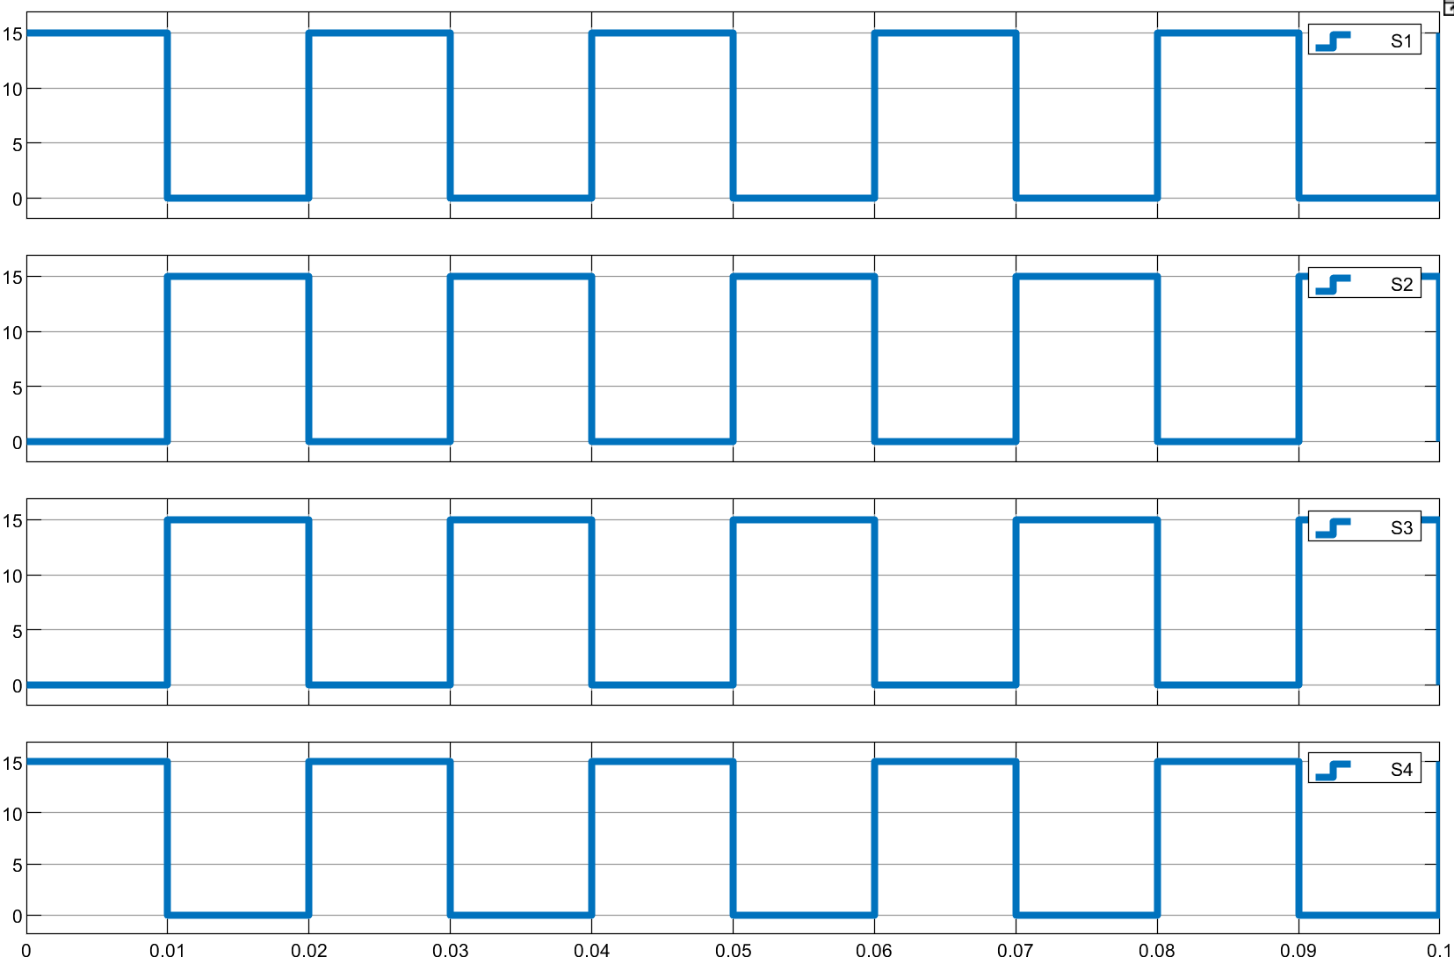
Time Sequence Waveform (θ=180°）
Parameters | values
R | 8Ω
Vdc | 400V
 | 180°
 | 0~360° (step size: 1°)
Inverter type | Full bridge
Conducting State | V1 | V2 | V3 | V4
0°~180° | on | off | off | on
180°~360° | off | on | on | off
Notes:
circuit diagram
trigger signal of thyristor
The natural commutation point of the three-phase fully controlled bridge is set to 30 degree, and the delay angel α is 40 degree. VT1 conducts from 70 to130.VT2 conducts from 130 to 250.

Slide 11
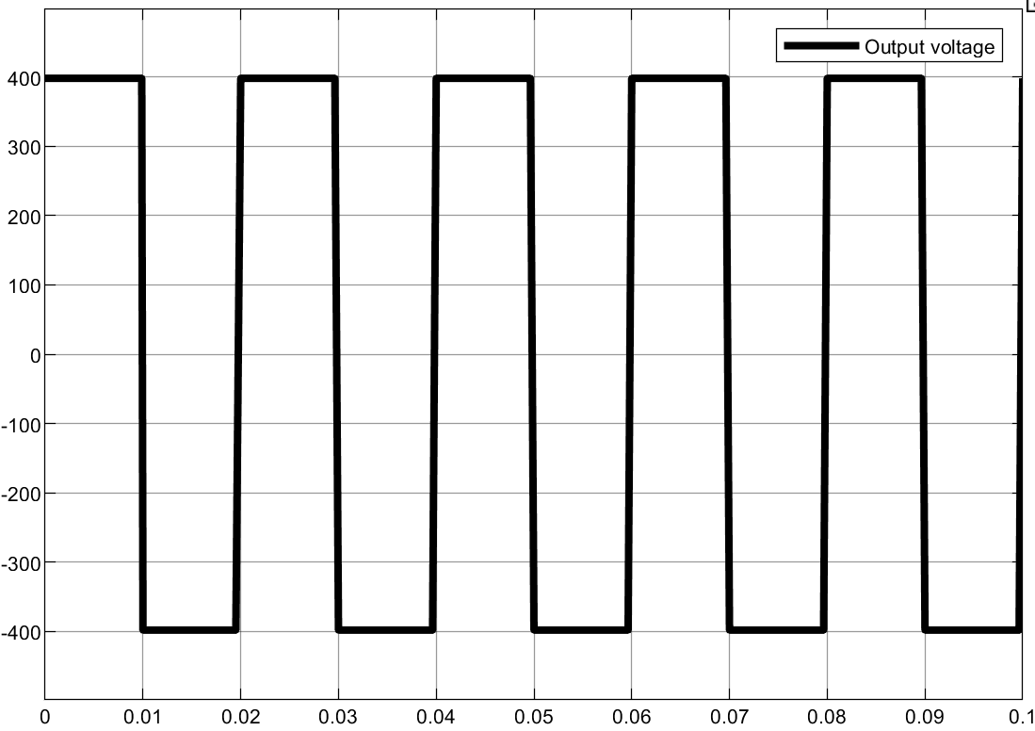
Output Voltage (θ=180°）
Conducting State | V1 | V2 | V3 | V4
0°~180° | on | off | off | on
180°~360° | off | on | on | off
Notes:
circuit diagram
trigger signal of thyristor
The natural commutation point of the three-phase fully controlled bridge is set to 30 degree, and the delay angel α is 40 degree. VT1 conducts from 70 to130.VT2 conducts from 130 to 250.

Slide 12
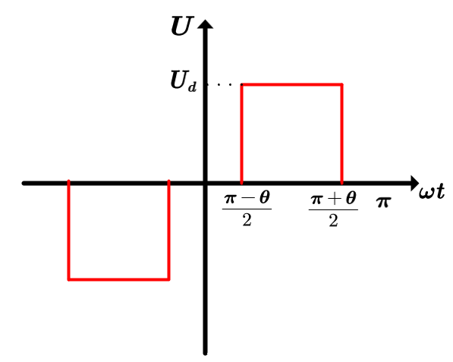
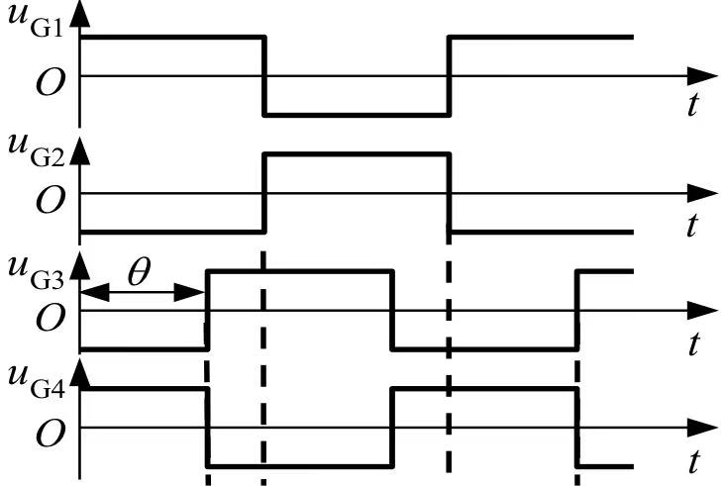
Relationship between I/O Voltage
Gate Voltage of four switching devices
Output Voltage Waveform

Slide 13
Operating Principle
of Multiple Single-phase VSIs
PART. 03

Slide 14
Operating Principle
When , nth harmonic component will be eliminated
Notes:
the voltage waveform of load the current wavefuorm of load
1)The thyristor will produce a voltage drop when it is turned on, which causes the analog value to be lower than the theoretical calculation value.
2)The inductance value is defined as infinite in theoretical calculation while is a finite value in simulation.
3)The theoretical calculation is actually a approximate calculation, for example, 根号6 ≈2.34，which have a influence on the results.
4)Essentially, MATLAB simulation calculation is Calculation of discrete points , which is also a approximate calculation.

Slide 15
External Phase-shifting Angle φ
PART. 04

Slide 16
Fundamental component of output voltage
(RMS value)
Parameters | values
R | 8Ω
Vdc | 400V
 | 180°
 | 0~360° (step size: 1°)
Inverter type | Full bridge

Slide 17
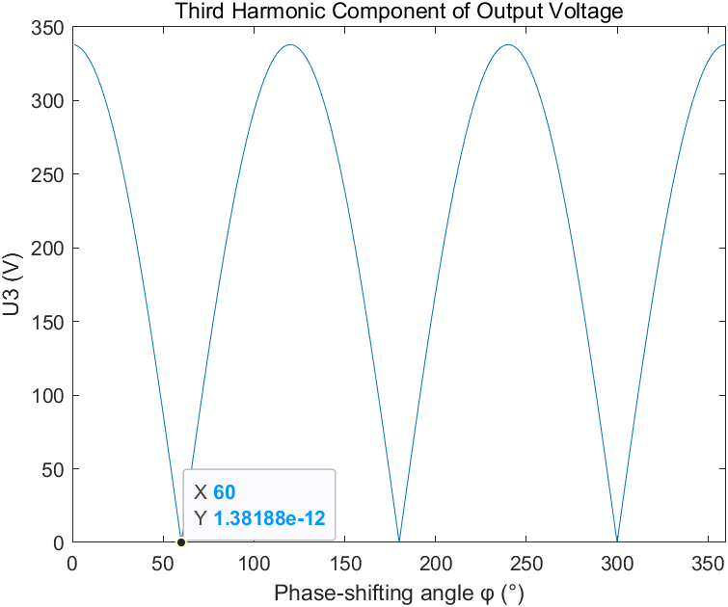
3rd harmonic component of output voltage
(Amplitude)
Parameters | values
R | 8Ω
Vdc | 400V
 | 180°
 | 0~360° (step size: 1°)
Inverter type | Full bridge

Slide 18
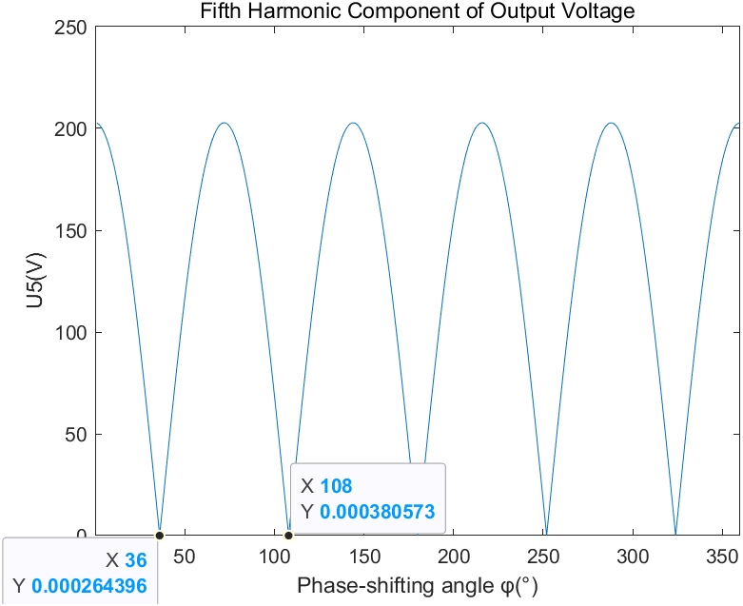
5th harmonic component of output voltage
(Amplitude)
Parameters | values
R | 8Ω
Vdc | 400V
 | 180°
 | 0~360° (step size: 1°)
Inverter type | Full bridge

Slide 19
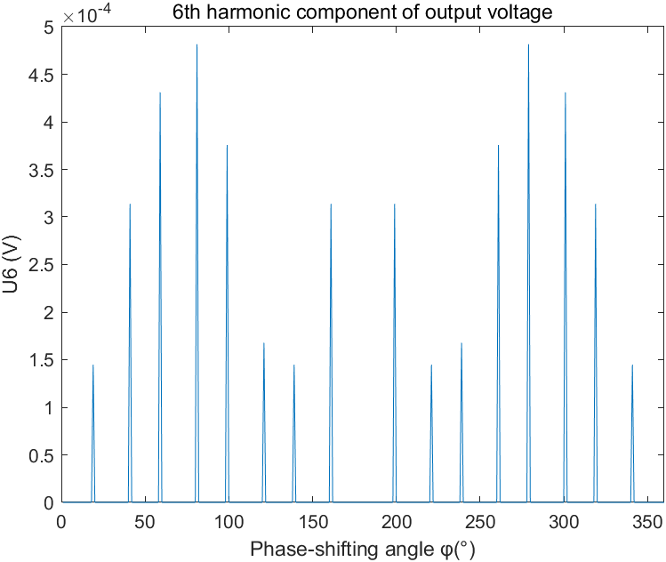
6th harmonic component of output voltage
(Amplitude)

Slide 20
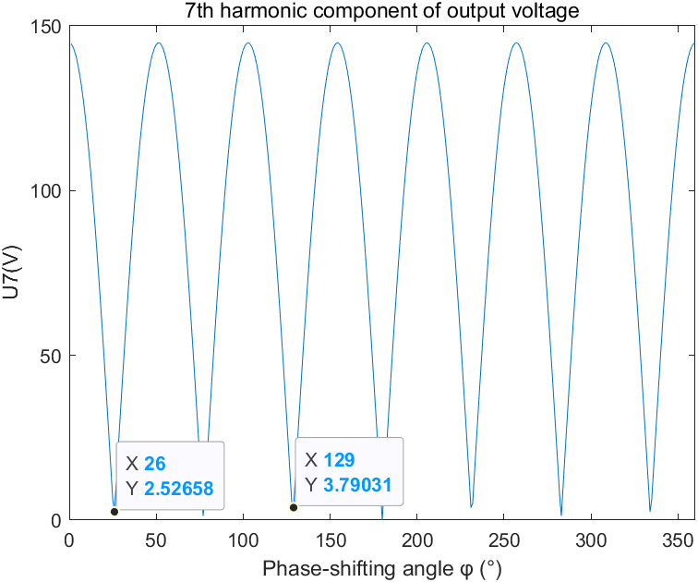
7th harmonic component of output voltage
(Amplitude)
Parameters | values
R | 8Ω
Vdc | 400V
 | 180°
 | 0~360° (step size: 1°)
Inverter type | Full bridge

Slide 21
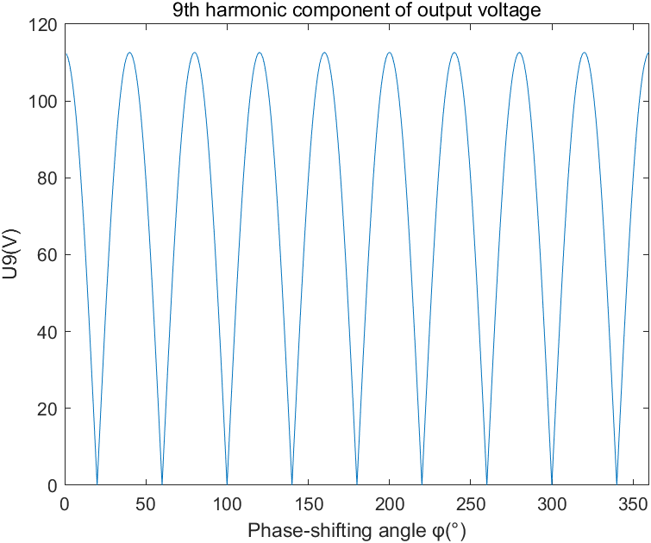
9th harmonic component of output voltage
(Amplitude)
Parameters | values
R | 8Ω
Vdc | 400V
 | 180°
 | 0~360° (step size: 1°)
Inverter type | Full bridge

Slide 22
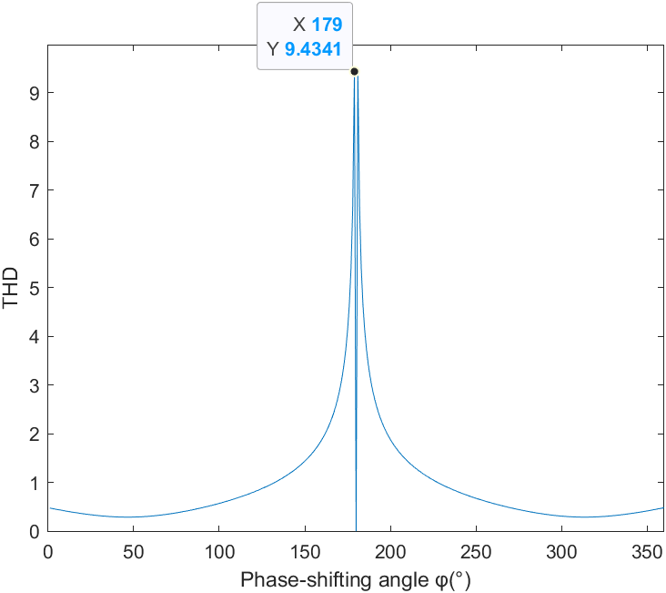
THD of Output Voltage
Parameters | values
R | 8Ω
Vdc | 400V
 | 180°
 | 0~360° (step size: 1°)
Inverter type | Full bridge

Slide 23
Part2: Three-Phase Full Bridge Inverter
Class 2213 Group 2
Members: Liu Ziyuan Meng Tangyunyu Wang Xingyi
Notes:
添加设计方向、设计独特性、n应用要扩充；建设内容要扩充；李处建议：1、个人身份介绍，我是陕西高等教育大数据中心主任**，我代表教育厅汇报。。。设计情况 2、简单介绍书 ，很多做了拉页处理，大事记可以放到ppt，在省政务大数据局支持和指导下，投入多少人多少天完成项目3、

Slide 24
Division of Work
Wang Xingyi: Simulation of part1, Slide of part1
Liu Ziyuan: Simulation of part2, Slide of part2
Mengtang Yunyu: Analysis of the result, Theoretical calculations

Slide 25
CONTENTS
01
Simulation Model
02
Waveforms of current and voltage
PART
PART
03
Analysis of harmonics
PART

Slide 26
Simulation
Model
PART. 01

Slide 27
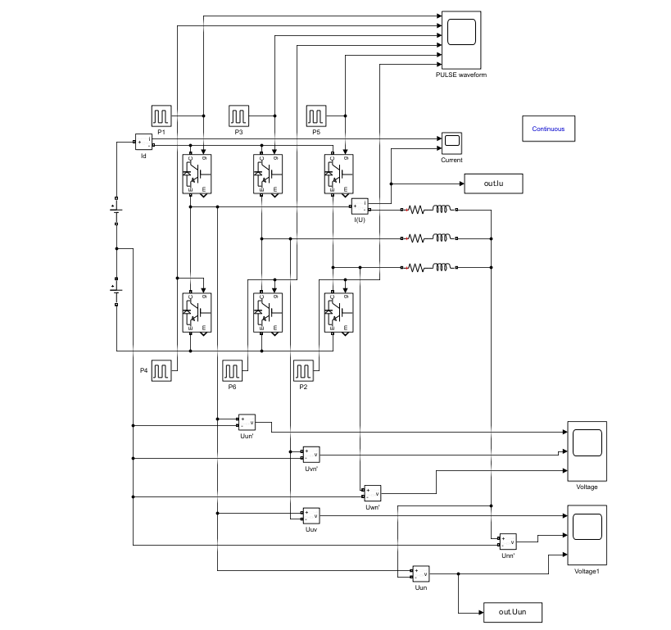
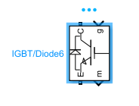
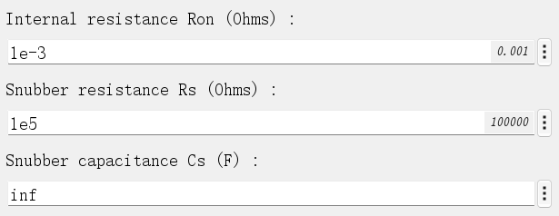
Three-Phase-Inverter
Parameters:
Udc=200V; f=50Hz;
R=10Ω,L=10mH

Slide 28
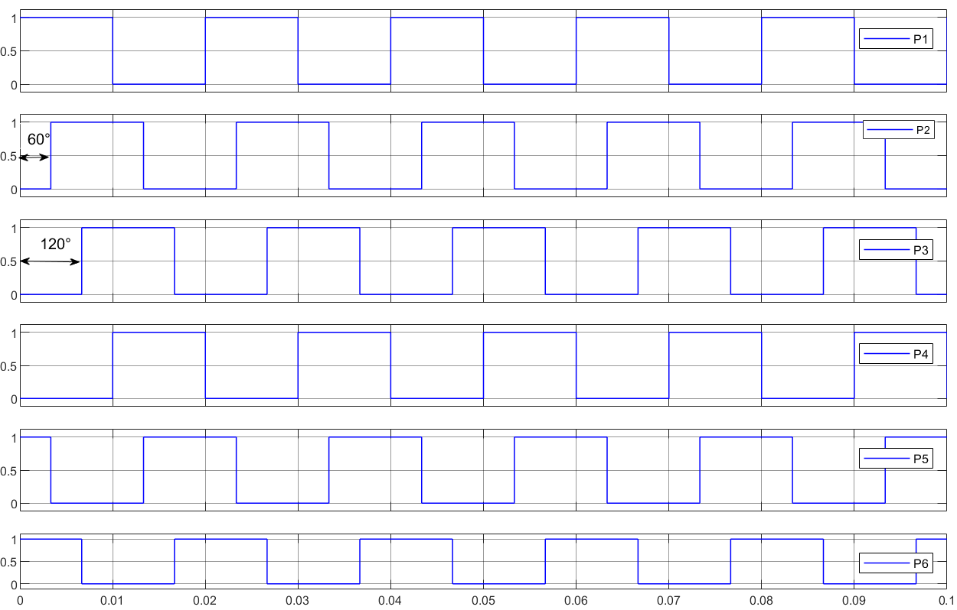
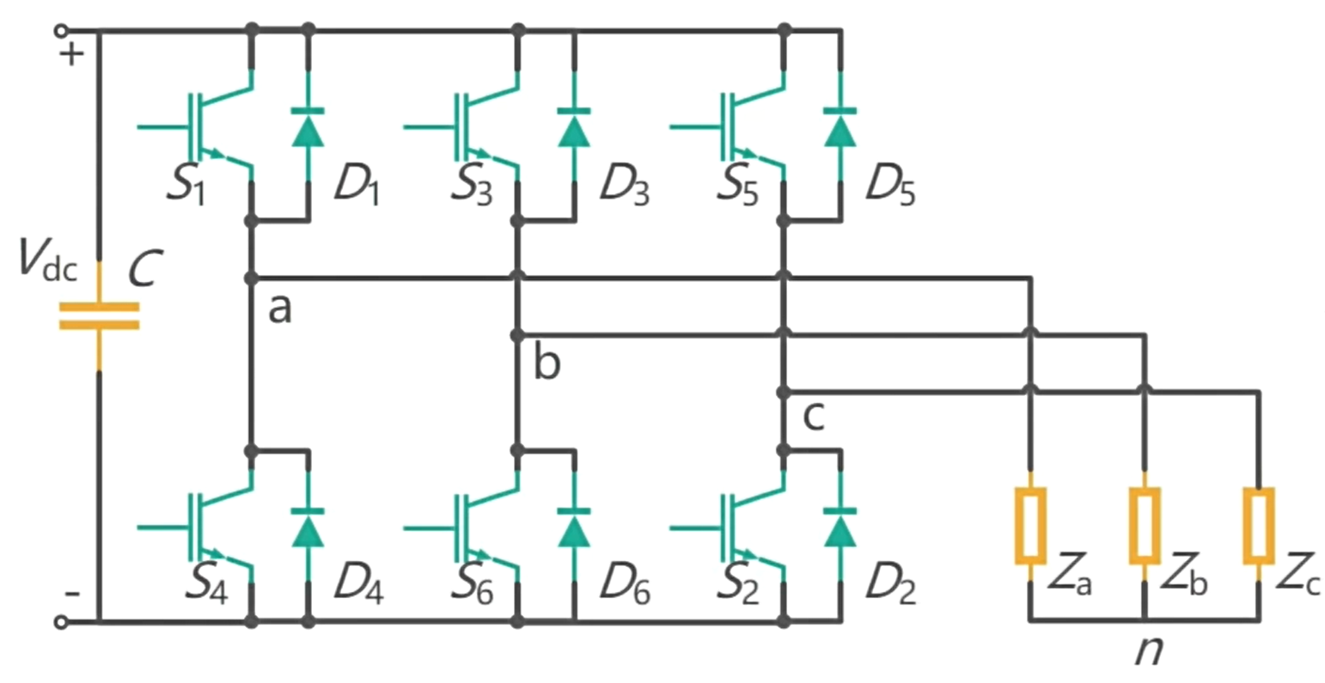
Three-Phase Inverter pulse signal
Conducting angle: 180 degrees
Duty cycle for pulse signal: 50%
 | B1 | B3 | B5 | B4 | B6 | B2
Conducting time | 0 | 0.0067s | 0.0133s | 0.01s | 0.0167s | 0.0033s
1. Upper and lower arms of the same phase conducting alternately.
2. Each phase differs by 120 degrees

Slide 29
Waveforms of
current and voltage
PART. 02

Slide 30
Waveform of U and I for IGBT/Diode(1 to 6)
If B1 is conductive:
1.U_{VT}=0
2. I_{VT} flow through the IGBT and the load
3.B4 is not conductive

Slide 31
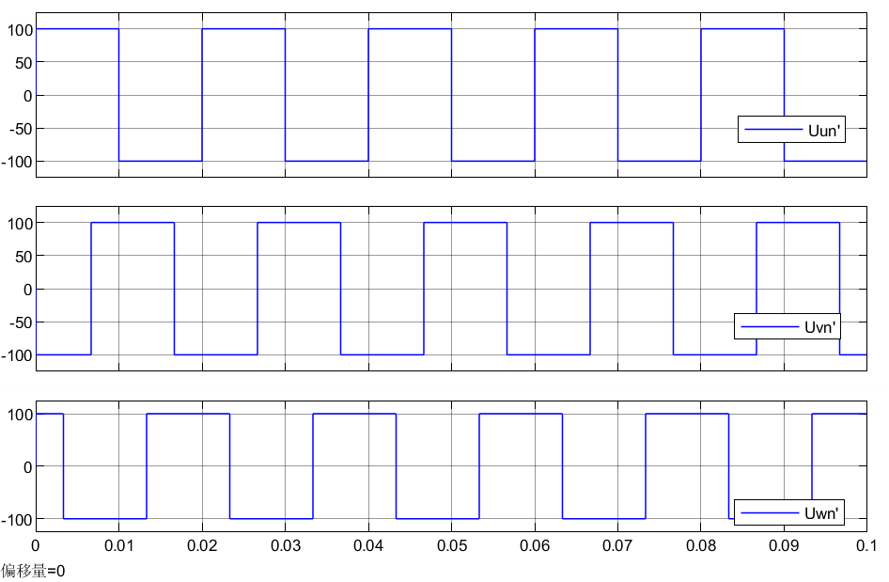
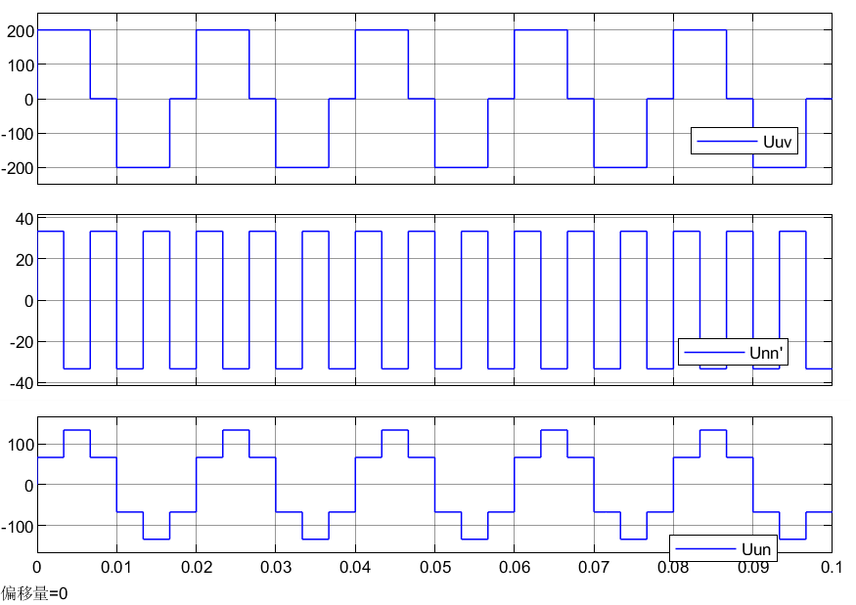
Waveform of voltage
Phase voltage
Upper and lower bridge arms of each phase conduct alternately
Square wave with an amplitude of 100V (Ud/2) and a phase difference of 120° between phases.

Slide 32
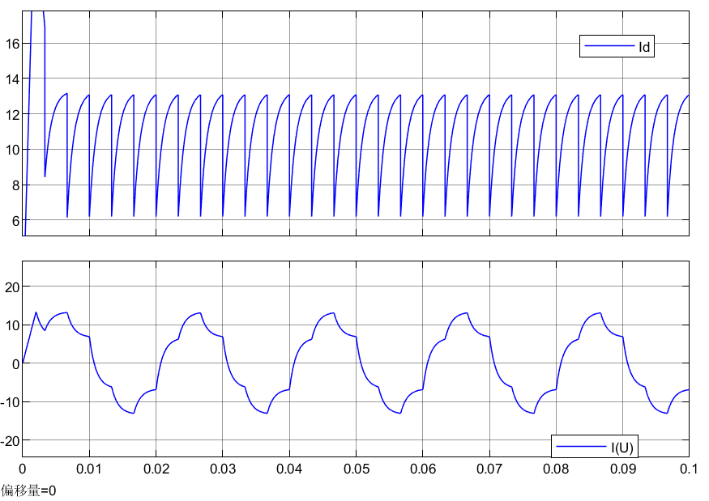
Waveform of current
Analysis:
𝜏= L/R = 0.001s
Smaller time constant (small inductor) :
1.Less time to reach its steady-state value
2.Steep waveform

Slide 33
PART. 03
Analysis of harmonics

Slide 34



Phase voltage
Phase voltage | Theoretical | Simulation | Error(%)
RMS value of fundamental wave/V | 90 | 90.01 | 0.02%
The percentage content of the 5th harmonic/% | 20 | 19.99 | 0.05%
The percentage content of the 7th harmonic/% | 14.28 | 14.27 | 0.07%
The percentage content of the11th harmonic/% | 9.09 | 9.08 | 0.11%
The percentage content of the 13th harmonic/% | 7.69 | 7.66 | 0.39%

Slide 35
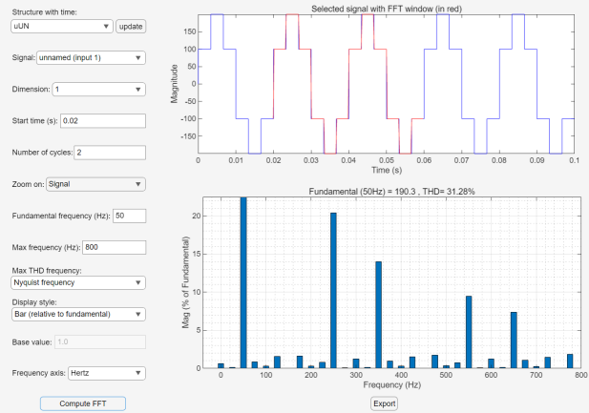
Phase voltage

Slide 36


Harmonics of Phase current
Phase current | Theoretical | Simulation | Error(%)
RMS value of fundamental wave/A | 8.586 | 8.591 | 0.05%
The percentage content of the 5th harmonic/% | 11.26 | 11.27 | 0.09%
The percentage content of the 7th harmonic/% | 6.20 | 6.21 | 0.16%
The percentage content of the 11th harmonic/% | 2.65 | 2.66 | 0.38%
The percentage content of the 13th harmonic/% | 1.92 | 1.93 | 0.52%

Slide 37
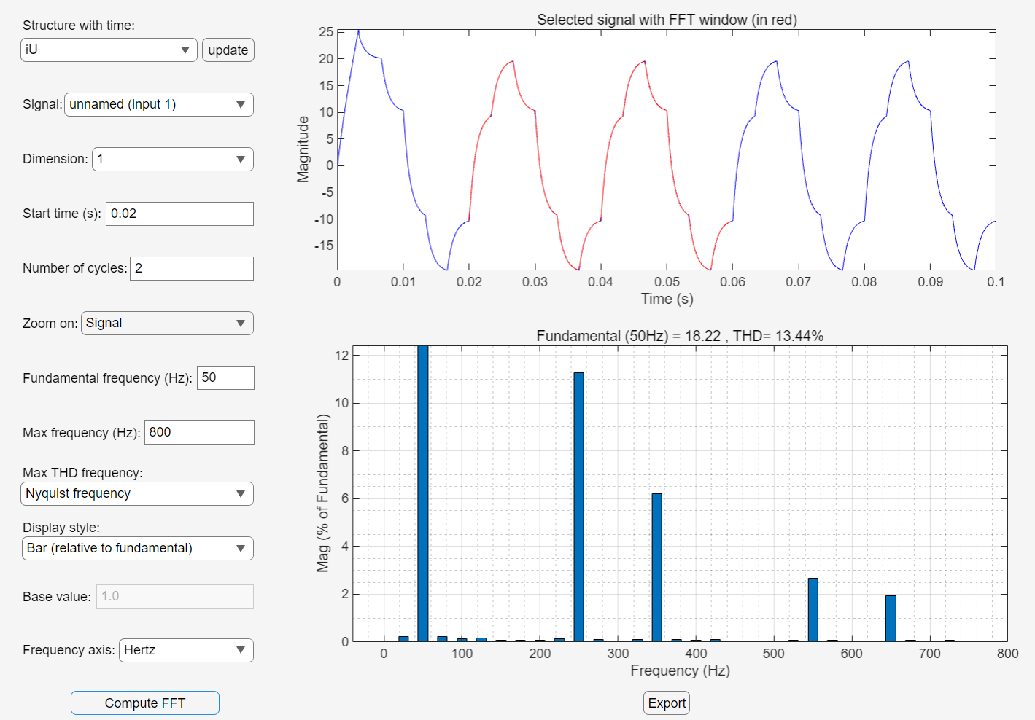
Phase current
Two cycles to analyse, and the starting time is 0.02s

Slide 38
Thanks！

