Slide 1

ML-Shared Bikes in London

Slide 2

Shared bikes
dataset
Target:
Based on the features of temperature, wind speed and whether it is a holiday, to predict the number of shared bikes borrowed in London.
Meaning:
Quantitative analysis of shared bicycle lending data can provide theoretical reference for shared bicycle companies to dispatch shared bicycles

Slide 3
Shared bikes
dataset
Features :
Feature name | meaning | type
timestamp | date | object
cnt | Number of borrowed bikes | Int /constant
T1/t2 | temperature | Float/constant
hum | humidity | Float/constant
Wind_speed | Wind speed | Float/constant
Weather_code | different weather | Int/classified
Is_holiday/is_weekend | Holiday/weekend or not | Boolean/classified
season | season | Int/classified

Slide 4

PART ONE
Data
Exploration

Slide 5
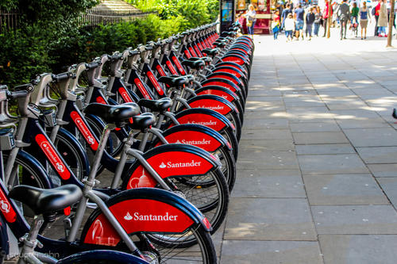
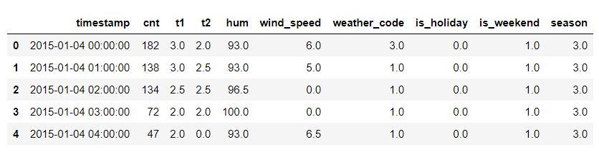
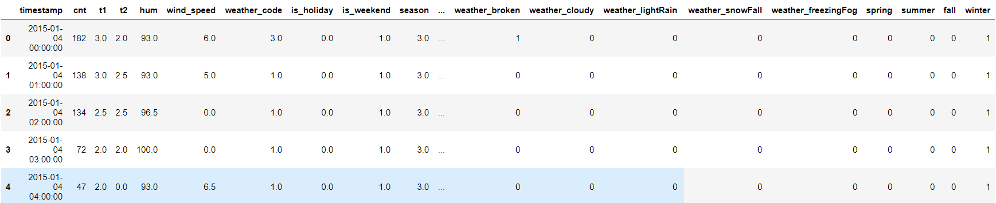
Hot Code
Source dataset
Dataset after hot cooding
Features of hot code: weather_code、season

Slide 6
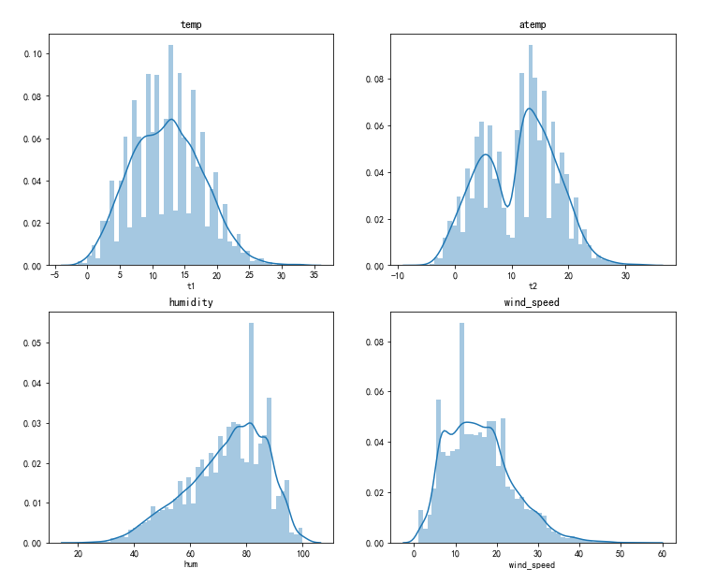
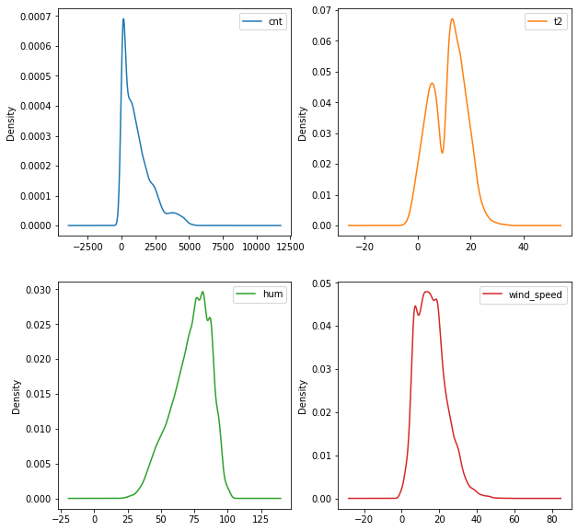
Visualization
Figure 1
Figure 2

Slide 7
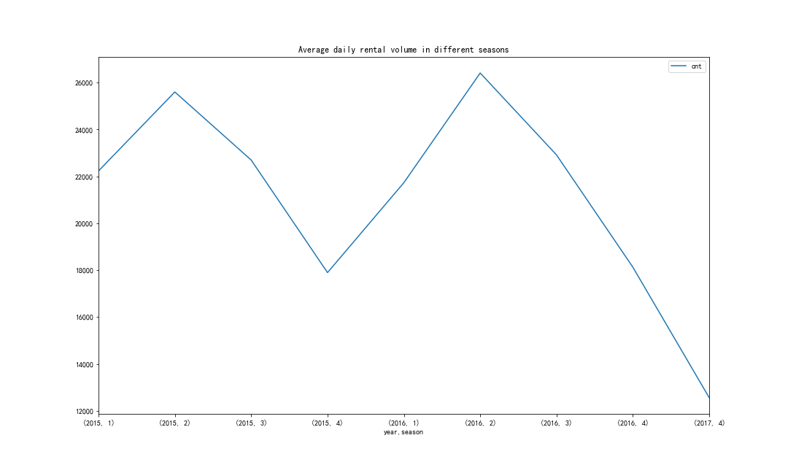
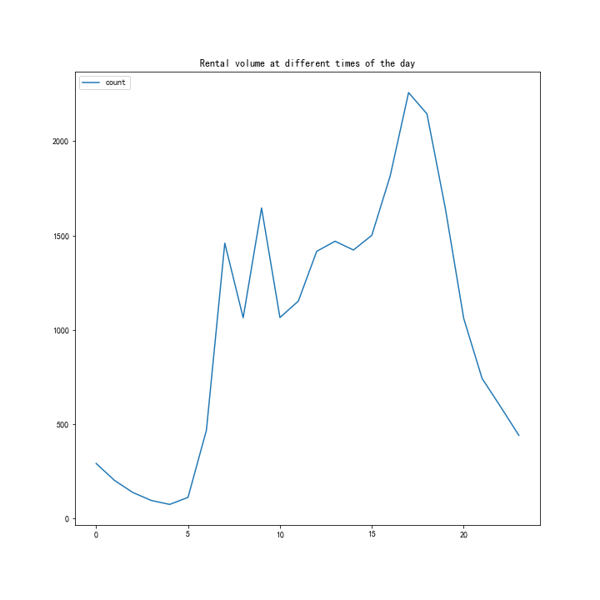
Visualization
Figure 3
Figure 4

Slide 8
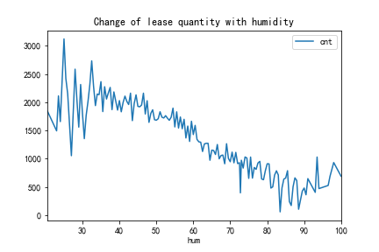
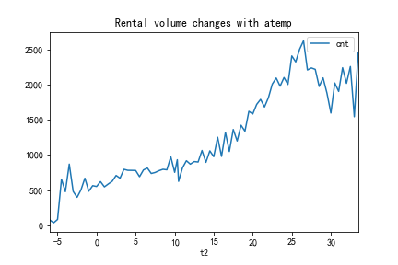
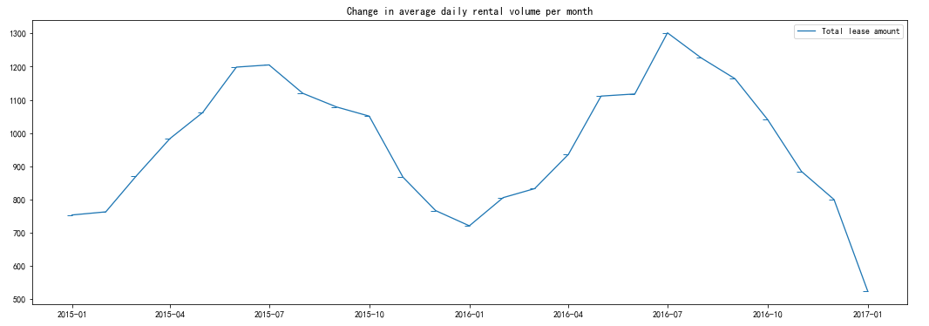
Visualization
Figure 5
Figure 6
Figure 7

Slide 9
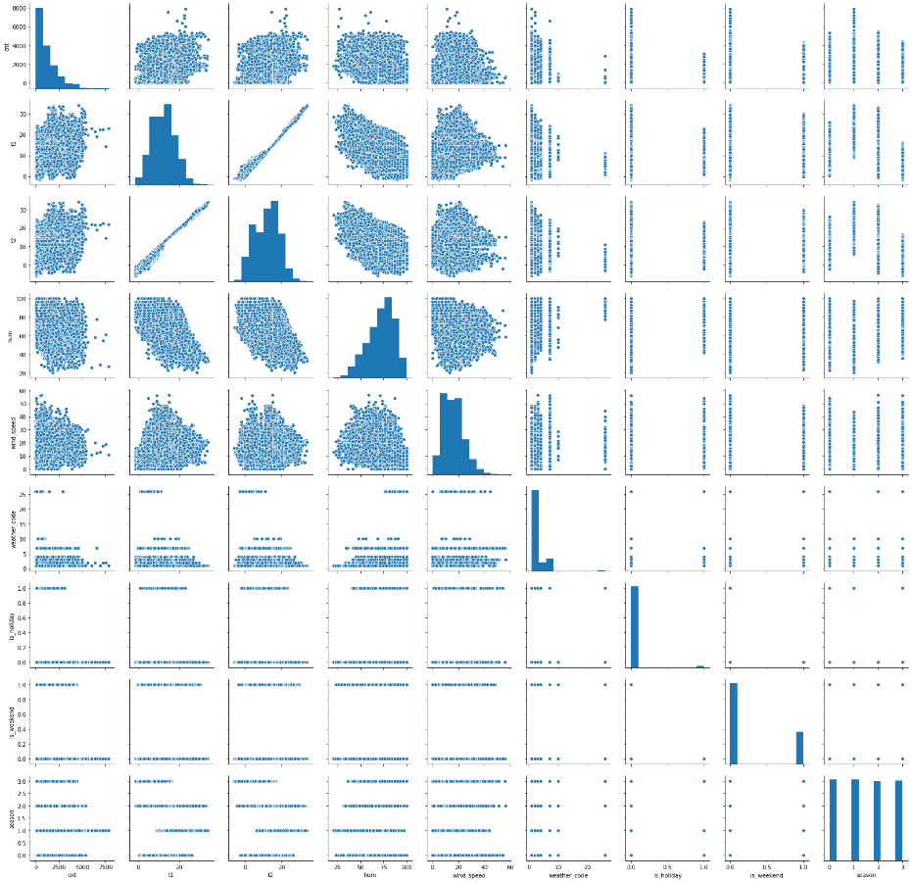
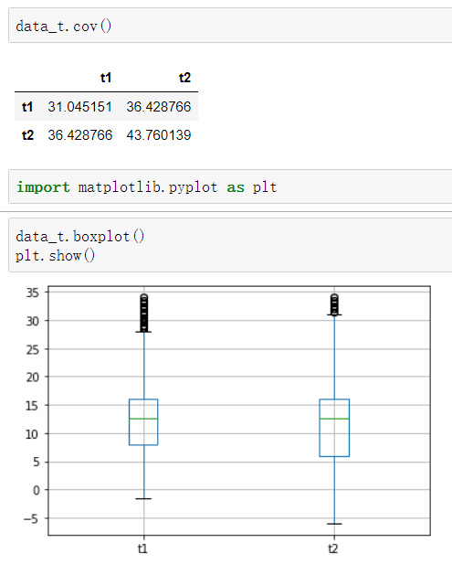
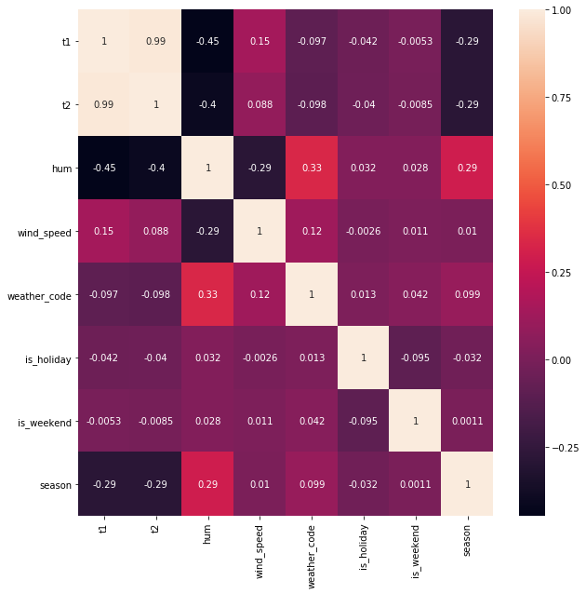
Figure 8
Figure 9
Figure 10
t1
t2
t1
t2
Redundancy
T1 is related to T2
Notes:
www.99ppt.com 专业的模板网站 为您提供更多优质模板

Slide 10
PART two
Models
Prediction

Slide 11
Models prediction
Random
Forest
Regression
Decision
Tree
KNN
Model 1
Model 2
Model 3
Model 4+
Compare other
models

Slide 12
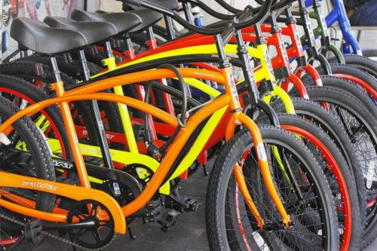
Decision Tree
Train of thought:
CNT is divided into four grades, and the classification standard is [min, Q1], [Q1, mean], [mean, Q3), [Q3, max). The rest continuous values are discretized according to 3siema principle
Building decision tree

Slide 13

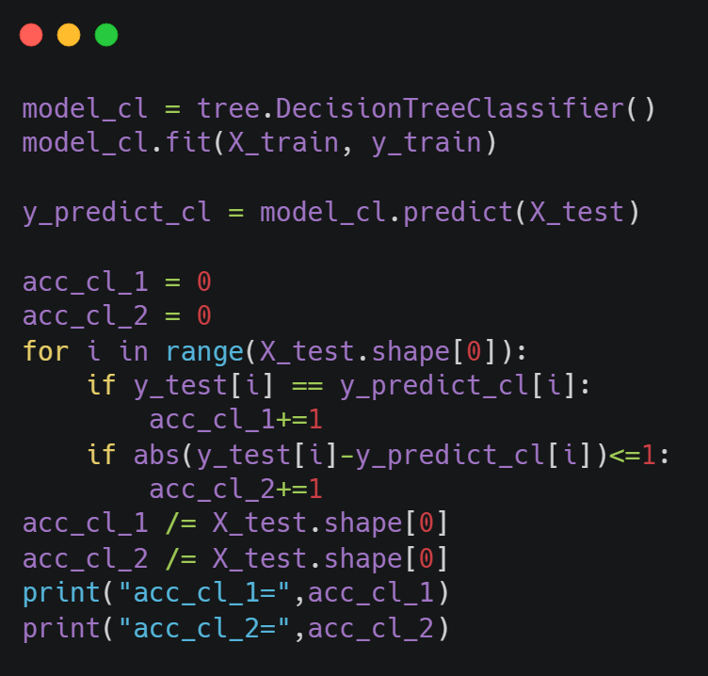
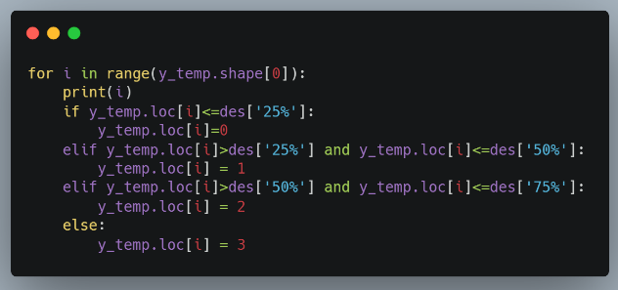
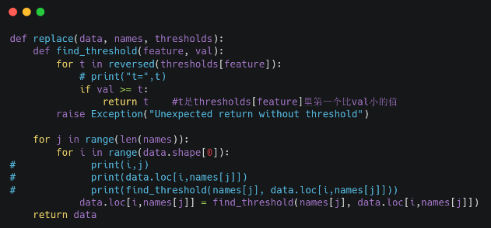
DecisionTreeClassifier
Model
Use DecisionTreeClassifier to train model
Classify the ‘cnt’ into 4 classes
Take T2, hum, wind "speed as the classified values

Slide 14
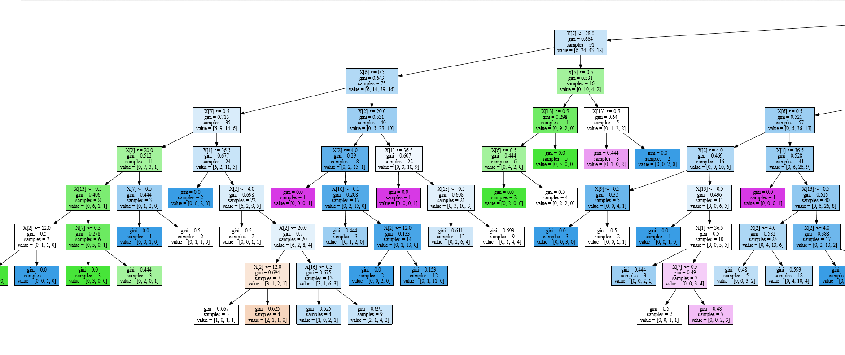
Part of decision tree model

Slide 15
Random Forest Regression

Slide 16
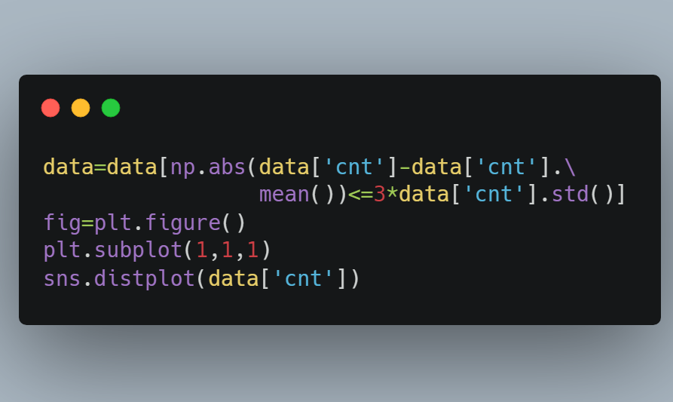
RandomForestRegressor

Slide 17
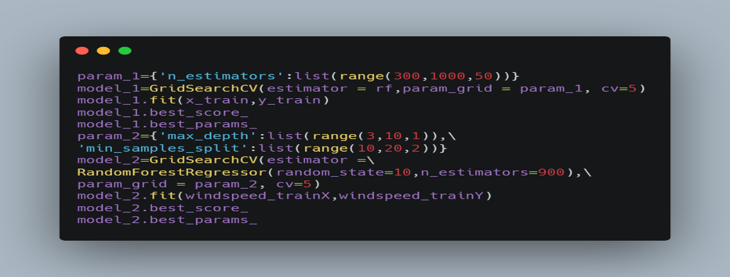
RandomForestRegressor

Slide 18
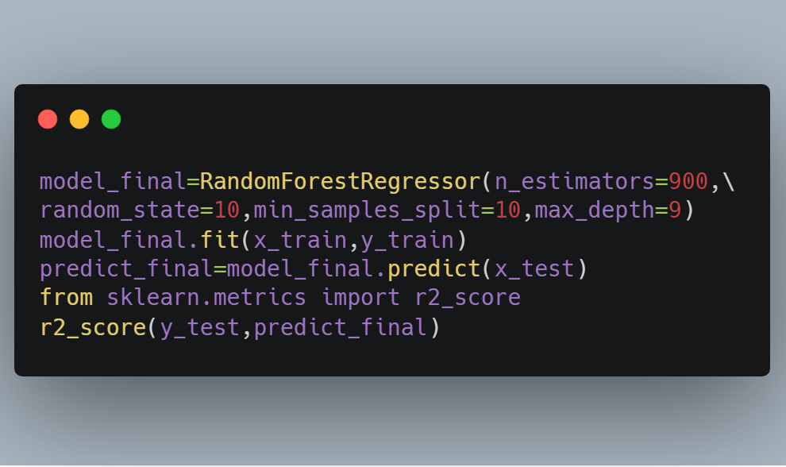
RandomForestRegressor

Slide 19
KNN

Slide 20
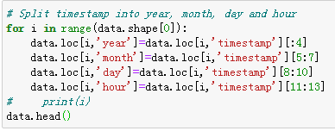
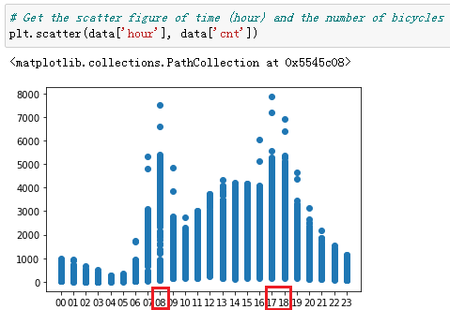
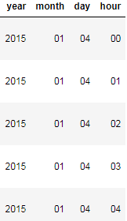
KNeighborsRegressor
Get more useful information

Slide 21

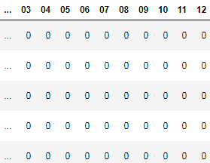
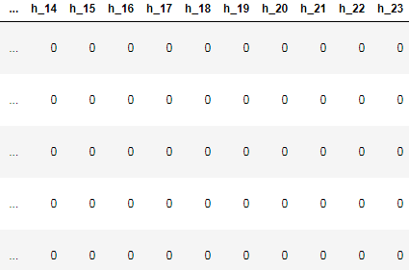
KNeighborsRegressor
Month can reflect the weather situation in more detail than season, so we can replace the season with month.

Slide 22

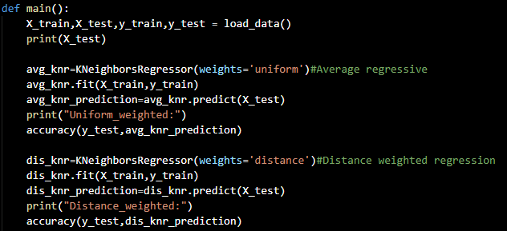
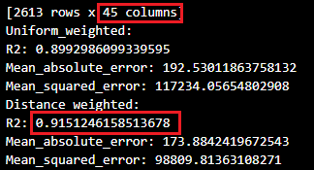
KNeighborsRegressor

Slide 23
Compare

Slide 24
KNeighborsRegressor
Models | R2_score
RandomForestRegressor | 0.78142
LinearRegression | 0.7085562212021134
Ridge | 0.7084899285504358
Lasso | 0.705065611096966
KNeighborsRegressor(weights='uniform') | 0.8992986099339595
KNeighborsRegressor(weights='distance') | 0.9151246158513678
Models | Accuracy
DecisionTreeClassifier-Four classification | 0.43346153846153845
DecisionTreeClassifier-Two classification | 0.7173076923076923

Slide 25
PART Three
Graphical
interface

Slide 26
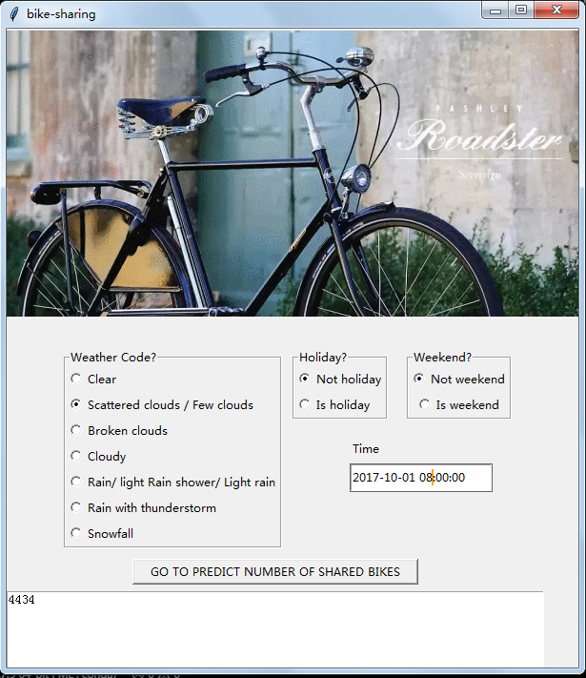
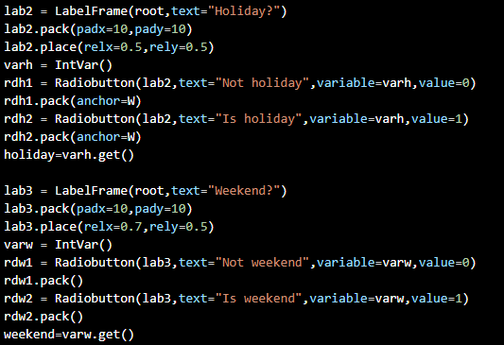
KNeighborsRegressor

Slide 27
Tkinter
Tkinter for Graphical interface
Introduce:
Use Tkinter of Python to generate visual GUI.
Features:
Simple and beautiful, easy to use.
Form:
input : time
output : number of bikes
select : features
Notes:
www.99ppt.com 专业的模板网站 为您提供更多优质模板

Slide 28
That’s all!
Thanks!

