Slide 1
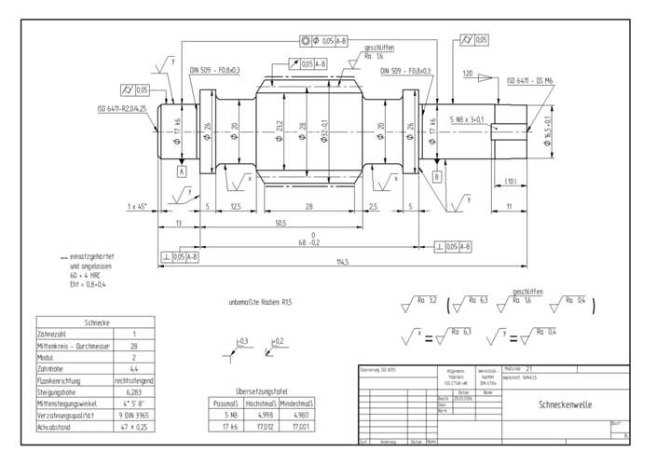
Unstructured File Format
Structured JSON
measures:[{
line: [[0.175, 0.355],[0.175,0.545]]
label: {
blurb: “17k6”,
size: {
size_type: “DIAMETER”,
nominal_size: 17 },
size_tolerance: {
toleration_type: “FIT_SIZE_ISO”,
blurb:”k6” }
}
… ]

Slide 2

PDF
TIFF
PNG
...

