Slide 1
M4ACADEMY
WORKFORCE TRAINING SERIES · FLAGSHIP COURSE 01
Reading Construction
Drawings & Specifications
From sheet navigation to CSI specifications — how to find, interpret,
cross-reference, and apply every piece of a construction document set.
Delivered in partnership with L.E.E.P., Inc. · 805 Harrison Street classroom + online modules
Notes:
Welcome. This course exists because most people in the field learned drawings by osmosis — nobody ever taught the system. Ten modules, 45–75 minutes each, ending with a capstone on a real drawing set. Emphasize: this is a hiring-pipeline course — Merge4Ward and regional employers interview completers.

Slide 2
COURSE OVERVIEW
Built for the people who build
01
02
03
New entrants
Working contractors
Field veterans
Students entering construction careers who need the document system from zero.
Subs and small GCs with strong hands but limited plan-reading exposure.
Experienced builders formalizing skills for estimating, QC, and inspections.
By the end, every participant can:
Navigate any sheet using title blocks, indexes, legends, and revision references
Follow callouts from plans to elevations, sections, and enlarged details
Trace one item across tags, schedules, details, and CSI spec sections
Recognize when a condition needs an RFI instead of an assumption
REFERENCE: reading_construction_drawings_and_specifications_training.docx · 97_REFERENCES/98_09_OSHA
Notes:
Three audiences, one system. The mix matters in the classroom: veterans anchor discussions with field stories; new entrants ask the questions veterans forgot they had. Learning outcomes map 1:1 to the course docx — these become the assessment rubric for funders.

Slide 3
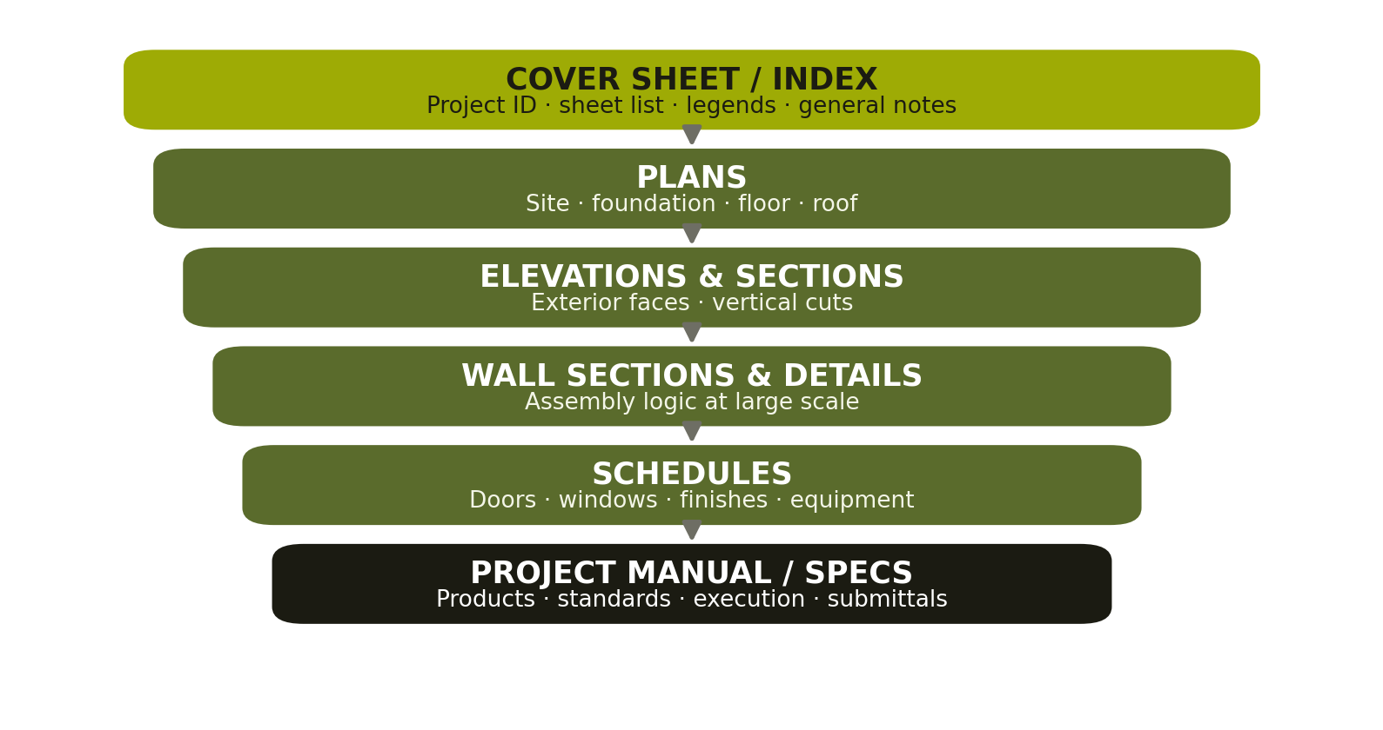
MODULE 1 · DOCUMENTS OVERVIEW
One project, one coordinated document set
Drawings show configuration — location, dimensions, relationships.
Specifications control quality — products, standards, execution, submittals.
Addenda and revisions change both — always confirm which issue governs.
REFERENCE: 8HR Blueprint Reading Principles – INST PPT.pdf · ArchitecturalDesign1.pdf
Notes:
The pyramid is the whole course in one image. Everything narrows from the cover sheet down to the spec book. Exercise: hand out a sheet index and ask 'where would you look for the fire rating of a corridor door?' — most say drawings; the answer is both.

Slide 4
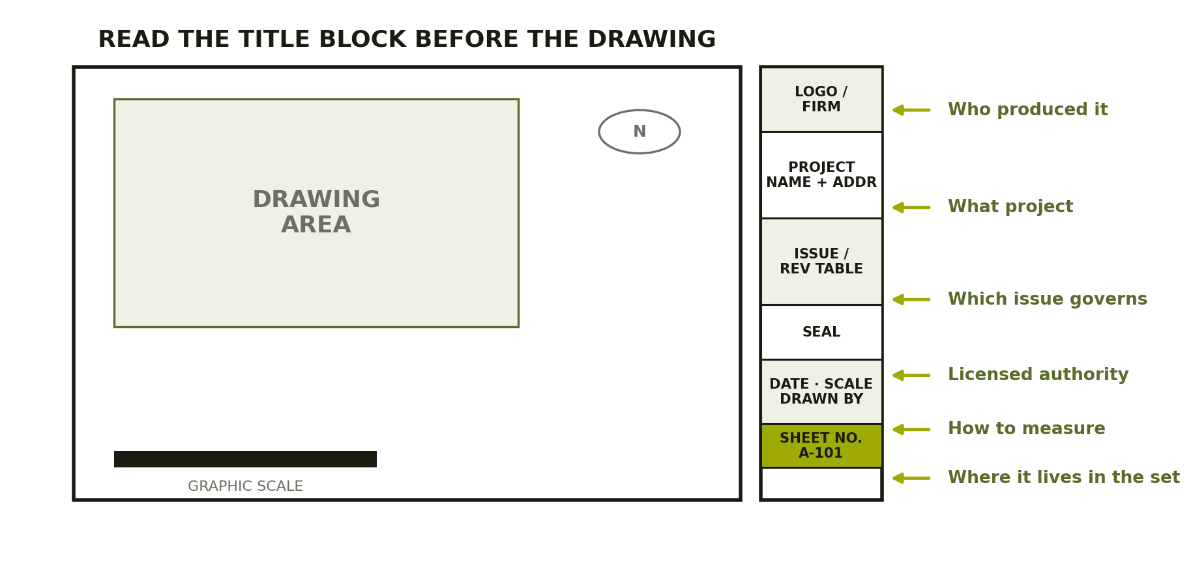
MODULE 2 · SHEET NAVIGATION
The title block is the sheet's ID card
Discipline prefixes
C civil · A architectural
S structural · M mechanical
P plumbing · E electrical
Never scale a drawing
Use written dimensions. Prints distort; dimensions don't.
REFERENCE: 8HR Blueprint Reading Principles – INST PPT.pdf · pair with a live sheet from GENERAL-SHALE details
Notes:
Drill: give every student a random sheet and 60 seconds to report sheet number, scale, latest revision date, and drawn-by. Repeat until it's automatic. The 'never scale' rule earns its red color — reproduce a sheet at 90% and watch a scaled measurement go wrong.

Slide 5
MODULE 3 · SYMBOLS & NOTES
Legends translate the graphics
1
Symbol legends
Every symbol on a plan has a legend entry — read the legend page first, not last.
2
Abbreviations & keynotes
Keynote tags declutter drawings but force you back to the note block. Practice the round trip.
3
General notes
Apply across many sheets. The most expensive mistakes hide in notes nobody read.
4
Revision clouds & deltas
A cloud plus a delta number ties geometry to the revision table in the title block.
REFERENCE: Example legend/addendum sheets in course source table · 8HR Blueprint Reading Principles
Notes:
Anchor activity: symbol scavenger hunt on a real legend sheet. Teams race to match 10 plan symbols to legend entries. The 'general notes' row is where instructors should tell a real money-lost story — everyone has one.

Slide 6
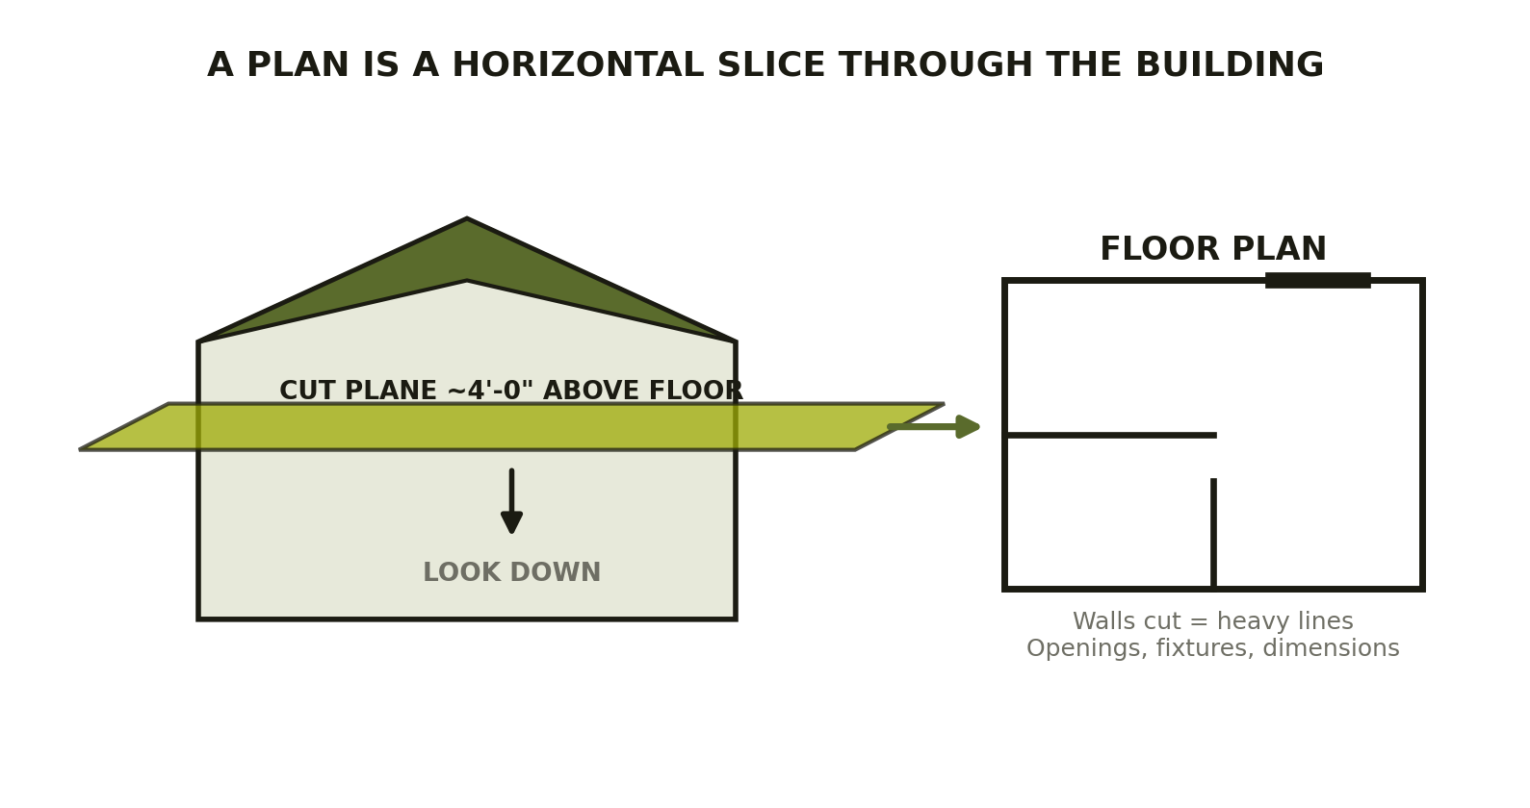
MODULE 4 · PLANS
A plan is a horizontal slice
Site · foundation · floor · roof — same logic, different level of the cut.
While reading plans, hunt for section cuts, detail callouts, and elevation markers — they are the doorways to the rest of the set.
REFERENCE: ArchitecturalDesign1.pdf · HUD_residential.pdf (plan chapters)
Notes:
The cut-plane mental model fixes 80% of beginner confusion — why door swings look the way they do, why upper cabinets are dashed, why stairs break mid-flight. Physically demonstrate with a shoebox model if teaching in person at Harrison Street.

Slide 7
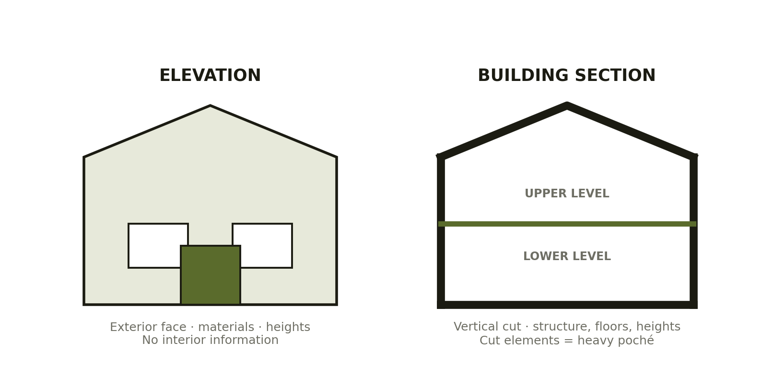
MODULE 5 · VERTICAL VIEWS
Elevations show faces. Sections show guts.
REFERENCE: ArchitecturalDesign1.pdf · APA_A535.pdf wall/roof assemblies
Notes:
Key distinction: an elevation is what you'd photograph from outside; a section is what you'd see if you sawed the building in half. Cut elements draw heavy (poché); elements beyond the cut draw light. Quiz with mixed views until students sort them instantly.

Slide 8
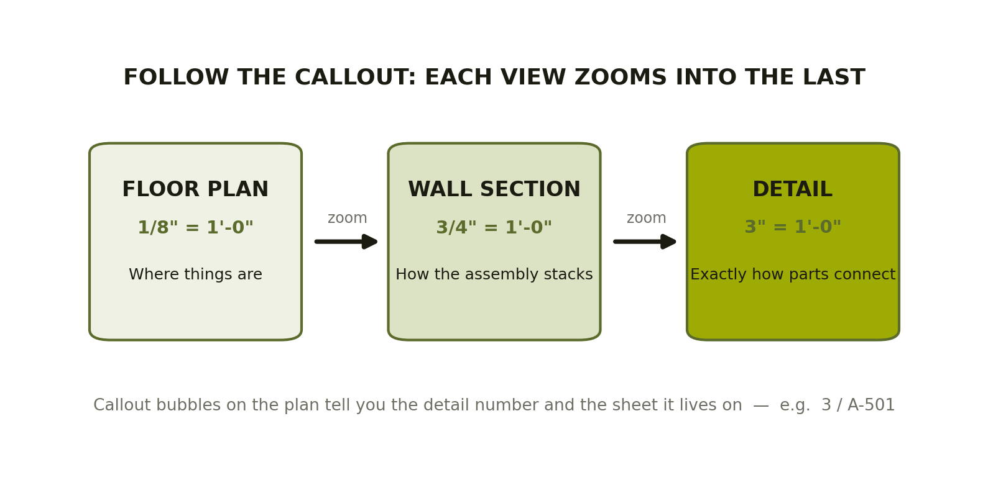
MODULE 5 · DETAILS
Follow the callout: zoom from plan to detail
REFERENCE: GENERAL-SHALE/GS-Thin-Brick-Installation-Guide.pdf · SIP_DETAILS · CLT_DETAILS folders
Notes:
This is where the REFERENCE library earns its keep: pull real details from the GENERAL-SHALE guide and the SIP/CLT detail folders and have students find the parent wall section for each. Callout literacy (detail 3 on sheet A-501 = '3/A-501') is the module's exit skill.

Slide 9
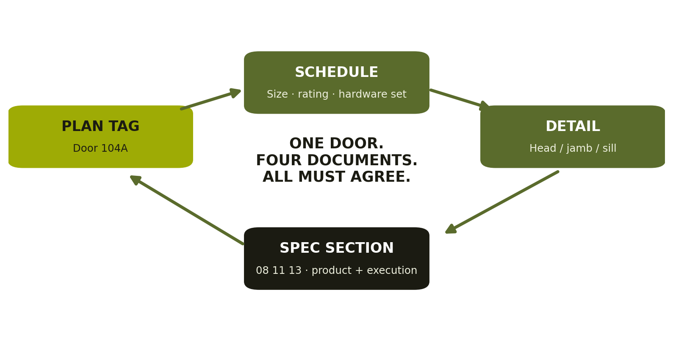
MODULE 6 · SCHEDULES & CROSS-REFERENCE
Trace one item through the whole set
The tracing drill
Pick one door. Find its plan tag, its schedule row, its head/jamb/sill details, and its spec section.
If any two disagree — that's not an error to ignore. That's an RFI.
REFERENCE: 8HR Blueprint Reading Principles · course docx Module 6 activities
Notes:
The four-node loop is the single most useful diagram in the course — it's how estimators, PMs, and inspectors actually think. Grade the drill: full credit only when the student cites sheet numbers for all four nodes.

Slide 10
MODULE 7 · COORDINATION
Consultant drawings must be read together
Openings & penetrations
Framing depths & clearances
Supports & attachment
Duct meets beam. Sleeve meets footing. Check S + M against A before cutting anything.
Equipment needs service space the architect drew as a closet. Verify early.
Who provides blocking? Whose detail governs? Silence between disciplines = your RFI.
Training rule: recognize when a condition requires clarification rather than assumption. Field improvisation on a coordination conflict is how rework — and litigation — is born.
REFERENCE: Course docx Module 7 · CSI Practice Guide excerpt (coordination drawings)
Notes:
War-story slide. Every instructor should bring one real clash: the duct that met the beam, the panel that blocked the door. The takeaway is professional judgment — knowing when to stop and ask is a skill employers pay for.

Slide 11
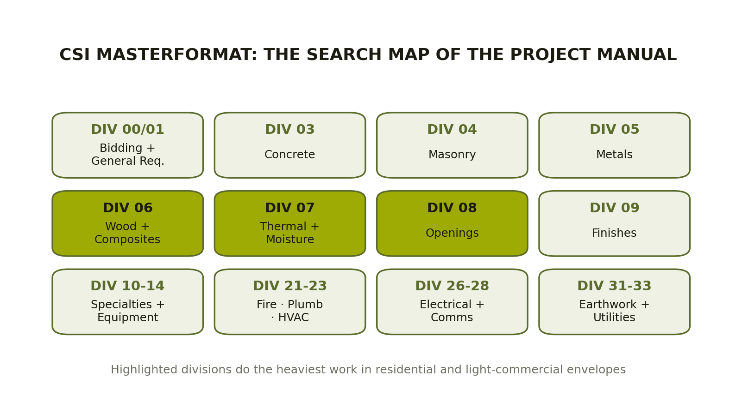
MODULE 8 · SPECIFICATIONS
MasterFormat is your search map
REFERENCE: MasterFormat 2018 divisions PDF · ARCAT CSI spec library (live examples by division)
Notes:
Don't memorize all 50 divisions — memorize the map's logic. Site work lives in the 30s, MEP in the 20s, envelope in 06–08. Timed drill: 'ceramic tile?' → Division 09. 'Anchor bolts?' → 05 or 03 depending. Wrong-but-reasoned answers are teaching gold.

Slide 12
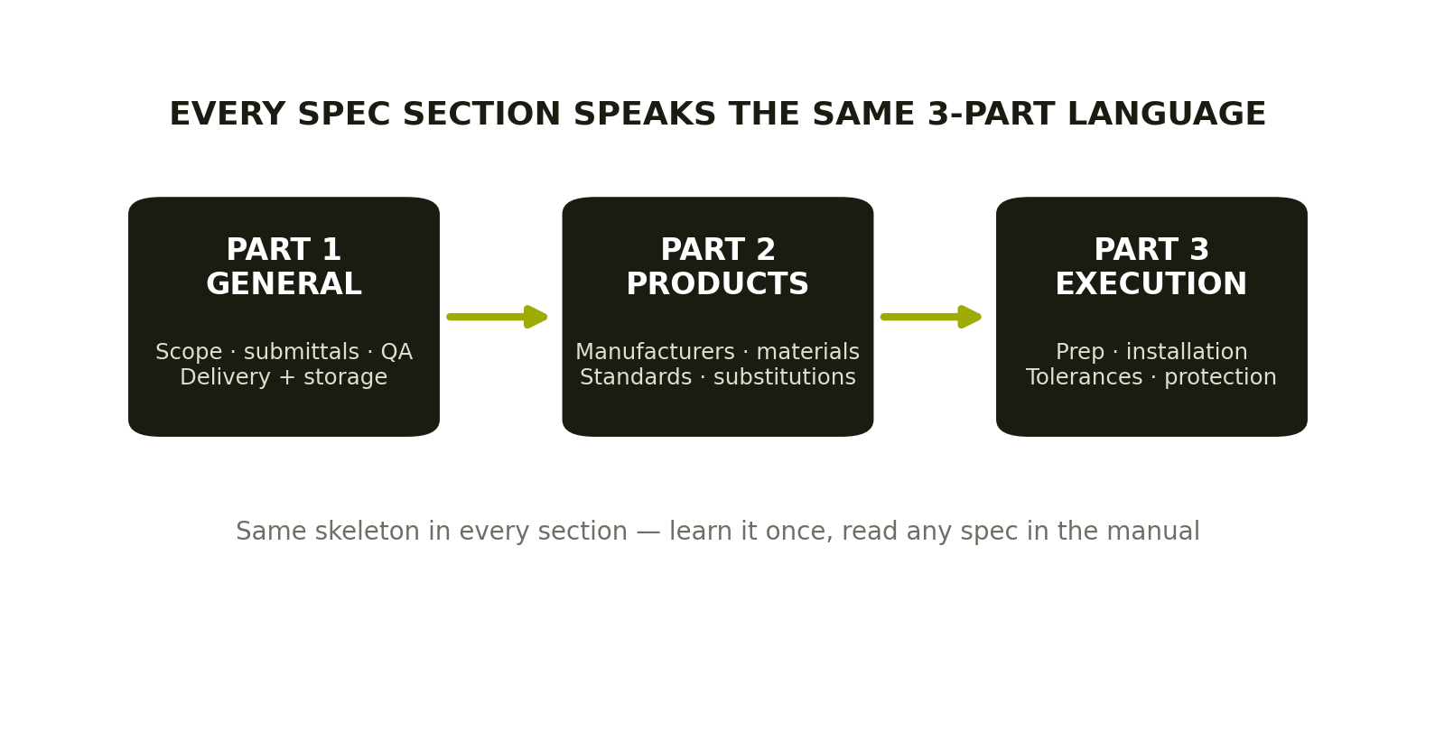
MODULE 8 · SPEC ANATOMY
Every section: General, Products, Execution
REFERENCE: ARCAT CSI specification examples · CSI Practice Guide excerpt
Notes:
Read one short spec section (thin brick — use the General Shale guide's companion spec) live in class, part by part. Part 1 tells you what paperwork you owe. Part 2 tells you what you may buy. Part 3 tells you how it must go in. Drawings almost never carry that last third.

Slide 13
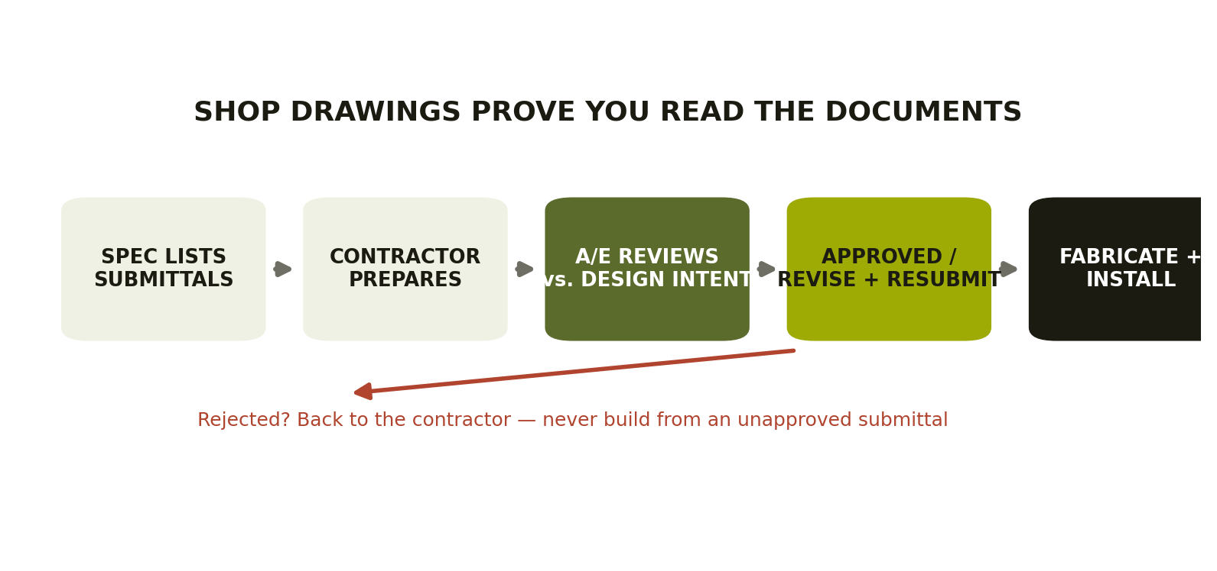
MODULE 9 · SUBMITTALS
Shop drawings prove you read the documents
REFERENCE: CSI Practice Guide excerpt · course docx Module 9
Notes:
Clarify roles hard here: shop drawings are contractor/supplier documents — they never replace design drawings. Approval means 'consistent with design intent,' not 'the architect now owns your dimensions.' Exercise: compare a window product data sheet against a spec section and find the two mismatches (planted).

Slide 14
MODULE 10 · FIELD APPLICATION
Red flags, RFIs, and the capstone
Call an RFI when you see:
CAPSTONE
Dimensions that don't close across a string
Detail referenced but missing from the set
Spec and drawing calling for different products
Existing conditions that contradict the drawings
Scope shown on one discipline's sheets only
A small real drawing package + spec excerpts. Answer practical field questions under time: locate, cross-reference, and flag what's missing.
Pass standard: information found quickly, accurately, and cited by sheet — pages never read in isolation.
REFERENCE: Capstone set candidates: GENERAL-SHALE guide + SIP_DETAILS sheets + ARCAT spec excerpts
Notes:
The capstone is the credential moment — scores here feed the completion certificate and the employer interview pipeline. Keep the question bank rotating; publish only the rubric.

Slide 15
Read the whole set.
Build with confidence.
10 modules · 45–75 min each · marked-up sheet exercises · printed checklists · timed capstone
Completion feeds the M4Academy employer interview pipeline.
M4ACADEMY · A MERGE 4 DESIGN INITIATIVE · IN PARTNERSHIP WITH L.E.E.P., INC.
Notes:
Close by connecting back to jobs: estimators, field engineers, QC leads, and inspectors all live in these documents daily. Next course in the series: Building Construction Sequence & Inspection Readiness.

