Slide 1
M4ACADEMY
WORKFORCE TRAINING SERIES · FLAGSHIP COURSE 02
Building Construction Sequence
& Inspection Readiness
From site readiness to certificate of occupancy — why the work happens in
this order, where the inspection gates sit, and how to pass them the first time.
Delivered in partnership with L.E.E.P., Inc. · 14 printable field checklists included
Notes:
Companion to Course 01. Course 01 teaches the documents; this course teaches the order of the work and the inspection logic behind it. Every module pairs with a printable checklist from the course package — students leave with the same sheets they'll use on real jobs.

Slide 2
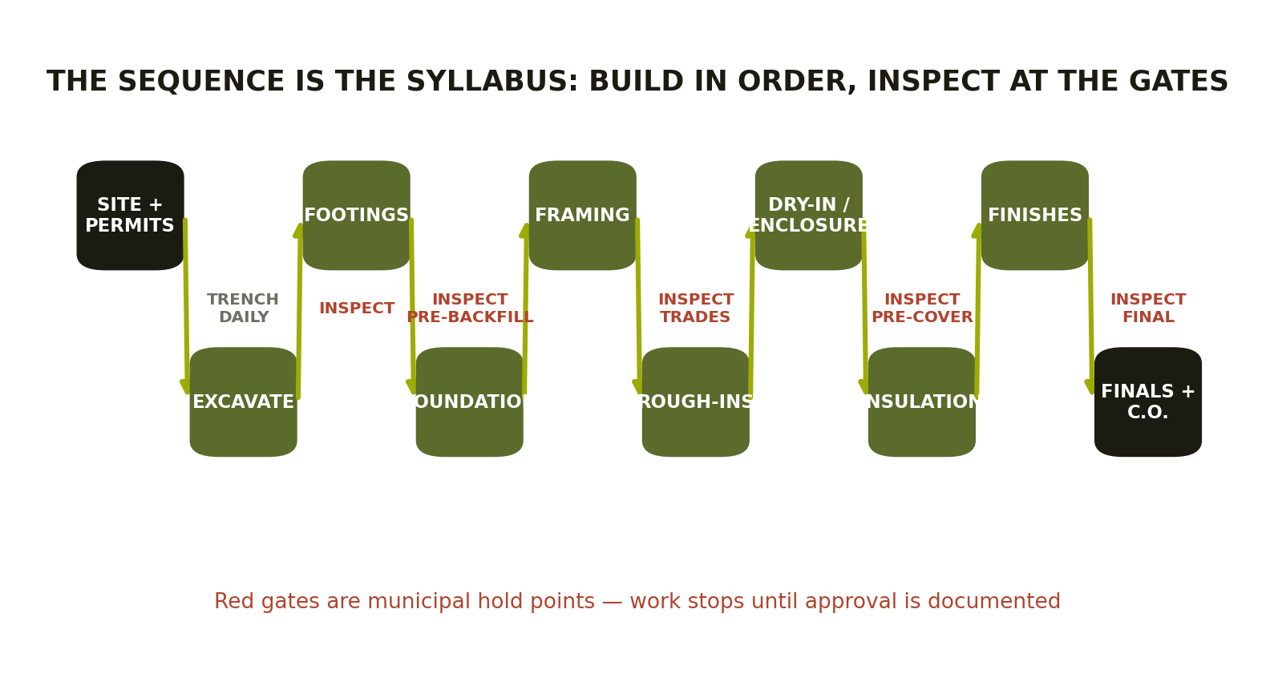
THE BIG PICTURE
The sequence is the syllabus
REFERENCE: constructionSteps.docx · Building Department – Required Inspections.pdf · ConstructionTradesFoundation.pdf
Notes:
Ten phases, four hard gates. The zigzag reads left to right; red labels mark municipal hold points. Everything in the next 50 minutes hangs on this one image — return to it at the start of every module.

Slide 3
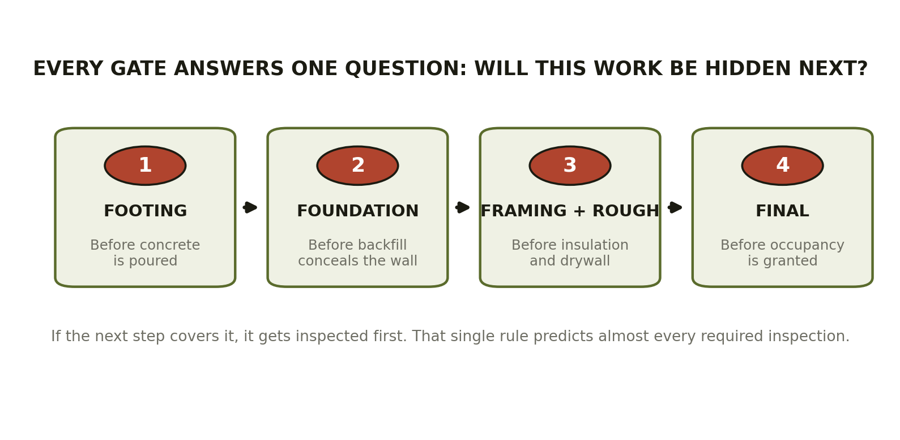
INSPECTION LOGIC
One question predicts every inspection
REFERENCE: Building Department – Required Inspections.pdf (footing → foundation → framing/rough → final)
Notes:
The unifying rule: if the next step conceals the work, it gets inspected first. Concrete hides rebar. Backfill hides waterproofing. Drywall hides everything. Students who internalize this stop memorizing inspection lists and start predicting them — including in unfamiliar jurisdictions.

Slide 4
PHASE 1 · PRE-CONSTRUCTION
Nothing moves before the paper is right
✓
Approved plans on site
✓
Utilities located
The permit set — not the bid set — is the only set that exists now.
Call before you dig. Every time. No exceptions.
✓
Permit active & posted
✓
Erosion controls installed
Verify scope matches what you're about to build.
Silt fence and inlet protection go in before disturbance, not after the complaint.
✓
Setbacks & layout staked
✓
Staging & spoil plan
Property lines confirmed before the first bucket of soil moves.
Where deliveries land and dirt piles live shapes the whole site's safety.
REFERENCE: building_construction_phase_checklists.docx §1 · Utah-Public-Works_Standards (layout & controls)
Notes:
Checklist 1 of 14. Emphasize that pre-construction failures are the cheapest to fix and the most embarrassing to explain — a building set on the wrong side of a setback line is a legal problem, not a construction problem.

Slide 5
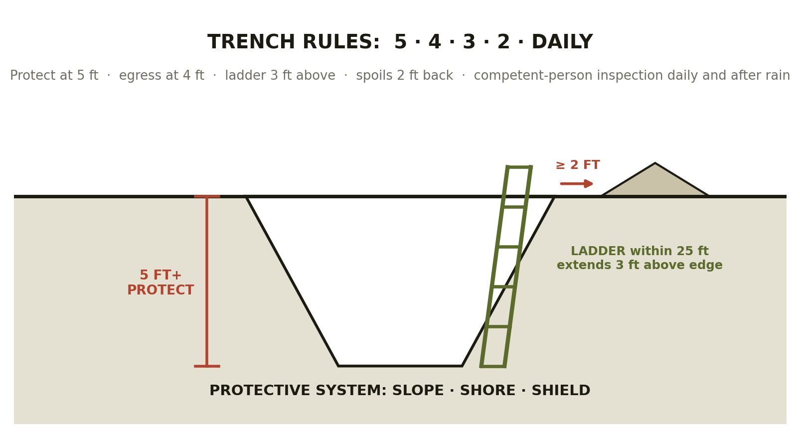
PHASE 2 · EXCAVATION
Trench rules: 5 · 4 · 3 · 2 · daily
The competent person
Named, trained, and on site before anyone enters. Inspects daily and after rain, vibration, or water intrusion — trench hazards change during the shift.
Trench collapses are measured in seconds and tons.
REFERENCE: OSHA 2202 · OSHA 3150 (excavations) · checklists docx §2 (daily trench sheet)
Notes:
This is the life-safety module — teach it with weight. OSHA 2202 and 3150 in the REFERENCE folder are the primary sources. The daily trench checklist is the one sheet in the package designed to be used every single morning, not once per phase.

Slide 6
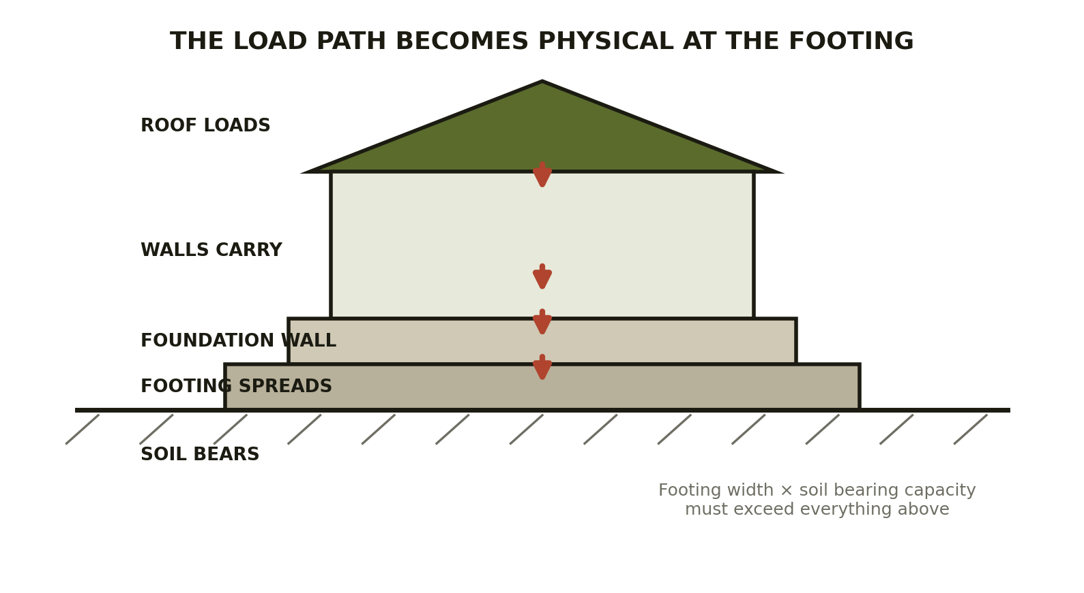
PHASE 3 · FOOTINGS
The load path becomes physical
Gate 1 readiness
Trench to line and grade · bearing surface clean and dry · forms set · rebar placed and visible · grounding electrode in
Concrete waits for the approval — not the other way around.
REFERENCE: HUD_residential.pdf (foundations) · checklists docx §3 · Building Dept inspections PDF
Notes:
Connect the physics to the inspection: the inspector isn't checking bureaucracy, they're checking the one surface that carries the whole building. Once concrete is placed, verification is impossible — which is exactly why the gate exists here.

Slide 7
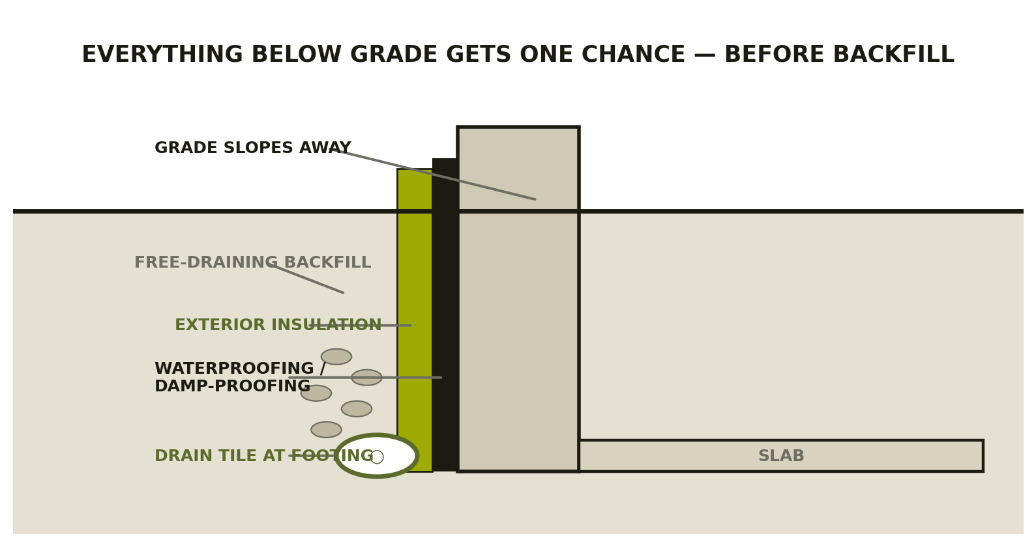
PHASE 4 · FOUNDATION
One chance to get below-grade right
Before backfill:
Waterproofing complete · drain tile at footing · under-slab plumbing in and visible · foundation insulation placed · engineer letter secured where required
REFERENCE: HUD_walls.pdf · LITEFORM-ICF + HYDROPAK product folders · checklists docx §4
Notes:
Gate 2. Everything on this wall section disappears under soil within days. Tie to products students will actually see: the ICF and drainage-board literature in 98_2.0_PRODUCTS gives real manufacturer installation requirements to compare against the generic diagram.

Slide 8
PHASE 5 · FRAMING
Precision early prevents compounded error
Sills & anchors
Headers & beams
Shear & nailing
Set to layout — every wall above inherits this line.
Sizes and bearing match the structural sheets, not habit.
Panel edges, patterns, and hold-downs per schedule.
Openings
Protection plates
Stairs & transitions
Rough openings framed to the window/door schedule.
Where pipe or wire runs close to the face of framing.
Openings guarded; rises and runs consistent.
REFERENCE: APA_A535.pdf · APA-Roofs.pdf · WEYERHAEUSER + BOISE-CASCADE + SIMPSON product folders · checklists §5
Notes:
Framing is where the manufacturer literature in the REFERENCE folder does the heaviest lifting — APA panel guides, Simpson connector catalogs, engineered-lumber span guides. A quarter-inch error at the sill is a one-inch error at the ridge.

Slide 9
PHASE 6 · TRADE ROUGH-INS
Trades fit the structure without wounding it
PLUMBING
ELECTRICAL
MECH / GAS
DWV routed & supported · top-out complete · water test holding · penetrations protected
Boxes & conductors set · grounding installed · service path ready · nail plates on
Ducts routed · vents in · condensate drains run · gas test complete
Sequence rule: every rough trade passes its inspection BEFORE the framing inspection is called. Drilling and notching limits protect the structure the trades pass through.
REFERENCE: checklists docx §6–§9 · Building Dept inspections PDF (rough trade prerequisites)
Notes:
Gate 3 is really a cluster: rough plumbing, electrical, mechanical, gas — then framing. Teach the dependency, not just the list. A framing call with an unapproved rough trade is a failed inspection and a lost day, every time.

Slide 10
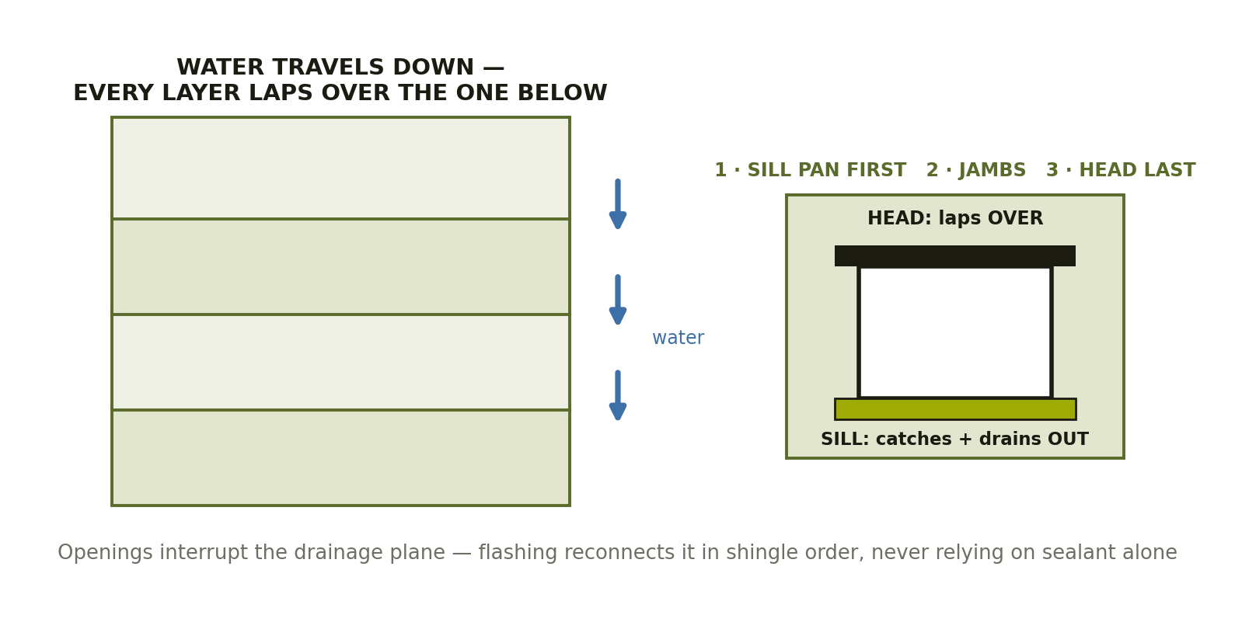
PHASE 7 · DRY-IN
Layered water-shedding, not a single barrier
Shingle logic
Upper laps over lower — everywhere, always. At roof-to-wall intersections, overlap is the rule.
Sealant is a helper, never the strategy.
REFERENCE: BARRICADE + HUBER (WRB) · APA-Roofs.pdf · GS-Thin-Brick guide (cladding) · checklists §10
Notes:
Cladding is the outer skin, not the whole weather barrier — the drainage plane behind it does the real work. Hands-on lab candidate for Harrison Street: flash a mock window opening in teams, then flood-test it. Sill pan first, jambs, head last.

Slide 11
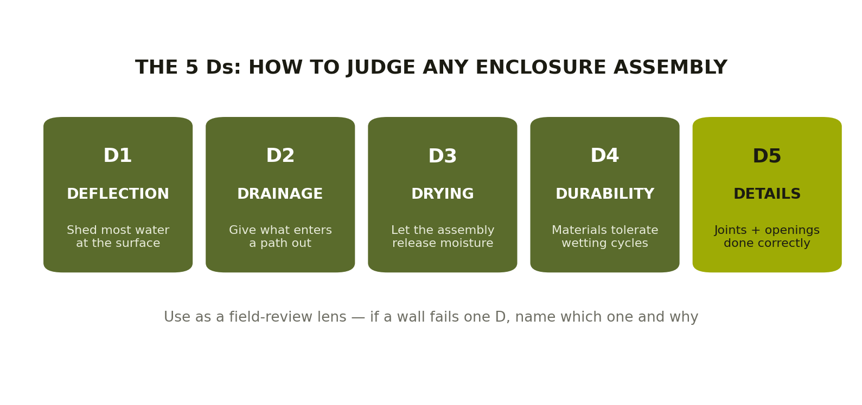
PHASE 7 · QUALITY LENS
Judge any assembly with the 5 Ds
REFERENCE: checklists docx §10 (enclosure field review) · ROCKWOOL + KEENE product folders (drainage/drying)
Notes:
The 5 Ds turn 'looks good to me' into a professional evaluation vocabulary. Field-review drill: photograph five wall conditions around Wilmington, have students name which D each one fails. Details is highlighted because it's where the other four go to die.

Slide 12
PHASE 8 · INSULATION
The last look before concealment
1
All prior roughs approved
No insulation call until plumbing, electrical, mechanical, and gas are signed off.
2
Thermal envelope complete
Full contact, no voids or compression — grade the install, not the bag label.
3
Air sealing & baffles
Continuity items done; ventilation channels open at eaves.
4
Certifications in hand
Insulation letter or shower-pan letter ready where accepted in lieu of inspection.
5
Nothing covered early
Drywall stays in the stack until the approval is documented.
REFERENCE: checklists docx §11 · ROCKWOOL product folder · Building Dept inspections PDF
Notes:
Gate 4 of the concealment gates. Insulation inspection is the cheapest inspection to pass and the most expensive to skip — tearing out finished drywall to fix a missed inspection is pure loss. Item 5 is red for a reason.

Slide 13
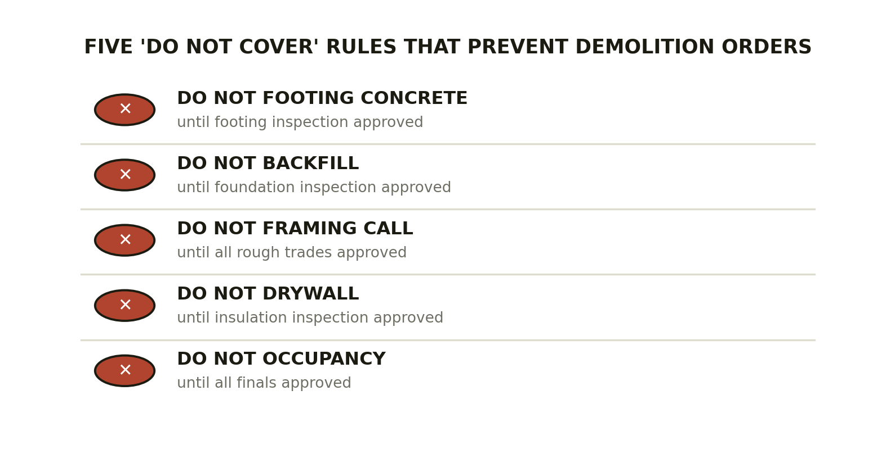
THE DISCIPLINE
Five rules that prevent demolition orders
REFERENCE: checklists docx §13 (field hold points) · Building Dept inspections PDF
Notes:
This slide is the wallet card of the whole course. Every one of these violations has forced someone, somewhere, to demolish finished work at their own cost. Rough approval is not final approval — the sixth rule hiding inside rule five.

Slide 14
PHASE 10 · FINALS & C.O.
Done means documented
FINAL SEQUENCE
THE 14-CHECKLIST SYSTEM
Final trade inspections approved — electrical, mechanical, plumbing, gas
Final building inspection scheduled after trade finals
Site & exterior conditions support approval
Certificate of Occupancy issued — then utilities transfer
Every phase in this course maps to a printable pre-inspection sheet — site readiness through final sign-off, plus the daily trench sheet and the master sign-off table.
Use them as QC before every inspection call: find your own corrections before the inspector finds them for you.
REFERENCE: building_construction_phase_checklists.docx §12–§14 (finals, hold points, sign-off sheet)
Notes:
The checklist package is the course's take-home product and its assessment tool: the capstone asks students to run a mock pre-inspection using the sheets on a staged set of conditions with planted defects. Local code always governs — the sheets ride alongside the approved permit set, never replace it.

Slide 15
Build in order.
Pass every gate the first time.
10 phases · 4 inspection gates · 14 printable field checklists · hands-on flashing lab
Completion feeds the M4Academy employer interview pipeline.
M4ACADEMY · A MERGE 4 DESIGN INITIATIVE · IN PARTNERSHIP WITH L.E.E.P., INC.
Notes:
Closing message: inspections aren't obstacles, they're the industry's built-in quality system — and knowing how to pass them first-time is a hireable skill. Pair this course with Course 01 for the full flagship sequence.

