Slide 1
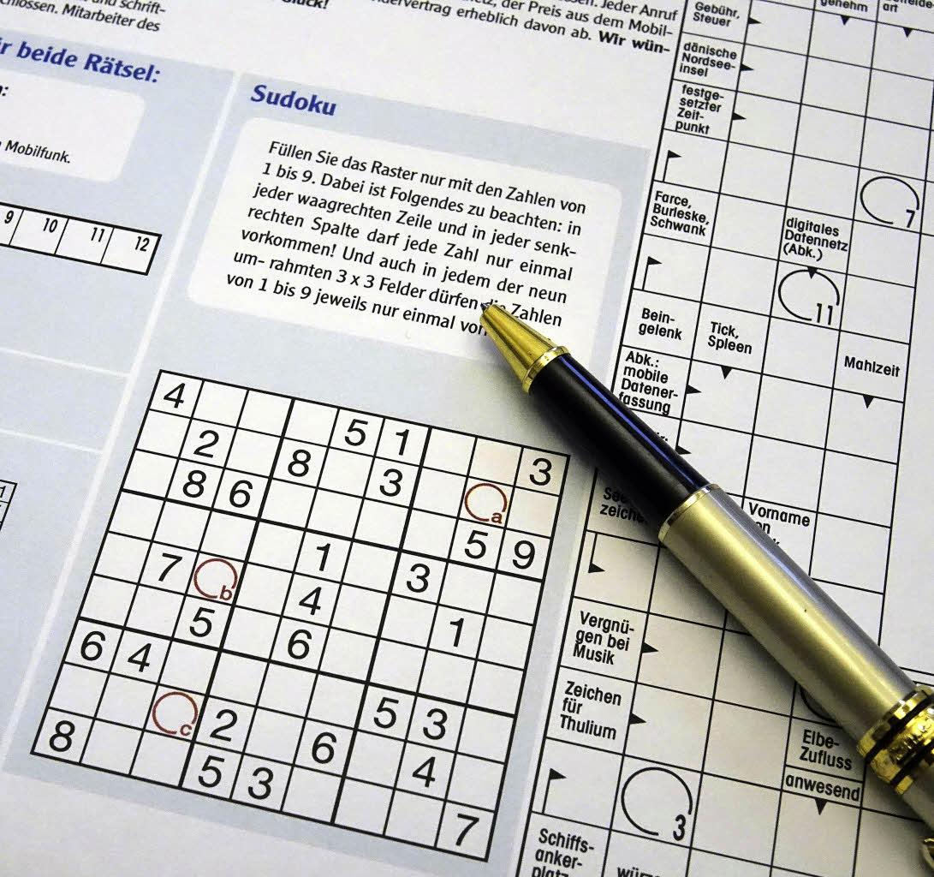
Notes:
«Typisches Alltagsproblem»

Slide 2
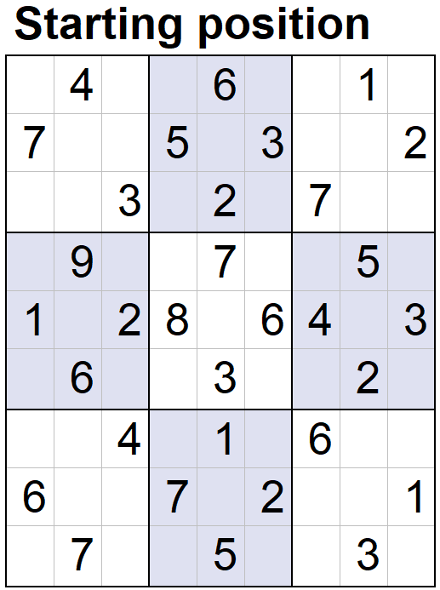
Notes:
•Two-dimensional array of integers (9x9)
•Regeln furs Spiel → Constraints
•1-9
•Different in rows
•Different in columns
•Different in box
•Solve solution

Slide 3
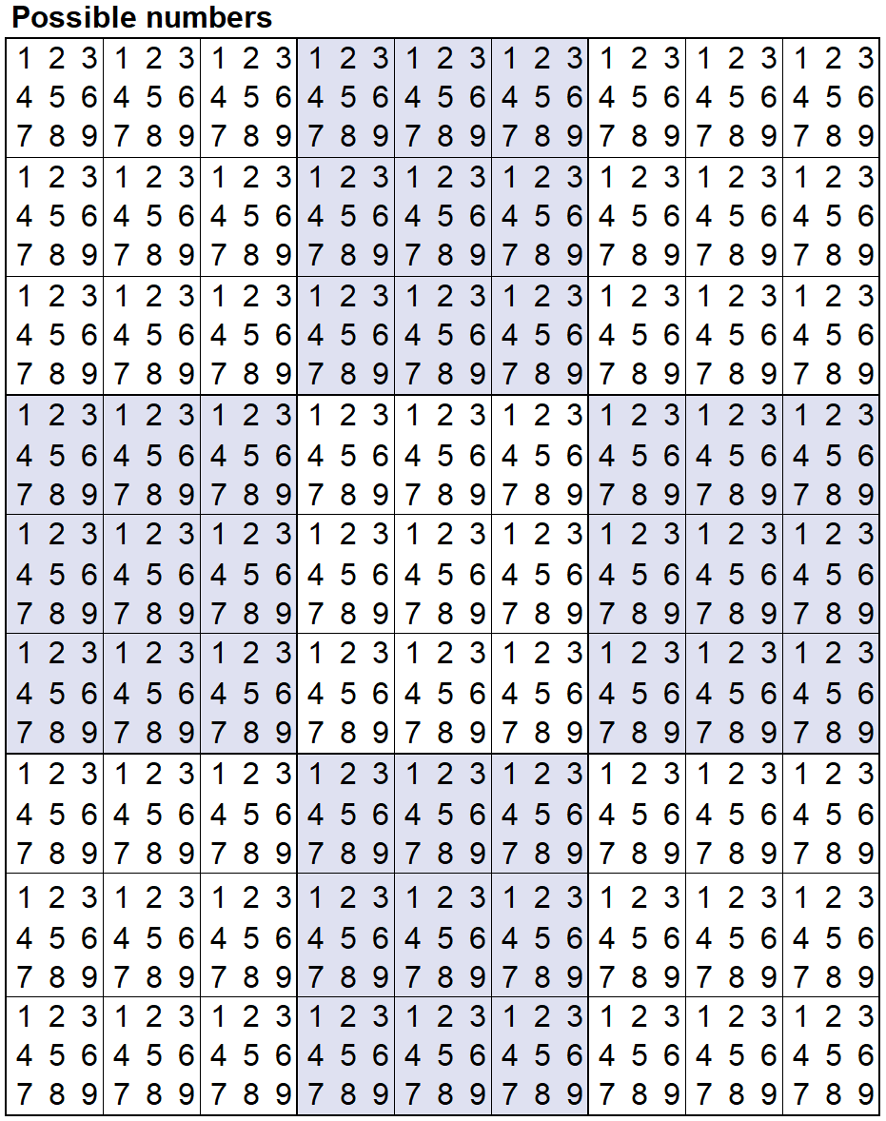
Notes:
•Big Solution Space
• Mögliche Varianten in 9x9 array für Zahlen 1-9 ohne weitere Constraints:
•2 x 10^77 possible solutions
•Solve the problem: take a look at the Solution space / Search space
•Solution space is pretty big. Almost as many possible solutions as there are atoms in the universe
•Brute force is not practical approach

Slide 4
Notes:
•Add fixed values (also constraints)
•Solution space gets reduced

Slide 5
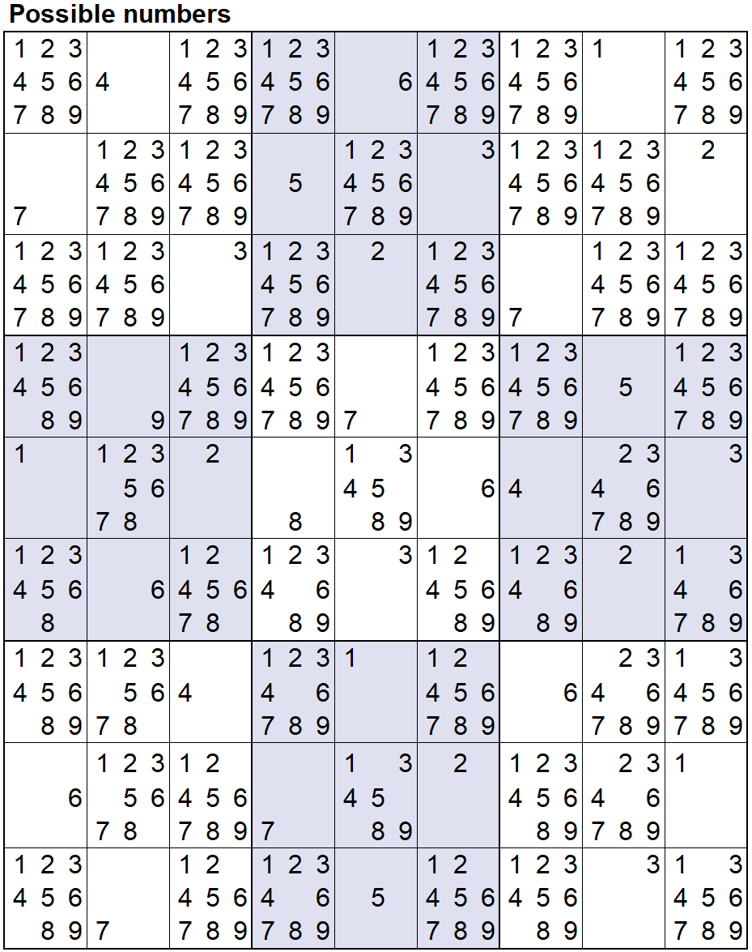
Notes:
* Wenn wir es im Kopf lösen würden, setzen wir die Zahlen, die wir mit Sicherheit wissen

Slide 6
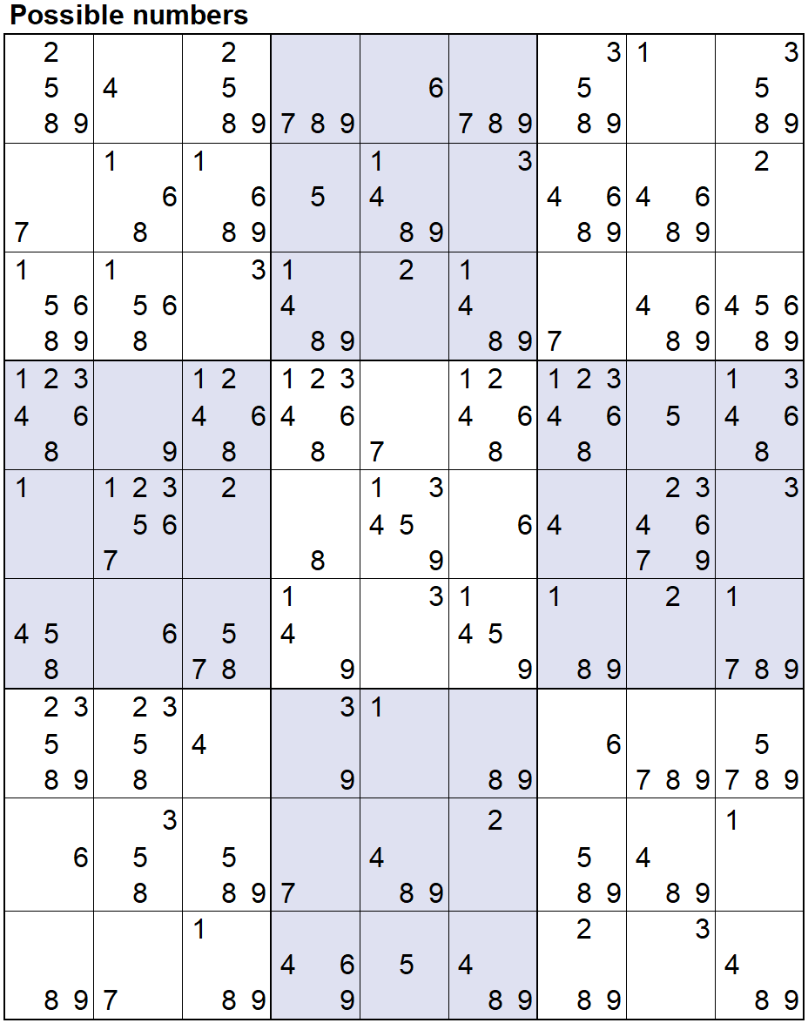
Notes:
•Reduce the solution space
•Still 4 x 10^21 possible solutions

Slide 7
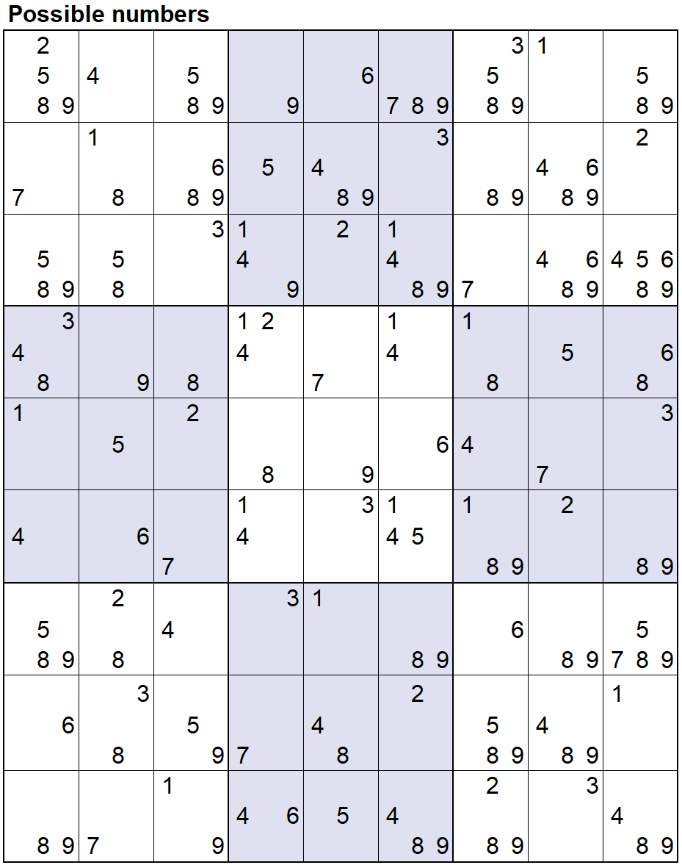
Notes:
•Where only one possible value remains, set as fixed
•Solution space is reduced again
•Continue with Iterative process

Slide 8
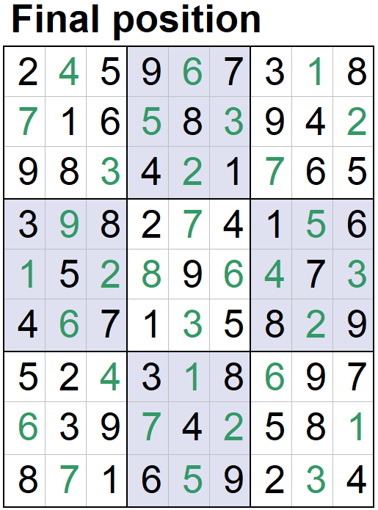
Notes:
•At the end: only one possible solution

