Slide 1
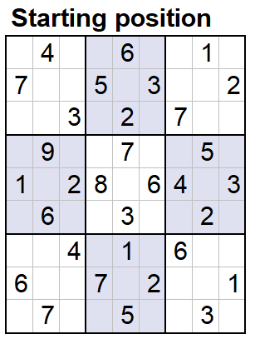
Sudoku
Two-dimensional array of integers (9x9)
Constraints
1-9
Different in rows
Different in columns
Different in box
Notes:
Solve solution
Code: two dimensional array

Slide 2
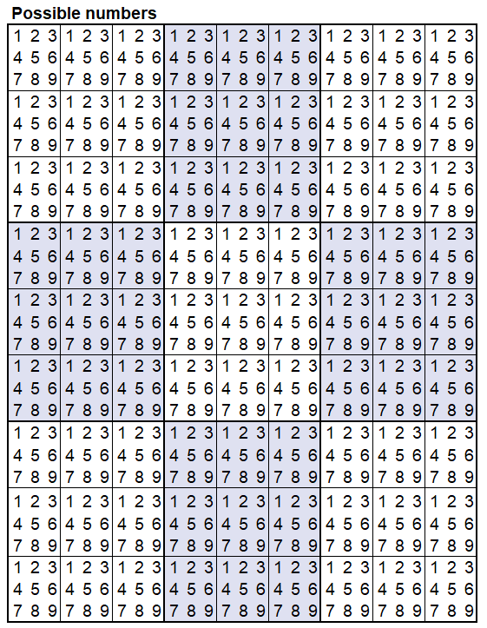
Sudoku
Solution space
2 x 10⁷⁷ possible solutions
Notes:
Solve the problem: take a look at the Solution space / Search space
Solution space is pretty big. Almost as many possible solutions as there are atoms in the universe
Brute force is not practical approach

Slide 3
Sudoku
Add values

Slide 4
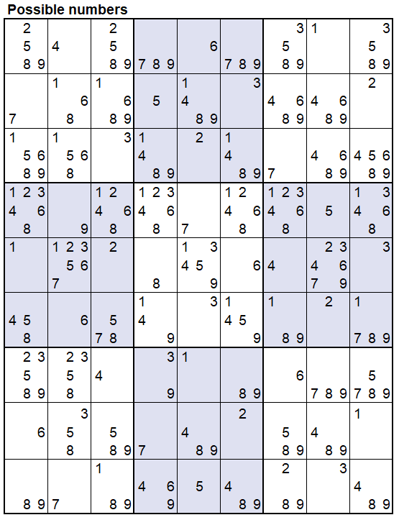
Sudoku
Reduce the solution space
Still 4 x 10²¹ possible solutions

Slide 5
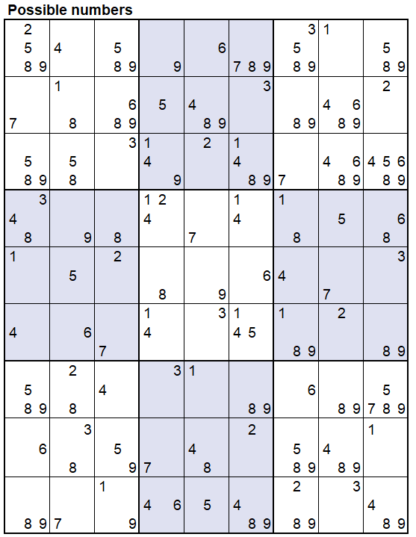
Sudoku
Where only one possible value remains, set as fixed
Solution space is reduced again
Continue with Iterative process

Slide 6
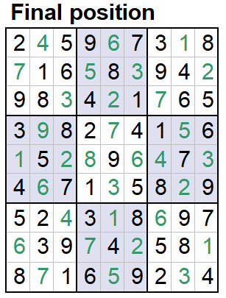
Sudoku
At the end: only one possible solution

