Slide 1
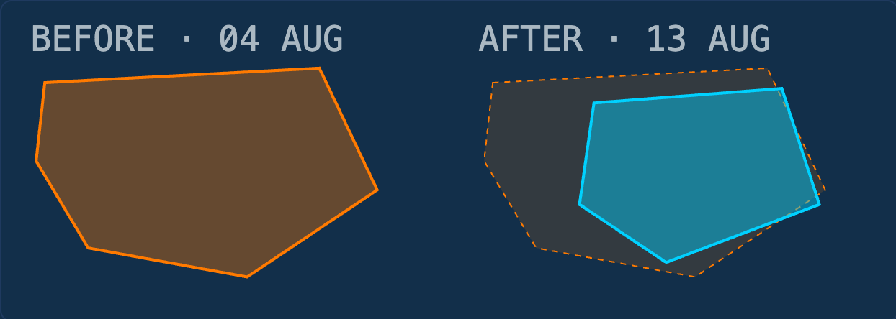
METHOD NOTE · GIS ANALYSIS
MEASURING BATTLEFIELD CHANGE FROM DEEPSTATE GEOMETRY
How polygon intersection separates occupied → liberated from occupied → gray/contested. 04–13 Aug 2026.
Orange · DeepState occupied Cyan · DeepState liberated Overlap · measured transition
Copyright Walker Rowe, Hypatia Academy Cyprus 2026
Notes:
Frame the talk: this is a method explanation, not a battlefield claim. We measure changes in DeepState's published classification using exact polygon geometry.

Slide 2
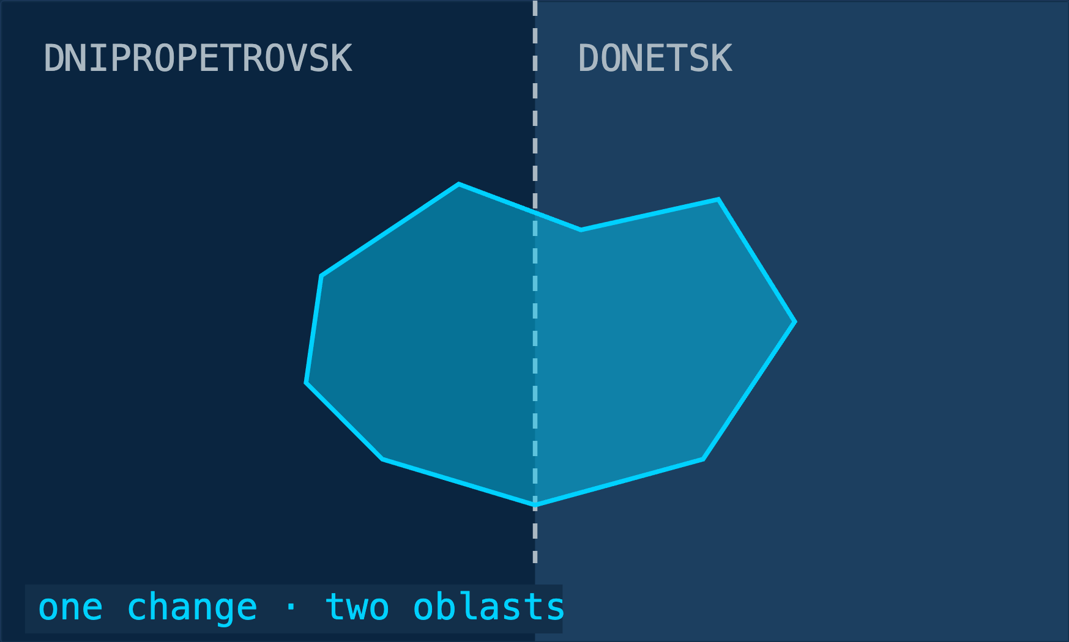
THE PROBLEM WITH ADMINISTRATIVE BOUNDARIES
The battlefield change crosses the Donetsk–Dnipropetrovsk boundary.
DEEPSTATE STATISTICS
Donetsk → one bucket
Dnipropetrovsk → another bucket
One geographic event can therefore be split between two administrative statistics. DeepState reports by oblast; this method follows the geographic transition itself.
Copyright Walker Rowe, Hypatia Academy Cyprus 2026
Notes:
Set up the motivation: a single geographic event can straddle an oblast boundary, so DeepState's per-oblast statistics split it into two buckets.

Slide 3
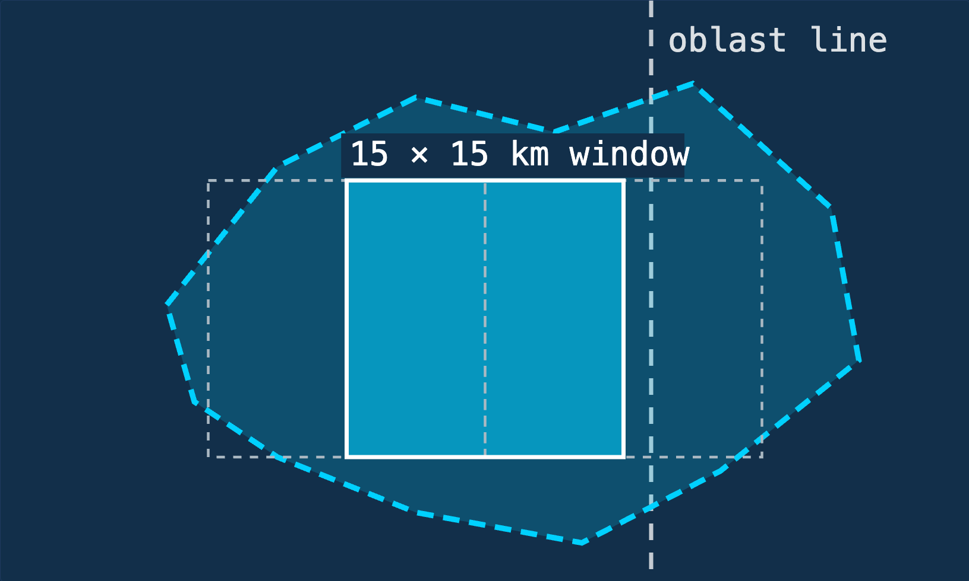
MY METHOD FOLLOWS THE CHANGE, NOT THE OBLAST
Calculate occupied_before ∩ liberated_latest
Slide overlapping 15 × 15 km windows across that geometry
Select the window containing the largest concentration
The DeepState polygons are not 15 × 15 km. The squares are only search windows. This is not more accurate than DeepState — it is more geographically precise for locating a local change, because it is not constrained by oblast boundaries.
WINNING HOTSPOT
39.72 km² occupied → liberated 28.77 km² occupied → gray/contested
Copyright Walker Rowe, Hypatia Academy Cyprus 2026
Notes:
The method in three steps: intersect, slide windows across the resulting geometry, keep the densest window. The windows follow the change, not the oblast.

Slide 4
DEEPSTATE STATUS CHANGE · 04–13 AUG 2026
68.49 KM² OF PREVIOUSLY OCCUPIED TERRITORY IS NO LONGER MAPPED OCCUPIED INSIDE THE HOTSPOT
39.72 km²
28.77 km²
68.49 km²
=
occupied → liberated
occupied → gray/contested
PREVIOUSLY OCCUPIED TERRITORY NO LONGER MAPPED OCCUPIED
Confirmed reclaimed in DeepState classification
Previously occupied, now contested/unknown
Newly mapped occupied: 0.00 km²
This is not a claim that Ukraine liberated 68.49 km². It is 68.49 km² that DeepState previously classified as occupied and no longer classifies as occupied.
Copyright Walker Rowe, Hypatia Academy Cyprus 2026
Notes:
The headline arithmetic. 39.72 confirmed liberated plus 28.77 became contested equals 68.49 km2 that DeepState no longer maps as occupied. Say explicitly: this is not 68.49 km2 liberated.

Slide 5
NOT ALL RUSSIAN CONTROL LOSS MEANS LIBERATION
OCCUPIED → LIBERATED
OCCUPIED → GRAY/CONTESTED
TOTAL
39.72 km²
28.77 km²
68.49 km²
Confirmed reclaimed in DeepState classification
Previously occupied, now contested/unknown
Previously occupied territory no longer mapped occupied
Gray matters only when we know what that same land was before.
occupied → gray can indicate a loss of Russian control. liberated → gray would indicate deterioration for Ukraine.
So the method compares transitions at the same coordinates instead of treating “gray increased” or “gray decreased” as inherently good or bad.
Copyright Walker Rowe, Hypatia Academy Cyprus 2026
Notes:
Three transitions side by side. Then the takeaway: a gray total on its own is ambiguous, because occupied to gray and liberated to gray point in opposite directions. That is why the method compares the same coordinates rather than category sizes.

Slide 6
WHAT EXACTLY ARE WE MEASURING?
Every DeepState snapshot is a set of GeoJSON polygons. Each polygon carries exact geographic coordinates plus a machine-readable status.
READ THIS FIRST
We are measuring changes in DeepState’s published classification — not independently determining battlefield control.
geoJSON.status.occupied
geoJSON.status.unknown
geoJSON.status.dismissed→ liberated
Copyright Walker Rowe, Hypatia Academy Cyprus 2026
Notes:
Each snapshot is GeoJSON: exact coordinates plus a machine-readable status field. Stress the disclaimer: we measure DeepState's classification, not ground truth.

Slide 7
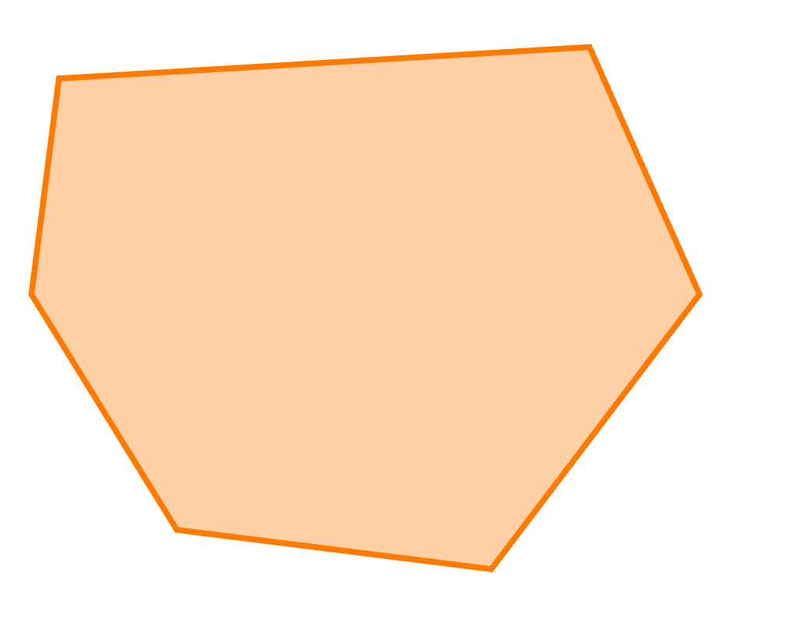
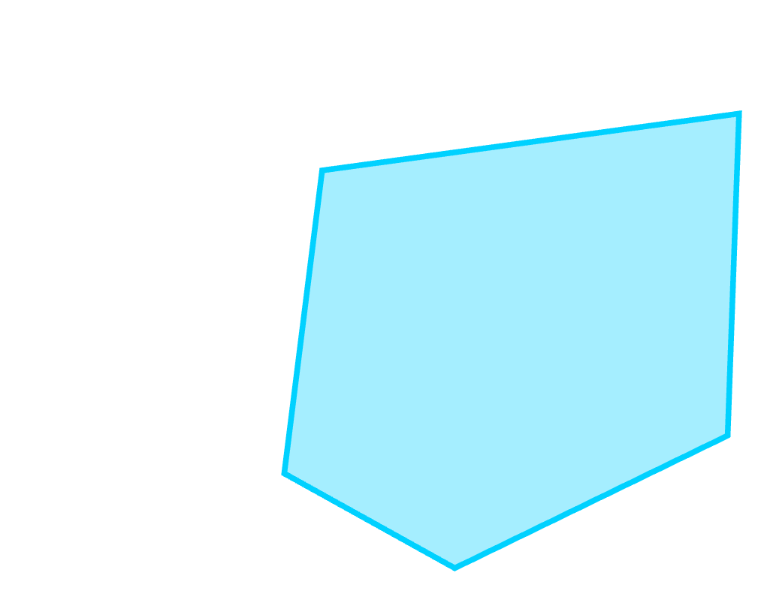
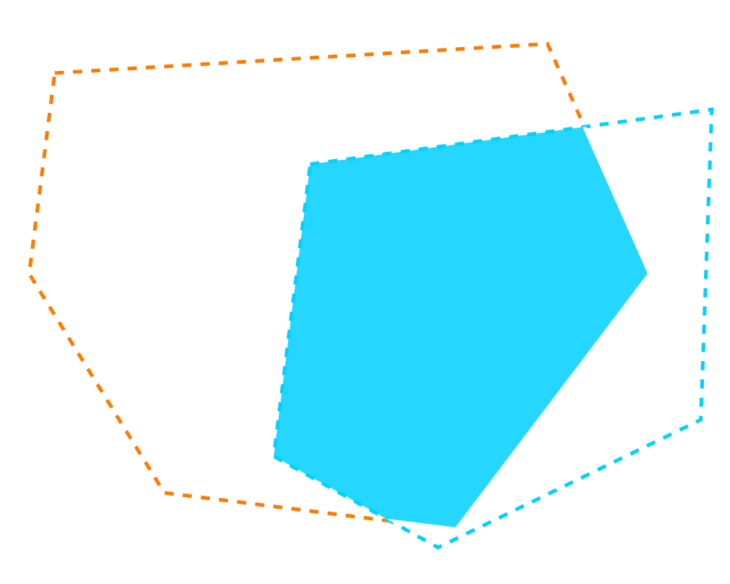
THE CENTRAL SPATIAL QUESTION
1 · OCCUPIED_BEFORE
2 · LIBERATED_LATEST
3 · INTERSECTION
gain = occupied_before.intersection(liberated_latest)
Every coordinate in the result was occupied at baseline and liberated at the latest snapshot.
Copyright Walker Rowe, Hypatia Academy Cyprus 2026
Notes:
The central operation. Walk the three panels left to right: baseline occupied, latest liberated, and the exact geometric intersection. Every coordinate in the result satisfies both conditions.

Slide 8
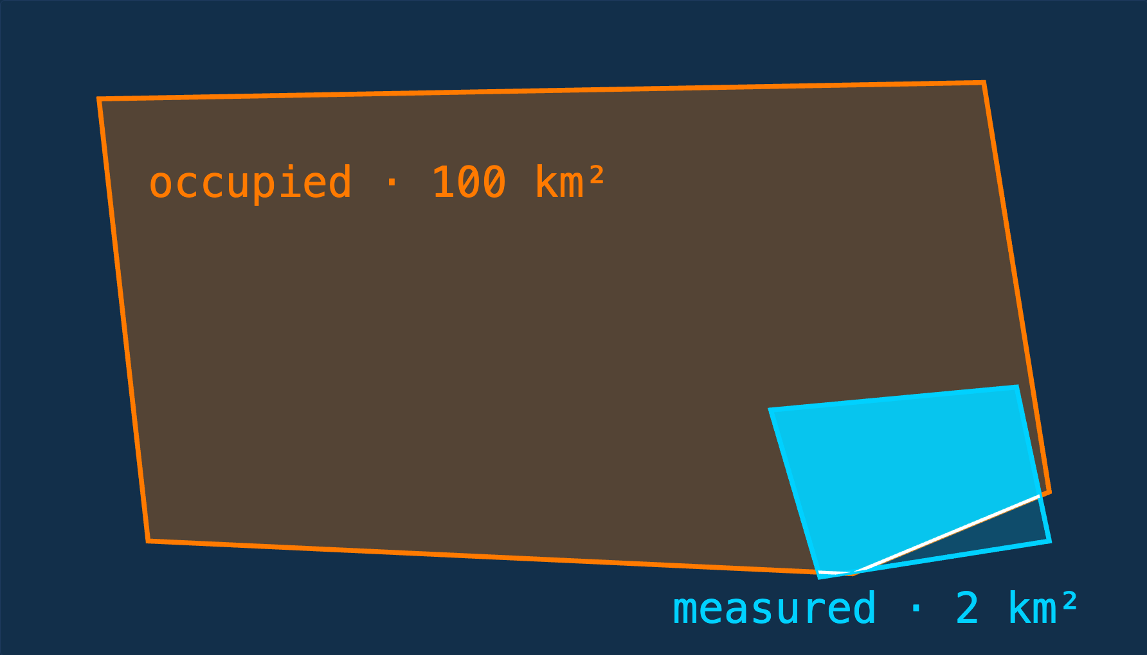
WHY POLYGON SIZE DOES NOT DISTORT THE RESULT
100 km² source polygon + 2 km² overlapping liberated area = 2 km² measured change , not 100 km².
1 · union polygons by status 2 · intersect the unions 3 · measure only the overlap
The size and number of DeepState source polygons therefore do not determine the result.
Copyright Walker Rowe, Hypatia Academy Cyprus 2026
Notes:
Anti-distortion argument. Polygons are unioned by status first, then intersected — so the size and count of source polygons never inflate the result. Use the README's 100 km² / 2 km² example.

Slide 9
FROM DEGREES TO SQUARE KILOMETRES
EPSG:4326 latitude / longitude
Latitude and longitude degrees are never used directly as area measurements.
↓
The hotspot comparison is reprojected to the European equal-area CRS EPSG:3035 specifically so that areas measured on different dates and at different latitudes are comparable.
EPSG:3035 European equal-area
↓
area in square metres
↓ ÷ 1,000,000
km²
Copyright Walker Rowe, Hypatia Academy Cyprus 2026
Notes:
Degrees are not square kilometres. The comparison is reprojected to EPSG:3035, an equal-area CRS, so areas are consistent across latitudes.

Slide 10
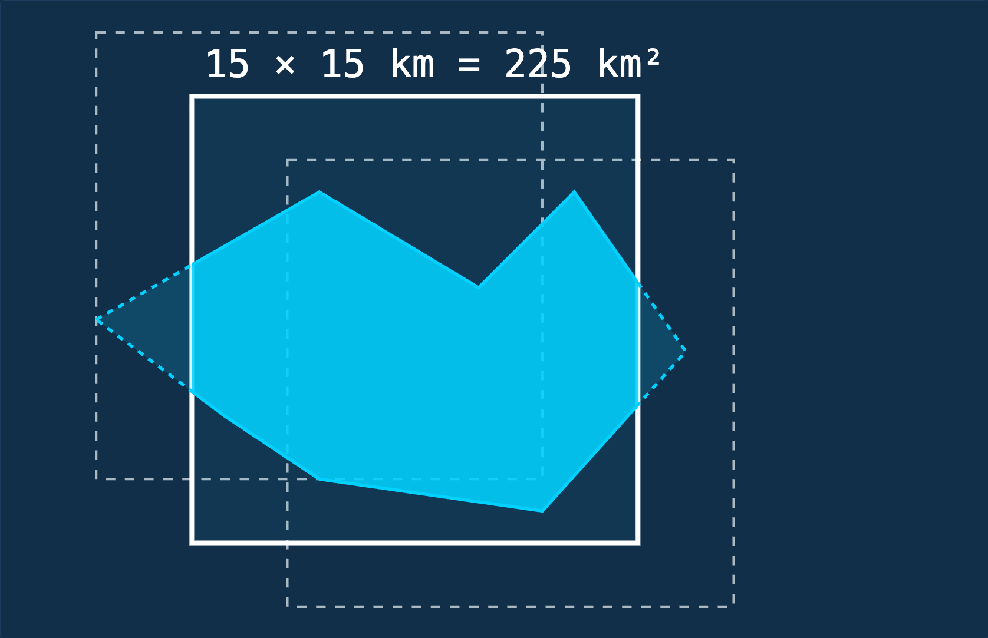
THE 15 × 15 KM WINDOW IS NOT THE MEASURED AREA
changed_m2 = gain.intersection(candidate).area
WINDOW AREA
GAIN INSIDE IT
225 km²
39.72 km²
HOTSPOT_WINDOW_KM = 15 HOTSPOT_STRIDE_KM = 5 MIN_GAIN_KM2 = 0.01
The DeepState source polygons are irregular. Transition geometries are calculated first; only then do overlapping 225 km² frames slide in 5 km steps to find the strongest concentration. The square is a search frame, never the measured area.
Copyright Walker Rowe, Hypatia Academy Cyprus 2026
Notes:
Two-part validation slide: the 15x15 km square is a search window, not a measurement. Overlapping windows on a 5 km stride keep a change cluster from being split by an arbitrary grid line; the stride changes which window wins, never the gain geometry.

Slide 11
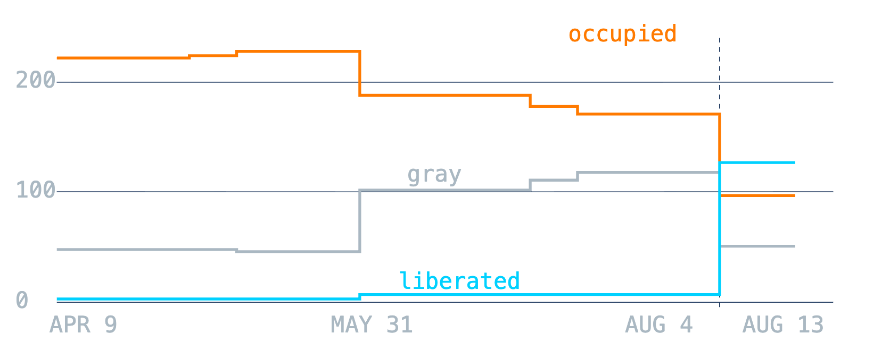
CATEGORY TOTALS ARE NOT TRANSITIONS
LAYER
AUG 4
AUG 13
DIFF
KM² PER LAYER · 9 APR → 13 AUG 2026
Liberated
7
127
+120
Occupied
171
97
−74
Gray
118
51
−67
Three-layer total
296
275
−21
A square kilometre can leave one category and appear in another, so reclaimed territory cannot be inferred by subtracting aggregate totals. The totals themselves are not conserved.
Copyright Walker Rowe, Hypatia Academy Cyprus 2026
Notes:
Why the +120 km2 figure was misleading (Aug 4 to Aug 13). These are category totals, not transitions. Note the three layers fall from 296 to 275 km2 — not a conserved land-accounting system.

Slide 12
ACCOUNTING FOR EVERY SQUARE METRE
BEFORE ↓ / AFTER →
LIBERATED
GRAY
OCCUPIED
UNCLASSIFIED
Inside a fixed mask, every square metre is assigned a before-state and an after-state.
occupied → liberated
39.72 km² confirmed reclaimed in DeepState classification
Occupied
counted
contested
unchanged
dropped
Gray
clarified
unchanged
lost
dropped
occupied → gray/contested
28.77 km² previously occupied, now contested/unknown
Liberated
unchanged
re-contested
reversed
dropped
gray → liberated
progress from contested to liberated
Unclassified
new claim
new claim
new claim
—
liberated → gray
deterioration / renewed contest
gray → occupied
Russian progress
liberated → occupied
re-lost territory
39.72 + 28.77 = 68.49 km² previously occupied territory no longer mapped occupied newly mapped occupied = 0.00 km²
The direction of the transition matters more than the total size of the category.
Copyright Walker Rowe, Hypatia Academy Cyprus 2026
Notes:
The accounting check: inside a fixed mask, every square metre gets a before-state and an after-state, so all flows are explicit. Only the occupied to liberated cell counts as confirmed reclaimed.

Slide 13
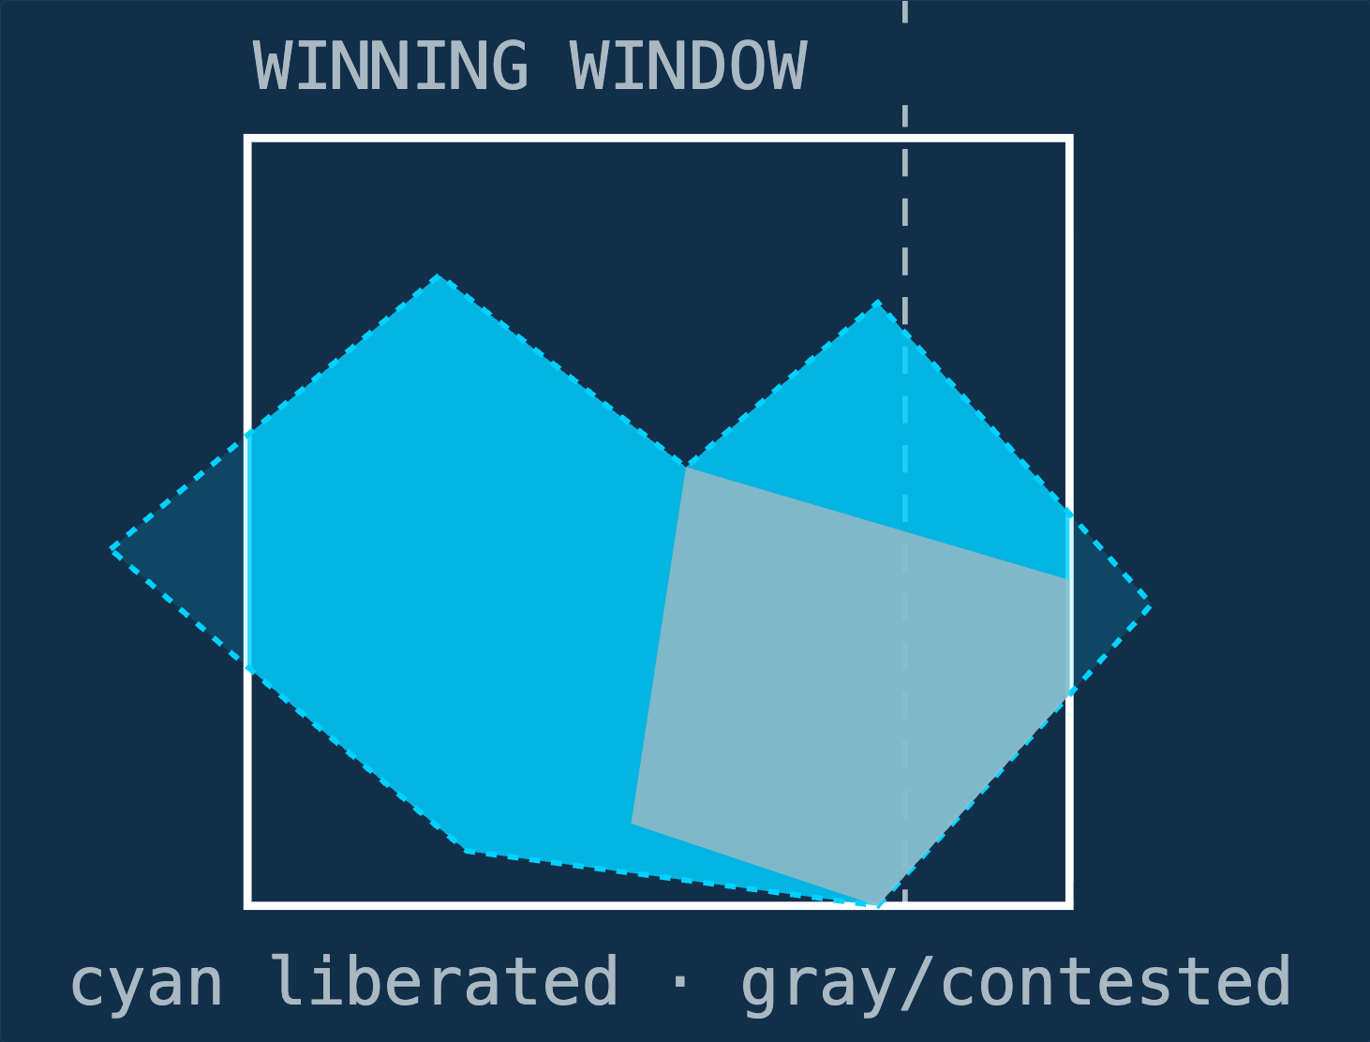
RESULT · 04 AUG → 13 AUG 2026
68.49 km²
PREVIOUSLY OCCUPIED TERRITORY NO LONGER MAPPED OCCUPIED
39.72 km²
28.77 km²
0.00 km²
occupied → liberated
occupied → gray/contested
newly mapped occupied
ANALYSIS BOUNDARY
68.49 km² is not all liberated territory. Only the 39.72 km² occupied → liberated portion is described as confirmed reclaimed.
NW 48.09186, 36.54102
SE 47.91895, 36.80103
The hotspot straddles the Dnipropetrovsk–Donetsk oblast boundary.
Copyright Walker Rowe, Hypatia Academy Cyprus 2026
Notes:
Lead with 68.49 km2 of mapped Russian control lost, then split it: 39.72 confirmed liberated, 28.77 contested, 0.00 newly occupied. Only the 39.72 is described as confirmed reclaimed. The hotspot straddles the Dnipropetrovsk-Donetsk boundary.

Slide 14
VALIDATION AND LIMITATIONS
WHAT IT ESTABLISHES
WHAT IT DOES NOT ESTABLISH
Same coordinates compared on two dates
Exact vector polygon intersection, not pixel counting
Equal-area projection for area measurement
Only occupied → liberated overlap counted as reclaimed
Search-window area never confused with changed area
DeepState may redraw or correct polygons
Updates can be delayed
Source geometry defines the spatial precision
Snapshots must be complete to compare
Where troops physically were, on the ground
This analysis measures changes in DeepState’s published geographic classifications. It does not independently determine battlefield ground truth — a map redraw, delayed update, or source correction can appear as a calculated transition.
So 68.49 km² means: that area was classified occupied in the earlier snapshot, and liberated or contested/unknown in the later one.
Copyright Walker Rowe, Hypatia Academy Cyprus 2026
Notes:
Close on rigor: what the calculation establishes and what it does not. All limitations are documented in the project.

