Slide 1
Team composition
Team name (Kaggle): Brownian Motion
Ranking (public score):
Challenge 1 (Flow Prediction): 7/12
Challenge 2 (First Arrival Detection): 2/8
Team contact:U of A student details: Janukan Sivajeyan
CCID: sivajeya
Email: sivajeya@ualberta.ca
Team composition:
Adil Attar: MSc. Physics
Janukan Sivajeyan: MSc. Electrical and Computer Engineering

Slide 2

Challenges
Challenge 1:
Flow Prediction: Predict the flow rate of 4 specific producer wells using reservoir information and the existing production and injection history.
Challenge 2:
First Arrival Detection: From sensor data, determine when the earthquakes hit

Slide 3
Challenge 1: Solution strategy
Did you choose a physics or machine learning approach (or hybrid):
Our approach mostly relied on machine learning

Slide 4
Challenge 1: Solution strategy
What physics principles/theories did you use? (Eg flow simulation, ray tracing)
We did not take the physics of the simulation into account

Slide 5
Challenge 1: Solution strategy
What machine learning principles/theories did you use? (eg neural network, clustering, pattern recognition)
The production output could be approximated as a polynomial after filtering out the smaller sinusoidal like variations
We used statistical regression algorithms (Lasso Regression) to predict the polynomial coefficients based on the provided training data

Slide 6
Challenge 1: Solution strategy
What physical and/or statistical attributes did you use? Eg traveltimes, porosities, mean, variance, kurtosis
We used the provided production time series for the producer wells
We used the porosity, permeability and thickness at each of the producer wells

Slide 7
Challenge 1: Solution strategy
What software + libraries did you use (eg TensorFlow, python, Matlab)
Solution implemented in Python (Jupyter Notebook)
Data processing with numpy and pandas
Visualization with matplotlib
Statistical Regression with sci-kit learn
Curve fitting and Signal Processing with scipy

Slide 8
Challenge 1: Solution strategy
What was your training strategy? How did you use the provided training data? How did you formulate the inputs and outputs of the ML algorithm(s)? What were the structures of the ML models?
We used a statistical regression algorithm (Lasso Regression) to compute the expected polynomial coefficients to model production rates
We fed in the averaged porosity, thickness and permeability of the specific producer wells (19,20,24,25) as inputs
We used the polynomial coefficients fitted from the training data as outputs for the model training

Slide 9
Challenge 1: Solution strategy
Why do you think you obtained a top score? What did you do differently or better?
Although our approach was able to get us into the middle of the leaderboard
Our approach could have been improved by factoring in the different porosity, thickness and permeability rather than just the values at the producer wells

Slide 10
Challenge 2: Solution strategy
Did you choose a physics or machine learning approach (or hybrid):
Hybrid Approach Used
Statistical Method: Logistic Regression
used to predict whether an earthquake occurs in a time interval
Model coefficients used to identify key predictors
Physics: Short Term Average/Long Term Average method
Algorithm implemented based on description on First Break Picking Wikipedia article
Used to visualize receiver data
Final prediction obtained from manual inspection of this plot

Slide 11
Challenge 2: Solution strategy
What physics principles/theories did you use? (Eg flow simulation, ray tracing)
STA/LTA method applied to z receiver data to visualize likelihood of an earthquake event occurring at a specific time
From visualization of the data, the detection could be approximated as occurring in the same time step for all receivers for a crude initial result.
Assumed that a single receiver’s data may not be reliable, model and final answer based on aggregate data of all receivers

Slide 12
Challenge 2: Solution strategy
What machine learning principles/theories did you use? (eg neural network, clustering, pattern recognition)
Classification: Simplified the initial problem into predicting whether an earthquake occurs within a specific interval
0 would correspond to no earthquake detected
1 would correspond to an earthquake detected
Logistic Regression model used to implement the classifier
Used sklearn.linear_model.LogisticRegression implementation from scikit learn

Slide 13
Challenge 2: Solution strategy
What physical and/or statistical attributes did you use? Eg traveltimes, porosities, mean, variance, kurtosis
Mean, min, max, standard deviation of averaged receiver data used to train model
Final answer determined from STA/LTA plot
Visualized STA/LTA metric over all the receivers to create an image
First Break Detection determined by location of bright lines
7 points selected (Receivers: 0, 20, 40, 60, 80, 100 ,126) and the rest of the data was determined with linear interpolation

Slide 14
Challenge 2: Solution strategy
What software + libraries did you use (eg TensorFlow, python, Matlab)
Solution implemented in Python (Scripts and Jupyter Notebook)
Data processing with numpy and pandas
Visualization with matplotlib
Statistical Learning with sci-kit learn

Slide 15
Challenge 2: Solution strategy
Data Strategy:
Split each training simulation into 100 smaller segments (2400 “different” simulations)
x, y, z data averaged over all of the receivers
For each dimension: computed the mean, max, min and standard deviation
Complete data set for training now consists of 2400 sets of 12 values
Model Training: sklearn.linear_model.LogisticRegression
Split the generated data 80/20 into train and test sets
Local evaluation of model typically yielded accuracy of above 90% (variations due to random splitting of test/train data)
Mean of z data had the highest coefficients within the trained model

Slide 16
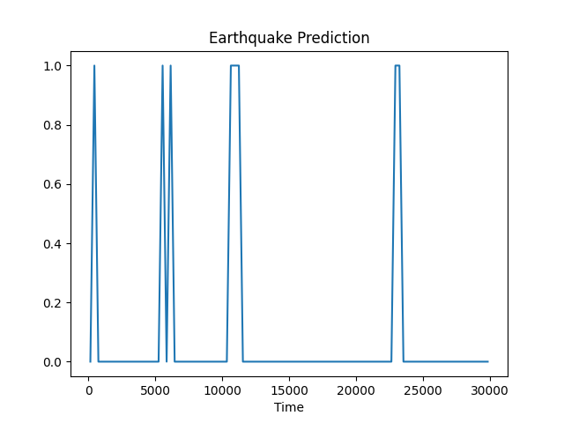
Classifier Results
On the left is the plot of the classification of the provided test data
0 corresponds to no earthquake event, 1 corresponds to a detected event
These results could not be used directly, visual interpretation required to predict the presence 4 earthquakes

Slide 17
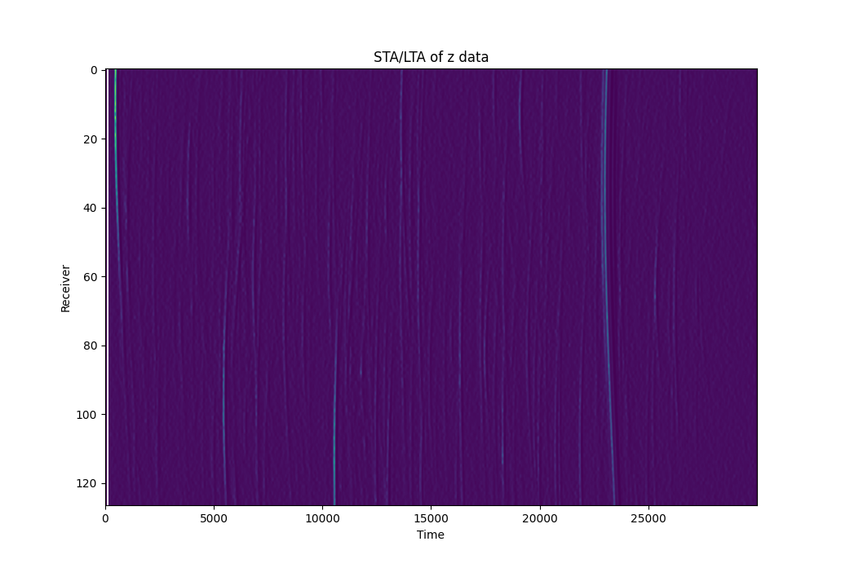
STA/LTA plot
STA/LTA could have been applied to any of x, y, z or their overall displacement
Logistic Regression identified z data as most significant for predicting earthquakes
Although there are bright lines associated with each earthquake, some interpretation required to predict missing line segments

Slide 19
Challenge 2: Solution strategy
Why do you think you obtained a top score? What did you do differently or better?
Simplifying the problem into easier problems i.e. training a classifier to predict if an earthquake occurs within an interval instead of training an entire model to count the number of earthquakes and their arrival time
Simpler models: The coefficients from the logistic classifier are much easier to interpret than the train parameters of a neural net

Slide 20
Both Challenges: Software
We would like to see your software/routines
Please create a Google Drive folder and send us the link (Juliana Leung juliana2@ualberta.ca; Mirko van der Baan mirko.vanderbaan@ualberta.ca; Thanh Nguyen thanh2@ualberta.ca
Your software will not distributed
Folder link: https://drive.google.com/drive/folders/1c24mWKAk2xu9wUgl_LBHPc42kPbTaZZc?usp=sharing

Slide 21
General feedback
How did you hear about the event?
Weekly student email newsletter

Slide 22
General feedback
Did your team attend (partially) in person? If yes was this helpful? If not, why not?
Partially in person, found it helpful for discussion

Slide 23
General feedback
What did you think of the external talks?
It was interesting to see the application of machine learning for industrial geophysics problems (1st talk)
Could not attend 2nd talk as we were focused on improving our results
What did you think of the internal talks on the data generation and background science?
Did not attend due to focusing on improving results

Slide 24
General feedback
What did you like about the event?
Appreciated the geophysics theme, data science events typically have either business or life sciences themes
The Kaggle platform provided quick feedback

Slide 25
General feedback
Any suggestions on what to change/improve?
Description of the strategy used would be easier to explain in a Jupyter notebook with the opportunity to include code snippets
Data could be released earlier to allow for more time to learn about machine learning/problem domain
Recommendations of introductory level material to learn more about the problem domain
The talks should be scheduled further away from the end of the competition.

Slide 26
General feedback
If we organized another datathon:
What would be a preferred date (eg during term, in the summer, in the weekend/during the week etc)
Any time as long as it doesn’t occur during midterm/finals season
Is 1 or 2 days better for the in person portion?
1 day for events would be better, however the dedicated workspace is helpful
Was it helpful to release the data a couple days in advance?
Yes, the data exploration phase was very time consuming. I think the data could have been released the weekend before the event

