Slide 1

CSC 533: Privacy in the Digital Age (Fall 2020) Lecture 11: Anonymous communication
Anupam Das
Sept. 17, 2020

Slide 2
Goals for today
What it means to be anonymous?
Anonymity w.r.t. sender, receiver and both party
Two types of anonymous communication protocol
Crowds
Chaum Mix / Mix Networks
Some slide contents have been taken from Amir Houmansadr and Christo Wilson

Slide 3
What does it mean to be anonymous?
Hiding the identities of the parties involved in digital communications from each other, or from third-parties
“Who you are” from the communicating party
“Who you are talking to” from everyone else

Slide 4

Why be Anonymous?
If you are a cyber-criminal!
DRM infringement, hacker, spammer, terrorist, etc.
But, also if you are:
Journalist
Whistleblower
Human rights activist
Business executive
Military/intelligence personnel
Abuse victims

Slide 5
Why be Anonymous?
How about normal people?
Avoid tracking by advertising companies
Protect sensitive personal information
Information on medical conditions
Advice on bankruptcy
Express unpopular or controversial opinions
Have a dual life
A professor who is also a pro in World of Warcraft!
Try uncommon things
…
It feels good to have some privacy!

Slide 6
Bottom-line: Anonymity is not for criminals only!

Slide 7
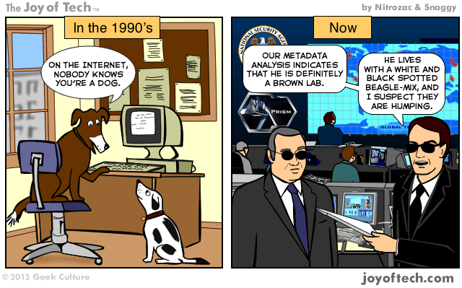
But, It’s Hard to be Anonymous!

Slide 8
You Are Not Anonymous
Your network location (IP address) can be linked directly to you
ISPs store communications records
Usually for several years (Data Retention Laws)
Law enforcement can subpoena these records
Your application is being tracked
Cookies, Flash cookies, E-Tags, HTML5 Storage
Centralized services like Skype, Google voice
Browser fingerprinting
Your activities can be used to identify you
Unique websites and apps that you use
Types of links that you click

Slide 9
Wiretapping is Ubiquitous
Your Internet access point can be wiretapped
Wireless traffic can be trivially intercepted
Airsnort, Firesheep, etc.
Wifi and Cellular traffic!
Encryption helps, if it’s strong
WEP and WPA are both vulnerable!
Tier 1 ASs and IXPs are compromised
NSA, GCHQ, “5 Eyes”
~1% of all Internet traffic
Focus on encrypted traffic

Slide 10
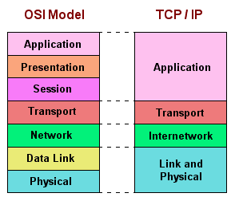
You Have to Protect at All Layers!
Challenge:
Maintain Performance

Slide 11
Types of attackers
From whom do we want to hide?
external attackers
local eavesdropper (sniffing on a particular link (e.g., LAN))
global eavesdropper (observing traffic in the whole network)
internal attackers
(colluding) compromised system elements (e.g., routers)

Slide 12
Types of anonymity
Sender anonymity (who sent this?)
A is sending to B, but B doesn’t know who is sending
Receiver anonymity (who is the destination?)
A is sending to B, but A doesn’t know who it is being sent to
Relationship anonymity (are sender A and receiver B linked?)
A is sending to B but no one else knows who is interacting with whom

Slide 13
Other desirable properties
Unlinkability: the inability to link two or more items of interests to break anonymity, like packets, events, people, actions, etc.
Pr(A visiting site XYZ) = Pr(B visiting site XYZ)
Knows someone visited but doesn’t know who exactly
Unobservability: items of interest are indistinguishable from all other items
Can’t distinguish whether A or B visiting site XYZ
Doesn’t knows if some visited the site at all

Slide 14














Quantifying Anonymity
How can we calculate how anonymous we are?
Anonymity Sets
Suspects (Anonymity Set)
Who sent this message?
Larger anonymity set = stronger anonymity

Slide 15


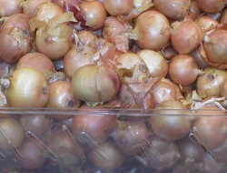
Anonymity loves company
The sole mechanism of anonymity is blending and obfuscation.
The Crowds approach
Data may be in clear text
Hide in a group and make everyone in the group equally responsible for an act
The Mix approach
Obfuscate the data
Blend the data with cover traffic
The Onion Routing approach
Obfuscate the data
Use cell padding to make data look similar

Slide 16
Some Crypto Background: Anonymity systems rely on some crypto

Slide 17
Crypto Algorithms
Symmetric algorithms
Conventional algorithms
Encryption and decryption keys are the same
Examples: DES, 3DES, AES, Blowfish
Asymmetric algorithms
Commonly known as Public Key algorithms
Encryption key and decryption key are different
Examples: RSA, Elliptic curve

Slide 18
Symmetric Key Crypto
Let’s say we have a plaintext message M
… a symmetric encryption algorithm E
… and a key K
M → E(K, M) = C → E(K, C) = M
Advantages:
Fast and easy to use
Disadvantages
How to securely communicate the key?
Cyphertext C
Symmetric encryption is reversible

Slide 19
Public Key Crypto
Let’s say we have plaintext message M
… a public key algorithm F
… and two keys K_{P} (public) and K_{S} (private)
M → F(K_{P}, M) = C → F(K_{S}, C) = M
M → F(K_{S}, M) = C → F(K_{P}, C) = M
Encrypt with the public key…
Decrypt with the private key

Slide 20




Public Key Crypto in Action
K_{P}
<K_{P}, K_{S}>
K_{P}
Safe to distribute the public key K_{P}
Can only decrypt with the private key K_{S}
Computationally infeasible to derive K_{S} from K_{P}

Slide 21


Crypto (SSL)
Data Traffic
Content is unobservable
Due to encryption
Source and destination are trivially linkable
No anonymity!

Slide 22






Anonymizing Proxies
HTTPS Proxy
No anonymity!
Source is known
Destination anonymity
Destination is known
Source anonymity

Slide 23

Anonymizing VPNs
VPN Gateway
No anonymity!
Source is known
Destination anonymity
Destination is known
Source anonymity

Slide 24
Using Metadata to Deanonymize
HTTPS Proxy
Reading Gmail
Watching YouTube
searching in Google
Etc…
No anonymity!
Fact: the NSA leverages packet size, timing correlation etc. to track users

Slide 25
Data To Protect
Personally Identifiable Information (PII)
Name, address, phone number, etc.
OS and browser information
Cookies, etc.
Language information
IP address
Amount of data sent and received
Traffic timing

Slide 26
Anonymity System: Crowds

Slide 27
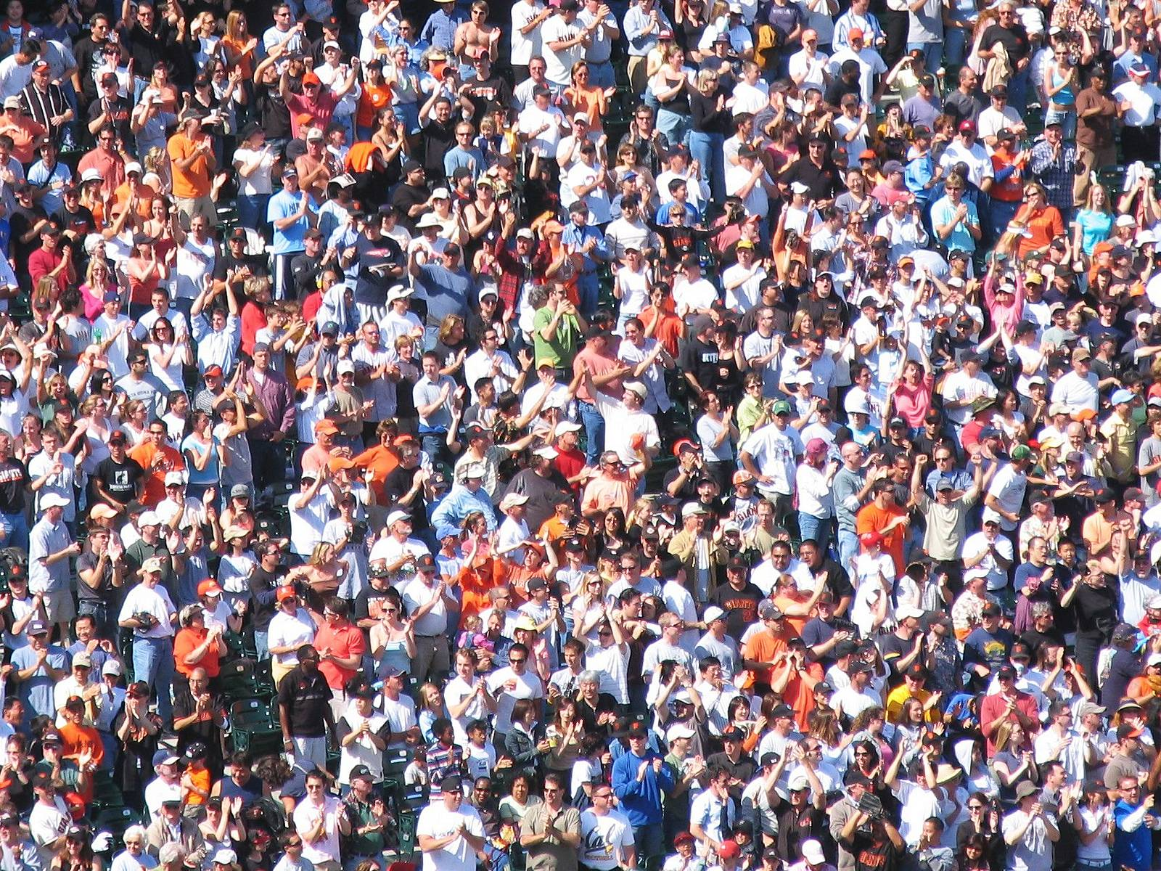

Slide 28
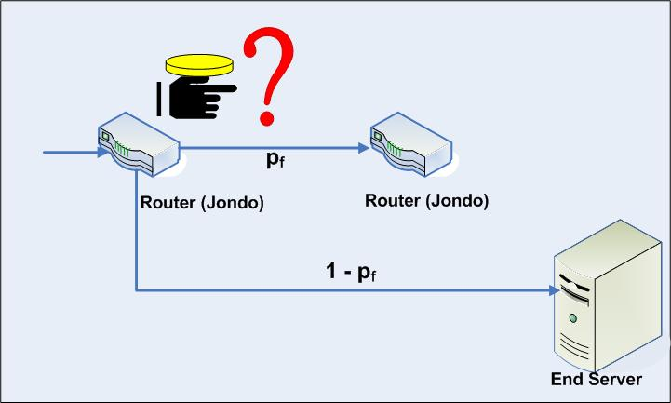
Crowds
Key idea
Users’ traffic blends into a crowd of users
Eavesdroppers and end-hosts don’t know which user originated what traffic
High-level implementation
Every user runs a proxy on their system
Proxy is called a jondo
From “John Doe,” i.e. an unknown person
When a message is received, select x [0, 1]
If x > p_{f}: forward the message to a random jondo
Else: deliver the message to the actual receiver

Slide 29
Crowds Example
Links between users use public key crypto (but each jondo can view the plaintext)
Users may appear on the path multiple times
Request and reply follow the same virtual paths which are constructed using an algorithm involving probabilities.
Final Destination

Slide 30
Anonymity in Crowds
log all incoming message and all outgoing message
if more outgoing message then target is a source
No source anonymity
target receives (m>=0) messages and send m+1 messages then target must be a sender (source)
each proxy should receive even number of messages
Destination anonymity is maintained
If the source isn’t sending directly to the receiver

Slide 31
Anonymity in Crowds
Source and destination are anonymous
Source and destination are behind jondo proxies
Destination is hidden by encryption

Slide 32
Anonymity in Crowds
Destination IP will be different from all jondo
Destination is known
Obviously
Source is anonymous
O(n) possible sources, where n is the number of jondos

Slide 33
Anonymity in Crowds
Destination is known
Evil jondo is able to decrypt the message and see the final destination (needed in the case where a jondo needs to send to the final destination)
Source is somewhat anonymous
Suppose there are c evil jondos out of n jondos
If p_{f} > 0.5, and n > 3(c + 1), then the source cannot be inferred with probability > 0.5

Slide 34
Other Implementation Details
Crowds requires a central server called a Blender
Keep track of who is running jondos
Kind of like a BitTorrent tracker
Broadcasts new jondos to existing jondos
Facilitates exchanges of public keys

Slide 35
Summary of Crowds
The good:
Crowds has excellent scalability
Each user helps forward messages and handle load
More users = better anonymity for everyone
Strong source anonymity guarantees
The bad:
Very weak destination anonymity
Evil jondos can always see the destination (a corrupt jondo can see the final destination)

Slide 36
Mixes

Slide 37
Mix Networks
A different approach to anonymity than Crowds
Originally designed for anonymous email
David Chaum, 1981
Concept has since been generalized for TCP traffic
Hugely influential ideas
Onion routing
Traffic mixing
Dummy traffic (a.k.a. cover traffic)

Slide 38
Chaum MIX
goal
sender anonymity (for communication partner)
unlinkability (for global eavesdropper)
MIX
batches messages
discards repeats
changes order
changes encoding

Slide 39



Mix Proxies and Onion Routing
Encrypted Tunnels
Mix
<K_{P}, K_{S}>
<K_{P}, K_{S}>
[K_{P} , K_{P} , K_{P}]
<K_{P}, K_{S}>
<K_{P}, K_{S}>
<K_{P}, K_{S}>
<K_{P}, K_{S}>
<K_{P}, K_{S}>
<K_{P}, K_{S}>
Non-encrypted data
E(K_{P} , E(K_{P} , E(K_{P} , M))) = C
Mixes form a cascade of anonymous proxies
All traffic is protected with layers of encryption

Slide 40
Another View of Encrypted Paths
<K_{P}, K_{S}>
<K_{P}, K_{S}>
<K_{P}, K_{S}>

Slide 41
MIX chaining
defense against colluding compromised MIXes
if a single MIX behaves correctly, unlinkability is still achieved
MIX
MIX
MIX

Slide 42

Return Traffic
In a mix network, how can the destination respond to the sender?
During path establishment, the sender places keys at each mix along the path
Data is re-encrypted as it travels the reverse path
<K_{P1} , K_{S1}>
<K_{P2} , K_{S2}>
<K_{P3} , K_{S3}>
K_{P1}
K_{P2}
K_{P3}

Slide 43



Traffic Mixing
Mix collects messages for t seconds
Messages are randomly shuffled and sent in a different order
Hinders timing attacks
Messages may be artificially delayed
Temporal correlation is warped
Problems:
Requires lots of traffic
Adds latency to network flows
Arrival Order
Send Order
1
1
4
2
2
3
3
4

Slide 44
Dummy / Cover Traffic
Simple idea:
Send useless traffic to help obfuscate real traffic

Slide 45
Conclusion
Presented a brief overview of some fundamental anonymity systems
How do they work?
What are the anonymity guarantees?
We will look at other forms of MIX network next class
A real-time MIX network – Onion routing (Tor)

Slide 46
Logistics
Homework 2 due Sept. 21 @11:59pm.

