Slide 1

CSC 533: Privacy in the Digital Age (Fall 2020) Lecture 3: k-anonymity
Anupam Das
Aug 18, 2020

Slide 2
Goals for today
What does k-anonymity mean?
Algorithms for achieving k-anonymity
Some contents are borrowed from online material provided by Dimitris Sacharidis, Vitaly Shmatikov, and Ashwin Machanavajjhala

Slide 3
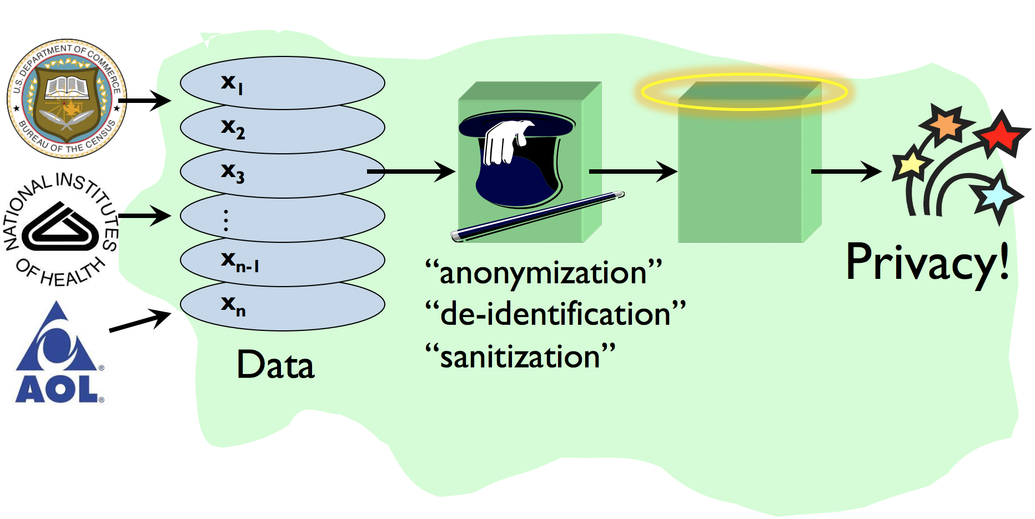
Recap: Privacy-preserving data release

Slide 4
Sample database
SSN | DoB | Gender | ZIP | Diagnosis
123456789 | 01/23/1964 | F | 15678 | Diabetes
623452189 | 02/03/1964 | M | 15609 | Asthma
873456721 | 09/13/1965 | F | 31892 | Diabetes
227656752 | 12/30/1967 | M | 31402 | Cancer
827356780 | 06/09/1961 | M | 31609 | Diabetes
723421709 | 08/21/1969 | F | 23194 | Asthma

Slide 5
Attribute classification
K₁, K₂,..., K_{m} - Key attributes
E.g., name, address, phone number, SSN
uniquely identifying!
Always remove before release
Q₁, Q₂,..., Q_{m} - Quasi-identifiers
individually not unique but when grouped they are
(5-digit ZIP code, birth date, gender)
S₁, S₂,..., S_{m} – Sensitive attributes
E.g., medical condition, salary, etc.
These attributes are often used for analytics

Slide 6
Identifying different attributes
Key attributes
Quasi identifier
Sensitive attributes
SSN | DoB | Gender | ZIP | Diagnosis
123456789 | 01/23/1964 | F | 15678 | Diabetes
623452189 | 02/03/1964 | M | 15609 | Asthma
873456721 | 09/13/1965 | F | 31892 | Diabetes
227656752 | 12/30/1967 | M | 31402 | Cancer
827356780 | 06/09/1961 | M | 31609 | Diabetes
723421709 | 08/21/1969 | F | 23194 | Asthma

Slide 7
Remove key attributes
DoB | Gender | ZIP | Diagnosis
01/23/1964 | F | 15678 | Diabetes
02/03/1964 | M | 15609 | Asthma
09/13/1965 | F | 31892 | Diabetes
12/30/1967 | M | 31402 | Cancer
06/09/1961 | M | 31609 | Diabetes
08/21/1969 | F | 23194 | Asthma
SSN | DoB | Gender | ZIP | Diagnosis
123456789 | 01/23/1964 | F | 15678 | Diabetes
623452189 | 02/03/1964 | M | 15609 | Asthma
873456721 | 09/13/1965 | F | 31892 | Diabetes
227656752 | 12/30/1967 | M | 31402 | Cancer
827356780 | 06/09/1961 | M | 31609 | Diabetes
723421709 | 08/21/1969 | F | 23194 | Asthma

Slide 8

Auxiliary information is out there
correlation
Auxiliary data (maybe public data)
Released data

Slide 9
Example: Linkage attack
Anonymized Medical Data
Voter registration data
Name | DoB | Gender | ZIP | Political Affiliation
Alice | 01/23/1964 | F | 15678 | Democratic
Alex | 06/17/1974 | M | 15609 | Republican
Ben | 11/13/1969 | F | 31892 | Democratic
Ema | 04/26/1971 | M | 54402 | Democratic
Rose | 05/15/1981 | M | 67709 | Republican
Kevin | 07/09/1989 | F | 12394 | Republican
DoB | Gender | ZIP | Diagnosis
01/23/1964 | F | 15678 | Diabetes
02/03/1964 | M | 15609 | Asthma
09/13/1965 | F | 31892 | Diabetes
12/30/1967 | M | 31402 | Cancer
06/09/1961 | M | 31609 | Diabetes
08/21/1969 | F | 23194 | Asthma
Last class we talked about
Massachusetts governor attack
how unique US consensus data was
Alice has diabetes

Slide 10
Mitigation techniques
k-anonymity (Sweeney et al. 2002)
l-diversity (Machanavajjhala et al. 2007)
t-closeness (Li et al. 2007)

Slide 11
k-anonymity
Generalize, modify, or distort quasi-identifier values so that no individual is uniquely identifiable from a group of k
In SQL, table T is k-anonymous if each
(SELECT COUNT(*) FROM T GROUP BY Quasi-Identifier) ≥ k
Parameter k indicates the “degree” of anonymity
These k records form an equivalence class

Slide 12
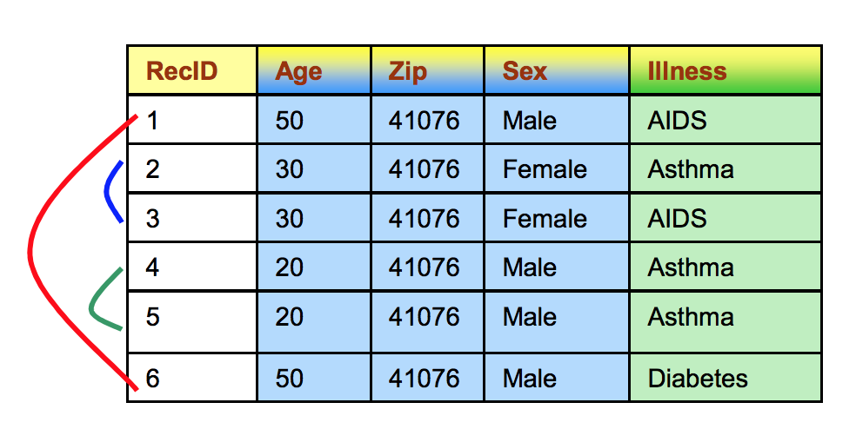
k-anonymity example
Here k=?
QID = { Age, Zip, Sex }
SELECT COUNT(*) FROM Patient GROUP BY Sex, Zip, Age;
If the results include groups with count less than k, then we don’t have k-anonymity property with respect to QID.

Slide 13
Achieving k-anonymity
Replace quasi-identifiers with less specific, but semantically consistent values until you get k identical records
There can be many sets of quasi-identifiers. If Q = {B, Z, S} is a quasi-identifier, then Q + {N} is also a quasi-identifier.
Need to guarantee k-anonymity against the largest set of quasi-identifiers

Slide 14
Methods to achieve k-anonymity
Generalization: a technique used to replace more specific value with generic and semantically similar values
Suppression: Data not released at all
Can be viewed as first level of generalization
Z
X,Y,Z → mapped to middle
= ?
Y
= ?
X
Z = quasi-identifier
X,Y,Z → X,Y

Slide 15
Generalization: Numeric values
ZIP
∗∗∗∗∗
130∗∗
Suppress one digit at a time
1305∗
1306∗
13053
13058
13063
13067
Age
*
< 40
Range or bounding box
< 30
3*
28
29
36
35

Slide 16
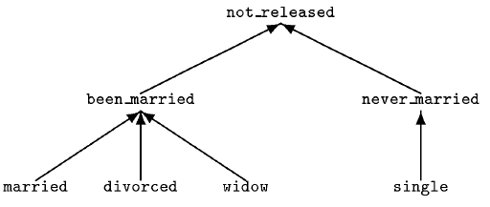
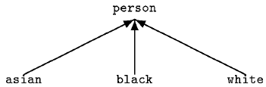
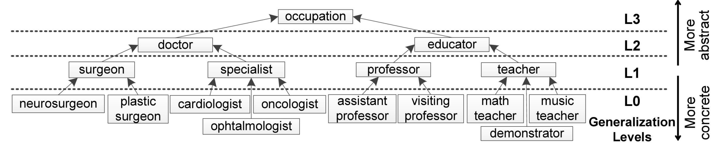
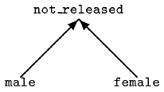
Generalization: Categorical values
Domain Generalization

Slide 17
Full domain vs. Local generalization
Full Domain: Generalize all values in an attribute to the same “level”
Every occurrence of 12345 is replaced with 123** in the database.
Answering queries on such datasets is easier.
Local Generalization: Values can be generalized to different levels.
12345 in one tuple may be generalized to 123**, and in another tuple entirely different generalization (say 1234*).
Allows k-anonymous datasets with lesser information loss.

Slide 18
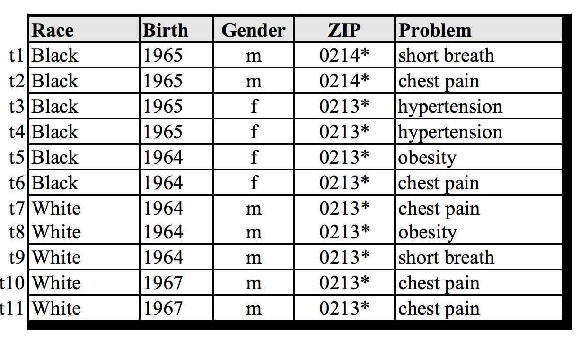
k-anonymous table
Here k=?

Slide 19
Example of generalization (1)
External data source
Released data source
Name | Birth | Gender | ZIP | Race
Andre | 1964 | m | 02135 | White
Beth | 1964 | f | 55410 | Black
Carol | 1964 | f | 90210 | White
Dan | 1967 | m | 02174 | White
Ellen | 1968 | f | 02237 | White
By linking these 2 tables, you still don’t learn Andre’s problem

Slide 20
Many generalizations possible
 | Identifiers | Non-Sensitive data |  |  | Sensitive data
# | Name | Zip | Age | Nationality | Condition
1 | Kumar | 13053 | 28 | Indian | Heart Disease
2 | Bob | 13067 | 29 | American | Heart Disease
3 | Ivan | 13053 | 35 | Canadian | Viral Infection
4 | Umeko | 13067 | 36 | Japanese | Cancer
Generalize: Age, nationality
Generalize: Zip, Age
# | Zip | Age | Nationality | Condition
1 | 13053 | < 40 | * | Heart Disease
2 | 13053 | < 40 | * | Viral Infection
3 | 13067 | < 40 | * | Heart Disease
4 | 13067 | < 40 | * | Cancer
# | Zip | Age | Nationality | Condition
1 | 130** | < 30 | American | Heart Disease
2 | 130** | < 30 | American | Viral Infection
3 | 130** | 3* | Asian | Heart Disease
4 | 130** | 3* | Asian | Cancer

Slide 21
How many generalizations possible?
Gender | Zipcode
male | 53715
female | 55410
female | 90210
male | 02274
male | 02237
The number of generalizations possible : (DGH_{i} = Maximum generalization level of A_{i})
(note, not all generalization creates a k-anonymity table)
Generalized tables possible=(2+1)*(1+1) = 6
zipcode
DGH_{zipcode}=2
gender
DGH_{gender}=1

Slide 22
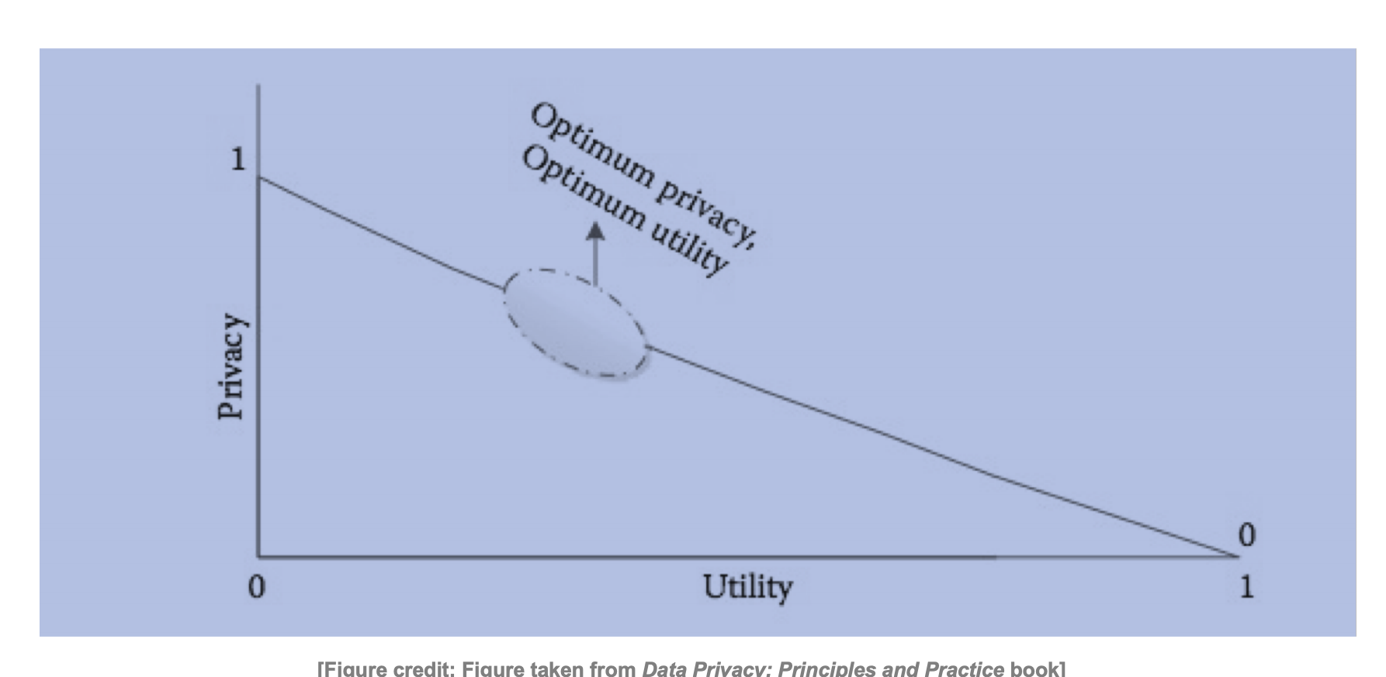
When to stop generalizing data?
The more generalization you do the more information loss (less utility)
Intuition: Don’t generalize the data more than what is needed

Slide 23
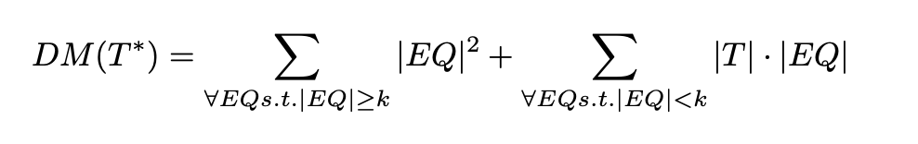
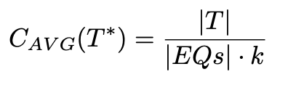
Minimal generalization
There are many k-minimal generalizations – which one is preferred?
No clear and “correct” answer :
Min. distortion:
Discernibility Metric (DM):
Average Equivalence Class Size Metric:
|T| = table size
|EQ| = equivalence class size
|EQs| = equivalence classes

Slide 24
Algorithm for finding minimal generalization
Theoretical Model (MinGen)
Store the set of all possible generalizations of table T over QI into allgens
Store from allgens all the tables which satisfied k-anonymity into protected
Define comparing measure score
From protected choose the table with best score

Slide 25
Finding minimal generalization is hard!
The search space is exponential
The problem is NP-Hard!
We are going to look at algorithmic approach–
Incognito: Efficient full-domain k-anonymity [LDR05]
Mondrian multidimensional k-anonymity [LDR06]
There is also software tools that can generate k-anonymous tables
https://dataprivacylab.org/dataprivacy/projects/kanonymity/kanonymity2.pdf

Slide 26
Generalization lattice
Birthdate | Sex | Zipcode
21/1/79 | male | 53715
10/1/79 | female | 55410
1/10/44 | female | 90210
21/2/83 | male | 02274
19/4/82 | male | 02237
assume domain hierarchies exist for all QI attributes
zipcode
birthdate
sex
objective
find the minimum generalization that satisfies k-anonymity
construct the generalization lattice for the entire QI set
more
generalization
i.e., maximize utility by finding minimum distance vector with k-anonymity
less

Slide 27
Generalization lattice: Incognito algorithm
Exploit monotonicity properties
(I) generalization property (~rollup)
if at some node k-anonymity holds, then it also holds for any subsequent (ancestor) node
e.g., <S1, Z0> is k-anonymous and, thus, so is <S1, Z1> and <S1, Z2>
(II) subset property (~apriori)
if for a set of QI attributes k-anonymity doesn’t hold then it doesn’t hold for any of its supersets
note: the entire lattice, which includes three dimensions <S,Z,B>, is too complex to show
e.g., <S0, Z0> is not k-anonymous and, thus <S0, Z0, B0> and <S0, Z0, B1> cannot be k-anonymous
incognito [LDR05] considers sets of QI attributes of increasing cardinality (~apriori) and prunes nodes in the lattice using the two properties above

Slide 28
Seen in the domain space
consider the multi-dimensional domain space
QI attributes are the dimensions
tuples are points in this space
attribute hierarchies partition dimensions
zipcode hierarchy
sex hierarchy

Slide 29
Domain folding
not 2-anonymous
incognito example
2 QI attributes, 7 tuples, hierarchies shown with bold lines
zipcode
rollup sex
2-anonymous
sex
rollup zipcode

Slide 30
Summary of Incognito algorithm
Problem:
Amongst all tables that satisfy k-anonymity, find the one that has minimum distortion
Solution:
Form a generalization lattice
Label whether such generalization satisfies k-anonymity (color or label it)
Only need to find the boundary of “minimal” generalizations that satisfy privacy.
Lattice can be efficiently pruned using bottom up traversal.
Checking k-anonymity is efficient

Slide 31
Other approach: Mondrian [LDR06]
Define utility measure: discernibility metric (DM)
penalizes each operation with the size of the group it creates
intuitively, the ideal grouping is the one in which all groups have size k
mondrian tries to construct groups of roughly equal size k
k=2
DM=6²+7²=85
Discernibility metric (DM)
DM=13²=169
|T| =table size
|EQ| = equivalence class size
DM=3*3²+2*2²=35
DM=3*3²+4²=43
Each bold line represents a suppression rule

Slide 32
Example: Mondrian [LDR06]
Attributes = {ZipCode, Age)
Age: <=26, >=27
Zip code: <=53711, >=53712,

Slide 33
Summary of Mondrian algorithm
Mondrian Multidimensional Partitioning
Recursive greedy partitioning of the space
Partition(region, k)
Choose the best dimension that results in even k-anonymous partition
If possible, partition the region according to that dimension into R1 and R2
Return Partition(R1, k) U Partition(R2, k) // Recursive
If not possible, Return
Workload driven by quality metric
E.g., Discernibility Metric

Slide 34
Comparing the two approaches
single dimensional global recoding
incognito [LDR05]
multi dimensional global recoding
mondrian [LDR06]
Figure out generalization lattice and select best node
Figure out boundaries and generate the generalization rules from them
generalization strength

Slide 35
Curse of dimensionality
Generalization fundamentally relies on spatial locality
Each record must have k close neighbors
Real-world datasets are very sparse
Many attributes (dimensions)
Netflix Prize dataset: 18,000 dimensions
Amazon customer records: several million dimensions
“Nearest neighbor” is very far

Slide 36
What does k-anonymity prevent?
Membership disclosure: Attacker cannot tell that a given person in the dataset (may or may not be in the dataset)
Sensitive attribute disclosure: Attacker cannot tell that a given person has a certain sensitive attribute (matching QI attributes do has k rows)
Identity disclosure: Attacker cannot tell which record corresponds to a given person
Assumes the adversary only knows the quasi-identifiers and no auxiliary information about the target

Slide 37
Attacks against k-anonymity
Three common attacks
Unsorted matching attack
Complementary release attack
Temporal inference attack
https://epic.org/privacy/reidentification/Sweeney_Article.pdf

Slide 38
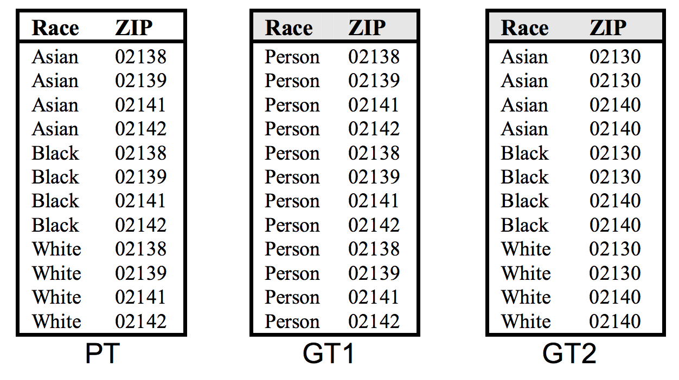
Unsorted matching attack
Based on the order of rows in the released datasets
This problem is often ignored in real-world use
Easy to correct by randomly sorting the rows
QID={Race, ZIP}

Slide 39
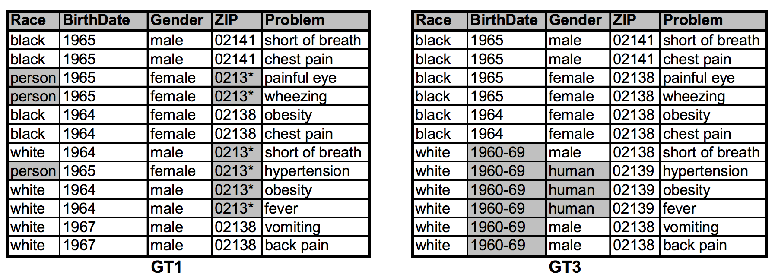
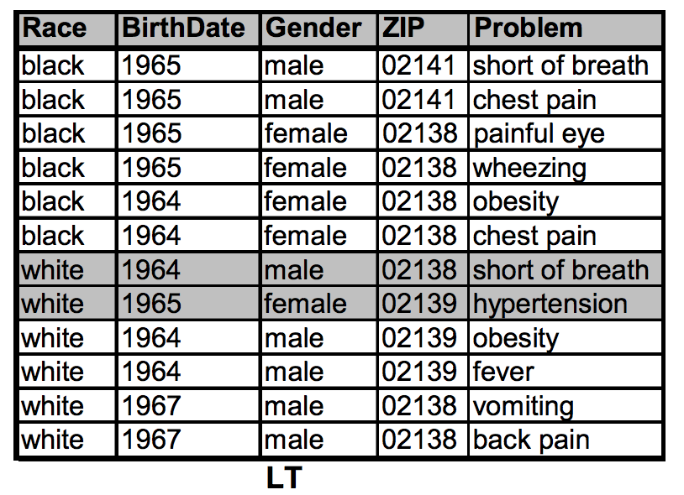
Complementary release attack
Linking GT1 and GT3 on {Problem} reveals LT
How can you protect against this type of attack?
QI_{GT3} = QI ∪ {Problem} or
GT1 is the basis of GT3

Slide 40
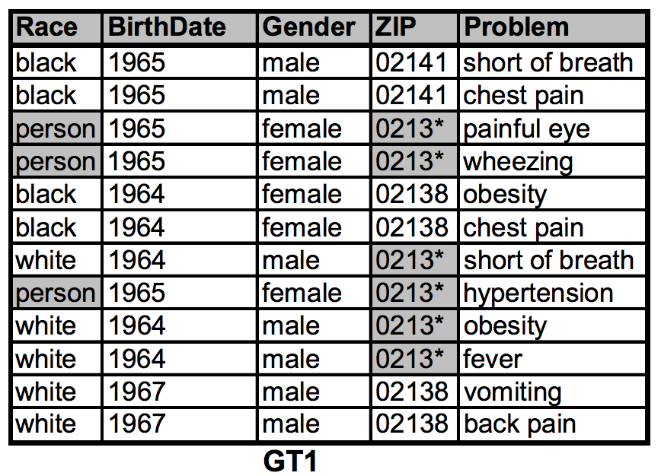
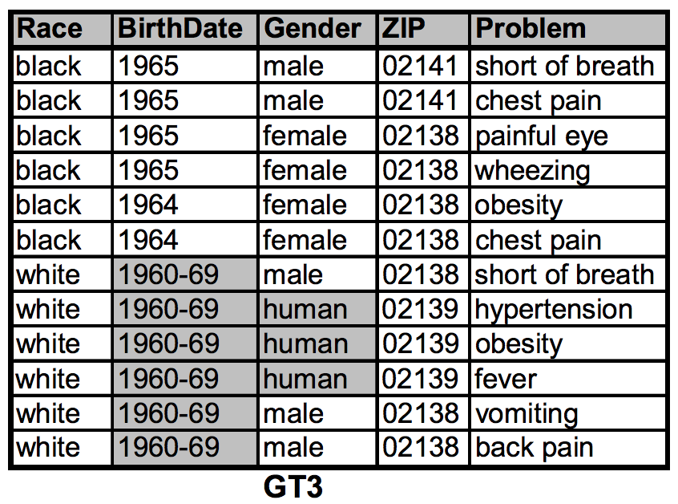
Temporal Inference attack
Linking GT1 and GT3 on {Problem} reveals LT
Solution: add new data to GT1 and then derive GT3 from GT1
………… new data
………… new data
GT3
LT

Slide 41
Exercise
 | Non-Sensitive Data |  |  | Sensitive Data
# | ZIP | Age | Nationality | Condition
1 | 13053 | 28 | Russian | Heart Disease
2 | 13068 | 29 | American | Heart Disease
3 | 13068 | 21 | Japanese | Viral Infection
4 | 13053 | 23 | American | Viral Infection
5 | 14853 | 50 | Indian | Cancer
6 | 14853 | 55 | Russian | Heart Disease
7 | 14850 | 47 | American | Viral Infection
8 | 14850 | 49 | American | Viral Infection
9 | 13053 | 31 | American | Cancer
10 | 13053 | 37 | Indian | Cancer
11 | 13068 | 36 | Japanese | Cancer
12 | 13068 | 35 | American | Cancer

Slide 42
Exercise (continue .)
 | Non-Sensitive Data |  |  | Sensitive Data
# | ZIP | Age | Nationality | Condition
1 | 13053 | 28 | * | Heart Disease
2 | 13068 | 29 | * | Heart Disease
3 | 13068 | 21 | * | Viral Infection
4 | 13053 | 23 | * | Viral Infection
5 | 14853 | 30 | * | Cancer
6 | 14853 | 35 | * | Heart Disease
7 | 14850 | 37 | * | Viral Infection
8 | 14850 | 39 | * | Viral Infection
9 | 13053 | 31 | * | Cancer
10 | 13053 | 37 | * | Cancer
11 | 13068 | 36 | * | Cancer
12 | 13068 | 35 | * | Cancer
ZIP
∗∗∗∗∗
Z3
130∗∗
Z2
1305∗
1306∗
Z1
13053
13058
13063
13067
Z0
Age
<40
A2
< 30
3*
A1
28
29
36
35
A0

Slide 43
Exercise (continue ..)
 | Non-Sensitive Data |  |  | Sensitive Data
# | ZIP | Age | Nationality | Condition
1 | 13053 | <30 | * | Heart Disease
2 | 13068 | <30 | * | Heart Disease
3 | 13068 | <30 | * | Viral Infection
4 | 13053 | <30 | * | Viral Infection
5 | 14853 | 3* | * | Cancer
6 | 14853 | 3* | * | Heart Disease
7 | 14850 | 3* | * | Viral Infection
8 | 14850 | 3* | * | Viral Infection
9 | 13053 | 3* | * | Cancer
10 | 13053 | 3* | * | Cancer
11 | 13068 | 3* | * | Cancer
12 | 13068 | 3* | * | Cancer
Applied:
A0 -> A1
Lattice point:
(Z0,A1)

Slide 44
Exercise (continue …)
 | Non-Sensitive Data |  |  | Sensitive Data
# | ZIP | Age | Nationality | Condition
1 | 1305* | <30 | * | Heart Disease
2 | 1306* | <30 | * | Heart Disease
3 | 1306* | <30 | * | Viral Infection
4 | 1305* | <30 | * | Viral Infection
5 | 1485* | 3* | * | Cancer
6 | 1485* | 3* | * | Heart Disease
7 | 1485* | 3* | * | Viral Infection
8 | 1485* | 3* | * | Viral Infection
9 | 1305* | 3* | * | Cancer
10 | 1305* | 3* | * | Cancer
11 | 1306* | 3* | * | Cancer
12 | 1306* | 3* | * | Cancer
Applied:
Z0 -> Z1, A0->A1
Lattice point:
(Z1,A1)

Slide 45
Exercise (continue …)
 | Non-Sensitive Data |  |  | Sensitive Data
# | ZIP | Age | Nationality | Condition
1 | 130** | <30 | * | Heart Disease
2 | 130** | <30 | * | Heart Disease
3 | 130** | <30 | * | Viral Infection
4 | 130** | <30 | * | Viral Infection
5 | 148** | 3* | * | Cancer
6 | 148** | 3* | * | Heart Disease
7 | 148** | 3* | * | Viral Infection
8 | 148** | 3* | * | Viral Infection
9 | 130** | 3* | * | Cancer
10 | 130** | 3* | * | Cancer
11 | 130** | 3* | * | Cancer
12 | 130** | 3* | * | Cancer
Applied:
Z1->Z2, Z0 -> Z1, A0->A1
Lattice point:
(Z2,A1)

Slide 46
Solution
 | Non-Sensitive Data |  |  | Sensitive Data
# | ZIP | Age | Nationality | Condition
1 | 130** | <30 | * | Heart Disease
2 | 130** | <30 | * | Heart Disease
3 | 130** | <30 | * | Viral Infection
4 | 130** | <30 | * | Viral Infection
5 | 148** | 3* | * | Cancer
6 | 148** | 3* | * | Heart Disease
7 | 148** | 3* | * | Viral Infection
8 | 148** | 3* | * | Viral Infection
9 | 130** | 3* | * | Cancer
10 | 130** | 3* | * | Cancer
11 | 130** | 3* | * | Cancer
12 | 130** | 3* | * | Cancer
We have 4-anonymity!!!
We have privacy!!!!
Or do we?

Slide 47
Project Idea
Course projects: groups of two to three students. The scope of the project will scale with the size of the group.
You are encouraged to suggest your own topic. Submit ideas through Moodle (submit 2-3 ideas).
https://piazza.com/class/kddxkw34mba52p?cid=11
Deadline | Task
08/22 (extended) | Project selection due (small paragraph)
08/24 (extended) | Project assigned to team group
08/28 | Project proposal, 1-3 pages (10 points)
10/06 | Project progress report, 4-8 pages (30 points)
11/16 | Final report, 8-10 pages (60 points)
https://anupamdas.org/teaching/csc-533-fa2020/projects.html

Slide 48
Logistics
Signup for:
Piazza (class discussion):
https://piazza.com/ncsu/fall2020/csc533
Moodle (lectures, videos, assignments, announcements):
https://moodle-courses2021.wolfware.ncsu.edu/course/view.php?id=2630
Office hours:
Campus students, Th 2-3pm.
https://ncsu.zoom.us/j/95186207307?pwd=YUdmMHJ0TkErcElzVytxampoaUlsdz09
DE students, Tu 8-9pm (NY time),
https://ncsu.zoom.us/j/91919947226?pwd=UmNNZjNVU093ajNFZEJYcnhrVXBDdz09
TA: Shaohu Zhang (szhang42@ncsu.edu)
M/W: 2-3pm
https://ncsu.zoom.us/j/98902722937?pwd=NTdGVHphTzJ2VTZPMERLaGtScVNSUT09

