Slide 1

CSC 533: Privacy in the Digital Age (Fall 2020) Lecture 4: l-diversity, t-closeness
Anupam Das
Aug 20, 2020

Slide 2
Goals for today
Discuss two additional privacy definitions that tries to address the limitations of k-anonymity
l-diversity
t-closeness
Some contents are borrowed from online material provided Vitaly Shmatikov and Ashwin Machanavajjhala

Slide 3
Recap: k-anonymity
Generalize, modify, or distort quasi-identifier values so that no individual is uniquely identifiable from a group of k
In SQL, table T is k-anonymous if each
(SELECT COUNT(*) FROM T GROUP BY Quasi-Identifier) ≥ k
Parameter k indicates the “degree” of anonymity
These k records form an equivalence class

Slide 4
Methods to achieve k-anonymity
Generalization: a technique used to replace more specific value with generic and semantically similar values
Suppression: Data not released at all
Can be viewed as first level of generalization
Z
X,Y,Z → mapped to middle
Generalization
Y
X
X,Y,Z → X,Y
Suppression

Slide 5
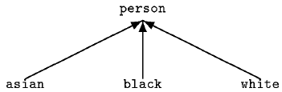
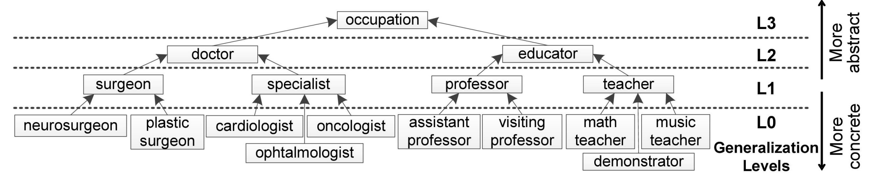
Generalization examples
ZIP
∗∗∗∗∗
130∗∗
1305∗
1306∗
13053
13058
13063
13067
Age
*
< 40
< 30
3*
28
29
36
35

Slide 6
Exercise
K=4, anonymity
 | Non-Sensitive Data |  |  | Sensitive Data
# | ZIP | Age | Nationality | Condition
1 | 13053 | 28 | Russian | Heart Disease
2 | 13068 | 29 | American | Heart Disease
3 | 13068 | 21 | Japanese | Viral Infection
4 | 13053 | 23 | American | Viral Infection
5 | 14853 | 39 | Indian | Cancer
6 | 14853 | 38 | Russian | Heart Disease
7 | 14850 | 37 | American | Viral Infection
8 | 14850 | 36 | American | Viral Infection
9 | 13053 | 31 | American | Cancer
10 | 13053 | 33 | Indian | Cancer
11 | 13068 | 34 | Japanese | Cancer
12 | 13068 | 35 | American | Cancer

Slide 7
Exercise (continue .)
 | Non-Sensitive Data |  |  | Sensitive Data
# | ZIP | Age | Nationality | Condition
1 | 13053 | 28 | * | Heart Disease
2 | 13068 | 29 | * | Heart Disease
3 | 13068 | 21 | * | Viral Infection
4 | 13053 | 23 | * | Viral Infection
5 | 14853 | 39 | * | Cancer
6 | 14853 | 38 | * | Heart Disease
7 | 14850 | 37 | * | Viral Infection
8 | 14850 | 36 | * | Viral Infection
9 | 13053 | 31 | * | Cancer
10 | 13053 | 37 | * | Cancer
11 | 13068 | 36 | * | Cancer
12 | 13068 | 35 | * | Cancer
ZIP
∗∗∗∗∗
Z3
130∗∗
Z2
1305∗
1306∗
Z1
13053
13058
13063
13067
Z0
Age
<40
A2
< 30
3*
A1
28
29
36
35
A0

Slide 8
Exercise (continue ..)
 | Non-Sensitive Data |  |  | Sensitive Data
# | ZIP | Age | Nationality | Condition
1 | 13053 | <30 | * | Heart Disease
2 | 13068 | <30 | * | Heart Disease
3 | 13068 | <30 | * | Viral Infection
4 | 13053 | <30 | * | Viral Infection
5 | 14853 | 3* | * | Cancer
6 | 14853 | 3* | * | Heart Disease
7 | 14850 | 3* | * | Viral Infection
8 | 14850 | 3* | * | Viral Infection
9 | 13053 | 3* | * | Cancer
10 | 13053 | 3* | * | Cancer
11 | 13068 | 3* | * | Cancer
12 | 13068 | 3* | * | Cancer
Age
<40
A2
< 30
3*
A1
28
29
36
35
A0
Applied:
A0 -> A1
Lattice point:
(Z0,A1)

Slide 9
Exercise (continue …)
 | Non-Sensitive Data |  |  | Sensitive Data
# | ZIP | Age | Nationality | Condition
1 | 1305* | <30 | * | Heart Disease
2 | 1306* | <30 | * | Heart Disease
3 | 1306* | <30 | * | Viral Infection
4 | 1305* | <30 | * | Viral Infection
5 | 1485* | 3* | * | Cancer
6 | 1485* | 3* | * | Heart Disease
7 | 1485* | 3* | * | Viral Infection
8 | 1485* | 3* | * | Viral Infection
9 | 1305* | 3* | * | Cancer
10 | 1305* | 3* | * | Cancer
11 | 1306* | 3* | * | Cancer
12 | 1306* | 3* | * | Cancer
ZIP
∗∗∗∗∗
Z3
130∗∗
Z2
1305∗
1306∗
Z1
13053
13058
13063
13067
Z0
Applied:
Z0 -> Z1, A0->A1
Lattice point:
(Z1,A1)

Slide 10
Exercise (continue …)
 | Non-Sensitive Data |  |  | Sensitive Data
# | ZIP | Age | Nationality | Condition
1 | 130** | <30 | * | Heart Disease
2 | 130** | <30 | * | Heart Disease
3 | 130** | <30 | * | Viral Infection
4 | 130** | <30 | * | Viral Infection
5 | 148** | 3* | * | Cancer
6 | 148** | 3* | * | Heart Disease
7 | 148** | 3* | * | Viral Infection
8 | 148** | 3* | * | Viral Infection
9 | 130** | 3* | * | Cancer
10 | 130** | 3* | * | Cancer
11 | 130** | 3* | * | Cancer
12 | 130** | 3* | * | Cancer
ZIP
∗∗∗∗∗
Z3
130∗∗
Z2
1305∗
1306∗
Z1
13053
13058
13063
13067
Z0
Applied:
Z1->Z2, Z0 -> Z1, A0->A1
Lattice point:
(Z2,A1)

Slide 11
Solution
 | Non-Sensitive Data |  |  | Sensitive Data
# | ZIP | Age | Nationality | Condition
1 | 130** | <30 | * | Heart Disease
2 | 130** | <30 | * | Heart Disease
3 | 130** | <30 | * | Viral Infection
4 | 130** | <30 | * | Viral Infection
5 | 148** | 3* | * | Cancer
6 | 148** | 3* | * | Heart Disease
7 | 148** | 3* | * | Viral Infection
8 | 148** | 3* | * | Viral Infection
9 | 130** | 3* | * | Cancer
10 | 130** | 3* | * | Cancer
11 | 130** | 3* | * | Cancer
12 | 130** | 3* | * | Cancer
We have 4-anonymity!!!
We have privacy!!!!
Or do we?

Slide 12
Attacks against k-anonymity
Three common attacks
Unsorted matching attack
Complementary release attack
Temporal inference attack
https://epic.org/privacy/reidentification/Sweeney_Article.pdf

Slide 13
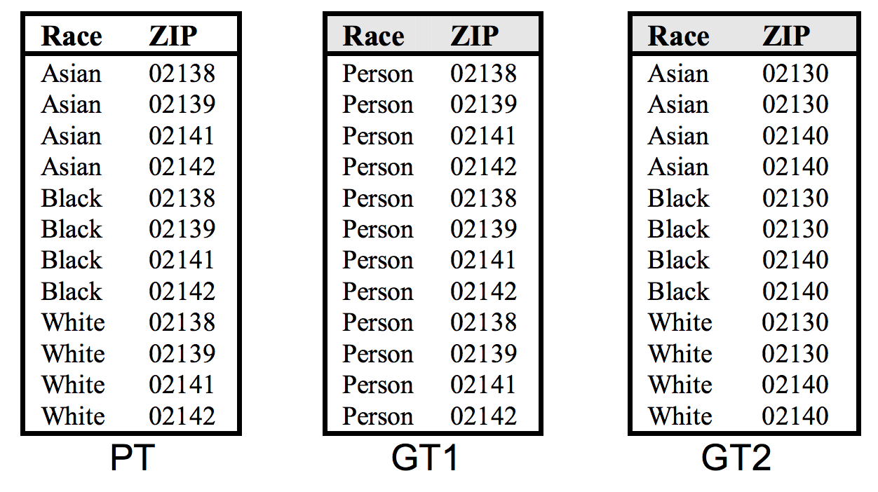
Unsorted matching attack
Based on the order of rows in the released datasets
This problem is often ignored in real-world use
Easy to correct by randomly sorting the rows
QID={Race, ZIP}

Slide 14
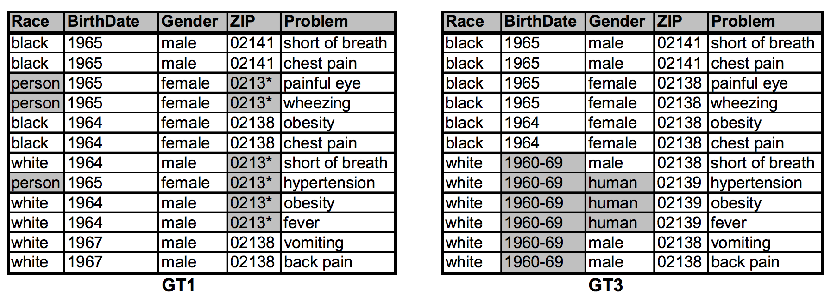
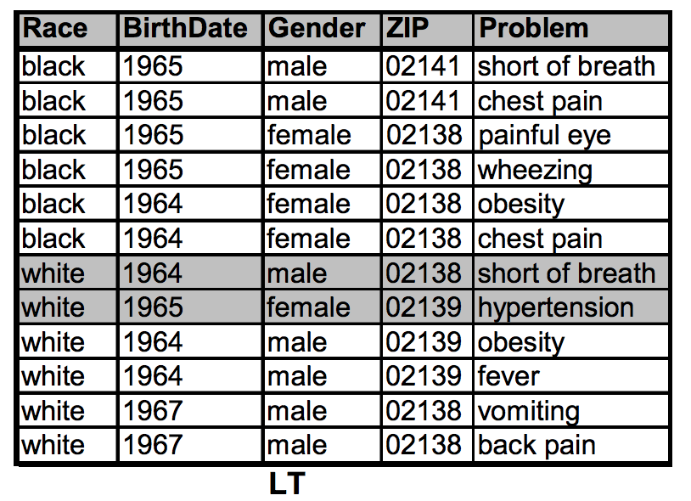
Complementary release attack
Linking GT1 and GT3 on {Problem} reveals LT
How can you protect against this type of attack?
QI_{GT3} = QI ∪ {Problem} or
GT1 is the basis of GT3

Slide 15
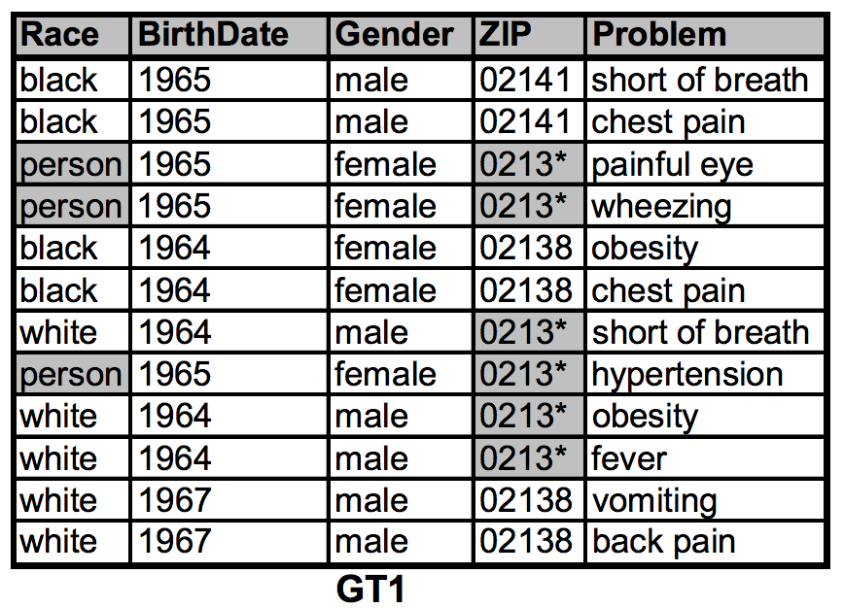
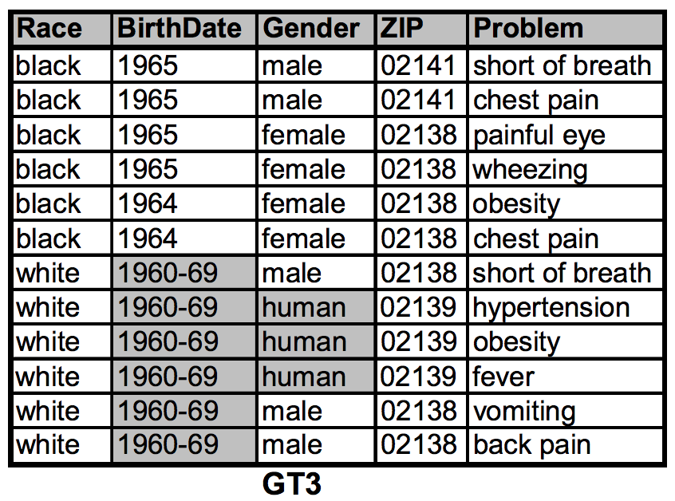
Temporal Inference attack
Linking GT1 and GT3 on {Problem} reveals LT
Solution: add new data to GT1 and then derive GT3 from GT1
………… new data
………… new data
GT3
LT

Slide 16
What else can go wrong?
 | Non-Sensitive Data |  |  | Sensitive Data
# | ZIP | Age | Nationality | Condition
1 | 130** | <30 | * | Heart Disease
2 | 130** | <30 | * | Heart Disease
3 | 130** | <30 | * | Viral Infection
4 | 130** | <30 | * | Viral Infection
5 | 148** | 3* | * | Cancer
6 | 148** | 3* | * | Heart Disease
7 | 148** | 3* | * | Viral Infection
8 | 148** | 3* | * | Viral Infection
9 | 130** | 3* | * | Cancer
10 | 130** | 3* | * | Cancer
11 | 130** | 3* | * | Cancer
12 | 130** | 3* | * | Cancer
Suppose attacker knows the non-sensitive attributes of
Umeko has viral infection!
Name | Zip | Age | National
Umeko | 13068 | 21 | Japanese
Bob | 13053 | 31 | American
And the fact that Japanese have very low incidence of heart disease
Bob has cancer!
Notes:
Back of the envelope calculation: 60,000 distinct tuples, 3 values for the sensitive attribute. 5-anonymity will create about 12,000 groups. On average, 1 out of 81 will have no diversity (all values will be the same). Therefore 148 groups (740 people) can be compromised.

Slide 17
Drawbacks of k-anonymity
Basic Reasons for leak:
Sensitive attributes lack diversity in values
Homogeneity Attack
Attacker has additional background knowledge
Background knowledge Attack
Hence a new solution has been proposed in-addition to k-anonymity
l-diversity

Slide 18
l-diversity
white | 787XX | Flu
white | 787XX | Shingles
white | 787XX | Acne
white | 787XX | Flu
white | 787XX | Acne
white | 787XX | Flu
Asian/AfrAm | 78XXX | Flu
Asian/AfrAm | 78XXX | Flu
Asian/AfrAm | 78XXX | Acne
Asian/AfrAm | 78XXX | Shingles
Asian/AfrAm | 78XXX | Acne
Asian/AfrAm | 78XXX | Flu
Sensitive attributes must be
“diverse” within each
equivalence class

Slide 19
l-diversity principle
A q-block is l-diverse if contains at least l ‘well represented” values for the sensitive attribute.
A table is l-diverse if every q-block is l-diverse

Slide 20
Exercise: k-anonymous and l-diverse
 | Non-Sensitive Data |  |  | Sensitive Data
# | ZIP | Age | Nationality | Condition
1 | 13053 | 28 | Russian | Heart Disease
2 | 13068 | 29 | American | Heart Disease
3 | 13068 | 21 | Japanese | Viral Infection
4 | 13053 | 23 | American | Viral Infection
5 | 14853 | 39 | Indian | Cancer
6 | 14853 | 38 | Russian | Heart Disease
7 | 14850 | 37 | American | Viral Infection
8 | 14850 | 36 | American | Viral Infection
9 | 13053 | 31 | American | Cancer
10 | 13053 | 33 | Indian | Cancer
11 | 13068 | 34 | Japanese | Cancer
12 | 13068 | 35 | American | Cancer

Slide 21
Initial solution
 | Non-Sensitive Data |  |  | Sensitive Data
# | ZIP | Age | Nationality | Condition
1 | 130** | <30 | * | Heart Disease
2 | 130** | <30 | * | Heart Disease
3 | 130** | <30 | * | Viral Infection
4 | 130** | <30 | * | Viral Infection
5 | 148** | 3* | * | Cancer
6 | 148** | 3* | * | Heart Disease
7 | 148** | 3* | * | Viral Infection
8 | 148** | 3* | * | Viral Infection
9 | 130** | 3* | * | Cancer
10 | 130** | 3* | * | Cancer
11 | 130** | 3* | * | Cancer
12 | 130** | 3* | * | Cancer
 | Non-Sensitive Data |  |  | Sensitive Data
# | ZIP | Age | Nationality | Condition
1 | 13053 | 28 | Russian | Heart Disease
2 | 13068 | 29 | American | Heart Disease
3 | 13068 | 21 | Japanese | Viral Infection
4 | 13053 | 23 | American | Viral Infection
5 | 14853 | 39 | Indian | Cancer
6 | 14853 | 38 | Russian | Heart Disease
7 | 14850 | 37 | American | Viral Infection
8 | 14850 | 36 | American | Viral Infection
9 | 13053 | 31 | American | Cancer
10 | 13053 | 33 | Indian | Cancer
11 | 13068 | 34 | Japanese | Cancer
12 | 13068 | 35 | American | Cancer

Slide 22
Lets go back one step
 | Non-Sensitive Data |  |  | Sensitive Data
# | ZIP | Age | Nationality | Condition
1 | 1305* | <30 | * | Heart Disease
2 | 1306* | <30 | * | Heart Disease
3 | 1306* | <30 | * | Viral Infection
4 | 1305* | <30 | * | Viral Infection
5 | 1485* | 3* | * | Cancer
6 | 1485* | 3* | * | Heart Disease
7 | 1485* | 3* | * | Viral Infection
8 | 1485* | 3* | * | Viral Infection
9 | 1305* | 3* | * | Cancer
10 | 1305* | 3* | * | Cancer
11 | 1306* | 3* | * | Cancer
12 | 1306* | 3* | * | Cancer
ZIP
∗∗∗∗∗
Z3
130∗∗
Z2
1305∗
1306∗
Z1
13053
13058
13063
13067
Z0
Applied:
Z0 -> Z1, A0->A1
Lattice point:
(Z1,A1)

Slide 23
We can do less generalization?
 | Non-Sensitive Data |  |  | Sensitive Data
# | ZIP | Age | Nationality | Condition
1 | 1305* | 28 | * | Heart Disease
2 | 1305* | 23 | * | Viral Infection
3 | 1305* | 31 | * | Cancer
4 | 1305* | 33 | * | Cancer
5 | 1485* | 39 | * | Cancer
6 | 1485* | 38 | * | Heart Disease
7 | 1485* | 37 | * | Viral Infection
8 | 1485* | 36 | * | Viral Infection
9 | 1306* | 29 | * | Heart Disease
10 | 1306* | 21 | * | Viral Infection
11 | 1306* | 34 | * | Cancer
12 | 1306* | 35 | * | Cancer

Slide 24
Are we done?
 | Non-Sensitive Data |  |  | Sensitive Data
# | ZIP | Age | Nationality | Condition
1 | 1305* | <= 35 | * | Heart Disease
2 | 1305* | <= 35 | * | Viral Infection
3 | 1305* | <= 35 | * | Cancer
4 | 1305* | <= 35 | * | Cancer
5 | 1485* | >= 36 | * | Cancer
6 | 1485* | >= 36 | * | Heart Disease
7 | 1485* | >= 36 | * | Viral Infection
8 | 1485* | >= 36 | * | Viral Infection
9 | 1306* | <= 35 | * | Heart Disease
10 | 1306* | <= 35 | * | Viral Infection
11 | 1306* | <= 35 | * | Cancer
12 | 1306* | <= 35 | * | Cancer
We have 3-distinct diversity!!!
We have privacy!!!!
Or do we?

Slide 25
What is wrong?
 | Non-Sensitive Data |  |  | Sensitive Data
# | ZIP | Age | Nat. | Condition
1 | 130** | <30 | * | Heart Disease
2 | 130** | <30 | * | Heart Disease
3 | 130** | <30 | * | Viral Infection
4 | 130** | <30 | * | Viral Infection
5 | 130** | <30 | * | Viral Infection
6 | 130** | <30 | * | Viral Infection
7 | 130** | <30 | * | Viral Infection
8 | 130** | <30 | * | Viral Infection
9 | 130** | <30 | * | Viral Infection
10 | 130** | <30 | * | Viral Infection
11 | 130** | <30 | * | Viral Infection
12 | 130** | <30 | * | Cancer
Suppose attacker knows the non-sensitive attributes of
And the fact that Japanese have very low incidence of heart disease
Still very likely that Umeko has viral infection!
Name | Zip | Age | National
Umeko | 13068 | 21 | Japanese
Notes:
Back of the envelope calculation: 60,000 distinct tuples, 3 values for the sensitive attribute. 5-anonymity will create about 12,000 groups. On average, 1 out of 81 will have no diversity (all values will be the same). Therefore 148 groups (740 people) can be compromised.

Slide 26
Variants of l-diversity
Probabilistic l-diversity
The frequency of the most frequent value in an equivalence class is bounded by 1/l
Entropy l-diversity
The entropy of the distribution of sensitive values in each equivalence class is at least log(l)
Sensitive values evenly distributed
Recursive (c, l)-diversity
r₁<c(r_{l}+r_{l+1}+…+r_{m}) where r_{i} is the frequency of the i^{th} most frequent value; for m=3 attributes (2,2)-diversity: r₁<2(r₂+r₃)
Intuition: the most frequent value does not appear too frequently

Slide 27
Neither Necessary, Nor Sufficient
Original dataset
Anonymization A
Anonymization B
… | Flu
… | Flu
… | Cancer
… | Flu
… | Flu
… | Flu
… | Flu
… | Flu
… | Flu
… | Cancer
… | Flu
… | Flu
Q1 | Flu
Q1 | Flu
Q1 | Cancer
Q1 | Flu
Q1 | Cancer
Q1 | Cancer
Q2 | Flu
Q2 | Flu
Q2 | Flu
Q2 | Flu
Q2 | Flu
Q2 | Flu
50% cancer ⇒ quasi-identifier group is “diverse”
Posterior belief just increased, someone in this group likely has cancer
Q1 | Flu
Q1 | Flu
Q1 | Flu
Q1 | Flu
Q1 | Flu
Q1 | Cancer
Q2 | Flu
Q2 | Flu
Q2 | Cancer
Q2 | Cancer
Q2 | Flu
Q2 | Flu
1% cancer ⇒ quasi-identifier group is not as “diverse”
…yet anonymized database does not leak anything
1% have cancer
Diff(Posterior belief, Prior belief) → information gain

Slide 28
Limitations of l-Diversity
Example: sensitive attribute is HIV+ (1%) or HIV- (99%)
Very different degrees of sensitivity!
l-diversity is unnecessary
2-diversity is unnecessary for an equivalence class that contains only HIV- records
l-diversity is difficult to achieve
Suppose there are 10000 records in total
To have distinct 2-diversity, there can be at most ____
10000*1%=100 equivalence classes

Slide 29
Skewness attack
Issue: When the overall distribution is skewed, satisfying l-diversity does not prevent attribute disclosure.
l-diversity does not consider overall distribution of sensitive values!

Slide 30
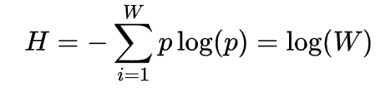
Skewness attack: another example
# | Age | Condition
1 | <30 | Cancer
2 | <30 | Cancer
3 | <30 | Healthy
4 | <30 | Healthy
5 | 3* | Cancer
6 | 3* | Healthy
7 | 3* | Healthy
8 | 3* | Healthy
9 | 3* | Healthy
10 | ≥30 | Healthy
11 | ≥30 | Cancer
12 | ≥30 | Cancer
13 | ≥30 | Cancer
14 | ≥30 | Cancer
Two sensitive values under condition:
Cancer (1%) and Healthy (99%)
Normal entropy: 1.0576
entropy: 2
Attacker learned a lot!
entropy: 1.65
Equivalent in terms of l-diversity, but very different semantically
entropy: 1.65
Notes:
Back of the envelope calculation: 60,000 distinct tuples, 3 values for the sensitive attribute. 5-anonymity will create about 12,000 groups. On average, 1 out of 81 will have no diversity (all values will be the same). Therefore 148 groups (740 people) can be compromised.

Slide 31
Similarity attack
A 3-diverse patient table
Conclusion
Bob’s salary is in [20k,40k], which is relatively low
Bob has some stomach-related disease
Similarity attack
Zipcode | Age | Salary | Disease
476** | 2* | 20K | Gastric Ulcer
476** | 2* | 30K | Gastritis
476** | 2* | 40K | Stomach Cancer
4790* | ≥40 | 50K | Gastritis
4790* | ≥40 | 100K | Flu
4790* | ≥40 | 70K | Bronchitis
476** | 3* | 60K | Bronchitis
476** | 3* | 80K | Pneumonia
476** | 3* | 90K | Stomach Cancer
Bob
Zip | Age
47678 | 27
l-diversity does not consider semantics of sensitive values!

Slide 32
t-closeness: main idea
Rationale
A completely generalized table
Age | Zipcode | …… | Gender | Disease
* | * | …… | * | Flu
* | * | …… | * | Heart Disease
* | * | …… | * | Cancer
. . . | . . . | …… …… …… | . . . | . . .
* | * | …… | * | Gastritis
Belief | Knowledge
B₀
External Knowledge
B₁
Overall distribution Q of sensitive values
Notes:
Ninghui Li and his team proposed a new privacy measure, the t-closeness. The idea is dividing the gained knowledge into two parts.

Slide 33
t-closeness: main idea (continue …)
Rationale
A released table
Age | Zipcode | …… | Gender | Disease
2* | 479** | …… | Male | Flu
2* | 479** | …… | Male | Heart Disease
2* | 479** | …… | Male | Cancer
. . . | . . . | …… …… …… | . . . | . . .
≥50 | 4766* | …… | * | Gastritis
Belief | Knowledge
B₀
External Knowledge
B₁
Overall distribution Q of sensitive values
B₂
Distribution P_{i} of sensitive values in each equivalence class
33

Slide 34
t-closeness: main idea (continue …)
Rationale
Observations
Q should be treated as public
Knowledge gain in two parts:
Whole population (from B₀ to B₁)
Specific individuals (from B₁ to B₂)
We try to bound knowledge gain between B₁ and B₂ instead
Principle
The distance between Q and P_{i} should be bounded by a threshold t
Belief | Knowledge
B₀
External Knowledge
B₁
Overall distribution Q of sensitive values
B₂
Distribution P_{i} of sensitive values in each equivalence class
34

Slide 35
t-closeness: recap
Privacy is measured by the information gain of an observer
Information Gain = Posterior Belief – Prior Belief
Q = the distribution of the sensitive attribute in the whole table
P_{i} = the distribution of the sensitive attribute in the equivalence class
Goal: make Q and P_{i} as similar as possible

Slide 36
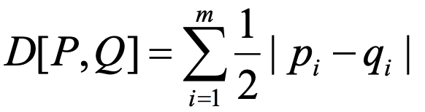
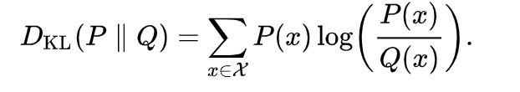
Distance between two prob. distributions
Given two distributions
P = (p₁ , p₂ , ..., p_{m})
Q = (q₁ , q₂ , ..., q_{m})
Two well-known distance measures are as follows
Trace -distance
KL-divergence
None of these measures reflect the semantic distance among values.
Q: {3K,4K,5K,6K,7K,8K,9K,10K,11k}, P1:{3K,4K,5k}, P2:{5K,7K,10K}
Intuitively, D[ P1 ,Q] D[ P2 ,Q]
?
>

Slide 37
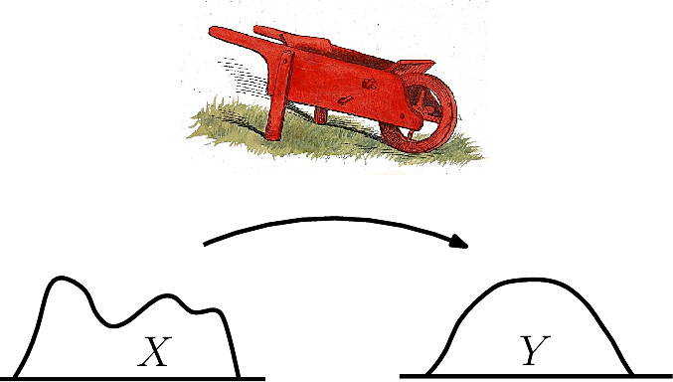
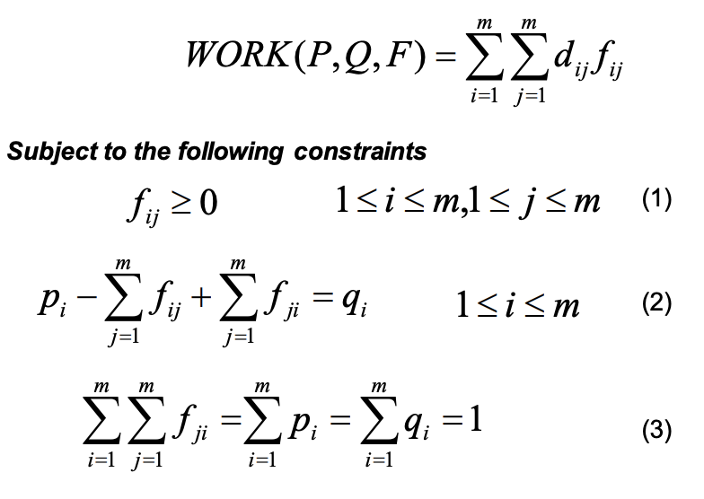
Earth Mover’s Distance (EMD)
If the distributions are interpreted as two different ways of piling up a certain amount of dirt over region D, EMD is the minimum cost of turning one pile into the other
– the cost is amount of dirt moved * the distance by which it is moved
– equal amount of dirt in both piles
Starting amount
Ending amount
Total moved into pile
Total moved from pile

Slide 38
EMD: example
3K
4K
5K
6K
7K
8K
9K
10K
11K
Q
Example –
Q= {3k,4k,5k,6k,7k,8k,9k,10k,11k}
P₁= {3k,4k,5k}
P₂= {6k,8k,11k}
D[P₁,Q] : transform P₁ to Q
– Move 1/9 probability for each of the following pairs
• 3k ->6k, 3k ->7k cost: 1/9*(3+4)/8
• 4k->8k,4k->9k cost: 1/9*(4+5)/8
• 5k->10k,5k->11k cost: 1/9*(5+6)/8
– Total cost: 1/9*27/8=0.375
D[P₂,Q]
–total cost is 1/9 * 12/8 = 0.167 < 0.375. This make more sense than the other two distance calculation method.
1/9
P1
3K
4K
5K
Hint: Split the dirt inside the 3k-bucket into 3 parts and move 1/3 of that (i.e., 1/9 of the total dirt in all bucket) to 6k and 7k. Similarly for others [LCM]

Slide 39
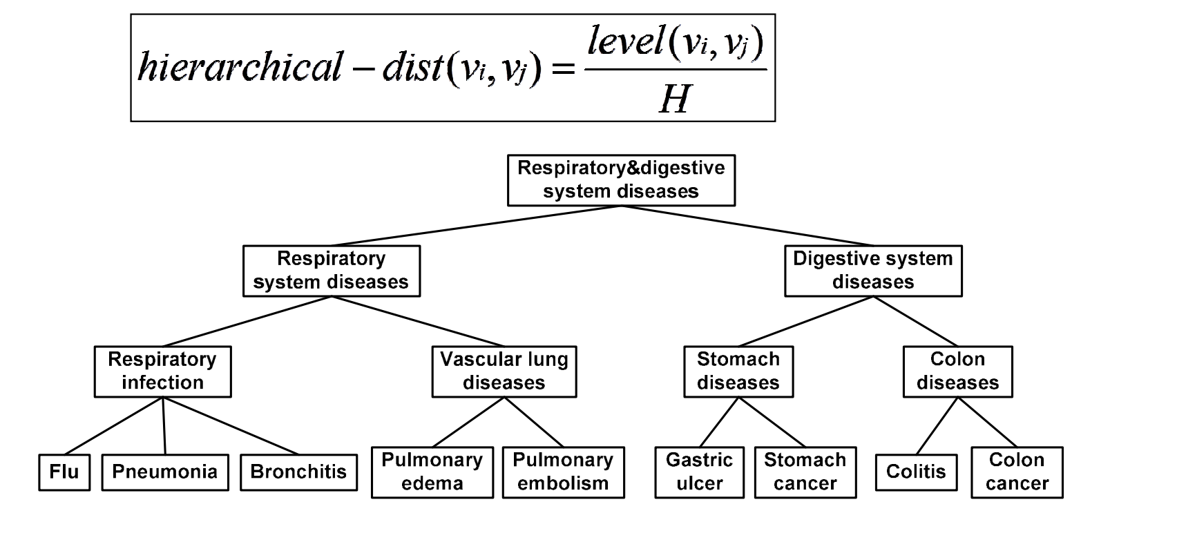
EMD for categorical value
EMD for categorical attributes
– Hierarchical distance is a metric
Level(v_{i},v_{j}) = height of the lowest common ancestor node of v_{i} and v_{j}.
Hierarchical distance (stomach and colon disease)?
= height(digestive system disease) / Height of tree
= 2/3

Slide 40
t-closeness: summary
An equivalence class is said to have t-closeness if the distance between the distribution of a sensitive attribute in this class and the distribution of the attribute in the whole table is no more than a threshold t.
A table is said to have t-closeness if all equivalence classes have t-closeness.
If different t values for different equivalence class report the maximum t value.
A distance measure called Earth Movers Distance is used. Intuitively, the amount of work needed to transform one distribution to another by moving mass between them

Slide 41
Are we secure now?
white | 787XX | HIV+ | Flu
Asian/AfrAm | 787XX | HIV- | Flu
Asian/AfrAm | 787XX | HIV+ | Shingles
white | 787XX | HIV- | Acne
white | 787XX | HIV- | Shingles
white | 787XX | HIV- | Acne
This is k-anonymous,
l-diverse and t-close…
…so secure, right?

Slide 42
Not quite!
Bob is Caucasian and
I heard he was
admitted to hospital
with flu…
white | 787XX | HIV+ | Flu
Asian/AfrAm | 787XX | HIV- | Flu
Asian/AfrAm | 787XX | HIV+ | Shingles
white | 787XX | HIV- | Acne
white | 787XX | HIV- | Shingles
white | 787XX | HIV- | Acne
This is against the rules!
“flu” is not a quasi-identifier
Yes… but quasi-identifier+{any attribute} = quasi-identifer

Slide 43
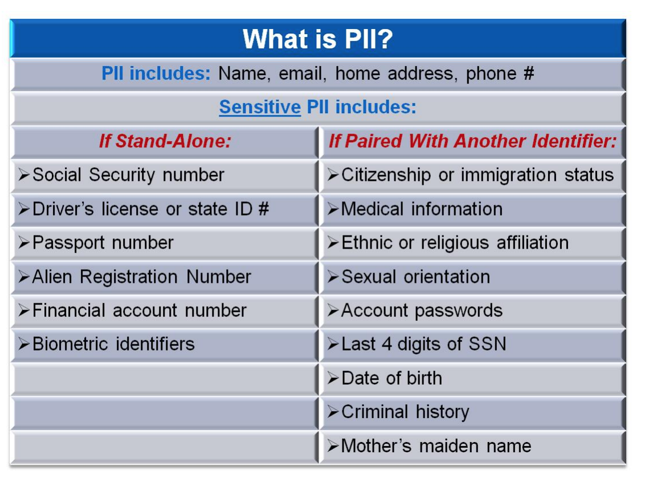
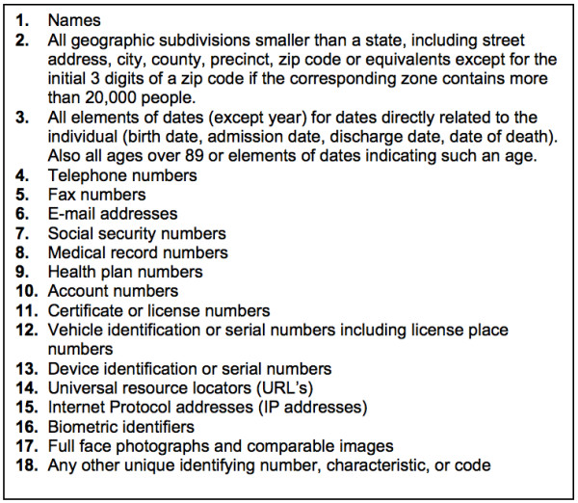
What data is personal/sensitive data?
Protected Health Information by HIPPA
PII by DHS
Is protecting all these data sufficient?

Slide 44
Myth of PII
Data are “anonymized” by removing personally identifying information (PII)
Name, Social Security number, phone number, email, address… what else?
Problem: PII list is not comprehensive
In released datasets, any information can be personally identifying (e.g., search queries)
Background information could be out there

Slide 45
Project Idea
Course projects: groups of two to three students. The scope of the project will scale with the size of the group.
You are encouraged to suggest your own topic. Submit ideas through Moodle (submit 2-3 ideas).
https://piazza.com/class/kddxkw34mba52p?cid=11
Deadline | Task
08/22 (extended) | Project selection due (small paragraph)
08/24 (extended) | Project assigned to team group
08/28 | Project proposal, 1-3 pages (10 points)
10/06 | Project progress report, 4-8 pages (30 points)
11/16 | Final report, 8-10 pages (60 points)
https://anupamdas.org/teaching/csc-533-fa2020/projects.html

Slide 46
Home Assignment 1
Home Assignment 1 will be released today (or by tomorrow)
Due Sept 4, 2020
Will appear in Moodle
Best 4 out of 5 will be counted
Due dates of assignments available
https://anupamdas.org/teaching/csc-533-fa2020/assignment.html

Slide 47
Logistics
Signup for:
Piazza (class discussion):
https://piazza.com/ncsu/fall2020/csc533
Moodle (lectures, videos, assignments, announcements):
https://moodle-courses2021.wolfware.ncsu.edu/course/view.php?id=2630
Office hours:
Campus students, Th 2-3pm.
https://ncsu.zoom.us/j/95186207307?pwd=YUdmMHJ0TkErcElzVytxampoaUlsdz09
DE students, Tu 8-9pm (NY time),
https://ncsu.zoom.us/j/91919947226?pwd=UmNNZjNVU093ajNFZEJYcnhrVXBDdz09
TA: Shaohu Zhang (szhang42@ncsu.edu)
M/W: 2-3pm
https://ncsu.zoom.us/j/98902722937?pwd=NTdGVHphTzJ2VTZPMERLaGtScVNSUT09

