Slide 1

CSC 533: Privacy in the Digital Age (Fall 2020) Lecture 7: Private Information Retrieval (PIR)
Anupam Das
Sept 03, 2020

Slide 2
Goals for today
What private information retrieval (PIR) means?
How is PIR implemented?
Use cases of PIR in the wild
Some contents are borrowed from online material provided by Stefan Dziembowsk, Amos Beimel, Amir Houmansadr

Slide 3
Thus far we have seen
We have focused on making the database more anonymous before releasing or answering queries.
The database owner (or curator) can see the query.
What is the query itself is sensitive in nature?
Say, Alice is an investor querying a stock-market database. Alice wants to obtain information from a database, but she does not want the database to learn which information she wanted.

Slide 4
What is the main issue?
The owners of databases know a lot about the users!
This poses a risk to users’ privacy.
E.g. consider database with stock prices…
Can we do something about it?
We can:
trust them that they will protect our secrecy,
or
use cryptography!
can we?

Slide 5

How can crypto help?
user U
database D
Note: this problem has nothing to do with secure communication!

Slide 6
Our setting
secure link
database D
user U
A new primitive:
Private Information Retrieval (PIR)
Goal: hide what information was retrieved

Slide 7
Private Information Retrieval (PIR): intro
Goal: allow user to query database while hiding the identity of the data-items she is after.
Note: hides identity of data-items; not the existence of interaction with the user.
Motivation: patent databases; stock quotes; web access; many more....
Analogy: imagine buying in a store without the seller knowing what you buy.

Slide 8
PIR: threat model
Semi-honest assumption on servers
Server is trustable in terms of honestly following the protocol
Server knows every bit of the data
Server may record client’s requests/queries
Malicious servers
Drop messages
Change messages
Collude with other parties
We are considering mostly semi-honest servers

Slide 9
Simple model
User: wishes to retrieve X_{i}
and
to keep i private
Server: holds n-bit string x
n should be thought of as very large
?
database B: vector of bits
index i = 1,…,n
X_{i}
X₁ | X₂ | … | X_{n}
the user should learn X_{i}
each B_{i} є {0,1}
(he may also learn other X_{i}’s)

Slide 10
Non-private protocol
i {1,…n}
x_{i}
x =x₁,x₂ , . . ., x_{n}
i
SERVER
USER
NO privacy!!!
Communication overhead:
log n
Notes:
(possibly skip)

Slide 11
Trivial private protocol
x₁,x₂ , . . ., x_{n}
x =x₁,x₂ , . . ., x_{n}
x_{i}
SERVER
USER
Server sends entire database x to User.
Information theoretic privacy.
Communication overhead:
n
Is this optimal?
Notes:
(possibly skip)

Slide 12
More “solutions”
User asks for additional random indices.
Pick a few random indices to hide the real one
Drawback :leaks information, reduces communication efficiency
Employ general crypto protocols to compute x_{i} privately.
Drawback: highly inefficient (polynomial in n).
Anonymity (e.g., via Anonymizers).
Note: addresses different problems: hides identity of user; not the fact that x_{i} is retrieved.

Slide 13
Two approaches
Information-Theoretic PIR [CGKS95,Amb97,...]
Replicate database among k servers.
Servers can collude.
Computational PIR [CG97,KO97,CMS99,...]
Computational privacy, based on cryptographic assumptions – NP hard to break the approach
Notes:
Note user privacy can be extended to t-privacy (against coalitions)
Info theoretic approach introduced by CGKS
Note that info theoretic approach there is a better model (random server) but I will mention it later, for now the basics..
For computational approach (against computationally bounded db), need some cryptographic assumption: also follows from our work (the OT is necessary)

Slide 14
Known communication upper bounds
Multiple servers, information-theoretic PIR:
2 servers, comm. n^{1/3} [CGKS95]
k servers, comm. n^{1/Ω(k)} [CGKS95, Amb96,…,BIKR02]
log n servers, comm. Poly( log(n) ) [BF90, CGKS95]
Single server, computational PIR:
Comm. Poly( log(n) ), n is the # of items
Under appropriate computational assumptions [KO97,CMS99]
Notes:
Most of the main contributions. Chronological order. Mine is in red…
since I won’t talk about random server model, let me talk about it now...

Slide 15
k-Server PIR
x {0,1}^{n}
S₁
i
x {0,1}^{n}
S₂
U
Correctness: User obtains x_{i}
Privacy: No single server gets information about i
x {0,1}^{n}
S_{k}
Notes:
Some hand-written slides about the CDOS, specific constructions, etc. check.
Clearly info theoretic SPIR is not possible with a single database (even PIR is not). However, even with multiple databases it is not possible, unless grant them access to shared random string.
(can be viewed as part of the data), can also be pseudo random, making data privacy computational while user privacy is still info-theoretic

Slide 16
Information-Theoretic 2-Server PIR
Best Known Protocol: comm. n^{1/3}
We’ll look at an example with comm. cost n and n^{1/2} today
Two protocols:
Protocol I: n bit queries, 1 bit answers (simpler version)
Protocol II: n^{1/2} bit queries, n^{1/2} bit answers

Slide 17
Protocol 1: 2-server O(n) PIR
S₁
S₂
n
0
1
0
0
1
1
0
1
0
0
1
0
0
1
0
0
1
1
0
1
0
0
1
0
0
1
0
0
1
1
0
1
0
0
1
0
i
Q₁⊂{0,1}^{n}
Q₁ is a random subset
Q₁ = 010110 … 0
n
i
*User sent O(n) bits
U

Slide 18
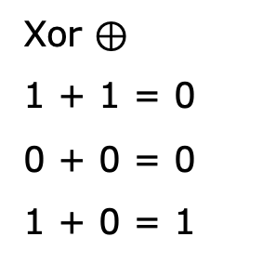

Protocol 1: 2-server O(n) PIR
S₁
S₂
n
0
1
0
0
1
1
0
1
0
0
1
0
0
1
0
0
1
1
0
1
0
0
1
0
0
1
0
0
1
1
0
1
0
0
1
0
Q₁
i
0
1
0
1
1
0
0
1
1
1
1
0
Consider only bits in S1 where Q₁ is 1 (i.e., dot product)
i
Q₁⊂{0,1^{}n}
Q₁ is a random subset
Xor $⊕$
1 + 1 = 0
0 + 0 = 0
1 + 0 = 1
1
0
1
1
0
0
1
Q₁ = 010110 … 0
$$⊕$$
component bit-wise Xor
n
0
i
*User sent O(n) bits
U

Slide 19

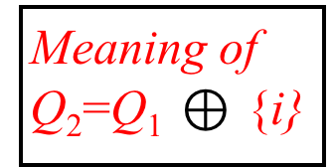
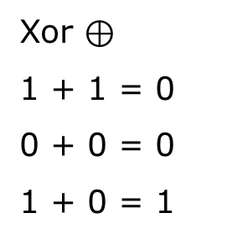
Protocol 1: 2-server O(n) PIR
S₁
S₂
n
0
1
0
0
1
1
0
1
0
0
1
0
0
1
0
0
1
1
0
1
0
0
1
0
0
1
0
0
1
1
0
1
0
0
1
0
i
Xor $⊕$
1 + 1 = 0
0 + 0 = 0
1 + 0 = 1
Q₁ = 010110 … 0
Q₁⊂{0,1}^{n}
$$⊕$$
{i} = 000010 … 0
Q₁ is a random subset
Q₁ = 010110 … 0
Meaning of Q₂=Q₁ $⊕$ {i}
Q₂ = 010100 … 0
n
i
*User sent O(n) bits
U

Slide 20
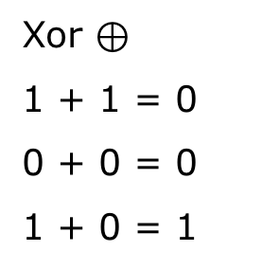

Protocol 1: 2-server O(n) PIR
S₁
S₂
n
0
1
0
0
1
1
0
1
0
0
1
0
0
1
0
0
1
1
0
1
0
0
1
0
0
1
0
0
1
1
0
1
0
0
1
0
Q₁
i
0
1
0
1
1
0
0
1
1
1
1
0
Q₂
0
1
0
1
0
0
0
1
1
1
1
0
Consider only bits in S2 where Q₂ is 1
i
Q₂ = 010100 … 0
Xor $⊕$
1 + 1 = 0
0 + 0 = 0
1 + 0 = 1
1
0
1
0
0
1
$$⊕$$
i
1
U
*User sent O(n) bits

Slide 21
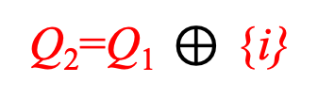
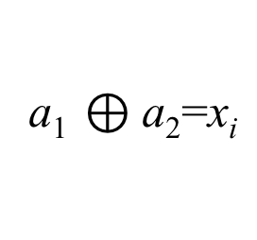
Protocol 1: 2-server PIR
n
0
0
1
0
0
1
1
0
1
0
0
1
0
1
S₁
i
S₂
Q₂=Q₁ $⊕$ {i}
Q₁ ⊂{0,1}^{n}
at random
a₁ $⊕$a₂=x_{i}
What if servers collude?
i
That is why semi-honest setting
U

Slide 22
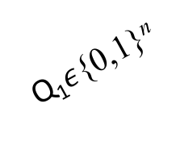
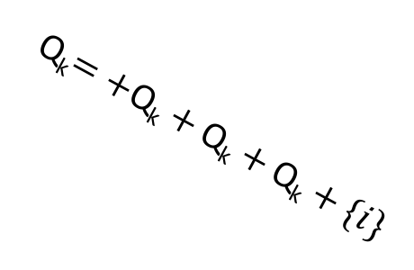

Protocol 1: k-server PIR
n
S₁
0
1
0
0
1
1
0
1
0
0
1
0
Q₁$ε\text{\{0,1\}}\text{n}$
i
Q₂$ε\text{\{0,1\}}\text{n}$
S₂
U
0
1
0
0
1
1
0
1
0
0
1
0
.
.
.
Q_{k}$=+\text{Q}\text{k}+\text{Q}\text{k}+\text{Q}\text{k}+\{i\}$
S_{k}
0
1
0
0
1
1
0
1
0
0
1
0
If (k-1) servers collude then still they can’t learn anything
(k-1) private

Slide 23
Protocol 1: k-server PIR cost
n
S₁
0
1
0
0
1
1
0
1
0
0
1
0
Q₁$ε\text{\{0,1\}}\text{n}$
i
Q₂$ε\text{\{0,1\}}\text{n}$
S₂
U
0
1
0
0
1
1
0
1
0
0
1
0
.
.
.
Q_{k}$=+\text{Q}\text{k}+\text{Q}\text{k}+\text{Q}\text{k}+\{i\}$
Communication cost:
user to server: O(k*n)
server to user: O(k*1)
n is assumed to be very large!
S_{k}
0
1
0
0
1
1
0
1
0
0
1
0

Slide 24
What if a response goes missing?
What happens if –
Miss one response from the servers?
One server maliciously perturbs the data?
We can’t reconstruct the data.
All servers have to respond properly
Which threat model is this?

Slide 25
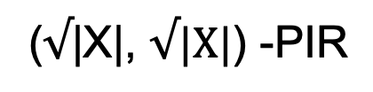
How to lower cost?
Idea: Given:
construct
Suppose that |X| = n² and present X as a n×n-matrix:
(|X|, 1) -PIR
($√$|X|, $√|X|$) -PIR
X1 | X2 | X3 | X4
X5 | X6 | X7 | X8
X9 | X10 | X11 | X12
X13 | X14 | X15 | X16
consider each row as a separate
database

Slide 26

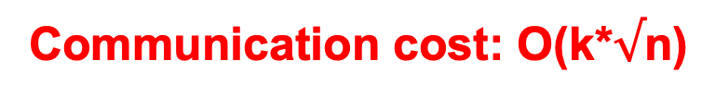
Protocol 2: PIR with O(n^{1/2}) Communication
S₁
Q₁ = <0100 … 0>
m=n^{1/2}
Q_{i} . X (dot product)
$$√n$$
X
m=n^{1/2}
i
Make the n-bit vector as a n^{1/2} * n^{1/2} matrix
Consider each row as a n^{1/2} -bit database
Perform dot product with each row and xor result across
Each server return one column DB
Take the xor of the i-th item across from all responses
server outputs
.
.
.
i-th row
j
S_{k}
m=n^{1/2}
m=n^{1/2}
X
i
Q_{k}= Q₁ xor Q₂ …. {j}
j-th column
j
Communication cost: O(k*$√$n)

Slide 27

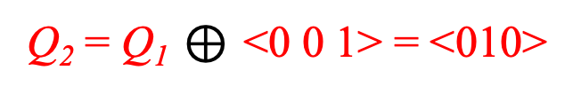
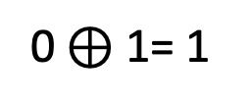


Exercise
k=5
0 | 1 | 0 | 0 | 1 | 1 | 0 | 0 | 1
Mapping index k to (i,j)
5/3 = 1 remainder 2
i=1 and j=2
Perform dot product with each row and xor result
S1
0 | 1 | 0
0 | 1 | 1
0 | 0 | 1
1
0
1
0.0 $⊕$1.1 $⊕$0.1 = 1
i=1
0.0 $⊕$1.1 $⊕1$.1 = 0
i=1
Q₁ = <0 1 1 > (random string of length 3)
0.0 $⊕0$.1 $⊕1$.1 = 1
j=2
0 $⊕$ 1= 1
S2
0 | 1 | 0
0 | 1 | 1
0 | 0 | 1
1
1
0
Q₂ = Q₁ $⊕$ <0 0 1> = <010>
{j}
i=1

Slide 28
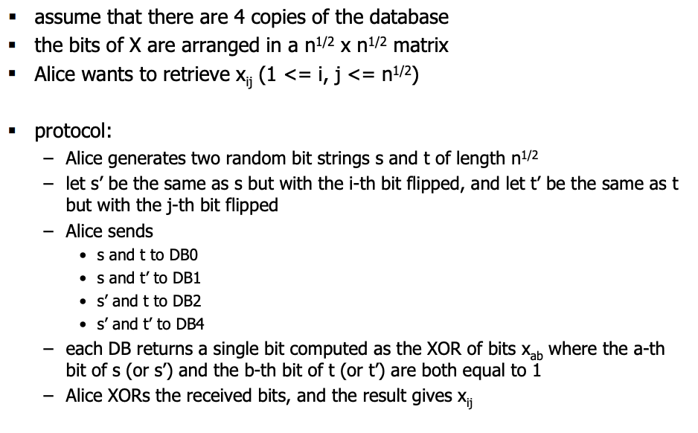
Illustrative example: PIR (protocol 2)

Slide 29
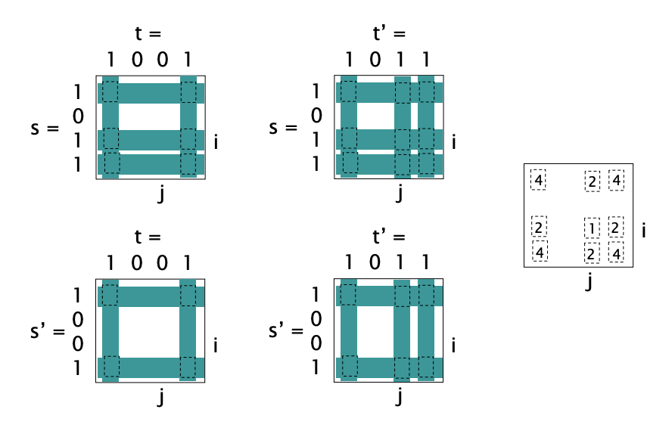
Illustrative example : PIR (protocol 2)
s = < 1 0 1 1 >
t = < 1 0 0 1 >
i= 3, j=3
DB₀
DB₁
A xor A = 0
Xor-ing same value results in 0
DB₃
DB₂
This is a very simplified version, not generalizable to all cases.
E.g., what if there are 5-servers? Use the technique explained earlier

Slide 30
Does the user get more data?
Wait -
Doesn’t the user get more data then required?
Is this an issue?
In the trivial case if the whole database was sent then the user would be able to see everything anyways.
In this context we are assuming it is fine.

Slide 31
Computational PIR
Only one server needed, no need to trust it
Based on cryptographic assumptions
Quadratic Residue (QR)
Downside: cryptographic operation has to run over the whole database, otherwise leaks information
High computation load on the server
N = p*q , p, q are primes.
QR(y, N) = 0 iff exists w such that w^2 = y (mod N)
1 otherwise
Understanding modulo: w^2 = y+k*N, k can be any integer
Example: 2^2 = 4 (mod 10), 4^2 = 6 (mod 10)
Security guarantees:
if p, q is unknown, it is computationally infeasible to determine Q(y,N).
If p, q is known, Q(y,N) can be determined in O(|N|^3)

Slide 32
Plausible application of PIR
Searching patent database
Looking up location-based service
WHOIS lookup (anti-front running)
Scalable anonymity systems
Open access e-print repository
Presence service (whose online without service provider knowing)

Slide 33
Questions
What is the difference between PIR and Differential Privacy?
PIR hides the date item retrieved while DP tries to hide the content of the data itself

Slide 34
Interesting video
PIR Tutorial
https://www.youtube.com/watch?v=XEYwMPwPxNI

Slide 35
Topic summary: Database privacy
What have we learned?
Linkage attacks and de-anonymization attacks
How to achieve k-anonymity
Problem with k-anonymity
l-diversity and t-closeness
Posterior and prior probabilities can leak information
Simply removing PII isn’t a good idea (PII list not comprehensive)
Differential privacy [plausible deniability of being in the dataset]
Different ways to achieve differential privacy
Private information retrieval techniques

Slide 36
Logistics
Home Work 1 due tomorrow @11:59pm

