Slide 1
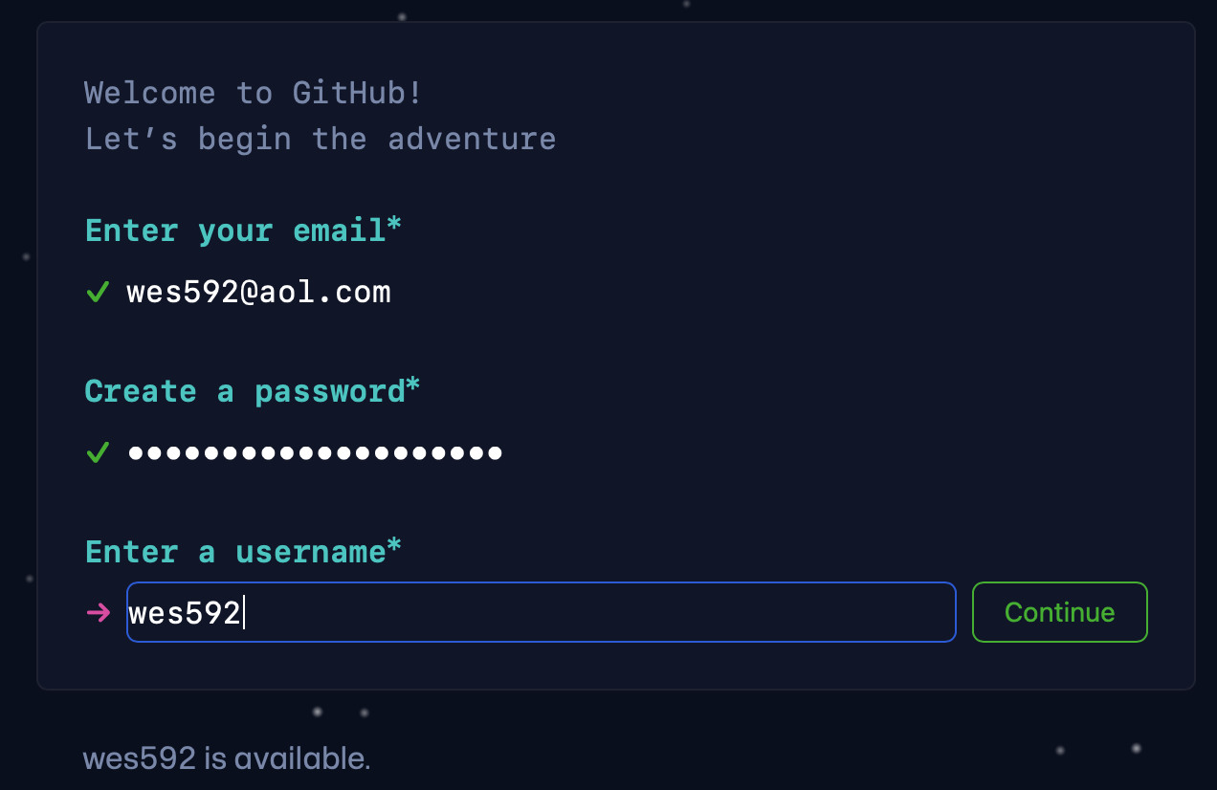
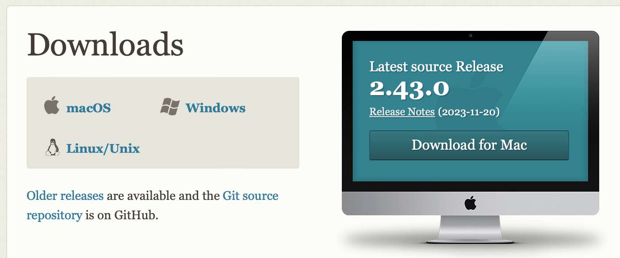
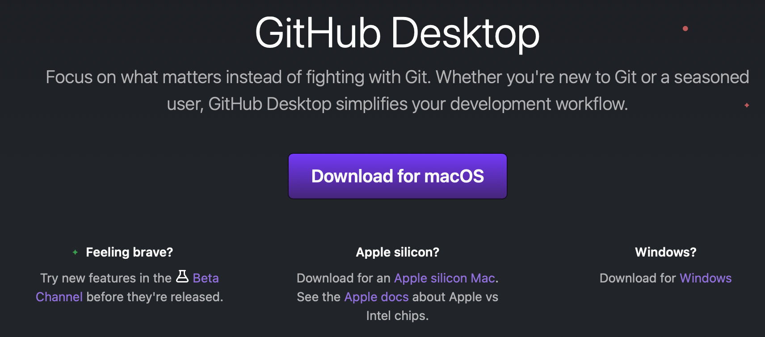
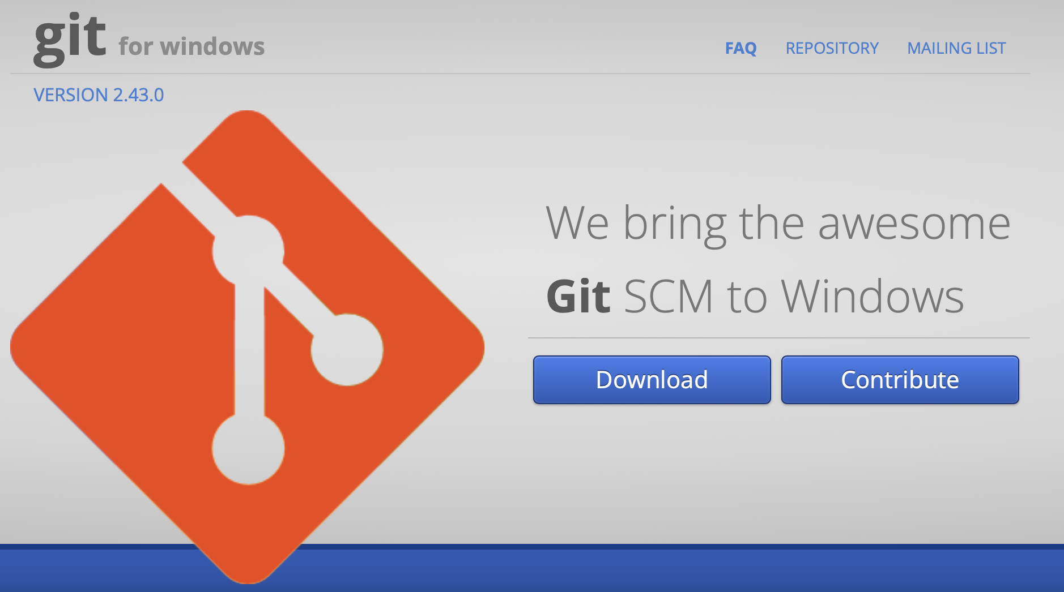
Tutorial – Set Up
Navigate to github.com and create a username
Download and install git (git-scm.com)
Download a GUI (git-scm.com/downloads/guis)
Easiest to start with github desktop (desktop.github.com)
Windows users: download git BASH (gitforwindows.org)

Slide 2
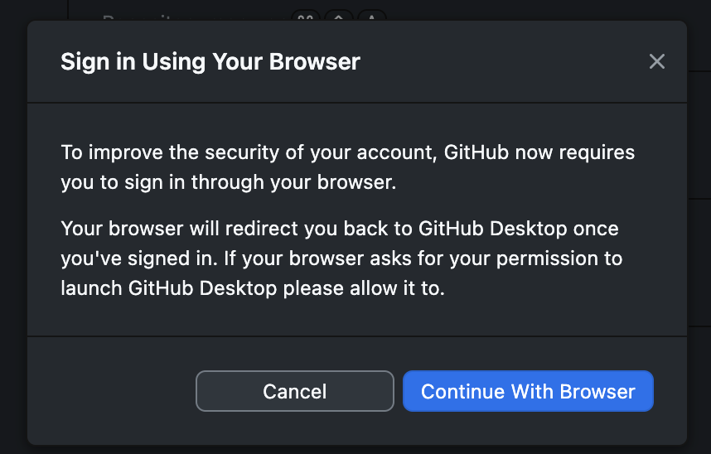
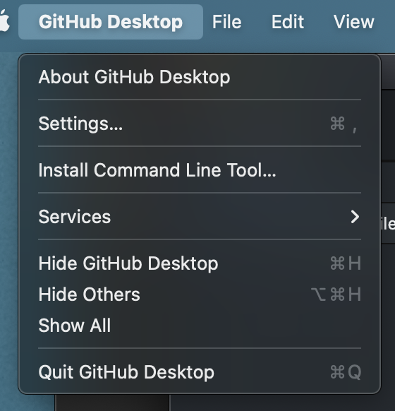
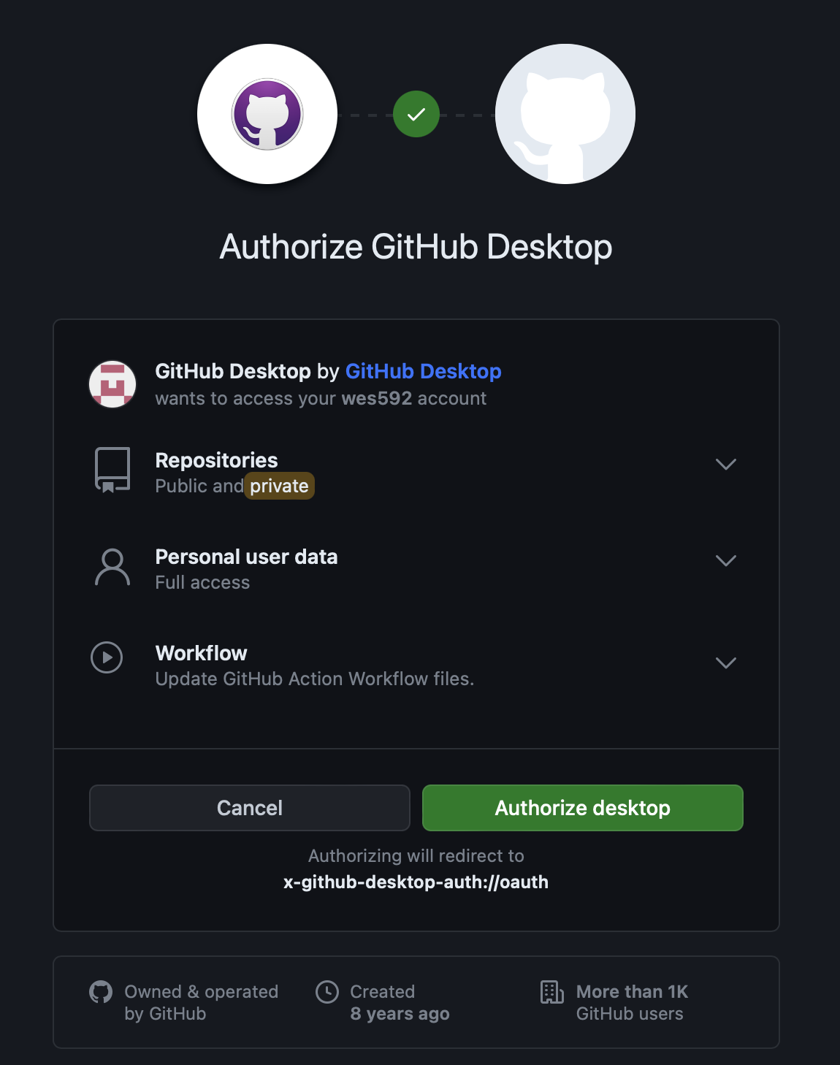
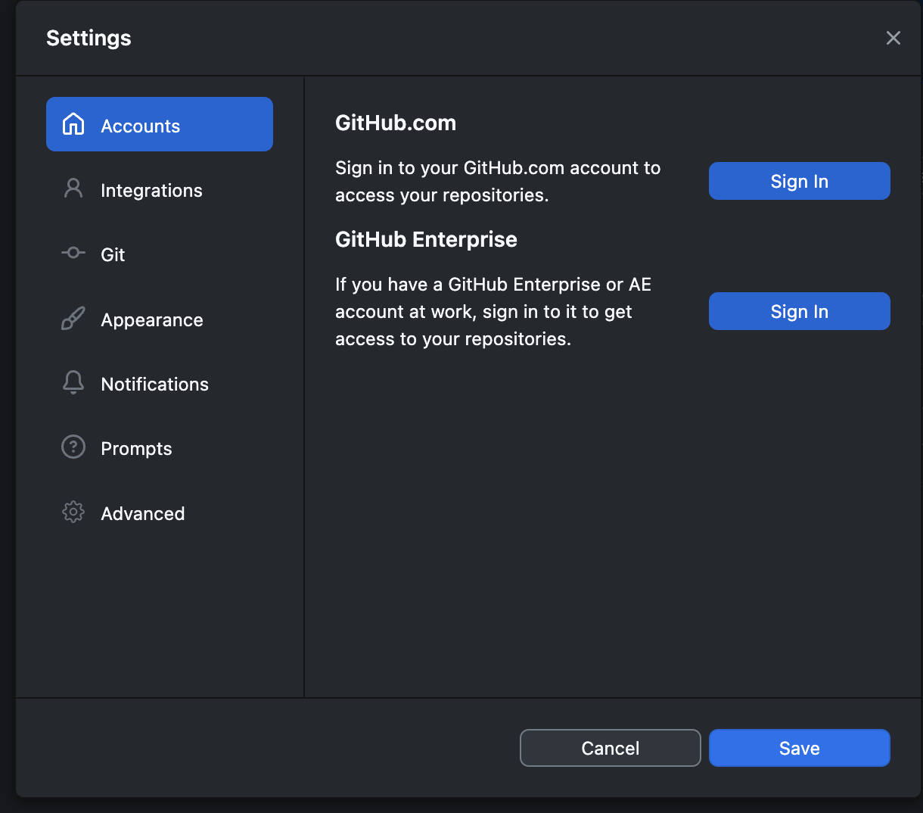
Tutorial – Initialize
Command Line:
Add your info to the config file (command line)
Authenticate GitHub Desktop

Slide 3
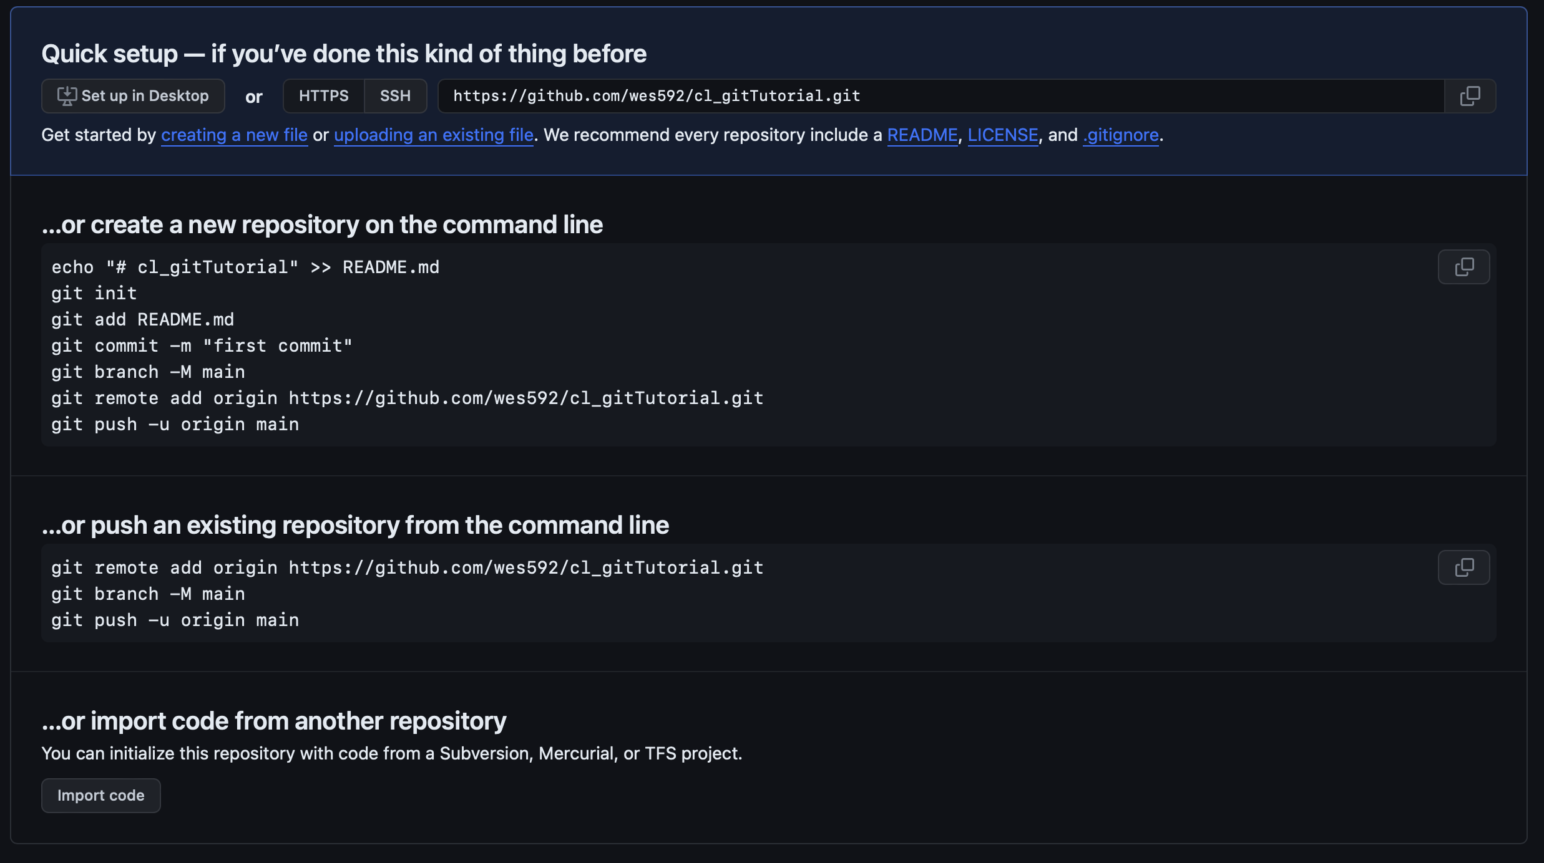
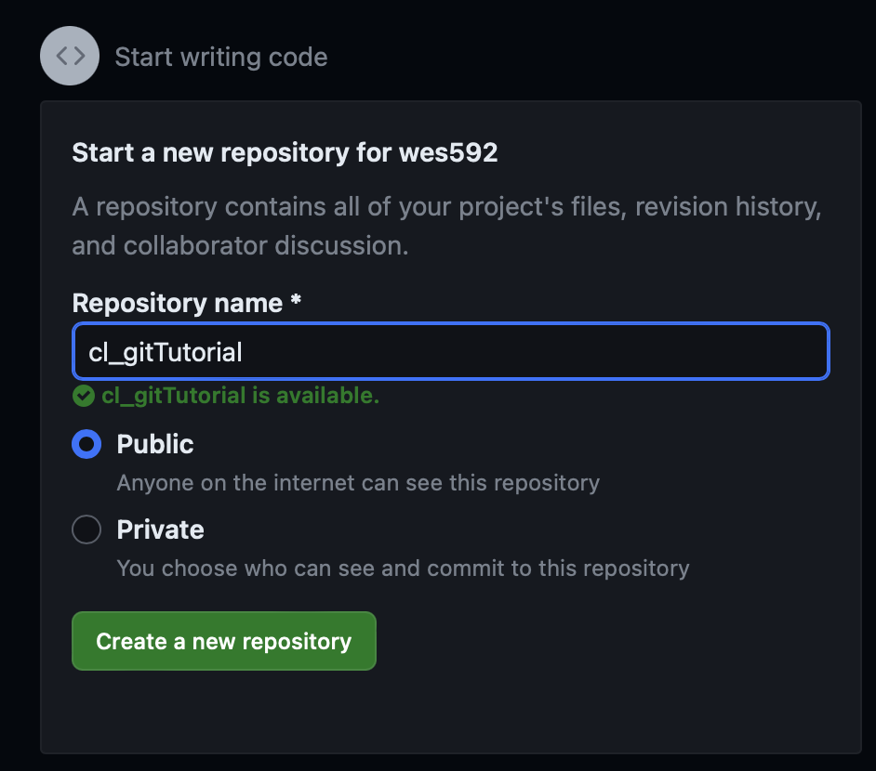
Tutorial – Access
Create your own repository
Clone an existing repository

Slide 4
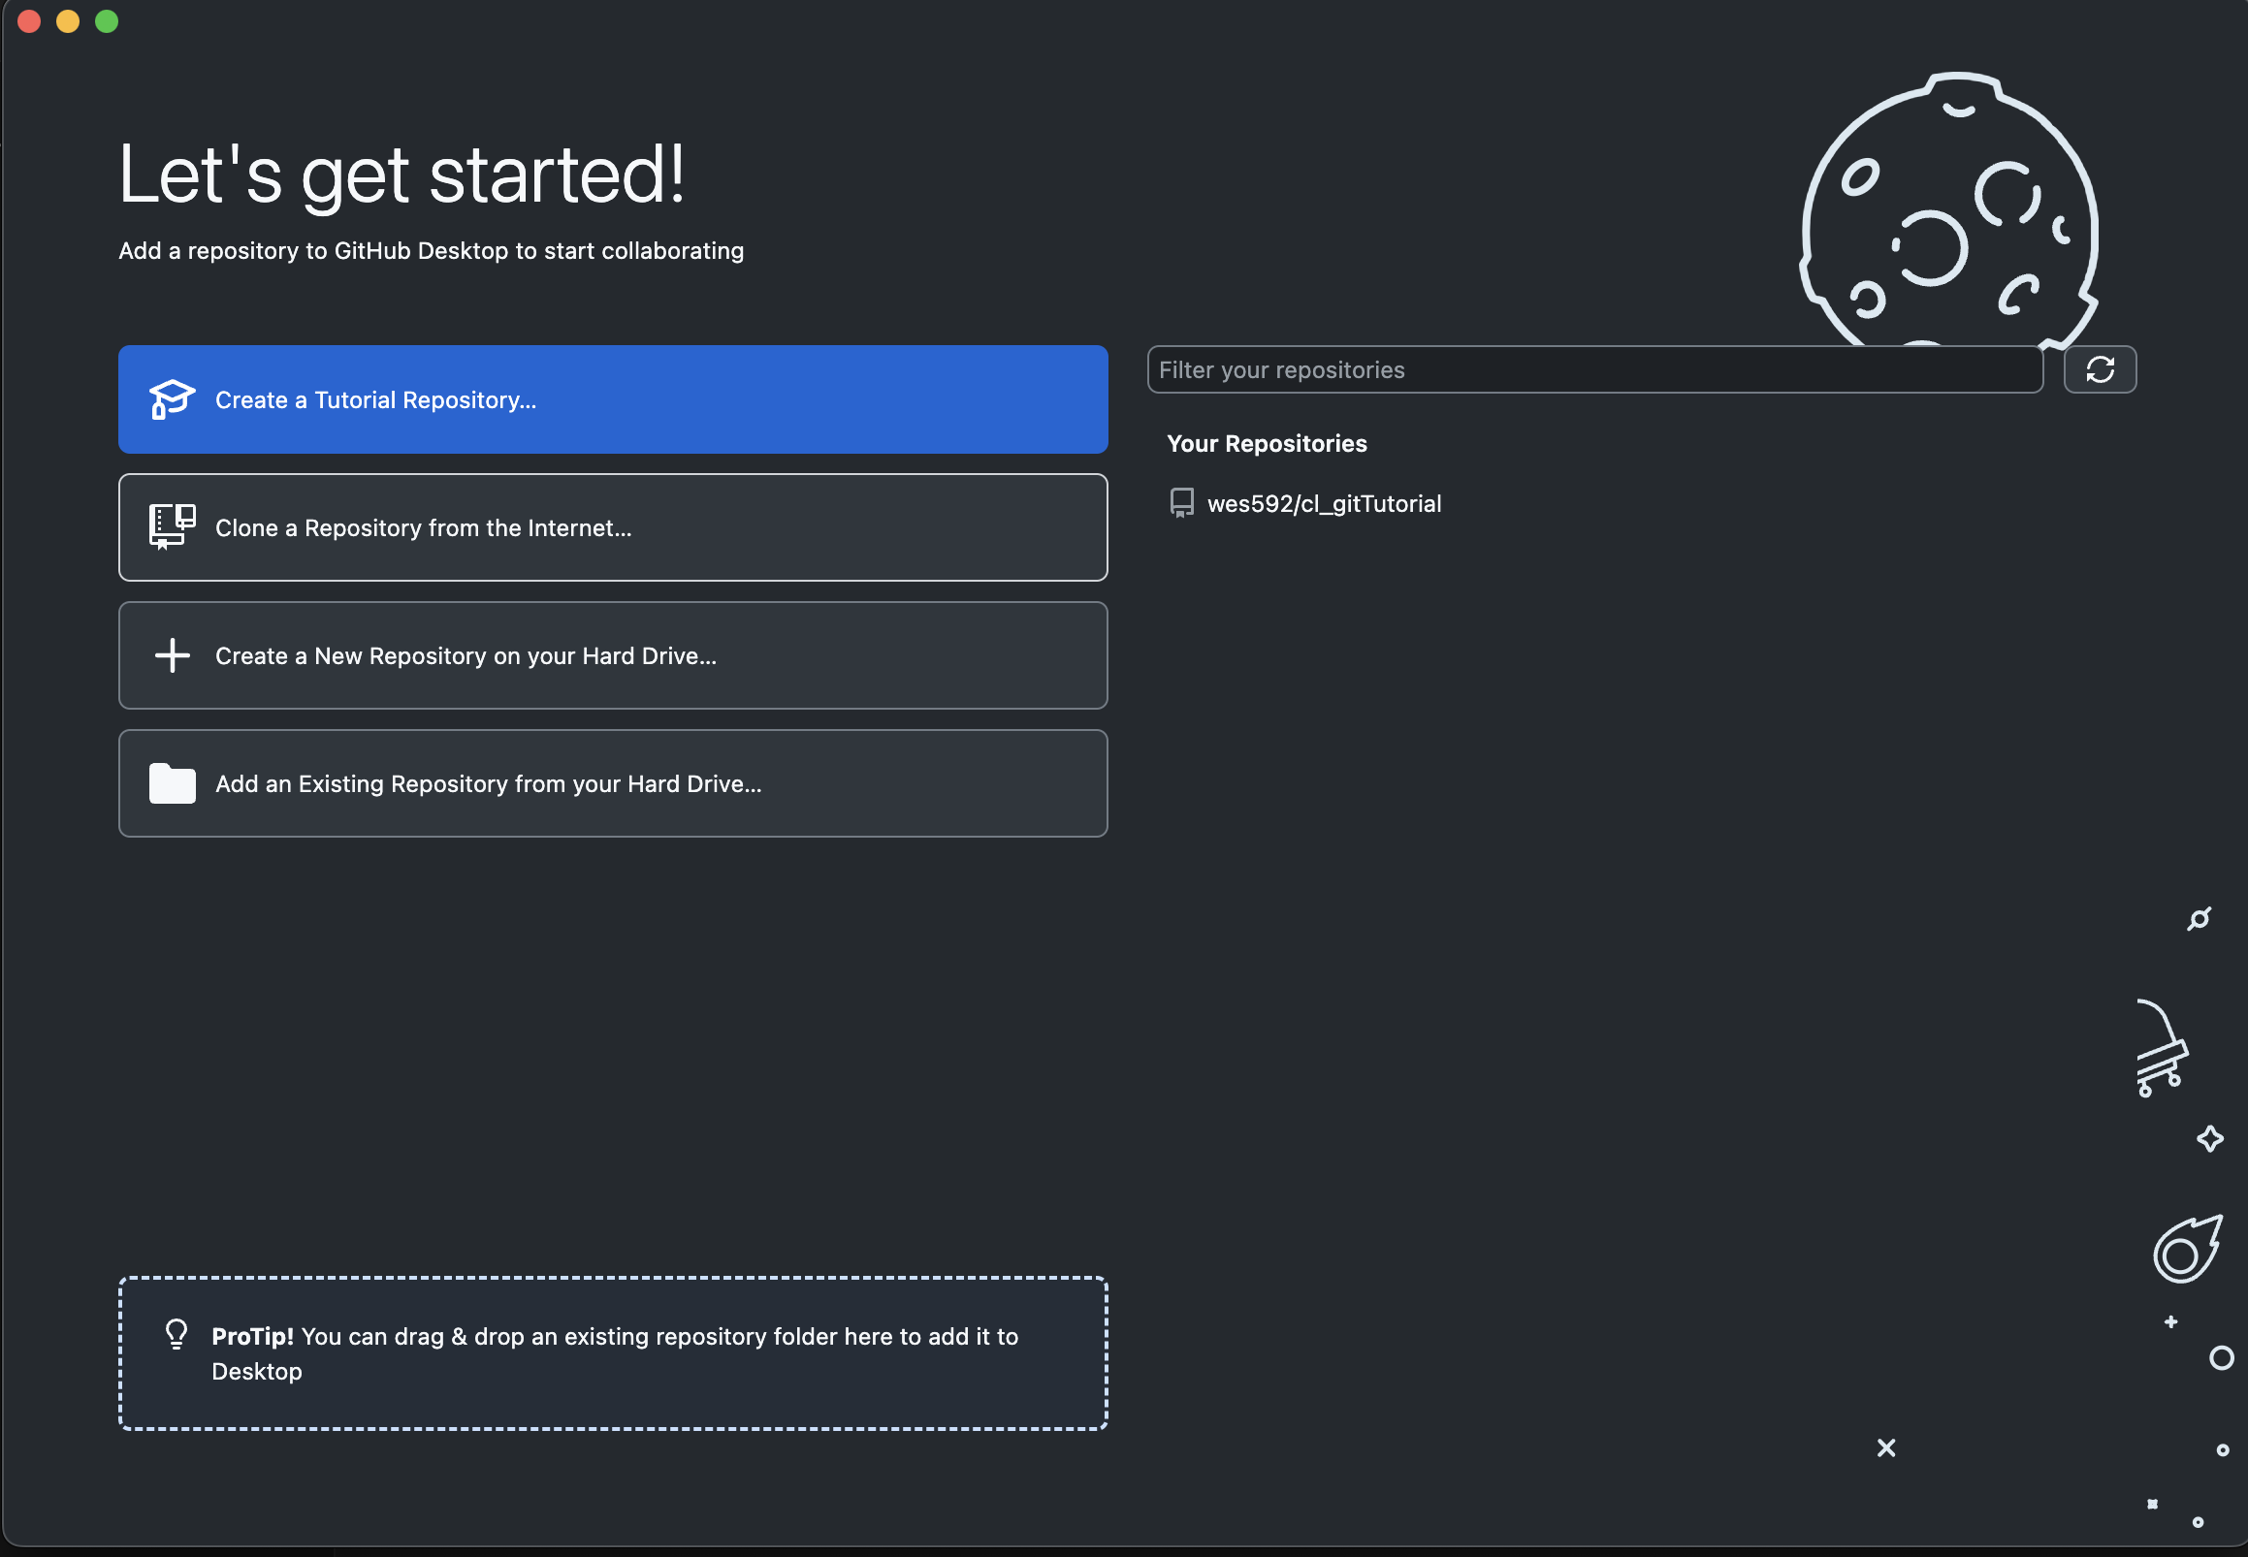
Tutorial – Access
Create your own repository
Clone an existing repository

Slide 5
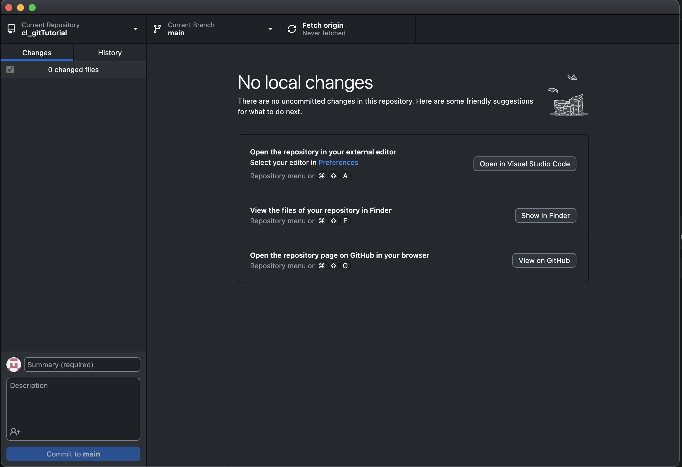
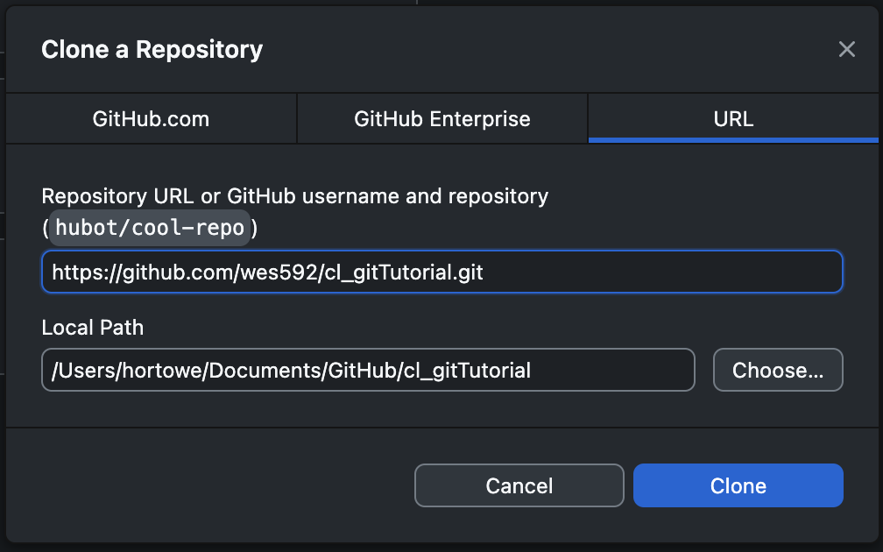
Tutorial – Access
Create your own repository
Clone an existing repository

