Slide 1
hello!
I am
Wesam Alsohle

Slide 2

Fake news
classifier
Sentiment Analysis
project

Slide 3
Roadmap
Frame the problem and look to the big picture
Prepare the data.
train and Fine tune the models.
1
3
5
2
4
6
Explore the data to gain insights.
vectorization
Evaluation final model.

Slide 4
1.
Frame the problem and look to the big picture

Slide 5
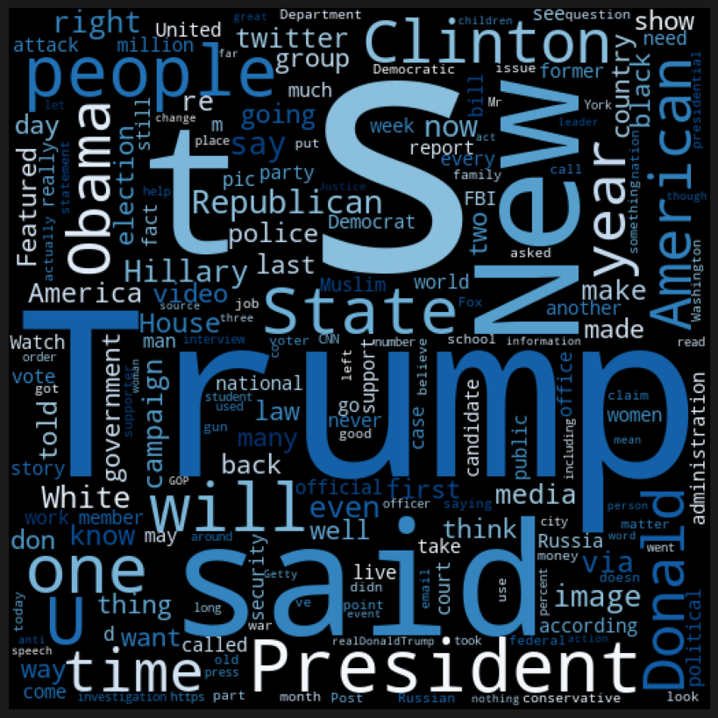

The binary classification of a news :
false, true

Slide 6
2.
Explore The Data to gain insight

Slide 7
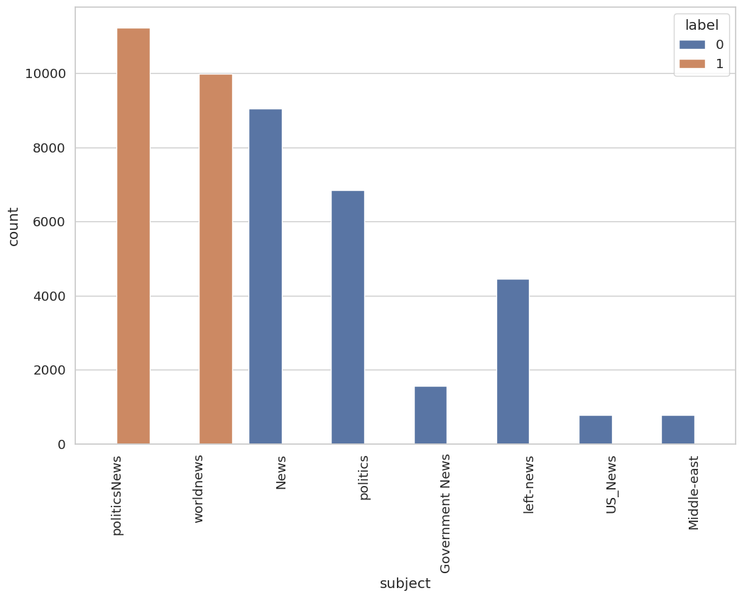
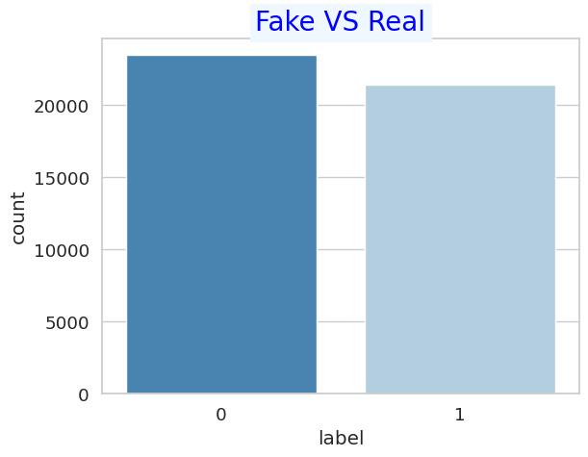
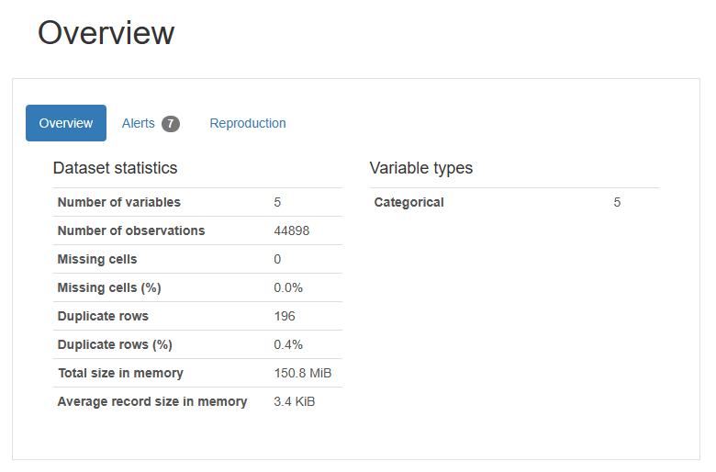
Explore Data Analysis

Slide 8
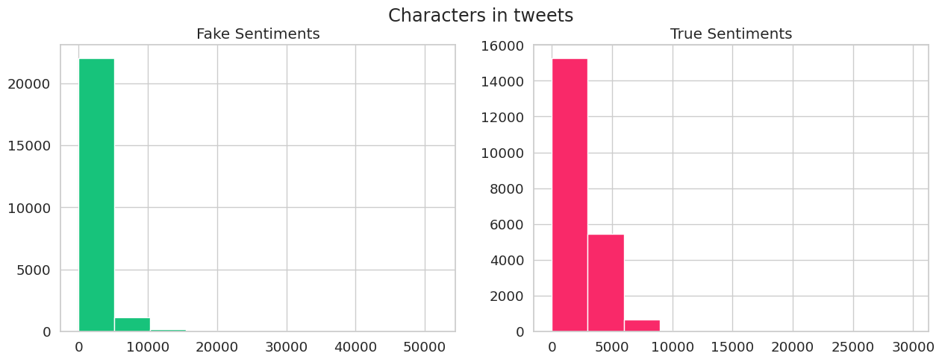
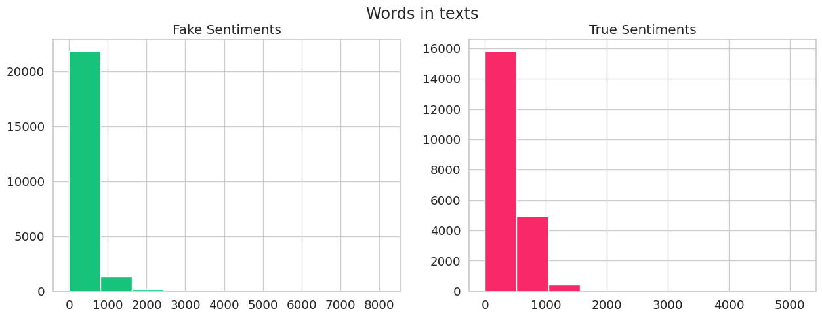
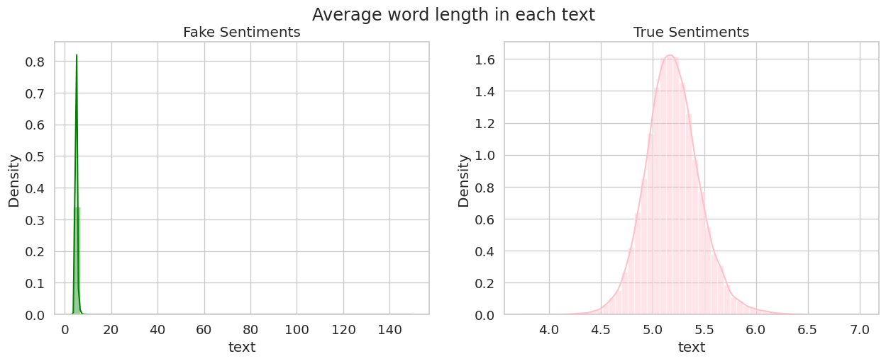
Explore Data Analysis
The average length of word in real news ranging from 4.5 to 6.0 whereas in the case of fake news it lies in the range of 0 to 20.This shows that in the fake news most of the words have length greater than the words of real news.
No of words in real news are lying in the range of 0 to 1500 whereas in the case of fake news it lies in the range of 0 to 2000.This shows that number of words in the fake news are higher than that of real news

Slide 9
3.
Prepare the data

Slide 10
Pre-processing
Combining the title with the text
Filtering
Normalization

Slide 11
Steps of Filtering
Removal of HTML & Urls Contents
Removal of Punctuation Marks
Removal of Special Characters
Removal of Stopwords
Removal of Emoji and Emoticons
Removal of Mintions
Removal of Digits
Removal of White spaces

Slide 12
Normalization
the process where in the context is used to convert a word to its meaningful base or room form.
Lemmatizing with spacy

Slide 13
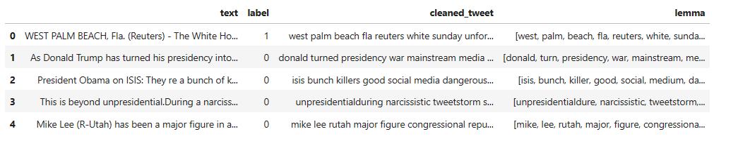
Filtering and Normalization

Slide 14
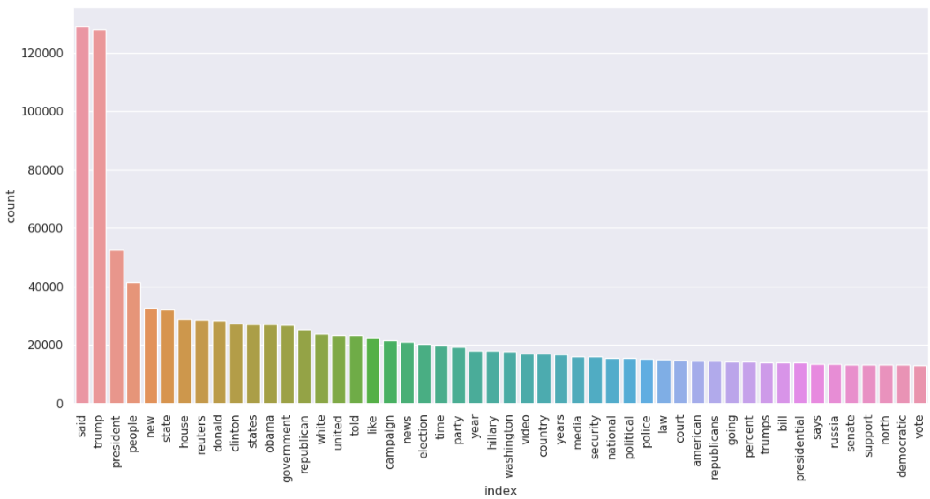
Find out common words

Slide 15
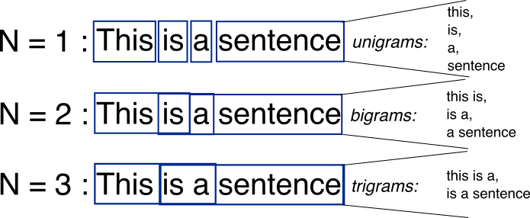
N-Gram Analysis

Slide 16
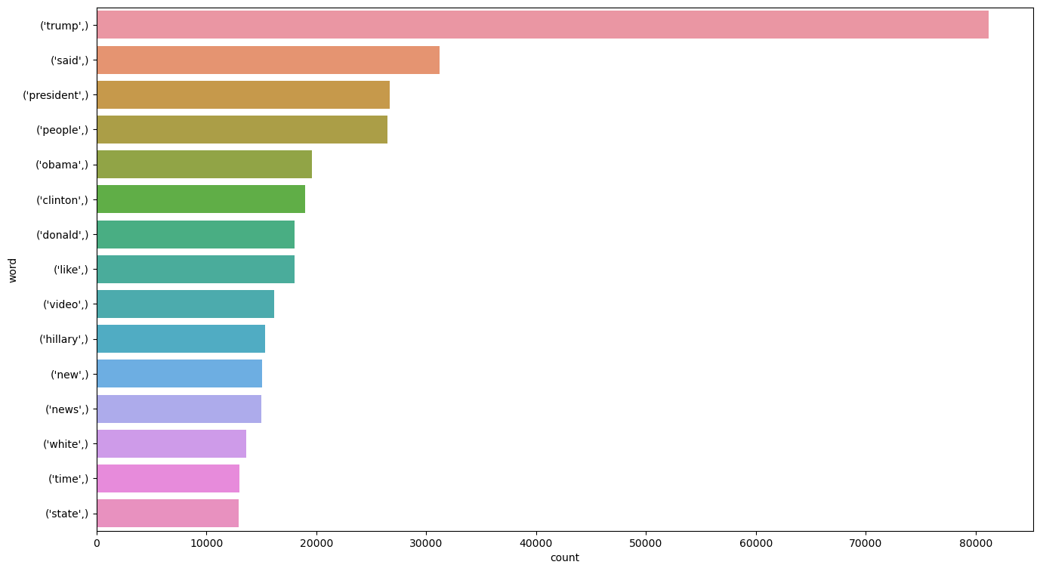
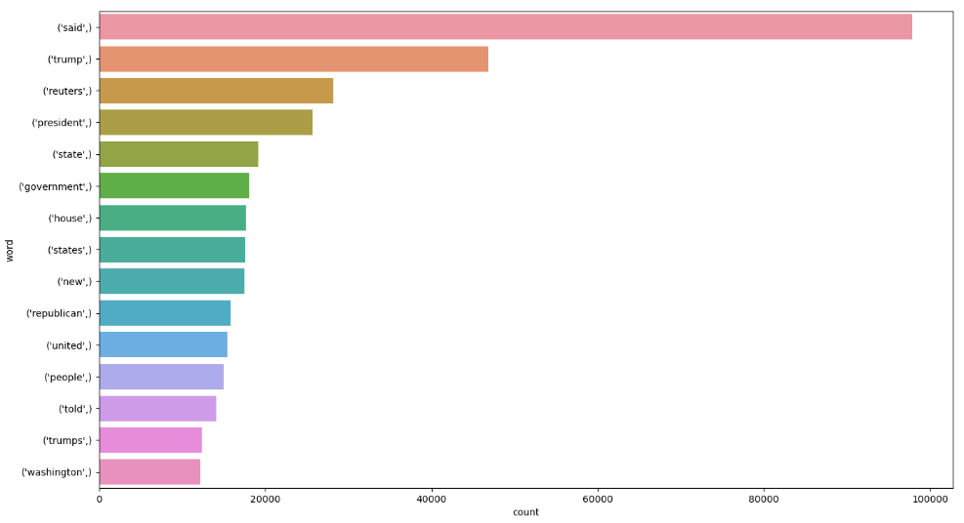
Uni-Gram Analysis

Slide 17
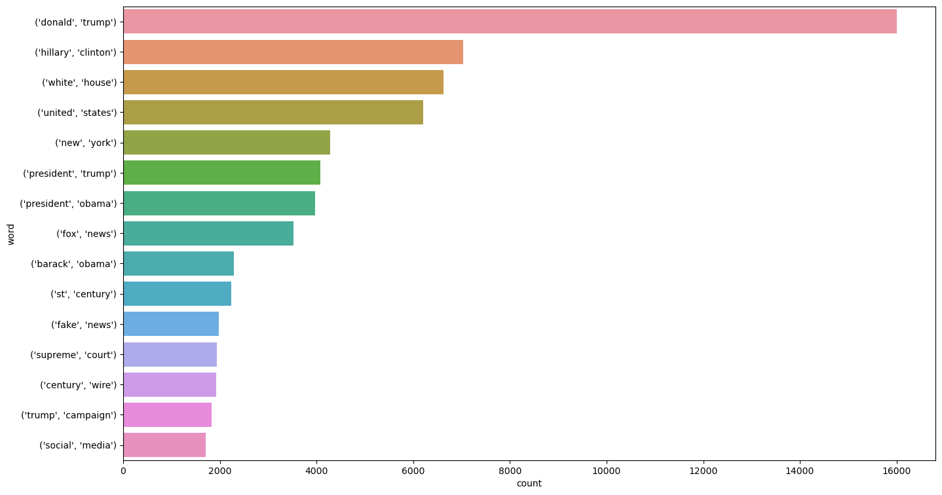
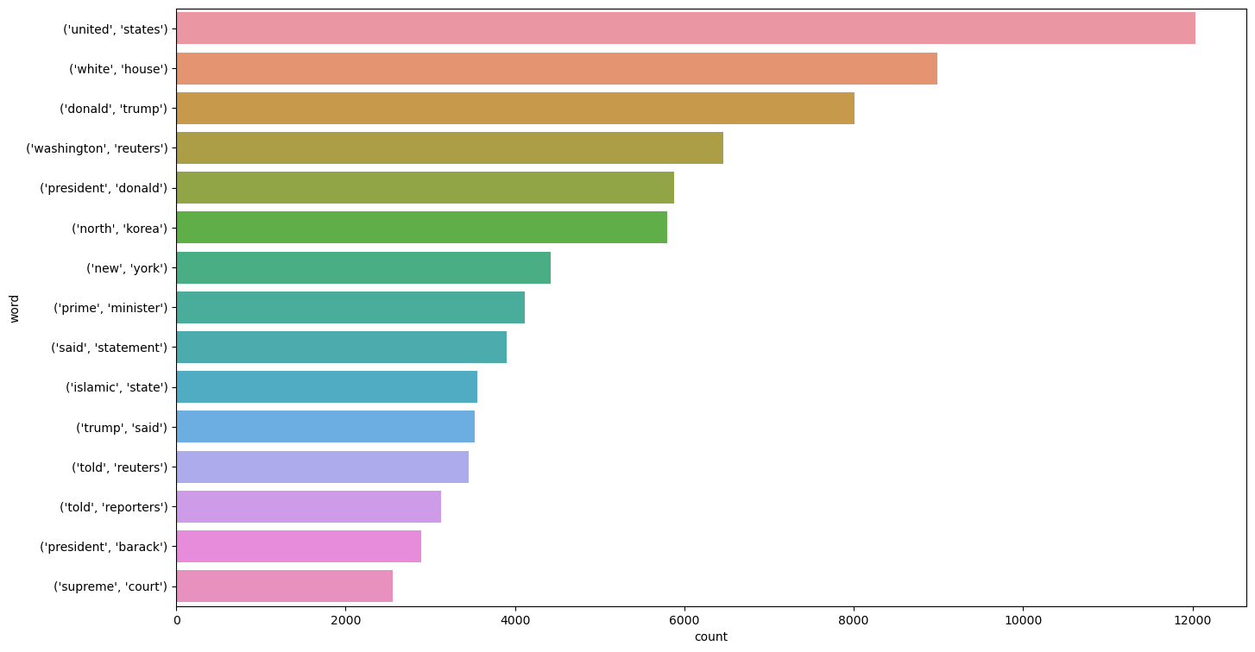
Bi-Gram Analysis

Slide 18
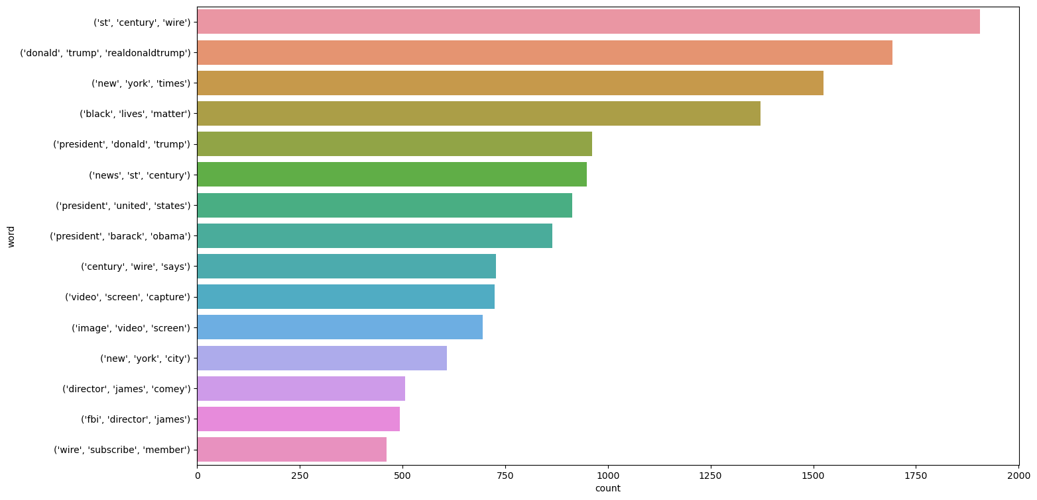
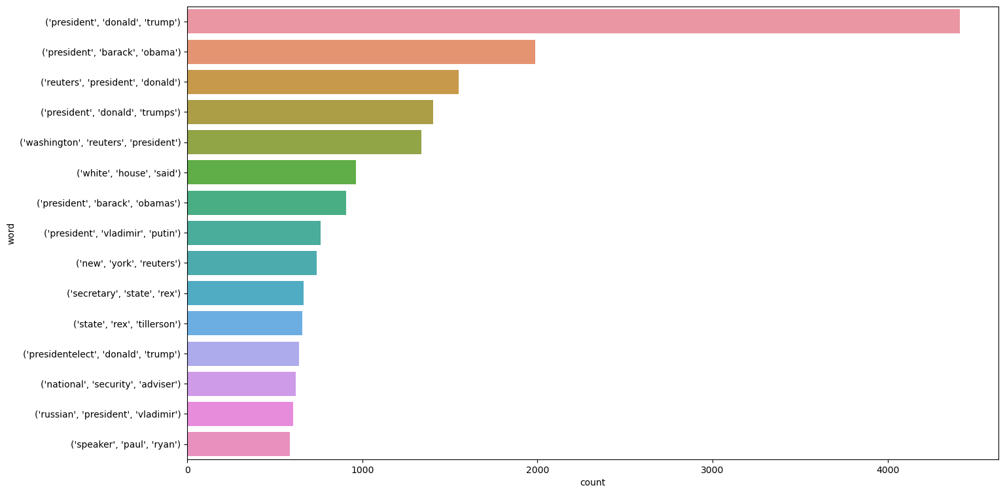
Tri-Gram Analysis

Slide 19
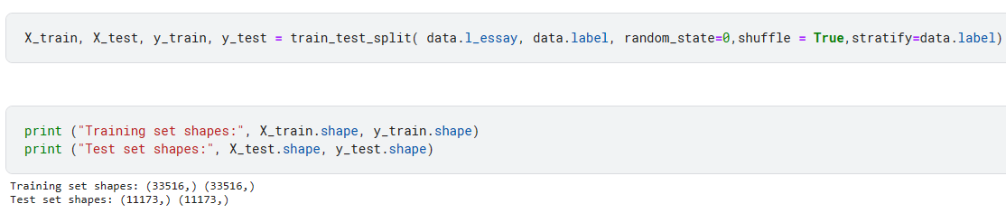
split the data
Splitting the data into 2 parts - training and testing data

Slide 20
4.
vectorization

Slide 21
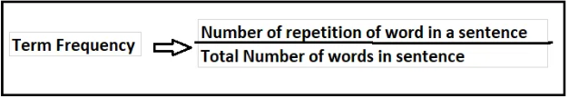
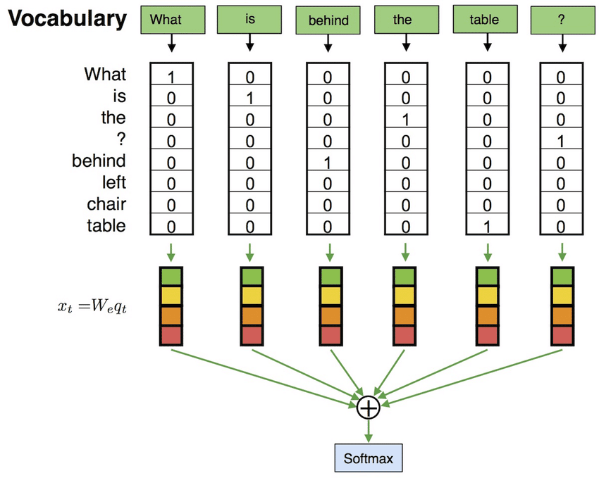
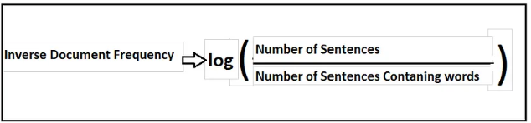
Extracting Features from Text
TfidfVectorizer:
CountVectorizer
create bag-of-words features
the frequency of each word that occurs in the entire text.
TF-IDF is intended to reflect how relevant a term is in a given document.

Slide 22
5.
Machine Learning Models

Slide 23
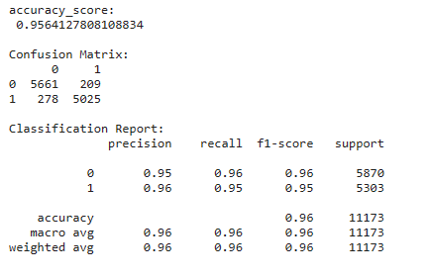
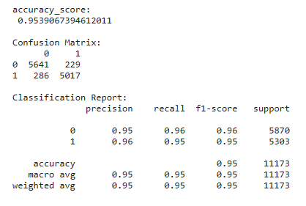
Naive bayes

Slide 24
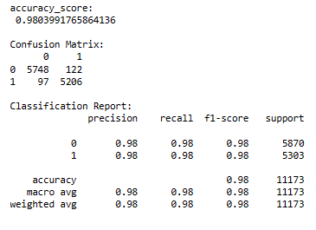
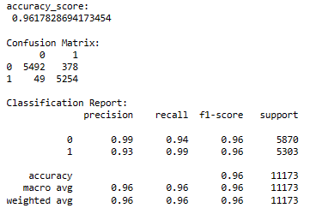
Logistic Regression

Slide 25
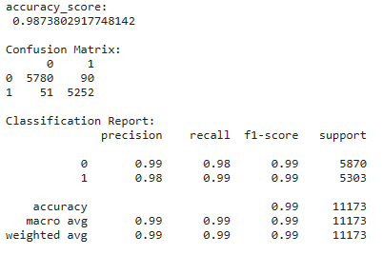
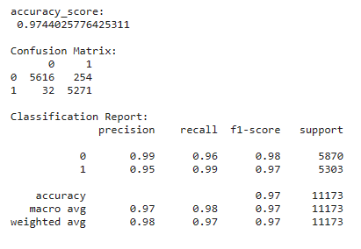
SGD

Slide 26
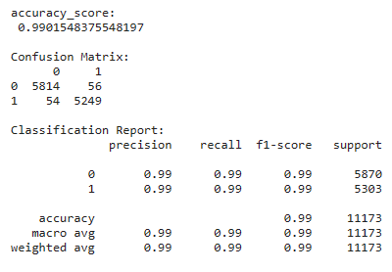

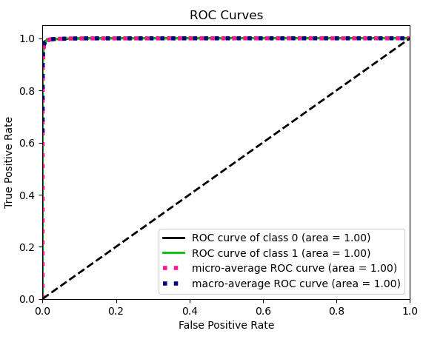
XGBoost

Slide 27
Tokenizing
Tokenizing Text -> Repsesent each word by a number.
tokenize the text into vectors.
Apply padding so we have the same length for each article.

Slide 28
6.
Deep Learning Models

Slide 29
6.
Building Simple RNN Model

Slide 30
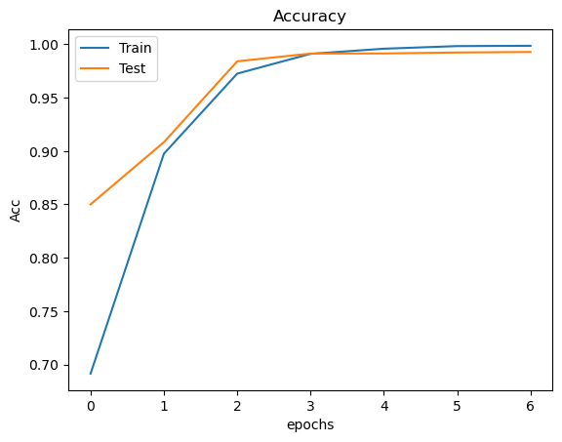
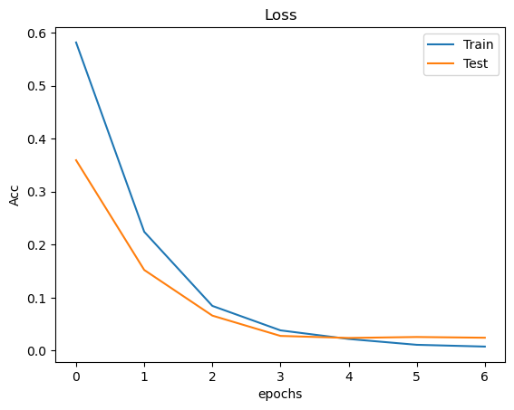
Learning carve for simple rnn model

Slide 31
6.
Building LSTM Model

Slide 32
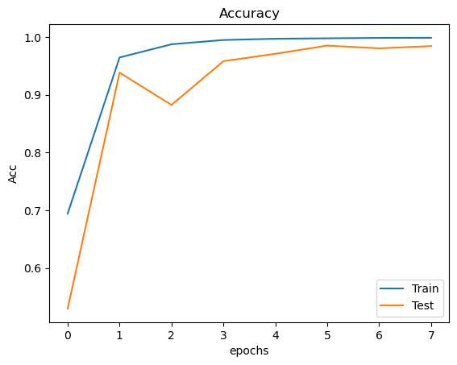
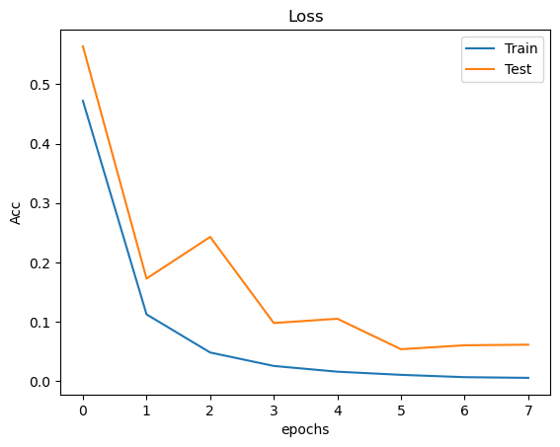
Learning carve for LSTM model

Slide 33
6.
Building GRU Model

Slide 34
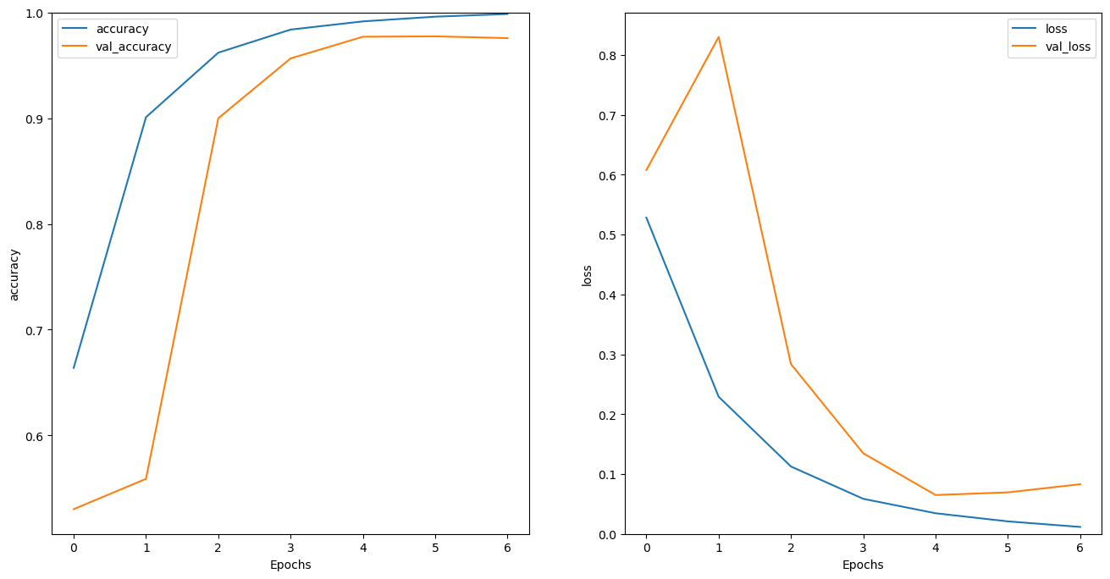
Learning carve for GRU model

Slide 35
7.
Fine tune The models & Evaluation

Slide 36
Evalute Simple RNN Model
Accuracy of the model on Training Data is - 99.68671798706055 %
Accuracy of the model on Testing Data is - 99.2034375667572 %

Slide 37
Evalute LSTM Model
Accuracy of the model on Training Data is - 99.54648613929749 % %
Accuracy of the model on Testing Data is - 98.51427674293518 %

Slide 38
Evalute GRU Model
Accuracy of the model on Training Data is - 99.19143319129944 %
Accuracy of the model on Testing Data is - 97.71771430969238 %

Slide 39
thanks for listening!
Any questions?

