Slide 1

Design Patterns for Chess
Wes Beard & Michael Leonard

Slide 2
Template Pattern
We chose to use the template pattern as our basis for the game pieces because:
We could keep common code in the abstract parent class
Analyzing king check, pieces in path, capturing pieces, etc.
Unique functionality of each piece can be customized inside
Moving, castling, checking, analyzing a capture, etc.
Common information to be stored for every piece
Space coordinates, side, piece type, visual elements, etc.

Slide 3
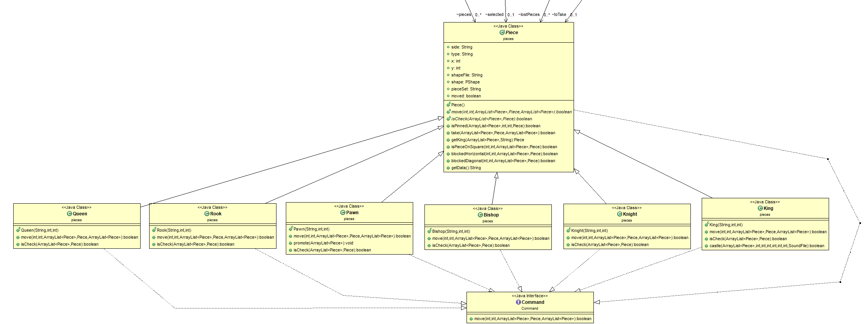
Template Pattern UML

Slide 4
Factory Pattern
We chose the factory pattern to build our piece objects because:
Very efficient way to create many objects at once
Lets us create all 36 pieces in only 22 lines
Allows us to use one function to create all the different types of pieces
We can simply pass in the type of piece and it will create the specific piece needed
Only need to have access to the factory as opposed to every single piece type
Simple to add new classes to the structure by constructing them with the factory

Slide 5
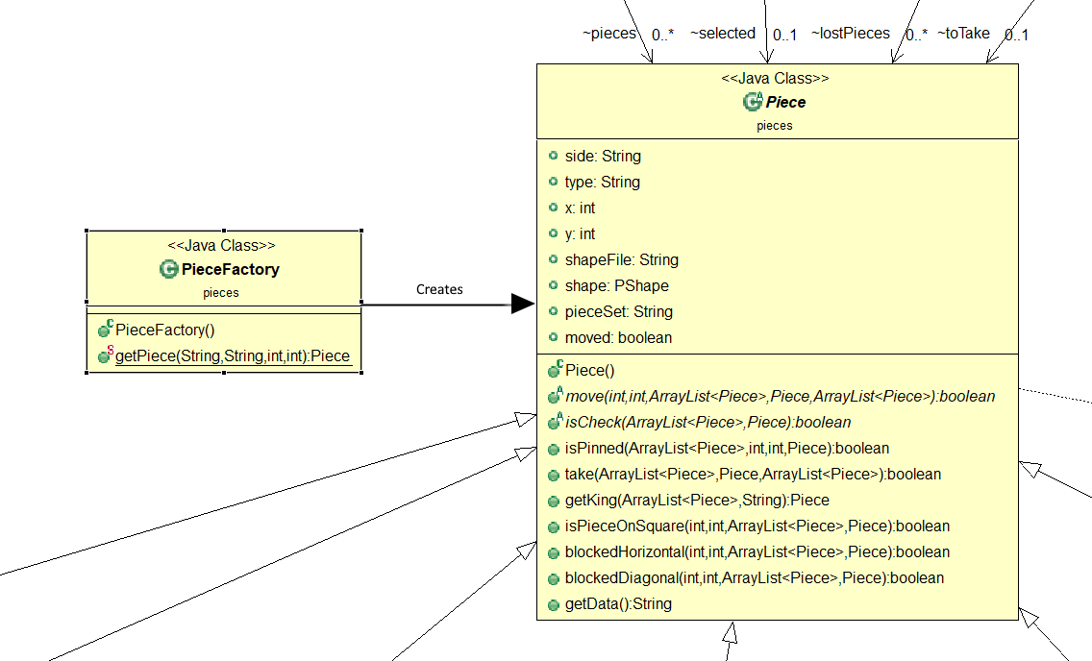
Factory Pattern UML

Slide 6
Command Pattern
The command pattern is what allows for replayability
It intercepts the Piece.move() function to record the action to be played back later
With every move logged, it also makes it easy to import/export games, as they can be put through the command design pattern just as moves are

Slide 7
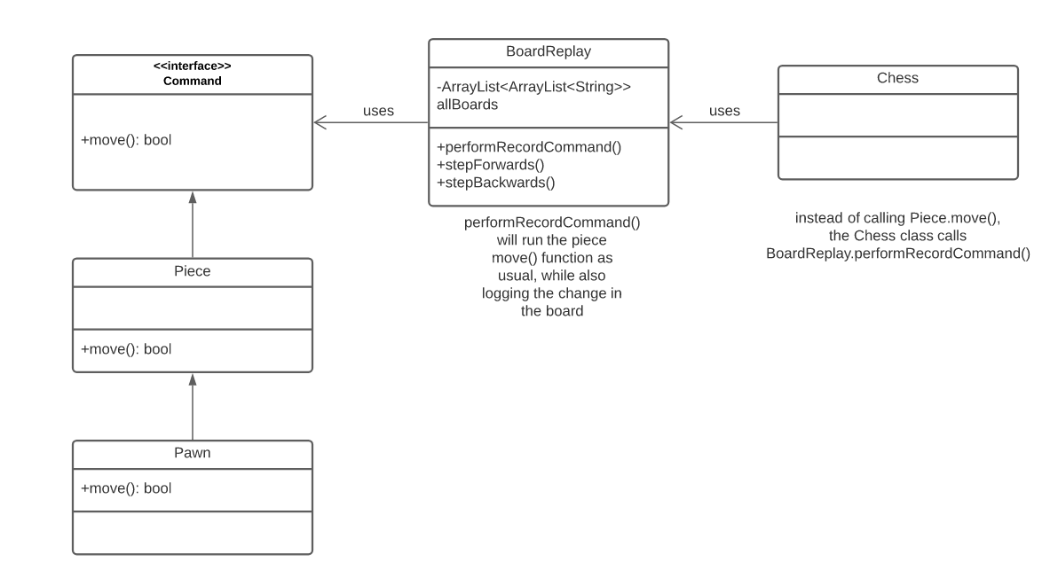
Command Pattern UML
(Simplified)

Slide 8
Strategy Pattern
The strategy pattern allows us to change which algorithm to use at runtime
We used it to import games using:
.FEN (standard chess format) files
.CHESS (custom file format) files
The behavior of the “Context” class changes depending on the file we’re importing, either LoadCustomCHESS or LoadFEN will be called depending on the file type.

Slide 9
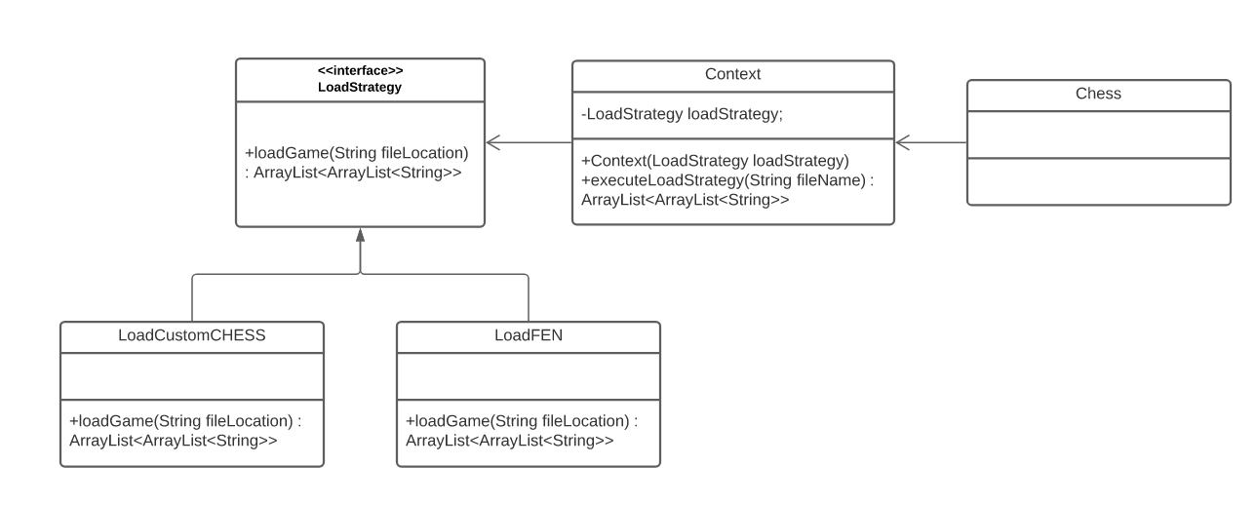
Strategy Pattern UML
(Simplified)

Slide 10
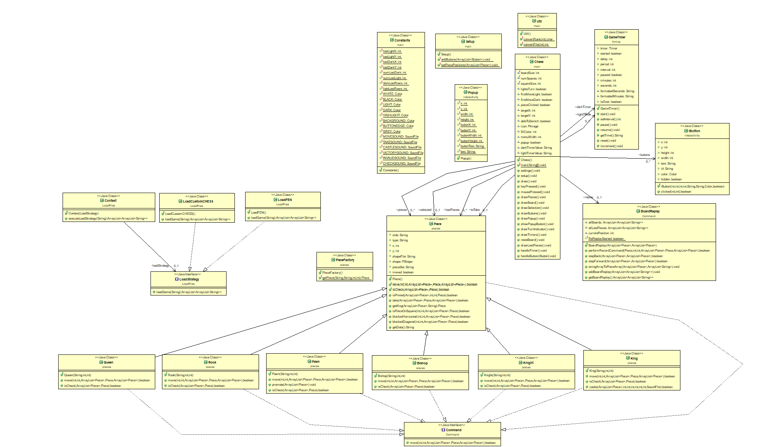
Full UML

