Slide 1
Fault Tolerant Runtime Research @ ANL
Wesley Bland
LBL Visit
3/4/14

Slide 2
Exascale Trends
Power/Energy is a known issue for Exascale
1Exaflop performance in a 20MW power envelope
We are currently at 34 Petaflops using 17MW (Tianhe-2; not including cooling)
Need a 25X increase in power efficiency to get to Exascale
Unfortunately, power/energy and Faults are strong duals – it’s almost impossible to improve one without effecting the other
Exascale Driven Trends in Technology
Packaging Density
Data movement is a problem for performance/energy, so we can expect processing units, memory, network interfaces, etc., to be packaged as close to each other as vendors can get away with
High packaging density also means more heat, more leakage, more faults
Near threshold voltage operation
Circuitry will be operated with as low power as possible, which means bit flips and errors are going to become more common
IC verification
Growing gap in silicon capability and verification ability with large amounts of dark silicon being added to chips that cannot be effectively tested in all configurations

Slide 3
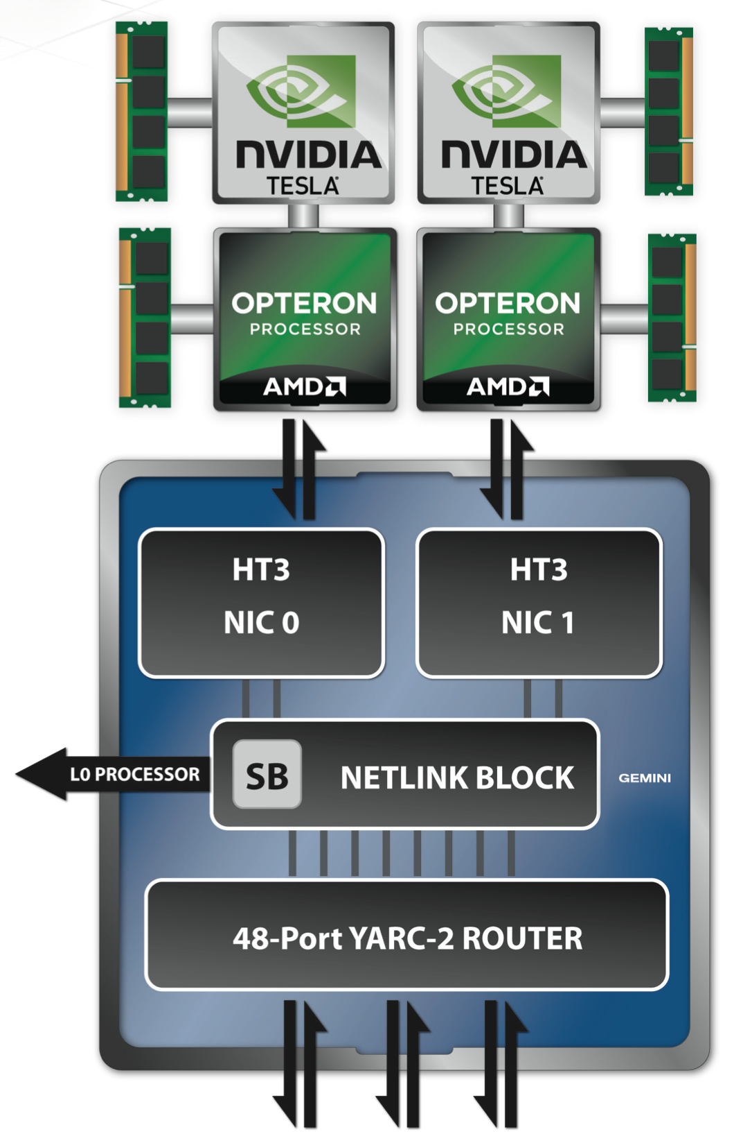
Hardware Failures
We expect future hardware to fail
We don’t expect full node failures to be as common as partial node failures
The only thing that really causes full node failure is power failure
Specific hardware will become unavailable
How do we react to failure of a particular portion of the machine?
Is our reaction the same regardless of the failure?
Low power thresholds will make this problem worse
Cray XK7

Slide 4
Current Failure Rates
Memory errors
Jaguar: Uncorrectable ECC error every 2 weeks
GPU errors
LANL (Fermi): 4% of 40K runs have bad residuals
Unrecoverable hardware error
Schroeder & Gibson (CMU): Up to two failures per day on LANL machines

Slide 5
What protections do we have?
There are existing hardware pieces that protect us from some failures
Memory
ECC
2D error coding (too expensive to be implemented most of the time)
CPU
Instruction caches are more resilient than data caches
Exponents are more reliable than mantissas
Disks
RAID

Slide 6
What can we do in software?
Hardware won’t fix everything for us.
Some parts will be either too hard, too expensive, or too power hungry to fix
For these problems we have to move to software
4 different ways of handling failures in software
Processes detect failures and all processes abort
Processes detect failures and only abort where errors occur
Other mechanisms detect failure and recover within existing processes
Failures are not explicitly detected, but handled automatically

Slide 7
Processes detect failures and all processes abort
Well studied already
Checkpoint/restart
People are studying improvements now
Scalable Checkpoint Restart (SCR)
Fault Tolerance Interface (FTI)
Default model of MPI up to now (version 3.0)

Slide 8
Processes detect failures and only abort where errors occur
Some processes will remain around while others won’t
Need to consider how to repair lots of parts of the application
Communication library (MPI)
Computational capacity (if necessary)
Data
C/R, ABFT, Natural Fault Tolerance, etc.

Slide 9
MPIXFT
MPI-3 Compatibly Recovery Library
Automatically repairs MPI communicators as failures occur
Handles running in n-1 model
Virtualizes MPI Communicator
User gets an MPIXFT wrapper communicator
On failure, the underlying MPI communicator is replaced with a new, working communicator
MPI_COMM
MPIXFT_COMM
MPI_COMM

Slide 10
MPIXFT Design
MPI_BARRIER
MPI_WAITANY
Possible because of new MPI-3 capabilities
Non-blocking equivalents for (almost) everything
MPI_COMM_CREATE_GROUP
MPI_IBARRIER
Failure notification request
0
1
0
1
2
3
MPI_ISEND()
2
COMM_CREATE_GROUP()
4
5
4
5

Slide 11
MIPXFT Results
MCCK Mini-app
Domain decomposition communication kernel
Overhead within standard deviation
Halo Exchange (1D, 2D, 3D)
Up to 6 outstanding requests at a time
Very low overhead

Slide 12
User Level Failure Mitigation
Proposed change to MPI Standard for MPI-4
Repair MPI after process failure
Enable more custom recovery than MPIXFT
Don’t pick a particular recovery technique as better or worse than others
Introduce minimal changes to MPI
Treat process failure as fail-stop failures
Transient failures are masked as fail-stop

Slide 13
TL;DR
5(ish) new functions (some non-blocking, RMA, and I/O equivalents)
MPI_COMM_FAILURE_ACK / MPI_COMM_FAILURE_GET_ACKED
Provide information about who has failed
MPI_COMM_REVOKE
Provides a way to propagate failure knowledge to all processes in a communicator
MPI_COMM_SHRINK
Creates a new communicator without failures from a communicator with failures
MPI_COMM_AGREE
Agreement algorithm to determine application completion, collective success, etc.
3 new error classes
MPI_ERR_PROC_FAILED
A process has failed somewhere in the communicator
MPI_ERR_REVOKED
The communicator has been revoked
MPI_ERR_PROC_FAILED_PENDING
A failure somewhere prevents the request from completing, but it is still valid

Slide 14
Failure Notification
Failure notification is local.
Notification of a failure for one process does not mean that all other processes in a communicator have also been notified.
If a process failure prevents an MPI function from returning correctly, it must return MPI_ERR_PROC_FAILED.
If the operation can return without an error, it should (i.e. point-to-point with non-failed processes.
Collectives might have inconsistent return codes across the ranks (i.e. MPI_REDUCE)
Some operations will always have to return an error:
MPI_ANY_SOURCE
MPI_ALLREDUCE / MPI_ALLGATHER / etc.
Special return code for MPI_ANY_SOURCE
MPI_ERR_PROC_FAILED_PENDING
Request is still valid and can be completed later (after acknowledgement on next slide)

Slide 15
Failure Notification
To find out which processes have failed, use the two-phase functions:
MPI_Comm_failure_ack(MPI_Comm comm)
Internally “marks” the group of processes which are currently locally know to have failed
Useful for MPI_COMM_AGREE later
Re-enables MPI_ANY_SOURCE operations on a communicator now that the user knows about the failures
Could be continuing old MPI_ANY_SOURCE requests or starting new ones
MPI_Comm_failure_get_acked(MPI_Comm comm, MPI_Group *failed_grp)
Returns an MPI_GROUP with the processes which were marked by the previous call to MPI_COMM_FAILURE_ACK
Will always return the same set of processes until FAILURE_ACK is called again
Must be careful to check that wildcards should continue before starting/restarting an operation
Don’t enter a deadlock because the failed process was supposed to send a message
Future MPI_ANY_SOURCE operations will not return errors unless a new failure occurs.

Slide 16
Recovery with only notification Master/Worker Example
Worker
1
Worker
2
Worker
3
Master
Post work to multiple processes
MPI_Recv returns error due to failure
MPI_ERR_PROC_FAILED if named
MPI_ERR_PROC_FAILED_PENDING if wildcard
Master discovers which process has failed with ACK/GET_ACKED
Master reassigns work to worker 2
Send
Recv
Discovery
Send

Slide 17
Failure Propagation
When necessary, manual propagation is available.
MPI_Comm_revoke(MPI_Comm comm)
Interrupts all non-local MPI calls on all processes in comm.
Once revoked, all non-local MPI calls on all processes in comm will return MPI_ERR_REVOKED.
Exceptions are MPI_COMM_SHRINK and MPI_COMM_AGREE (later)
Necessary for deadlock prevention
Often unnecessary
Let the application discover the error as it impacts correct completion of an operation.

Slide 18

Failure Recovery
Some applications will not need recovery.
Point-to-point applications can keep working and ignore the failed processes.
If collective communications are required, a new communicator must be created.
MPI_Comm_shrink(MPI_Comm *comm, MPI_Comm *newcomm)
Creates a new communicator from the old communicator excluding failed processes
If a failure occurs during the shrink, it is also excluded.
No requirement that comm has a failure. In this case, it will act identically to MPI_Comm_dup.
Can also be used to validate knowledge of all failures in a communicator.
Shrink the communicator, compare the new group to the old one, free the new communicator (if not needed).
Same cost as querying all processes to learn about all failures

Slide 19
Recovery with Revoke/Shrink ABFT Example
0
1
2
3
ABFT Style application
Iterations with reductions
After failure, revoke communicator
Remaining processes shrink to form new communicator
Continue with fewer processes after repairing data
MPI_ALLREDUCE
MPI_COMM_REVOKE
MPI_COMM_SHRINK

Slide 20
Fault Tolerant Consensus
Sometimes it is necessary to decide if an algorithm is done.
MPI_Comm_agree(MPI_comm comm, int *flag);
Performs fault tolerant agreement over boolean flag
Non-acknowledged, failed processes cause MPI_ERR_PROC_FAILED.
Will work correctly over a revoked communicator.
Expensive operation. Should be used sparingly.
Can also pair with collectives to provide global return codes if necessary.
Can also be used as a global failure detector
Very expensive way of doing this, but possible.
Also includes a non-blocking version

Slide 21
One-sided
MPI_WIN_REVOKE
Provides same functionality as MPI_COMM_REVOKE
The state of memory targeted by any process in an epoch in which operations raised an error related to process failure is undefined.
Local memory targeted by remote read operations is still valid.
It’s possible that an implementation can provide stronger semantics.
If so, it should do so and provide a description.
We may revisit this in the future if a portable solution emerges.
MPI_WIN_FREE has the same semantics as MPI_COMM_FREE

Slide 22
File I/O
When an error is returned, the file pointer associated with the call is undefined.
Local file pointers can be set manually
Application can use MPI_COMM_AGREE to determine the position of the pointer
Shared file pointers are broken
MPI_FILE_REVOKE
Provides same functionality as MPI_COMM_REVOKE
MPI_FILE_CLOSE has similar to semantics to MPI_COMM_FREE

Slide 23
Other mechanisms detect failure and recover within existing processes
Data corruption
Network failure
Accelerator failure

Slide 24
GVR (Global View Resilience)
Parallel Computation proceeds from phase to phase
Phases create new
logical versions
Rollback & re-compute if uncorrected error
App-semantics
based recovery
Multi-versioned, distributed memory
Application commits “versions” which are stored by a backend
Versions are coordinated across entire system
Different from C/R
Don’t roll back full application stack, just the specific data.

Slide 25
MPI Memory Resilience (Planned Work)
Integrate memory stashing within the MPI stack
Data can be replicated across different kinds of memories (or storage)
On error, repair data from backup memory (or disk)
Traditional
MPI_PUT
Replicated
MPI_PUT

Slide 26
Network Failures
Topology disruptions
What is the tradeoff of completing our application with a broken topology vs. restarting and recreating the correct topology
NIC Failures
Fall back to other NICs
Treat as a process failure (from the perspective of other off-node processes)
Dropped packets
Handled by lower levels of network stack

Slide 27
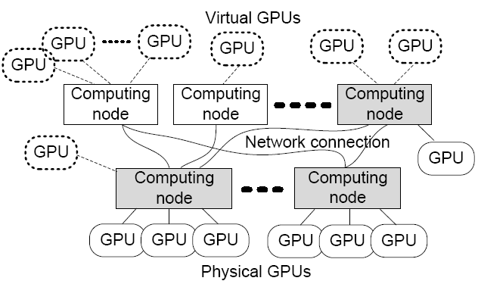
VOCL: Transparent Remote GPU Computing
Transparent utilization of remote GPUs
Efficient GPU resource management:
Migration (GPU / server)
Power Management: pVOCL
Compute Node
Compute Node
Application
VOCL Proxy
OpenCL API
OpenCL API
Native OpenCL Library
Native OpenCL Library
Physical GPU
Physical GPU
Traditional Model
Compute Node
Compute Node
Application
VOCL Proxy
MPI
OpenCL API
OpenCL API
VOCL Library
Native OpenCL Library
Virtual GPU
Virtual GPU
Physical GPU
VOCL Model

Slide 28
VOCL-FT (Fault Tolerant Virtual OpenCL)
Synchronous Detection Model
Asynchronous Detection Model
User App.
VOCL FT
Functionality
User App.
VOCL FT Thread
bufferWrite
lanchKernel
bufferRead
sync
lanchKernel
bufferRead
sync
bufferWrite
lanchKernel
bufferRead
sync
bufferWrite detecting thread
lanchKernel
bufferRead
sync
lanchKernel
bufferRead
sync
bufferWrite
lanchKernel
bufferRead
sync
ECC Query
ECC Query
ECC Query
ECC Query
ECC Query
ECC Query
Checkpointing
ECC Query
Checkpointing
Double- (uncorrected) and single-bit (corrected) error counters may be queried in both models
Minimum overhead, but
double-bit errors will trash whole executions

Slide 29
Failures are not explicitly detected, but handled automatically
Some algorithms take care of this automatically
Iterative methods
Naturally fault tolerant algorithms
Can other things be done to support this kind of failure model?

Slide 30
Conclusion
Lots of ways to provide fault tolerance
Abort everyone
Abort some processes
Handle failure of portion of system without process failure
Handle failure recovery automatically via algorithms, etc.
We are already looking at #2 & #3
Some of this work will go / is going back into MPI
ULFM
Some will be made available externally
GVR
We want to make all parts of the system more reliable, not just the full system view

