Slide 1
All Eyes On Me:
Effects of Twitch and Genre on Player Behavior and Sentiment
Presented By: Alex Bragg & Wes Dufelmeier
Notes:
Wes: This presentation works hand in hand with a dashboard that expresses data gathered from Steam’s API and Twitch data from Sullygnome. The Presentation walks through the dashboard in sequential order jumping between presentation and dashboard.

Slide 2
Table of contents
01
02
03
04
05
2 - 5
6
7 - 8
Saturation Compared to Reviews
Player Behavior
Fighting for Relevance
9 - 11
12 -13
Increasing Player Base
Conclusion and Recommendation
1
Notes:
Wes: We jump into the dashboard right from the start. Switch to the dashboard to show off the decomposition tree on Page 1(Home), to show a high level view of the data, and Page 2 (Review Comparison), show off some of the genres(indie, action, accounting) note their patterns.

Slide 3
Saturation Compared to Reviews
The more games the more reviews
People engage with things they like
Polarization is real
2
Notes:
Wes: Here are the insights for Page 2(Review Comparison) of the dashboard. The more games a genre has, the more reviews it will have on the whole. Positive reviews often outnumber negative ones. Highly popular or polarizing games will produce spikes in less saturated genres.
After this slide, we jump back to the dashboard to show off Page 3 (Every Game), show off some interactable elements and point out CS2 as an outlier. Then bring it back here for the next slide.

Slide 4
Counter Strike and Esports
Players
Tournaments
Counter-Strike is the biggest esports game by the number of competitors, with a total count of 16441 pro players.
The biggest esports game by the number of tournaments is also Counter-Strike, with a total count of 8297 tournaments.
Prize Money
X- Factor
The fastest-rising individual esports game is Counter-Strike 2, which has accrued $12,172,739 in prize money since being released in September 2023.
The coupling of randomized loot crates for skins and betting on esports matches creates a greater sense of stakes on each match and greater investment in the game.
published, E. L. (2016, July 6). CS:GO’s controversial skin gambling, explained. PC Gamer. https://www.pcgamer.com/csgo-skin-gambling/
‌
Schellenberg, Kristjan. “Top 10 Esports Games - What Are the Biggest Paying Esports in 2021?” Esports.net, 13 May 2024, www.esports.net/news/top-10-esports-games/.
3
Notes:
E-sports can be a large driver of game traffic. Skim past players, tournaments, and prize money, these are here to explain the nature of CS2 as an outlier. The insight to focus on is the grey area of skin gambling in CS and how that boosts engagement. But, is e-sports the key to driving player base growth?

Slide 5
“Riot generally does not use esports as a way to acquire new game players. Esports aren't an effective way to do so because in order to really enjoy the competition, a viewer needs to have a foundational knowledge of the game.”
John Needham, President of Esports at Riot Games
Needham, John. “Building the Future of Sport at Riot Games.” Riot Games, 19 Apr. 2023, www.riotgames.com/en/news/building-the-future-of-sport-at-riot-games.
4
Notes:
Wes: No, E-sports are examples of games played at the height of their complexity, which can be alienating to viewers on the outside.

Slide 6
Why All The Investment?
5
Notes:
Wes: This slide can be brushed over or used as a call and response for the audience. Either way, we move to the next slide.

Slide 7
20,000
Games released in 2024
6
Notes:
Wes: Here’s our answer to the previous slide, make note that even if 3/4ths of these games never see any engagement or sales your still up against thousands of competitors on Steam. We jump back to the dashboard to show off Page 4 (Trending), which shows the fiercness of competition to remain relevant in a competitive market.

Slide 8
Player Stats
7
Notes:
Wes: Here we pose the question why is it so hard to capture and hold a gamer’s attention? This can be broken down into 4 other questions: how long do gamers play in a give time frame, how many games do they play in that time, how many games does a gamer own, and how many of those games get played?

Slide 9

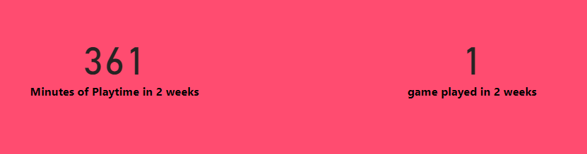
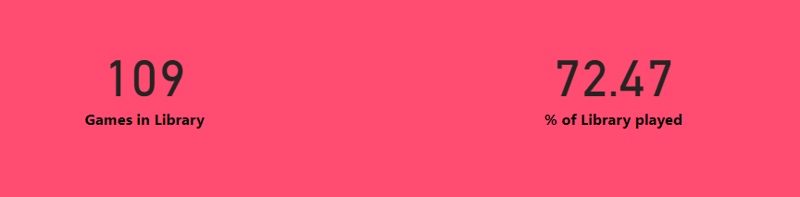
Player Behavior
8
Notes:
Wes: here we have the answer, most people aren’t variety streamers. They play one game when they have the time until they finish or grow tired of it and move on to something else. How do you make sure your game is the one they chose to play.

Slide 10
Twitch
9
Notes:
Wes: We switch back to the dashboard to show off the last two pages, Page 4 (Watch Time) and Page 5 (Watch and Play). Make special note of the free to play games, indies, and old games on Page 4 and the outlines of MMOs and Free to play games on Page 5.

Slide 11
“Gaming influencers and streamers are much better at describing the fundamentals of a game, one reason why we are increasingly opening up our broadcasts for co-streaming.…An important distinction in the motivation to watch esports versus traditional sports is that ~60% of our viewers watch esports to get better at playing the game.”
John Needham, President of Esports at Riot Games
Needham, John. “Building the Future of Sport at Riot Games.” Riot Games, 19 Apr. 2023, www.riotgames.com/en/news/building-the-future-of-sport-at-riot-games.
10
Notes:
Wes: Having good relationships with influencers is the key to growing your player base, because their interest and passion in your product is genuine and that energy is infectious. Twitch also has a great strength in building community which can further entrench players into you ecosystem.

Slide 12
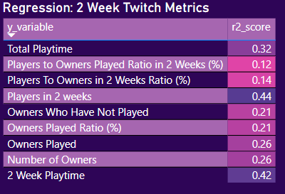
Player Predictions
11
Notes:
Wes: Here we show the regression results for twitch’s effect on game performance. The effect is modest, but provides insight on the fact that Twitch effects the here and now and nudges viewers to be players. These insights provide direction for game makers to [ush their games a launch and try to get as many streamers to try their game as possible to give the impression of saturation and interest.

Slide 13
Conclusions
Games with no monetary barrier to entry (Free To Play) equate to popular and profitable games by way of word of mouth.
Esports can help keep a game relevant and profitable long after their release date, but does not expand the player base to the level that streaming is able to.
The point of esports is to turn players into true believers.
Saturation of games does not affect negative sentiment as expected.
12

Slide 14
Recommendations
Invest in Free To Play games, esports leagues, and MMOs.
Provide regular updates to games to advance status.
When a game or update is released, focus on making as many sponsored deals with as many streamers as possible.
This is to maximize the effect that twitch viewership will have on player behavior.
Don’t worry about the saturation of genres, as they do not affect negative sentiment.
13

Slide 15
Thank You!
Any Questions?

