Slide 1

Evaluating Wind Investment Prospects
Presented By: Voltaic Research

Slide 2
Table of contents
01
02
03
04
05
06
Global
Manufacturers
Operators
Slide# 3-5
Slide# 6-10
Slide# 11-16
State of Wind
Controversy
Conclusions
Slide# 17-28
Slide# 29-33
Slide # 34 - 36

Slide 3
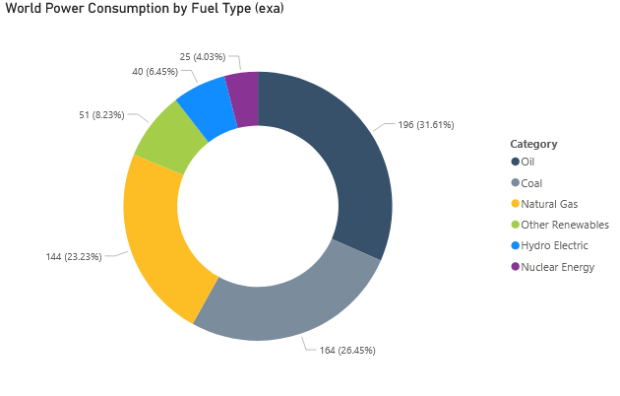
Global Energy Consumption (2023)
Energy institute. “2023 Regional Overview – access to energy and sustainability
”, Accessed: 8 October 2024, https://www.energyinst.org/statistical-review

Slide 4
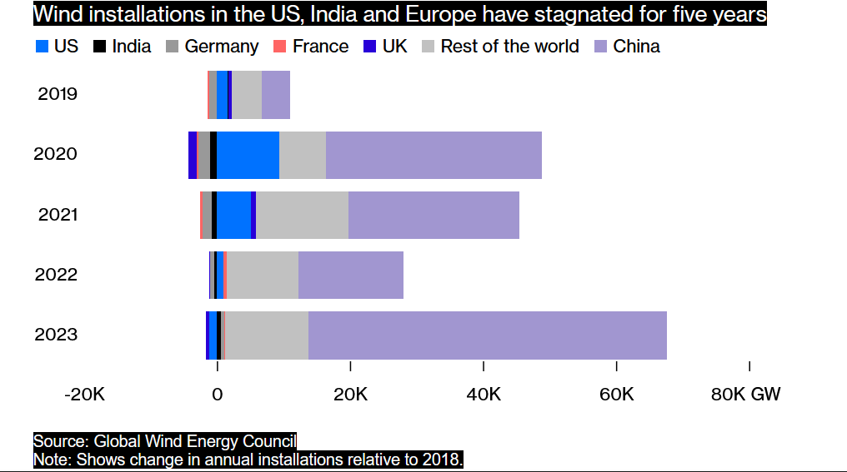
China Leads the Charge on Wind for 4 Years
Fickling, David. “China Accounts for All the World’s Wind Power Growth.” Bloomberg.com, Bloomberg, 20 Apr. 2024, www.bloomberg.com/opinion/articles/2024-04-20/china-accounts-for-all-the-world-s-wind-power-growth?sref=UBrhZ1ro&leadSource=uverify%20wall. Accessed 11 Oct. 2024.
‌
Notes:
This offshore wind turbine is designed for areas with wind speeds of 8 meters per second and above. With average winds of 10 meters per second, just one of these giants can generate 100 GWh of power annually, which is enough to power 55,000 homes. That’s enough to cut standard coal consumption by 30,000 tons and reduce CO2 emissions by 80,000 tons.

Slide 5
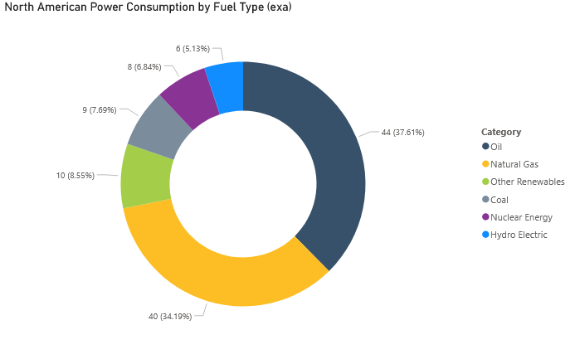
North American Energy Consumption (2023)

Slide 6
170.18 MW
Average Cumulative Capacity of Wind Farms In The US

Slide 7
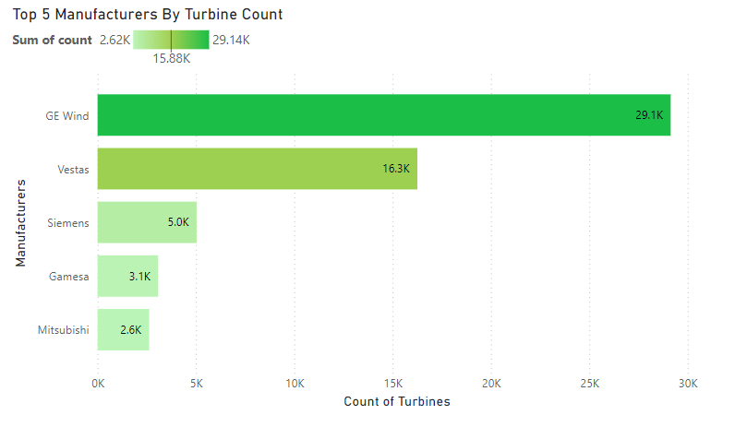
Biggest Players In Turbine Production
All manufacturers displayed invest in fossil fuels, except for Vestas.

Slide 8
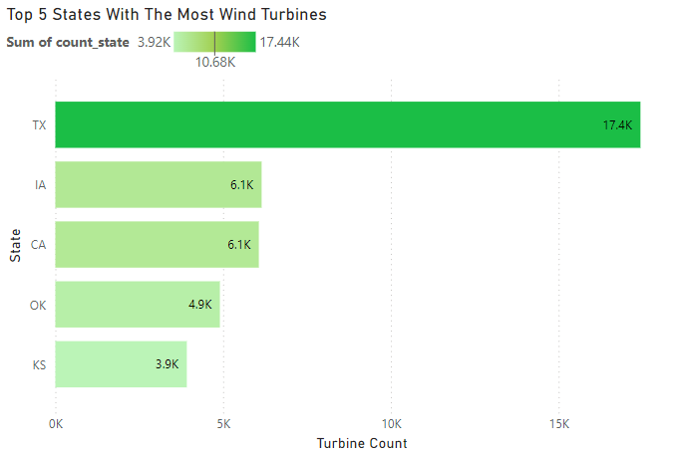
States With The Most Turbines

Slide 9
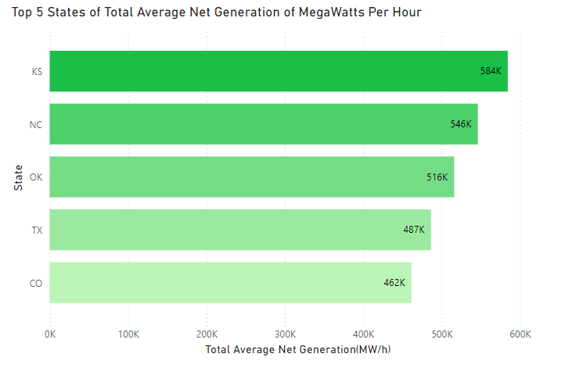
States that Produce the Most Wind Energy
“Wind provided more than 9% of electricity nationwide, over 50% in Iowa and South Dakota, and over 30% in Kansas, Oklahoma, and North Dakota.”
“Frequently Asked Questions about Wind Energy.” Energy.gov, 2013, www.energy.gov/eere/wind/frequently-asked-questions-about-wind-energy.

Slide 10
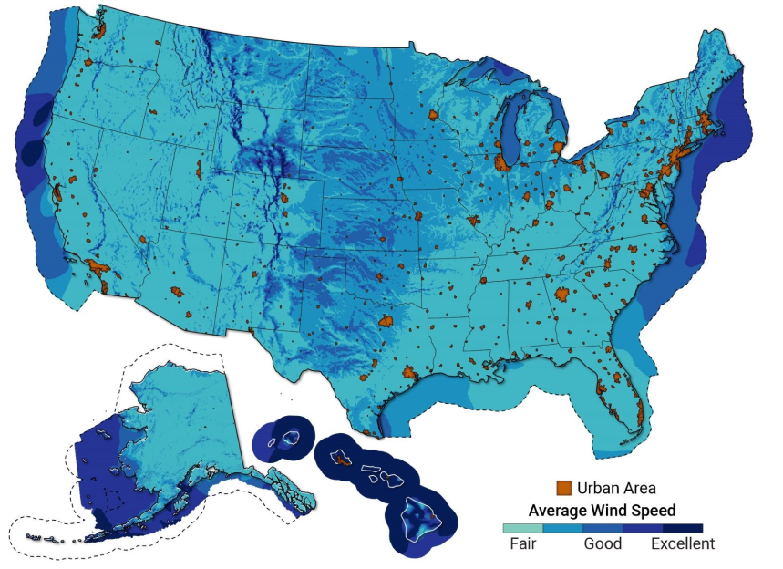
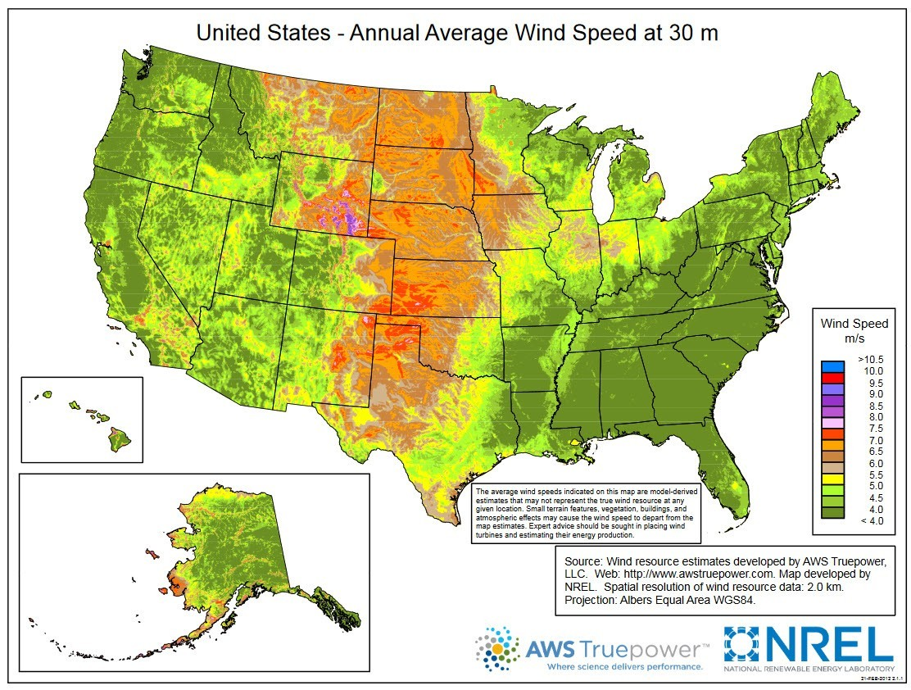
Average Wind Speeds Across The US
Edited by Office of Energy Efficiency & Renewable Energy, Top 10 Things You Didn’t Know about Offshore Wind Energy | Department of Energy, 21 Aug. 2024, www.energy.gov/eere/wind/articles/top-10-things-you-didnt-know-about-offshore-wind-energy.

Slide 11
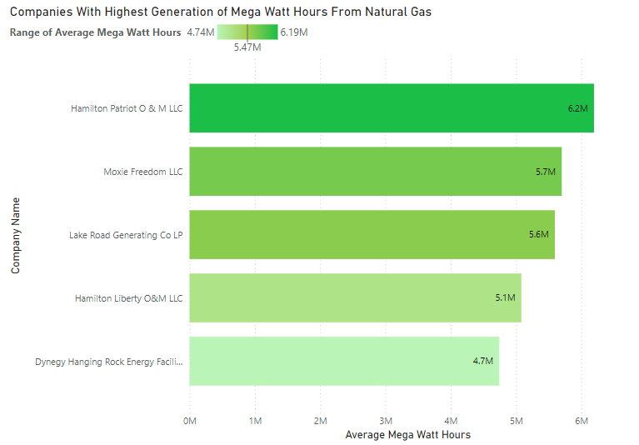
Companies With The Highest Energy Output: Natural Gas

Slide 12
653
Companies operate wind farms in the US

Slide 13
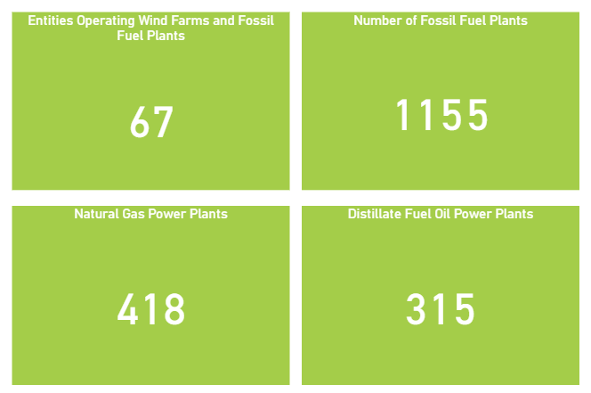
Wind Farms and Fossil Fuel plants

Slide 14

Operators of Wind Farms and Fossil Fuel Plants

Slide 15
Notes:
Many of the larger companies that operate both wind farms and fossil fuel plants operate in several states

Slide 16
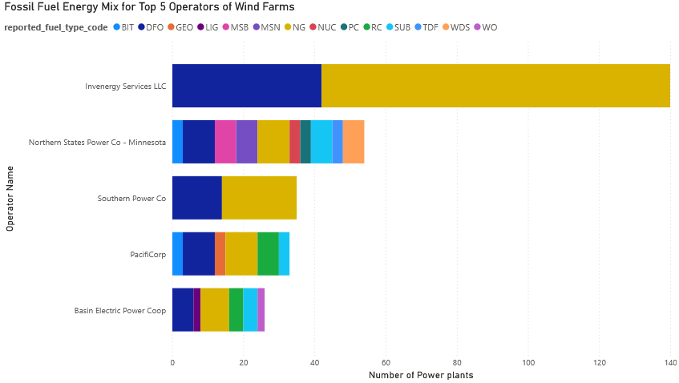
Fossil Fuel Energy Mix

Slide 17
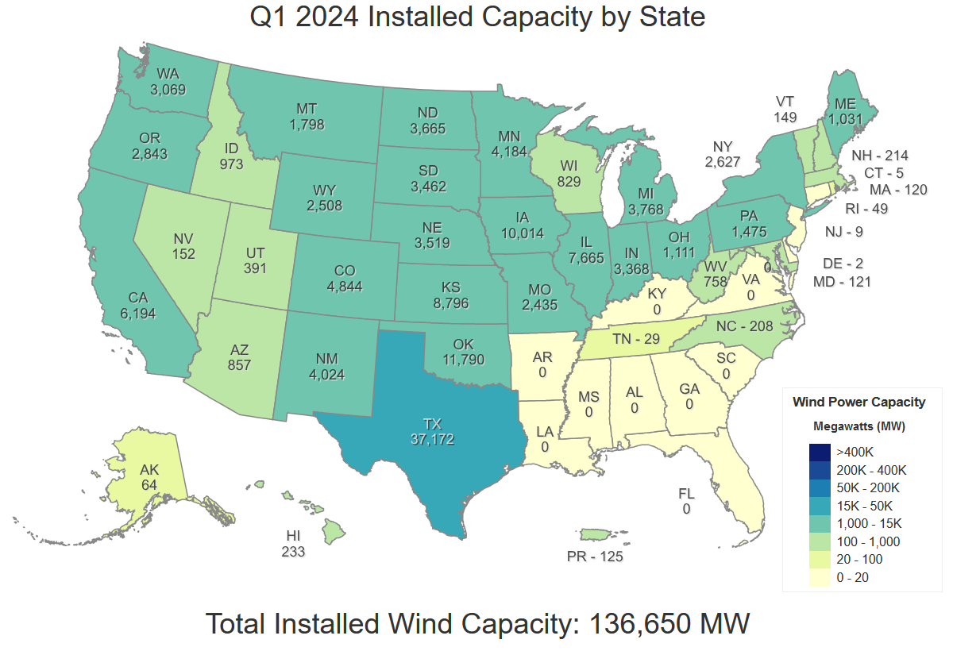
State Wind Energy Capacity
WINDExchange, Q1 2024 Installed Capacity by State | Department of Energy, Accessed: 9 October 2024, https://windexchange.energy.gov/maps-data/321

Slide 18
Individual Wind Turbines Across The US

Slide 19
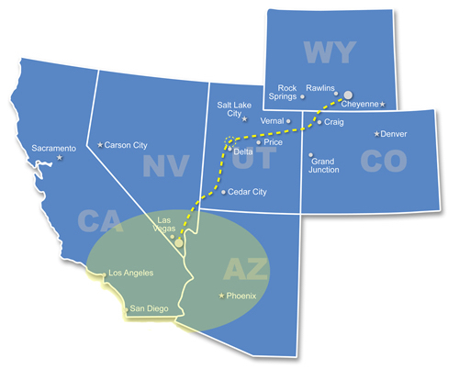
Wind Power is Highly Transferable
Wind power is highly transferable, evidenced by large-scale, state-crossing transmission projects like the TransWest Express Transmission(TWE) and the SunZia Projects.
The TWE will travel 732 miles from the 3,000-megawatt Chokecherry wind farm in Wyoming to supply Nevada, Arizona, and California with wind energy.
The SunZia Transmission project will travel 550 miles from the 3,500-megawatt SunZia wind farm in New Mexico to supply Arizona with electricity.
https://www.wyomingpublicmedia.org/people/will-walkey. “Feds Greenlight Major Transmission Line That Will Deliver Wyoming Wind Power to the Southwest.” Wyoming Public Media, 14 Apr. 2023, www.wyomingpublicmedia.org/natural-resources-energy/2023-04-14/feds-greenlight-major-transmission-line-that-will-deliver-wyoming-wind-power-to-the-southwest.

Slide 20
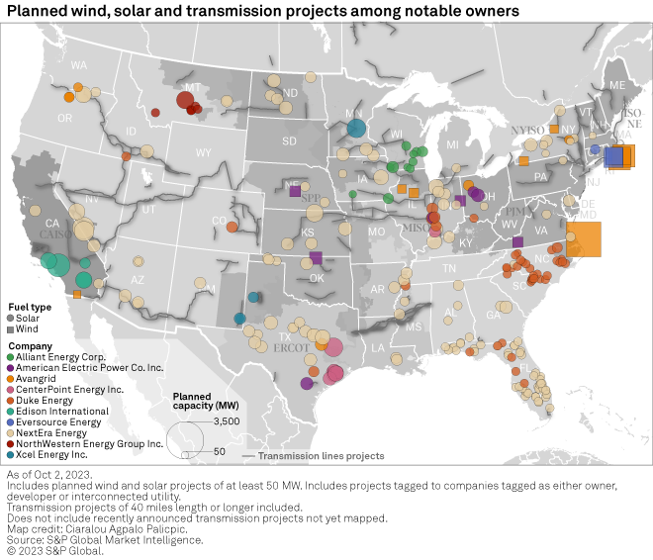
The Future of Wind Power
Wilson, Adam. “Curtailment, congestion costs rise as transmission upgrades lag renewable growth”, 2 November 2023, Accessed: 9 October 2024, https://www.spglobal.com/market-intelligence/en/news-insights/research/curtailment-congestion-costs-rise-as-transmission-upgrades-lag-renewable-growth
Notes:
The easy spots, low hanging fruit have gone and now we must look to off-shore opportunities to fulfill our needs

Slide 21
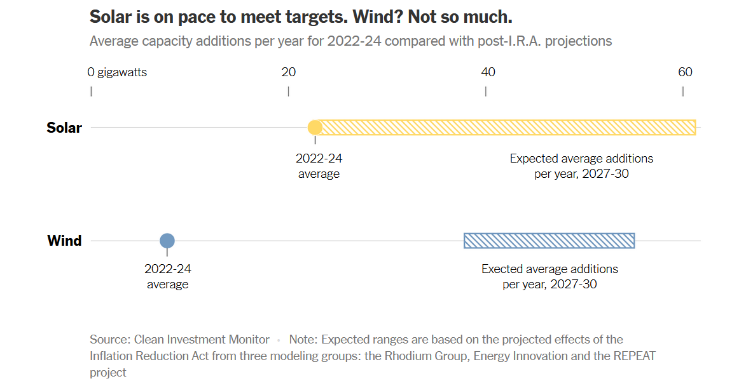
Solar Grows and Wind Stalls
Plumer, Brad, and Nadja Popovich. “As Solar Power Surges, U.S. Wind Is in Trouble.” The New York Times, 4 June 2024, www.nytimes.com/interactive/2024/06/04/climate/us-wind-energy-solar-power.html.

Slide 22
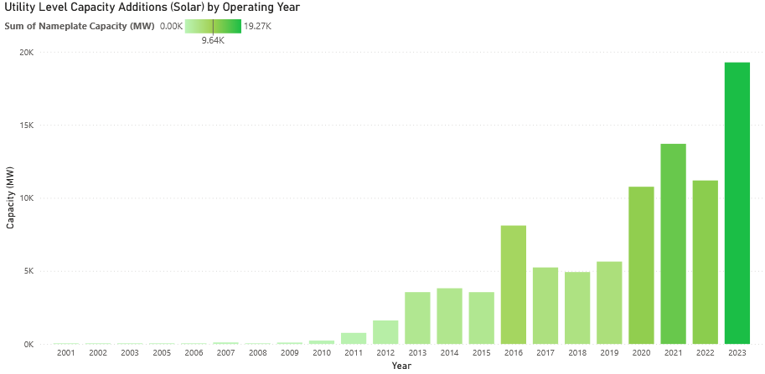
Solar’s Upward Trend

Slide 23
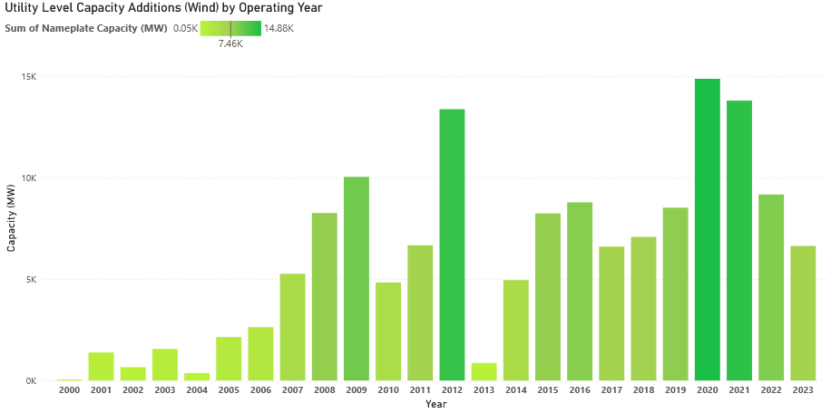
Wind Projects Fluctuate

Slide 24
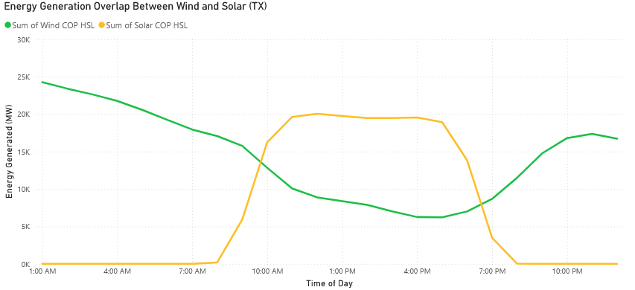
Wind and Solar are Complimentary
Notes:
Intermittent electricity

Slide 25
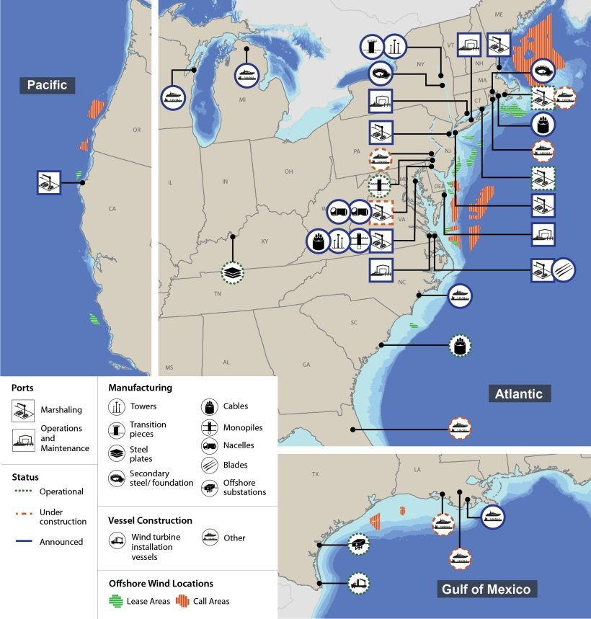
Plans for Offshore Wind Farms
Edited by Office of Energy Efficiency & Renewable Energy, Top 10 Things You Didn’t Know about Offshore Wind Energy | Department of Energy, 21 Aug. 2024, www.energy.gov/eere/wind/articles/top-10-things-you-didnt-know-about-offshore-wind-energy.
Notes:
Off-shore wind farms are a country wide effort

Slide 26
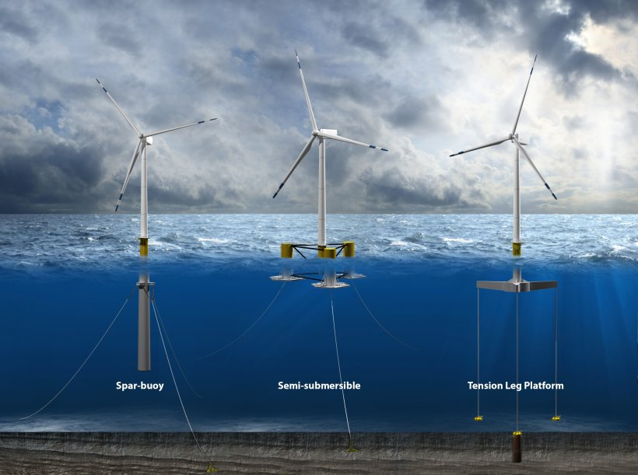
Offshore Turbine Structure
Edited by Office of Energy Efficiency & Renewable Energy, Top 10 Things You Didn’t Know about Offshore Wind Energy | Department of Energy, 21 Aug. 2024, www.energy.gov/eere/wind/articles/top-10-things-you-didnt-know-about-offshore-wind-energy.

Slide 27
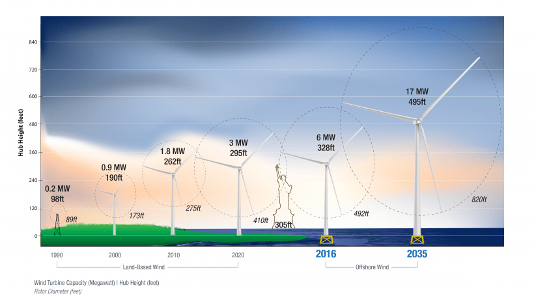
The Bigger, The Better
Edited by Office of Energy Efficiency & Renewable Energy, Top 10 Things You Didn’t Know about Offshore Wind Energy | Department of Energy, 21 Aug. 2024, www.energy.gov/eere/wind/articles/top-10-things-you-didnt-know-about-offshore-wind-energy.

Slide 28
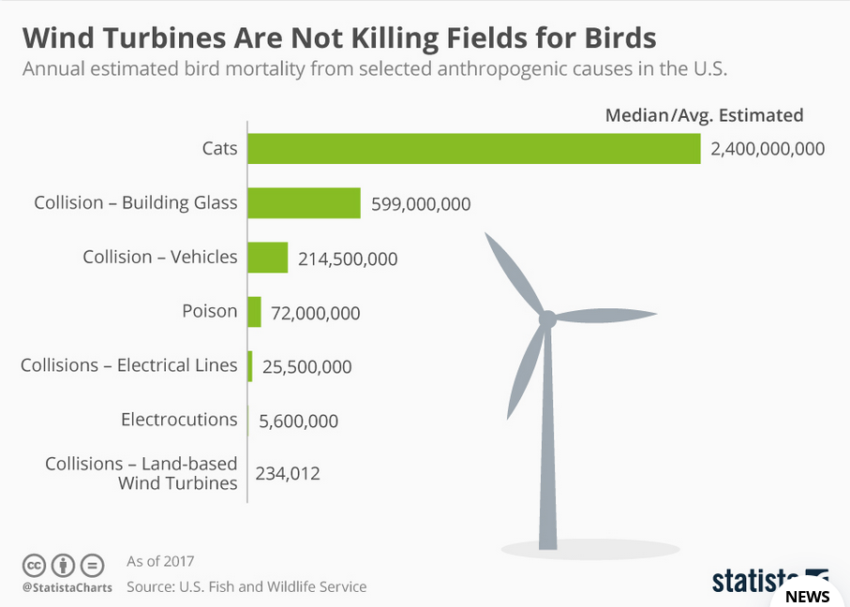
Causes Of Bird Deaths

Slide 29
Public Sentiment
In March 2023, Idaho State Legislature opposed the implementation of the Lava Ridge Energy Project.
Would visually compromise the Minidoka National Historic site.
Kalaeloa, Hawaii experienced protests in October 2019 due to the Na Pua Makani wind farm project.
Demonstrators say the turbines threaten the already endangered Hawaiian hoary bat.
The protests resulted in at least 130 arrests.

Slide 30
Pitfalls of Wind Energy
China leads the charge on wind.
Snarled work pipelines, outdated power grid systems, and lengthy permitting processes.
Solar is commercially and residentially viable.
Announcements of new wind can cause an outsized backlash.
Notes:
China leads the charge on wind energy by a wide margin, which presents a deceiving growth rate, out of context.
Snarled work pipelines, outdated power grid systems, and lengthy permitting processes stall many wind farm projects.
Solar outpaces wind by a wide margin due to photovoltaic cells' commercially and residentially viable nature.
Announcements of new wind farms too close to residential or sacred sites can cause an outsized backlash.

Slide 31
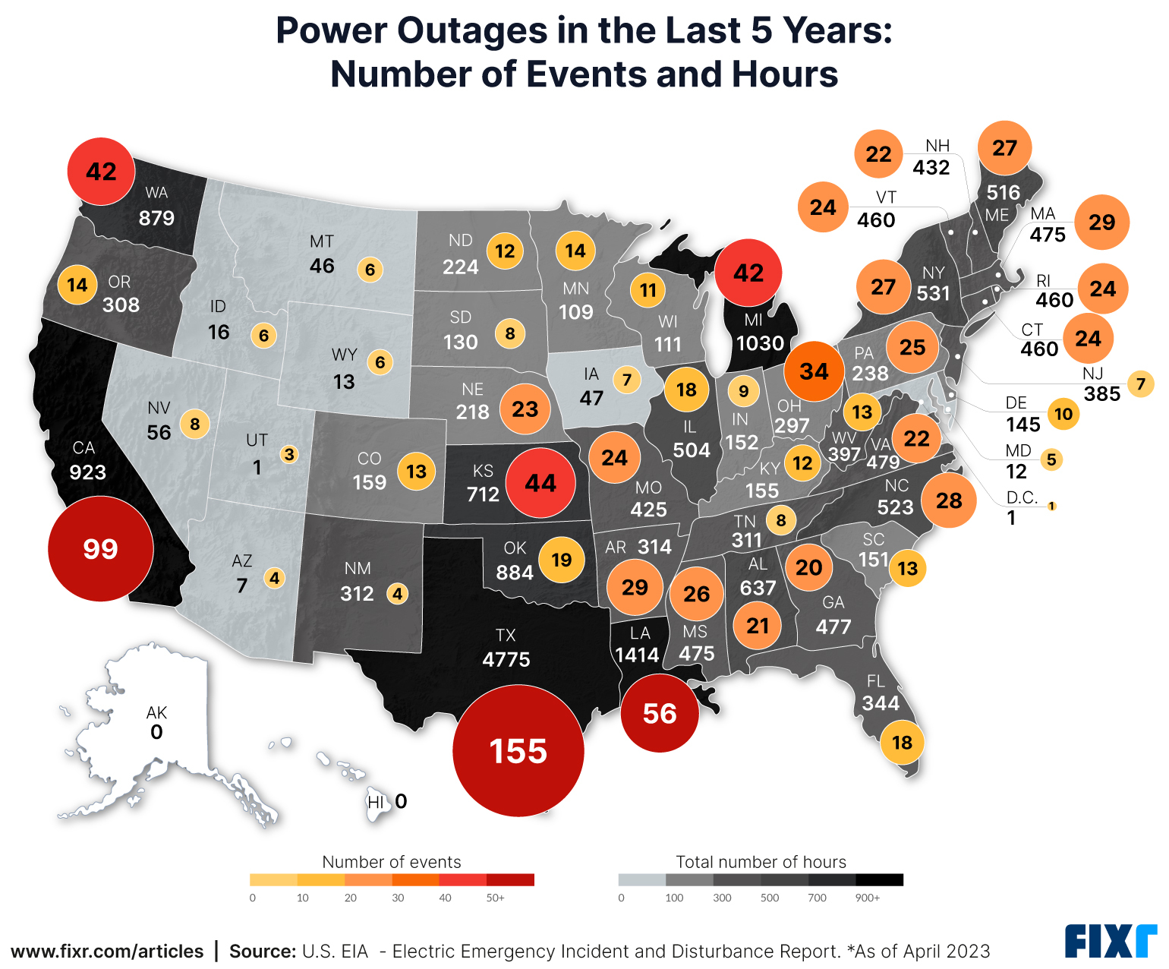
All States Blackout Map
Alexander, Carol. “Analyzing State-Level Power Outages and Solutions for Homeowners”,
1 August 2024, Accessed: 14 October 2024, https://www.fixr.com/article
s/power-outage-solutions

Slide 32
Wind Turbines Won’t Bail You Out
In February 2021, Texas experienced a massive power outage statewide due to a severe cold wave.
As natural gas infrastructure froze, wind turbines were unable to contribute to the needs of the grid.
Global Warming Solutions. “The Texas Freeze: Timeline of events”, 31 January 2022,
Accessed: 10 October 2024, https://environmentamerica.org/texas/center/articles/the-texas-freeze-timeline-of- events/

Slide 33
Conclusions
Wind farms are costly projects requiring large upfront investments.
Wind energy is highly transferable.
Utility level solar is growing more quickly than wind.
Wind energy works best alongside solar.
Onshore wind energy can’t keep up with the needs of the grid.
Public reactions to wind energy projects can be unpredictable and volatile.
Notes:
Wind farms are costly projects requiring large upfront investments.
Wind energy is highly transferable, evidenced by transmission projects crossing state lines to share electricity generated by windfarms.
Utility level solar is growing more quickly than wind.
Wind energy works best alongside solar, as they have complimentary down periods.
Onshore wind energy can’t keep up with the needs of the grid.
Public reactions to wind energy projects can be unpredictable, volatile, or used as political battlegrounds between federal and state or local government.

Slide 34
Recommendation
Oil companies with experience in offshore drilling will be invaluable investors and mentors to off-shore wind farms, an energy concept in its infancy.
When choosing locations to invest in fossil fuel powerplants, it is best to invest in a non-gusty region.
The best region to choose from the analysis gathered is the South-Eastern United States.
Photovoltaic cells are a cheaper and easier investment to make.

Slide 35
Thank You!
Any questions?

