Slide 1
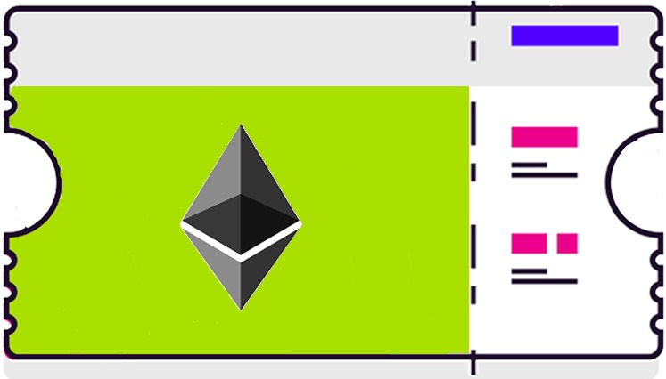
Blockchain Ticketing System
Present by: Team Bloctsys

Slide 2
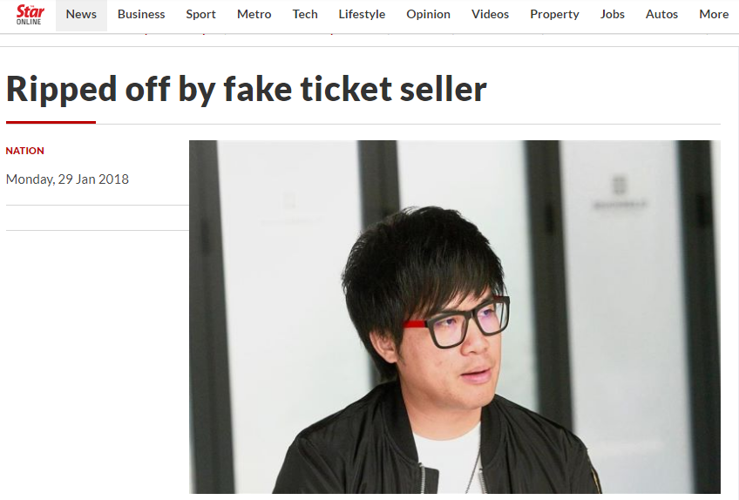

Slide 3


Slide 4

Solution

Slide 5
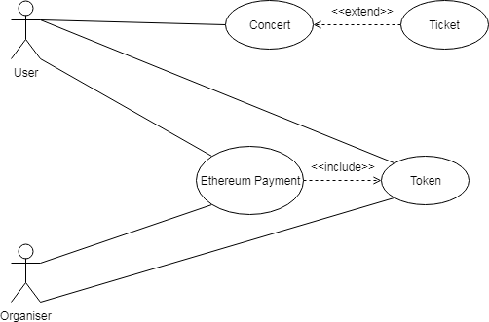
Use Case
Action | Description
Concert | User select the specific concert and ticket type.
Payment | Payment will be done using Ethereum, after transaction is done, user will receive the Token as ticket.

Slide 6
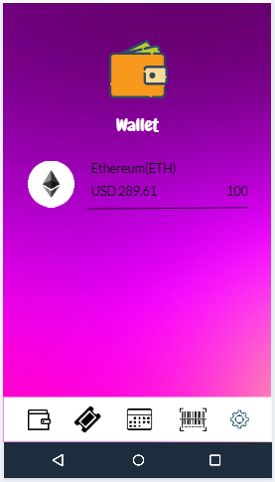
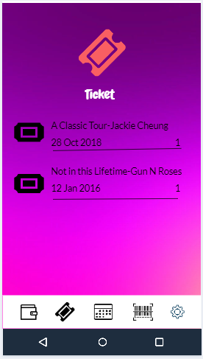
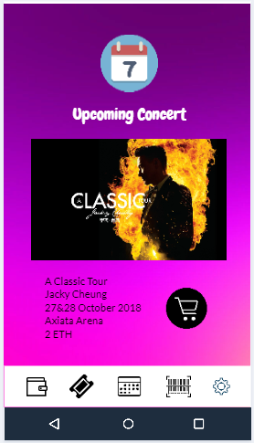
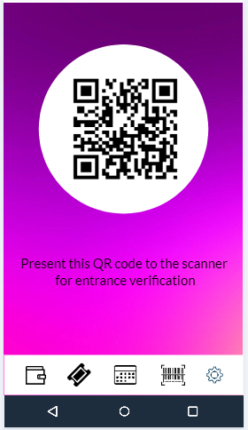
Prototype Design

Slide 7
Demo

Slide 8
Q&A

