Slide 1
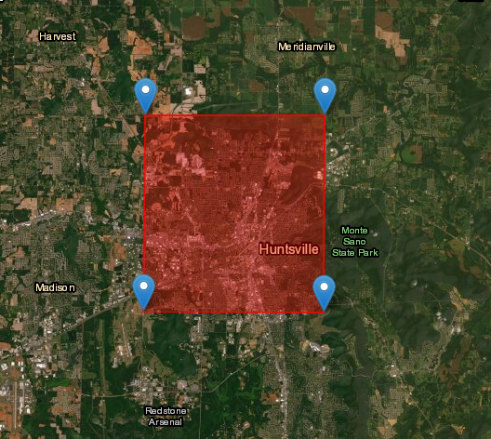
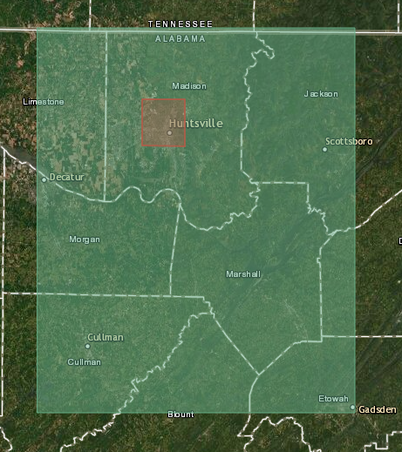
Huntsville area selected 12km x 13km
Total Area in Geotiff
SRTM (34, -87)
91km x 111km (INCORRECT)

Slide 2
gdalinfo
size: 3601x3601

