Slide 1
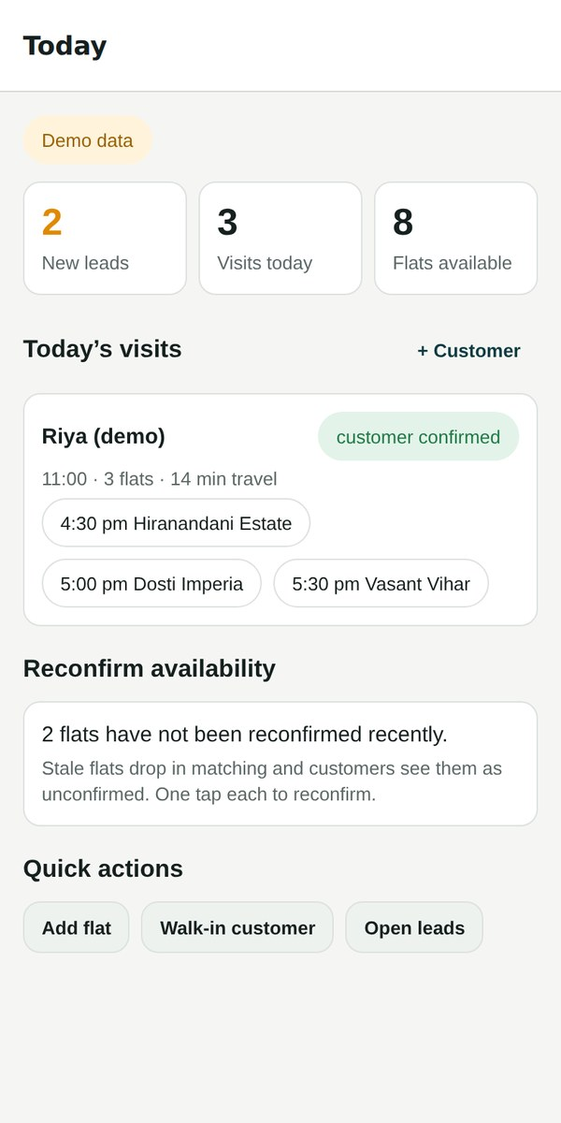
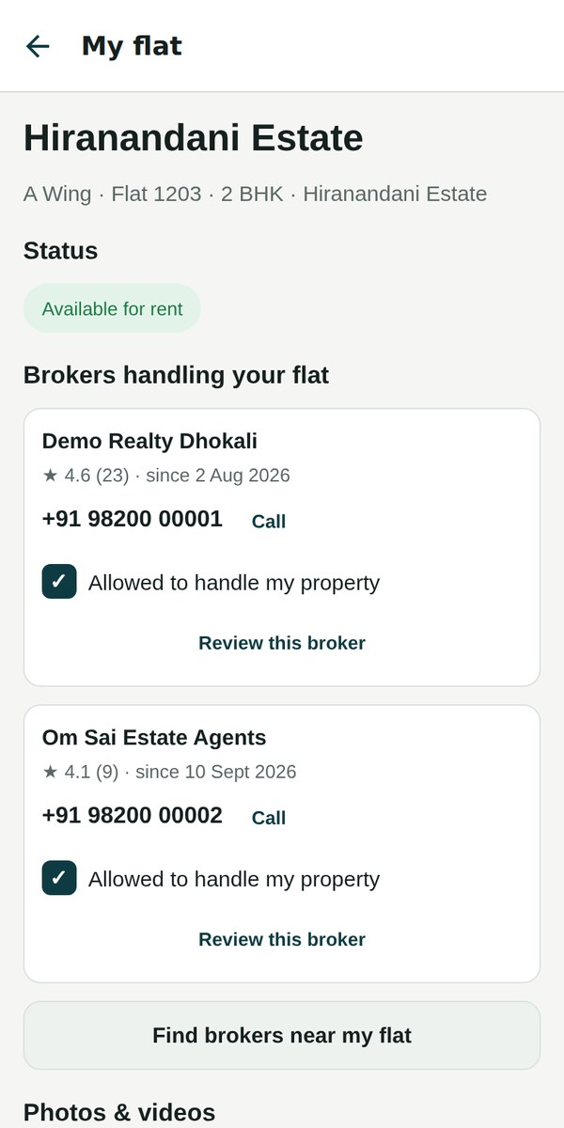
Only Broker
The broker’s operating system for India’s metro rental and resale market
Flats · Customers · Site visits · Owners — in one app
Rentals first, sales built in · Pilot: Thane West, MMR
September 2026
Notes:
Only Broker is a broker-first real-estate platform. Unlike portals that are built around listings or around cutting the broker out, we give the broker the tools to run their whole business — flats, customers, site visits, staff — and we bring owners and customers to them. We start with rentals in Thane West; sales (new and resale) are already in the data model.

Slide 2




Brokers run rentals on notebooks and WhatsApp
Portals work against brokers
One flat, five spellings
Built around listings or around cutting the broker out. The person who actually closes the deal is an afterthought.
“Hiranandani Est.”, “HE Thane”, “Hira Nandani”… Duplicates everywhere, and “available” is often weeks out of date.
Customers live in notebooks
Site visits are wasted
Walk-ins and phone calls live in a notebook. No follow-up, no history, no way to reach them all at once.
Flats already rented get shown, keys go missing, owners aren’t told, routes are guessed.
Notes:
Four everyday pains. Brokers are the ones who close deals, yet portals treat them as a cost to remove. Their inventory is scattered and duplicated, their customers mostly offline, and site visits are inefficient. Every one of these is what Only Broker is designed to fix.

Slide 3





Built like ride-hailing: the broker is the driver
Broker app
Owners
Customers
Ops console
Flats, customers, matching, visit plans, field staff, broadcasts
Register the flat, choose which brokers may handle it, add photos, see status
Shortlists, visit plans, consent and reviews by WhatsApp link — or the app
Verify brokers, keep buildings clean, check the audit trail
Foundation: one clean universe of real buildings
Every flat is tied to exactly one real society, wing and floor — Thane West first, then the rest of MMR.
Notes:
Think of ride-hailing, where the driver is the hero. Here the broker is the driver. Owners and customers are brought to brokers, and a small ops team keeps the data clean. Everything sits on one clean universe of real buildings — that is the foundation competitors don't have.

Slide 4





Six rules we never bend
Flats & customers belong to the broker
Closed universe of buildings
Never shown, offered, moved or swapped between brokers. Enforced by the database itself.
Nobody invents a building. Typos become matches, not duplicates.
The owner decides who handles the flat
Offline customers are first-class
A broker gets it only after the owner ticks “Allow this broker”. Unticking is final.
Everything a customer or owner does in the app also works from a WhatsApp link.
Meet brokers where they are
Conduct-based house rules only
Pick flats their own way (“HE A-1203”); the matching engine earns trust, it is never forced.
Pets, cooking, smoking, occupancy — never religion, caste, community or gender.
Notes:
These rules came from founder decisions and they are built into the product, not just policy. The first one matters most for broker trust: the platform never takes a flat or a customer from one broker and gives it to another.

Slide 5
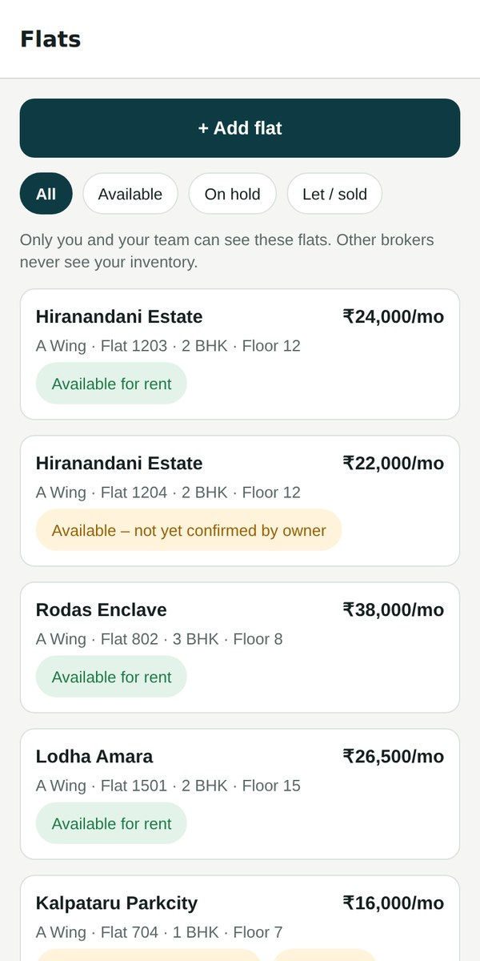
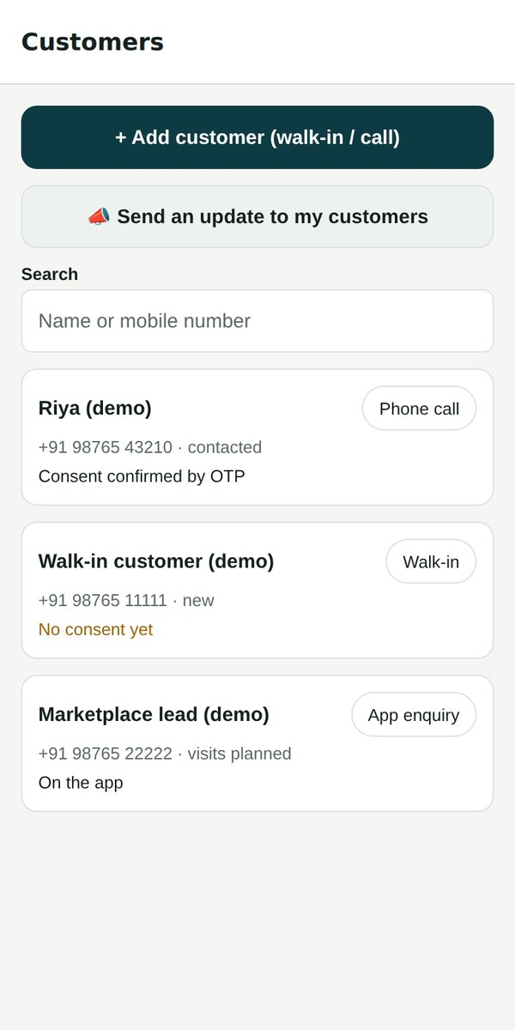
One app for the broker’s whole day
USP
Today: new leads, today’s visits, flats to reconfirm.
Flats: status, keys, owner contact, stale reminders.
Customers: walk-ins and calls, consent, requirements, full history.
Add a flat in ~10 taps or upload an Excel sheet — messy spellings are matched automatically.
Android & iPhone one codebase; Android test app installable today.
Today
Flats
Customers
Notes:
This is the broker's daily home. Everything is in one place: leads, visits, their own flats and their own customers. Adding a flat takes about ten taps; brokers with Excel sheets can upload them and we match their spellings to real buildings.

Slide 6
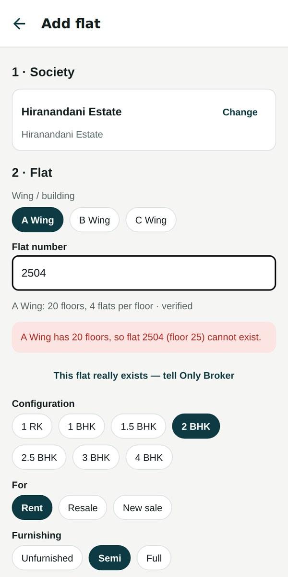
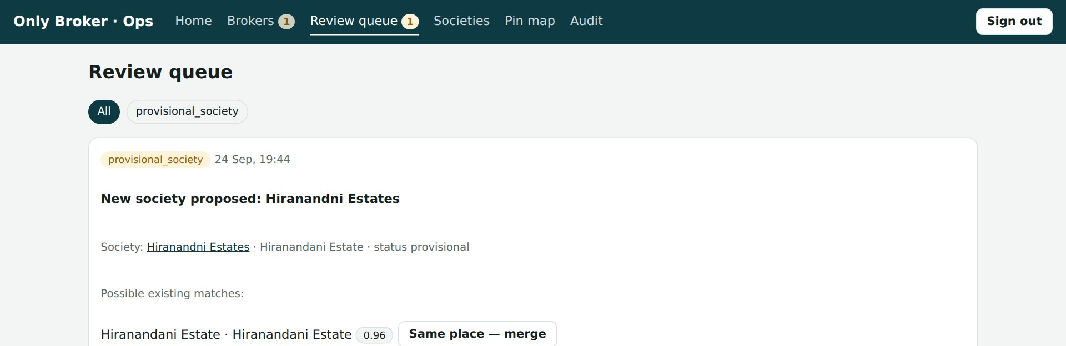
A closed universe of buildings = clean data
MOAT
Ops review queue: a misspelled new society is matched to the real one (96%)
Every flat → one real society, wing and floor. Wing layouts (floors, flats per floor, refuge floors) refuse “2504” in a 20-floor wing.
Spellings and nicknames are learned. “Hiranandni Estates”, “HE” → Hiranandani Estate. Each confirmed spelling makes the next upload cleaner.
Unknown names never create buildings — they become a request our team approves or merges.
Impossible flat refused at entry
Notes:
This is our first moat. Portals let anyone type anything, so the same building exists many times and data rots. We keep a closed universe: every flat belongs to one real building, wing and floor. Mistakes are caught at entry, and every correction teaches the system. The longer we run, the cleaner the data gets — hard for a competitor to copy.

Slide 7
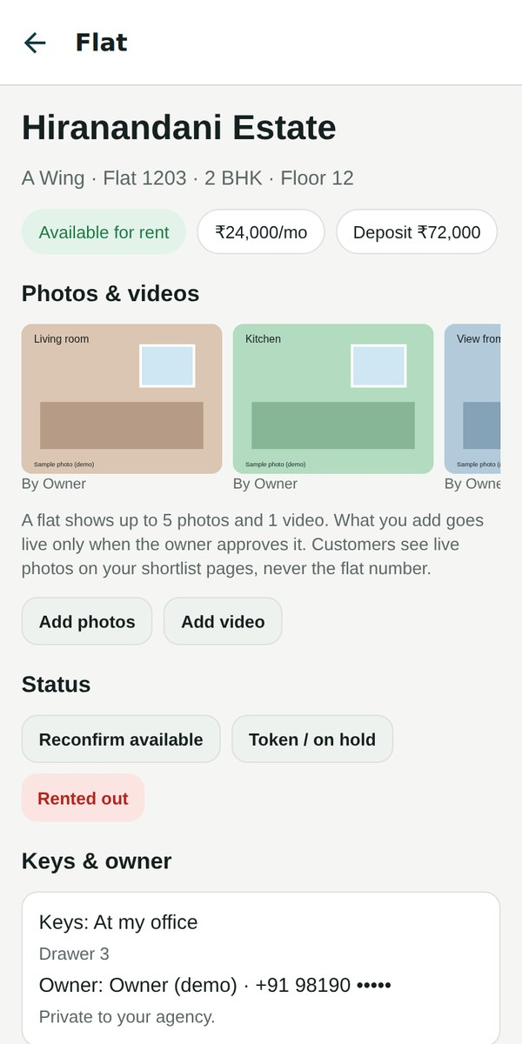
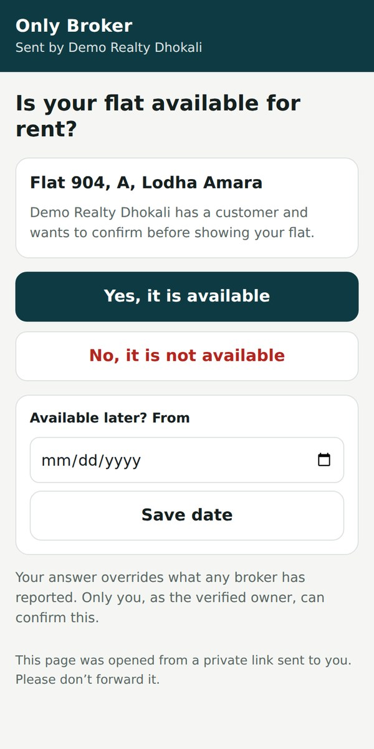
One flat, one truth — confirmed by the owner
MOAT
Owner confirms availability with one tap from a WhatsApp link — no app, no login.
Rented by one broker? Every other broker holding that flat is alerted (without saying who).
Stale flats get reminders at 21 days and are marked “unverified” — customers stop seeing ghost listings.
200-attribute dictionary, only 17 essential. Owner answers override broker answers; distances to station, schools and autos are computed from the map.
Broker’s flat page
Owner’s WhatsApp link
Notes:
Many brokers may hold the same flat, but there is one physical flat and one truth about it. The owner confirms status from a WhatsApp link. When any broker marks it rented, the others are warned so nobody wastes a visit. Our attribute dictionary has 200 fields but a broker only needs 17 to list a flat.

Slide 8
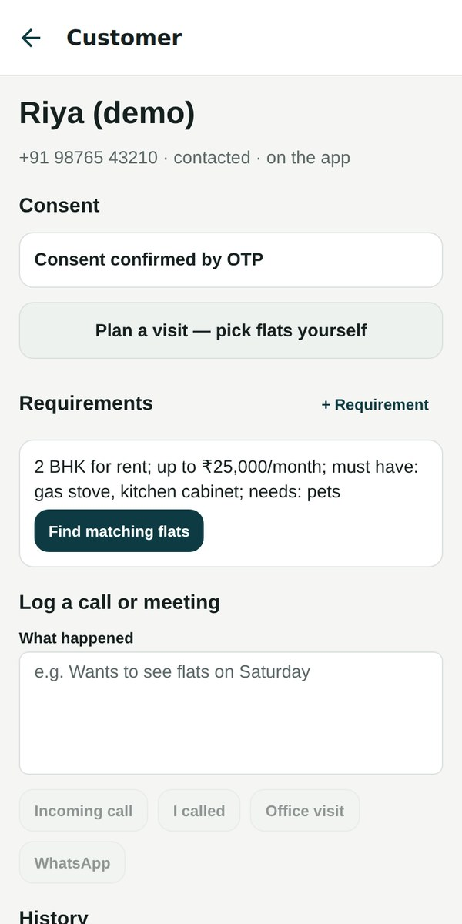
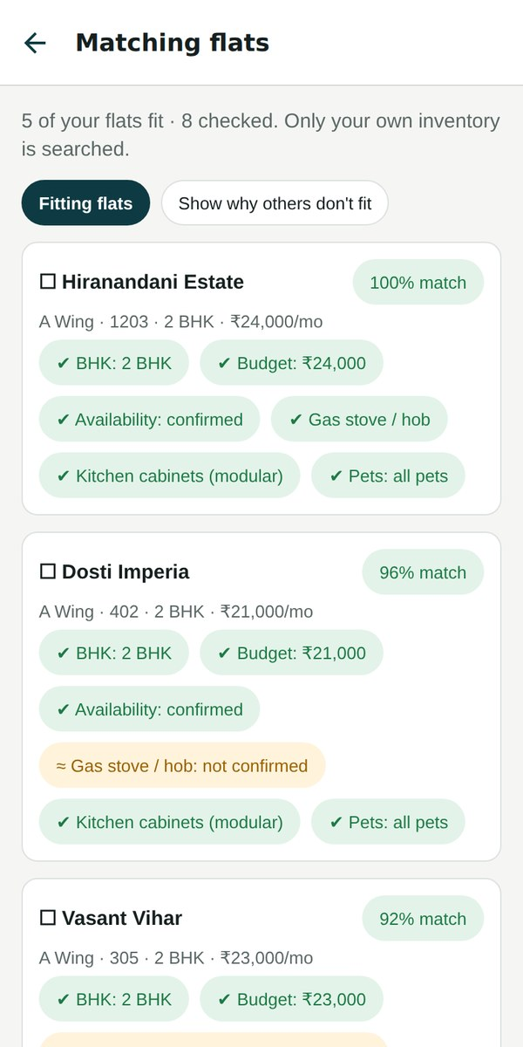
Matching that explains itself
USP
Searches only the broker’s own flats. Never another broker’s inventory.
Every match shows why: ✓ fits, ✗ doesn’t fit, ? not confirmed — budget, BHK, pets, gas stove, availability…
“Show why others don’t fit” so the broker can talk the customer through trade-offs.
One tap to a WhatsApp shortlist — the customer taps “Interested”, and it lands in their history.
Customer & requirement
Explained matches
Notes:
Matching respects the broker's ownership: it only looks at their own flats. Each result explains itself with green, red and amber chips, so a broker can trust it and explain it to the customer.

Slide 9
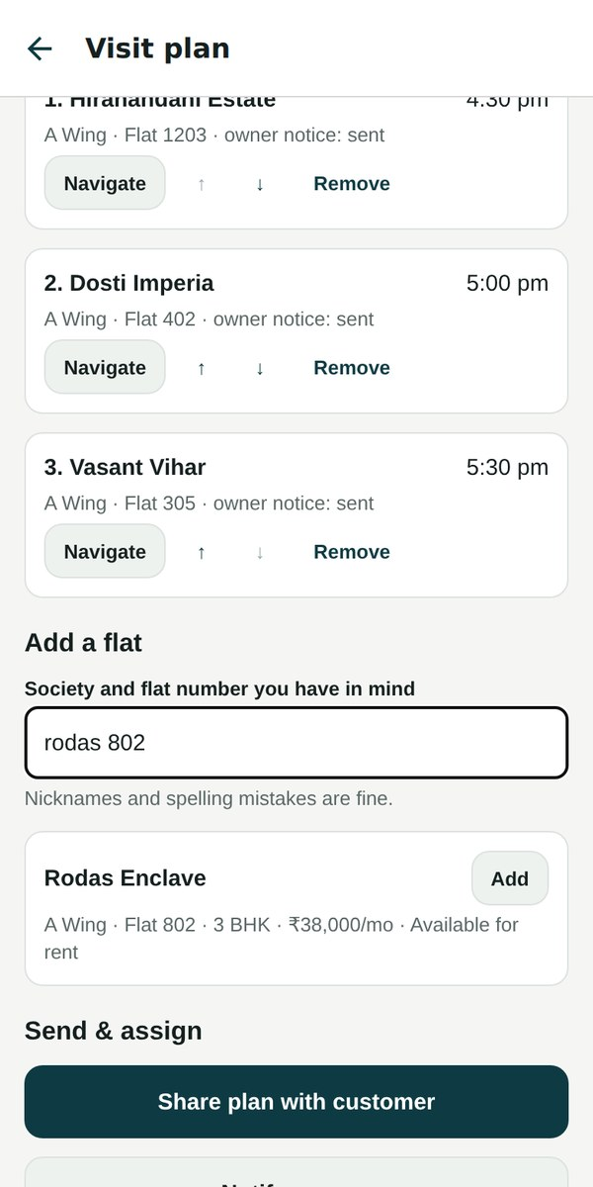
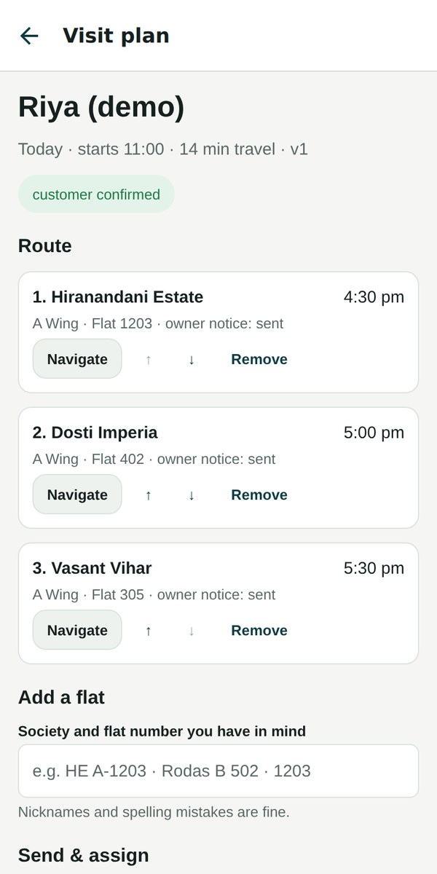
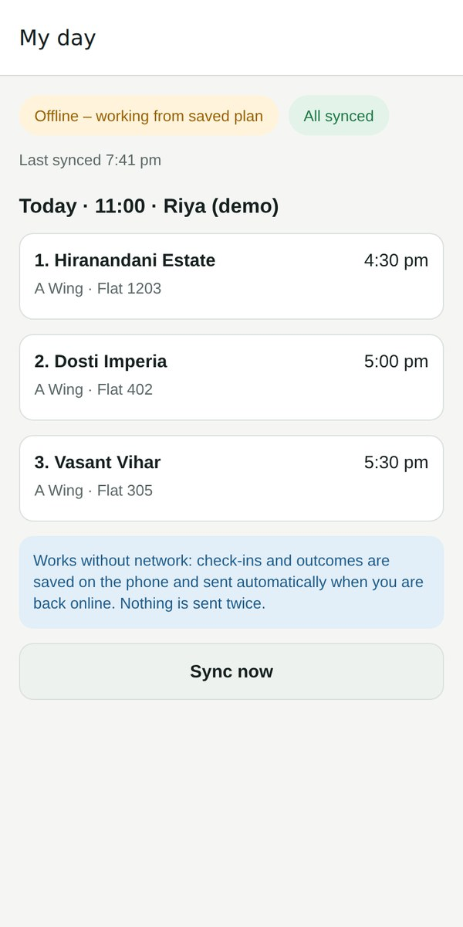
Site visits: plan your way, run them like a fleet
USP
Pick flats yourself: type the society and flat you have in mind (“HE A-1203”).
Shortest route and time slots worked out automatically.
Customer confirms the plan from a WhatsApp link; owners are notified.
Field staff see only their route; check-ins and outcomes work without network and sync later.
Keys always known: office, owner, staff, lock-box.
“rodas 802” → add to route
Optimised route
Field staff — works offline
Notes:
Brokers keep using their own judgement — they can type a society and flat number and add it straight to the route. The system then does the boring work: routing, notifying owners, sending the customer a confirmation link, and assigning field staff, whose app works even without network.

Slide 10
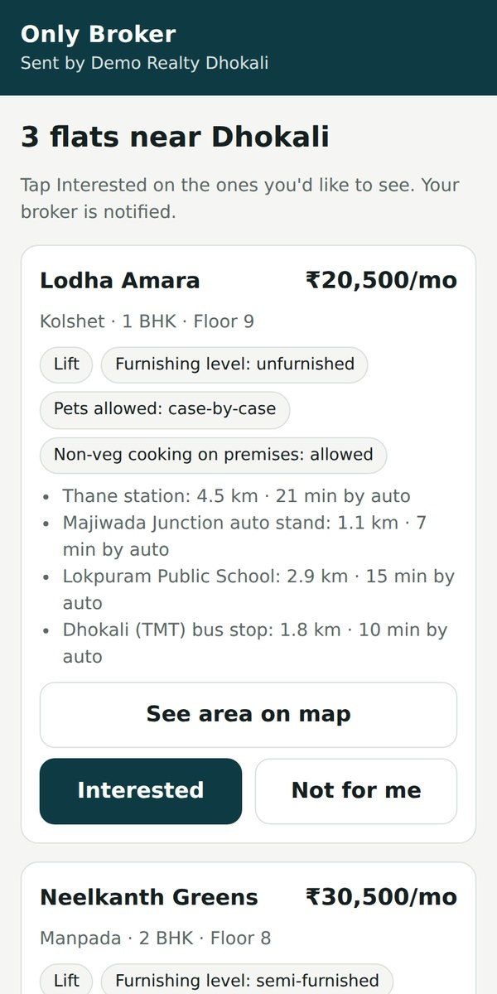
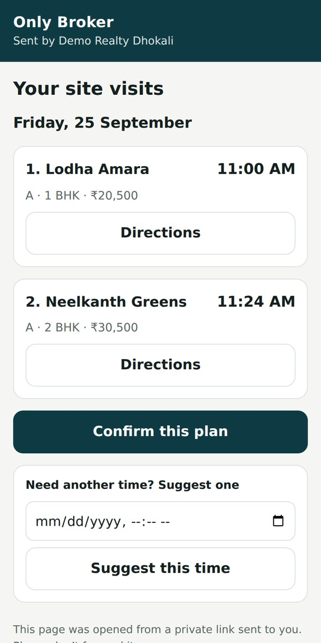
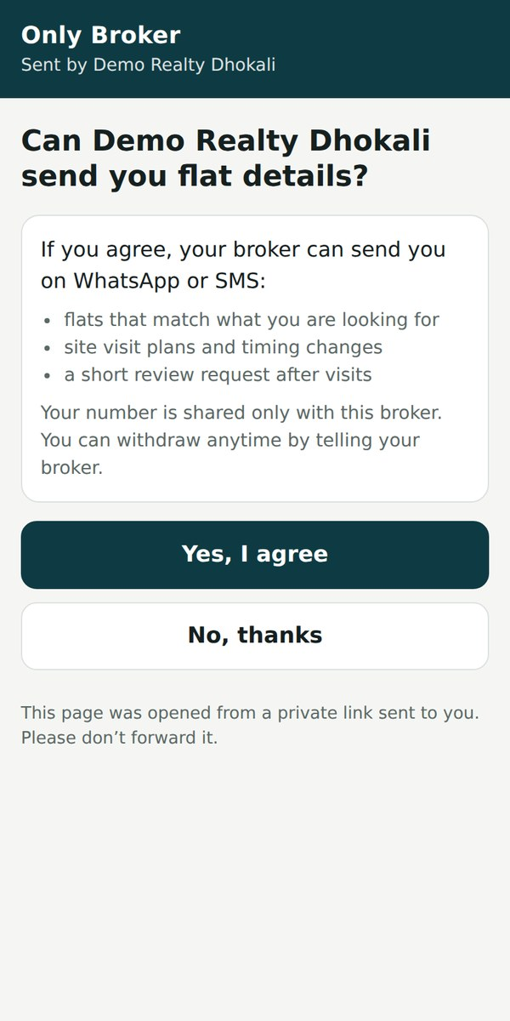
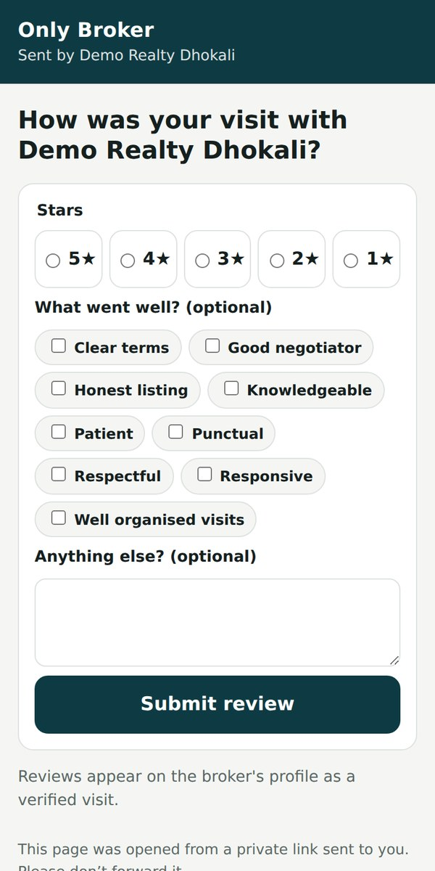
No app needed: WhatsApp links do it all
USP
Shortlist — tap Interested
Visit plan — confirm
Consent — DPDP-ready
Review after the visit
Walk-in and phone customers become real, reachable customers — without installing anything. Flat numbers stay hidden until the visit.
Notes:
Most customers are offline. We don't force an app on them: every step — shortlist, visit confirmation, consent, review — works from a private link on WhatsApp or SMS. Their responses flow straight into the broker's customer history.

Slide 11
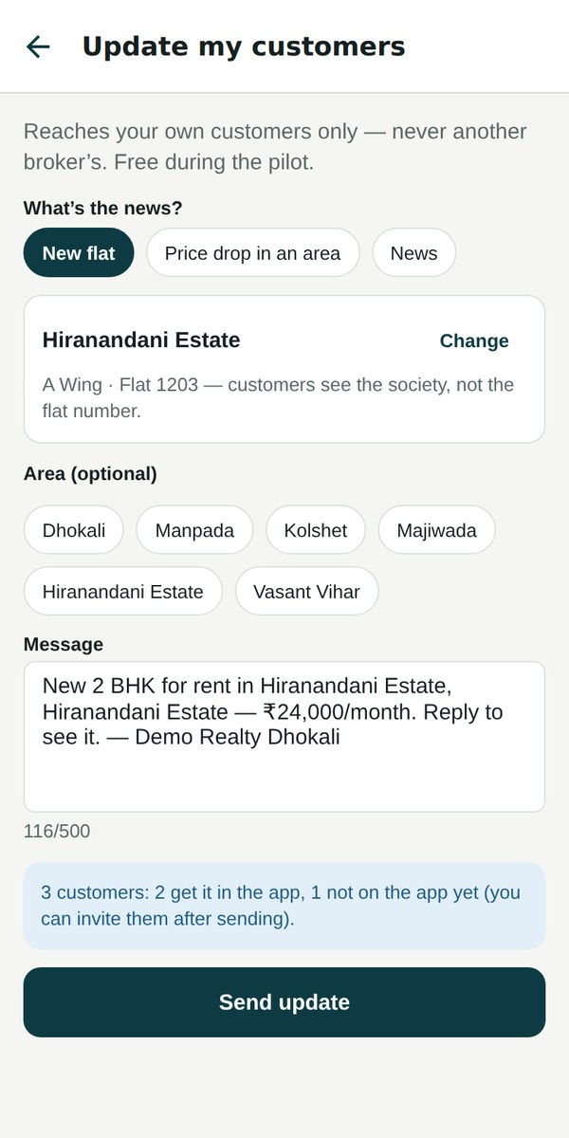
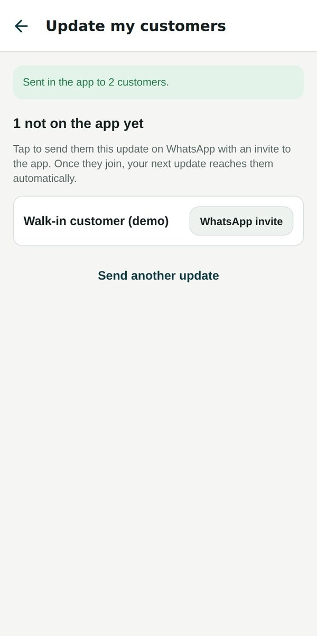
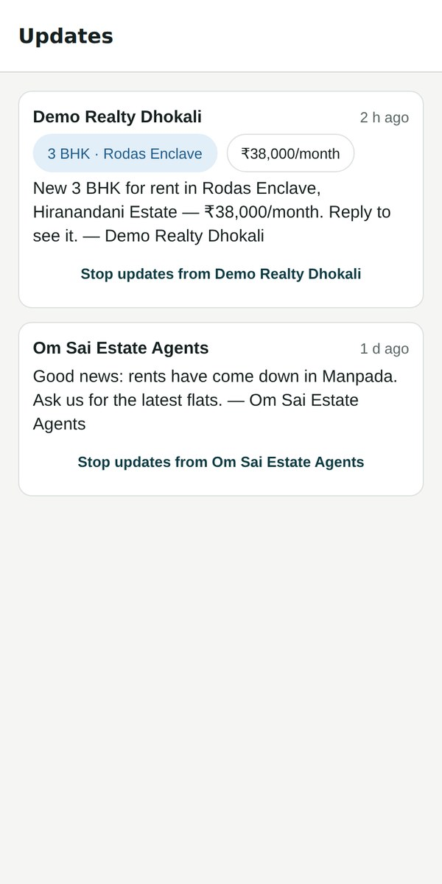
A broker’s second asset: their customer list
MOAT
Private, like their flats. Never visible to any other broker.
Broadcast in one tap: new flat, price drop in an area, or news — to all customers or those looking in one area.
Customers not on the app yet get a WhatsApp invite with the same news.
Growth loop: every broadcast pulls more offline customers onto the platform.
Customers stay in control: “Stop updates from this broker”. Free in the pilot, credits later.
Compose
Invite the rest
Customer’s updates
Notes:
Brokers have two assets: flats and customers. Broadcasts make the customer list valuable — one message reaches everyone. Customers who aren't on the app yet get a WhatsApp invite, so the more a broker broadcasts, the more of their offline customers join. That's a built-in growth engine, and it makes brokers stay.

Slide 12
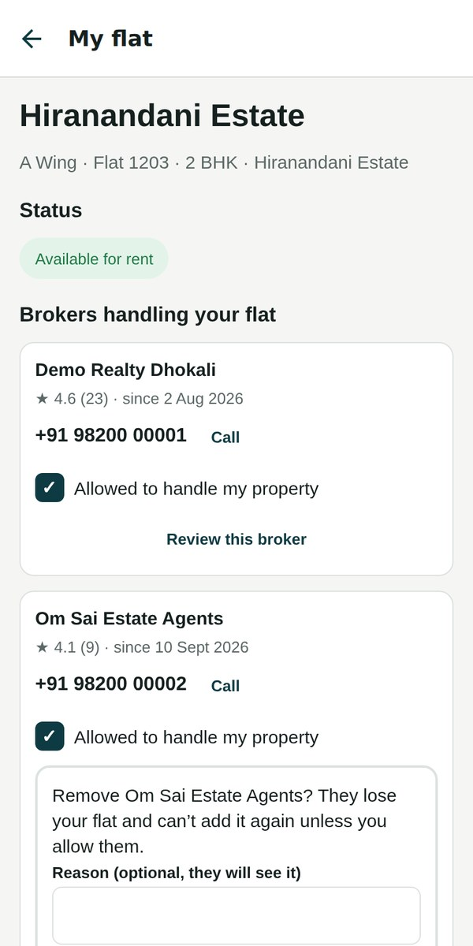
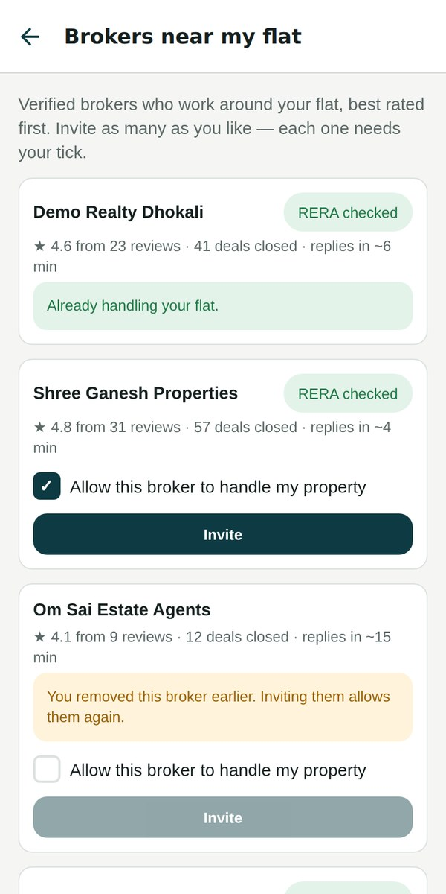
Owners in control — without extra work
USP
Register with proof (index II / share certificate / bill) — kept, not checked: a deterrent.
“Allow this broker to handle my property” — no flat reaches a broker without the tick.
Untick any broker: they lose the flat and can’t re-add it; they may ask to be added back.
Read-only status: “currently serviced by … · number · review”.
Who handles my flat
Untick = remove, final
Invite needs the tick
Notes:
Owners get a simple, powerful control: a tick box. A broker only receives an owner's flat after the owner ticks "Allow this broker to handle my property", and unticking removes them — the owner's decision is final. Owners can also see who is handling the flat, call them, and review them.

Slide 13
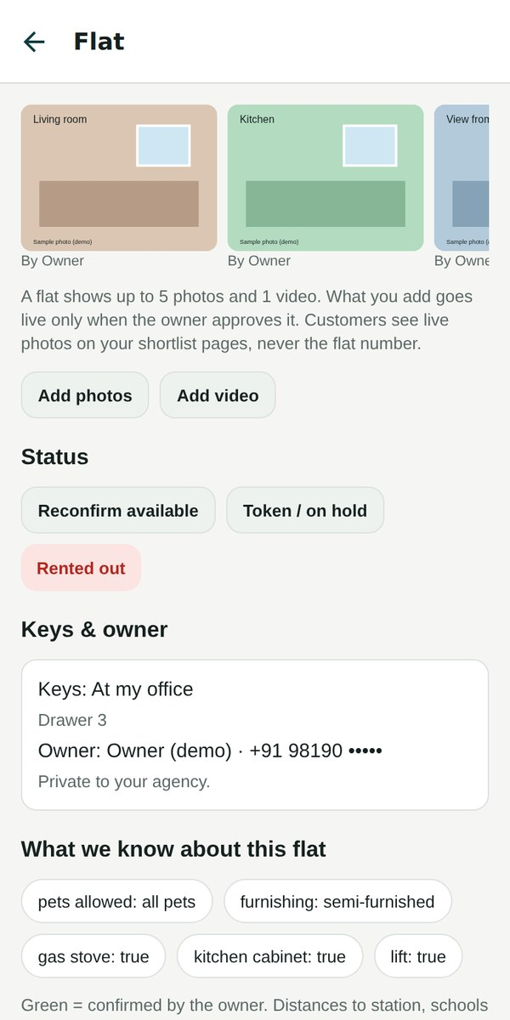



Photos & videos: one good set per flat
1. Owner or broker uploads
Customers never can. Photos are straightened, resized, and location details removed.
2. Owner approves
A broker’s upload stays “waiting” until the owner approves. Max 5 photos + 1 video per flat.
3. Live everywhere it helps
Every broker holding the flat, and the customer’s shortlist page — never the flat number.
Flat photos on the broker’s page
Notes:
Photos belong to the flat, not to one broker, so there's one good set instead of ten bad ones. Owners and the brokers they allow can upload; nothing a broker uploads goes live until the owner approves. Customers see live photos on their shortlist, but never the flat number.

Slide 14
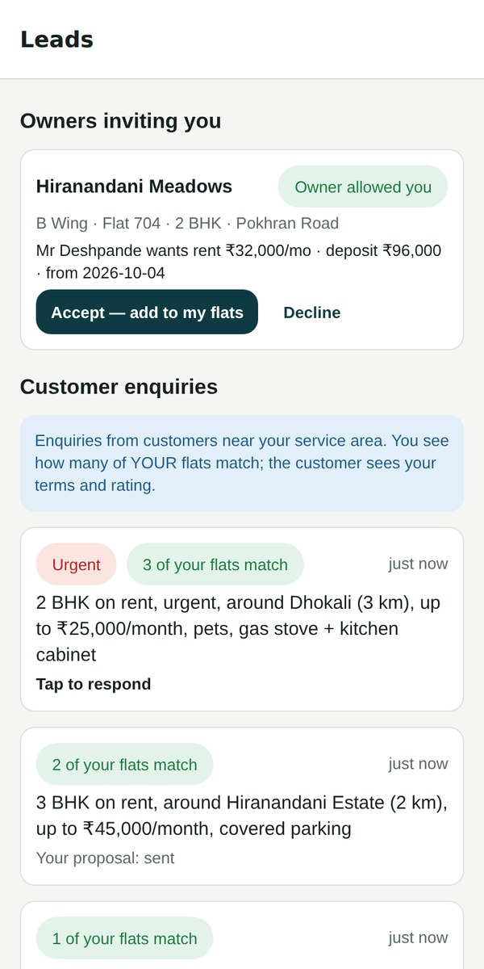
Next: one enquiry, every relevant broker
MOAT
One enquiry, every nearby broker: the customer posts once; brokers who work in that area get it instantly.
Brokers see how many of THEIR flats match before they respond — and reply with their terms and rating.
Owners invite brokers from a list of verified brokers near their flat, ranked by rating.
Anonymous supply map: customers see where flats are, never whose — small clusters are hidden.
Status: built and tested in the backend; switched on after the pilot proves the broker app.
Broker’s leads
Notes:
Once brokers depend on the app, we switch on the marketplace. A customer posts one enquiry and every relevant broker nearby gets it — like a ride request. Brokers compete on terms, rating and response time. The pieces are already built; we switch them on after the pilot.

Slide 15
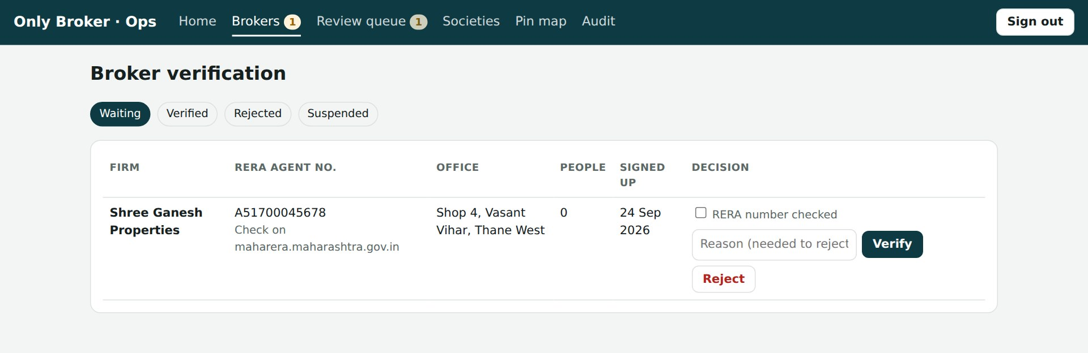
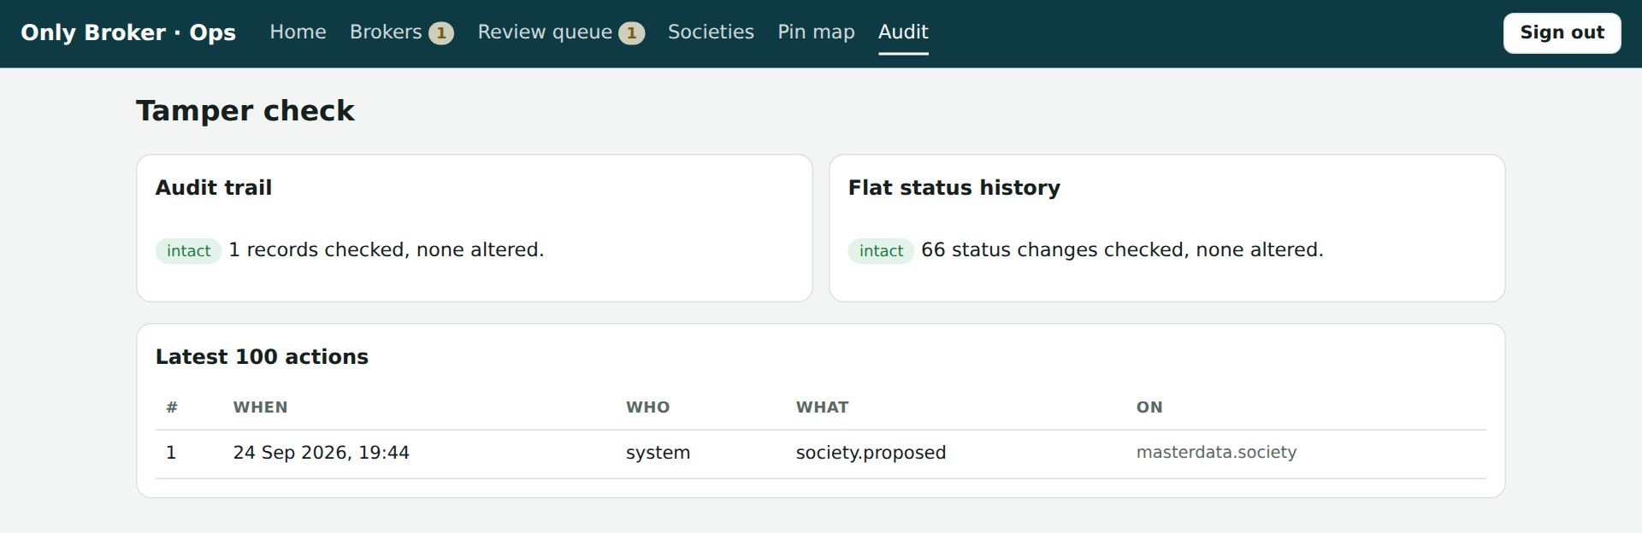
Trust by design: privacy, audit, compliance
MOAT
Each broker’s data is walled off by the database itself — checked by automated tests on every change.
Tamper-evident audit trail and flat-status history: any altered record is detected.
Phone numbers encrypted; owner numbers never reach customers or field staff.
Customer consent recorded (OTP, link or verbal) — ready for India’s DPDP Act.
Brokers verified by our team, with MahaRERA number check.
Ops console: broker verification (RERA) and tamper check
Notes:
Brokers will only put their business on a platform they trust. Isolation between brokers is enforced by the database, not just the app, and it is tested automatically. Every change is audited in a tamper-evident log. Consent and encryption keep us ready for the DPDP Act.

Slide 16

Why this is hard to copy
Data that gets cleaner with use
Brokers’ two assets live here
Owners trust the tick
Offline reach loop
Trust by design
Closed universe of buildings, learned spellings and wing layouts — every upload improves it.
Flats and customers, with their full history — switching away means leaving the business behind.
Owner control and reviews make owners send flats to brokers through us.
Links and broadcasts pull walk-in customers onto the platform, broker by broker.
Isolation, audit and consent built in from day one — slow and costly to retrofit.
Notes:
Five moats. Clean data that compounds with use. Lock-in, because brokers' flats and customers live here. Owner trust through the tick and reviews. A growth loop through WhatsApp links and broadcasts. And trust built in from the start — isolation, audit and consent — which is expensive for anyone else to retrofit.

Slide 17


How we make money (to be tested in the pilot)
Broker subscription
Message credits
Marketplace leads
Monthly plan per firm, with seats for managers and field staff. The core revenue line.
Plans include a number of broadcasts and WhatsApp messages; brokers top up. Free in the pilot.
After the pilot: credits to respond to customer enquiries and owner invitations.
Pilot: free for Thane West brokers. We measure time saved per flat, stale-listing rate, visits per customer — and what brokers would pay.
Notes:
Brokers pay because the app saves them time and makes them money. Subscription is the core; broadcasts and messages are a natural usage-based add-on; marketplace leads come later. Pricing is still to be decided — the pilot is free and will tell us willingness to pay.

Slide 18
Where we are today
190+
4
200
Live
automated server tests, all passing
app modes: broker, field staff, owner, customer
flat attributes — only 17 essential
Android test app & online demo
Done
Now
Next
Then
Later
Build the core
Clean Thane West data
Pilot broker on the real app
Measure the pilot
More brokers → marketplace
Notes:
The core is built and tested: broker, field staff, owner and customer modes, the link pages, the ops console and the data checks. We are now cleaning Thane West data with the pilot broker. Next, the pilot broker moves onto the real app on a server with real SMS and WhatsApp.

Slide 19
Next 90 days
Thane West data
Pilot broker confirms map pins; wings, floors and flats per floor loaded (MahaRERA + site visits).
Pilot broker live
Server in the cloud, real logins, Android app; iPhone via TestFlight.
Real messages
DLT sender ID and templates, WhatsApp Business, Google Maps accounts.
Measure & price
Time per flat, stale listings, visits per deal, willingness to pay → pricing decision.
Notes:
Four workstreams for the next 90 days: clean Thane West data, put the pilot broker on the live app, switch on real SMS and WhatsApp, and measure the pilot so we can set pricing.

Slide 20
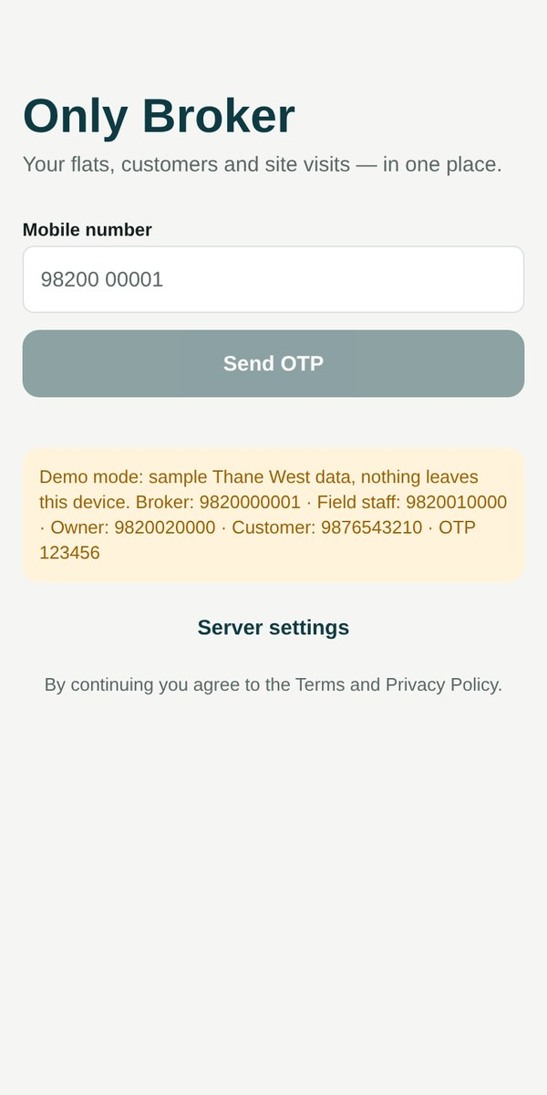
See it working
Online demo (any phone or laptop)
claude.ai/artifact/3ibs72K1zjuPdY2dF5rbXZ
Demo logins — OTP 123456
Broker 98200 00001 · Field staff 98200 10000
Owner 98200 20000 · Customer 98765 43210
Only Broker — the broker is the driver.
Notes:
Now let me show you the app itself. Every login uses OTP 123456 in the demo. I'll start as the broker, then switch to the owner and the customer.

