Slide 1
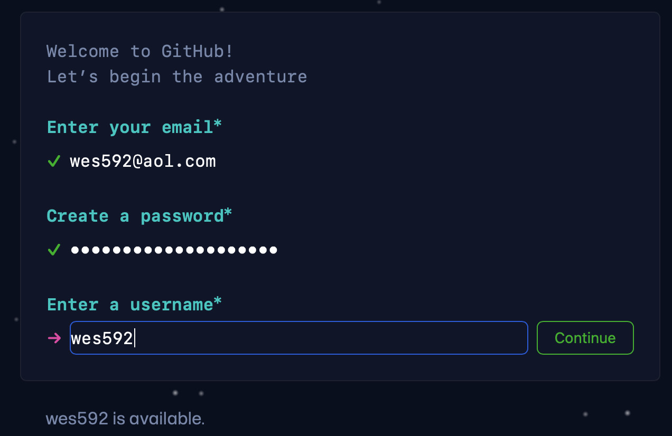
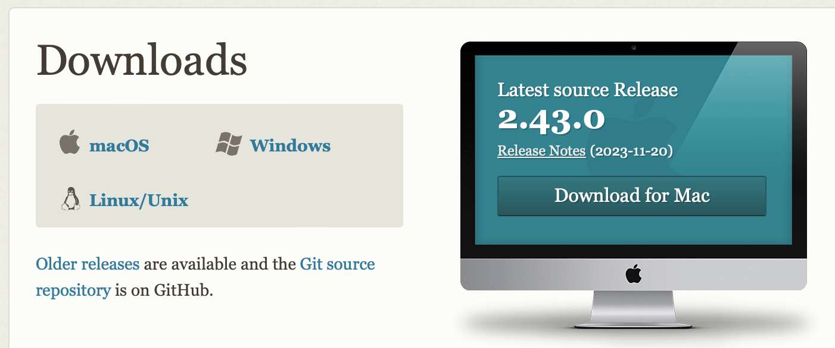
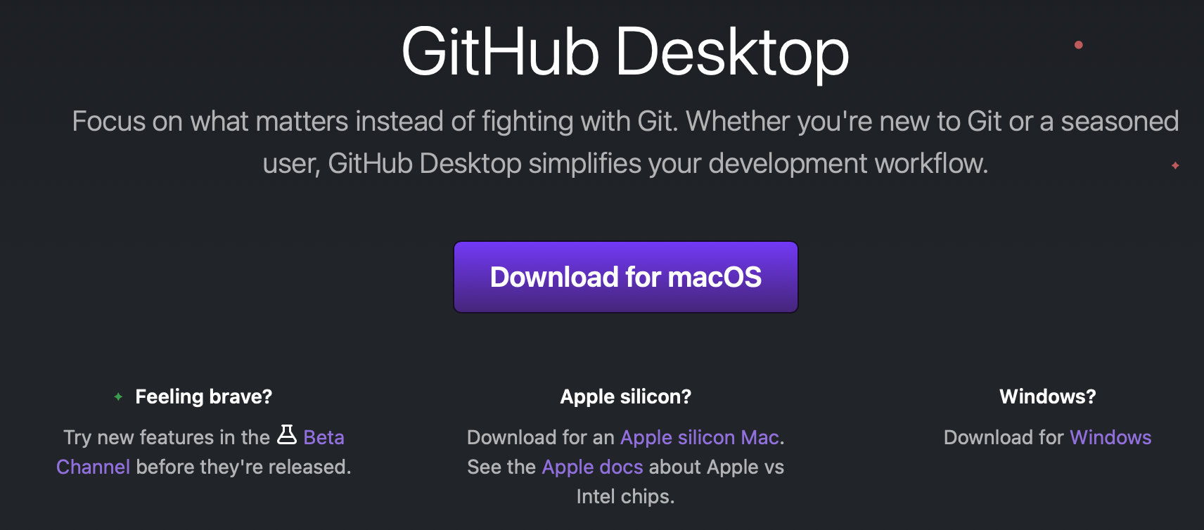
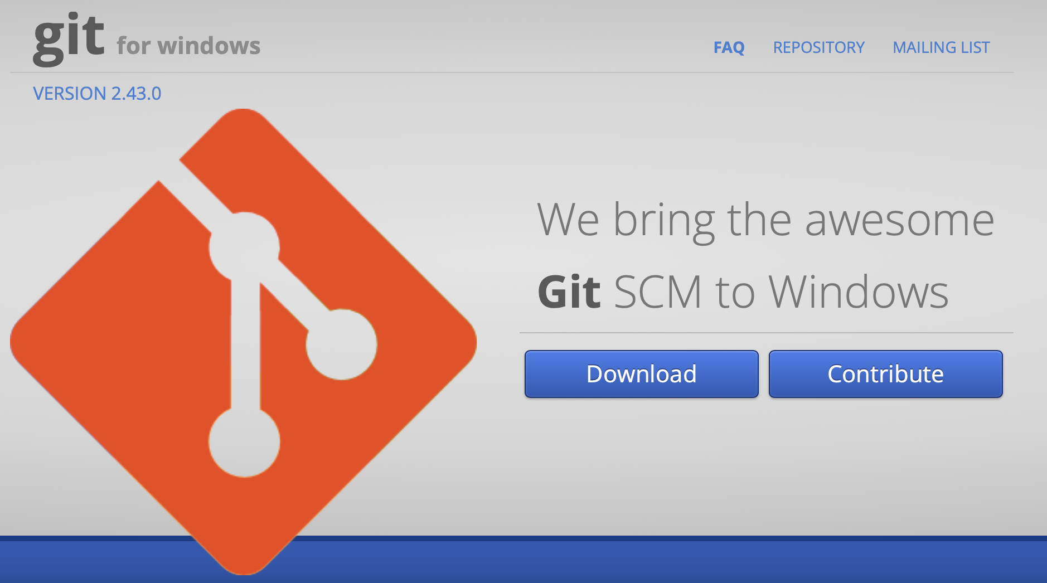
Tutorial – Set Up
Navigate to github.com and create a username
Download and install git (git-scm.com/downloads)
Download a GUI (git-scm.com/downloads/guis)
Easiest to start with github desktop (desktop.github.com)
Windows users: download git BASH (gitforwindows.org)

Slide 2
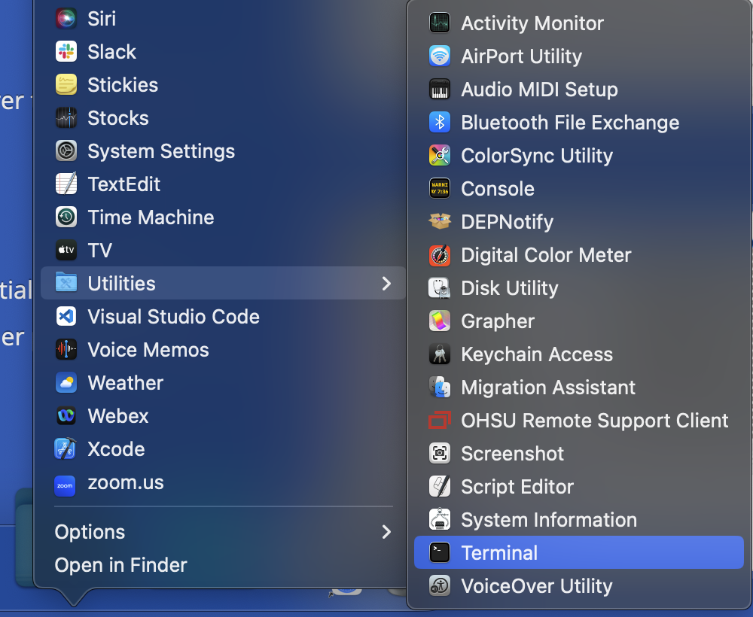
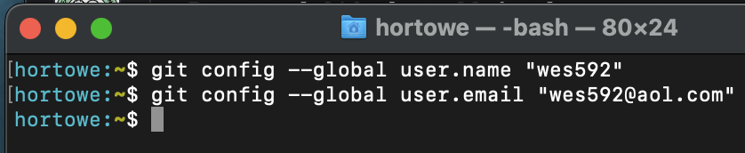
Tutorial – Initialize
Add your info to the config file (command line)
Authenticate GitHub Desktop
1. Open up terminal (or gitBASH for windows)
2. Add your username and email

Slide 3
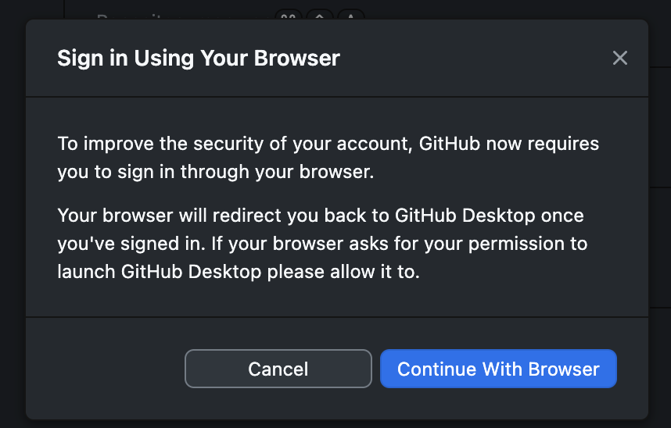
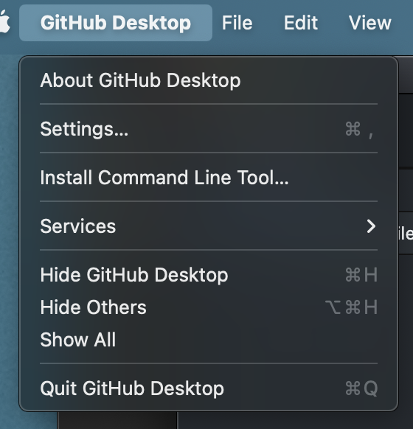
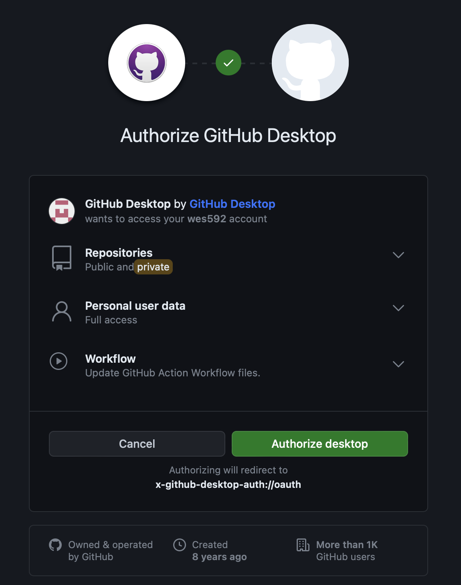
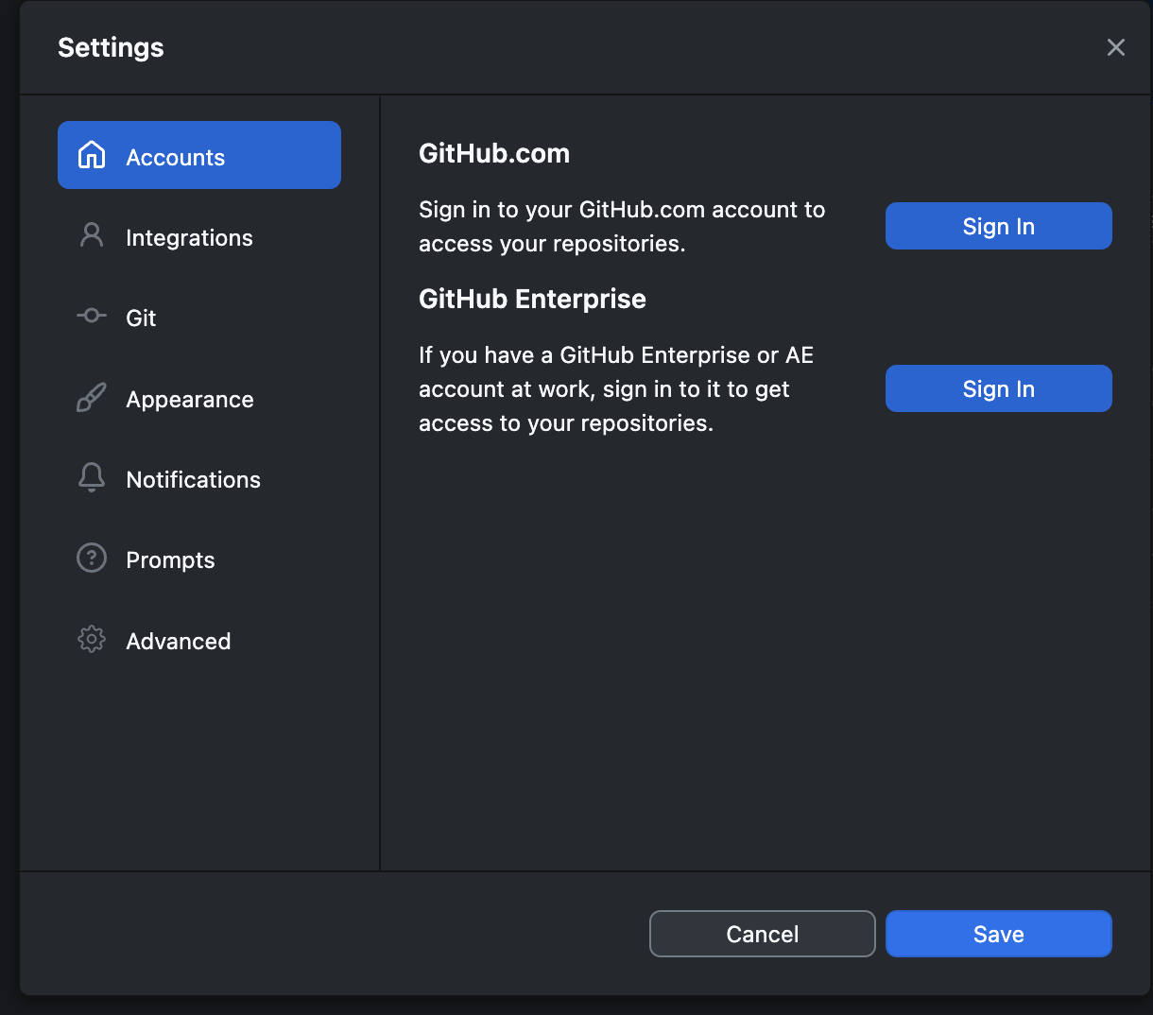
Tutorial – Initialize
Add your info to the config file (command line)
Authenticate GitHub Desktop
Finish in the browser
Sign in
Open app and go to settings/preferences

Slide 4
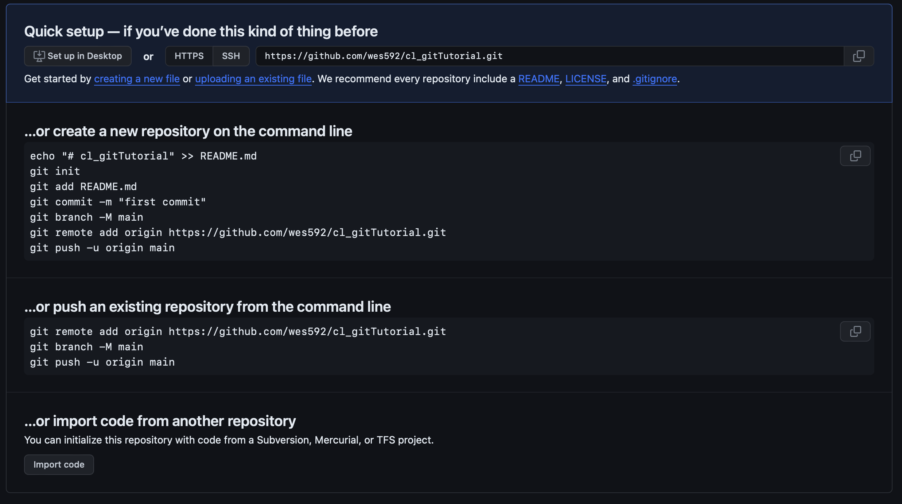
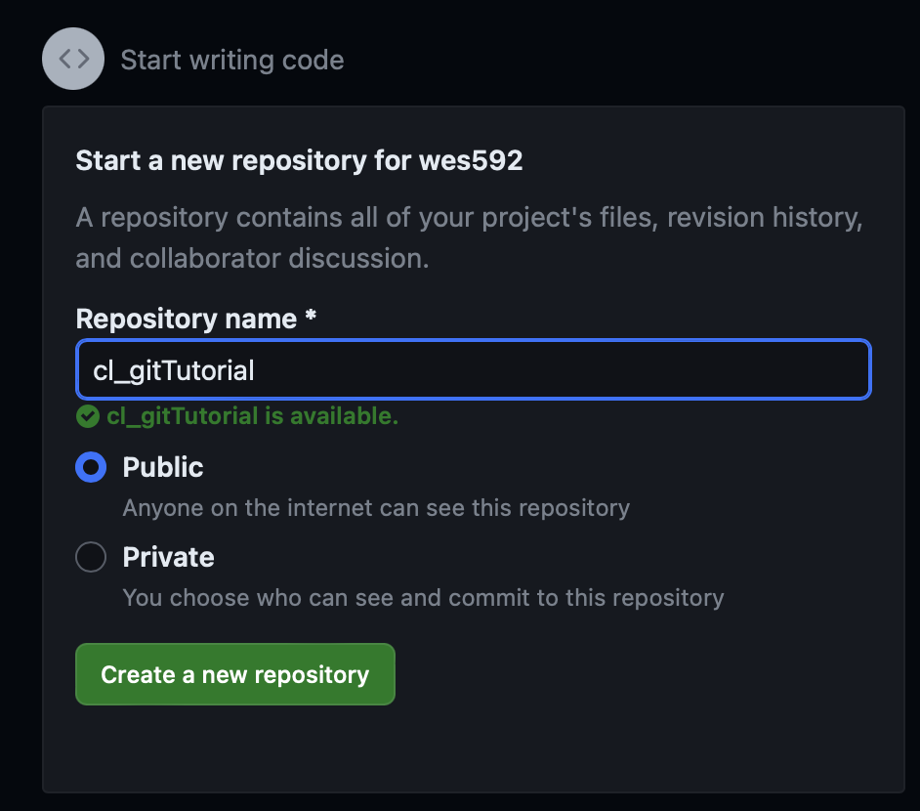
Tutorial – Access
Create your own repository
Clone an existing repository

Slide 5
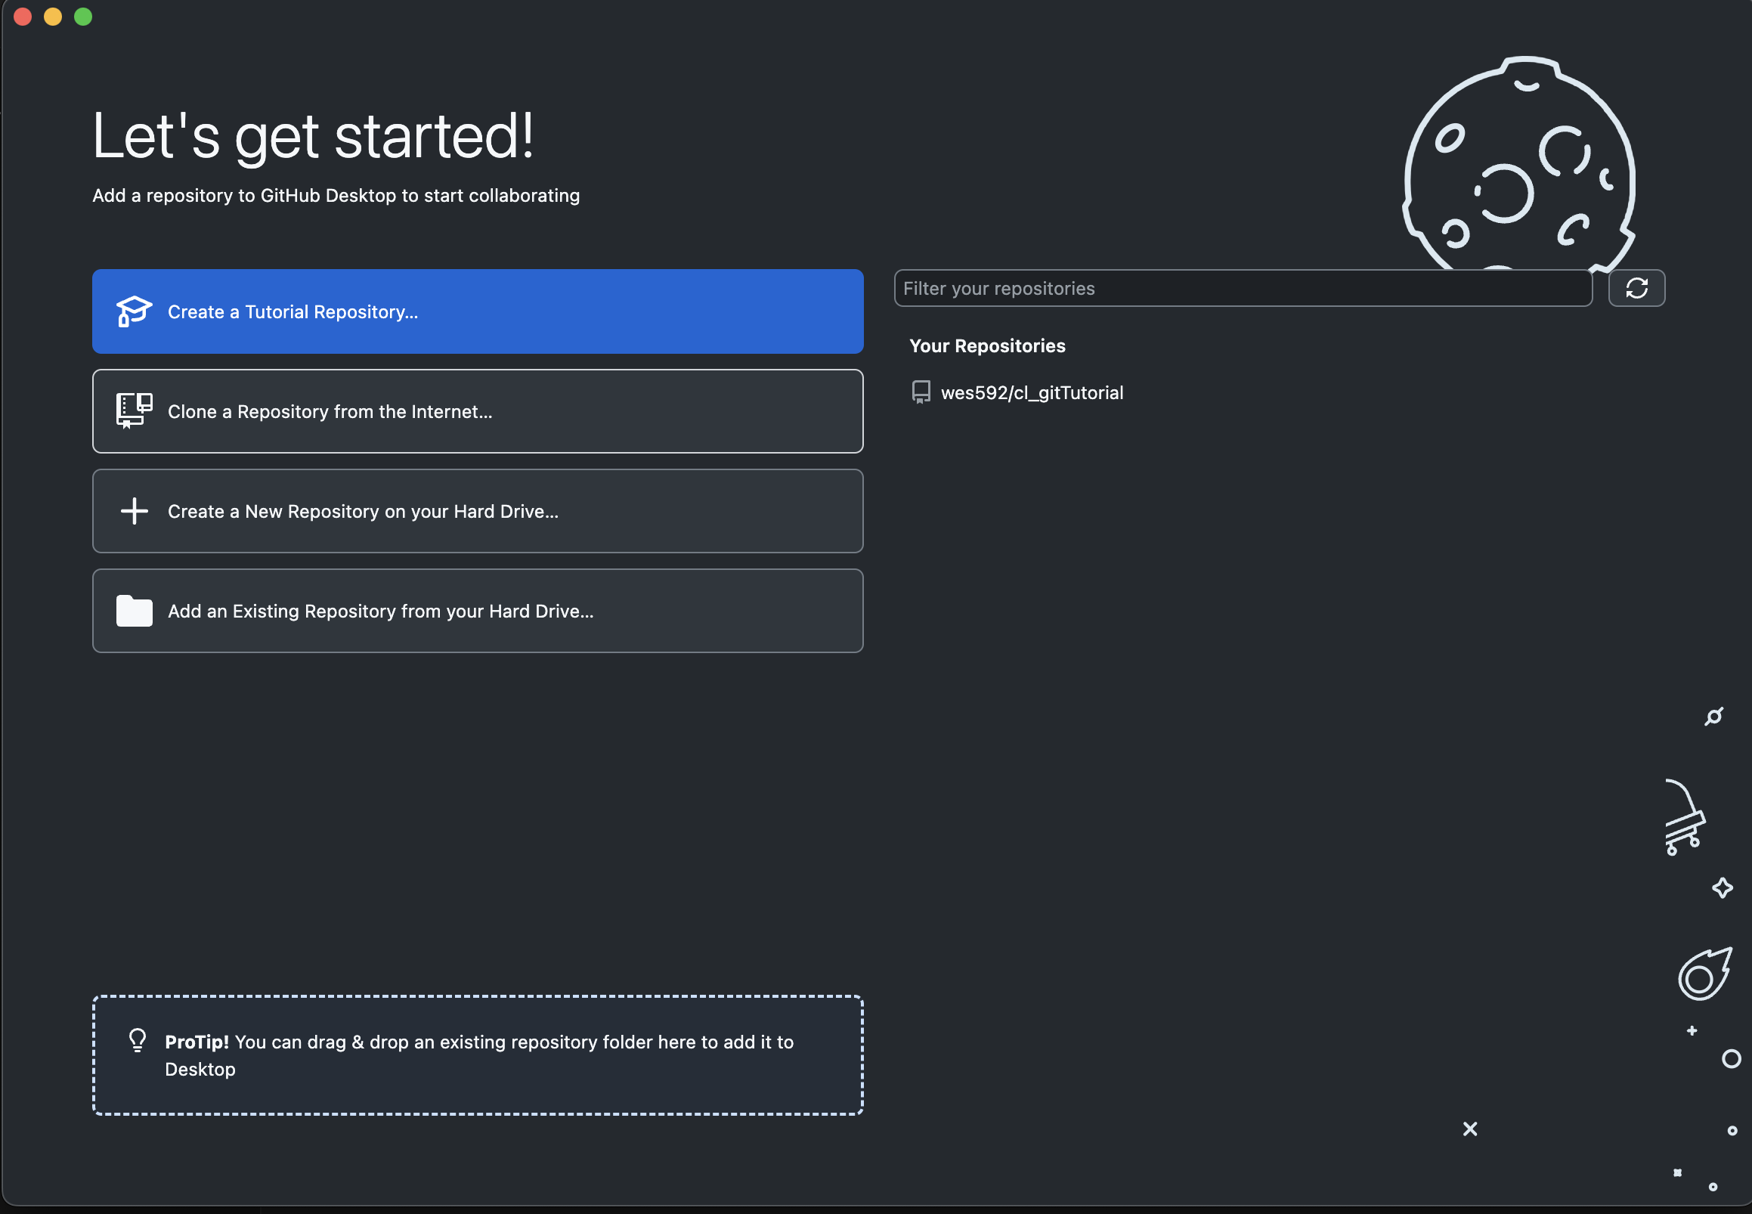
Tutorial – Access
Create your own repository
Clone an existing repository

Slide 6
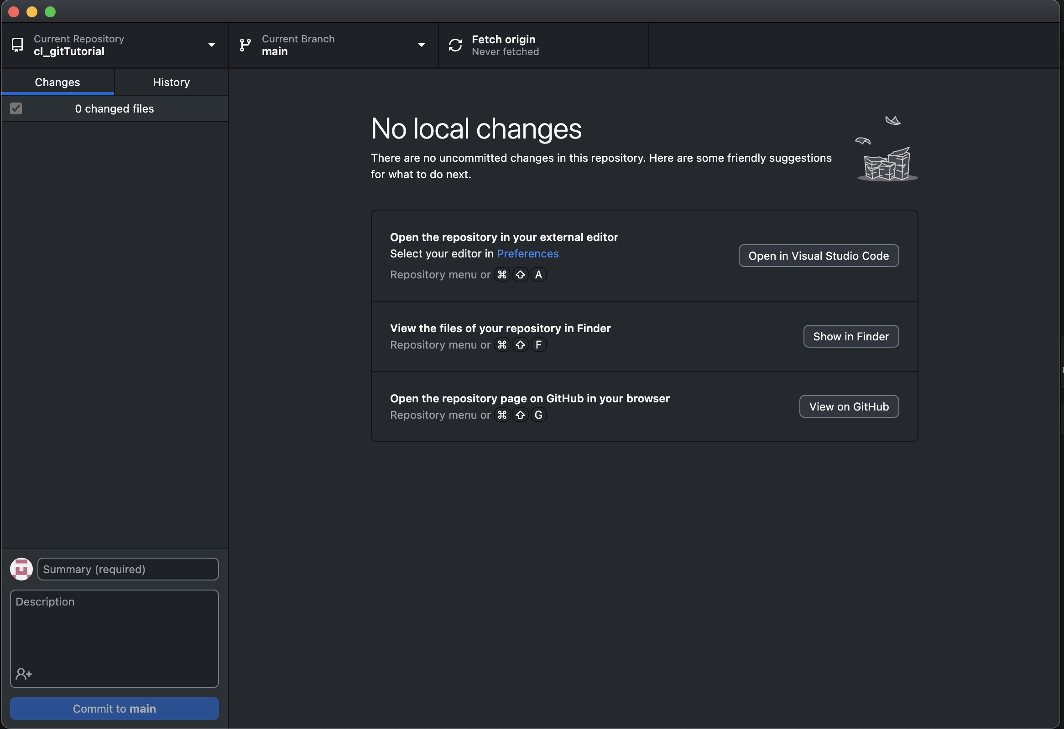
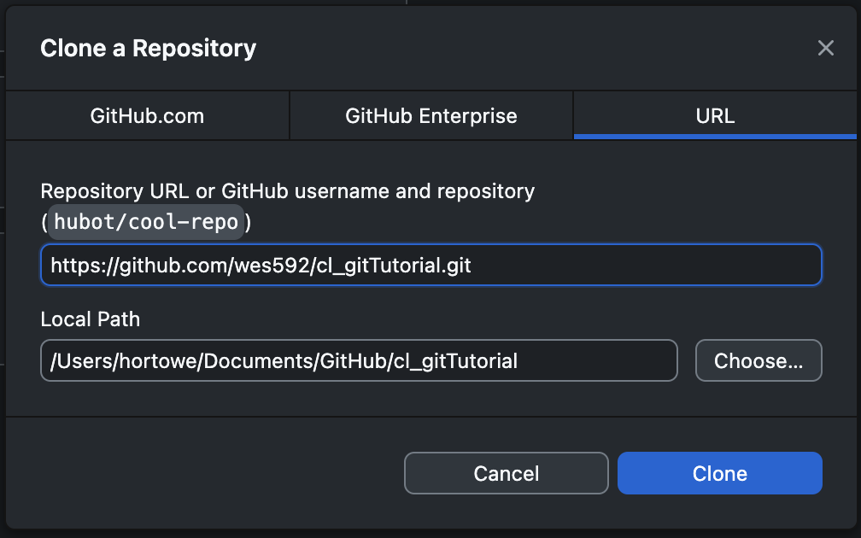
Tutorial – Access
Create your own repository
Clone an existing repository

