Slide 1


DFIR WITH DINOSAURS
UNEARTHING ARTIFACTS AND HOST HUNTING WITH VELOCIRAPTOR
Wes Lambert
2021

Slide 2
Introduction
Open source endpoint forensics, monitoring, and response
Written in Go
Linux, macOS, Windows
Lightweight, scalable, flexible, and fast!

Slide 3




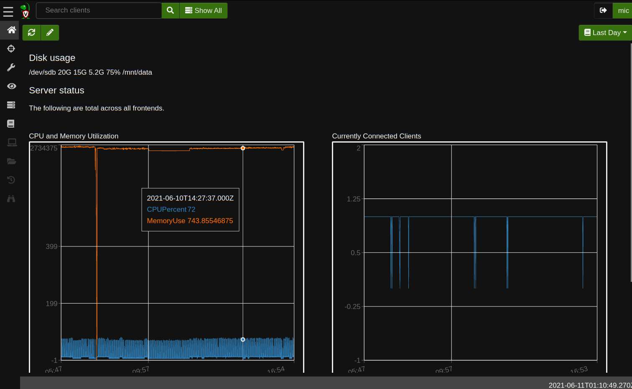
Architecture
Server
Client
Administrative (Web) Interface

Slide 4
Deployment Modes
Standalone
Cloud
Triage/Offline collector
Artifact Development/Evaluation

Slide 5



VQL (Velociraptor Query Language)
Similar to SQL syntax
Used for:
Collecting data from endpoints
Performing monitoring and response
Managing the Velociraptor server
Columns
Plugin/Args
Filter Condition
SELECT X, Y, Z FROM plugin(arg=1) WHERE X = 1

Slide 6
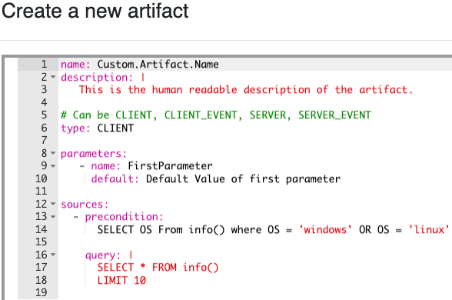
Artifacts
One or multiple queries written in VQL
Encapsulate expert knowledge
One of the following types:
  Client Artifact
  Client Event Artifact
  Server Artifact
  Server Event Artifact

Slide 7
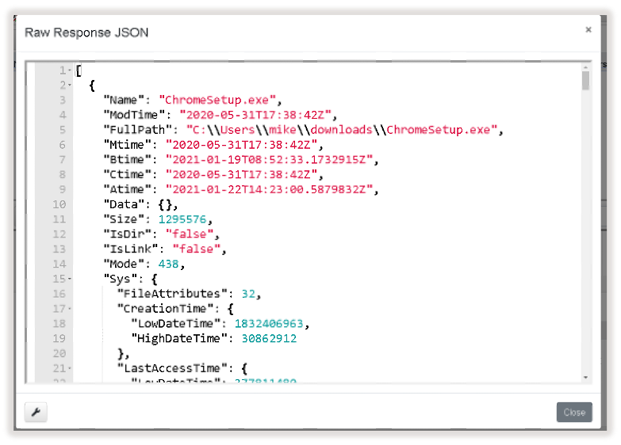
Searching for Files
glob()
Search by filename
Search by file size or other properties
https://docs.velociraptor.app/docs/forensic/filesystem/

Slide 8
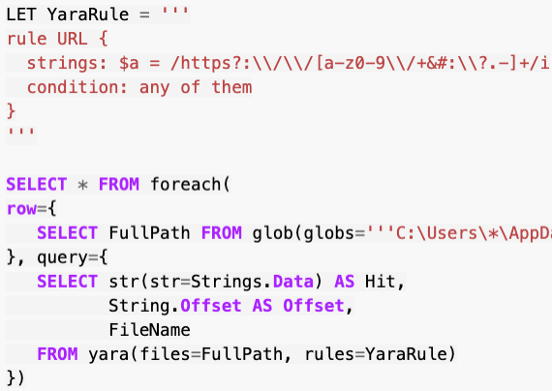
Searching Content
yara()
Search for URLs in process memory
Search binaries for malware signatures
No need to parse files unless there is a match
https://docs.velociraptor.app/docs/forensic/searching/

Slide 9
NTFS Analysis
NTFS Accessor
$MFT – record of files on disk
$I30 – residual data in index stream slack space
USN Journal – filesystem changes
VSS copies – analyze files from earlier snapshots
https://docs.velociraptor.app/docs/forensic/ntfs/

Slide 10
Evidence of Execution
Prefetch – first and last execution
BAM – last execution
Shimcache – last modified
Amcache – SHA1, first execution
SRUM – application usage, CPU time, network data
https://docs.velociraptor.app/docs/forensic/evidence_of_execution/

Slide 11
Event Logs
Windows Event Logs/EVTX parsing
ETW – generation/publishing of events for event logs (providers/consumers)
https://docs.velociraptor.app/docs/forensic/event_logs/

Slide 12
Volatile State
WMI – system configuration details
Mutants – named mutex object used by malware to prevent multiple instances from running at same time
Process analysis – process creation, executable location, command line invocation
Mapped memory – identify/inspect linked DLLs
https://docs.velociraptor.app/docs/forensic/volatile/

Slide 13
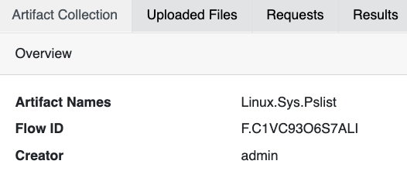
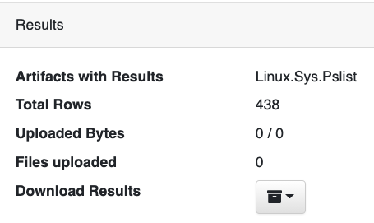
Targeted Collection
Artifacts can be selected for a single client on an ad-hoc basis
Multiple artifacts can be collected at a time
Files can be uploaded for further investigation

Slide 14
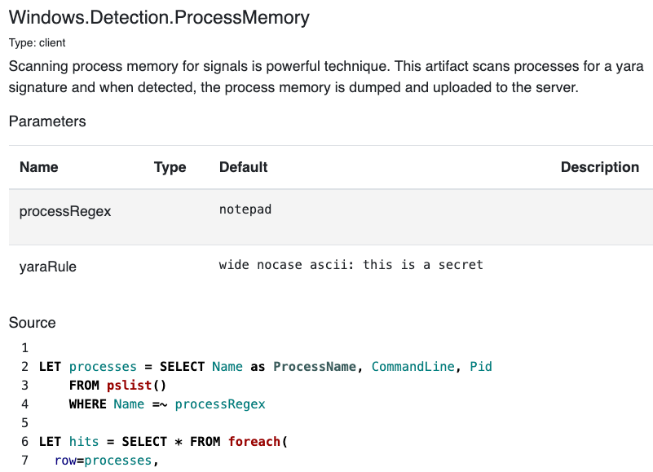
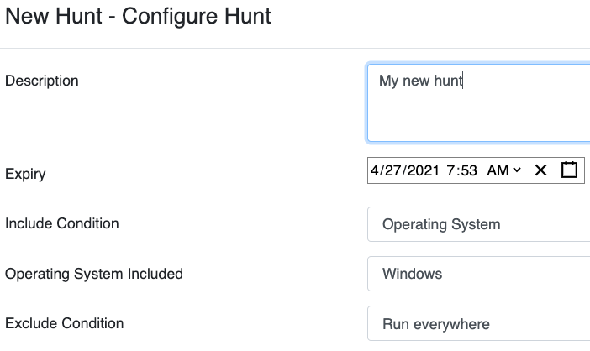
Hunting
Schedule a hunt across all or a subset of clients
Clients will enroll in the hunt as they come online
Stack results from hunts to identify outliers or commonalities

Slide 15
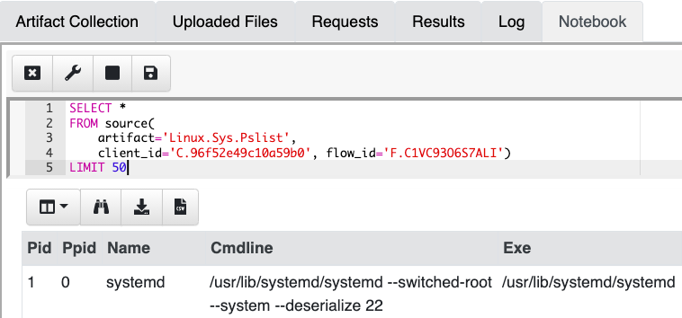
Notebooks
Similar concept to Jupyter notebooks
Test queries before creating artifacts
Post-process collection/hunt results

Slide 16
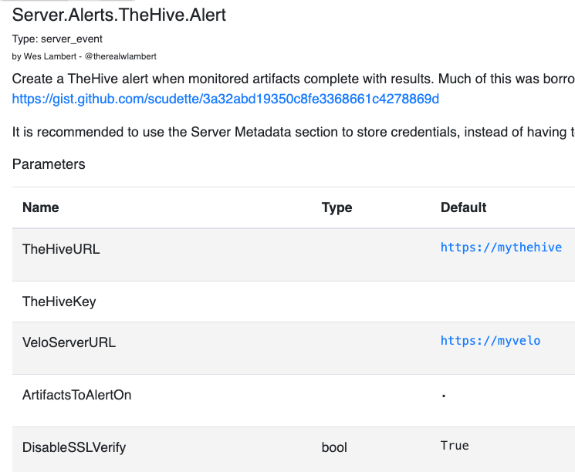
Detection
Client Event Artifacts
  Detect when something happens on a client
Server Event Artifacts
  Detect when something happens on the server

Slide 17
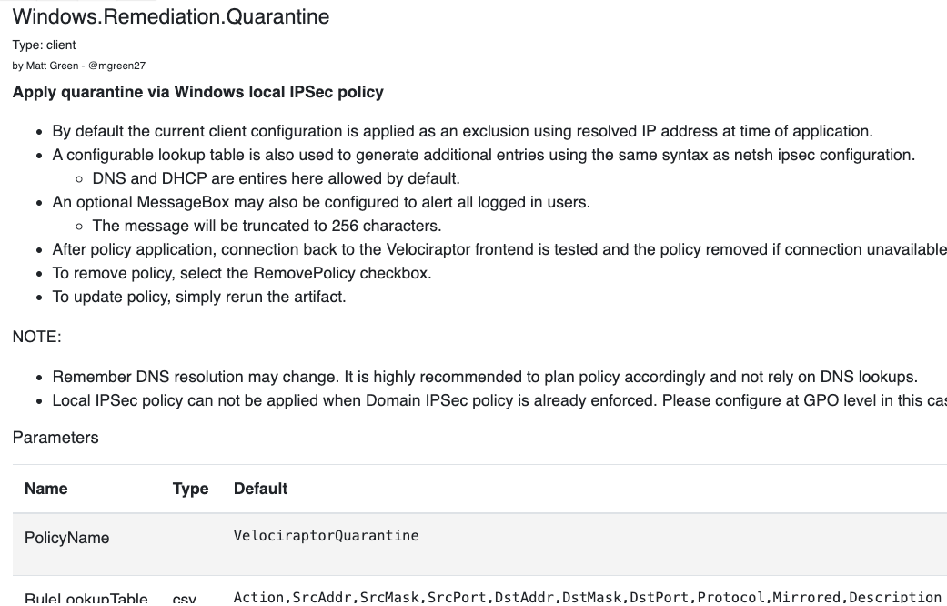
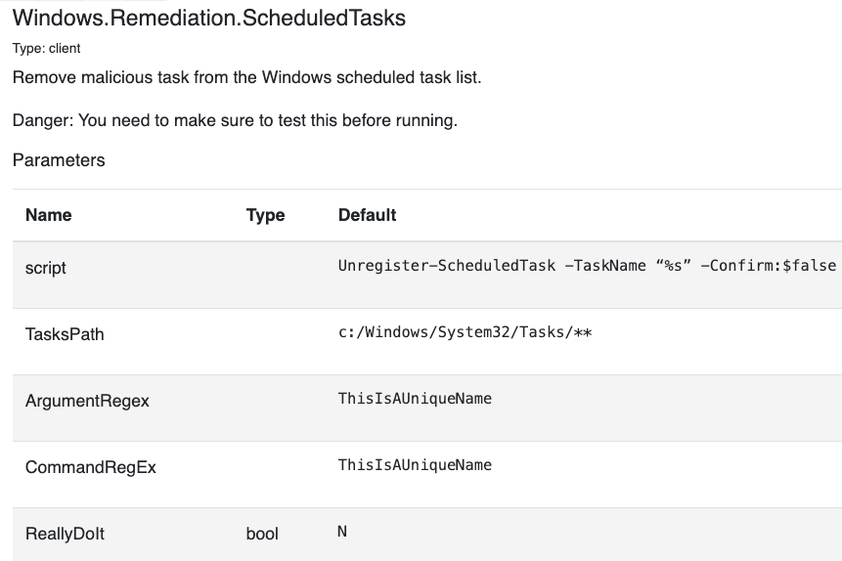
Remediation
Kill processes
Remove scheduled tasks
Isolate hosts
Run arbitrary commands

Slide 18
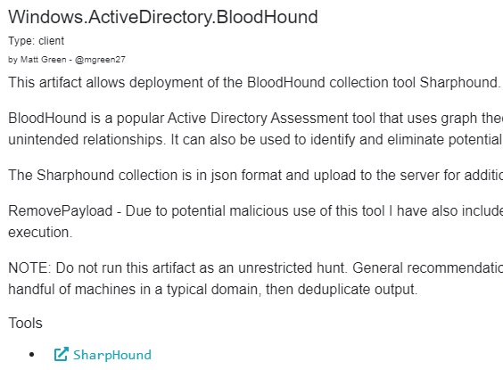
Tools
Velociraptor can utilize external tools
Pull down required tools when artifact is run
Build collector binary that includes tools

Slide 19
Automation
gRPC-based API, with ACL-based access
Automate response actions from Python, or a SOAR tool
  Hunt for files/hashes/processes provided from an alert from a security tool
  Isolate affected hosts
  pip install pyvelociraptor
  pyvelociraptor -c api.config.yaml “SELECT * from info()”

Slide 20
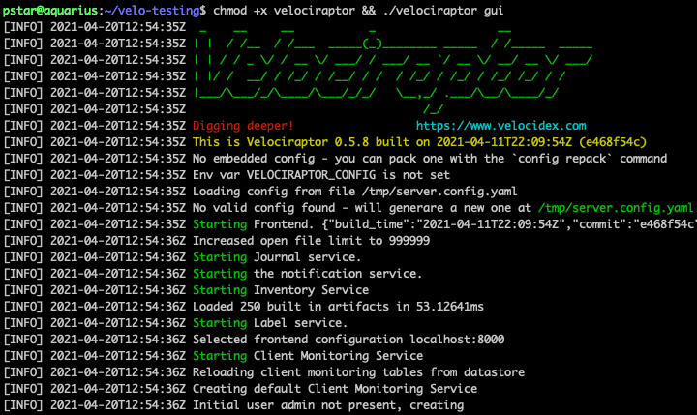
Start Digging!
Get latest binary from: https://github.com/Velocidex/velociraptor/releases
Run:
./velociraptor gui

Slide 21
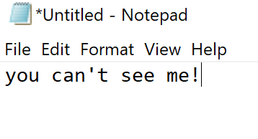
Exercise 1: Scanning Process Memory
Process memory can be scanned using YARA – let’s see how!
Invoke notepad.exe, and type the following:
“you can’t see me!”
https://velociraptor.velocidex.com/digging-into-process-memory-33c60a640cdb

Slide 22
Exercise 1: Scanning Process Memory
Start a new notebook, and paste the following:
SELECT * FROM foreach(
row={
SELECT * FROM pslist()
WHERE Name =~ "notepad"
}, query={
SELECT Pid, Name, String FROM yara(
accessor="process",
files=format(format="/%d", args=Pid),
context=20,
rules='rule x {strings: $a=”you can\’t see me!" wide nocase condition: $a}'
)
})
Select all processes containing “notepad” in the name
For each notepad process, use the pid to scan using the provided YARA rule

Slide 23
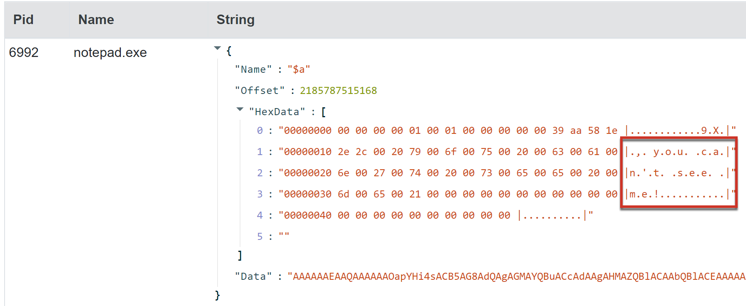
Exercise 1: Scanning Process Memory
We can see you!
While a trivial example in this case, the ability to quickly scan process memory can be quite powerful!
We could also apply this to an artifact, and hunt across our entire fleet if we wanted.
(Windows.Detection.ProcessMemory)

Slide 24
Exercise 2: Suspicious Service Installation
We can use Velociraptor to determine what services are installed, and stack those services across hosts to quickly and easily identity outliers or commonalities
First, we’ll start a pool of clients with the following:
./velociraptor.exe --config filestore\client.config.yaml pool_client --number 10 --writeback_dir filestore

Slide 25
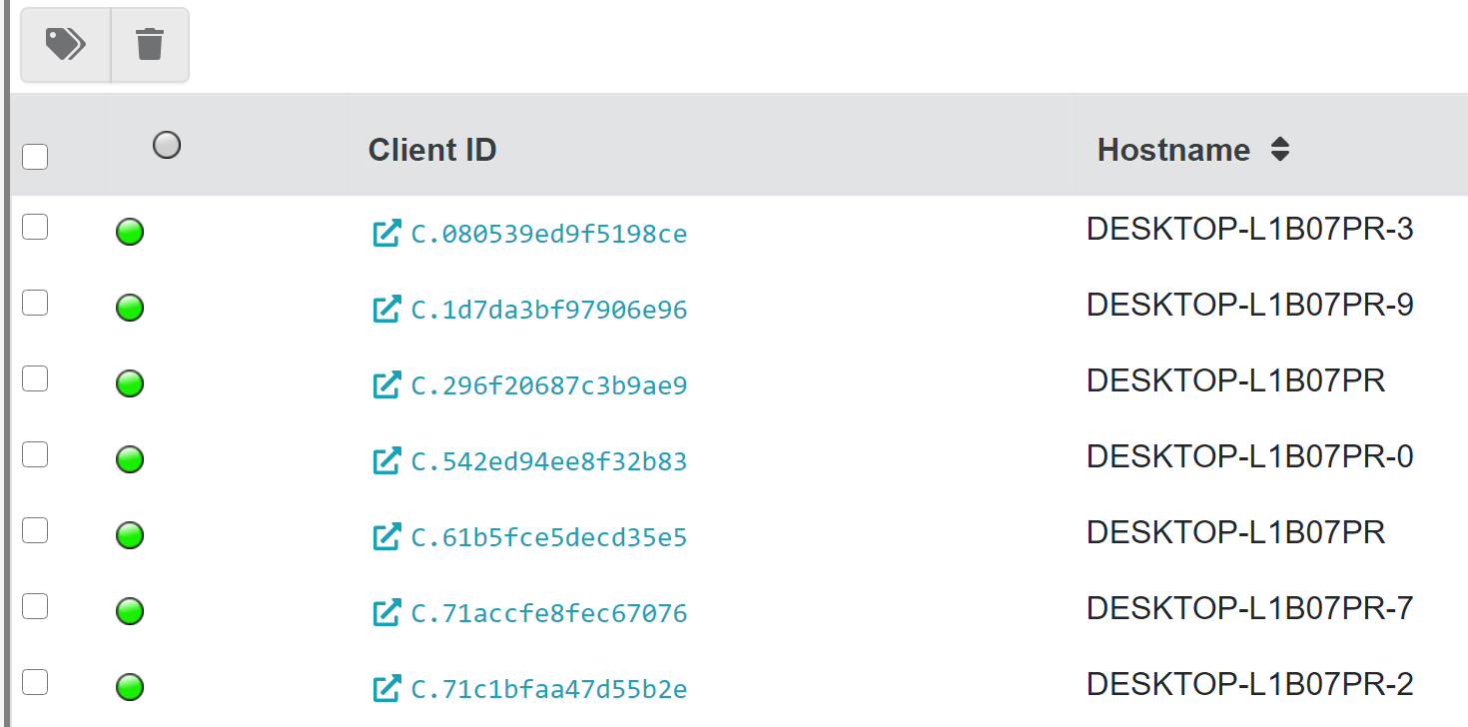
Exercise 2: Suspicious Service Installation
From the Clients menu, we can now see multiple clients joined to the server:

Slide 26
Exercise 2: Suspicious Service Installation
We can start a hunt with the Windows.System.Services artifact to get a list of installed services on the hosts, then post-process the results in a notebook with the following VQL:
SELECT Name, Status, PathName, UserAccount, Created, count() as COUNT
FROM source()
GROUP BY Name,
ORDER BY COUNT
The results show that the count for each service is the same (no outliers)

Slide 27
Exercise 2: Suspicious Service Installation
Next, we’ll install a malicious service with the following:
sc.exe create backdoor binpath="c:\Windows\Notepad.exe"
Then, we’ll start two more clients to simulate the malicious service being installed on only them:
./velociraptor.exe --config filestore\client.config.yaml pool_client --number 12 --writeback_dir filestore

Slide 28
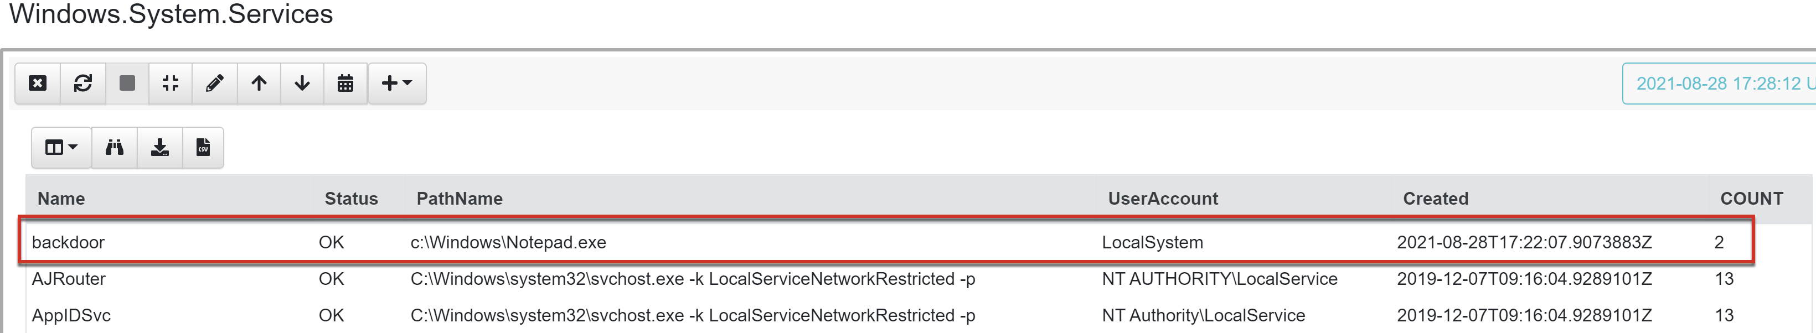
Exercise 2: Suspicious Service Installation
The new clients will join the pre-existing hunt as they come online
After post-processing the hunt results in a notebook, through stacking we can see there are two clients that contain the “malicious” backdoor service

Slide 29
Twitter:
@therealwlambert (Wes Lambert)
@velocidex (Mike Cohen)
@mgreen27 (Matthew Green)
Github:
https://github/velocidex/velociraptor
Articles/Docs:
docs.velociraptor.app
medium.com/velociraptor-ir
Discord:
https://docs.velociraptor.app/discord
Thanks for
attending!

