Slide 1

Augmenting the Onion Facilitating Enhanced Detection and Response With Open Source Tools
Wes Lambert
Defcon 27 Packet Hacking Village, 2019

Slide 2
Me, Myself, and Onion
Husband and father of four
Co-manager of household operations
Coffee, Indian food, and FOSS lover
Senior Engineer, Security Onion Solutions

Slide 3
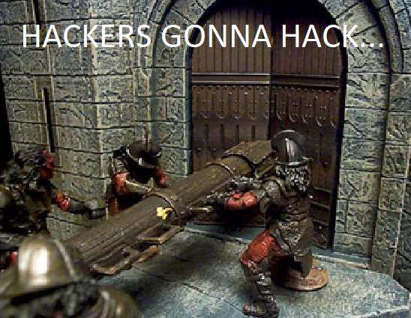
Introduction
Shift from pure prevention to include detection and response.
Bad guys WILL get in at some point!
Even the next-nextest-generation firewall won’t save you.

Slide 4
s/Prevention/Detection/
When the bad guys get in, we need some way to find them.
We need to have a way to retrieve data about our network.
We need data that is easily digestible.
We need data that provides context around an event.
We need to build upon NSM and implement enterprise-wide security monitoring.

Slide 5
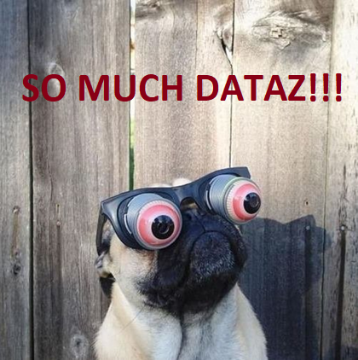
The (Security) Onion
Open source enterprise security monitoring and log management platform
Alert Data (IDS Alerts) – Snort /Suricata
Session Data (Connections) – Bro
Transaction Data (DNS/FTP/HTTP) - Bro
Extracted Content Data (Files) - Bro
Full Content Data (PCAP) – netsniff-ng
Host Data (Wazuh, Beats, Symon, Autoruns)
Alerting (Email, Slack, Scripts) - Elastalert
Data Enrichment and Visualization (Elastic Stack)
https://securityonion.net

Slide 6
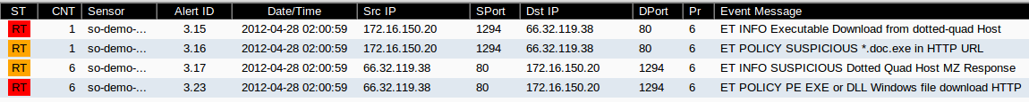
Security Onion – Alert DAta
Generated by matching a pre-defined signature that says this is something of which to be aware.
Tells us something may have happened – further investigation required to determine if something of significance.

Slide 7
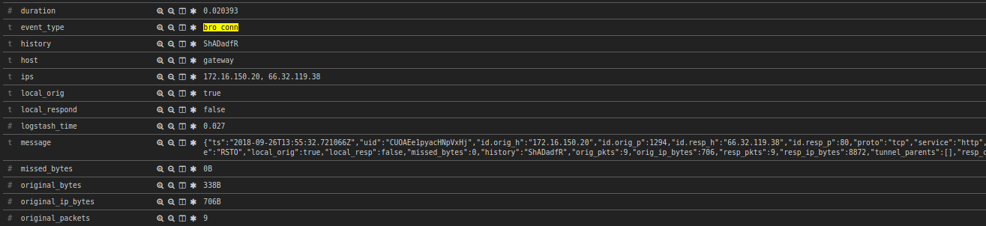
Security Onion – Session Data
Summary data, similar to Netflow
Can identify type of traffic (ex. FTP, HTTP, DNS, etc.)
Can be used to correlate other activity through the UID

Slide 8
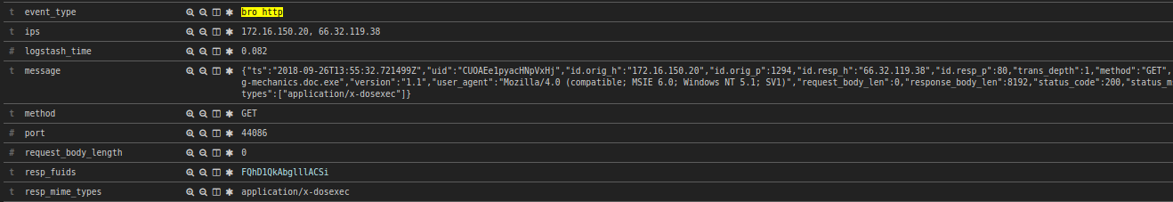

Security Onion – TRANSACTION DAta
Describes transactions between two hosts
In this case, HTTP traffic
Can tie to a unique FUID (File ID) found in files.log

Slide 9
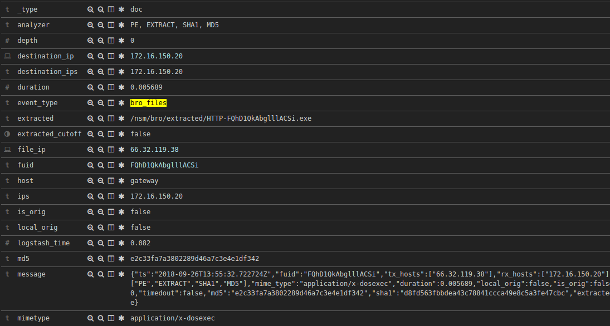
Security Onion – EXTRACTED CONTENT
EXEs, etc. extracted from network traffic for future analysis
Send to Cuckoo Sandbox, FSF (File Scanning Framework), or Strelka
Be cautious about types of files to extract (performance-wise)

Slide 10
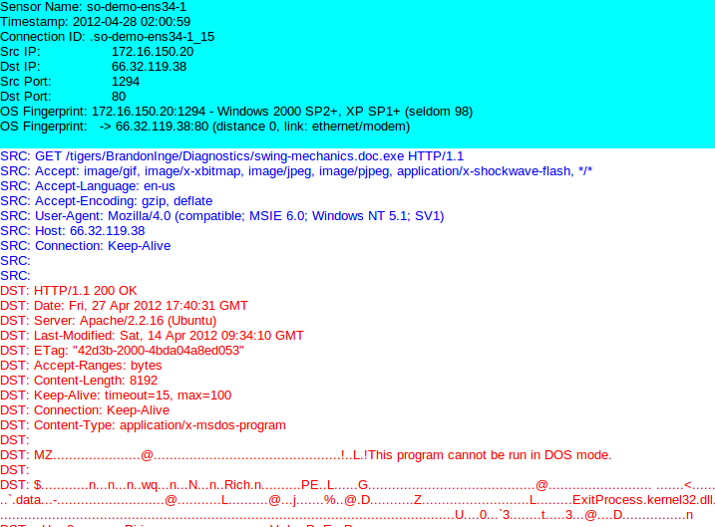
Security Onion – FULL CONTENT
Start with alert/session/transaction data and drill-down for more context.
Observe the entire stream of communication with generated transcripts.
Manually carve objects out of the transcript or using something like NetworkMiner or Wireshark (against pcap) using a Security Onion analyst VM.

Slide 11
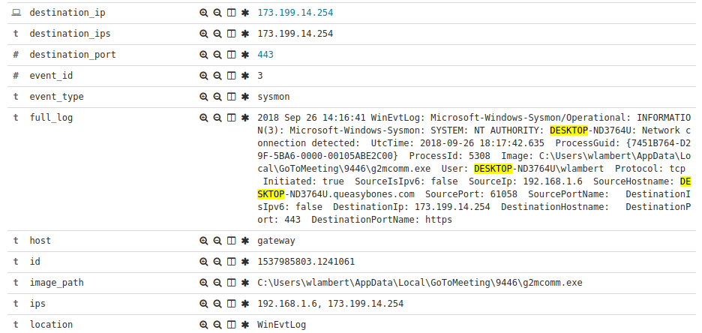
Security Onion – HOST DATA
Wazuh – Host-based FIM (File Integrity Monitoring), Log transport
Winlogbeat – Windows Logs
Filebeat – Web server logs (ISS, Apache, Nginx), Application Logs
Sysmon (via Wazuh/WLB)
Autoruns (via Wazuh/WLB)
OSQuery (not native at the moment)

Slide 12
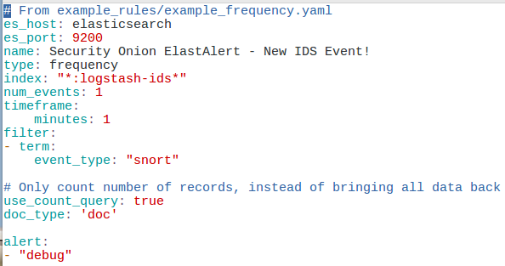
SECURITY ONION - Alerting
Provides mechanism to extend information gathered to another platform for notification or analysis
Email
Elastalert – create a rule to trigger
Email
Slack
JIRA
Python script(s)

Slide 13
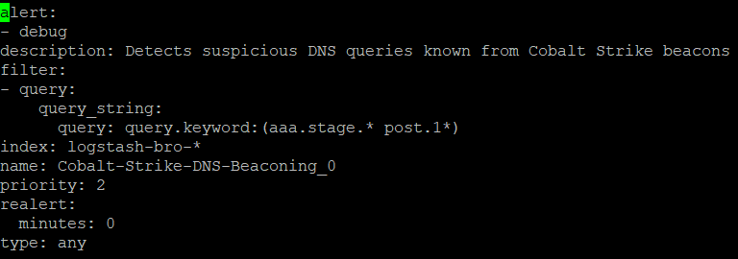
Security Onion – SIGMA ALERtinG
Use sigmac.py to convert standard Sigma rules to a format Security Onion understands
Implement Sigma rules via Elastalert
Could also add in MITRE ATT&CK Techniques/IDs
https://github.com/weslambert/securityonion-sigma

Slide 14
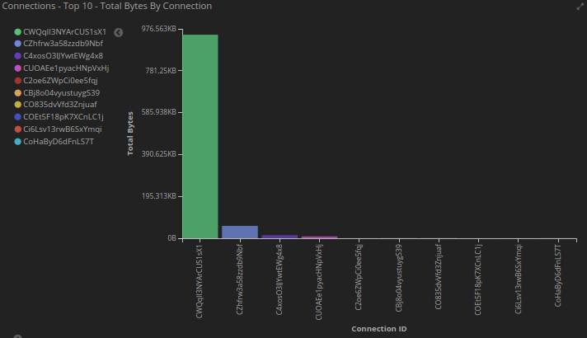
SECURITY ONION – ENRICHMENT and Visualization
Enrich records with GeoIP and other plugins info in Logstash pipeline
Create custom enrichment aligning with corporate IT inventory or data
Visualize data and correlations in Kibana
Get to answers faster

Slide 15


MISP
Platform for sharing threat intel
Provides correlation of IOCs/events
Ability to import/export various types of data w/ a feature-rich API (integrations galore!)
https://misp-project.org/

Slide 16
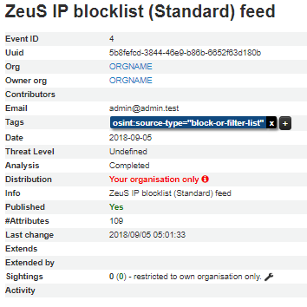
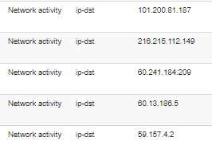
MISP - EVENT
Typically Contains:
Owner/Org
Email
Date
Tags
Info
Threat Level
Analysis Status
Attributes
Publish Status
Sightings

Slide 17
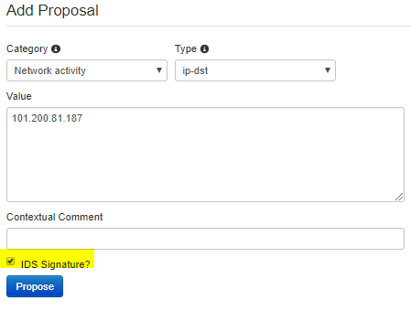
MISP - Attributes
An event can contain several, if not, many attributes (and of different types).
Correlation can be performed among events and their attributes.
Can be a source/destination IP address, hash, registry key, filename, etc.

Slide 18
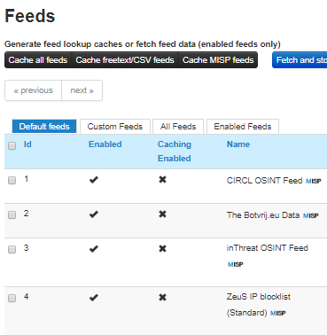
MISP - FEEDS
HUGE list of default feeds available,
including:
ZeuS IP blocklist (Standard)
Malwaredomainlist
Phishtank
Integrate custom feeds
Utilize feed attributes in IDS signatures

Slide 19
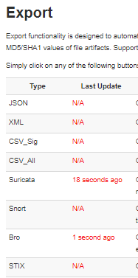
MISP - SIGNATURES
Export IDS signatures generated by attributes from feeds or your own added attributes and use them with Snort or Suricata
Export Bro Intel data to feed in to the Bro Intel Framework
Zeus Blocklist:
alert ip $HOME_NET any-> 101.200.81.187 any (msg: "MISP e4 [] Outgoing To IP: 101.200.81.187"; classtype:trojan-activity; sid:4000041; rev:1; priority:4; reference:url,/events/view/4;)

Slide 20

MISP - API
PyMISP (client)
Automation
NIDS Export (Snort/Suricata + Bro)
Elasticsearch enrichment
Add sightings
Manage users
Get/search/delete event data

Slide 21
MISP – Elasticsearch Enrichment
Dockerized method to interact with MISP API to look for attribute matches
Utilize local Memcached instance (Docker) for caching
Have Logstash perform lookup in Memcached
Populate log events with correlated threat data
Shout-out to @DCSecuritydk for the idea/original implementation!
https://www.securitydistractions.com/2019/05/17/enriching-elasticsearch-with-threat-data-part-1-misp/
https://github.com/weslambert/misp2elastic

Slide 22
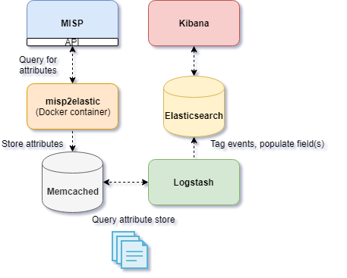
MISP – Elasticsearch Enrichment: FloW

Slide 23
MISP – NIDS Rules/Bro Intel
Interact with MISP export API to export Snort/Suricata rules and/or Bro intel
Add Snort/Suricata rules to Security Onion’s local rules (misp.rules)
Populate Bro’s intel.dat with intel from MISP
https://securityonion.readthedocs.io/en/latest/misp.html?#nids-rules

Slide 24
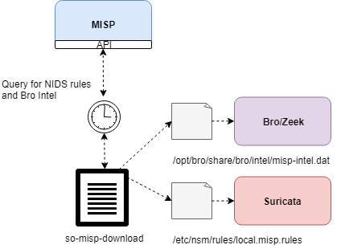
MISP – NIDS RULES/Bro Intel: FloW

Slide 25

THE HIVE
Security Incident Response Platform
Used for tracking incidents and enriching cases with external data
Integrates well with MISP
API

Slide 26
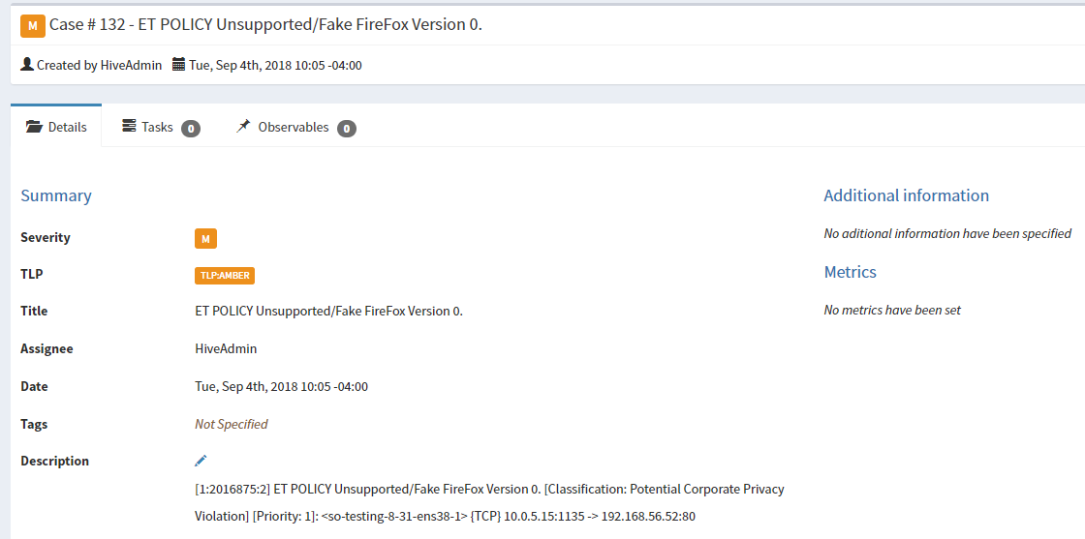
The Hive - CASES
A declaration of investigation or something out of the ordinary
Typically populated with information to include one or more observables
Can assign tags or other additional information

Slide 27
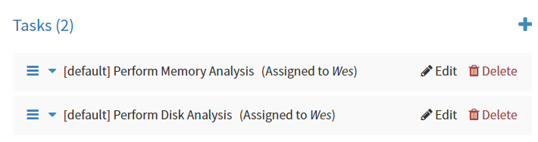
THEHIVE – CASE TEMPLATES
Case templates allow us to define initial steps in an investigation
Saves time
Allows new (and even seasoned analysts) to quickly get started on investigation/remediation tasks

Slide 28
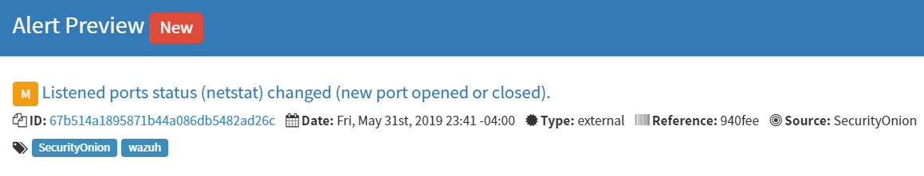
THEHIVE - ALerts
Can be generated from a noteworthy event (from external source)
Offers a general overview of a potential threat/incident
Can be merged into case if further investigation is needed/warranted, or can be discarded if necessary

Slide 29
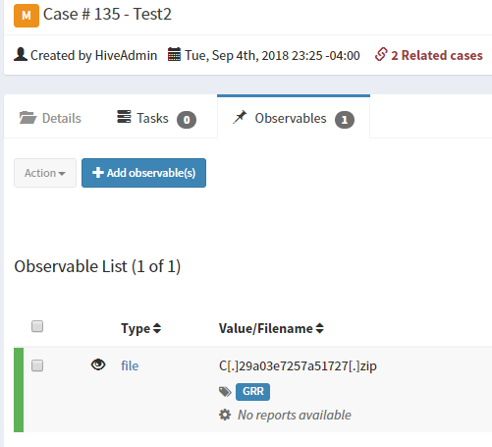
The Hive - Observables
Piece(s) of information attached to an event that can potentially be analyzed by one of the available
analyzers to gain greater context.
Can be a :
File
Domain
IP
Hash
or something else

Slide 30

The Hive - ANalyzers
Enrich case observables with external data sources
Analyzers include:
Cuckoo (file, URL analysis)
Dshield (reputation)
EmergingThreats (reputation, malware, etc.)
Greynoise (look for scanning activity)
Joe Sandbox (file analysis)
MISP (query MISP instances)
Nessus (scan hosts)
and many more!
WUT?

Slide 31
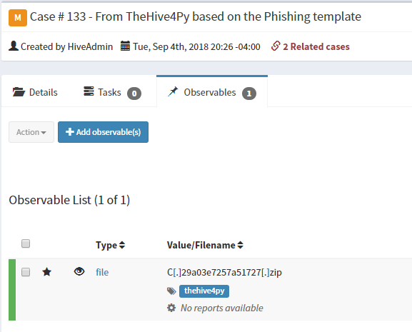
The Hive - API
The Hive4Py or custom Python client
Create a case
Attach observables to a case
Attach a task to a case
Raise an alert

Slide 32
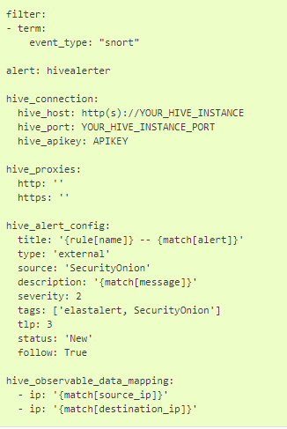
TheHive - Elastalert
Automatically send certain types of events to TheHive as alerts
Define observables to attach
For more functionality, integrate with custom Python scripting to perform other actions
https://securityonion.readthedocs.io/en/latest/hive.html

Slide 33
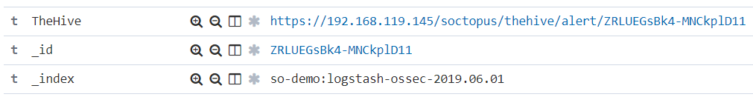
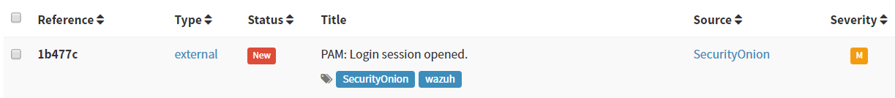
TheHive - SOCtopus
Simple Flask API running in a Docker container that allows analysts to automate certain tasks
For example, click a link from Kibana to forward an event to TheHive as an alert
https://github.com/weslambert/SOCtopus

Slide 34

GOOGLE GRR
Remote live forensics
Quickly triage incidents and perform analysis remotely across many different hosts
API for easy integration
https://github.com/google/grr

Slide 35
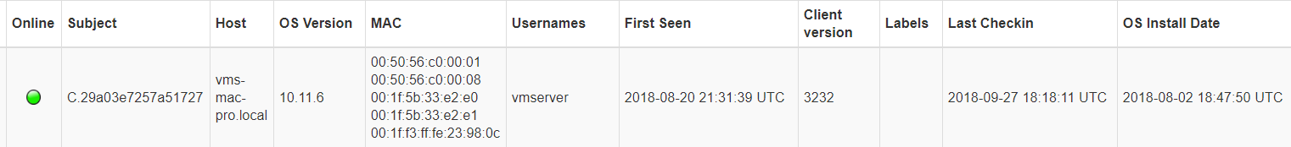
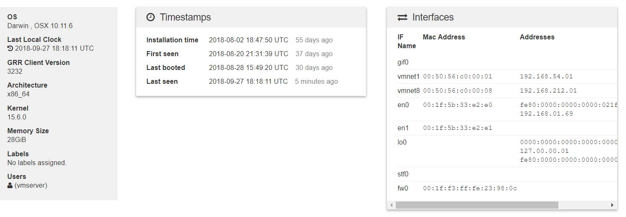
GRR - CLientS
Installed on endpoints
OS / activity info
Allows for remote data/file retrieval/analysis
Provides historical info

Slide 36
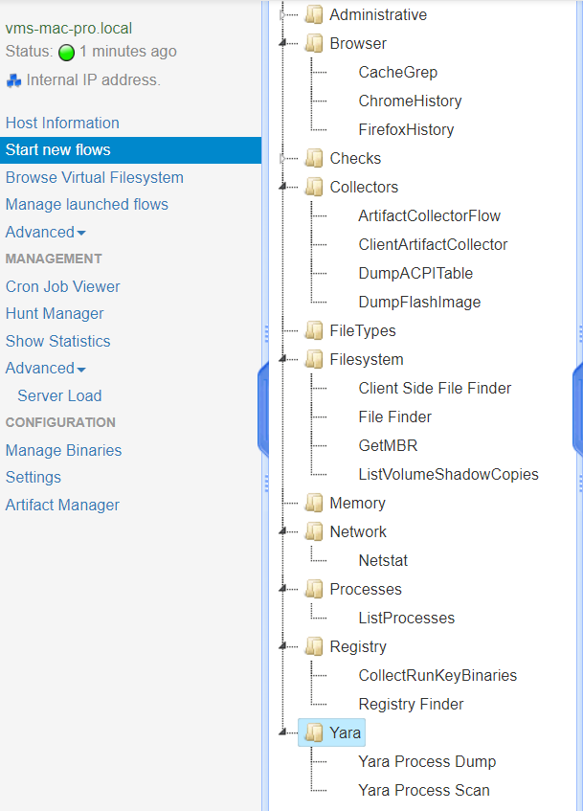
GRR - FLOW
Collect Chrome history
Look for specific files
List currently running processes
List current network connections
Scan process memory with YARA

Slide 37
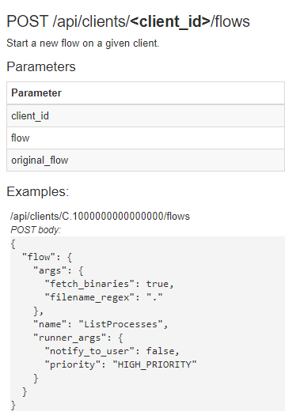
GRR - API
Python client library available
Query GRR for client information
Generate or grant approvals
Automate the issuance of flows
Get the results for issued flows

Slide 38
StrelKA
Real-time file scanning system
Threat hunting, detection, incident response
Go and Python 3.6+, gRPC
Perform file extraction and metadata collection at scale
Great for pairing with files extracted from sensors, for example extracted files from Bro (/nsm/bro/extracted)
https://github.com/target/strelka
https://cfc-open-source.slack.com/
@jshlbrd

Slide 39
Strelka - SCANNERS
Scanners are assigned to files based on “flavors” and “tastes”
Flavors
MIME Flavors – libmagic determines which scanners(s) to use
YARA flavors – YARA rule matches determine which scanner(s) to use
External flavors – assigned by a file request or parent file

Slide 40
Strelka – Use Cases
Extracting nested files
Identifying malicious scripts
Identifying suspicious executables
Log import functions for Mach-O and MZ files, and segments from ELF files
Identifying suspicious text
Interacting with external systems
Cuckoo Sandbox
MMBot – estimate maliciousness

Slide 41
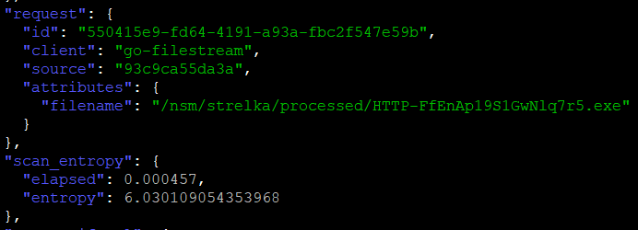
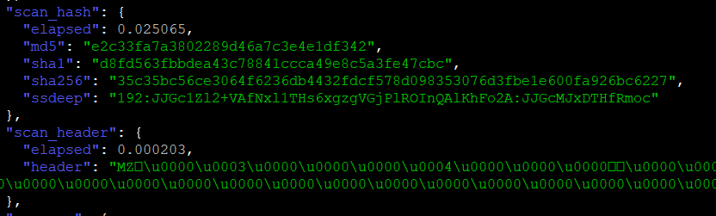
StRELKA – SCAN RESULTS
JSON
Snake/Camel case
Built in mgmt./compression

Slide 42
STRELKA + Security Onion
Integrate with Security Onion to provide analysis of Bro’s extracted files, and greater correlational capability via Kibana
Correlate with Bro FUID to tie back to original extracted file and see relevant traffic
Take advantage of aggregations/visualizations to quickly identify anomalies/trends
https://github.com/weslambert/securityonion-strelka

Slide 43
ALL TOGETHER, NOW

Slide 44
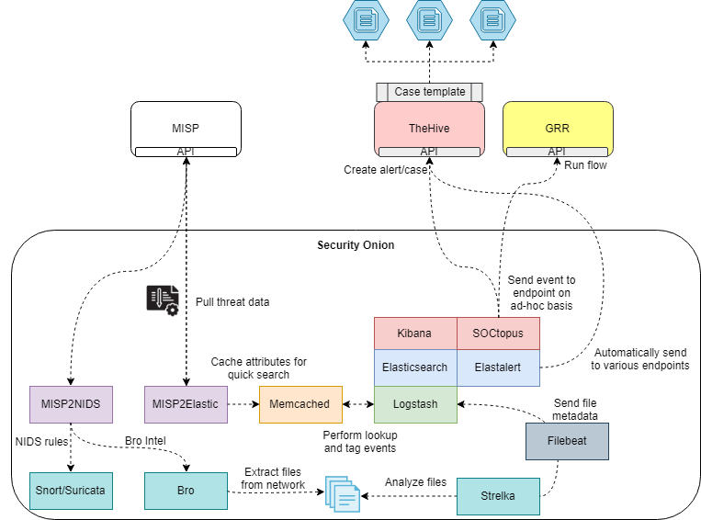

Slide 45
Tools
ElastAlert - https://github.com/Yelp/elastalert
Fast IR - https://github.com/certsocietegenerale/FIR
FSF - https://github.com/EmersonElectricCo/fsf
Google GRR - https://github.com/google/grr
MISP - https://misp-project.org/
Security Onion – https://securityonion.net
TheHive - https://thehive-project.org/
Security Onion – https://secruityonion.net
Strelka - https://github.com/target/strelka

Slide 46
Drop Me A Line
Twitter:
@therealwlambert
@securityonion
Github:
https://github.com/weslambert

