Slide 1
Why did Japan Release the Contaminated Water?
23政治哲学 胡志强

Slide 2
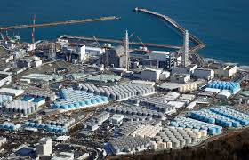
1. Brief Description
On March 11, 2011, the Great East Japan Earthquake and tsunami occurred, causing severe damage to the Fukushima Daiichi Nuclear Power Station.

Slide 3
2. Externality
Externality is a concept employed by utilitarians to justify private property. They use externality to refer to the consequences of an actor’s choices that are not included in (i.e., that are external to) the actor’s private cost-benefit analysis.

Slide 4

3. Overconsumption and pollution
Suppose that land is communally owned. Every person has the right to hunt, till,
or mine the land.

Slide 5
4. Why
As Japan releases the waste water into the pacific ocean, the costs are borne by all human beings and the benefits are harvested by the Japanese alone.

Slide 6
Thanks!

