Slide 1
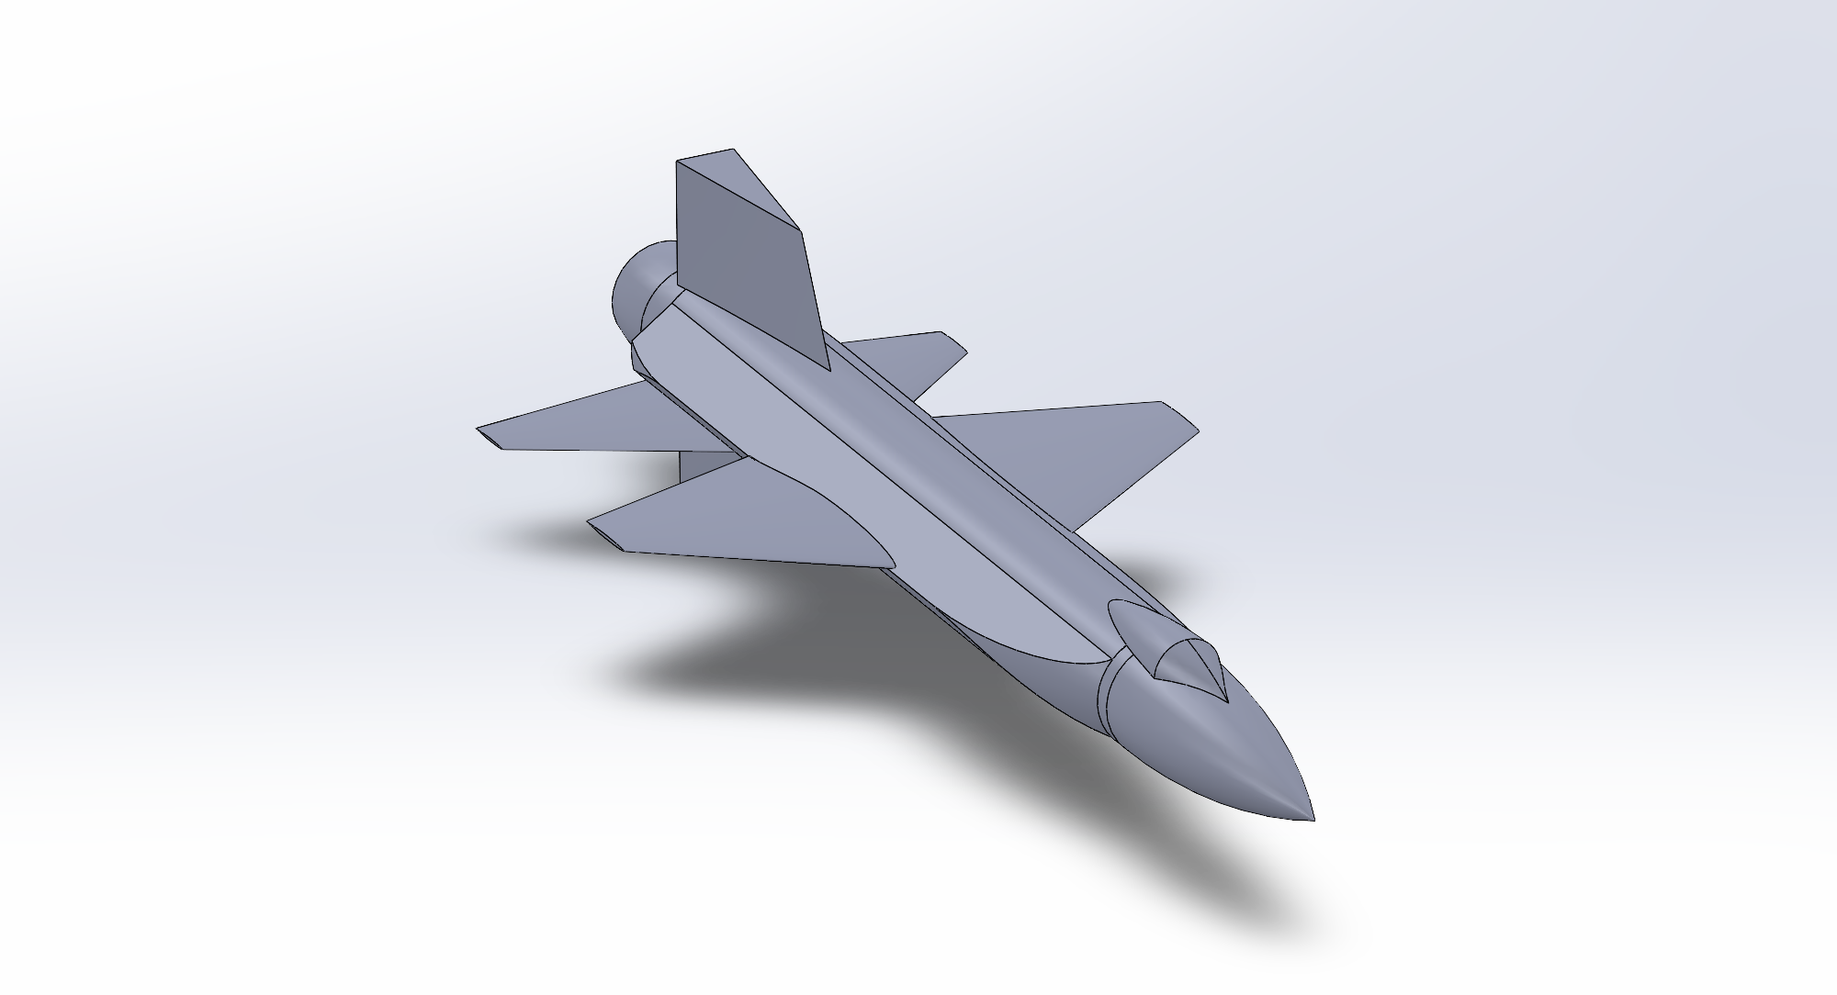
X-15 Final Briefing

Slide 2
Systems V-Diagram
Mission
Develop an aircraft capable of sustained hypersonic flight
Concept Exploration
Identify thermal protection as a key design challenge due to high heating rates
System Requirements
Reduce heating rates from 120BTU/ft²/s to 30BTU/ft²/s​ and skin temperatures from 2,400ºF to 1,200ºF [1]
Implement a thermal ablative coating system to achieve target heating reduction
Higher-Level Design

Slide 3
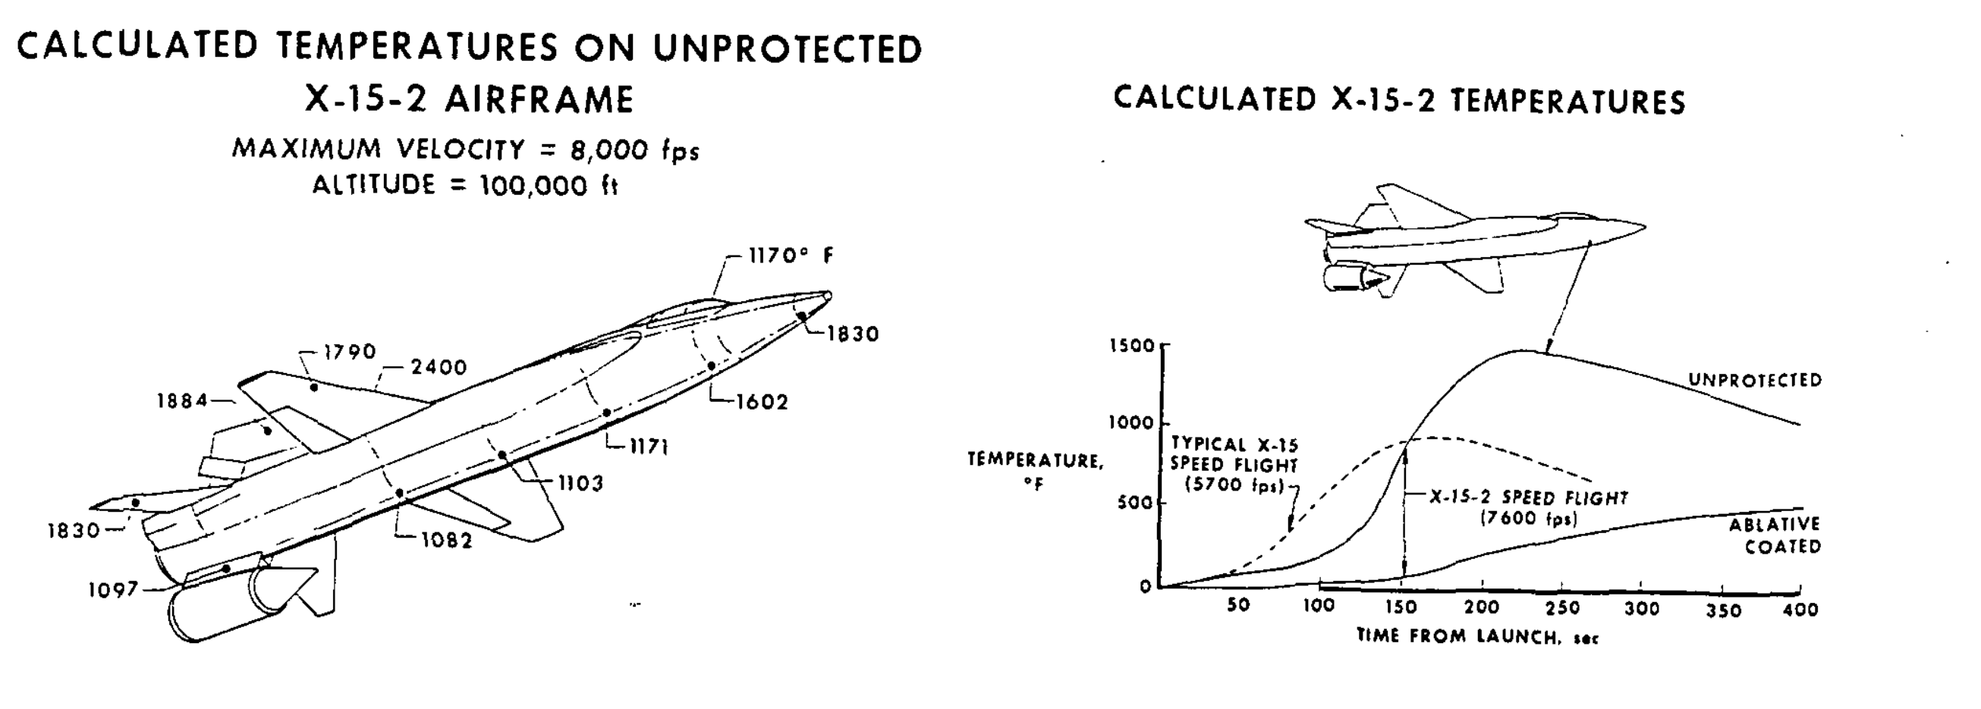


Simulation Overview
[2]

Slide 4
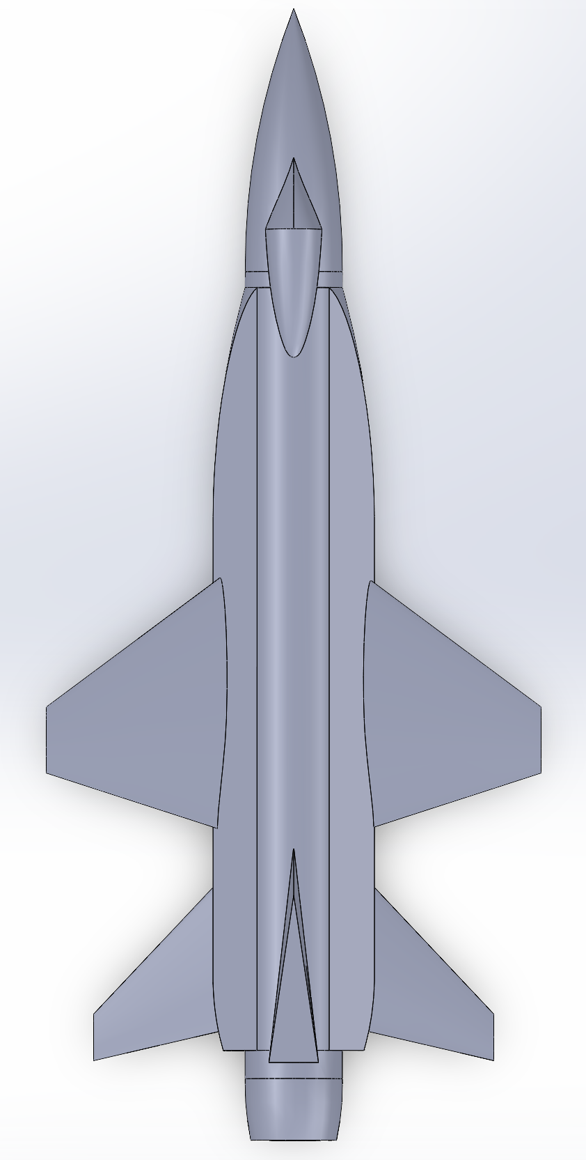
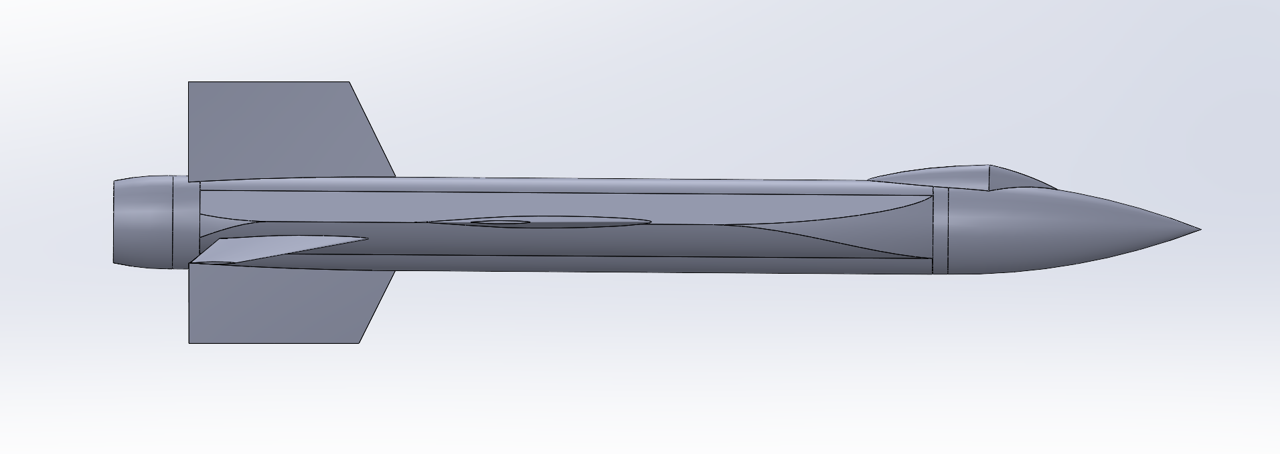
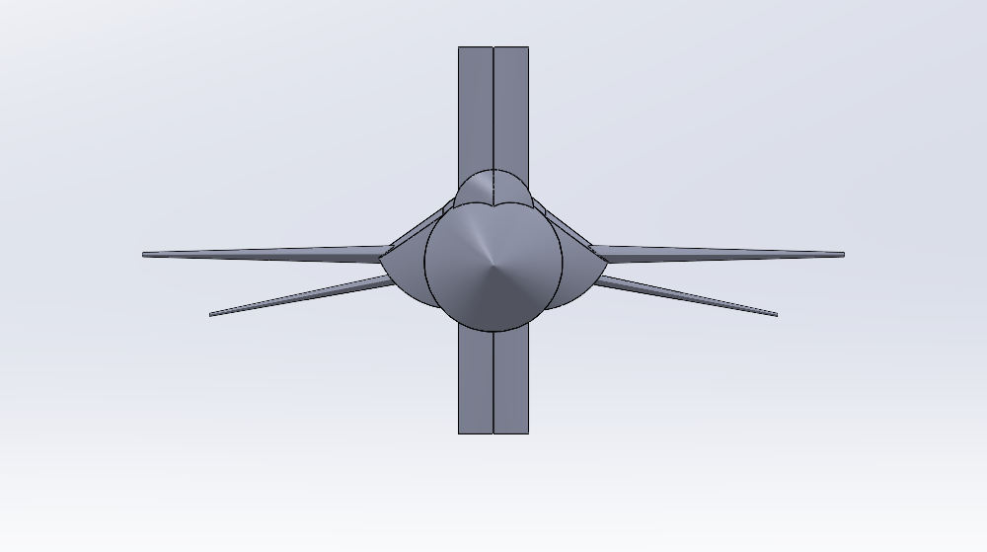
Finalized SolidWorks Model

Slide 5
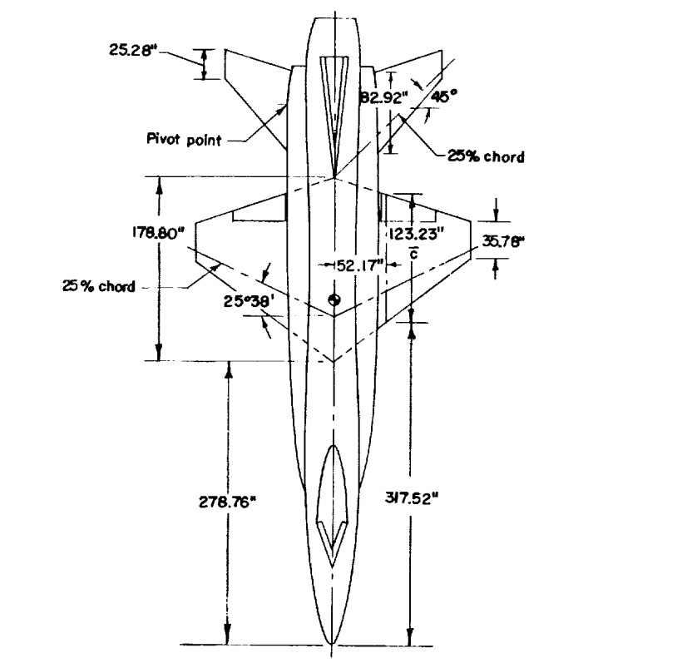
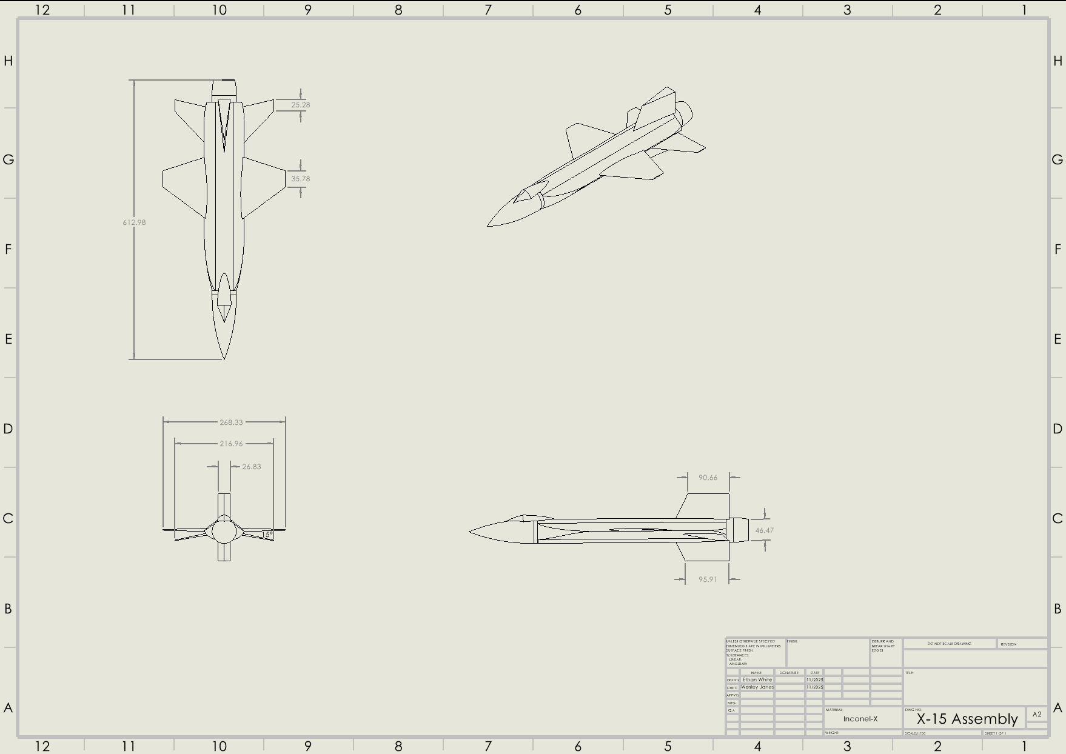
Dimension Verification
25.28”
35.78”
[3]

Slide 6
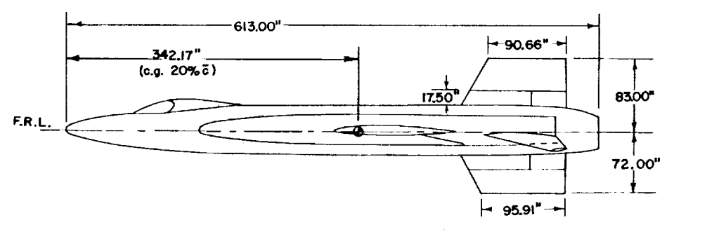
Dimension Verification
[3]
90.66”
95.91”

Slide 7
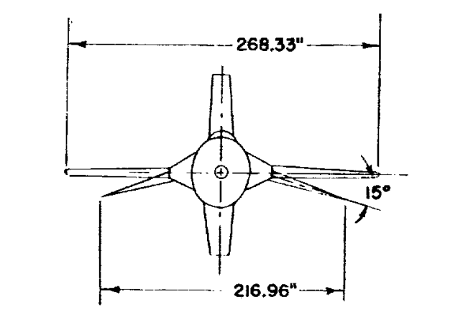
Dimension Verification
268.33”
216.96”
[3]
15°

Slide 8
ANSYS Workflow
Geometry
Mesh
Initialized mesh with default ANSYS settings
Checked and refined mesh
Setup
Execution
Initialize solution
Defined spherical fluid domain
Ran a time-steady, Density-based solver
Subtracted X-15 airframe from domain
Enabled Energy equation and viscous model (k-ω SST)
Run simulation
Analyze results against technical report data using static pressure contours
Input freestream conditions at desired altitude

Slide 9
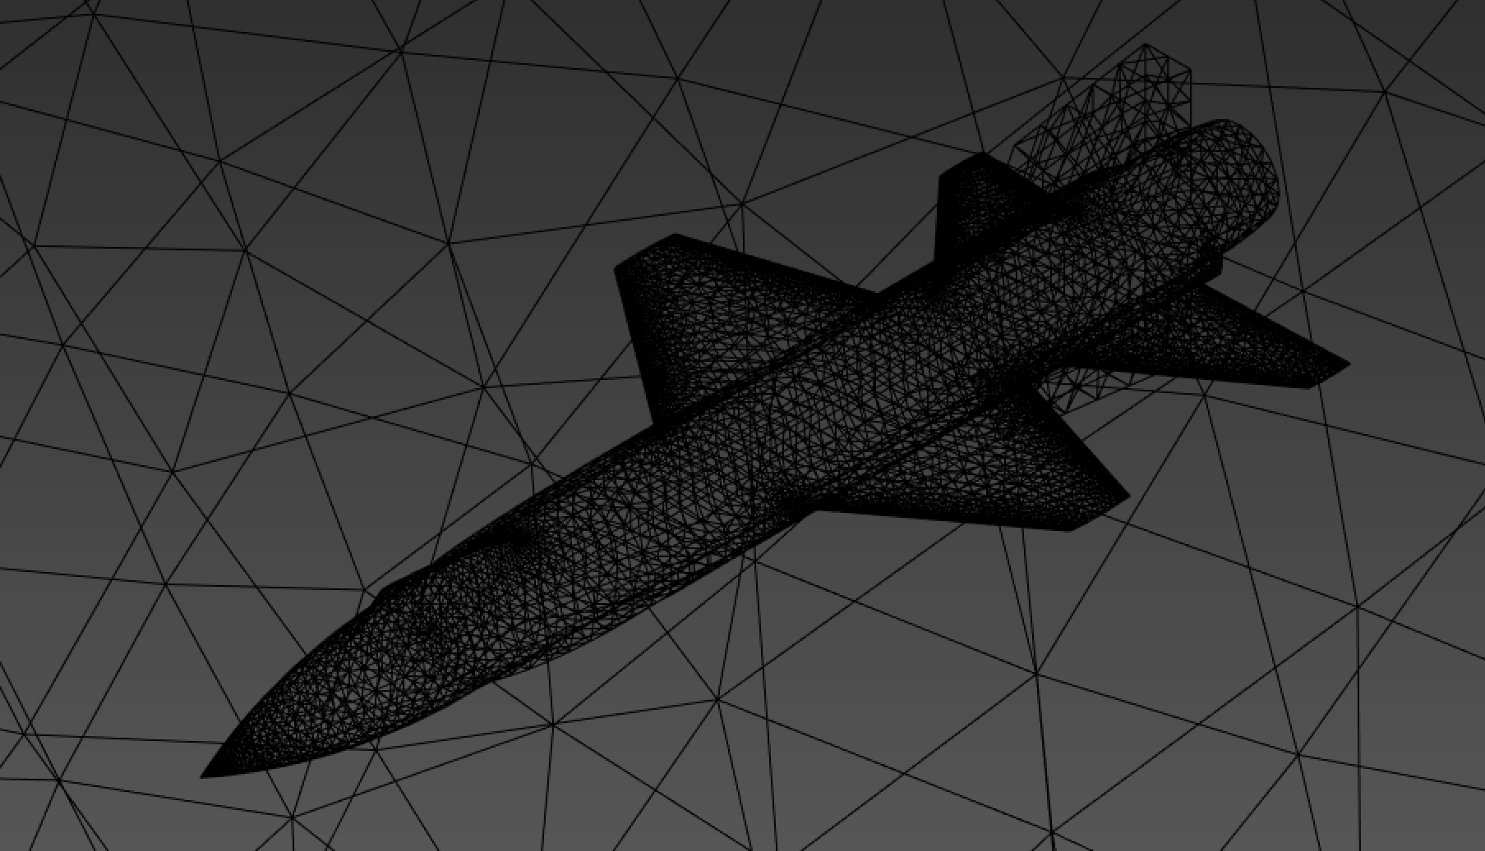
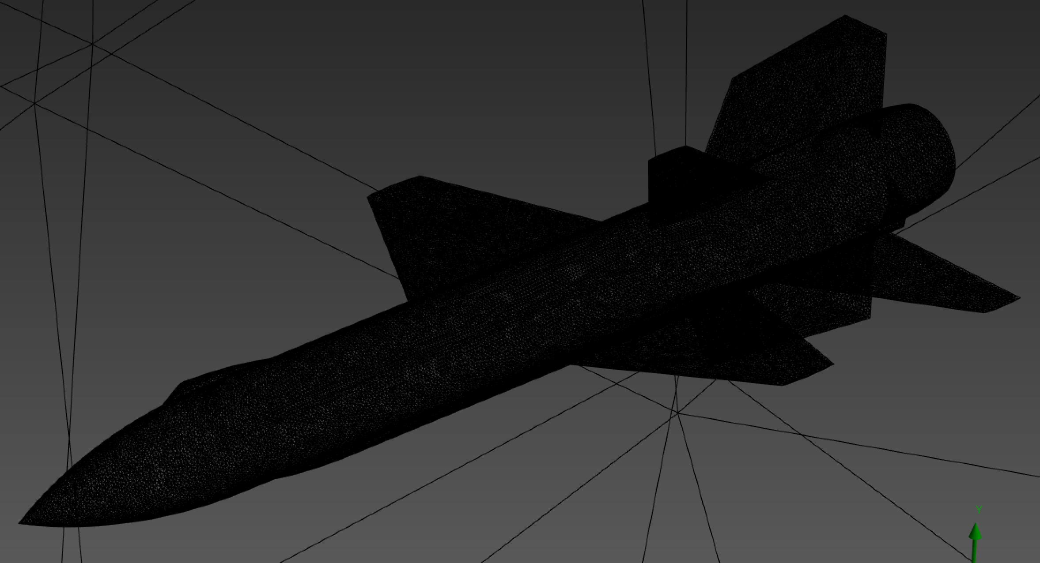
ANSYS Meshing

Slide 10



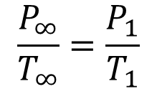
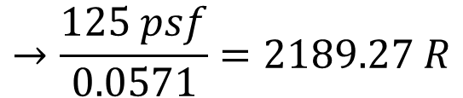
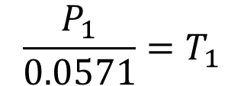
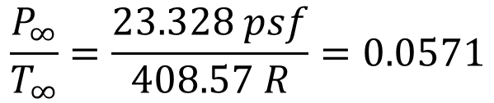
Governing Equations
Gay-Lussac’s Law
Example application at 100,00 feet
$$\frac{P_{∞}}{T_{∞}}=\frac{P_{1}}{T_{1}}$$
Freestream Pressure and Temperature at 100,000 feet:
$$\frac{P_{∞}}{T_{∞}}=\frac{23.328 psf}{408.57 R}=0.0571$$
Solve for temperature using a known static pressure point on the airframe:
Fahrenheit to Rankin
$$R=F+491.67$$
$$\frac{P_{1}}{0.0571}=T_{1}$$
$$→\frac{125 psf}{0.0571}=2189.27 R$$
$$2189.27 R=F+491.67 →$$
$$F=1697.59 °F$$

Slide 11
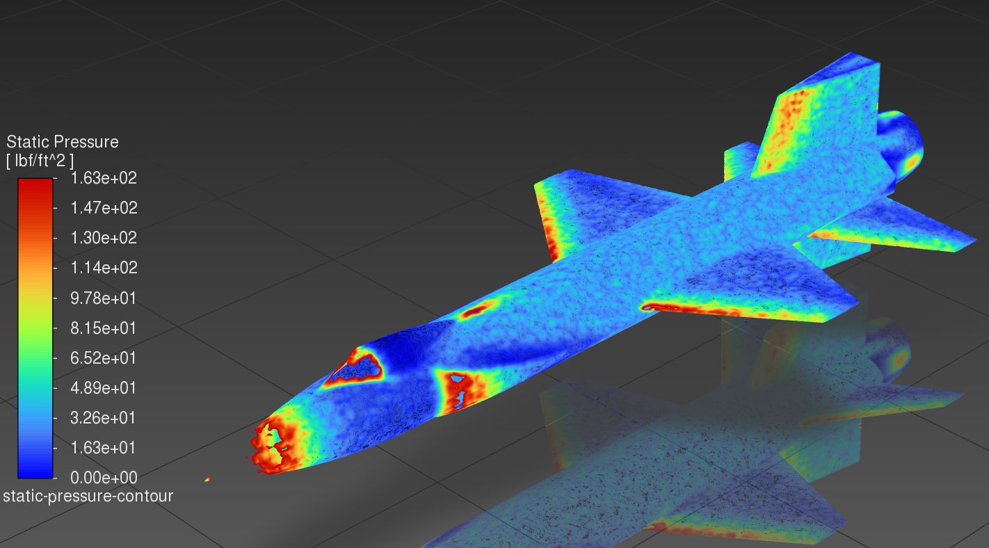
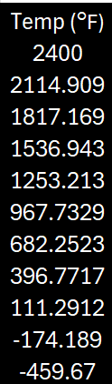
ANSYS Results
Mach: 8 / Altitude: 100,000 ft
NASA’s Analytical Results
1,850°F
1,800°F
2,450°F
3,000°F
[2]

Slide 12
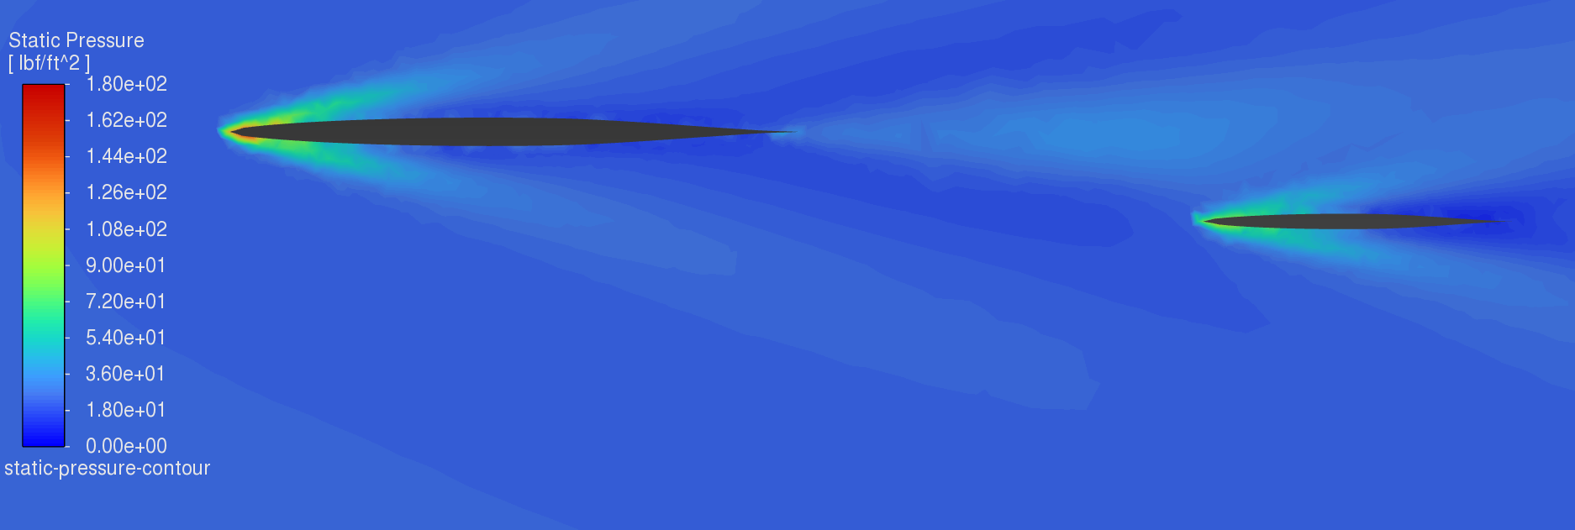
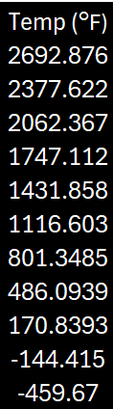
ANSYS Results
NASA’s Analytical Results
Mach: 8 / Altitude: 100,000 ft
1,750°F
2,300°F
1,500°F
[2]

Slide 13
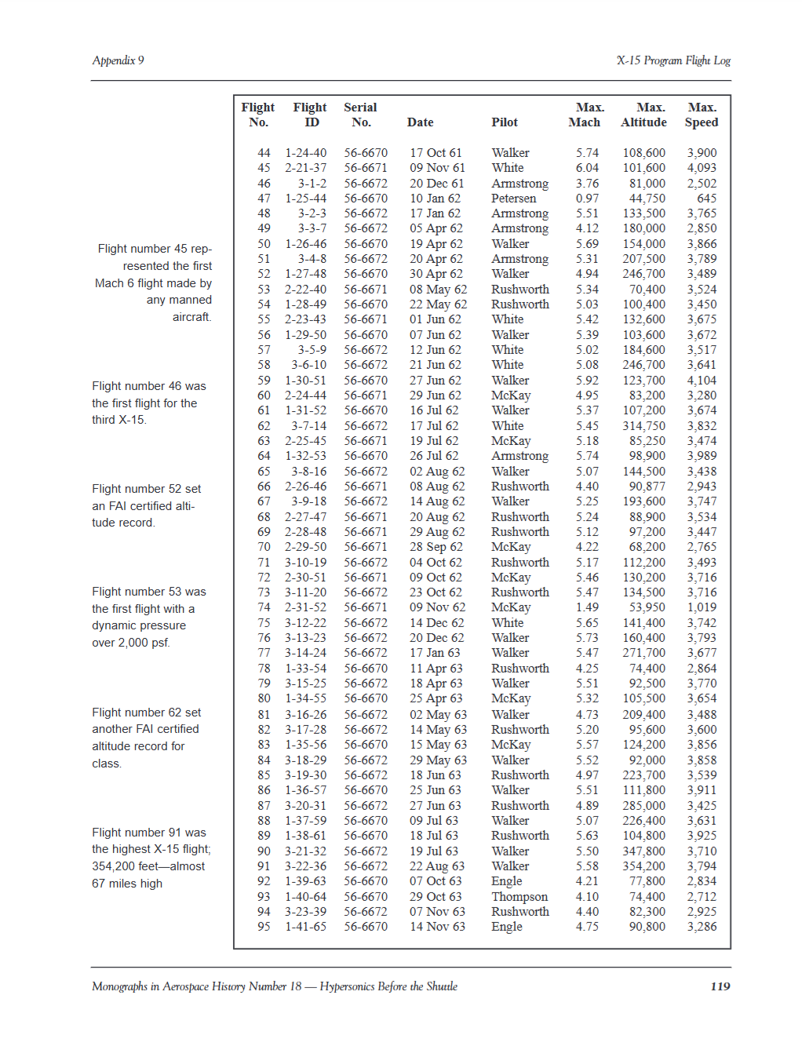
ANSYS Verification
[4]
[4]

Slide 14
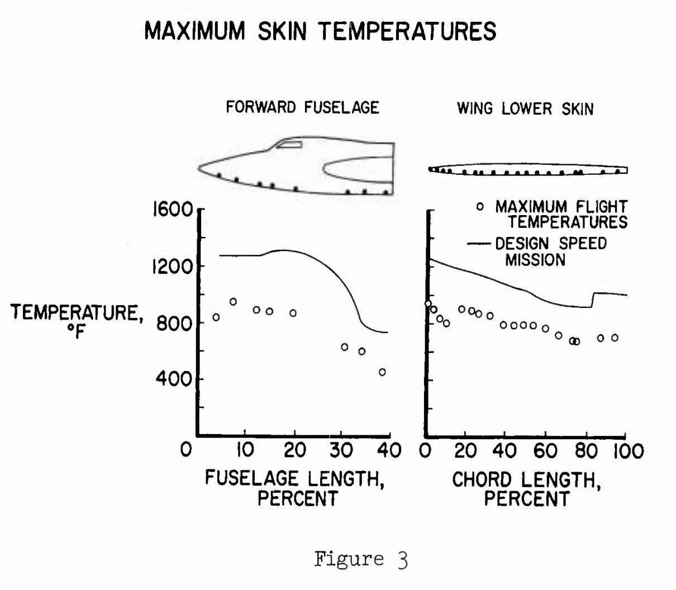
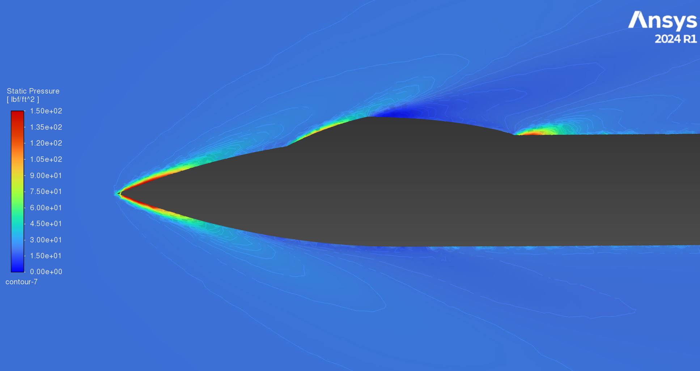
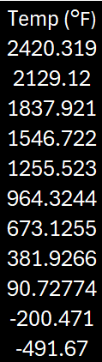
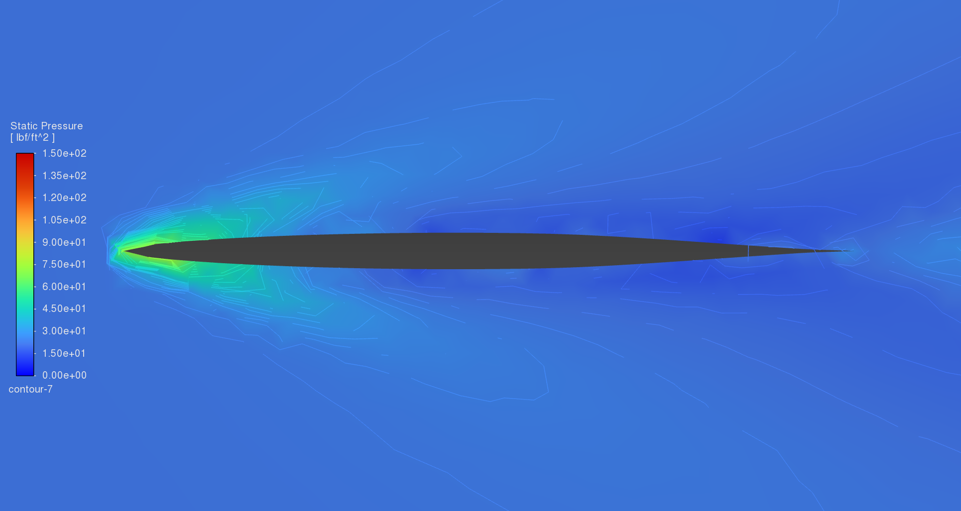
ANSYS Verification Results
NASA’s Analytical Results
Mach: 6.04 / Altitude: 101,600 ft
2,400°F
900°F
900°F

Slide 15
Conclusion

Slide 16
References
[1] A. B. Price, “Thermal protection system X-15A-2 Design report,” NASA Contractor Report CR-82003, 1968.
[2] NASA, “Progress of the X-15 Research Airplane Program,” in Proceedings of the 4th Conference on Progress of the X-15 Research Airplane Program, Edwards AFB, CA, Oct. 7, 1965, NASA-SP-90.
[3] W. D. Grantham and S. H. Scher, “Analytical investigation and prediction of spin and recovery characteristics of the North American X-15 airplane,” NASA Technical Memorandum NASA-TM-X-294, Oct. 1, 1960.
[4] D. R. Jenkins, *Hypersonics Before the Shuttle: A Concise History of the X-15 Research Airplane*, NASA History Series, Monographs in Aerospace History no. 18, NASA Publication SP-2000-4518, June 2000.
[5] E. E. Kordes, “Structural Heating Experiences on the X-15 Airplane,” NASA Technical Memorandum NASA-TM-X-711, Mar. 1962.

