Slide 1


Layout 01
Mão na Massa

Slide 2
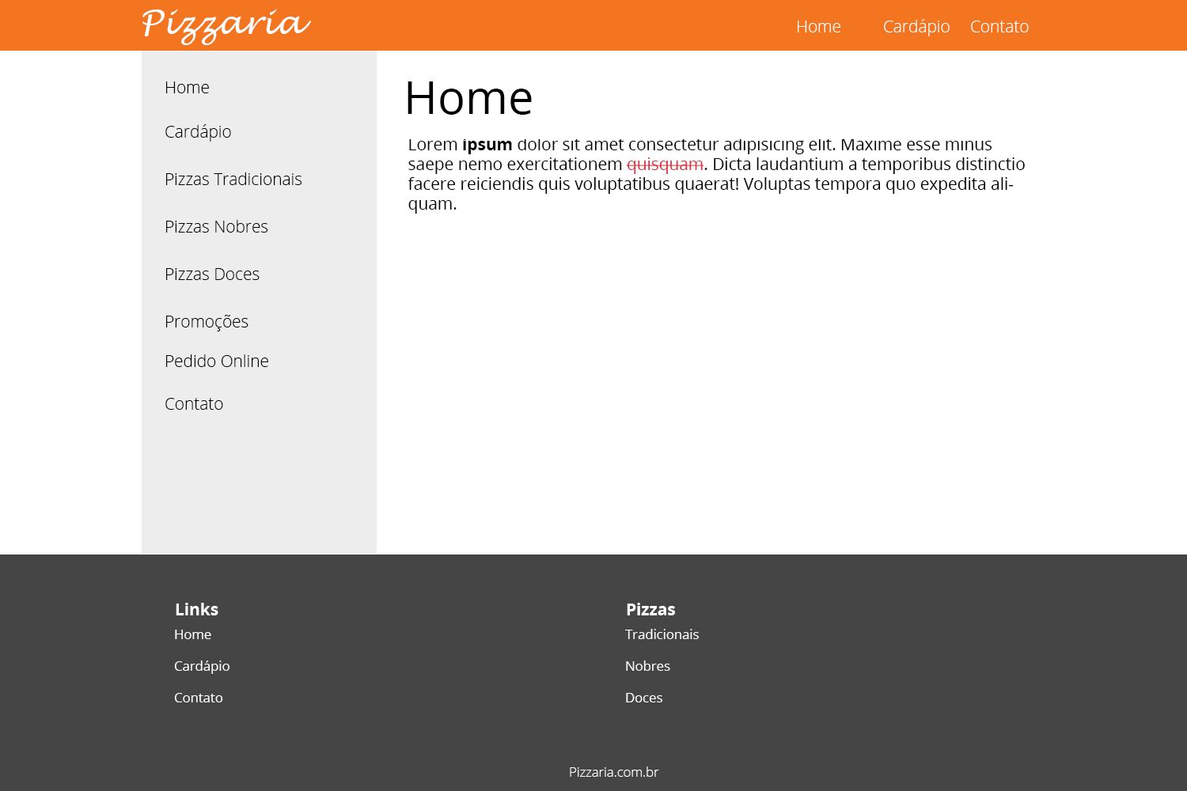

Slide 3
Cores
#F37520
#EDEDED
#454545
#FFFFFF

