Slide 1
The Gendorf Dashboard allows a production engineer to pull on key variables/levers. The idea is to onboard this as part of a site assessment
Objective: Create a datadashboard that is user friendly – visually appealing
Method: Python/Plotly, PowerBI, Tableau, Excel w/ Powerview
Key Output from the dashboard: EBITDA related KPIs (some screenshots below)

Slide 2
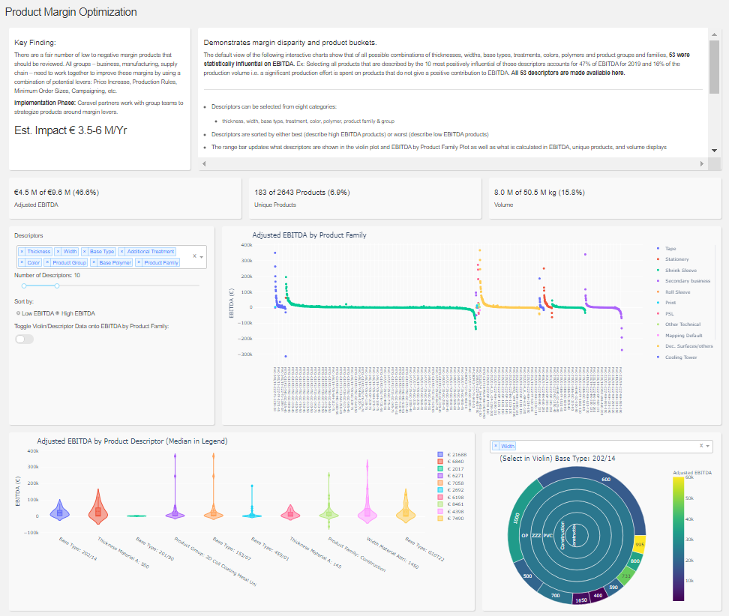

Slide 3
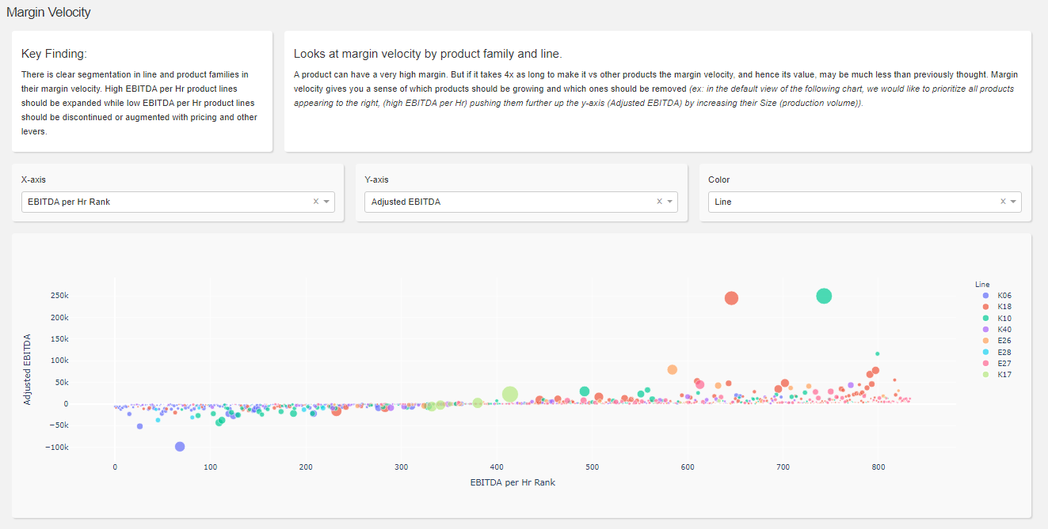

Slide 4
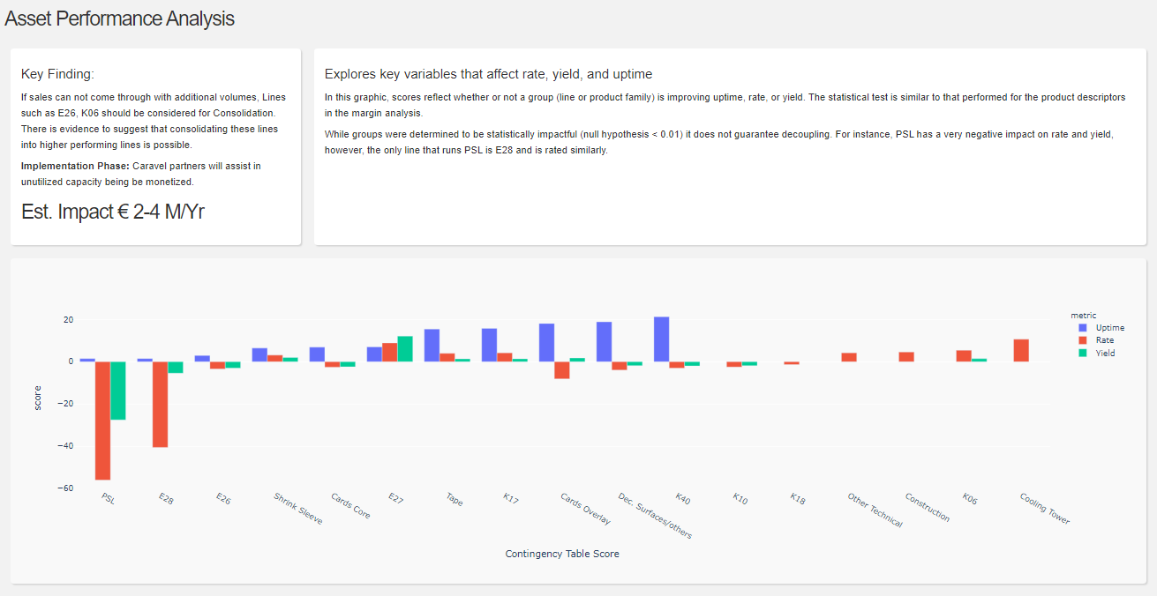

Slide 5
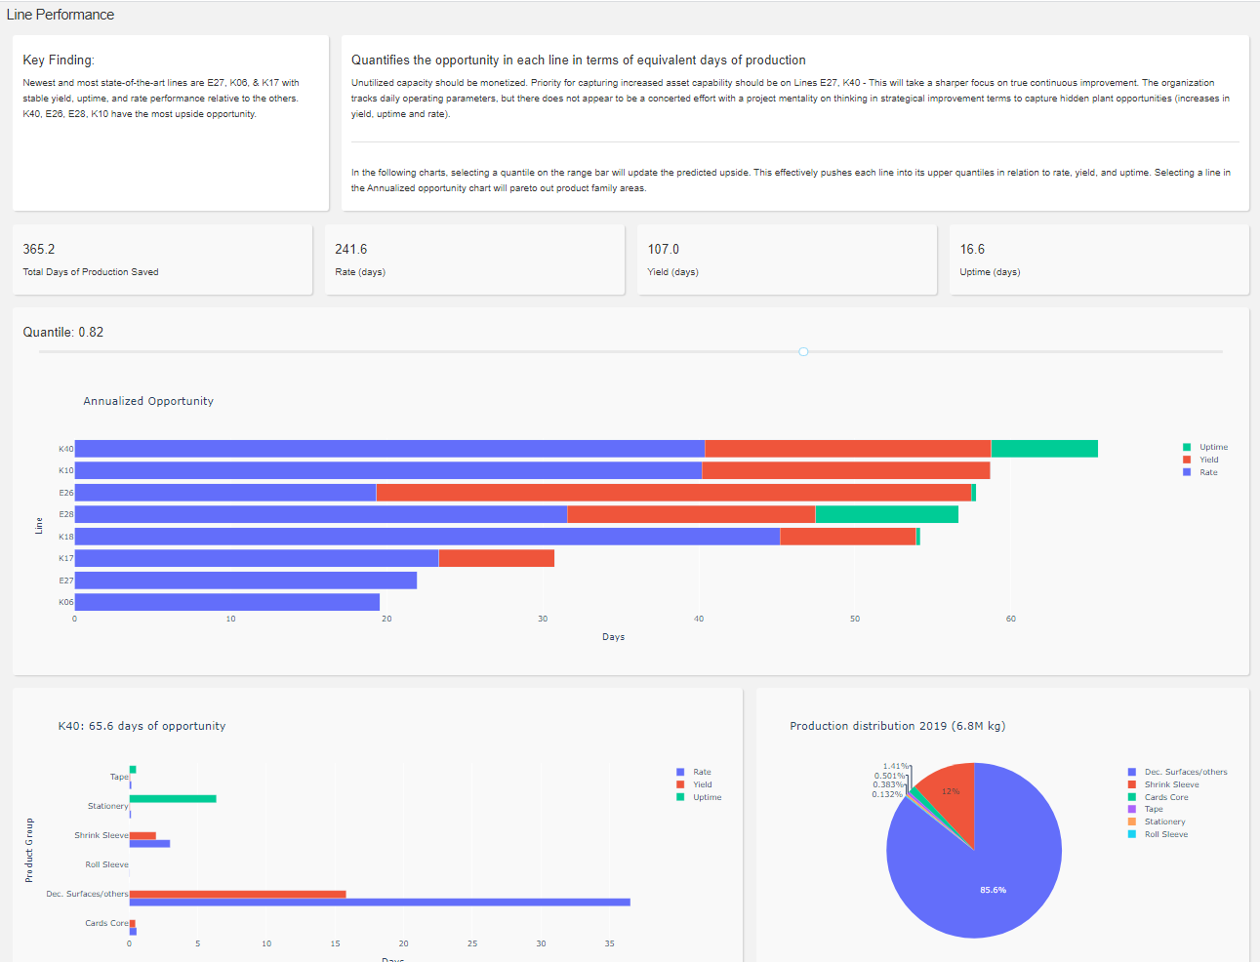

Slide 6
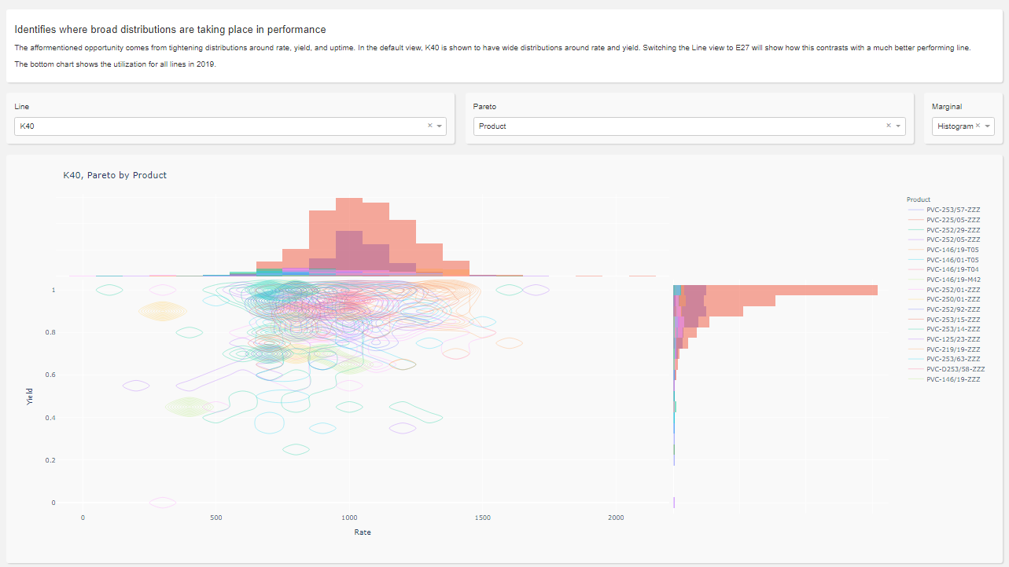

Slide 7
