Slide 1
Decklizer: Walkthrough
BERRY PLASTICS – 9/2/2020

Slide 2
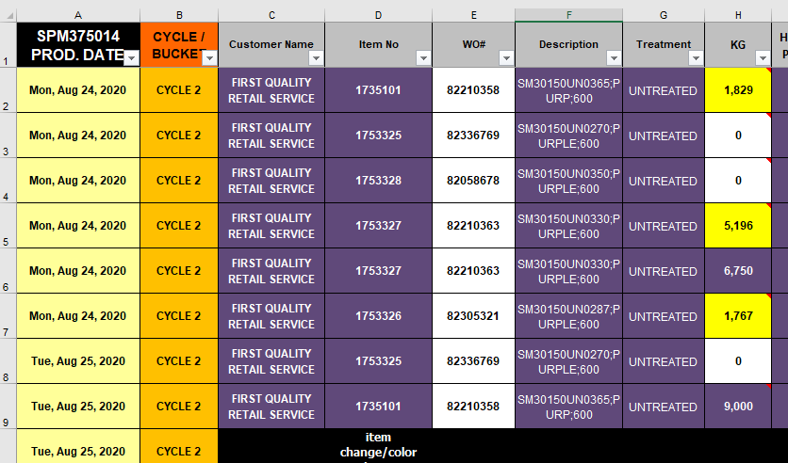
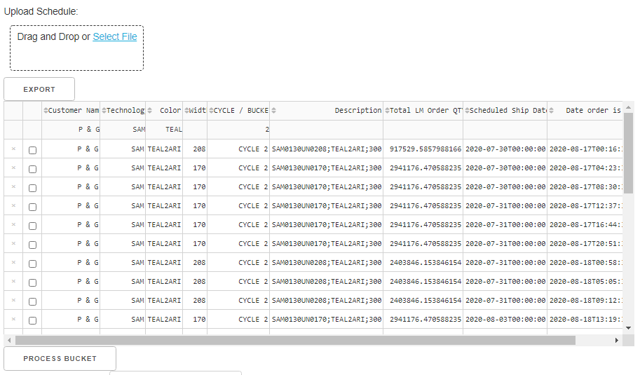
Upload and Process Schedule Data
Upload schedule data
Reads first sheet from excel file
1a
1b
Use filter to select deckle
2
2
Hit “Process Bucket” to auto-populate deckle parameters

Slide 3
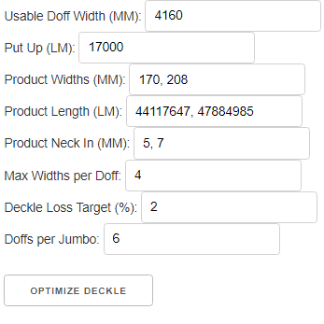
Set Decklizer Optimization Parameters
Change any parameters and constraints
1
Hit “Optimize Deckle” will run 10-20 seconds
2

Slide 4
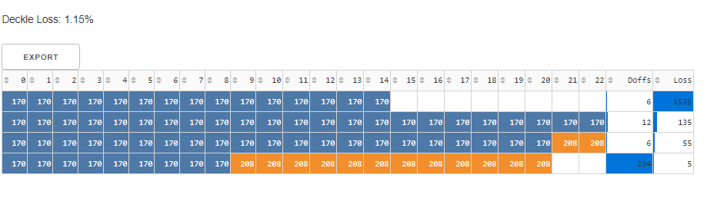
Inspect Layout Summary
Note material loss
1
Note unique layouts, re-run optimization if a different number is desired
2

Slide 5
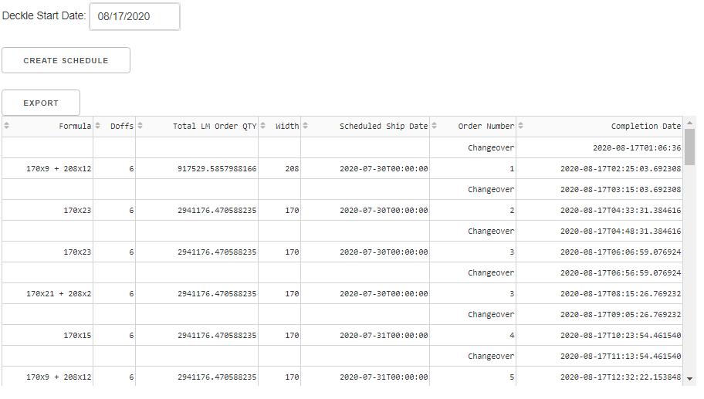
Create Optimized Deckle Schedule
Start date auto-populates from first completed order off Reicofil
1
2
Hit “Create Schedule”
3
Export to Excel

Slide 6
Key Steps
Upload and Process Schedule Data
Set Deckle Optimization Parameters
Inspect Layout Summary
Create Optimized Deckle Schedule

Slide 7
Send Questions/Comments to wbeckner@mfganalytic.com

