Slide 1
MATH 1051H-A: Lecture #07

Slide 2
Checking for independence:
If P(A occurs, given that B is true) = $P(A | B)=P(A)$, then A and B are independent.

Slide 3
The Gun Ownership Question
P(protects citizens) = 0.58
P(randomly selected NC resident says gun ownership protects citizens, given that the resident is white) = P(protects citizens $|$ White) = 0.67
P(protects citizens $|$ Black) = 0.28
P(protects citizens $|$ Hispanic) = 0.64
P(protects citizens) varies by race/ethnicity, therefore opinion on gun ownership and race ethnicity are most likely dependent.

Slide 4
Determining dependence based on sample data
If conditional probabilities calculated based on sample data suggest dependence between two variables, the next step is to conduct a hypothesis test to determine if the observed difference between the probabilities is likely or unlikely to have happened by chance.
If the observed difference between the conditional probabilities is large, then there is stronger evidence that the difference is real.
If a sample is large, then even a small difference can provide strong evidence of a real difference.

Slide 5
More on dependence
We saw that P(protects citizens $|$ White) = 0.67 and P(protects citizens $|$ Hispanic) = 0.64. Under which condition would you be more convinced of a real difference between the proportions of Whites and Hispanics who think gun widespread gun ownership protects citizens? $n=500$ or $n=50,000$

Slide 6
Product rule for independent events: $P(A and B)=P(A)×P(B)$
More generally, $P(A_{1} and ⋯ and A_{k})=P(A_{1})×⋯×P(A_{k})$

Slide 7
Example
You toss a coin twice, what is the probability of getting two tails in a row?
$P(T on the first toss)×P(T on the second toss)=\frac{1}{2}×\frac{1}{2}=\frac{1}{4}$

Slide 8
Practice
A recent Gallup poll suggests that 25.5% of Texans do not have health insurance as of June 2012. Assuming that the uninsured rate stayed constant, what is the probability that two randomly selected Texans are both uninsured?
${25.5}^{2}$
${0.255}^{2}$
$0.255×2$
$(1−0.255)^{2}$
http://www.gallup.com/poll/156851/uninsured-rate-stable-across-states-far-2012.aspx

Slide 9
Disjoint vs. complementary
Do the sum of probabilities of two disjoint events always add up to 1?

Slide 10
Disjoint vs. complementary
Do the sum of probabilities of two disjoint events always add up to 1?
Not necessarily, there may be more than 2 events in the sample space, e.g. party affiliation.

Slide 11
Disjoint vs. complementary
Do the sum of probabilities of two disjoint events always add up to 1?
Not necessarily, there may be more than 2 events in the sample space, e.g. party affiliation.
Do the sum of probabilities of two complementary events always add up to 1?

Slide 12
Disjoint vs. complementary
Do the sum of probabilities of two disjoint events always add up to 1?
Not necessarily, there may be more than 2 events in the sample space, e.g. party affiliation.
Do the sum of probabilities of two complementary events always add up to 1?
Yes, that’s the definition of complementary, e.g. heads and tails.

Slide 13
Putting everything together…
If we were to randomly select 5 Texans, what is the probability that at least one is uninsured?
If we were to randomly select 5 Texans, the sample space for the number of Texans who are uninsured would be: $S=\{0,1,2,3,4,5\}$
We are interested in instances where at least one person is uninsured: $S=\{0,$ 1, 2, 3, 4, 5$\}$
So we can divide up the sample space into two categories: $S=\{0,$ at least one$\}$

Slide 14
Putting everything together…
Since the probability of the sample space must add up to 1, and $P(at least one)=1−P(none)$
$$\begin{matrix}Prob(at least 1 uninsured) & =1−Prob(none uninsured) \\ & =1−[(1−0.255)^{5}] \\ & =1−{0.745}^{5} \\ & =1−0.23 \\ & =0.77\end{matrix}$$

Slide 15
Practice
Roughly 20% of undergraduates at a university are vegetarian or vegan. What is the probability that, among a random sample of 3 undergraduates, at least one is vegetarian or vegan?
$1−0.2×3$
$1−{0.2}^{3}$
${0.8}^{3}$
$1−0.8×3$
$1−{0.8}^{3}$

Slide 16
Practice
$$\begin{matrix}P(at least 1 from veg) & =1−P(none veg) \\ & =1−(1−0.2)^{3} \\ & =1−{0.8}^{3} \\ & =1−0.512=0.488\end{matrix}$$

Slide 17
Practice
Roughly 20% of undergraduates at a university are vegetarian or vegan. What is the probability that, among a random sample of 3 undergraduates, at least one is vegetarian or vegan?
$1−0.2×3$
$1−{0.2}^{3}$
${0.8}^{3}$
$1−0.8×3$
$1−{0.8}^{3}$

Slide 18
Conditional probability

Slide 19
Relapse
Researchers randomly assigned 72 chronic users of cocaine into three groups: desipramine (antidepressant), lithium (standard treatment for cocaine) and placebo. Results of the study are summarized below.

Slide 20
 | relapse | no relapse | total
desipramine | 10 | 14 | 24
lithium | 18 | 6 | 24
placebo | 20 | 4 | 24
total | 48 | 24 | 72

Slide 21
http://www.oswego.edu/~srp/stats/2_way_tbl_1.htm

Slide 22
Marginal probability
What is the probability that a patient relapsed?

Slide 23
 | relapse | no relapse | total
desipramine | 10 | 14 | 24
lithium | 18 | 6 | 24
placebo | 20 | 4 | 24
total | 48 | 24 | 72

Slide 24
Marginal probability
What is the probability that a patient relapsed?

Slide 25
 | relapse | no relapse | total
desipramine | 10 | 14 | 24
lithium | 18 | 6 | 24
placebo | 20 | 4 | 24
total | 48 | 24 | 72

Slide 26
$P(relapsed)=\frac{48}{72}≈0.67$

Slide 27
Joint probability
What is the probability that a patient received the antidepressant (desipramine) and relapsed?

Slide 28
 | relapse | no relapse | total
desipramine | 10 | 14 | 24
lithium | 18 | 6 | 24
placebo | 20 | 4 | 24
total | 48 | 24 | 72

Slide 29
$P(relapsed and desipramine)=\frac{10}{72}≈0.14$

Slide 30
Conditional probability
The conditional probability of the outcome of interest $A$ given condition $B$ is calculated as
$P(A|B)=\frac{P(A and B)}{P(B)}$

Slide 31
 | relapse | no relapse | total
desipramine | 10 | 14 | 24
lithium | 18 | 6 | 24
placebo | 20 | 4 | 24
total | 48 | 24 | 72

Slide 32
Conditional probability
The conditional probability of the outcome of interest $A$ given condition $B$ is calculated as
$$\begin{matrix}P(relapse|desipramine) & =\frac{P(relapse and desipramine)}{P(desipramine)} \\ & =\frac{10/72}{24/72} \\ & =\frac{10}{24}=0.42\end{matrix}$$

Slide 33
Conditional probability (cont.)
If we know that a patient received the antidepressant (desipramine), what is the probability that they relapsed?

Slide 34
 | relapse | no relapse | total
desipramine | 10 | 14 | 24
lithium | 18 | 6 | 24
placebo | 20 | 4 | 24
total | 48 | 24 | 72

Slide 35
$$\begin{matrix}P(relapse|desipramine) & =\frac{10}{24}≈0.42\end{matrix}$$

Slide 36
Conditional probability (cont.)
$$\begin{matrix}P(relapse|desipramine) & =\frac{10}{24}≈0.42 \\ P(relapse|lithium) & =\frac{18}{24}≈0.75 \\ P(relapse|placebo) & =\frac{20}{24}≈0.83\end{matrix}$$

Slide 37
Conditional probability (cont.)
If we know that a patient relapsed, what is the probability that they received the antidepressant (desipramine)?

Slide 38
 | relapse | no relapse | total
desipramine | 10 | 14 | 24
lithium | 18 | 6 | 24
placebo | 20 | 4 | 24
total | 48 | 24 | 72

Slide 39
$$\begin{matrix}P(desipramine|relapse) & =\frac{10}{48}≈0.21\end{matrix}$$

Slide 40
General multiplication rule
Earlier we saw that if two events are independent, their joint probability is simply the product of their probabilities. If the events are not believed to be independent, the joint probability is calculated slightly differently.
If $A$ and $B$ represent two outcomes or events, then $P(A and B)=P(A|B)×P(B)$ Note that this formula is simply the conditional probability formula, rearranged.
It is useful to think of $A$ as the outcome of interest and $B$ as the condition.

Slide 41
Independence and conditional probabilities
Consider the following (hypothetical) distribution of gender and major of students in an introductory statistics class:

Slide 42
 | social science | non-social science | total
female | 30 | 20 | 50
male | 30 | 20 | 50
total | 60 | 40 | 100

Slide 43
The probability that a randomly selected student is a social science major is $\frac{60}{100}=0.6$.
The probability that a randomly selected student is a social science major given that they are female is $\frac{30}{50}=0.6$.
Since $P(SS|M)$ also equals 0.6, major of students in this class does not depend on their gender: P(SS $|$ F) = P(SS).

Slide 44
Independence and conditional probabilities (cont.)
Generically, if $P(A|B)=P(A)$ then the events $A$ and $B$ are said to be independent.
Conceptually: Giving $B$ doesn’t tell us anything about $A$.
Mathematically: We know that if events $A$ and $B$ are independent, $P(A and B)=P(A)×P(B)$. Then,
$$ P(A|B) = \frac{P(\text{A\text{ and }B})}{P(B)} = \frac{P(A) \times P(B)}{P(B)} = P(A) $$

Slide 45
Breast cancer screening
American Cancer Society estimates that about 1.7% of women have breast cancer.
Susan G. Komen For The Cure Foundation states that mammography correctly identifies about 78% of women who truly have breast cancer.
An article published in 2003 suggests that up to 10% of all mammograms result in false positives for patients who do not have cancer.
These percentages are approximate, and very difficult to estimate.
http://www.cancer.org/cancer/cancerbasics/cancer-prevalence http://ww5.komen.org/BreastCancer/AccuracyofMammograms.html http://www.ncbi.nlm.nih.gov/pmc/articles/PMC1360940

Slide 46
Inverting probabilities
When a patient goes through breast cancer screening there are two competing claims: patient had cancer and patient doesn’t have cancer. If a mammogram yields a positive result, what is the probability that patient actually has cancer?

Slide 47
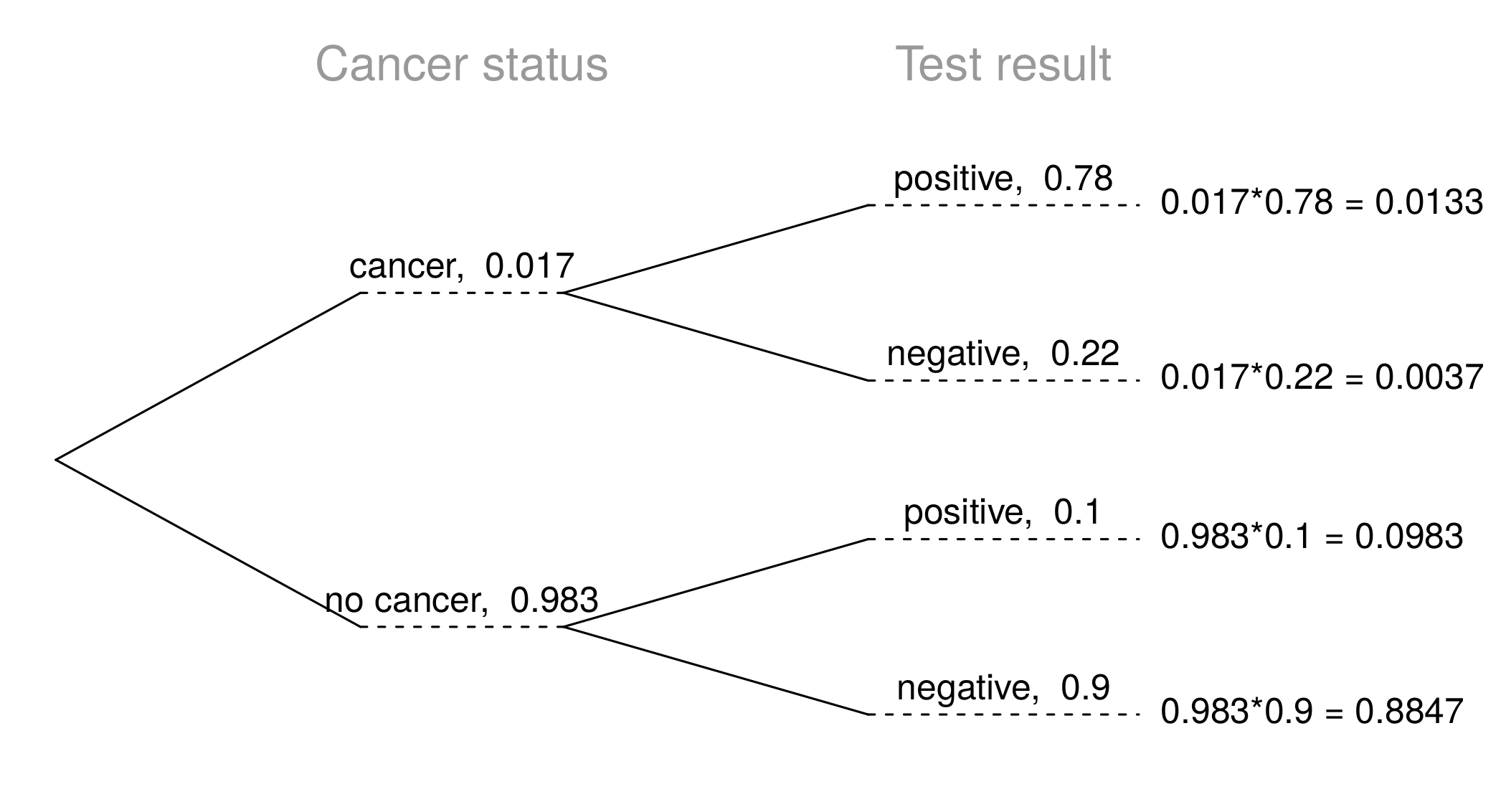

Slide 48
Inverting probabilities (ctd.)
$$\begin{matrix}P(C|+) & =\frac{P(C and +)}{P(+)} \\ & =\frac{0.0133}{0.0133+0.0983} \\ & =0.12\end{matrix}$$
Note: Tree diagrams are useful for inverting probabilities: we are given $P(+|C)$ and asked for $P(C|+)$.

Slide 49
Practice
Suppose a woman who gets tested once and obtains a positive result wants to get tested again. In the second test, what should we assume to be the probability of this specific woman having cancer?
0.017
0.12
0.0133
0.88

Slide 50
Practice
Suppose a woman who gets tested once and obtains a positive result wants to get tested again. In the second test, what should we assume to be the probability of this specific woman having cancer?
0.017
0.12
0.0133
0.88

Slide 51
Practice
What is the probability that this woman has cancer if this second mammogram also yielded a positive result?

Slide 53
Practice
What is the probability that this woman has cancer if this second mammogram also yielded a positive result?
0.0936
0.088
0.48
0.52

Slide 54
Practice
What is the probability that this woman has cancer if this second mammogram also yielded a positive result?
0.0936
0.088
0.48
0.52
$P(C|+)=\frac{P(C and +)}{P(+)}=\frac{0.0936}{0.0936+0.088}=0.52$

Slide 55
Bayes’ Theorem
The conditional probability formula we have seen so far is a special case of the Bayes’ Theorem, which is applicable even when events have more than just two outcomes.
Bayes’ Theorem:
$$\begin{matrix}P(outcome & A_{1} of variable 1|outcome B of variable 2) \\ & =\frac{P(B|A_{1})P(A_{1})}{P(B|A_{1})P(A_{1})+P(B|A_{2})P(A_{2})+⋯+P(B|A_{k})P(A_{k})}\end{matrix}$$
where $A_{2}$, $⋯$, $A_{k}$ represent all other possible outcomes of variable 1.

Slide 56
Application activity: Inverting probabilities
A common epidemiological model for the spread of diseases is the SIR model, where the population is partitioned into three groups: Susceptible, Infected, and Recovered. This is a reasonable model for diseases like chickenpox where a single infection usually provides immunity to subsequent infections. Sometimes these diseases can also be difficult to detect.
Imagine a population in the midst of an epidemic where 60% of the population is considered susceptible, 10% is infected, and 30% is recovered. The only test for the disease is accurate 95% of the time for susceptible individuals, 99% for infected individuals, but 65% for recovered individuals. (Note: In this case accurate means returning a negative result for susceptible and recovered individuals and a positive result for infected individuals).
Draw a probability tree to reflect the information given above. If the individual has tested positive, what is the probability that they are actually infected?

Slide 57
Application activity: Inverting probabilities (cont.)

Slide 58
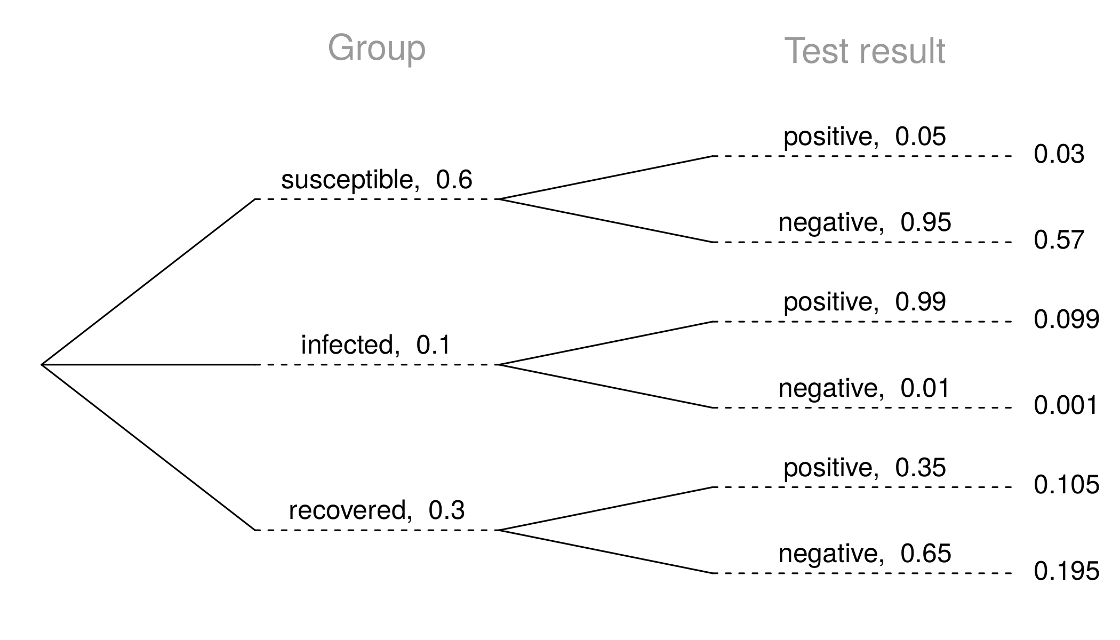

Slide 59
$$P(inf | +)=\frac{P(inf and +)}{P(+)}=\frac{0.099}{0.03+0.099+0.105}≈0.423$$

