Slide 1
MATH 1051H-A: Lecture #02

Slide 2
‘Perhaps H.G. Wells was right when he said “Statistical thinking will one day be as necessary for efficient citizenship as the ability to read and write.”’
Samuel S. Wilks, President of the American Statistical Association, December 28, 1950
“I keep saying the sexy job in the next ten years will be statisticians. People think I’m joking, but who would’ve guessed that computer engineers would’ve been the sexy job of the 1990s?”
Hal Varian, The McKinsey Quarterly, January 2009

Slide 3
Case Study: Treating Chronic Fatigue Syndrome

Slide 4
Treating Chronic Fatigue Syndrome
Objective. Evaluate the effectiveness of cognitive-behavior therapy for chronic fatigue syndrome.
Participant pool. 142 patients who were recruited from referrals by primary care physicians and consultants to a hospital clinic specializing in chronic fatigue syndrome.
Actual participants. Only 60 of the 142 referred patients entered the study. Some were excluded because they didn’t meet the diagnostic criteria, some had other health issues, and some refused to be a part of the study.
Study from: Deale, et. al. 1997. Cognitive behavior therapy for chronic fatigue syndrome: A randomized controlled trial. The American Journal of Psychiatry 154:3.

Slide 5
Study Design
Patients randomly assigned to treatment and control groups, 30 patients in each group:
Treatment: Cognitive behavior therapy $−$ collaborative, educative, and with a behavioral emphasis. Patients were shown on how activity could be increased steadily and safely without exacerbating symptoms.
Control: Relaxation $−$ No advice was given about how activity could be increased. Instead progressive muscle relaxation, visualization, and rapid relaxation skills were taught.

Slide 6
Results
The table below shows the distribution of patients with good outcomes at 6-month follow-up. Note that 7 patients dropped out of the study: 3 from the treatment and 4 from the control group.
Proportion with good outcomes
Good outcome
Yes
No
Total
Groups
Treatment
19
8
27
Control
5
21
26
Total
24
29
53
Treatment Group: 19/27 = 0.70 = 70%
Control Group: 5/26 = 0.19 = 19%

Slide 7
Understanding the results
Do the data show a “real” difference between the groups?
Suppose you flip a coin 100 times. While the chance a coin lands heads in any given coin flip is 50%, we probably won’t observe exactly 50 heads. This type of fluctuation is part of almost any type of data generating process.
The observed difference between the two groups (70 - 19 = 51%) may be real, or may be due to natural variation.
Since the difference is quite large, it is more believable that the difference is real.
We use statistical tools to determine if the difference is so large that we should reject the notion that it was due to chance.

Slide 8
Generalizing the results
Are the results of this study generalizable to all patients with chronic fatigue syndrome?
No. These patients had specific characteristics and volunteered to be a part of this study, therefore they may not be representative of all patients with chronic fatigue syndrome.
While we cannot immediately generalize the results to all patients, this first study is encouraging. The method at least works for patients with some narrow set of characteristics, and that gives hope that it will work, at least to some degree, with other patients.

Slide 9
Data Basics

Slide 10
Data matrix
Data collected on students in a statistics class on a variety of variables

Slide 11
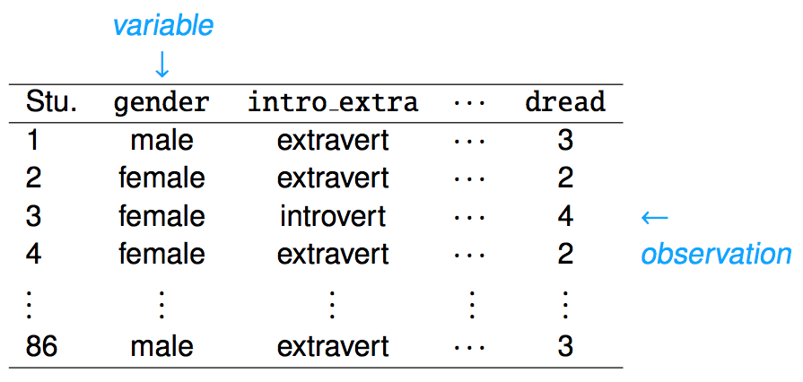

Slide 12
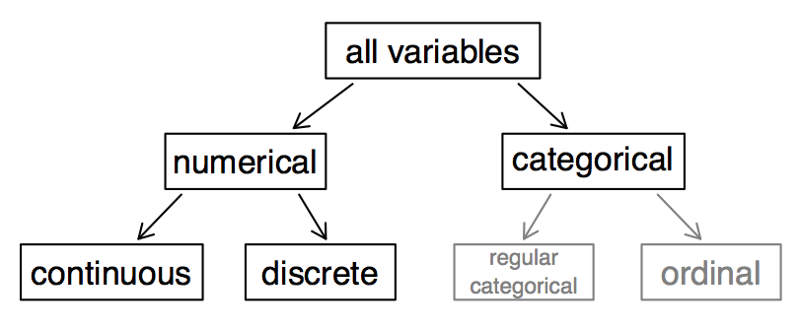
Types of variables

Slide 13
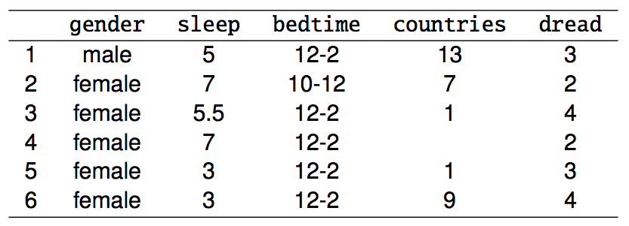
Types of variables (cont.)

Slide 14
gender $−$ categorical
sleep $−$ numerical, continuous
bedtime $−$ categorical, ordinal
countries $−$ numerical, discrete
dread $−$ categorical, ordinal (could also be used as numerical)

Slide 15
Why Do We Need to Care?
The type of data determines the type of analysis that you can perform and the statistics that make sense. Example: Top hockey players in the NHL according to goals (regular season) in 2017-2018.
The mean number of goals is a value that makes sense. The variable Number of Goals is numerical.
The mean jersey number is a value that does not make sense. The variable Jersey Number is not numerical.
If considering jersey numbers, the proportion of players with even jersey numbers is a value that makes sense. The variable Odd or Even Jersey Number is categorical.

Slide 16
Practice
What type of variable is a telephone area code?
numerical, continuous
numerical, discrete
categorical
categorical, ordinal

Slide 17
Practice
What type of variable is a telephone area code?
numerical, continuous
numerical, discrete
categorical
categorical, ordinal

Slide 18
Numerical Data
Numerical (or quantitative) data are numbers representing counts or measurements.
Weights of athletes
Number of siblings
GPA

Slide 19
Working with Numerical Data
We can further distinguish between numerical data by breaking them into two types:
discrete numerical data (integers)
continuous numerical data (real numbers)

Slide 20
Categorical Data
Categorical (or qualitative) data are names or labels (categories!)
country codes for telephones (e.g., USA and Canada are 1)
Social Insurance Numbers (e.g., 516 248 917 - Canadian system)
car colours (red, blue, green, … fuscia?)

Slide 21
Ordinal Data
Ordinal Data are categorical data which have a natural order structure
days of the week (Sunday, Monday, …)
months of the year (January, February, …)
letter grades (A, B, C, D, F)
ranking scheme (Excellent, Good, Fair, Poor)

Slide 22
Relationships between variables
Does there appear to be a relationship between the hours of study per week and the GPA of a student?

Slide 23
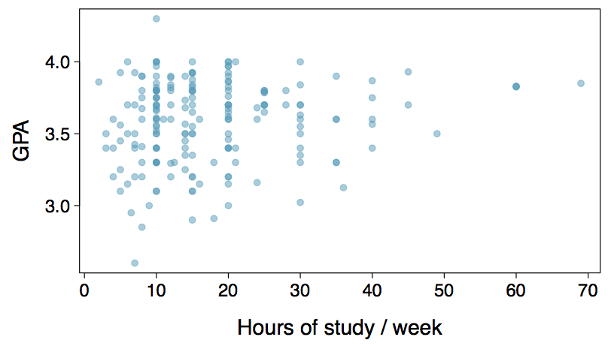

Slide 24
Can you spot anything unusual about any of the data points?

Slide 25
Practice
Based on the scatterplot, which of the following statements is correct about the head and skull length of possums?
There is no relationship between head length and skull width, i.e. the variables are independent.
Head length and skull width are positively associated.
Skull width and head length are negatively associated.
A longer head causes the skull to be wider.
A wider skull causes the head to be longer.

Slide 26
Practice
Based on the scatterplot, which of the following statements is correct about the head and skull length of possums?
There is no relationship between head length and skull width, i.e. the variables are independent.
Head length and skull width are positively associated.
Skull width and head length are negatively associated.
A longer head causes the skull to be wider.
A wider skull causes the head to be longer.

Slide 27
Associated versus Independent
When two variables show some connection with one another, they are called associated variables.
Associated variables can also be called dependent variables, and vice-versa
If two variables are not associated, i.e., there is no evident connection between the two, then they are said to be independent.

Slide 28
Overview of Data Collection Principles

Slide 29
Populations and Samples
Research Question Can people become better, more efficient runners on their own, merely by running?
Population of Interest All people
Sample Group of adult women who recently joined a running group
Population to which results can be generalized Adult women, if the data are randomly sampled
Image source: http://well.blogs.nytimes.com/2012/08/29/finding-your-ideal-running-form

Slide 30
Anecdotal evidence and early smoking research
Anti-smoking research started in the 1930s and 1940s when cigarette smoking became increasingly popular. While some smokers seemed to be sensitive to cigarette smoke, others were completely unaffected.
Anti-smoking research was faced with resistance based on anecdotal evidence such as “My uncle smokes three packs a day and he’s in perfectly good health”, evidence based on a limited sample size that might not be representative of the population.
It was concluded that “smoking is a complex human behavior, by its nature difficult to study, confounded by human variability.”
In time researchers were able to examine larger samples of cases (smokers), and trends showing that smoking has negative health impacts became much clearer.
Brandt, The Cigarette Century (2009), Basic Books.

Slide 31
Census
Wouldn’t it be better to just include everyone and “sample” the entire population?
This is called a census
There are problems with taking a census:
It can be difficult to complete a census: there always seem to be some individuals who are hard to locate or hard to measure. And these difficult-to-find people may have certain characteristics that distinguish them from the rest of the population.
Populations rarely stand still. Even if you could take a census, the population changes constantly, so it’s never possible to get a perfect measure.
Taking a census may be more complex than sampling.

Slide 32
http://www.npr.org/templates/story/story.php?storyId=125380052

Slide 33
Exploratory analysis to inference
Sampling is natural.
Think about sampling something you are cooking - you taste (examine) a small part of what you’re cooking to get an idea about the dish as a whole.
When you taste a spoonful of soup and decide the spoonful you tasted isn’t salty enough, that’s exploratory analysis.
If you generalize and conclude that your entire soup needs salt, that’s an inference.
For your inference to be valid, the spoonful you tasted (the sample) needs to be representative of the entire pot (the population).
If your spoonful comes only from the surface and the salt is collected at the bottom of the pot, what you tasted is probably not representative of the whole pot.
If you first stir the soup thoroughly before you taste, your spoonful will more likely be representative of the whole pot.

Slide 34
Sampling bias
Non-response: If only a small fraction of the randomly sampled people choose to respond to a survey, the sample may no longer be representative of the population.
Voluntary response: Occurs when the sample consists of people who volunteer to respond because they have strong opinions on the issue. Such a sample will also not be representative of the population.
Convenience sample: Individuals who are easily accessible are more likely to be included in the sample.

Slide 35
Sampling bias example: Landon versus FDR
A historical example of a biased sample yielding misleading results. In 1936, Alf Landon became the Republican presidential nominee, opposing the re-election of Franklin Delano Roosevelt, a Democrat.
Landon (GOP)
FDR (DEM)

Slide 36
The Literary Digest Poll
The Literary Digest polled about 10 million Americans, and got responses from about 2.4 million.
The poll showed that Landon would likely be the overwhelming winner and FDR would get only 43% of the votes.
Election result: FDR won, with 62% of the votes (and 98.5% of the electoral votes $−$ the most lop-sided electoral vote victory in US history).
The magazine was completely discredited because of the poll, and was soon discontinued.

Slide 37
The Literary Digest Poll $−$ what went wrong?
The magazine had surveyed
its own readers,
registered automobile owners, and
registered telephone users.
These groups had incomes well above the national average of the day (remember, this is Great Depression era) which resulted in lists of voters far more likely to support Republicans than a truly typical voter of the time, i.e., the sample was not representative of the American population at the time.

Slide 38
Large samples are preferable, but …
The Literary Digest election poll was based on a sample size of 2.4 million, which is huge, but since the sample was biased, the sample did not yield an accurate prediction.
Back to the soup analogy: If the soup is not well stirred, it doesn’t matter how large a spoon you have, it will still not taste right. If the soup is well stirred, a small spoon will suffice to test the soup.

Slide 39
Practice
A school district is considering whether it will no longer allow high school students to park at school after two recent accidents where students were severely injured. As a first step, they survey parents by mail, asking them whether or not the parents would object to this policy change. Of 6,000 surveys that go out, 1,200 are returned. Of these 1,200 surveys that were completed, 960 agreed with the policy change and 240 disagreed. Which of the following statements are true?
Some of the mailings may have never reached the parents.
The school district has strong support from parents to move forward with the policy approval.
It is possible that majority of the parents of high school students disagree with the policy change.
The survey results are unlikely to be biased because all parents were mailed a survey.
(a) Only 1 (b) 1 and 2 (c) 1 and 3 (d) 3 and 4 (e) Only 4

Slide 40
Practice
A school district is considering whether it will no longer allow high school students to park at school after two recent accidents where students were severely injured. As a first step, they survey parents by mail, asking them whether or not the parents would object to this policy change. Of 6,000 surveys that go out, 1,200 are returned. Of these 1,200 surveys that were completed, 960 agreed with the policy change and 240 disagreed. Which of the following statements are true?
Some of the mailings may have never reached the parents.
The school district has strong support from parents to move forward with the policy approval.
It is possible that majority of the parents of high school students disagree with the policy change.
The survey results are unlikely to be biased because all parents were mailed a survey.
(a) Only 1 (b) 1 and 2 (c) 1 and 3 (d) 3 and 4 (e) Only 4

Slide 41
Sampling Errors
There are a number of ways things can go wrong. Some examples:
non-response
self-selection
framing bias
sensitive topics
interviewer bias
timing
More details in a handout that will be posted on Blackboard.

Slide 42
Explanatory and Response Variables
To identify the explanatory variable in a pair of variables, identify which of the two is suspected of affecting the other:
$$explanatory variable\overset{might affect}{→}response variable$$
Labeling variables as explanatory and response does not guarantee the relationship between the two is actually causal, even if there is an association identified between the two variables. We use these labels only to keep track of which variable we suspect affects the other.

Slide 43
Methods of Collecting Data
Observational study: Researchers collect data in a way that does not directly interfere with how the data arise, i.e. they merely “observe”, and can only establish an association between the explanatory and response variables.
Experiment: Researchers randomly assign subjects to various treatments in order to establish causal connections between the explanatory and response variables.
If you’re going to walk away with one thing from this class, let it be “correlation does not imply causation”.
http://xkcd.com/552/
Observational studies and sampling strategies
New study sponsored by General Mills says that eating breakfast makes girls thinner
By ALEX DOMINGUEZ, Associated Press
Girls who regularly ate breakfast, particularly one that includes cereal, were slimmer than those who skipped the morning meal, according to a study that tracked nearly 2,400 girls for 10 years.
Girls who ate breakfast of any type had a lower average body mass index, a common obesity gauge, than those who said they didn’t. The index was even lower for girls who said they ate cereal for breakfast, according to findings of the study conducted by the Maryland Medical Research Institute. The study received funding from the National Institutes of Health and cereal-maker General Mills.
“Not eating breakfast is the worst thing you can do, that’s really the take-home message for teenage girls,” said study author Bruce Barton, the Maryland institute’s president and CEO.
The fiber in cereal and healthier foods that normally accompany cereal, such as milk and orange juice, may account for the lower body mass index among cereal eaters, Barton said.
The results were gleaned from a larger NIH survey of 2,379 girls in California, Ohio and Maryland who were tracked between ages 9 and 19. Results of the study appear in the September issue of the Journal of the American Dietetic Association.
Nearly one in three adolescent girls in the United States is overweight, according to the association. The problem is particularly troubling because research shows becoming overweight as a child can lead to a lifetime struggle with obesity.
As part of the survey, the girls were asked once a year what they had eaten during the previous three days. The data were adjusted to compensate for factors such as differences in physical activity among the girls and normal increases in body fat during adolescence.
What type of study is this: observational or experiment?
“Girls who regularly ate breakfast, particularly one that includes cereal, were slimmer than those who skipped the morning meal, according to a study that tracked nearly 2,400 girls for 10 years. […] As part of the survey, the girls were asked once a year what they had eaten during the previous three days.”
This is an observational study since the researchers merely observed the behavior of the girls (subjects) as opposed to imposing treatments on them.
What is the conclusion of the study?
There is an association between girls eating breakfast and being slimmer.
Who sponsored the study?
General Mills (cereal manufacturer)
3 Possible Explanations
Eating breakfast causes girls to be thinner.
Being thin causes girls to eat breakfast.
A third variable is responsible for both. What could it be? An extraneous variable that affects both the explanatory and the response variable and that make it seem like there is a relationship between the two is called a confounding variable.

Slide 44
Prospective versus Retrospective Studies
A prospective study identifies individuals and collects information as events unfold.
Example: The Nurses Health Study has been recruiting registered nurses and then collecting data from them using questionnaires since 1976.
Retrospective studies collect data after events have taken place.
Example: Researchers reviewing past events in medical records.

Slide 45
Obtaining Good Samples
Almost all statistical methods are based on the notion of implied randomness.
If observational data are not collected in a random framework from a population, these statistical methods – the estimates and errors associated with the estimates – are not reliable.
Most commonly used random sampling techniques are simple, stratified, and cluster sampling.

Slide 46
Simple Random Sample
Randomly select cases from the population, where there is no implied connection between the points that are selected.

Slide 47
Stratified Sample
Strata are made up of similar observations. We take a simple random sample from each stratum.

Slide 48
Cluster Sample
Clusters are usually not made up of homogeneous observations, and we take a simple random sample from a random sample of clusters. Usually preferred for economical reasons.

Slide 49
Practice
A city council has requested a household survey be conducted in a suburban area of their city. The area is broken into many distinct and unique neighborhoods, some including large homes, some with only apartments. Which approach would likely be the least effective?
Simple random sampling
Cluster sampling
Stratified sampling
Blocked sampling

Slide 50
Practice
A city council has requested a household survey be conducted in a suburban area of their city. The area is broken into many distinct and unique neighborhoods, some including large homes, some with only apartments. Which approach would likely be the least effective?
Simple random sampling
Cluster sampling
Stratified sampling
Blocked sampling

Slide 51
Conclusion and Note
The only way to avoid the potential bias of samples is to select the sample randomly. Aside from Simple Random Sampling, the other techniques mentioned can be used to assist in this.
Handout posted to Blackboard reviewing the topic, and you can read Chapter 1.4.2 in our text.

Slide 52
Experiments

Slide 53
Principles of Experimental Design
Studies where researchers assign treatments to cases are called experiments. If the assignment of treatments to cases (e.g., using a coin flip to determine which treatment a patient receives), the study is called a randomized experiment.
Randomized experiments have a series of four principles.

Slide 54
Principle 1: Controlling
Researchers assign treatments to cases, and do their best to control for other differences between groups.
Example: in a drug trial, patients may be asked to take a pill daily. Some may take the pill dry (ick!), some with just a sip of water, some with coffee, and others with juice. To control for the effect of accompanying liquid, a doctor may ask all patients to drink a 12 oz glass of water with the pill.

Slide 55
Principle 2: Randomization
Researchers randomize patients into treatment groups to account for variables that cannot be controlled.
Example: some patients are more susceptible to disease than others due to dietary habits. Randomizing patients into treatment/control groups helps even out these differences, possibly preventing accidental bias.

Slide 56
Principle 3: Replication
The more cases researchers observe, the more accurately they can estimate the effects of explanatory variables on response variables. In a single study, we replicate by collecting a sufficiently large sample. Additionally, scientists often replicate an entire study over again to verify earlier findings.

Slide 57
Principle 4: Blocking
Researchers sometimes know (or suspect) that variables other than the treatment influence the response. Under this situation, they may first group individuals by this variable, and then randomize cases within each block. This is known as blocking.
Example: If we were researching the effect of a drug on heart attacks, we might first split patients into high-risk and low-risk blocks (based on diet, physique, genetic screening, or some other approach), and then randomly assign half of each block to the control group, and the other half to the drug (treatment) group.

Slide 58
More on Blocking
We would like to design an experiment to investigate if energy gels makes you run faster:
Treatment: energy gel
Control: no energy gel
It is suspected that energy gels might affect pro and amateur athletes differently, therefore we block for pro status:
Divide the sample to pro and amateur
Randomly assign pro athletes to treatment and control groups
Randomly assign amateur athletes to treatment and control groups
Pro/amateur status is equally represented in the resulting treatment and control groups
Why is this important? Can you think of other variables to block for?

Slide 59
Practice
A study is designed to test the effect of light level and noise level on exam performance of students. The researcher also believes that light and noise levels might have different effects on males and females, so wants to make sure both genders are equally represented in each group. Which of the below is correct?
There are 3 explanatory variables (light, noise, gender) and 1 response variable (exam performance)
There are 2 explanatory variables (light and noise), 1 blocking variable (gender), and 1 response variable (exam performance)
There is 1 explanatory variable (gender) and 3 response variables (light, noise, exam performance)
There are 2 blocking variables (light and noise), 1 explanatory variable (gender), and 1 response variable (exam performance)

Slide 60
Practice
A study is designed to test the effect of light level and noise level on exam performance of students. The researcher also believes that light and noise levels might have different effects on males and females, so wants to make sure both genders are equally represented in each group. Which of the below is correct?}
There are 3 explanatory variables (light, noise, gender) and 1 response variable (exam performance)
There are 2 explanatory variables (light and noise), 1 blocking variable (gender), and 1 response variable (exam performance)
There is 1 explanatory variable (gender) and 3 response variables (light, noise, exam performance)
There are 2 blocking variables (light and noise), 1 explanatory variable (gender), and 1 response variable (exam performance)

Slide 61
Difference between Blocking and Explanatory Variables
Factors are conditions we can impose on the experimental units.
Blocking variables are characteristics that the experimental units come with, that we would like to control for.
Blocking is like stratifying, except used in experimental settings when randomly assigning, as opposed to when sampling.

Slide 62
More Experimental Design Terminology
Placebo: fake treatment, often used as the control group for medical studies
Placebo effect: experimental units showing improvement simply because they believe they are receiving a special treatment
Blinding: when experimental units do not know whether they are in the control or treatment group
Double-blind: when both the experimental units and the researchers who interact with the patients do not know who is in the control and who is in the treatment group

Slide 63
Practice
What is the main difference between observational studies and experiments?
Experiments take place in a lab while observational studies do not need to.
In an observational study we only look at what happened in the past.
Most experiments use random assignment while observational studies do not.
Observational studies are completely useless since no causal inference can be made based on their findings.

Slide 64
Practice
What is the main difference between observational studies and experiments?
Experiments take place in a lab while observational studies do not need to.
In an observational study we only look at what happened in the past.
Most experiments use random assignment while observational studies do not.
Observational studies are completely useless since no causal inference can be made based on their findings.

Slide 65
Random Assignment versus Random Sampling

Slide 66
Next Time
We will explore Experimental Design further in the following lectures - it is one of the most overlooked areas in an introductory class, but has the most benefit for students later on.
Most of you are scientists - you’re going to do experiments! Designing them from the start to be more effective will improve your science.

