Slide 1
Lecture 09

Slide 2
–>

Slide 3
Note
This set of slides covers Chapters 3.3-3.5 in the 4th edition of our textbook, and Chapters 2.3-2.5 in the 3rd edition.

Slide 4
Sampling from small populations

Slide 5
Sampling with replacement
When sampling with replacement, you put back what you just drew.
Imagine you have a bag with 5 red, 3 blue and 2 orange chips in it. What is the probability that the first chip you draw is blue?

Slide 6


Slide 7
Sampling with replacement
When sampling with replacement, you put back what you just drew.
Imagine you have a bag with 5 red, 3 blue and 2 orange chips in it. What is the probability that the first chip you draw is blue?

Slide 9
$$Prob(1^{st} chip B)=\frac{3}{5+3+2}=\frac{3}{10}=0.3$$

Slide 10
Sampling with replacement
When sampling with replacement, you put back what you just drew.
Suppose you did indeed pull a blue chip in the first draw. If drawing with replacement, what is the probability of drawing a blue chip in the second draw?

Slide 12
Sampling with replacement
When sampling with replacement, you put back what you just drew.
Suppose you did indeed pull a blue chip in the first draw. If drawing with replacement, what is the probability of drawing a blue chip in the second draw?

Slide 13
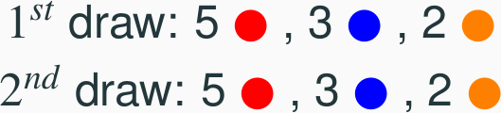

Slide 14
$$Prob(2^{nd} chip B|1^{st} chip B)=\frac{3}{10}=0.3$$

Slide 15
Sampling with replacement (cont.)
Suppose you actually pulled an orange chip in the first draw. If drawing with replacement, what is the probability of drawing a blue chip in the second draw?

Slide 17
Sampling with replacement (cont.)
Suppose you actually pulled an orange chip in the first draw. If drawing with replacement, what is the probability of drawing a blue chip in the second draw?

Slide 19
$$Prob(2^{nd} chip B|1^{st} chip O)=\frac{3}{10}=0.3$$

Slide 20
Sampling with replacement (cont.)
If drawing with replacement, what is the probability of drawing two blue chips in a row?

Slide 22
Sampling with replacement (cont.)
If drawing with replacement, what is the probability of drawing two blue chips in a row?

Slide 24
$$ Prob(1^{st} \text{ chip } B) \cdot Prob(2^{nd} \text{ chip } B | 1^{st} \text{ chip } B) \\= 0.3 \times 0.3 = 0.3^2 = 0.09 $$

Slide 25
Sampling with replacement (cont.)
When drawing with replacement, probability of the second chip being blue does not depend on the color of the first chip since whatever we draw in the first draw gets put back in the bag.
$$Prob(B|B)=Prob(B|O)$$
In addition, this probability is equal to the probability of drawing a blue chip in the first draw, since the composition of the bag never changes when sampling with replacement.
$$Prob(B|B)=Prob(B)$$
When drawing with replacement, draws are independent.

Slide 26
Sampling without replacement
When drawing without replacement you do not put back what you just drew.
Suppose you pulled a blue chip in the first draw. If drawing without replacement, what is the probability of drawing a blue chip in the second draw?

Slide 27
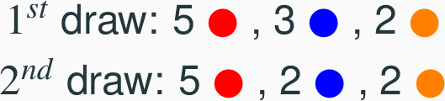

Slide 28
Sampling without replacement
When drawing without replacement you do not put back what you just drew.
Suppose you pulled a blue chip in the first draw. If drawing without replacement, what is the probability of drawing a blue chip in the second draw?

Slide 30
$$Prob(2^{nd} chip B|1^{st} chip B)=\frac{2}{9}=0.22$$

Slide 31
Sampling without replacement
When drawing without replacement you do not put back what you just drew.
If drawing without replacement, what is the probability of drawing two blue chips in a row?

Slide 33
Sampling without replacement
When drawing without replacement you do not put back what you just drew.
If drawing without replacement, what is the probability of drawing two blue chips in a row?

Slide 35
$$ Prob(1^{st} \text{ chip } B) \cdot Prob(2^{nd} \text{ chip } B | 1^{st} \text{ chip } B) \\ = 0.3 \times 0.22 = 0.066 $$

Slide 36
Sampling without replacement (cont.)
When drawing without replacement, the probability of the second chip being blue given the first was blue is not equal to the probability of drawing a blue chip in the first draw since the composition of the bag changes with the outcome of the first draw.
$$Prob(B|B)≠Prob(B)$$
When drawing without replacement, draws are not independent.
This is especially important to take note of when the sample sizes are small. If we were dealing with, say, 10,000 chips in a (giant) bag, taking out one chip of any color would not have as big an impact on the probabilities in the second draw.

Slide 37
Practice
In most card games cards are dealt without replacement. What is the probability of being dealt an ace and then a 3? Choose the closest answer.
0.0045
0.0059
0.0060
0.1553

Slide 38
Practice
In most card games cards are dealt without replacement. What is the probability of being dealt an ace and then a 3? Choose the closest answer.
0.0045
0.0059
0.0060
0.1553
$$P(ace then 3)=\frac{4}{52}×\frac{4}{51}≈0.0060$$

Slide 39
Random variables

Slide 40
Random variables
A random variable is a numeric quantity whose value depends on the outcome of a random event
We use a capital letter, like $X$, to denote a random variable
The values of a random variable are denoted with a lowercase letter, in this case $x$
We write this as $P(X=x)$

Slide 41
Random variables
A random variable is a numeric quantity whose value depends on the outcome of a random event
We use a capital letter, like $X$, to denote a random variable
The values of a random variable are denoted with a lowercase letter, in this case $x$
We write this as $P(X=x)$
There are two types of random variables:
Discrete random variables often take only integer values
Example: Number of credit hours, Difference in number of credit hours this term vs last
Continuous random variables take real (decimal) values
Example: Cost of books this term, Difference in cost of books this term vs last

Slide 42
Expectation
We are often interested in the average outcome of a random variable.
We call this the expected value, or mean, and it is a weighted average of the possible outcomes
$$μ=E(X)=\sum_{i=1}^{k}{x_{i}} P(X=x_{i})$$

Slide 43
Expected value of a discrete random variable
In a game of cards you win $1 if you draw a heart, $5 if you draw an ace (including the ace of hearts), $10 if you draw the king of spades and nothing for any other card you draw. Write the probability model for your winnings, and calculate your expected winning.

Slide 44
Event | $X$ | $P(X)$ | $X P(X)$
Heart (not ace) | $1$ | 12/52 | 12/52
Ace | $5$ | 4/52 | 20/52
King of spades | $10$ | 1/52 | 10/52
All else | $0$ | 35/52 | 0

Slide 45
Expected value of a discrete random variable
Event | $X$ | $P(X)$ | $X P(X)$
Heart (not ace) | $1$ | 12/52 | 12/52
Ace | $5$ | 4/52 | 20/52
King of spades | $10$ | 1/52 | 10/52
All else | $0$ | 35/52 | 0
Total |  |  | $E[X]=42/52≈0.81$

Slide 46
Expected value of a discrete random variable (cont.)
Below is a visual representation of the probability distribution of winnings from this game:

Slide 47
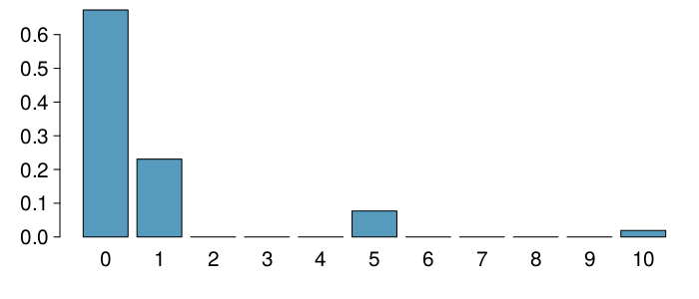

Slide 48
Variability in random variables
We are also often interested in the variability in the values of a random variable.
$$ \sigma^2 = Var(X) = \sum_{i = 1}^k \left(x_i - E(X)\right)^2 P(X = x_i)\\ \;\\ \sigma = SD(X) = \sqrt{Var(X)} $$

Slide 49
Variability of a discrete random variable
For the previous card game example, how much would you expect the winnings to vary from game to game?

Slide 50
$X$ | $P(X)$ | $X P(X)$ | $(X−E[X])^{2}$ | $P(X)⋅(X−E[X])^{2}$
1 | 12/52 | 1 x 12/52 = 12/52 | $(1-0.81)^2 = 0.0361 | 12/52 x 0.0361 = 0.0083
5 | 4/52 | 5 x 4/52 = 20/52 | $(5-0.81)^2 = 17.5561 | 4/52 x 17.5561 = 1.3505
10 | 1/52 | 10 x 1/52 = 10/52 | $(10-0.81)^2 = 84.4561 | 1/52 x 84.0889 = 1.6242
0 | 35/52 | 0 x 35/52 = 0 | $(0-0.81)^2 = 0.6561 | 35/52 x 0.6561 = 0.4416
 |  | $E[X]=0.81$

Slide 51
Variability of a discrete random variable
For the previous card game example, how much would you expect the winnings to vary from game to game?

Slide 52
$X$ | $P(X)$ | $X P(X)$ | $(X−E[X])^{2}$ | $P(X)⋅(X−E[X])^{2}$
1 | 12/52 | 1 x 12/52 = 12/52 | $(1-0.81)^2 = 0.0361 | 12/52 x 0.0361 = 0.0083
5 | 4/52 | 5 x 4/52 = 20/52 | $(5-0.81)^2 = 17.5561 | 4/52 x 17.5561 = 1.3505
10 | 1/52 | 10 x 1/52 = 10/52 | $(10-0.81)^2 = 84.4561 | 1/52 x 84.0889 = 1.6242
0 | 35/52 | 0 x 35/52 = 0 | $(0-0.81)^2 = 0.6561 | 35/52 x 0.6561 = 0.4416
 |  | $E[X]=0.81$ |  | $V[X]=3.4246$
 |  |  |  | $SD(X)=\sqrt{3.4246}=1.85$

Slide 53
Variability: the R way
We could also do all of this in R, and it’s easier: no tracking decimals, no computations!
x <- c(1, 5, 10, 0) pX <- c(12/52, 4/52, 1/52, 35/52) var <- pX * (x - sum(x * pX))^2 var
## [1] 0.008534365 1.351957214 1.624971552 0.439093081
sum(var)
## [1] 3.424556

Slide 54
Linear combinations of random variables
A linear combination of random variables $X$ and $Y$ is given by
$$aX+bY$$
where $a$ and $b$ are some fixed numbers.

Slide 55
Linear combinations of random variables
A linear combination of random variables $X$ and $Y$ is given by
$$aX+bY$$
where $a$ and $b$ are some fixed numbers.
The average value of a linear combination of random variables is given by
$$E(aX+bY)=a×E(X)+b×E(Y)$$

Slide 56
Calculating the expectation of a linear combination
On average you take 10 minutes for each statistics homework problem and 15 minutes for each chemistry homework problem. This week you have 5 statistics and 4 chemistry homework problems assigned. What is the total time you expect to spend on statistics and physics homework for the week?

Slide 57
Calculating the expectation of a linear combination
On average you take 10 minutes for each statistics homework problem and 15 minutes for each chemistry homework problem. This week you have 5 statistics and 4 chemistry homework problems assigned. What is the total time you expect to spend on statistics and physics homework for the week?
$$\begin{matrix}E(S+S+S+S+S+C+C+C+C) & =5×E(S)+4×E(C) \\ & =5×10+4×15 \\ & =50+60 \\ & =110 min \end{matrix}$$

Slide 58
Variability in linear combinations of random variables
The variability of a linear combination of two independent random variables is calculated as
$$V(aX+bY)=a^{2}×V(X)+b^{2}×V(Y)$$
The standard deviation of the linear combination is the square root of the variance.
If the random variables are not independent, the variance calculation gets a little more complicated and is beyond the scope of this course.

Slide 59
Calculating the variance of a linear combination
The standard deviation of the time you take for each statistics homework problem is 1.5 minutes, and it is 2 minutes for each chemistry problem. What is the standard deviation of the time you expect to spend on statistics and physics homework for the week if you have 5 statistics and 4 chemistry homework problems assigned? Suppose that the time it takes to complete each problem is independent of another.

Slide 60
Calculating the variance of a linear combination
The standard deviation of the time you take for each statistics homework problem is 1.5 minutes, and it is 2 minutes for each chemistry problem. What is the standard deviation of the time you expect to spend on statistics and physics homework for the week if you have 5 statistics and 4 chemistry homework problems assigned? Suppose that the time it takes to complete each problem is independent of another.
V(S+S+S+S+S+C+C+C)=V(S)+V(S)+V(S)+V(S)+==V(S)+V(C)+V(C)+V(C)+V(C)=5×V(S)+4×V(C)=5×1.52+4×22=27.25

Slide 61
Calculating Variance: the R way
5 * 1.5^2 + 4 * 2^2
## [1] 27.25

Slide 62
Practice
A casino game costs $5 to play. If the first card you draw is red, then you get to draw a second card (without replacement). If the second card is the ace of clubs, you win $500. If not, you don’t win anything, i.e. lose your $5. What is your expected profits/losses from playing this game? Remember: profit/loss = winnings - cost.
A profit of 5 cents
A loss of 10 cents
A loss of 25 cents
A loss of 30 cents

Slide 63
Practice
A casino game costs $5 to play. If the first card you draw is red, then you get to draw a second card (without replacement). If the second card is the ace of clubs, you win $500. If not, you don’t win anything, i.e. lose your $5. What is your expected profits/losses from playing this game? Remember: profit/loss = winnings - cost.
$$ \text{A profit of 5 cents}\qquad \text{A loss of 25 cents}\\ \text{A loss of 10 cents} \qquad \text{A loss of 30 cents} $$

Slide 64
Event | Win | Profit:$X$ | $P(X)$ | $X⋅P(X)$
Red, A{$♣$} | 500 | $500−5=495$ | $\frac{26}{52}⋅\frac{1}{51}=0.0098$ | $495×0.0098=4.851$
Other | 0 | $0−5=−5$ | $1−0.0098=0.9902$ | $−5×0.9902=−4.951$
 |  |  |  | $E(X)=−0.1$

Slide 65
Fair game
A fair game is defined as a game that costs as much as its expected payout, i.e. expected profit is 0.

Slide 66
Fair game
A fair game is defined as a game that costs as much as its expected payout, i.e. expected profit is 0.
Do you think casino games in Vegas cost more or less than their expected payouts?
If those games cost less than their expected payouts, it would mean that the casinos would be losing money on average, and hence they wouldn’t be able to pay for all this:

Slide 67
Simplifying random variables
Random variables do not work like normal algebraic variables:
$$X+X≠2X$$

Slide 68
Simplifying random variables
Random variables do not work like normal algebraic variables:
$$X+X≠2X$$
$$\begin{matrix}E(X+X) & =E(X)+E(X) \\ & =2E(X) \\ & \\ E(2X) & =2E(X) \\ & \end{matrix}$$

Slide 69
Simplifying random variables (cont.)
$$ \begin{align*} Var(X + X) &= Var(X) + Var(X)~{\scriptsize \text{(assuming independence)}} \\ &= 2~Var(X) \\ &~ \\ Var(2X) &= 2^2~Var(X) \\ &= 4~Var(X) \end{align*} $$
So:
$$E(X+X)=E(2X), but Var(X+X)≠Var(2X)$$

Slide 70
Adding or multiplying?
A company has 5 Lincoln Town Cars in its fleet. Historical data show that annual maintenance cost for each car is on average $2,154 with a standard deviation of $132. What is the mean and the standard deviation of the total annual maintenance cost for this fleet?
Note that we have 5 cars each with the given annual maintenance cost $(X_{1}+X_{2}+X_{3}+X_{4}+X_{5})$, not one car that had 5 times the given annual maintenance cost $(5X)$.

Slide 71
Adding or multiplying?
$$\begin{matrix}E(X_{1}+X_{2}+X_{3}+X_{4}+X_{5}) & = & E(X_{1})+E(X_{2})+⋯+E(X_{5}) \\ & = & 5×E(X)=5×2,154=\$10,770 \\ Var(X_{1}+X_{2}+X_{3}+X_{4}+X_{5}) & = & Var(X_{1})+Var(X_{2})+⋯+Var(X_{5}) \\ & = & 5×V(X)=5×{132}^{2}=\$87,120 \\ SD(X_{1}+X_{2}+X_{3}+X_{4}+X_{5}) & = & \sqrt{87,120}=295.16\end{matrix}$$

Slide 72
The Binomial Distribution

Slide 73
Binomial Distribution
A very important discrete distribution is the binomial distribution, which results when we have:
a fixed number of trials $n$
only two outcomes possible in each trial
each trial is independent
the probability of a success is the same
Definition: the binomial distribution counts the number of successes in $n$ independent trials of an experiment with fixed probability of success $p$

Slide 74
Binomial Notation
$n$ - the fixed number of trials/experiments
$x$ - a specific number of successes we are interested in (must be between $0$ and $n$, obviously)
$p$ - probability of success in any one trial/experiment
$P(X)$ - the probability of getting exactly $x$ successes in $n$ trials

Slide 75
Things To Be Cautious Of
make sure that $x$ and $p$ are referring to the same event as success
make sure that all trials/experiments are independent
when sampling without replacement, make sure your total number of trials/experiments is small when compraed to population

Slide 76
Example 1
Suppose you have no idea how to answer the questions on a True/False test with 10 questions, and you decide to just flip a coin for each one. You then count how many questions you actually got correct.
$x=$ number of questions correct
$n=10$
$p=0.5$ (fair coin?)
trials are independent, since the coin flips have nothing to do with one another
In this situation, what is the probability of getting at least 6/10?

Slide 77
Example 2
According to Statistics Canada, as of the last census in 2016, 86.3% of Canadians between the ages of 25 and 64 have a completed high school diploma, or equivalent. If we randomly select 15 Canadians aged 25-64, what is the probability distribution of the number of sampled people who have completed a high school diploma?
Find the probability that at least 8 out of 15 randomly selected Canadians aged 25-64 will have such a diploma.

Slide 78
The Binomial Probability Formula
$$P(x)=\frac{n!}{(n−x)!x!}⋅p^{x}⋅(1−p)^{n−x}$$
Note that this probability formula is for one specific value of $x$. So if you are asked something involving multiple cases of $x$, you have to do multiple computations!
We will use R to compute these, as they are very, very tedious by hand.

Slide 79
Example 2
$n=15$
$p=0.863$
$x≥8$
Then:
sum( dbinom(8:15, 15, 0.863) )
## [1] 0.9996765
pbinom(q = 7, size = 15, prob = 0.863, lower.tail = FALSE)
## [1] 0.9996765
(Note: we’ll talk more about the $q=7$ in a couple of slides)

Slide 80
R Syntax for Computing Things with Binomials
There are two functions we will use: dbinom() and pbinom(). The d stands for distribution, and corresponds to the formula back two slides.
Example:
dbinom(x = 6, size = 10, prob = 0.5)
## [1] 0.2050781
This gives the probability of exactly six correct answers in ten trials with a 50/50 probability (Example 1).

Slide 81
R Syntax for Computing Things with Binomials
Example:
pbinom(q = 6, size = 10, prob = 0.5, lower.tail = TRUE)
## [1] 0.828125
This gives the probability of getting six or less correct answers in ten trials, again with a 50/50 probability (like Example 1).

Slide 82
R Syntax for Computing Things with Binomials
Example:
pbinom(q = 6, size = 10, prob = 0.5, lower.tail = FALSE)
## [1] 0.171875
This gives the probability of getting MORE THAN SIX correct answers in ten trials, again with a 50/50 probability (like Example 1).
Note: this is not “greater than or equal to”, it is strictly greater than. That is, if q = 6, this means {7, 8, 9, 10}, not {6, 7, 8, 9, 10}.

Slide 83
General R Syntax
pbinom(q = max or min number of successes, size = total number of trials, prob = probability of success, lower.tail = TRUE for q being max, FALSE for q being min) dbinom(x = number of successes interested in, size = total number of trials, prob = probability of success)

Slide 84
Continuous Distributions

Slide 85
Continuous distributions
Below is a histogram of the distribution of heights of US adults.
The proportion of data that falls in the shaded bins gives the probability that a randomly sampled US adult is between 180 cm and 185 cm (about 5’11" to 6’1").

Slide 86
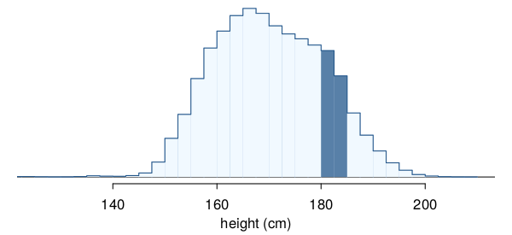

Slide 87
From histograms to continuous distributions
Since height is a continuous numerical variable, its probability density function is a smooth curve.

Slide 88
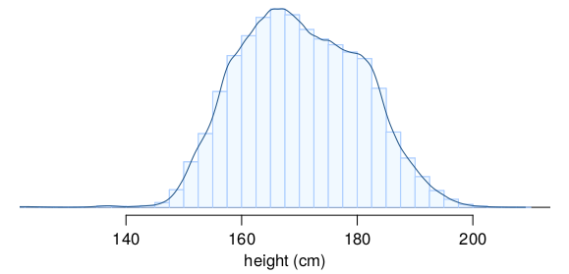

Slide 89
Probabilities from continuous distributions
Therefore, the probability that a randomly sampled US adult is between 180 cm and 185 cm can also be estimated as the shaded area under the curve.

Slide 90
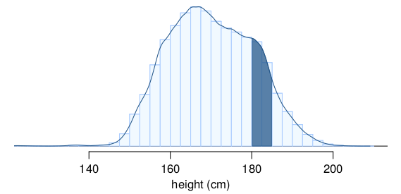

Slide 91
By definition…
Since continuous probabilities are estimated as “the area under the curve”, the probability of a person being exactly 180 cm (or any exact value) is defined as 0.

Slide 92
