Slide 1
Lecture 14

Slide 2
Geometric distribution

Slide 3
Milgram experiment
Stanley Milgram, a Yale University psychologist, conducted a series of experiments on obedience to authority starting in 1963.
Experimenter (E) orders the teacher (T), the subject of the experiment, to give severe electric shocks to a learner (L) each time the learner answers a question incorrectly.
The learner is actually an actor, and the electric shocks are not real, but a prerecorded sound is played each time the teacher administers an electric shock.

Slide 4
Milgram experiment (cont.)
These experiments measured the willingness of study participants to obey an authority figure who instructed them to perform acts that conflicted with their personal conscience.
Milgram found that about 65% of people would obey authority and give such shocks.
Over the years, additional research suggested this number is approximately consistent across communities and time.

Slide 5
Bernouilli random variables
Each person in Milgram’s experiment can be thought of as a trial.
A person is labeled a success if she refuses to administer a severe shock, and failure if she administers such shock.
Since only 35% of people refused to administer a shock, probability of success is $p=0.35$.
When an individual trial has only two possible outcomes, it is called a Bernoulli random variable.

Slide 6
Geometric distribution
Dr. Smith wants to repeat Milgram’s experiments but she only wants to sample people until she finds someone who will not inflict a severe shock. What is the probability that she stops after the first person?
$$P(1^{st} person refuses)=0.35$$

Slide 7
Geometric distribution
… the third person?
$$ P(1^{st}\text{ and }2^{nd}\text{ shock, }3^{rd}\text{ refuses}) = S ( 0.65) \times S (0.65) \times R (0.35) \\= 0.65^2 \times 0.35 \approx 0.15 $$

Slide 8
Geometric distribution
… the tenth person?
$$ P(\text{9 shock, } 10^{th}\text{ refuses}) = \underbrace{S (0.65) \times \cdots \times S (0.65)}_{9\text{ of these}} \times R (0.35) \\= 0.65^9 \times 0.35 \approx 0.0072 $$

Slide 9
Geometric distribution (cont.)
The Geometric distribution describes the waiting time until a success for independent and identically distributed (iid) Bernouilli random variables.
independence: outcomes of trials don’t affect each other
identical: the probability of success is the same for each trial

Slide 10
Geometric distribution (cont.)
Geometric probabilities: If $p$ represents probability of success, $(1−p)$ represents probability of failure, and $n$ represents number of independent trials $P(success on the n^{th} trial)=(1−p)^{n−1}p$.
Can we calculate the probability of rolling a 6 for the first time on the 6$​^{th}$ roll of a die using the geometric distribution? Note that what was a success (rolling a 6) and what was a failure (not rolling a 6) are clearly defined and one or the other must happen for each trial.}
no, on the roll of a die there are more than 2 possible outcomes
yes, why not

Slide 11
Geometric distribution (cont.)
Can we calculate the probability of rolling a 6 for the first time on the 6$​^{th}$ roll of a die using the geometric distribution? Note that what was a success (rolling a 6) and what was a failure (not rolling a 6) are clearly defined and one or the other must happen for each trial.}
no, on the roll of a die there are more than 2 possible outcomes
yes, why not
$$P(6 on the 6^{th} roll)={\left(\frac{5}{6}\right)}^{5}\left(\frac{1}{6}\right)≈0.067$$

Slide 12
Expected value
How many people is Dr. Smith expected to test before finding the first one that refuses to administer the shock?

Slide 13
Expected value
How many people is Dr. Smith expected to test before finding the first one that refuses to administer the shock?
The expected value, or the mean, of a geometric distribution is defined as $\frac{1}{p}$.
$$μ=\frac{1}{p}=\frac{1}{0.35}=2.86$$
Thus, we would expect her to test 2.86 people before finding the first one that refuses to administer the shock.
But how can she test a non-whole number of people?

Slide 14
Expected value and its variability
Mean and standard deviation of geometric distribution:
$$μ=\frac{1}{p} σ=\sqrt{\frac{1−p}{p^{2}}}$$
Going back to Dr. Smith’s experiment:
$$σ=\sqrt{\frac{1−p}{p^{2}}}=\sqrt{\frac{1−0.35}{{0.35}^{2}}}=2.3$$

Slide 15
Expected value and its variability
Going back to Dr. Smith’s experiment:
$$σ=\sqrt{\frac{1−p}{p^{2}}}=\sqrt{\frac{1−0.35}{{0.35}^{2}}}=2.3$$
Dr. Smith is expected to test 2.86 people before finding the first one that refuses to administer the shock, give or take 2.3 people.
These values only make sense in the context of repeating the experiment many many times.

Slide 16
Binomial Distribution

Slide 17
Binomial: Redux
We’ve already talked about the binomial once, but let’s revisit it a little more today, with some more details.

Slide 18
The Binomial Distribution
Suppose we randomly select four individuals to participate in the Milgram experiment. What is the probability that exactly 1 of them will refuse to administer the shock?

Slide 19
The Binomial Distribution
Let’s call these people Allen (A), Brittany (B), Caroline (C), and Damian (D). Each one of the four scenarios below will satisfy the condition of “exactly 1 of them refuses to administer the shock”:
Scenario 1: A (refuse) $×$ B (shock) $×$ C (shock) $×$ D (shock) = $0.35×{0.65}^{3}=0.096$.
Scenario 2: A (shock) $×$ B (refuse) $×$ C (shock) $×$ D (shock) = $0.65×0.35×{0.65}^{2}=0.096$.
Scenario 3: A (shock) $×$ B (shock) $×$ C (refuse) $×$ D (shock) = ${0.65}^{2}×0.35×0.65=0.096$.
Scenario 4: A (shock) $×$ B (shock) $×$ C (shock) $×$ D (refuse) = ${0.65}^{3}×0.35=0.096$.

Slide 20
The Binomial Distribution
Let’s call these people Allen (A), Brittany (B), Caroline (C), and Damian (D). Each one of the four scenarios below will satisfy the condition of “exactly 1 of them refuses to administer the shock”:
The probability of exactly one 1 of 4 people refusing to administer the shock is the sum of all of these probabilities.
$$0.0961+0.0961+0.0961+0.0961=4×0.0961=0.3844$$

Slide 21
The Binomial distribution
The question from the prior slide asked for the probability of given number of successes, $k$, in a given number of trials, $n,($k = 1$ success in $n=4$ trials), and we calculated this probability as
$$\# of scenarios ×P(single scenario)$$

Slide 22
The Binomial distribution
The question from the prior slide asked for the probability of given number of successes, $k$, in a given number of trials, $n,($k = 1$ success in $n=4$ trials), and we calculated this probability as
$$\# of scenarios ×P(single scenario)$$
$\# of scenarios$: there is a less tedious way to figure this out, we’ll get to that shortly…
$P(single scenario)=p^{k} (1−p)^{(n−k)}$
“probability of success to the power of number of successes, probability of failure to the power of number of failures”

Slide 23
The Binomial distribution
So the Binomial distribution describes the probability of having exactly $k$ successes in $n$ independent Bernouilli trials with probability of success $p$.

Slide 24
Counting the # of scenarios
Earlier we wrote out all possible scenarios that fit the condition of exactly one person refusing to administer the shock. If $n$ was larger and/or $k$ was different than 1, for example, $n=9$ and $k=2$:
RRSSSSSSS SRRSSSSSS … SSSSSSRRS SSSSSSSRR …
then writing out all possible scenarios would be incredibly tedious and prone to errors. Remember: the RR don’t have to be together. We have to figure out all the RSSR too, etc., etc.

Slide 25
Calculating the # of scenarios
The choose function is useful for calculating the number of ways to choose $k$ successes in $n$ trials.
$$\left({n \atop k}\right)=\frac{n!}{k!(n−k)!}$$
$k=1$, $n=4$: $\left({4 \atop 1}\right)=\frac{4!}{1!(4−1)!}=\frac{4×3×2×1}{1×(3×2×1)}=4$
$k=2$, $n=9$: $\left({9 \atop 2}\right)=\frac{9!}{2!(9−1)!}=\frac{9×8×7!}{2×1×7!}=\frac{72}{2}=36$
choose(9, 2)
## [1] 36

Slide 26
Calculating the # of scenarios
You can also do this on all scientific calculators, using the nCr button (or equivalent).

Slide 27
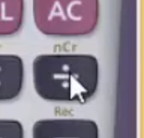

Slide 28
Properties of the choose function
Which of the following is false?
There are $n$ ways of getting 1 success in $n$ trials, $\left({n \atop 1}\right)=n$.
There is only 1 way of getting $n$ successes in $n$ trials, $\left({n \atop n}\right)=1$.
There is only 1 way of getting $n$ failures in $n$ trials, $\left({n \atop 0}\right)=1$.
There are $n−1$ ways of getting $n−1$ successes in $n$ trials, $\left({n \atop n−1}\right)=n−1$.

Slide 29
Properties of the choose function
Which of the following is false?
There are $n$ ways of getting 1 success in $n$ trials, $\left({n \atop 1}\right)=n$.
There is only 1 way of getting $n$ successes in $n$ trials, $\left({n \atop n}\right)=1$.
There is only 1 way of getting $n$ failures in $n$ trials, $\left({n \atop 0}\right)=1$.
There are $n−1$ ways of getting $n−1$ successes in $n$ trials, $\left({n \atop n−1}\right)=n−1$.

Slide 30
Binomial distribution (cont.)
Binomial probabilities
If $p$ represents probability of success, $(1−p)$ represents probability of failure, $n$ represents number of independent trials, and $k$ represents number of successes
$$P(k successes in n trials)=\left({n \atop k}\right) p^{k} (1−p)^{(n−k)}$$

Slide 31
Practice
Which of the following is not a condition that needs to be met for the binomial distribution to be applicable?
the trials must be independent
the number of trials, $n$, must be fixed
each trial outcome must be classified as a success or a failure
the number of desired successes, $k$, must be greater than the number of trials
the probability of success, $p$, must be the same for each trial

Slide 32
Practice
Which of the following is not a condition that needs to be met for the binomial distribution to be applicable?
the trials must be independent
the number of trials, $n$, must be fixed
each trial outcome must be classified as a success or a failure
the number of desired successes, $k$, must be greater than the number of trials
the probability of success, $p$, must be the same for each trial

Slide 33
Gallup Poll: Obesity in America
A 2012 Gallup survey suggests that 26.2% of Americans are obese. Among a random sample of 10 Americans, what is the probability that exactly 8 are obese?
pretty high?
pretty low?
Gallup: http://www.gallup.com/poll/160061/obesity-rate-stable-2012.aspx , January 23, 2013.

Slide 34
Gallup Poll: Obesity in America
A 2012 Gallup survey suggests that 26.2% of Americans are obese. Among a random sample of 10 Americans, what is the probability that exactly 8 are obese?
${0.262}^{8}×{0.738}^{2}$
$\left({8 \atop 10}\right)×{0.262}^{8}×{0.738}^{2}$
$\left({10 \atop 8}\right)×{0.262}^{8}×{0.738}^{2}$
$\left({10 \atop 8}\right)×{0.262}^{2}×{0.738}^{8}$

Slide 35
Gallup Poll: Obesity in America
A 2012 Gallup survey suggests that 26.2% of Americans are obese. Among a random sample of 10 Americans, what is the probability that exactly 8 are obese?
${0.262}^{8}×{0.738}^{2}$
$\left({8 \atop 10}\right)×{0.262}^{8}×{0.738}^{2}$
$\left({10 \atop 8}\right)×{0.262}^{8}×{0.738}^{2}=45×{0.262}^{8}×{0.738}^{2}=0.0005$
$\left({10 \atop 8}\right)×{0.262}^{2}×{0.738}^{8}$

Slide 36
The birthday problem
What is the probability that 2 randomly chosen people share a birthday?
Pretty low, $\frac{1}{365}≈0.0027$.

Slide 37
The birthday problem
What is the probability that 2 randomly chosen people share a birthday?
Pretty low, $\frac{1}{365}≈0.0027$.
What is the probability that at least 2 people out of 366 people share a birthday?
Exactly 1! (Excluding the possibility of a leap year birthday.)

Slide 38
The birthday problem (cont.)
What is the probability that at least 2 people (1 match) out of 121 people share a birthday?
Somewhat complicated to calculate, but we can think of it as the complement of the probability that there are no matches in 121 people.
$$\begin{matrix}P(no matches) & = & 1×\left(1−\frac{1}{365}\right)×\left(1−\frac{2}{365}\right)×⋯×\left(1−\frac{120}{365}\right)\end{matrix}$$

Slide 39
The birthday problem (cont.)
What is the probability that at least 2 people (1 match) out of 121 people share a birthday?
$$\begin{matrix}P(no matches) & = & \frac{365×364×⋯×245}{{365}^{121}} \\ & = & \frac{365!}{{365}^{121}×(365−121)!} \\ & = & \frac{121!×\left({365 \atop 121}\right)}{{365}^{121}}≈0 \\ P(at least 1 match) & ≈ & 1\end{matrix}$$

Slide 40
Expected value
A 2012 Gallup survey suggests that 26.2% of Americans are obese.
Among a random sample of 100 Americans, how many would you expect to be obese?

Slide 41
Expected value
A 2012 Gallup survey suggests that 26.2% of Americans are obese.
Among a random sample of 100 Americans, how many would you expect to be obese?
Easy enough, $100×0.262=26.2$.
Or more formally, $μ=np=100×0.262=26.2$.
But this doesn’t mean in every random sample of 100 people exactly 26.2 will be obese. In fact, that’s not even possible. In some samples this value will be less, and in others more. How much would we expect this value to vary?

Slide 42
Expected value and its variability
Mean and standard deviation of binomial distribution
$$μ=np σ=\sqrt{np(1−p)}$$
Going back to the obesity rate:
$$σ=\sqrt{np(1−p)}=\sqrt{100×0.262×0.738}≈4.4$$
We would expect 26.2 out of 100 randomly sampled Americans to be obese, with a standard deviation of 4.4.
Note: Mean and standard deviation of a binomial might not always be whole numbers, and that is alright, these values represent what we would expect to see on average.

Slide 43
Unusual observations
Using the notion that observations that are more than 2 standard deviations away from the mean are considered unusual and the mean and the standard deviation we just computed, we can calculate a range for the plausible number of obese Americans in random samples of 100.
$$26.2±(2×4.4)=(17.4,35)$$

Slide 44
Gallup Poll: Home Schooling
An August 2012 Gallup poll suggests that 13% of Americans think home schooling provides an excellent education for children. Would a random sample of 1,000 Americans where only 100 share this opinion be considered unusual?}
Yes
No

Slide 45
Gallup Poll: Home Schooling
$$\begin{matrix}μ & =np=1,000×0.13=130 \\ σ & =\sqrt{np(1−p)}=\sqrt{1,000×0.13×0.87}≈10.6\end{matrix}$$
Method 1: Range of usual observations: $130±2×10.6=(108.8,151.2)$ (100 is outside this range, so would be considered unusual)
Method 2: Z-score of observation: $Z=\frac{x−mean}{SD}=\frac{100−130}{10.6}=−2.83$ (100 is more than 2 SD below the mean, so would be considered unusual)
http://www.gallup.com/poll/156974/private-schools-top-marks-educating-children.aspx

Slide 46
Normal approximation to the binomial (Practice)
Go to https://gallery.shinyapps.io/dist_calc/ and choose Binomial coin experiment in the drop down menu on the left.
Set the number of trials to 20 and the probability of success to 0.15. Describe the shape of the distribution of number of successes.
Keeping $p$ constant at 0.15, determine the minimum sample size required to obtain a unimodal and symmetric distribution of number of successes. Please submit only one response per team.
Further considerations:
What happens to the shape of the distribution as $n$ stays constant and $p$ changes?
What happens to the shape of the distribution as $p$ stays constant and $n$ changes?

Slide 47
Distributions of number of successes
Hollow histograms of samples from the binomial model where $p=0.10$ and $n=10$, $30$, $100$, and $300$. What happens as $n$ increases?

Slide 48
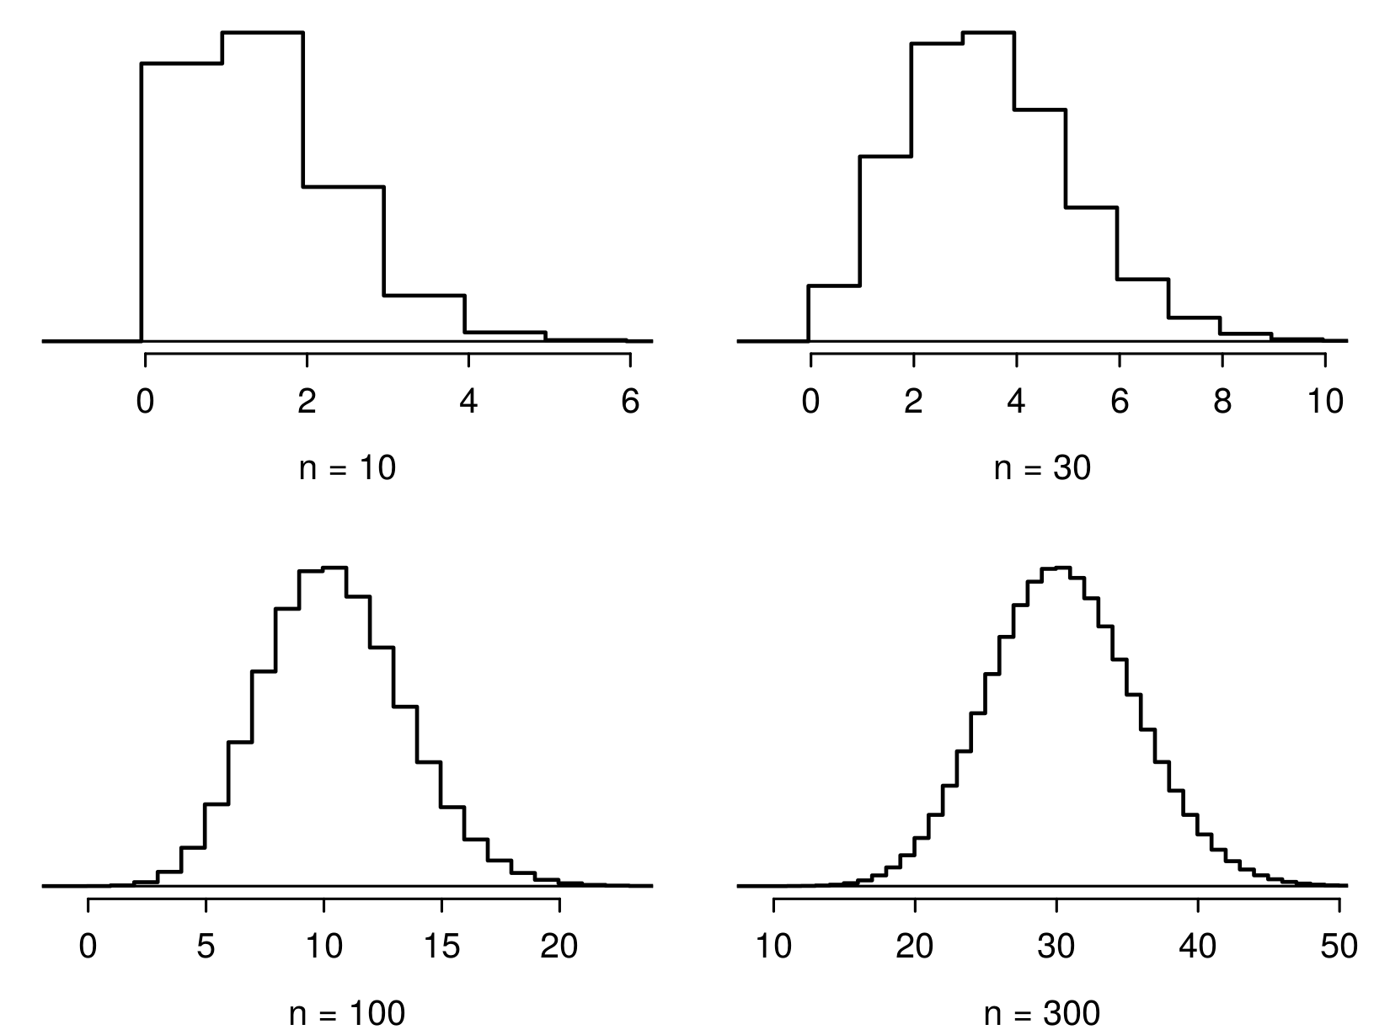

Slide 49
Low large is large enough?
The sample size is considered large enough if the expected number of successes and failures are both at least 10.
$$np≥10 and n(1−p)≥10$$

Slide 50
Practice
Below are four pairs of Binomial distribution parameters. Which distribution can be approximated by the normal distribution?
$n=100,p=0.95$
$n=25,p=0.45$
$n=150,p=0.05$
$n=500,p=0.015$

Slide 51
Practice
Below are four pairs of Binomial distribution parameters. Which distribution can be approximated by the normal distribution?
$n=100,p=0.95$
$n=25,p=0.45→25×0.45=11.25;25×0.55=13.75$
$n=150,p=0.05$
$n=500,p=0.015$

Slide 52
An analysis of Facebook users
A recent study found that “Facebook users get more than they give”. For example:
40% of Facebook users in our sample made a friend request, but 63% received at least one request
Users in our sample pressed the like button next to friends’ content an average of 14 times, but had their content “liked” an average of 20 times
Users sent 9 personal messages, but received 12
12% of users tagged a friend in a photo, but 35% were themselves tagged in a photo
Any guesses for how this pattern can be explained?

Slide 53
An analysis of Facebook users
A recent study found that ``Facebook users get more than they give". For example:
40% of Facebook users in our sample made a friend request, but 63% received at least one request
Users in our sample pressed the like button next to friends’ content an average of 14 times, but had their content “liked” an average of 20 times
Users sent 9 personal messages, but received 12
12% of users tagged a friend in a photo, but 35% were themselves tagged in a photo
Any guesses for how this pattern can be explained?
Power users contribute much more content than the typical user.
http://www.pewinternet.org/Reports/2012/Facebook-users/Summary.aspx

Slide 54
This study also found that approximately 25% of Facebook users are considered power users. The same study found that the average Facebook user has 245 friends. What is the probability that the average Facebook user with 245 friends has 70 or more friends who would be considered power users? Note any assumptions you must make.
We are given that $n=245,p=0.25$, and we are asked for the probability $P(K≥70)$. To proceed, we need independence, which we’ll assume but could check if we had access to more Facebook data.

Slide 55
We are given that $n=245,p=0.25$, and we are asked for the probability $P(K≥70)$. To proceed, we need independence, which we’ll assume but could check if we had access to more Facebook data.
$$\begin{matrix}P(X≥70) & =P(K=70 or K=71 or K=72 or ⋯ or K=245) \\ & =P(K=70)+P(K=71)+P(K=72)+⋯+P(K=245)\end{matrix}$$
This seems like an awful lot of work…

Slide 56
Could Use R …
sum(dbinom(x = 70:245, size = 245, prob = 0.25))
## [1] 0.112763
pbinom(q = 69, size = 245, prob = 0.25, lower.tail = FALSE)
## [1] 0.112763

Slide 57
Normal approximation to the binomial
When the sample size is large enough, the binomial distribution with parameters $n$ and $p$ can be approximated by the normal model with parameters $μ=np$ and $σ=\sqrt{np(1−p)}$.
In the case of the Facebook power users, $n=245$ and $p=0.25$.
$$μ=245×0.25=61.25 σ=\sqrt{245×0.25×0.75}=6.778$$
$Bin(n=245,p=0.25)≈N(μ=61.25,σ=6.778)$.

Slide 58
Normal approximation to the binomial
In the case of the Facebook power users, $n=245$ and $p=0.25$.
$$μ=245×0.25=61.25 σ=\sqrt{245×0.25×0.75}=6.778$$
$Bin(n=245,p=0.25)≈N(μ=61.25,σ=6.778)$.

Slide 59
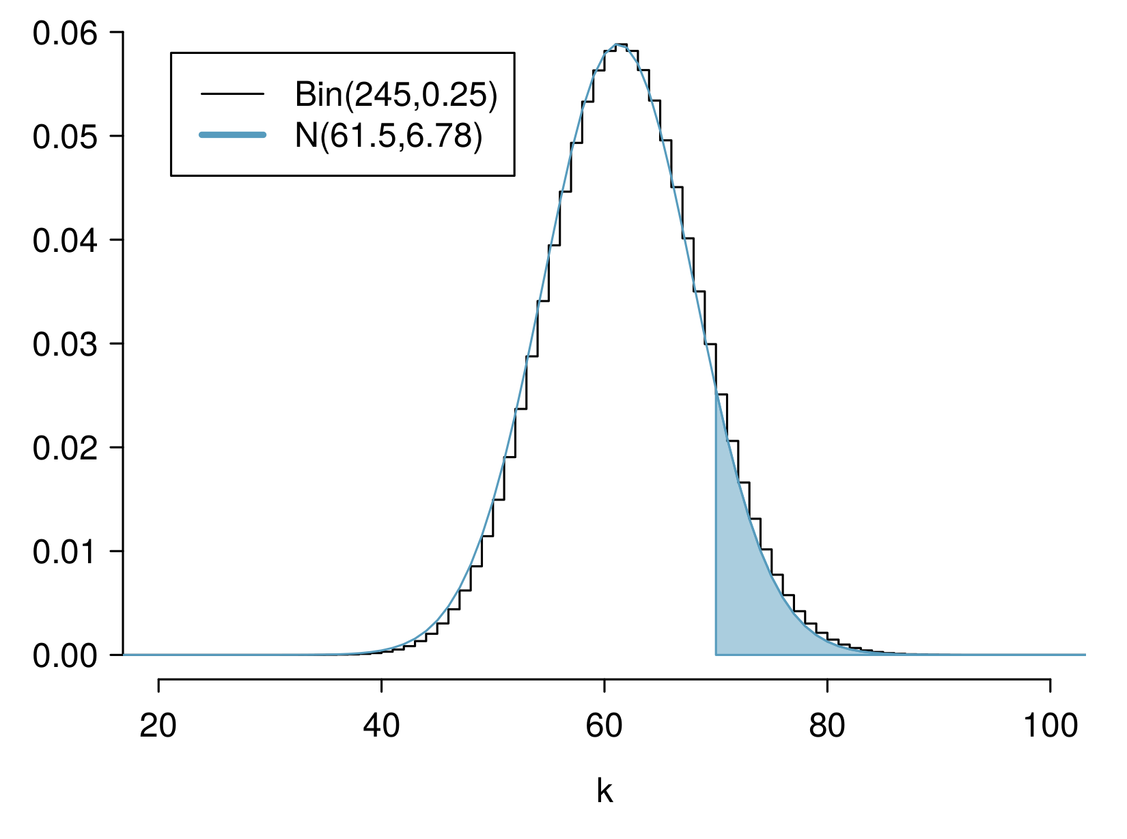

Slide 60
Computing the Approximation
What is the probability that the average Facebook user with 245 friends has 70 or more friends who would be considered power users?
$$\begin{matrix}Z & =\frac{obs−mean}{SD}=\frac{70−61.25}{6.778} \\ & =1.29094 \\ P(Z>1.29094) & =1−0.90164 \\ & =0.09836\end{matrix}$$

Slide 61
Computing the Approximation
What is the probability that the average Facebook user with 245 friends has 70 or more friends who would be considered power users?
But where did this $P(Z>1.29)$ answer come from? R again!
$$\begin{matrix}Z & =\frac{obs−mean}{SD}=\frac{70−61.25}{6.778} \\ & =1.29094 \\ P(Z>1.29094) & =1−0.90164 \\ & =0.09836\end{matrix}$$

Slide 62
Computing Normal Probabilities
Just like we did for pbinom() and dbinom(), we can do for pnorm() and dnorm(). You saw this in workshop last week.
pnorm(1.290964, lower.tail = FALSE)
## [1] 0.09835808

Slide 63
This seems … bad
We know the exact probability, done using pbinom(), is 0.1128. So why is this “approximation” giving an answer of 0.09836?

Slide 64
This seems … bad
We know the exact probability, done using pbinom(), is 0.1128. So why is this “approximation” giving an answer of 0.09836?

Slide 66
“Correction for Continuity”
The normal approximation to the binomial can be a little rough. There is a correction for continuity which can be used instead:
The cutoff values for the lower end of a shaded region should be reduced by 0.5
The cutoff values for the upper end should be increased by 0.5.
Since we are doing a “greater than” probability, the lower end of the shaded region is our relevant object, so we reduce.

Slide 67
Computing Normal Probabilities
$$\begin{matrix}Z & =\frac{obs−mean}{SD}=\frac{(70−0.5)−61.25}{6.778} \\ & =1.217173 \\ P(Z>1.217173) & =1−0.8882308 \\ & =0.1117692\end{matrix}$$
pnorm(1.217173, lower.tail = FALSE)
## [1] 0.1117692
That’s much better!

