Slide 1
Lecture 15

Slide 2
Inverse Normal Problems

Slide 3
The Inverse Problem
As we’ve seen in the previous, we often need to take $Z$-scores and find probabilities from them. Sometimes this is in a normal problem, sometimes an approximation, and so on.
What if you wanted to go backward? What would this look like?

Slide 4
Inverse Problem Statement
What if I told you “the probability of this event happening is 0.5”. What would the $Z$-score of such a setup be?
$$P(Z≤z_{0})=0.5$$
What’s the unknown here? $z_{0}$!

Slide 5
How do we solve for $z_{0}$?
trial and error?
use tables?
use R!

Slide 6
Using R to Find $z_{0}$
qnorm(p = 0.5, mean = 0, sd = 1, lower.tail = TRUE)
## [1] 0
Does this make sense? This is saying that $z_{0}=0$ has probability to its left of 0.5.
pnorm(q = 0, mean = 0, sd = 1, lower.tail = TRUE)
## [1] 0.5

Slide 7
Checking Again
x <- seq(from = -3, to = 3, by = 0.01) plot(x, dnorm(x), type = "l", xlab = "Z") abline(h = 0) abline(v = 0, col = "red")

Slide 8
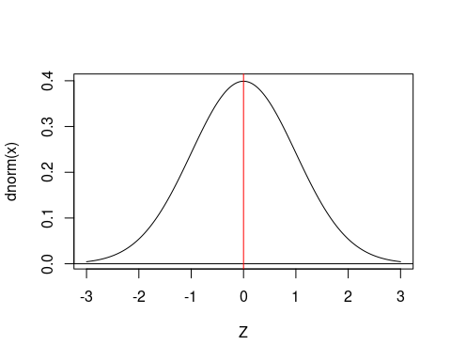

Slide 9
Practice
What value of $z_{0}$ has $P(−z_{0}≤Z≤z_{0})=0.3$?

Slide 10
Practice
What value of $z_{0}$ has $P(−z_{0}≤Z≤z_{0})=0.3$?

Slide 11
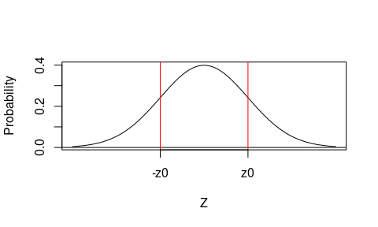

Slide 12
So what do we actually need to run?

Slide 13
Practice
qnorm(p = 0.15, mean = 0, sd = 1, lower.tail = TRUE)
## [1] -1.036433
This is -z0, because we used 0.15 area to the left, and lower.tail = TRUE.
qnorm(p = 0.15, mean = 0, sd = 1, lower.tail = FALSE)
## [1] 1.036433
And this is $z_{0}$, because lower.tail = FALSE.

Slide 14
More Practice
We’re now going to solve a series of problems in all the variations of this that we can do.

Slide 15
Problem Type 1: Simple Left
What value of $z_{0}$ has $P(−2≤Z≤z_{0})=0.7$?

Slide 16
Problem Type 2: Simple Right
What value of $z_{0}$ has $P(−z_{0}≤Z≤1.0)=0.4$ ?

Slide 17
Problem Type 3: Symmetric, known
What value of $z_{0}$ has $P(−z_{0}≤Z≤z_{0})=0.4$ ?

Slide 18
Problem Type 4: Symmetric, Indirect information
If the region from $−z_{0}$ to $z_{0}$ is 90% of the area under a standard normal curve, find $z_{0}$.

Slide 19
Problem Type 5: Not Symmetric, known
What value of $z_{0}$ has $P(−2⋅z_{0}≤Z≤z_{0})=0.6$ ?

Slide 20
Problem Type 6: Not Symmetric, Indirect information
If the 90th percentile of your distribution is equal to 11, and the 5th percentile is equal to 4, find $μ$ and $σ$.

