Slide 1
MATH 1051H-A: Lecture #06

Slide 2
Considering Categorical Data

Slide 3
Contingency Tables
A table that summarizes data for two categorical variables is called a contingency table.
The contingency table below shows the distribution of students’ genders and whether or not they are looking for a spouse while in college.
looking for spouse
No
Yes
Total
gender
Female
86
51
137
Male
52
18
70
Total
138
69
207

Slide 4
Bar Plots
A bar plot is a common way to display a single categorical variable. A bar plot where proportions instead of frequencies are shown is called a relative frequency bar plot.

Slide 5
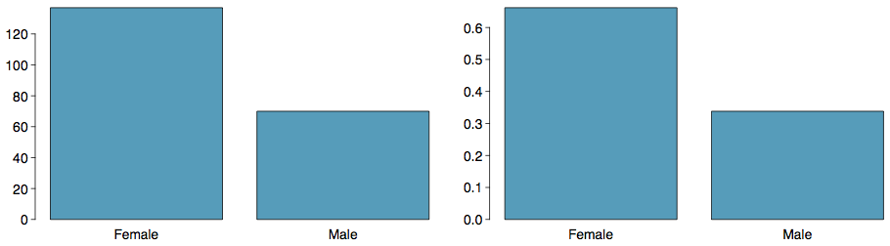

Slide 6
How are bar plots different than histograms? Bar plots are used for displaying distributions of categorical variables, while histograms are used for numerical variables. The x-axis in a histogram is a number line, hence the order of the bars cannot be changed, while in a bar plot the categories can be listed in any order (though some orderings make more sense than others, especially for ordinal variables.)

Slide 7
Choosing the Appropriate Proportion
Does there appear to be a relationship between gender and whether the student is looking for a spouse in college?
looking for spouse
No
Yes
Total
gender
Female
86
51
137
Male
52
18
70
Total
138
69
207
To answer this question we examine the row proportions:
% Females looking for a spouse: 51 / 137 ~ 0.37
% Males looking for a spouse: 18 / 70 ~ 0.26

Slide 8
Segmented Bar and Mosaic Plots
What are the differences between the three visualizations shown below?

Slide 9
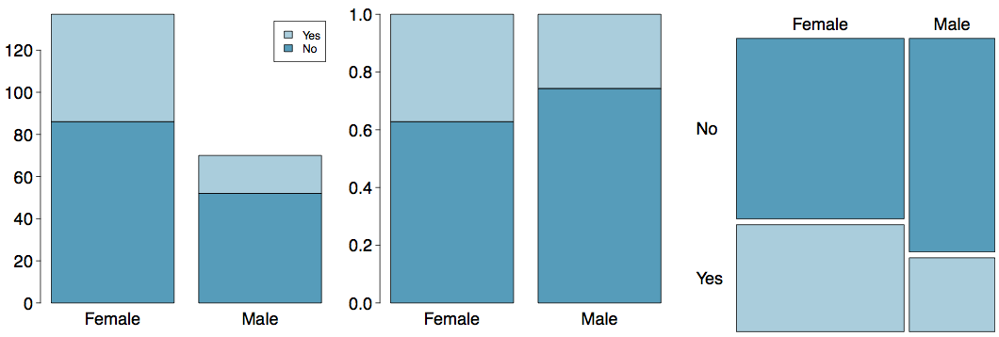

Slide 10
Pie Charts
Can you tell which order encompasses the lowest percentage of mammal species?
http://www.bucknell.edu/msw3

Slide 11
Comparing Numerical Data Across Groups
Does there appear to be a relationship between class year and the number of clubs students are in?

Slide 12
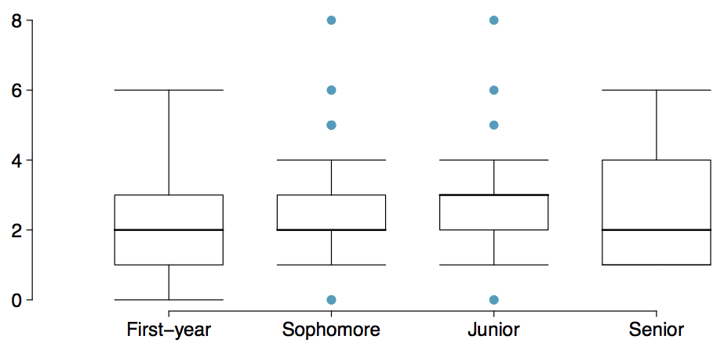

Slide 13
Defining Probability

Slide 14
Note
We will definitely not finish these notes today. This will spill into Friday, and possibly next week. We are done Chapter 2 of the 4th edition of the textbook for now, though.

Slide 15
Random processes
A random process is a situation in which we know what outcomes could happen, but we don’t know which particular outcome will happen.
Examples: coin tosses, die rolls, iTunes shuffle, whether the stock market goes up or down tomorrow, etc.
It can be helpful to model a process as random even if it is not truly random.
http://www.cnet.com.au/itunes-just-how-random-is-random-339274094.htm

Slide 16
Probability
There are several possible interpretations of probability but they (almost) completely agree on the mathematical rules probability must follow.
$P(A)$ = Probability of event A
$0≤P(A)≤1$

Slide 17
Probability: Frequentist
Frequentist interpretation:
The probability of an outcome is the proportion of times the outcome would occur if we observed the random process an infinite number of times.
relies on a “multiverse” concept for most problems, “if”

Slide 18
Probability: Bayesian
Bayesian interpretation:
A Bayesian interprets probability as a subjective degree of belief: For the same event, two separate people could have different viewpoints and so assign different probabilities.
Largely popularized by revolutionary advance in computational technology and methods during the last twenty years.

Slide 19
Practice
Which of the following events would you be most surprised by?
exactly 3 heads in 10 coin flips
exactly 3 heads in 100 coin flips
exactly 3 heads in 1000 coin flips

Slide 20
Practice
Which of the following events would you be most surprised by?
exactly 3 heads in 10 coin flips
exactly 3 heads in 100 coin flips
exactly 3 heads in 1000 coin flips

Slide 21
Law of large numbers
The Law of large numbers states that as more observations are collected, the proportion of occurrences with a particular outcome, ${\hat{p}}_{n}$, converges to the probability of that outcome, $p$.

Slide 22
Law of large numbers (cont.)
When tossing a fair coin, if heads comes up on each of the first 10 tosses, what do you think the chance is that another head will come up on the next toss? 0.5, less than 0.5, or more than 0.5?

Slide 24
Law of large numbers (cont.)
When tossing a fair coin, if heads comes up on each of the first 10 tosses, what do you think the chance is that another head will come up on the next toss? 0.5, less than 0.5, or more than 0.5?

Slide 26
Law of large numbers (cont.)

Slide 28
* The probability is still 0.5, or there is still a 50% chance that another head will come up on the next toss.
$$P(H{ on 11}^{th} toss)=P(T{ on 11}^{th} toss)=0.5$$
* The coin is not “due” for a tail. * The common misunderstanding of the LLN is that random processes are supposed to compensate for whatever happened in the past; this is just not true and is also called the gambler’s fallacy (or law of averages.

Slide 29
Disjoint and non-disjoint outcomes
Disjoint (mutually exclusive) outcomes: Cannot happen at the same time.
The outcome of a single coin toss cannot be a head and a tail.
A student both cannot fail and pass a class.
A single card drawn from a deck cannot be an ace and a queen.

Slide 30
Disjoint and non-disjoint outcomes
Disjoint (mutually exclusive) outcomes: Cannot happen at the same time.
The outcome of a single coin toss cannot be a head and a tail.
A student both cannot fail and pass a class.
A single card drawn from a deck cannot be an ace and a queen.
Non-disjoint outcomes: Can happen at the same time.
A student can get an A in Stats and A in Econ in the same semester.

Slide 31
Union of non-disjoint events
What is the probability of drawing a jack or a red card from a well shuffled full deck?

Slide 32
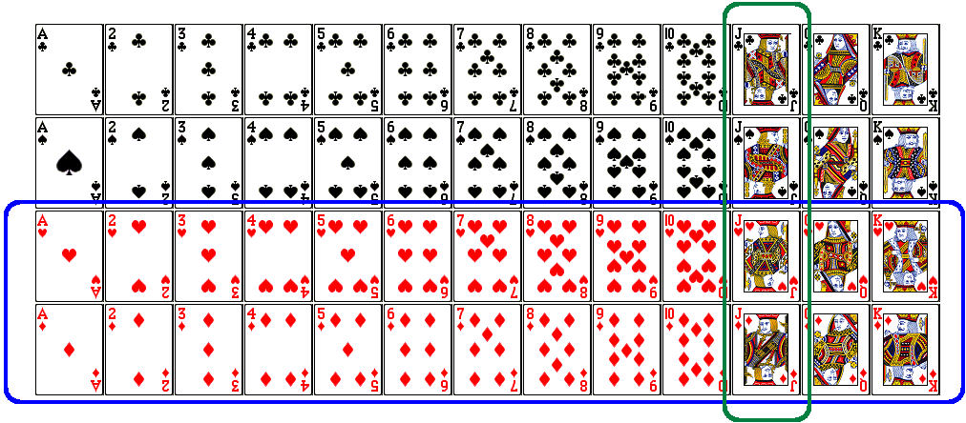

Slide 33
$$\begin{matrix}P(jack or red) & =P(jack)+P(red)−P(jack and red) \\ & =\frac{4}{52}+\frac{26}{52}−\frac{2}{52}=\frac{28}{52}\end{matrix}$$
Figure from http://www.milefoot.com/math/discrete/counting/cardfreq.htm

Slide 34
Practice
What is the probability that a randomly sampled student thinks marijuana should be legalized or they agree with their parents’ political views?

Slide 35
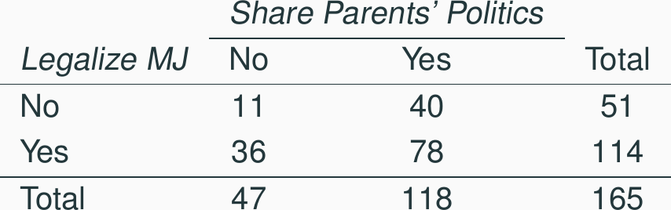

Slide 36
$\frac{40+36−78}{165}$
$\frac{114+118−78}{165}$
$\frac{78}{165}$
$\frac{78}{188}$

Slide 37
Practice
What is the probability that a randomly sampled student thinks marijuana should be legalized or they agree with their parents’ political views?

Slide 39
$\frac{40+36−78}{165}$
$\frac{114+118−78}{165}$
$\frac{78}{165}$
$\frac{78}{188}$

Slide 40
Recap
General addition rule $P(A or B)=P(A)+P(B)−P(A and B)$
For disjoint events $P(A and B)=0$, so the above formula simplifies to $P(A or B)=P(A)+P(B)$.

Slide 41
Probability distributions
A probability distribution lists all possible events and the probabilities with which they occur.
The probability distribution for the gender of one child:

Slide 42
Event | Male | Female
Probability | 0.5 | 0.5

Slide 43
Probability distributions
A probability distribution lists all possible events and the probabilities with which they occur.
Rules for probability distributions:
The events listed must be disjoint
Each probability must be between 0 and 1
The probabilities must total 1

Slide 44
Probability distributions
A probability distribution lists all possible events and the probabilities with which they occur.
The probability distribution for the genders of two children:

Slide 45
Event | MM | FF | MF | FM
Probability | 0.25 | 0.25 | 0.25 | 0.25

Slide 46
Practice
In a survey, 52% of respondents said they like pizza. What is the probability that a randomly selected respondent from this sample is a pizza hater.
0.48
more than 0.48
less than 0.48
cannot calculate using only the information given

Slide 47
Practice
In a survey, 52% of respondents said they like pizza. What is the probability that a randomly selected respondent from this sample is a pizza hater.
0.48
more than 0.48
less than 0.48
cannot calculate using only the information given
More: If the only two states people can be in are pizza likers and pizza haters, then the first option (1) is possible. However, it is also possible there are people who are ambivalent about pizza, or love pizza (more than like?), or who have never eaten pizza! The only answer we can eliminate is (b), because it is impossible by the rules of probability.

Slide 48
Sample space and complements
The sample space is the collection of all possible outcomes of a trial (or experiment).
A couple has one child, what is the sample space for the gender of this child? $S=\{M,F\}$
A couple has two children, what is the sample space for the gender of these children? $S=$

Slide 49
Sample space and complements
The sample space is the collection of all possible outcomes of a trial (or experiment).
A couple has one child, what is the sample space for the gender of this child? $S=\{M,F\}$
A couple has two children, what is the sample space for the gender of these children? $S=\{MM,FF,FM,MF\}$

Slide 50
Sample space and complements
The sample space is the collection of all possible outcomes of a trial (or experiment).
A couple has one child, what is the sample space for the gender of this child? $S=\{M,F\}$
A couple has two children, what is the sample space for the gender of these children? $S=\{MM,FF,FM,MF\}$

Slide 51
Sample space and complements
Complementary events are two mutually exclusive events whose probabilities that add up to 1.
A couple has one child. If we know that the child is not a boy, what is gender of this child? $\{M,F\}$. Male and female are complementary outcomes.
A couple has two children, if we know that they are not both female, what are the possible gender combinations for these children? $\{MM,FF,FM,MF\}$

Slide 52
Independence
Two processes are said to be independent of one another if knowing the outcome of one provides no useful information about the outcome of the other.
Knowing that the coin landed on a head on the first toss does not provide any useful information for determining what the coin will land on in the second toss. $→$ Outcomes of two tosses of a coin are independent.

Slide 53
Independence
Two processes are said to be independent of one another if knowing the outcome of one provides no useful information about the outcome of the other.
Knowing that the coin landed on a head on the first toss does not provide any useful information for determining what the coin will land on in the second toss. $→$ Outcomes of two tosses of a coin are independent.
Knowing that the first card drawn from a deck is an ace does provide useful information for determining the probability of drawing an ace in the second draw. $→$ Outcomes of two draws from a deck of cards (without replacement) are dependent.

Slide 54
Practice
Between January 9-12, 2013, SurveyUSA interviewed a random sample of 500 North Carolina residents asking them whether they think widespread gun ownership protects law abiding citizens from crime, or makes society more dangerous. 58% of all respondents said it protects citizens. 67% of White respondents, 28% of Black respondents, and 64% of Hispanic respondents shared this view. Which of the below is true?
Opinions on gun ownership and race ethnicity are most likely
complementary
mutually exclusive
independent
dependent
disjoint
http://www.surveyusa.com/client/PollReport.aspx?g=a5f460ef-bba9-484b-8579-1101ea26421b

Slide 55
Practice
Between January 9-12, 2013, SurveyUSA interviewed a random sample of 500 North Carolina residents asking them whether they think widespread gun ownership protects law abiding citizens from crime, or makes society more dangerous. 58% of all respondents said it protects citizens. 67% of White respondents, 28% of Black respondents, and 64% of Hispanic respondents shared this view. Which of the below is true?
Opinions on gun ownership and race ethnicity are most likely
complementary
mutually exclusive
independent
dependent
disjoint
http://www.surveyusa.com/client/PollReport.aspx?g=a5f460ef-bba9-484b-8579-1101ea26421b

Slide 56
Checking for independence:
If P(A occurs, given that B is true) = $P(A | B)=P(A)$, then A and B are independent.

Slide 57
The Gun Ownership Question
P(protects citizens) = 0.58
P(randomly selected NC resident says gun ownership protects citizens, given that the resident is white) = P(protects citizens $|$ White) = 0.67
P(protects citizens $|$ Black) = 0.28
P(protects citizens $|$ Hispanic) = 0.64
P(protects citizens) varies by race/ethnicity, therefore opinion on gun ownership and race ethnicity are most likely dependent.

Slide 58
Determining dependence based on sample data
If conditional probabilities calculated based on sample data suggest dependence between two variables, the next step is to conduct a hypothesis test to determine if the observed difference between the probabilities is likely or unlikely to have happened by chance.
If the observed difference between the conditional probabilities is large, then there is stronger evidence that the difference is real.
If a sample is large, then even a small difference can provide strong evidence of a real difference.

Slide 59
More on dependence
We saw that P(protects citizens $|$ White) = 0.67 and P(protects citizens $|$ Hispanic) = 0.64. Under which condition would you be more convinced of a real difference between the proportions of Whites and Hispanics who think gun widespread gun ownership protects citizens? $n=500$ or $n=50,000$

Slide 60
Product rule for independent events: $P(A and B)=P(A)×P(B)$
More generally, $P(A_{1} and ⋯ and A_{k})=P(A_{1})×⋯×P(A_{k})$

Slide 61
Example
You toss a coin twice, what is the probability of getting two tails in a row?
$P(T on the first toss)×P(T on the second toss)=\frac{1}{2}×\frac{1}{2}=\frac{1}{4}$

Slide 62
Practice
A recent Gallup poll suggests that 25.5% of Texans do not have health insurance as of June 2012. Assuming that the uninsured rate stayed constant, what is the probability that two randomly selected Texans are both uninsured?
${25.5}^{2}$
${0.255}^{2}$
$0.255×2$
$(1−0.255)^{2}$
http://www.gallup.com/poll/156851/uninsured-rate-stable-across-states-far-2012.aspx

Slide 63
Disjoint vs. complementary
Do the sum of probabilities of two disjoint events always add up to 1?

Slide 64
Disjoint vs. complementary
Do the sum of probabilities of two disjoint events always add up to 1?
Not necessarily, there may be more than 2 events in the sample space, e.g. party affiliation.

Slide 65
Disjoint vs. complementary
Do the sum of probabilities of two disjoint events always add up to 1?
Not necessarily, there may be more than 2 events in the sample space, e.g. party affiliation.
Do the sum of probabilities of two complementary events always add up to 1?

Slide 66
Disjoint vs. complementary
Do the sum of probabilities of two disjoint events always add up to 1?
Not necessarily, there may be more than 2 events in the sample space, e.g. party affiliation.
Do the sum of probabilities of two complementary events always add up to 1?
Yes, that’s the definition of complementary, e.g. heads and tails.

Slide 67
Putting everything together…
If we were to randomly select 5 Texans, what is the probability that at least one is uninsured?
If we were to randomly select 5 Texans, the sample space for the number of Texans who are uninsured would be: $S=\{0,1,2,3,4,5\}$
We are interested in instances where at least one person is uninsured: $S=\{0,$ 1, 2, 3, 4, 5$\}$
So we can divide up the sample space into two categories: $S=\{0,$ at least one$\}$

Slide 68
Putting everything together…
Since the probability of the sample space must add up to 1, and $P(at least one)=1−P(none)$
$$\begin{matrix}Prob(at least 1 uninsured) & =1−Prob(none uninsured) \\ & =1−[(1−0.255)^{5}] \\ & =1−{0.745}^{5} \\ & =1−0.23 \\ & =0.77\end{matrix}$$

Slide 69
Practice
Roughly 20% of undergraduates at a university are vegetarian or vegan. What is the probability that, among a random sample of 3 undergraduates, at least one is vegetarian or vegan?
$1−0.2×3$
$1−{0.2}^{3}$
${0.8}^{3}$
$1−0.8×3$
$1−{0.8}^{3}$

Slide 70
Practice
$$\begin{matrix}P(at least 1 from veg) & =1−P(none veg) \\ & =1−(1−0.2)^{3} \\ & =1−{0.8}^{3} \\ & =1−0.512=0.488\end{matrix}$$

Slide 71
Practice
Roughly 20% of undergraduates at a university are vegetarian or vegan. What is the probability that, among a random sample of 3 undergraduates, at least one is vegetarian or vegan?
$1−0.2×3$
$1−{0.2}^{3}$
${0.8}^{3}$
$1−0.8×3$
$1−{0.8}^{3}$

Slide 72
Conditional probability

Slide 73
Relapse
Researchers randomly assigned 72 chronic users of cocaine into three groups: desipramine (antidepressant), lithium (standard treatment for cocaine) and placebo. Results of the study are summarized below.

Slide 74
 | relapse | no relapse | total
desipramine | 10 | 14 | 24
lithium | 18 | 6 | 24
placebo | 20 | 4 | 24
total | 48 | 24 | 72

Slide 75
http://www.oswego.edu/~srp/stats/2_way_tbl_1.htm

Slide 76
Marginal probability
What is the probability that a patient relapsed?

Slide 77
 | relapse | no relapse | total
desipramine | 10 | 14 | 24
lithium | 18 | 6 | 24
placebo | 20 | 4 | 24
total | 48 | 24 | 72

Slide 78
Marginal probability
What is the probability that a patient relapsed?

Slide 79
 | relapse | no relapse | total
desipramine | 10 | 14 | 24
lithium | 18 | 6 | 24
placebo | 20 | 4 | 24
total | 48 | 24 | 72

Slide 80
$P(relapsed)=\frac{48}{72}≈0.67$

Slide 81
Joint probability
What is the probability that a patient received the antidepressant (desipramine) and relapsed?

Slide 82
 | relapse | no relapse | total
desipramine | 10 | 14 | 24
lithium | 18 | 6 | 24
placebo | 20 | 4 | 24
total | 48 | 24 | 72

Slide 83
$P(relapsed and desipramine)=\frac{10}{72}≈0.14$

Slide 84
Conditional probability
The conditional probability of the outcome of interest $A$ given condition $B$ is calculated as
$P(A|B)=\frac{P(A and B)}{P(B)}$

Slide 85
 | relapse | no relapse | total
desipramine | 10 | 14 | 24
lithium | 18 | 6 | 24
placebo | 20 | 4 | 24
total | 48 | 24 | 72

Slide 86
Conditional probability
The conditional probability of the outcome of interest $A$ given condition $B$ is calculated as
$$\begin{matrix}P(relapse|desipramine) & =\frac{P(relapse and desipramine)}{P(desipramine)} \\ & =\frac{10/72}{24/72} \\ & =\frac{10}{24}=0.42\end{matrix}$$

Slide 87
Conditional probability (cont.)
If we know that a patient received the antidepressant (desipramine), what is the probability that they relapsed?

Slide 88
 | relapse | no relapse | total
desipramine | 10 | 14 | 24
lithium | 18 | 6 | 24
placebo | 20 | 4 | 24
total | 48 | 24 | 72

Slide 89
$$\begin{matrix}P(relapse|desipramine) & =\frac{10}{24}≈0.42\end{matrix}$$

Slide 90
Conditional probability (cont.)
$$\begin{matrix}P(relapse|desipramine) & =\frac{10}{24}≈0.42 \\ P(relapse|lithium) & =\frac{18}{24}≈0.75 \\ P(relapse|placebo) & =\frac{20}{24}≈0.83\end{matrix}$$

Slide 91
Conditional probability (cont.)
If we know that a patient relapsed, what is the probability that they received the antidepressant (desipramine)?

Slide 92
 | relapse | no relapse | total
desipramine | 10 | 14 | 24
lithium | 18 | 6 | 24
placebo | 20 | 4 | 24
total | 48 | 24 | 72

Slide 93
$$\begin{matrix}P(desipramine|relapse) & =\frac{10}{48}≈0.21\end{matrix}$$

Slide 94
General multiplication rule
Earlier we saw that if two events are independent, their joint probability is simply the product of their probabilities. If the events are not believed to be independent, the joint probability is calculated slightly differently.
If $A$ and $B$ represent two outcomes or events, then $P(A and B)=P(A|B)×P(B)$ Note that this formula is simply the conditional probability formula, rearranged.
It is useful to think of $A$ as the outcome of interest and $B$ as the condition.

Slide 95
Independence and conditional probabilities
Consider the following (hypothetical) distribution of gender and major of students in an introductory statistics class:

Slide 96
soc | ial science non | -social science tot | al
female | 30 | 20 | 50
male | 30 | 20 | 50
total | 60 | 40 | 100

Slide 97
The probability that a randomly selected student is a social science major is $\frac{60}{100}=0.6$.
The probability that a randomly selected student is a social science major given that they are female is $\frac{30}{50}=0.6$.
Since $P(SS|M)$ also equals 0.6, major of students in this class does not depend on their gender: P(SS $|$ F) = P(SS).

Slide 98
Independence and conditional probabilities (cont.)
Generically, if $P(A|B)=P(A)$ then the events $A$ and $B$ are said to be independent.
Conceptually: Giving $B$ doesn’t tell us anything about $A$.
Mathematically: We know that if events $A$ and $B$ are independent, $P(A and B)=P(A)×P(B)$. Then,
$$ P(A|B) = \frac{P(\text{A\text{ and }B})}{P(B)} = \frac{P(A) \times P(B)}{P(B)} = P(A) $$

Slide 99
Breast cancer screening
American Cancer Society estimates that about 1.7% of women have breast cancer.
Susan G. Komen For The Cure Foundation states that mammography correctly identifies about 78% of women who truly have breast cancer.
An article published in 2003 suggests that up to 10% of all mammograms result in false positives for patients who do not have cancer.
These percentages are approximate, and very difficult to estimate.
http://www.cancer.org/cancer/cancerbasics/cancer-prevalence http://ww5.komen.org/BreastCancer/AccuracyofMammograms.html http://www.ncbi.nlm.nih.gov/pmc/articles/PMC1360940

Slide 100
Inverting probabilities
When a patient goes through breast cancer screening there are two competing claims: patient had cancer and patient doesn’t have cancer. If a mammogram yields a positive result, what is the probability that patient actually has cancer?

Slide 101
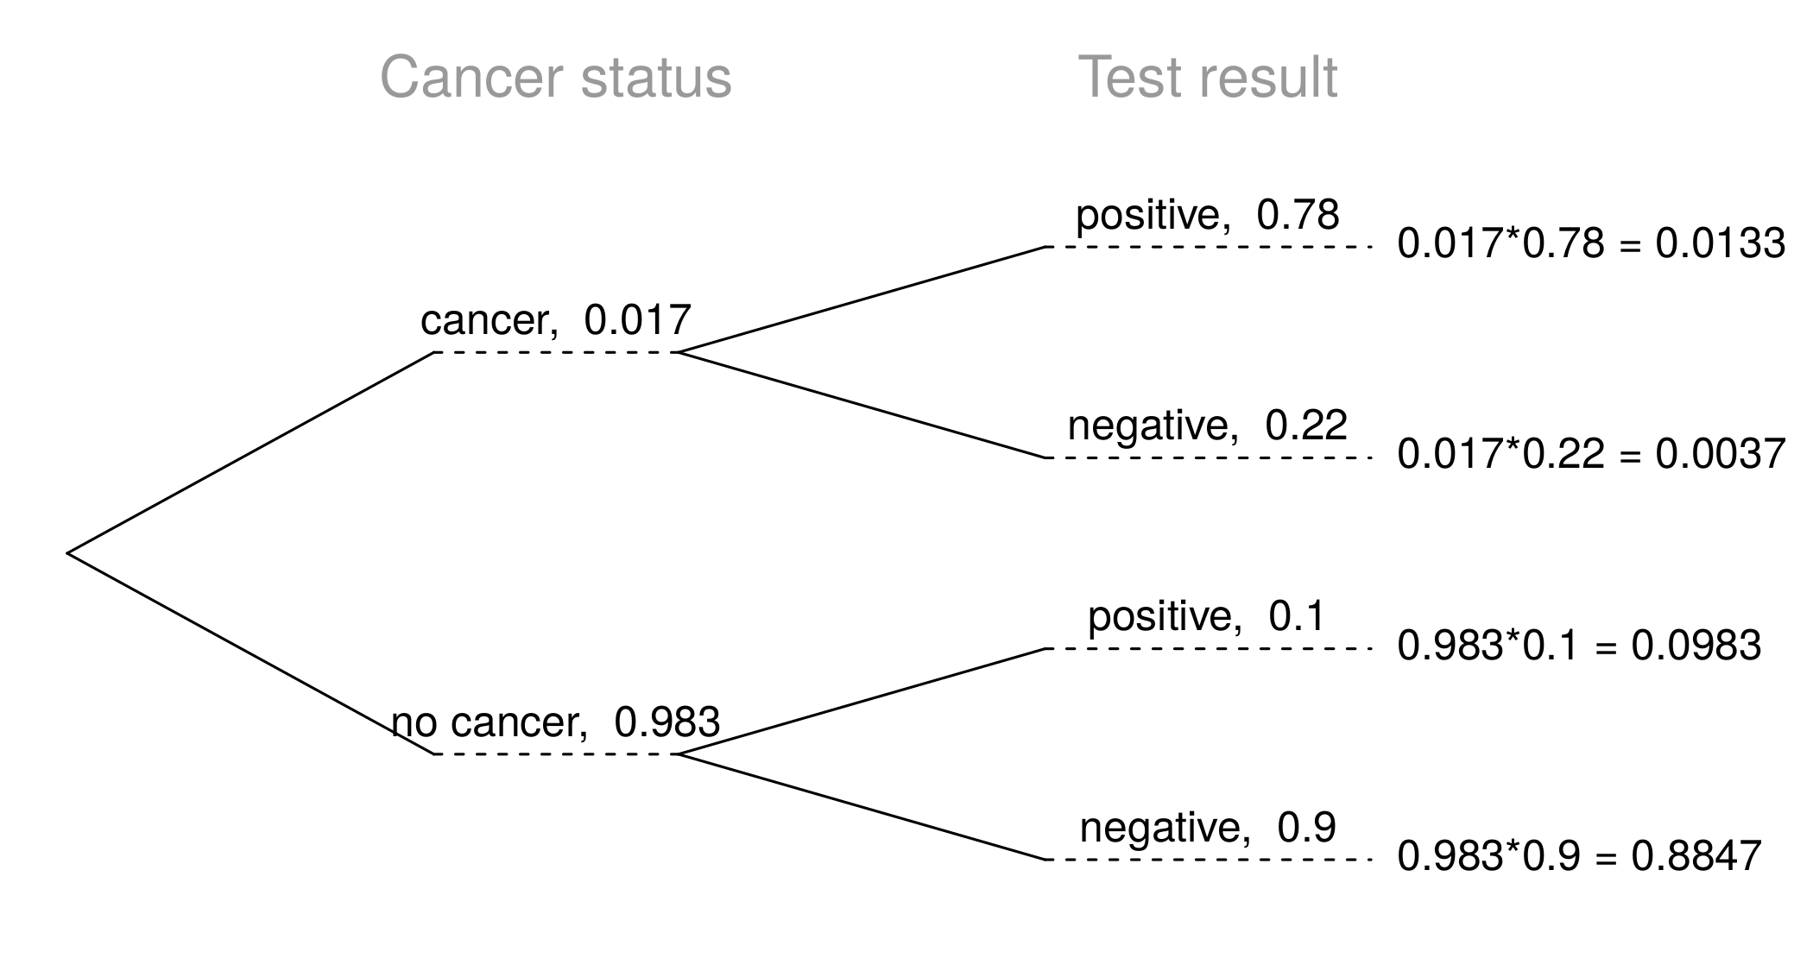

Slide 102
Inverting probabilities (ctd.)
$$\begin{matrix}P(C|+) & =\frac{P(C and +)}{P(+)} \\ & =\frac{0.0133}{0.0133+0.0983} \\ & =0.12\end{matrix}$$
Note: Tree diagrams are useful for inverting probabilities: we are given $P(+|C)$ and asked for $P(C|+)$.

Slide 103
Practice
Suppose a woman who gets tested once and obtains a positive result wants to get tested again. In the second test, what should we assume to be the probability of this specific woman having cancer?
0.017
0.12
0.0133
0.88

Slide 104
Practice
Suppose a woman who gets tested once and obtains a positive result wants to get tested again. In the second test, what should we assume to be the probability of this specific woman having cancer?
0.017
0.12
0.0133
0.88

Slide 105
Practice
What is the probability that this woman has cancer if this second mammogram also yielded a positive result?

Slide 107
Practice
What is the probability that this woman has cancer if this second mammogram also yielded a positive result?
0.0936
0.088
0.48
0.52

Slide 108
Practice
What is the probability that this woman has cancer if this second mammogram also yielded a positive result?
0.0936
0.088
0.48
0.52
$P(C|+)=\frac{P(C and +)}{P(+)}=\frac{0.0936}{0.0936+0.088}=0.52$

Slide 109
Bayes’ Theorem
The conditional probability formula we have seen so far is a special case of the Bayes’ Theorem, which is applicable even when events have more than just two outcomes.
Bayes’ Theorem:
$$\begin{matrix}P(outcome & A_{1} of variable 1|outcome B of variable 2) \\ & =\frac{P(B|A_{1})P(A_{1})}{P(B|A_{1})P(A_{1})+P(B|A_{2})P(A_{2})+⋯+P(B|A_{k})P(A_{k})}\end{matrix}$$
where $A_{2}$, $⋯$, $A_{k}$ represent all other possible outcomes of variable 1.

Slide 110
Application activity: Inverting probabilities
A common epidemiological model for the spread of diseases is the SIR model, where the population is partitioned into three groups: Susceptible, Infected, and Recovered. This is a reasonable model for diseases like chickenpox where a single infection usually provides immunity to subsequent infections. Sometimes these diseases can also be difficult to detect.
Imagine a population in the midst of an epidemic where 60% of the population is considered susceptible, 10% is infected, and 30% is recovered. The only test for the disease is accurate 95% of the time for susceptible individuals, 99% for infected individuals, but 65% for recovered individuals. (Note: In this case accurate means returning a negative result for susceptible and recovered individuals and a positive result for infected individuals).
Draw a probability tree to reflect the information given above. If the individual has tested positive, what is the probability that they are actually infected?

Slide 111
Application activity: Inverting probabilities (cont.)

Slide 112
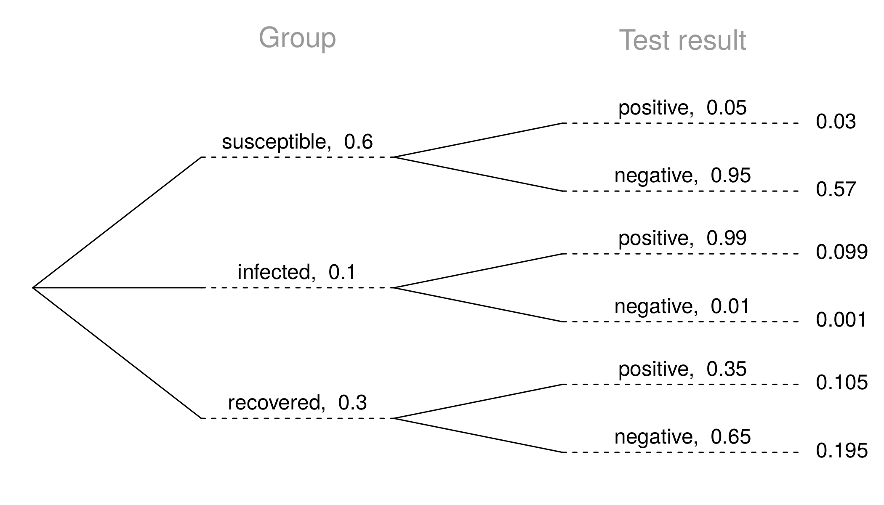

Slide 113
$$P(inf | +)=\frac{P(inf and +)}{P(+)}=\frac{0.099}{0.03+0.099+0.105}≈0.423$$

