Slide 1
MATH 1051H-A: Lecture #05

Slide 2
Plotting as Numerical Summary

Slide 3
Box Plot
The box in a box plot represents the middle 50% of the data, and the thick line in the box is the median.

Slide 4
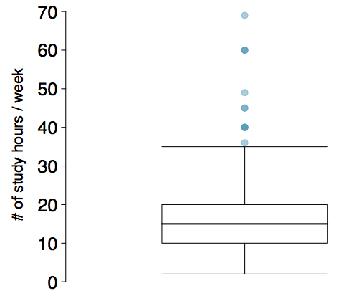

Slide 5
Anatomy of a Box Plot

Slide 6
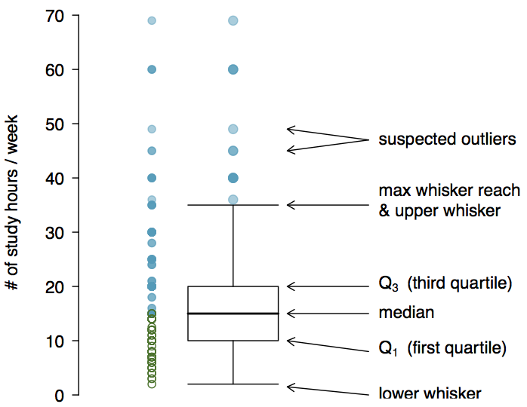

Slide 7
Whiskers and Outliers
The whiskers of a box plot can extend up to $1.5×IQR$ away from the quartiles.
max upper whisker reach = $Q3+1.5×IQR$
max lower whisker reach = $Q1−1.5×IQR$
Example: IQR: 20 - 10 = 10
max upper whisker reach = $20+1.5×10=35$
max lower whisker reach = $10−1.5×10=−5$
A potential outlier is defined as an observation beyond the maximum reach of the whiskers. It is an observation that appears extreme relative to the rest of the data.

Slide 8
Outliers (continued)
Why is it important to look for outliers?
Identify extreme skew in the distribution.
Identify data collection and entry errors.
Provide insight into interesting features of the data.

Slide 9
Extreme Observations
How would sample statistics such as mean, median, SD, and IQR of household income be affected if the largest value was replaced with $10 million? What if the smallest value was replaced with $10 million?

Slide 10
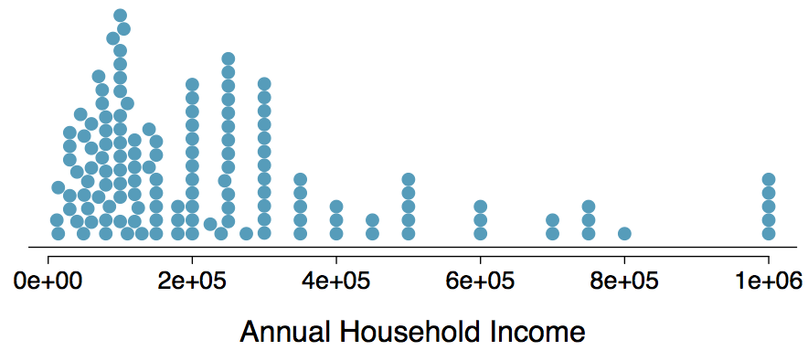

Slide 11
Robust Statistics

Slide 12
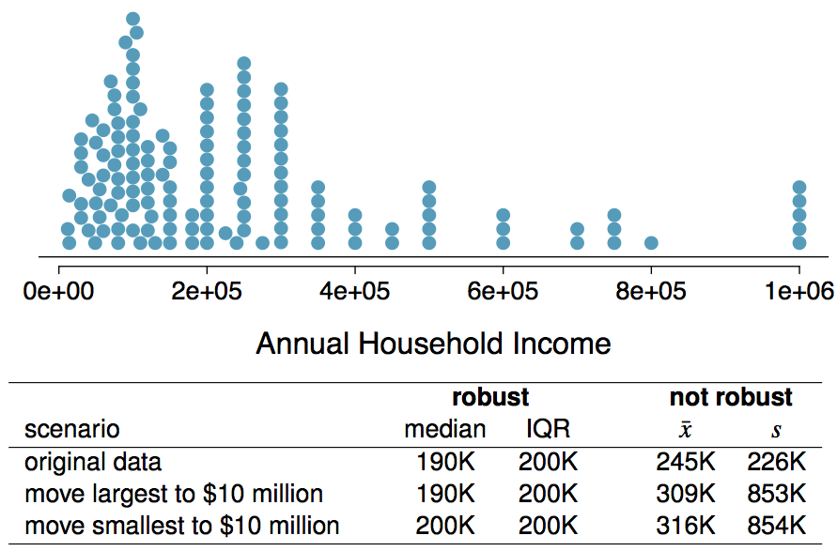

Slide 13
Robust Statistics
Median and IQR are more robust to skewness and outliers than mean and SD. Therefore,
for skewed distributions it is often more helpful to use median and IQR to describe the center and spread
for symmetric distributions it is often more helpful to use the mean and SD to describe the center and spread
If you would like to estimate the typical household income for a student, would you be more interested in the mean or median income?

Slide 14
Robust Statistics
Median and IQR are more robust to skewness and outliers than mean and SD. Therefore,
for skewed distributions it is often more helpful to use median and IQR to describe the center and spread
for symmetric distributions it is often more helpful to use the mean and SD to describe the center and spread
If you would like to estimate the typical household income for a student, would you be more interested in the mean or median income?
Median

Slide 15
Mean versus Median
If the distribution is symmetric, center is often defined as the mean:
mean $≈$ median
If the distribution is skewed or has extreme outliers, center is often defined as the median
Right-skewed: mean > median
Left-skewed: mean < median

Slide 16
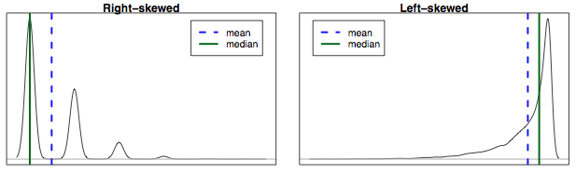

Slide 17
Practice
Which is most likely true for the distribution of percentage of time actually spent taking notes in class versus on Facebook, Twitter, etc.?

Slide 18
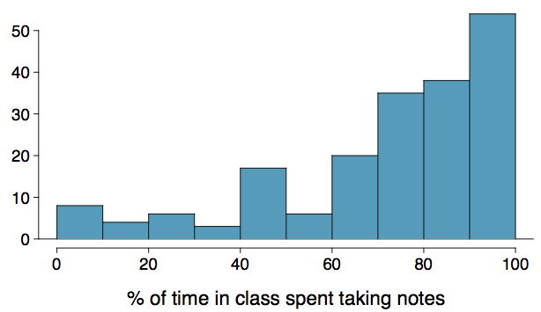

Slide 19
mean > median 3. mean $≈$ median
mean < median 4. impossible to tell

Slide 20
Practice
Which is most likely true for the distribution of percentage of time actually spent taking notes in class versus on Facebook, Twitter, etc.?
If we compute, the mean = 80% and the median = 76%. So …
mean > median 3. mean $≈$ median
mean < median 4. impossible to tell

Slide 21
Extremely Skewed Data
When data are extremely skewed, transforming them might make modeling easier. A common transformation is the log transformation.
The histograms on the left shows the distribution of number of basketball games attended by students. The histogram on the right shows the distribution of log of number of games attended.

Slide 22
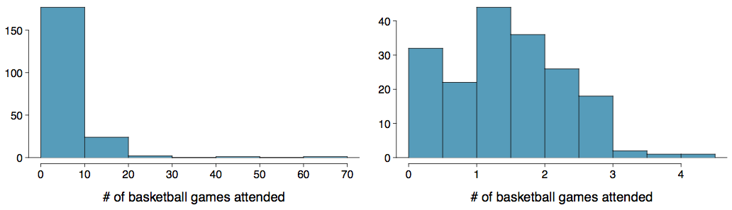

Slide 23
Pros and Cons of Transformations
Skewed data are easier to model with when they are transformed because outliers tend to become far less prominent after an appropriate transformation.

Slide 24
# of games | 70 | 50 | 25 | $⋯$
# of games | 4.25 | 3.91 | 3.22 | $⋯$

Slide 25
However, results of an analysis might be difficult to interpret because the log of a measured variable is usually meaningless.
What other variables would you expect to be extremely skewed?

Slide 26
Pros and Cons of Transformations
Skewed data are easier to model with when they are transformed because outliers tend to become far less prominent after an appropriate transformation.

Slide 27
# of games | 70 | 50 | 25 | $⋯$
# of games | 4.25 | 3.91 | 3.22 | $⋯$

Slide 28
However, results of an analysis might be difficult to interpret because the log of a measured variable is usually meaningless.
What other variables would you expect to be extremely skewed?
Salary, housing prices, ability to throw a football, …

Slide 29
If Time Allows …
Back to RStudio!

