Slide 1
Lecture 12 (and 14 and 15)

Slide 2
–>

Slide 3
Some Notes

Slide 4
Lectures
These slides are long - we definitely won’t finish today. These slides will be used for Lecture 14 (Wednesday after reading week) and 15 (Friday after reading week) as well.

Slide 5
Midterm
Reminder that our midterm is on Friday! Please show up on time, and bring at least two writing implements (pen or pencil is fine) and a hand calculator. It will make things easier if you don’t bring a backpack - space will be an issue.
Further reminder: as you enter the room for the midterm, come to the front, and fill in the middle first. Do not sit on the ends of rows, or someone will snap at you for being in the way (that someone might be me …).

Slide 6
Normal Distribution

Slide 7
The Normal Distribution
Unimodal and symmetric, bell shaped curve
Many variables are nearly normal, but none are exactly normal
Denoted as $N(μ,σ)→$ Normal with mean $μ$ and standard deviation $σ$

Slide 8
Heights of Males
“The male heights on OkCupid very nearly follow the expected normal distribution – except the whole thing is shifted to the right of where it should be. Almost universally guys like to add a couple inches.”
“You can also see a more subtle vanity at work: starting at roughly 5’8”, the top of the dotted curve tilts even further rightward. This means that guys as they get closer to six feet round up a bit more than usual, stretching for that coveted psychological benchmark.”
http://blog.okcupid.com/index.php/the-biggest-lies-in-online-dating

Slide 9
Heights of Females
“When we looked into the data for women, we were surprised to see height exaggeration was just as widespread, though without the lurch towards a benchmark height.”
http://blog.okcupid.com/index.php/the-biggest-lies-in-online-dating

Slide 10
Normal distributions with different parameters

Slide 11
SAT scores are distributed nearly normally with mean 1500 and standard deviation 300. ACT scores are distributed nearly normally with mean 21 and standard deviation 5. A college admissions officer wants to determine which of the two applicants scored better on their standardized test with respect to the other test takers: Pam, who earned an 1800 on her SAT, or Jim, who scored a 24 on his ACT?

Slide 12
Standardizing with Z-scores
Since we cannot just compare these two raw scores, we instead compare how many standard deviations beyond the mean each observation is.
Pam’s score is $(1800−1500)/300=1$ standard deviation above the mean.
Jim’s score is $(24−21)/5=0.6$ standard deviations above the mean.

Slide 13
Standardizing with Z-scores (continued)
These are called standardized scores, or Z-scores (or Z scores).
Z score of an observation is the number of standard deviations it falls above or below the mean.
$$Z=(observation−mean)/SD$$
Z scores are defined for distributions of any shape, but only when the distribution is normal can we use Z scores to calculate percentiles.
Observations that are more than 2 SD away from the mean ($|Z|>2$) are usually considered unusual.

Slide 14
Percentiles
Percentile is the percentage of observations that fall below a given data point
Graphically, percentile is the area below the probability distribution curve to the left of that observation

Slide 15
Calculating Percentiles using Computation
There are many ways to compute percentiles/areas under the curve.
R:
pnorm(1800, mean = 1500, sd = 300)
## [1] 0.8413447
Applets:

Slide 16
Calculating Percentiles - Look them Up!

Slide 17
Six Sigma
The term six sigma process comes from the notion that if one has six standard deviations between the process mean and the nearest specification limit, as shown in the graph, practically no items will fail to meet specifications.
http://en.wikipedia.org/wiki/Six_Sigma

Slide 18
Example: Quality Control
At the Heinz ketchup factory, the amounts which go into bottles of ketchup are supposed to be normally distributed with mean 36 oz. and standard deviation 0.11 oz. Once every 30 minutes a bottle is selected from the production line, and its contents are noted precisely. If the amount of ketchup in the bottle is below 35.8 oz. or above 36.2 oz., then the bottle fails the quality control inspection. What percent of bottles have less than 35.8 ounces of ketchup?
Let $X$ = amount of ketchup in a bottle: $X∼N(μ=36,σ=0.11)$
$$Z=\frac{35.8−36}{0.11}=−1.82$$

Slide 19
Finding the exact probability - using the $Z$ table

Slide 20
Finding the exact probability - using the $Z$ table

Slide 21
Finding the exact probability - using R
pnorm(-1.82)
## [1] 0.0343795
Simpler!

Slide 22
Practice
What percentage of bottles pass the quality control inspection?
1.82% 4. 93.12%
3.44% 5. 95.56%
6.88%

Slide 23
Practice
What percentage of bottles pass the quality control inspection?
1.82% 4. 93.12%
3.44% 5. 95.56%
6.88%
$$\begin{matrix}Z_{35.8} & =\frac{35.8−36}{0.11}=−1.82 \\ Z_{36.2} & =\frac{36.2−36}{0.11}=1.82 \\ P(35.8<X<36.2) & =P(−1.82<Z<1.82)=0.9656−0.0344=0.9312=93.12\%\end{matrix}$$

Slide 24
Example: Finding Cutoff Points
Body temperatures of healthy humans are distributed nearly normally with mean 98.2$​^{∘}$F and standard deviation 0.73$​^{∘}$F. What is the cutoff for the lowest 3% of human body temperatures?
$$\begin{matrix}P(X<x) & =0.03→P(Z<−1.88)=0.03 \\ Z & =\frac{obs−mean}{SD}→\frac{x−98.2}{0.73}=−1.88 \\ x & =(−1.88×0.73)+98.2={96.8}^{∘}F\end{matrix}$$
Mackowiak, Wasserman, and Levine (1992), A Critical Appraisal of 98.6 Degrees F, the Upper Limit of the Normal Body Temperature, and Other Legacies of Carl Reinhold August Wunderlick.

Slide 25
Practice
Body temperatures of healthy humans are distributed nearly normally with mean 98.2$​^{∘}$F and standard deviation 0.73$​^{∘}$F. What is the cutoff for the highest 10% of human body temperatures?
97.3$​^{∘}$F 3. 99.4$​^{∘}$F
99.1$​^{∘}$F 4. 99.6$​^{∘}$F

Slide 26
Practice
Body temperatures of healthy humans are distributed nearly normally with mean 98.2$​^{∘}$F and standard deviation 0.73$​^{∘}$F. What is the cutoff for the highest 10% of human body temperatures?
97.3$​^{∘}$F 3. 99.4$​^{∘}$F
99.1$​^{∘}$F 4. 99.6$​^{∘}$F
$$\begin{matrix}P(X>x) & =0.10→P(Z>1.28)=0.10 \\ Z & =\frac{obs−mean}{SD}→\frac{x−98.2}{0.73}=1.28 \\ x & =(1.28×0.73)+98.2={99.1}^{∘}F\end{matrix}$$

Slide 27
68-95-99.7 Rule
For normally distributed data,
about 68% falls within 1 SD of the mean
about 95% falls within 2 SD of the mean
about 99.7% falls within 3 SD of the mean
It is possible for observations to fall 4, 5 or even more standard deviations away from the mean, but these occurrences are very rare if the data are nearly normal.

Slide 28
Describing variability using the 68-95-99.7 Rule
SAT scores are distributed nearly normally, with mean 1500 and standard deviation 300.
$≈$ 68% of students score between 1200 and 1800 on the SAT
$≈$ 95% of students score between 900 and 2100 on the SAT
$≈$ 99.7% of students score between 600 and 2400 on the SAT
Note that it is not possible to achieve more than 2400 points on the SAT. In 2015, 1.7 million students took the SAT, with an average score of 1490 and less than 8500 students scoring higher than 2280.

Slide 29
Example: Number of nights of sleep on school nights

Slide 30
Example: Number of nights of sleep on school nights
Mean = 6.88 hours, SD = 0.92 hours. 72% of the data are within 1 SD of the mean: 6.88 $±$ 0.93.

Slide 31
Example: Number of nights of sleep on school nights
Mean = 6.88 hours, SD = 0.92 hours. 72% of the data are within 1 SD of the mean: 6.88 $±$ 0.93. 92% of the data are within 2 SD of the mean: 6.88 $±$ 2 $×$ 0.93.

Slide 32
Example: Number of nights of sleep on school nights
Mean = 6.88 hours, SD = 0.92 hours. 72% of the data are within 1 SD of the mean: 6.88 $±$ 0.93. 92% of the data are within 2 SD of the mean: 6.88 $±$ 2 $×$ 0.93. 99% of the data are within 3 SD of the mean: 6.88 $±$ 3 $×$ 0.93.

Slide 33
Practice
Which of the following is false?
Majority of Z scores in a right skewed distribution are negative.
In a skewed distributions the Z score of the mean might be different than 0.
For a normal distribution, IQR is less than 2 x SD.
Z scores are helpful for determining how unusual a data point is compared to the rest of the data in the distribution.

Slide 34
Practice
Which of the following is false?
Majority of Z scores in a right skewed distribution are negative.
In a skewed distributions the Z score of the mean might be different than 0.
For a normal distribution, the IQR is less than 2 x SD.
Z scores are helpful for determining how unusual a data point is compared to the rest of the data in the distribution.

Slide 35
The Normal Approximation

Slide 36
Evaluating The Normal Approximation
We often use the normal distribution as an approximation, taking real data and assuming it follows the normal.
How do we tell whether this is a good assumption?

Slide 37
Normal probability plot (QQ)
A histogram and normal probability plot of a sample of 100 male heights.

Slide 38
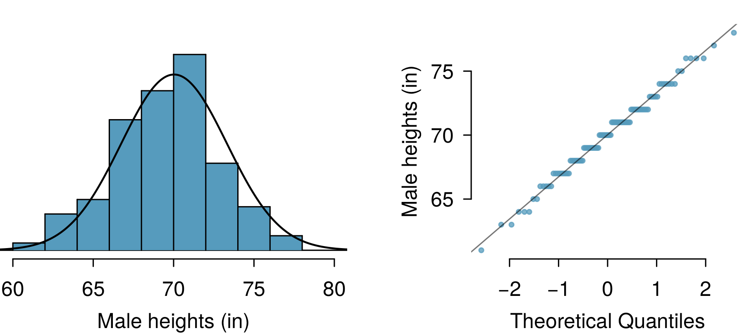

Slide 39
The right hand plot is also called a quantile-quantile plot, or QQ plot for short.

Slide 40
Anatomy of a normal probability plot
Data are plotted on the y-axis of a normal probability plot, and theoretical quantiles (following a normal distribution) on the x-axis.
If there is a linear relationship in the plot, then the data follow a nearly normal distribution.
Constructing a normal probability plot requires calculating percentiles and corresponding z-scores for each observation, which is tedious. Therefore we generally rely on R when making these plots.

Slide 41
NBA Heights, 2008-09
Below is a histogram and normal probability plot for the NBA heights from the 2008-2009 season. Do these data appear to follow a normal distribution?

Slide 42
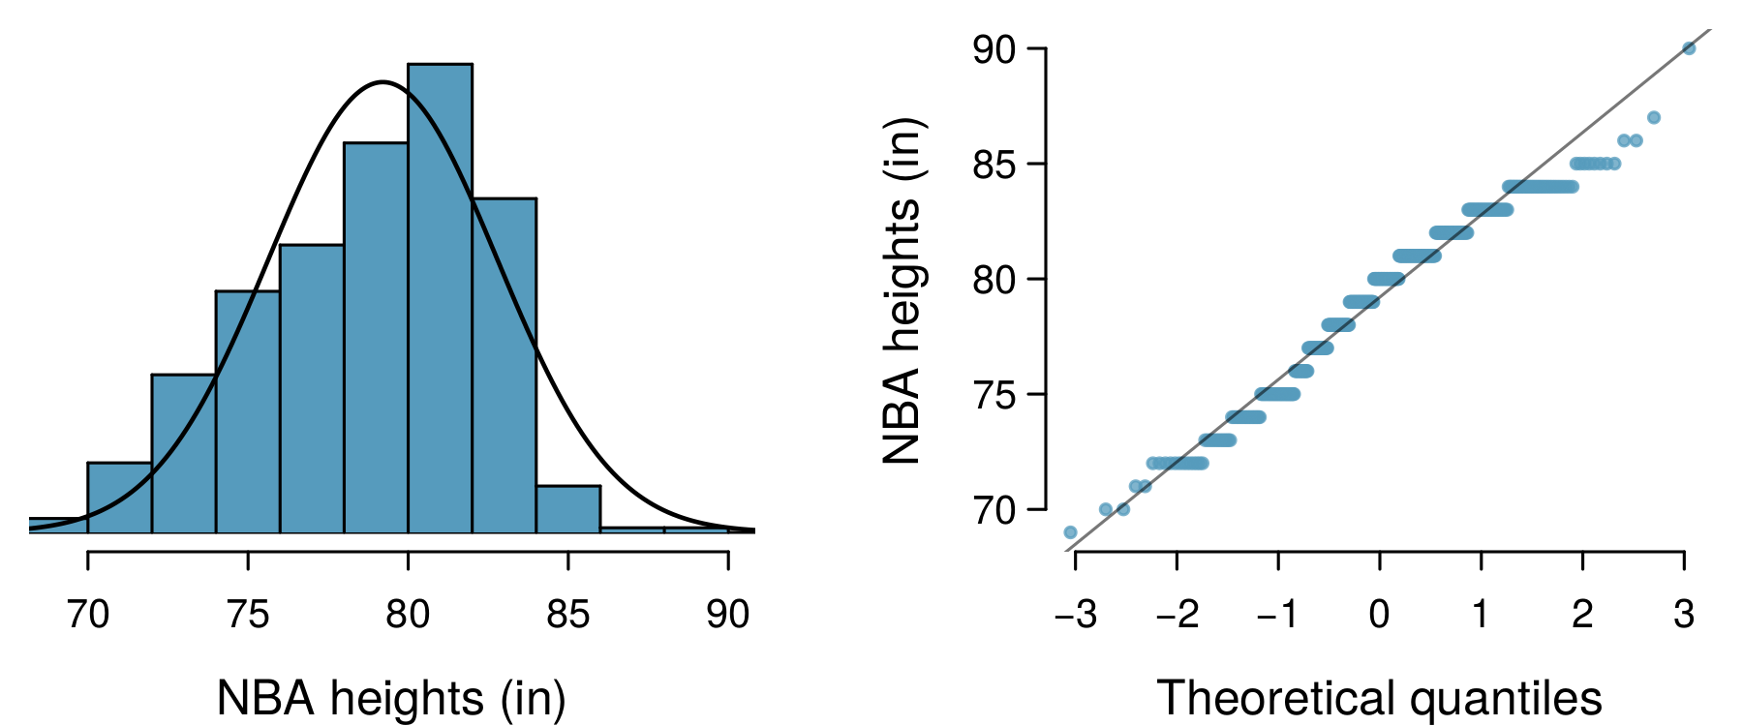

Slide 43
NBA Heights, 2008-09
Below is a histogram and normal probability plot for the NBA heights from the 2008-2009 season. Do these data appear to follow a normal distribution?

Slide 45
Why do the points on the normal probability have jumps?

Slide 46
Normal probability plot and skewness
Left Skew

Slide 47
Normal probability plot and skewness
Right Skew

Slide 48
Normal probability plot and skewness
Long Tails

Slide 49
Normal probability plot and skewness
Short Tails

Slide 50
Geometric distribution

Slide 51
Milgram experiment
Stanley Milgram, a Yale University psychologist, conducted a series of experiments on obedience to authority starting in 1963.
Experimenter (E) orders the teacher (T), the subject of the experiment, to give severe electric shocks to a learner (L) each time the learner answers a question incorrectly.
The learner is actually an actor, and the electric shocks are not real, but a prerecorded sound is played each time the teacher administers an electric shock.

Slide 52
Milgram experiment (cont.)
These experiments measured the willingness of study participants to obey an authority figure who instructed them to perform acts that conflicted with their personal conscience.
Milgram found that about 65% of people would obey authority and give such shocks.
Over the years, additional research suggested this number is approximately consistent across communities and time.

Slide 53
Bernouilli random variables
Each person in Milgram’s experiment can be thought of as a trial.
A person is labeled a success if she refuses to administer a severe shock, and failure if she administers such shock.
Since only 35% of people refused to administer a shock, probability of success is $p=0.35$.
When an individual trial has only two possible outcomes, it is called a Bernoulli random variable.

Slide 54
Geometric distribution
Dr. Smith wants to repeat Milgram’s experiments but she only wants to sample people until she finds someone who will not inflict a severe shock. What is the probability that she stops after the first person?
$$P(1^{st} person refuses)=0.35$$

Slide 55
Geometric distribution
… the third person?
$$ P(1^{st}\text{ and }2^{nd}\text{ shock, }3^{rd}\text{ refuses}) = S ( 0.65) \times S (0.65) \times R (0.35) \\= 0.65^2 \times 0.35 \approx 0.15 $$

Slide 56
Geometric distribution
… the tenth person?
$$ P(\text{9 shock, } 10^{th}\text{ refuses}) = \underbrace{S (0.65) \times \cdots \times S (0.65)}_{9\text{ of these}} \times R (0.35) \\= 0.65^9 \times 0.35 \approx 0.0072 $$

Slide 57
Geometric distribution (cont.)
The Geometric distribution describes the waiting time until a success for independent and identically distributed (iid) Bernouilli random variables.
independence: outcomes of trials don’t affect each other
identical: the probability of success is the same for each trial

Slide 58
Geometric distribution (cont.)
Geometric probabilities: If $p$ represents probability of success, $(1−p)$ represents probability of failure, and $n$ represents number of independent trials $P(success on the n^{th} trial)=(1−p)^{n−1}p$.
Can we calculate the probability of rolling a 6 for the first time on the 6$​^{th}$ roll of a die using the geometric distribution? Note that what was a success (rolling a 6) and what was a failure (not rolling a 6) are clearly defined and one or the other must happen for each trial.}
no, on the roll of a die there are more than 2 possible outcomes
yes, why not

Slide 59
Geometric distribution (cont.)
Can we calculate the probability of rolling a 6 for the first time on the 6$​^{th}$ roll of a die using the geometric distribution? Note that what was a success (rolling a 6) and what was a failure (not rolling a 6) are clearly defined and one or the other must happen for each trial.}
no, on the roll of a die there are more than 2 possible outcomes
yes, why not
$$P(6 on the 6^{th} roll)={\left(\frac{5}{6}\right)}^{5}\left(\frac{1}{6}\right)≈0.067$$

Slide 60
Expected value
How many people is Dr. Smith expected to test before finding the first one that refuses to administer the shock?

Slide 61
Expected value
How many people is Dr. Smith expected to test before finding the first one that refuses to administer the shock?
The expected value, or the mean, of a geometric distribution is defined as $\frac{1}{p}$.
$$μ=\frac{1}{p}=\frac{1}{0.35}=2.86$$
Thus, we would expect her to test 2.86 people before finding the first one that refuses to administer the shock.
But how can she test a non-whole number of people?

Slide 62
Expected value and its variability
Mean and standard deviation of geometric distribution:
$$μ=\frac{1}{p} σ=\sqrt{\frac{1−p}{p^{2}}}$$
Going back to Dr. Smith’s experiment:
$$σ=\sqrt{\frac{1−p}{p^{2}}}=\sqrt{\frac{1−0.35}{{0.35}^{2}}}=2.3$$

Slide 63
Expected value and its variability
Going back to Dr. Smith’s experiment:
$$σ=\sqrt{\frac{1−p}{p^{2}}}=\sqrt{\frac{1−0.35}{{0.35}^{2}}}=2.3$$
Dr. Smith is expected to test 2.86 people before finding the first one that refuses to administer the shock, give or take 2.3 people.
These values only make sense in the context of repeating the experiment many many times.

Slide 64
Binomial Distribution

Slide 65
Binomial: Redux
We’ve already talked about the binomial once, but let’s revisit it a little more today, with some more details.

Slide 66
The Binomial Distribution
Suppose we randomly select four individuals to participate in the Milgram experiment. What is the probability that exactly 1 of them will refuse to administer the shock?

Slide 67
The Binomial Distribution
Let’s call these people Allen (A), Brittany (B), Caroline (C), and Damian (D). Each one of the four scenarios below will satisfy the condition of “exactly 1 of them refuses to administer the shock”:
Scenario 1: A (refuse) $×$ B (shock) $×$ C (shock) $×$ D (shock) = $0.35×{0.65}^{3}=0.096$.
Scenario 2: A (shock) $×$ B (refuse) $×$ C (shock) $×$ D (shock) = $0.65×0.35×{0.65}^{2}=0.096$.
Scenario 3: A (shock) $×$ B (shock) $×$ C (refuse) $×$ D (shock) = ${0.65}^{2}×0.35×0.65=0.096$.
Scenario 4: A (shock) $×$ B (shock) $×$ C (shock) $×$ D (refuse) = ${0.65}^{3}×0.35=0.096$.

Slide 68
The Binomial Distribution
Let’s call these people Allen (A), Brittany (B), Caroline (C), and Damian (D). Each one of the four scenarios below will satisfy the condition of “exactly 1 of them refuses to administer the shock”:
The probability of exactly one 1 of 4 people refusing to administer the shock is the sum of all of these probabilities.
$$0.0961+0.0961+0.0961+0.0961=4×0.0961=0.3844$$

Slide 69
The Binomial distribution
The question from the prior slide asked for the probability of given number of successes, $k$, in a given number of trials, $n,($k = 1$ success in $n=4$ trials), and we calculated this probability as
$$\# of scenarios ×P(single scenario)$$

Slide 70
The Binomial distribution
The question from the prior slide asked for the probability of given number of successes, $k$, in a given number of trials, $n,($k = 1$ success in $n=4$ trials), and we calculated this probability as
$$\# of scenarios ×P(single scenario)$$
$\# of scenarios$: there is a less tedious way to figure this out, we’ll get to that shortly…
$P(single scenario)=p^{k} (1−p)^{(n−k)}$
“probability of success to the power of number of successes, probability of failure to the power of number of failures”

Slide 71
The Binomial distribution
So the Binomial distribution describes the probability of having exactly $k$ successes in $n$ independent Bernouilli trials with probability of success $p$.

Slide 72
Counting the # of scenarios
Earlier we wrote out all possible scenarios that fit the condition of exactly one person refusing to administer the shock. If $n$ was larger and/or $k$ was different than 1, for example, $n=9$ and $k=2$:
RRSSSSSSS SRRSSSSSS … SSSSSSRRS SSSSSSSRR …
then writing out all possible scenarios would be incredibly tedious and prone to errors. Remember: the RR don’t have to be together. We have to figure out all the RSSR too, etc., etc.

Slide 73
Calculating the # of scenarios
The choose function is useful for calculating the number of ways to choose $k$ successes in $n$ trials.
$$\left({n \atop k}\right)=\frac{n!}{k!(n−k)!}$$
$k=1$, $n=4$: $\left({4 \atop 1}\right)=\frac{4!}{1!(4−1)!}=\frac{4×3×2×1}{1×(3×2×1)}=4$
$k=2$, $n=9$: $\left({9 \atop 2}\right)=\frac{9!}{2!(9−1)!}=\frac{9×8×7!}{2×1×7!}=\frac{72}{2}=36$
choose(9, 2)
## [1] 36

Slide 74
Calculating the # of scenarios
You can also do this on all scientific calculators, using the nCr button (or equivalent).

Slide 75
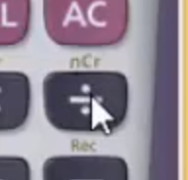

Slide 76
Properties of the choose function
Which of the following is false?
There are $n$ ways of getting 1 success in $n$ trials, $\left({n \atop 1}\right)=n$.
There is only 1 way of getting $n$ successes in $n$ trials, $\left({n \atop n}\right)=1$.
There is only 1 way of getting $n$ failures in $n$ trials, $\left({n \atop 0}\right)=1$.
There are $n−1$ ways of getting $n−1$ successes in $n$ trials, $\left({n \atop n−1}\right)=n−1$.

Slide 77
Properties of the choose function
Which of the following is false?
There are $n$ ways of getting 1 success in $n$ trials, $\left({n \atop 1}\right)=n$.
There is only 1 way of getting $n$ successes in $n$ trials, $\left({n \atop n}\right)=1$.
There is only 1 way of getting $n$ failures in $n$ trials, $\left({n \atop 0}\right)=1$.
There are $n−1$ ways of getting $n−1$ successes in $n$ trials, $\left({n \atop n−1}\right)=n−1$.

Slide 78
Binomial distribution (cont.)
Binomial probabilities
If $p$ represents probability of success, $(1−p)$ represents probability of failure, $n$ represents number of independent trials, and $k$ represents number of successes
$$P(k successes in n trials)=\left({n \atop k}\right) p^{k} (1−p)^{(n−k)}$$

Slide 79
Practice
Which of the following is not a condition that needs to be met for the binomial distribution to be applicable?
the trials must be independent
the number of trials, $n$, must be fixed
each trial outcome must be classified as a success or a failure
the number of desired successes, $k$, must be greater than the number of trials
the probability of success, $p$, must be the same for each trial

Slide 80
Practice
Which of the following is not a condition that needs to be met for the binomial distribution to be applicable?
the trials must be independent
the number of trials, $n$, must be fixed
each trial outcome must be classified as a success or a failure
the number of desired successes, $k$, must be greater than the number of trials
the probability of success, $p$, must be the same for each trial

Slide 81
Gallup Poll: Obesity in America
A 2012 Gallup survey suggests that 26.2% of Americans are obese. Among a random sample of 10 Americans, what is the probability that exactly 8 are obese?
pretty high?
pretty low?
Gallup: http://www.gallup.com/poll/160061/obesity-rate-stable-2012.aspx , January 23, 2013.

Slide 82
Gallup Poll: Obesity in America
A 2012 Gallup survey suggests that 26.2% of Americans are obese. Among a random sample of 10 Americans, what is the probability that exactly 8 are obese?
${0.262}^{8}×{0.738}^{2}$
$\left({8 \atop 10}\right)×{0.262}^{8}×{0.738}^{2}$
$\left({10 \atop 8}\right)×{0.262}^{8}×{0.738}^{2}$
$\left({10 \atop 8}\right)×{0.262}^{2}×{0.738}^{8}$

Slide 83
Gallup Poll: Obesity in America
A 2012 Gallup survey suggests that 26.2% of Americans are obese. Among a random sample of 10 Americans, what is the probability that exactly 8 are obese?
${0.262}^{8}×{0.738}^{2}$
$\left({8 \atop 10}\right)×{0.262}^{8}×{0.738}^{2}$
$\left({10 \atop 8}\right)×{0.262}^{8}×{0.738}^{2}=45×{0.262}^{8}×{0.738}^{2}=0.0005$
$\left({10 \atop 8}\right)×{0.262}^{2}×{0.738}^{8}$

Slide 84
The birthday problem
What is the probability that 2 randomly chosen people share a birthday?
Pretty low, $\frac{1}{365}≈0.0027$.

Slide 85
The birthday problem
What is the probability that 2 randomly chosen people share a birthday?
Pretty low, $\frac{1}{365}≈0.0027$.
What is the probability that at least 2 people out of 366 people share a birthday?
Exactly 1! (Excluding the possibility of a leap year birthday.)

Slide 86
The birthday problem (cont.)
What is the probability that at least 2 people (1 match) out of 121 people share a birthday?
Somewhat complicated to calculate, but we can think of it as the complement of the probability that there are no matches in 121 people.
$$\begin{matrix}P(no matches) & = & 1×\left(1−\frac{1}{365}\right)×\left(1−\frac{2}{365}\right)×⋯×\left(1−\frac{120}{365}\right)\end{matrix}$$

Slide 87
The birthday problem (cont.)
What is the probability that at least 2 people (1 match) out of 121 people share a birthday?
$$\begin{matrix}P(no matches) & = & \frac{365×364×⋯×245}{{365}^{121}} \\ & = & \frac{365!}{{365}^{121}×(365−121)!} \\ & = & \frac{121!×\left({365 \atop 121}\right)}{{365}^{121}}≈0 \\ P(at least 1 match) & ≈ & 1\end{matrix}$$

Slide 88
Expected value
A 2012 Gallup survey suggests that 26.2% of Americans are obese.
Among a random sample of 100 Americans, how many would you expect to be obese?

Slide 89
Expected value
A 2012 Gallup survey suggests that 26.2% of Americans are obese.
Among a random sample of 100 Americans, how many would you expect to be obese?
Easy enough, $100×0.262=26.2$.
Or more formally, $μ=np=100×0.262=26.2$.
But this doesn’t mean in every random sample of 100 people exactly 26.2 will be obese. In fact, that’s not even possible. In some samples this value will be less, and in others more. How much would we expect this value to vary?

Slide 90
Expected value and its variability
Mean and standard deviation of binomial distribution
$$μ=np σ=\sqrt{np(1−p)}$$
Going back to the obesity rate:
$$σ=\sqrt{np(1−p)}=\sqrt{100×0.262×0.738}≈4.4$$
We would expect 26.2 out of 100 randomly sampled Americans to be obese, with a standard deviation of 4.4.
Note: Mean and standard deviation of a binomial might not always be whole numbers, and that is alright, these values represent what we would expect to see on average.

Slide 91
Unusual observations
Using the notion that observations that are more than 2 standard deviations away from the mean are considered unusual and the mean and the standard deviation we just computed, we can calculate a range for the plausible number of obese Americans in random samples of 100.
$$26.2±(2×4.4)=(17.4,35)$$

Slide 92
Gallup Poll: Home Schooling
An August 2012 Gallup poll suggests that 13% of Americans think home schooling provides an excellent education for children. Would a random sample of 1,000 Americans where only 100 share this opinion be considered unusual?}
Yes
No

Slide 93
Gallup Poll: Home Schooling
$$\begin{matrix}μ & =np=1,000×0.13=130 \\ σ & =\sqrt{np(1−p)}=\sqrt{1,000×0.13×0.87}≈10.6\end{matrix}$$
Method 1: Range of usual observations: $130±2×10.6=(108.8,151.2)$ (100 is outside this range, so would be considered unusual)
Method 2: Z-score of observation: $Z=\frac{x−mean}{SD}=\frac{100−130}{10.6}=−2.83$ (100 is more than 2 SD below the mean, so would be considered unusual)
http://www.gallup.com/poll/156974/private-schools-top-marks-educating-children.aspx

Slide 94
Normal approximation to the binomial (Practice)
Go to https://gallery.shinyapps.io/dist_calc/ and choose Binomial coin experiment in the drop down menu on the left.
Set the number of trials to 20 and the probability of success to 0.15. Describe the shape of the distribution of number of successes.
Keeping $p$ constant at 0.15, determine the minimum sample size required to obtain a unimodal and symmetric distribution of number of successes. Please submit only one response per team.
Further considerations:
What happens to the shape of the distribution as $n$ stays constant and $p$ changes?
What happens to the shape of the distribution as $p$ stays constant and $n$ changes?

Slide 95
Distributions of number of successes
Hollow histograms of samples from the binomial model where $p=0.10$ and $n=10$, $30$, $100$, and $300$. What happens as $n$ increases?

Slide 96
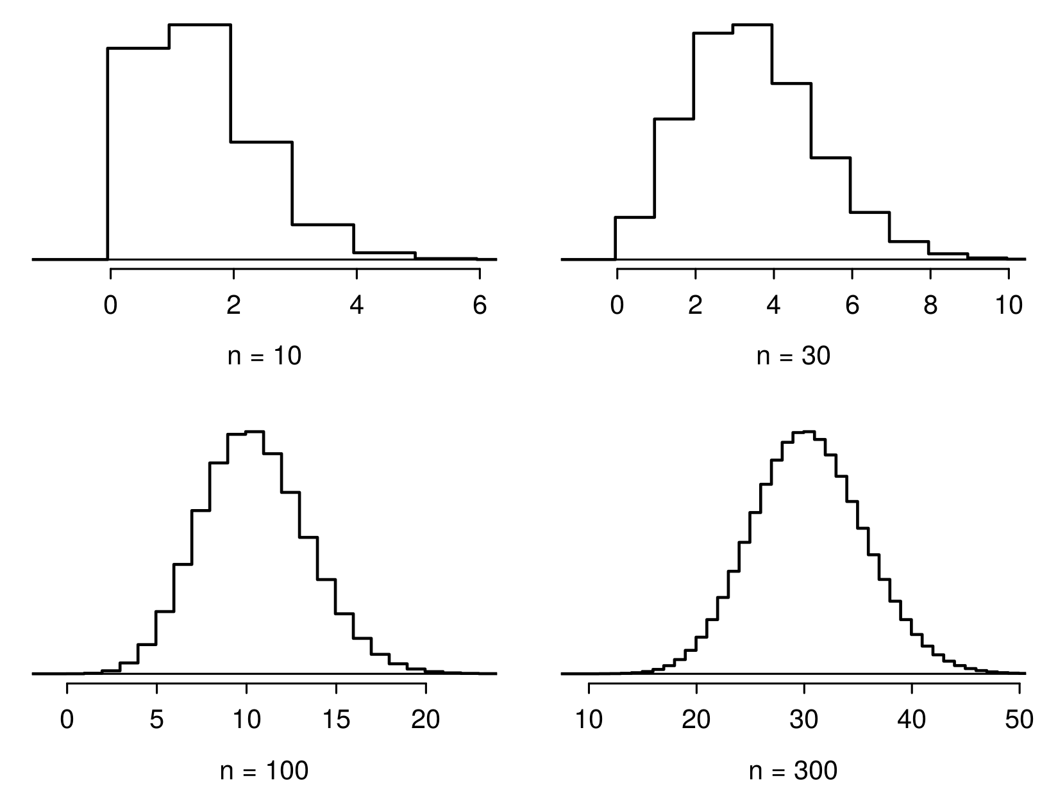

Slide 97
Low large is large enough?
The sample size is considered large enough if the expected number of successes and failures are both at least 10.
$$np≥10 and n(1−p)≥10$$

Slide 98
Practice
Below are four pairs of Binomial distribution parameters. Which distribution can be approximated by the normal distribution?
$n=100,p=0.95$
$n=25,p=0.45$
$n=150,p=0.05$
$n=500,p=0.015$

Slide 99
Practice
Below are four pairs of Binomial distribution parameters. Which distribution can be approximated by the normal distribution?
$n=100,p=0.95$
$n=25,p=0.45→25×0.45=11.25;25×0.55=13.75$
$n=150,p=0.05$
$n=500,p=0.015$

Slide 100
An analysis of Facebook users
A recent study found that “Facebook users get more than they give”. For example:
40% of Facebook users in our sample made a friend request, but 63% received at least one request
Users in our sample pressed the like button next to friends’ content an average of 14 times, but had their content “liked” an average of 20 times
Users sent 9 personal messages, but received 12
12% of users tagged a friend in a photo, but 35% were themselves tagged in a photo
Any guesses for how this pattern can be explained?

Slide 101
An analysis of Facebook users
A recent study found that ``Facebook users get more than they give". For example:
40% of Facebook users in our sample made a friend request, but 63% received at least one request
Users in our sample pressed the like button next to friends’ content an average of 14 times, but had their content “liked” an average of 20 times
Users sent 9 personal messages, but received 12
12% of users tagged a friend in a photo, but 35% were themselves tagged in a photo
Any guesses for how this pattern can be explained?
Power users contribute much more content than the typical user.
http://www.pewinternet.org/Reports/2012/Facebook-users/Summary.aspx

Slide 102
This study also found that approximately 25% of Facebook users are considered power users. The same study found that the average Facebook user has 245 friends. What is the probability that the average Facebook user with 245 friends has 70 or more friends who would be considered power users? Note any assumptions you must make.
We are given that $n=245,p=0.25$, and we are asked for the probability $P(K≥70)$. To proceed, we need independence, which we’ll assume but could check if we had access to more Facebook data.

Slide 103
We are given that $n=245,p=0.25$, and we are asked for the probability $P(K≥70)$. To proceed, we need independence, which we’ll assume but could check if we had access to more Facebook data.
$$\begin{matrix}P(X≥70) & =P(K=70 or K=71 or K=72 or ⋯ or K=245) \\ & =P(K=70)+P(K=71)+P(K=72)+⋯+P(K=245)\end{matrix}$$
This seems like an awful lot of work…

Slide 104
Could Use R …
sum(dbinom(x = 70:245, size = 245, prob = 0.25))
## [1] 0.112763
pbinom(q = 69, size = 245, prob = 0.25, lower.tail = FALSE)
## [1] 0.112763

Slide 105
Normal approximation to the binomial
When the sample size is large enough, the binomial distribution with parameters $n$ and $p$ can be approximated by the normal model with parameters $μ=np$ and $σ=\sqrt{np(1−p)}$.
In the case of the Facebook power users, $n=245$ and $p=0.25$.
$$μ=245×0.25=61.25 σ=\sqrt{245×0.25×0.75}=6.778$$
$Bin(n=245,p=0.25)≈N(μ=61.25,σ=6.778)$.

Slide 106
Normal approximation to the binomial
In the case of the Facebook power users, $n=245$ and $p=0.25$.
$$μ=245×0.25=61.25 σ=\sqrt{245×0.25×0.75}=6.778$$
$Bin(n=245,p=0.25)≈N(μ=61.25,σ=6.778)$.

Slide 107
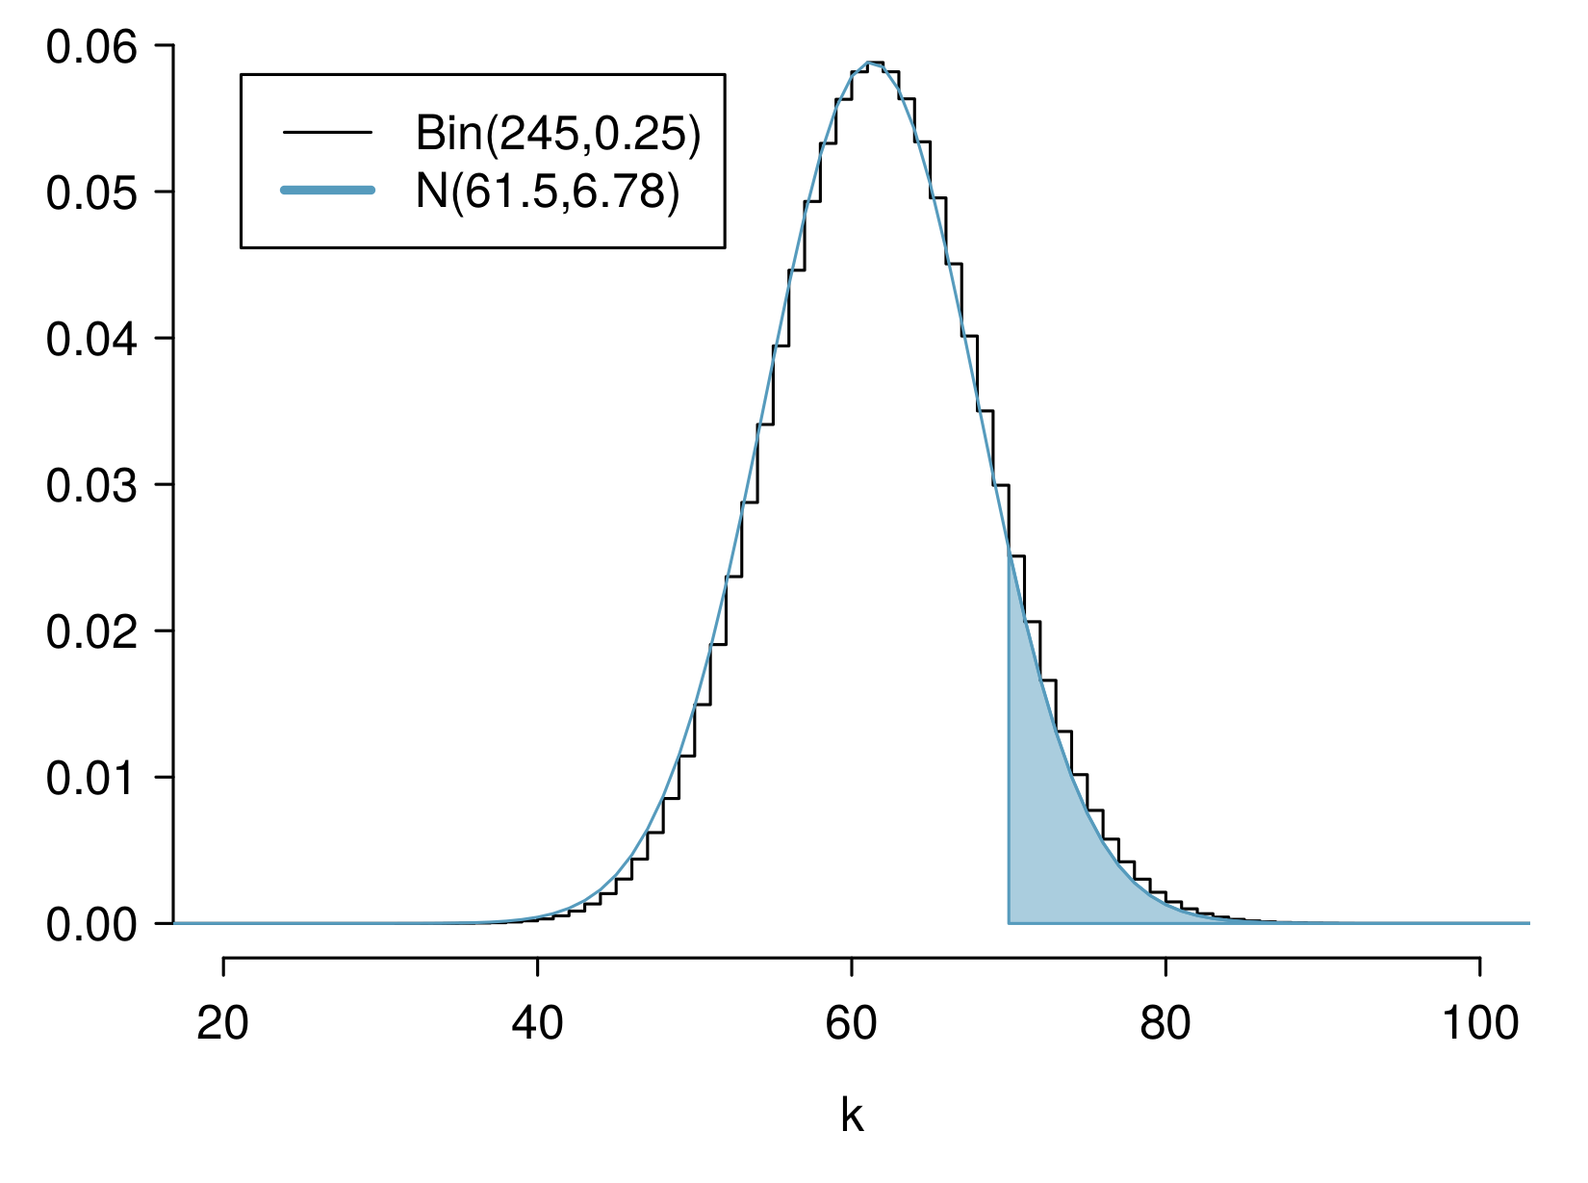

Slide 108
Computing the Approximation
What is the probability that the average Facebook user with 245 friends has 70 or more friends who would be considered power users?
$$\begin{matrix}Z & =\frac{obs−mean}{SD}=\frac{70−61.25}{6.778} \\ & =1.29094 \\ P(Z>1.29094) & =1−0.90164 \\ & =0.09836\end{matrix}$$

Slide 109
Computing the Approximation
What is the probability that the average Facebook user with 245 friends has 70 or more friends who would be considered power users?
But where did this $P(Z>1.29)$ answer come from? R again!
$$\begin{matrix}Z & =\frac{obs−mean}{SD}=\frac{70−61.25}{6.778} \\ & =1.29094 \\ P(Z>1.29094) & =1−0.90164 \\ & =0.09836\end{matrix}$$

Slide 110
Computing Normal Probabilities
Just like we did for pbinom() and dbinom(), we can do for pnorm() and dnorm(). You saw this in workshop last week.
pnorm(1.290964, lower.tail = FALSE)
## [1] 0.09835808

Slide 111
This seems … bad
We know the exact probability, done using pbinom(), is 0.1128. So why is this “approximation” giving an answer of 0.09836?

Slide 112
This seems … bad
We know the exact probability, done using pbinom(), is 0.1128. So why is this “approximation” giving an answer of 0.09836?

Slide 114
“Correction for Continuity”
The normal approximation to the binomial can be a little rough. There is a correction for continuity which can be used instead:
The cutoff values for the lower end of a shaded region should be reduced by 0.5
The cutoff values for the upper end should be increased by 0.5.
Since we are doing a “greater than” probability, the lower end of the shaded region is our relevant object, so we reduce.

Slide 115
Computing Normal Probabilities
$$\begin{matrix}Z & =\frac{obs−mean}{SD}=\frac{(70−0.5)−61.25}{6.778} \\ & =1.217173 \\ P(Z>1.217173) & =1−0.8882308 \\ & =0.1117692\end{matrix}$$
pnorm(1.217173, lower.tail = FALSE)
## [1] 0.1117692
That’s much better!

Slide 116
Inverse Normal Problems

Slide 117
The Inverse Problem
As we’ve seen in the previous, we often need to take $Z$-scores and find probabilities from them. Sometimes this is in a normal problem, sometimes an approximation, and so on.
What if you wanted to go backward? What would this look like?

Slide 118
Inverse Problem Statement
What if I told you “the probability of this event happening is 0.5”. What would the $Z$-score of such a setup be?
$$P(Z≤z_{0})=0.5$$
What’s the unknown here? $z_{0}$!

Slide 119
How do we solve for $z_{0}$?
trial and error?
use tables?
use R!

Slide 120
Using R to Find $z_{0}$
qnorm(p = 0.5, mean = 0, sd = 1, lower.tail = TRUE)
## [1] 0
Does this make sense? This is saying that $z_{0}=0$ has probability to its left of 0.5.
pnorm(q = 0, mean = 0, sd = 1, lower.tail = TRUE)
## [1] 0.5

Slide 121
Checking Again
x <- seq(from = -3, to = 3, by = 0.01) plot(x, dnorm(x), type = "l", xlab = "Z") abline(h = 0) abline(v = 0, col = "red")

Slide 122
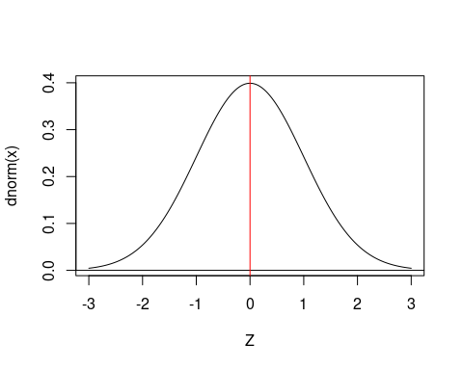

Slide 123
Practice
What value of $z_{0}$ has $P(−z_{0}≤Z≤z_{0})=0.3$?

Slide 124
Practice
What value of $z_{0}$ has $P(−z_{0}≤Z≤z_{0})=0.3$?

Slide 125
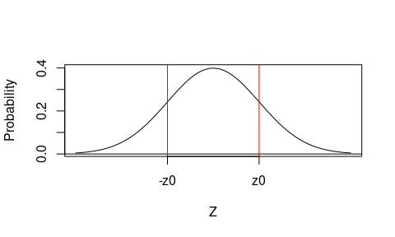

Slide 126
So what do we actually need to run?

Slide 127
Practice
qnorm(p = 0.15, mean = 0, sd = 1, lower.tail = TRUE)
## [1] -1.036433
This is -z0, because we used 0.15 area to the left, and lower.tail = TRUE.
qnorm(p = 0.15, mean = 0, sd = 1, lower.tail = FALSE)
## [1] 1.036433
And this is $z_{0}$, because lower.tail = FALSE.

