Slide 1
Lecture 20

Slide 2
The Central Limit Theorem

Slide 3
The Central Limit Theorem Revisited
We discussed the Central Limit Theorem earlier in the course. Let’s revisit it now that we know a little more about test statistics and hypothesis tests.

Slide 4
Average number of basketball games attended
Consider the population data for the number of basketball games attended at Duke University.

Slide 5
Average number of basketball games attended (cont.)
Sampling distribution, $n=10$:
What does each observation in this distribution represent?
Is the variability of the sampling distribution smaller or larger than the variability of the population distribution? Why?

Slide 6
Average number of basketball games attended (cont.)
Sampling distribution, $n=10$:
What does each observation in this distribution represent? - Sample mean ($\overline{x}$) of samples of size $n=10$.
Is the variability of the sampling distribution smaller or larger than the variability of the population distribution? Why?

Slide 7
Average number of basketball games attended (cont.)
Sampling distribution, $n=10$:
What does each observation in this distribution represent? Sample mean ($\overline{x}$) of samples of size $n=10$.
Is the variability of the sampling distribution smaller or larger than the variability of the population distribution? Why? - Smaller, sample means will vary less than individual observations.

Slide 8
Average number of basketball games attended (cont.)
Sampling distribution, $n=30$:
How did the shape, center, and spread of the sampling distribution change going from $n=10$ to $n=30$?

Slide 9
Average number of basketball games attended (cont.)
Sampling distribution, $n=30$:
How did the shape, center, and spread of the sampling distribution change going from $n=10$ to $n=30$? Shape is more symmetric, center is about the same, spread is smaller.

Slide 10
Average number of basketball games attended (cont.)
Sampling distribution, $n=70$:

Slide 11
Average number of basketball games attended (cont.)
The mean of the sampling distribution is 5.75, and the standard deviation of the sampling distribution (also called the standard error, or SE - we saw this already!) is 0.75. Which of the following is the most reasonable guess for the 95% confidence interval for the true average number of basketball games attended by students?
$5.75±0.75$
$5.75±2×0.75$
$5.75±3×0.75$
cannot tell from the information given

Slide 12
Average number of basketball games attended (cont.)
The mean of the sampling distribution is 5.75, and the standard deviation of the sampling distribution (also called the standard error, or SE - we saw this already!) is 0.75. Which of the following is the most reasonable guess for the 95% confidence interval for the true average number of basketball games attended by students?
$5.75±0.75$
$5.75±2×0.75→(4.25,7.25)$
$5.75±3×0.75$
cannot tell from the information given

Slide 13
Four plots: Determine which plot (A, B, or C) is which.
At top: distribution for a population ($μ=10,σ=7$),
a single random sample of 100 observations from this population,
a distribution of 100 sample means from random samples with size 7, and
a distribution of 100 sample means from random samples with size 49.
A - (3); B - (2); C - (4)
A - (2); B - (3); C - (4)
A - (3); B - (4); C - (2)
A - (4); B - (2); C - (3)

Slide 14
Four plots: Determine which plot (A, B, or C) is which.
At top: distribution for a population ($μ=10,σ=7$),
a single random sample of 100 observations from this population,
a distribution of 100 sample means from random samples with size 7, and
a distribution of 100 sample means from random samples with size 49.
A - (3); B - (2); C - (4)
A - (2); B - (3); C - (4)
A - (3); B - (4); C - (2)
A - (4); B - (2); C - (3)

Slide 15
Inference for other estimators

Slide 16
Inference for other estimators
The sample mean is not the only point estimate for which the sampling distribution is nearly normal. For example, the sampling distribution of sample proportions is also nearly normal when $n$ is sufficiently large (more on this later)

Slide 17
Inference for other estimators
The sample mean is not the only point estimate for which the sampling distribution is nearly normal. For example, the sampling distribution of sample proportions is also nearly normal when $n$ is sufficiently large (we’ll talk about this in detail in two weeks).
An important assumption about point estimates is that they are unbiased, i.e., the sampling distribution of the estimate is centered at the true population parameter it estimates.

Slide 18
Inference for other estimators
The sample mean is not the only point estimate for which the sampling distribution is nearly normal. For example, the sampling distribution of sample proportions is also nearly normal when $n$ is sufficiently large (we’ll talk about this in detail in two weeks).
An important assumption about point estimates is that they are unbiased, i.e. the sampling distribution of the estimate is centered at the true population parameter it estimates.
An unbiased estimate does not naturally over or underestimate the parameter. Rather, it tends to provide a “good” estimate.
The sample mean is an example of an unbiased point estimate, as are each of the examples we introduce in this section.

Slide 19
Inference for other estimators
The sample mean is not the only point estimate for which the sampling distribution is nearly normal. For example, the sampling distribution of sample proportions is also nearly normal when $n$ is sufficiently large (we’ll talk about this in detail in two weeks).
An important assumption about point estimates is that they are unbiased, i.e. the sampling distribution of the estimate is centered at the true population parameter it estimates.
That is, an unbiased estimate does not naturally over or underestimate the parameter. Rather, it tends to provide a “good” estimate.
The sample mean is an example of an unbiased point estimate, as are each of the examples we introduce in this section.
Some point estimates follow distributions other than the normal distribution, and some scenarios require statistical techniques that we haven’t covered yet - we will discuss most of these in the next course (1052H)

Slide 20
Confidence intervals for nearly normal point estimates
A confidence interval based on an unbiased and nearly normal point estimate is
$$point estimate±z^{⋆}SE$$
where $z^{⋆}$ is selected to correspond to the confidence level, and SE represents the standard error. (We’ve seen this before!)
Remember that the value $z^{⋆}SE$ is called the margin of error (ME).

Slide 21
Practice
One of the earliest examples of behavioral asymmetry is a preference in humans for turning the head to the right, rather than to the left, during the final weeks of gestation and for the first 6 months after birth. This is thought to influence subsequent development of perceptual and motor preferences. A study of 124 couples found that 64.5% turned their heads to the right when kissing. The standard error associated with this estimate is roughly 4%. Which of the below is false?
The 95% confidence interval for the percentage of kissers who turn their heads to the right is roughly $64.5\%±4$.
A higher sample size would yield a lower standard error.
The margin of error for a 95% confidence interval for the percentage of kissers who turn their heads to the right is roughly 8%.
The 99.7% confidence interval for the percentage of kissers who turn their heads to the right is roughly $64.5\%±12\%$.
Gunturkun, O. (2003), "Adult persistence of head-turning asymmetry. Nature. Volume 421.

Slide 22
Practice
One of the earliest examples of behavioral asymmetry is a preference in humans for turning the head to the right, rather than to the left, during the final weeks of gestation and for the first 6 months after birth. This is thought to influence subsequent development of perceptual and motor preferences. A study of 124 couples found that 64.5% turned their heads to the right when kissing. The standard error associated with this estimate is roughly 4%. Which of the below is false?
The 95% confidence interval for the percentage of kissers who turn their heads to the right is roughly $64.5\%±4$.
A higher sample size would yield a lower standard error.
The margin of error for a 95% confidence interval for the percentage of kissers who turn their heads to the right is roughly 8%.
The 99.7% confidence interval for the percentage of kissers who turn their heads to the right is roughly $64.5\%±12\%$.
Gunturkun, O. (2003), "Adult persistence of head-turning asymmetry. Nature. Volume 421.

Slide 23
Non-normal point estimates
We may apply the ideas of confidence intervals and hypothesis testing to cases where the point estimate or test statistic is not necessarily normal. There are many reasons why such a situation may arise:
the sample size is too small for the normal approximation to be valid;
the standard error estimate may be poor; or
the point estimate tends towards some distribution that is not the normal distribution.

Slide 24
Non-normal point estimates
We may apply the ideas of confidence intervals and hypothesis testing to cases where the point estimate or test statistic is not necessarily normal. There are many reasons why such a situation may arise:
the sample size is too small for the normal approximation to be valid;
the standard error estimate may be poor; or
the point estimate tends towards some distribution that is not the normal distribution.
For each case where the normal approximation is not valid, our first task is always to understand and characterize the sampling distribution of the point estimate or test statistic. Next, we can apply the general frameworks for confidence intervals and hypothesis testing to these alternative distributions.

Slide 25
When to retreat
Statistical tools rely on the following two main conditions:
Independence: A random sample from less than 10% of the population ensures independence of observations. In experiments, this is ensured by random assignment. If independence fails, then advanced techniques must be used, and in some such cases, inference may not be possible.
Sample size and skew: For example, if the sample size is too small, the skew too strong, or extreme outliers are present, then the normal model for the sample mean will fail.
Whenever conditions are not satisfied for a statistical technique:
Learn new methods that are appropriate for the data.
Consult a statistician.
Ignore the failure of conditions. This last option effectively invalidates any analysis and may discredit novel and interesting findings.

Slide 26
Practice
All else held equal, will the p-value be lower if $n=100$ or $n=10000$?
$n=100$
$n=10000$

Slide 27
Practice
All else held equal, will the p-value be lower if $n=100$ or $n=10,000$?
$n=100$
$n=10,000$

Slide 28
Practice
All else held equal, will the p-value be lower if $n=100$ or $n=10,000$?
$n=100$
$n=10,000$
Suppose $\overline{x}=50$, $s=2$, $H_{0}:μ=49.5$, and $H_{A}:μ>49.5$.
$$\begin{matrix}Z_{n=100} & = & \frac{50−49.5}{\frac{2}{\sqrt{100}}}=\frac{50−49.5}{\frac{2}{10}}=\frac{0.5}{0.2}=2.5, p-value=0.0062\end{matrix}$$

Slide 29
Practice
All else held equal, will the p-value be lower if $n=100$ or $n=10,000$?
$n=100$
$n=10,000$
Suppose $\overline{x}=50$, $s=2$, $H_{0}:μ=49.5$, and $H_{A}:μ>49.5$.
$$\begin{matrix}Z_{n=100} & = & \frac{50−49.5}{\frac{2}{\sqrt{100}}}=\frac{50−49.5}{\frac{2}{10}}=\frac{0.5}{0.2}=2.5, p-value=0.0062 \\ Z_{n=10000} & = & \frac{50−49.5}{\frac{2}{\sqrt{10000}}}=\frac{50−49.5}{\frac{2}{100}}=\frac{0.5}{0.02}=25, p-value≈0\end{matrix}$$
As $n$ increases - $SE$ $↓$, $Z$ $↑$, p-value $↓$

Slide 30
Demonstration
Imagine we test the hypothesis $H_{0}:μ=10$ vs. $H_{A}:μ>10$ for the following 8 samples. Assume $σ=2$.

Slide 31
$\overline{x}$ | $10.05$ | $10.10$ | $10.2$
$n=30$ | p = 0.45 | p = 0.39 | p = 0.29
$n=5000$

Slide 32
Demonstration
Imagine we test the hypothesis $H_{0}:μ=10$ vs. $H_{A}:μ>10$ for the following 8 samples. Assume $σ=2$.

Slide 33
$\overline{x}$ | $10.05$ | $10.10$ | $10.2$
$n=30$ | p = 0.45 | p = 0.39 | p = 0.29
$n=5000$ | p = 0.04 | p = 0.0002 | p $≈0$

Slide 34
Demonstration
Imagine we test the hypothesis $H_{0}:μ=10$ vs. $H_{A}:μ>10$ for the following 8 samples. Assume $σ=2$.

Slide 35
$\overline{x}$ | $10.05$ | $10.10$ | $10.2$
$n=30$ | p = 0.45 | p = 0.39 | p = 0.29
$n=5000$ | p = 0.04 | p = 0.0002 | p $≈0$

Slide 36
When $n$ is large, even small deviations from the null (small effect sizes), which may be considered practically insignificant, can yield statistically significant results.

Slide 37
Statistical vs. practical significance
Real differences between the point estimate and null value are easier to detect with larger samples.
However, very large samples will result in statistical significance even for tiny differences between the sample mean and the null value (effect size), even when the difference is not practically significant.
This is especially important to research: if we conduct a study, we want to focus on finding meaningful results (we want observed differences to be real, but also large enough to matter).
The role of a statistician is not just in the analysis of data, but also in planning and design of a study.

Slide 38
Aphorism
“To call in the statistician after the experiment is done may be no more than asking him to perform a postmortem examination: he may be able to say what the experiment died of.” - Sir Ronald Aylmer Fisher, Address to Indian Statistical Congress (1938)
It’s ok to need help: you’re not statisticians, and you won’t be at the end of this class!

Slide 39
The t Distribution

Slide 40
A Specific Example of Non-Normal
In the last discussion, we talked about how we might approach certain problems where the normal assumption does not hold. We’re now going to start looking at a specific, famous example of this kind of problem - the t distribution.

Slide 41
Case Study: Friday the 13th
Between 1990 - 1992 researchers in the UK collected data on traffic flow, accidents, and hospital admissions on Friday 13th and the previous Friday, Friday 6th. Below is an excerpt from this data set on traffic flow. We can assume that traffic flow on a given day at locations 1 and 2 are independent.

Slide 42
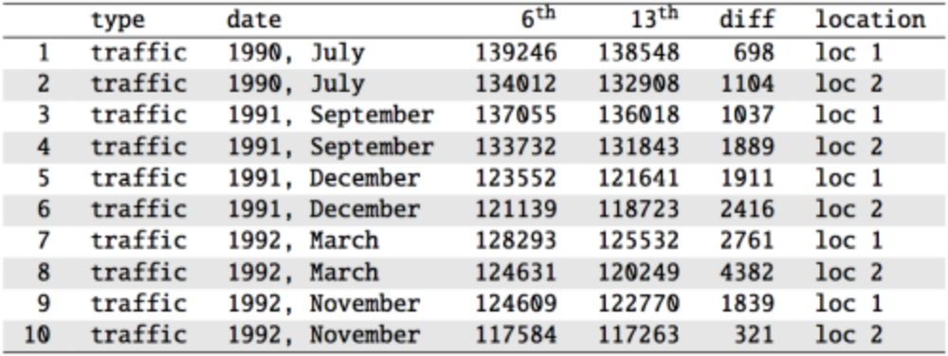

Slide 43
Scanlon, T.J., Luben, R.N., Scanlon, F.L., Singleton, N. (1993), “Is Friday the 13th Bad For Your Health?” BMJ, 307, 1584-1586.

Slide 44
Friday the 13th
We want to investigate if people’s behavior is different on Friday 13th compared to Friday 6th. One approach is to compare the traffic flow on these two days.
$H_{0}$: Average traffic flow on Friday 6th and 13th are equal.
$H_{A}$: Average traffic flow on Friday 6th and 13th are different.
Each case in the data set represents traffic flow recorded at the same location in the same month of the same year: one count from Friday 6th and the other Friday 13th. Are these two counts independent?

Slide 45
Friday the 13th
We want to investigate if people’s behavior is different on Friday 13th compared to Friday 6th. One approach is to compare the traffic flow on these two days.
$H_{0}$: Average traffic flow on Friday 6th and 13th are equal.
$H_{A}$: Average traffic flow on Friday 6th and 13th are different.
Each case in the data set represents traffic flow recorded at the same location in the same month of the same year: one count from Friday 6th and the other Friday 13th. Are these two counts independent?
No

Slide 46
Hypotheses
What are the hypotheses for testing for a difference between the average traffic flow between Friday 6th and 13th?
$H_{0}:μ_{6th}=μ_{13th} versusH_{A}:μ_{6th}≠μ_{13th}$
$H_{0}:p_{6th}=p_{13th} versusH_{A}:p_{6th}≠p_{13th}$
$H_{0}:μ_{diff}=0 versus H_{A}:μ_{diff}≠0$
$H_{0}:{\overline{x}}_{diff}=0 versus H_{A}:{\overline{x}}_{diff}≠0$

Slide 47
Hypotheses
What are the hypotheses for testing for a difference between the average traffic flow between Friday 6th and 13th?
$H_{0}:μ_{6th}=μ_{13th} versus H_{A}:μ_{6th}≠μ_{13th}$
$H_{0}:p_{6th}=p_{13th} versus H_{A}:p_{6th}≠p_{13th}$
$H_{0}:μ_{diff}=0 versus H_{A}:μ_{diff}≠0$
$H_{0}:{\overline{x}}_{diff}=0 versus H_{A}:{\overline{x}}_{diff}≠0$

Slide 48
A Plot of the Data

Slide 49
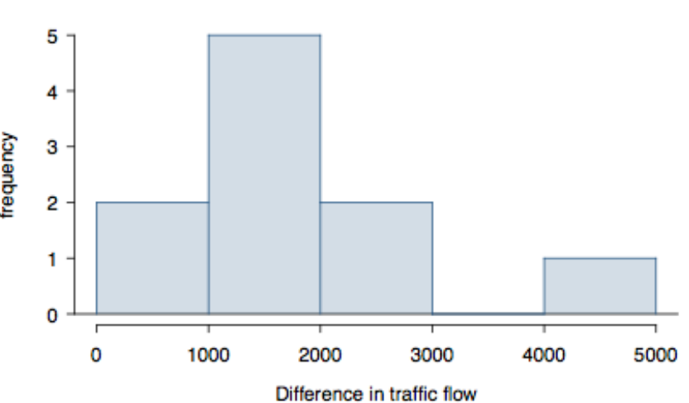

Slide 50
Conditions
Independence: we are told to assume that the cases (rows in the table) are independent
Sample size/skew: the sample distribution, shown on the last slide, does not seem to be extremely skewed, but it’s very difficult to assess with such a small sample size. We might want to think about whether we would expect the population distribution to be skewed or not – probably not, as it should be equally likely to have days with lower than average traffic and higher than average traffic.
Note: $n<30$!
So what do we do when the sample size is small?

Slide 51
Review: Purpose of Large Sample
As long as observations are independent, and the population distribution is not extremely skewed, a large sample would ensure that:
the sampling distribution of the mean is nearly normal
the estimate of the standard error (SE) , as $\frac{s}{\sqrt{n}}$, is reliable

Slide 52
The normality condition
The CLT, which states that sampling distributions will be nearly normal, holds true for any sample size as long as the population distribution is nearly normal.
While this is a helpful special case, it’s inherently difficult to verify normality in small data sets.
We should exercise caution when verifying the normality condition for small samples. It is important to not only examine the data but also think about where the data come from.
For example, ask: would I expect this distribution to be symmetric, and am I confident that outliers are rare?

Slide 53
The $t$ Distribution
When working with small samples, and the population standard deviation is unknown (almost always), the uncertainty of the standard error estimate is addressed by using a new distribution: the $t$ distribution.
This distribution also has a bell shape, but its tails are thicker than the normal model’s.
Therefore observations are more likely to fall beyond two SDs from the mean than under the normal distribution.
These extra thick tails are helpful for resolving our problem with a less reliable estimate the standard error (since $n$ is small)

Slide 54
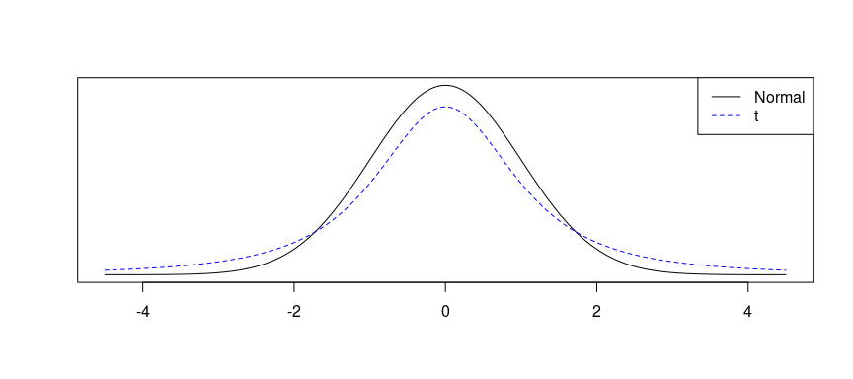
A plot of $t$ versus $N$

Slide 55
The $t$ Distribution (ctd.)
Always centered at zero, like the standard normal ($z$) distribution.
Has a single parameter: degrees of freedom ($df$) – like $χ^{2}$.
What happens to the shape of the $t$ distribution as $df$ increases?

Slide 56
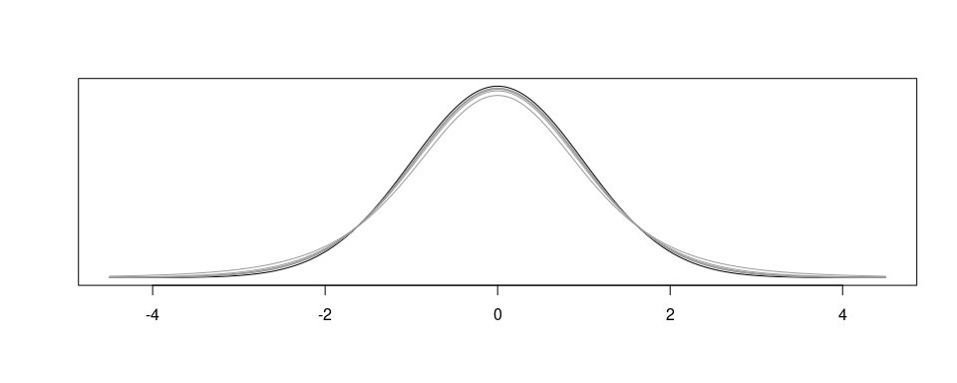
The $t$ Distribution (ctd.)

Slide 57
As $df→∞$, the $t$ distribution approaches the normal!

Slide 58
Asymptotic
What $df$ is required to give arbitrary decimal agreement between the $t$ and $z$ curves?
2 decimals: $df=14$
3 decimals: $df=136$
4 decimals: $df=1370$
What do we usually ask for? 30 $df$ corresponds to 3 decimals for the $[−3,3]$ domain, which is good enough. So once $df>30$, just use a $z$ instead.

Slide 59
Back to Friday the 13th

Slide 61
We have, from this table:
${\overline{x}}_{diff}=1836$
$s_{diff}=1176$
$n=10$

Slide 62
Finding the test statistic
The test statistic for inference on a small-sample mean ($n<50$) is the $t$ statistic with $df=n−1$.
$$t_{df}=\frac{point estimate−null value}{SE}$$
In this context, these become:
Point Estimate: ${\overline{x}}_{diff}=1836$
SE: $SE=\frac{s_{diff}}{\sqrt{n}}=\frac{1176}{\sqrt{10}}=371.88$
$t$: $t=\frac{1836−0}{371.88}=4.937$
$df$: $df=10−1=9$
Note: the null value is $0$ here because the null hypothesis we set at the start of the lecture is $μ_{diff}=0$.

Slide 63
Finding the p-value
The p-value of this test statistic is, again, the tail area under the null (t) distribution.
2 * pt(4.937, df = 9, lower.tail = FALSE)
## [1] 0.0008055524
Since this p-value is smaller than an arbitrary $α=0.05$, we would conclude at a 95% level of significance that our mean difference is not 0. Thus, the data provide convincing evidence of a difference between traffic flow on Friday the 6th and Friday the 13th.

Slide 64
A graphical display

Slide 65
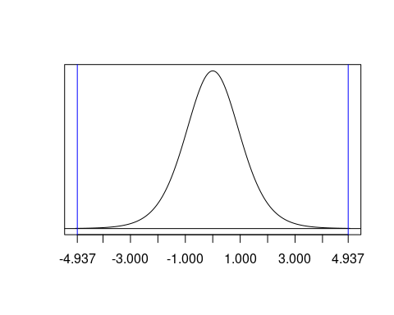

Slide 66
What is the difference?
We concluded that there is a difference in the traffic flow between Friday 6th and 13th.
But it would be more interesting to find out what exactly this difference is.
We can use a confidence interval to estimate this difference.

Slide 67
Confidence intervals for a small-sample mean
Confidence intervals are always of the form
$$point estimate±ME$$
ME is always calculated as the product of a critical value (remember: $z^{*}$) and SE.
Since small-sample means follow a $t$ distribution (and not a $z$ distribution), the critical value is a $t^{*}$ (as opposed to a $z^{*}$).
$$point estimate±t^{*}×SE$$

Slide 68
Finding the critical $t^{*}$
Since $n=10$, we have $df=10−1=9$.
qt(0.025, df = 9)
## [1] -2.262157
qt(0.975, df = 9)
## [1] 2.262157

Slide 69
Practice
Which of the following is the correct calculation of a 95% confidence interval for the difference between the traffic flow between Friday 6th and 13th?
${\overline{x}}_{diff}=1836$, $s_{diff}=1176$ and $n=10$, with $SE=371.88$.
$1836±1.96×372$
$1836±2.26×372$
$1836±2.26×1176$

Slide 70
Practice
Which of the following is the correct calculation of a 95% confidence interval for the difference between the traffic flow between Friday 6th and 13th?
${\overline{x}}_{diff}=1836$, $s_{diff}=1176$ and $n=10$, with $SE=371.88$.
$1836±1.96×372$
$1836±2.26×372→(995,2677)$
$1836±2.26×1176$

Slide 71
Interpreting the CI
Which of the following is the best interpretation for the confidence interval we just calculated?
$$μ_{diff: 6th - 13th}=(995,2677)$$
We are 95% confident that …
the difference between the average number of cars on the road on Friday 6th and 13th is between 995 and 2,677.
on Friday 6th there are 995 to 2,677 fewer cars on the road than on the Friday 13th, on average.
on Friday 6th there are 995 fewer to 2,677 more cars on the road than on the Friday 13th, on average.
on Friday 13th there are 995 to 2,677 fewer cars on the road than on the Friday 6th, on average.

Slide 72
Interpreting the CI
Which of the following is the best interpretation for the confidence interval we just calculated?
$$μ_{diff: 6th - 13th}=(995,2677)$$
We are 95% confident that …
the difference between the average number of cars on the road on Friday 6th and 13th is between 995 and 2,677.
on Friday 6th there are 995 to 2,677 fewer cars on the road than on the Friday 13th, on average.
on Friday 6th there are 995 fewer to 2,677 more cars on the road than on the Friday 13th, on average.
on Friday 13th there are 995 to 2,677 fewer cars on the road than on the Friday 6th, on average.

Slide 73
Synthesis
Does the conclusion from the hypothesis test agree with the findings of the confidence interval?
Do you think the findings of this study suggests that people believe Friday 13th is a day of bad luck?

Slide 74
Synthesis
Does the conclusion from the hypothesis test agree with the findings of the confidence interval?
Yes, the hypothesis test found a significant difference, and the CI does not contain the null value of 0.
Do you think the findings of this study suggests that people believe Friday 13th is a day of bad luck?
No, this is an observational study. We have just observed a significant difference between the number of cars on the road on these two days. We have not tested for people’s beliefs.

Slide 75
Recap: Inference using a small sample mean
If $n<30$, sample means follow a $t$ distribution with $SE=\frac{s}{\sqrt{n}}$.
Conditions:
independence of observations (often verified by a random sample, and if sampling without replacement, $n<10\%$ of population)
$n<30$ and no extreme skew
Hypothesis Testing:
$$t_{df}=\frac{point estimate−null value}{SE}, where df=n−1.$$
Confidence Interval:
$$point estimate±t_{df}^{*}×SE.$$

Slide 76
One Final Note
Note: The example we used was for paired means (difference between dependent groups). We took the difference between the observations and used only these differences (one sample) in our analysis, therefore the mechanics are the same as when we are working with just one sample.
This is the next topic we’ll cover!

