Slide 1
Lecture 06

Slide 2
Normal Distribution

Slide 3
The Normal Distribution
Unimodal and symmetric, bell shaped curve
Many variables are nearly normal, but none are exactly normal
Denoted as $N(μ,σ)→$ Normal with mean $μ$ and standard deviation $σ$

Slide 4
Heights of Males
“The male heights on OkCupid very nearly follow the expected normal distribution – except the whole thing is shifted to the right of where it should be. Almost universally guys like to add a couple inches.”
“You can also see a more subtle vanity at work: starting at roughly 5’8”, the top of the dotted curve tilts even further rightward. This means that guys as they get closer to six feet round up a bit more than usual, stretching for that coveted psychological benchmark.”
http://blog.okcupid.com/index.php/the-biggest-lies-in-online-dating

Slide 5
Heights of Females
“When we looked into the data for women, we were surprised to see height exaggeration was just as widespread, though without the lurch towards a benchmark height.”
http://blog.okcupid.com/index.php/the-biggest-lies-in-online-dating

Slide 6
Normal distributions with different parameters

Slide 7
SAT scores are distributed nearly normally with mean 1500 and standard deviation 300. ACT scores are distributed nearly normally with mean 21 and standard deviation 5. A college admissions officer wants to determine which of the two applicants scored better on their standardized test with respect to the other test takers: Pam, who earned an 1800 on her SAT, or Jim, who scored a 24 on his ACT?

Slide 8
Standardizing with Z-scores
Since we cannot just compare these two raw scores, we instead compare how many standard deviations beyond the mean each observation is.
Pam’s score is $(1800−1500)/300=1$ standard deviation above the mean.
Jim’s score is $(24−21)/5=0.6$ standard deviations above the mean.

Slide 9
Standardizing with Z-scores (continued)
These are called standardized scores, or Z-scores (or Z scores).
Z score of an observation is the number of standard deviations it falls above or below the mean.
$$Z=(observation−mean)/SD$$
Z scores are defined for distributions of any shape, but only when the distribution is normal can we use Z scores to calculate percentiles.
Observations that are more than 2 SD away from the mean ($|Z|>2$) are usually considered unusual.

Slide 10
Percentiles
Percentile is the percentage of observations that fall below a given data point
Graphically, percentile is the area below the probability distribution curve to the left of that observation

Slide 11
Calculating Percentiles using Computation
There are many ways to compute percentiles/areas under the curve.
R:
pnorm(1800, mean = 1500, sd = 300)
## [1] 0.8413447
Applets:

Slide 12
Six Sigma
The term six sigma process comes from the notion that if one has six standard deviations between the process mean and the nearest specification limit, as shown in the graph, practically no items will fail to meet specifications.
http://en.wikipedia.org/wiki/Six_Sigma

Slide 13
Example: Quality Control
At the Heinz ketchup factory, the amounts which go into bottles of ketchup are supposed to be normally distributed with mean 36 oz. and standard deviation 0.11 oz. Once every 30 minutes a bottle is selected from the production line, and its contents are noted precisely. If the amount of ketchup in the bottle is below 35.8 oz. or above 36.2 oz., then the bottle fails the quality control inspection. What percent of bottles have less than 35.8 ounces of ketchup?
Let $X$ = amount of ketchup in a bottle: $X∼N(μ=36,σ=0.11)$
$$Z=\frac{35.8−36}{0.11}=−1.82$$

Slide 14
Finding the exact probability - using R
pnorm(q = -1.82, lower.tail = TRUE)
## [1] 0.0343795
Simple!

Slide 15
Practice
What percentage of bottles pass the quality control inspection?
1.82% 4. 93.12%
3.44% 5. 95.56%
6.88%

Slide 16
Practice
What percentage of bottles pass the quality control inspection?
1.82% 4.
93.12%
3.44% 5. 95.56%
6.88%
$$\begin{matrix}Z_{35.8} & =\frac{35.8−36}{0.11}=−1.82 \\ Z_{36.2} & =\frac{36.2−36}{0.11}=1.82 \\ P(35.8<X<36.2) & =P(−1.82<Z<1.82)=0.9656−0.0344=0.9312=93.12\%\end{matrix}$$

Slide 17
Example: Finding Cutoff Points
Body temperatures of healthy humans are distributed nearly normally with mean 98.2$​^{∘}$F and standard deviation 0.73$​^{∘}$F. What is the cutoff for the lowest 3% of human body temperatures?
$$\begin{matrix}P(X<x) & =0.03→P(Z<−1.88)=0.03 \\ Z & =\frac{obs−mean}{SD}→\frac{x−98.2}{0.73}=−1.88 \\ x & =(−1.88×0.73)+98.2={96.8}^{∘}F\end{matrix}$$
Mackowiak, Wasserman, and Levine (1992), A Critical Appraisal of 98.6 Degrees F, the Upper Limit of the Normal Body Temperature, and Other Legacies of Carl Reinhold August Wunderlick.

Slide 18
Practice
Body temperatures of healthy humans are distributed nearly normally with mean 98.2$​^{∘}$F and standard deviation 0.73$​^{∘}$F. What is the cutoff for the highest 10% of human body temperatures?
97.3$​^{∘}$F 3. 99.4$​^{∘}$F
99.1$​^{∘}$F 4. 99.6$​^{∘}$F

Slide 19
Practice
Body temperatures of healthy humans are distributed nearly normally with mean 98.2$​^{∘}$F and standard deviation 0.73$​^{∘}$F. What is the cutoff for the highest 10% of human body temperatures?
97.3$​^{∘}$F 3. 99.4$​^{∘}$F
99.1$​^{∘}$F 4. 99.6$​^{∘}$F
$$\begin{matrix}P(X>x) & =0.10→P(Z>1.28)=0.10 \\ Z & =\frac{obs−mean}{SD}→\frac{x−98.2}{0.73}=1.28 \\ x & =(1.28×0.73)+98.2={99.1}^{∘}F\end{matrix}$$

Slide 20
68-95-99.7 Rule
For normally distributed data,
about 68% falls within 1 SD of the mean
about 95% falls within 2 SD of the mean
about 99.7% falls within 3 SD of the mean
It is possible for observations to fall 4, 5 or even more standard deviations away from the mean, but these occurrences are very rare if the data are nearly normal.

Slide 21
Describing variability using the 68-95-99.7 Rule
SAT scores are distributed nearly normally, with mean 1500 and standard deviation 300.
$≈$ 68% of students score between 1200 and 1800 on the SAT
$≈$ 95% of students score between 900 and 2100 on the SAT
$≈$ 99.7% of students score between 600 and 2400 on the SAT
Note that it is not possible to achieve more than 2400 points on the SAT. In 2015, 1.7 million students took the SAT, with an average score of 1490 and less than 8500 students scoring higher than 2280.

Slide 22
Example: Number of nights of sleep on school nights

Slide 23
Example: Number of nights of sleep on school nights
Mean = 6.88 hours, SD = 0.92 hours. 72% of the data are within 1 SD of the mean: 6.88 $±$ 0.93.

Slide 24
Example: Number of nights of sleep on school nights
Mean = 6.88 hours, SD = 0.92 hours. 72% of the data are within 1 SD of the mean: 6.88 $±$ 0.93. 92% of the data are within 2 SD of the mean: 6.88 $±$ 2 $×$ 0.93.

Slide 25
Example: Number of nights of sleep on school nights
Mean = 6.88 hours, SD = 0.92 hours. 72% of the data are within 1 SD of the mean: 6.88 $±$ 0.93. 92% of the data are within 2 SD of the mean: 6.88 $±$ 2 $×$ 0.93. 99% of the data are within 3 SD of the mean: 6.88 $±$ 3 $×$ 0.93.

Slide 26
Practice
Which of the following is false?
Majority of Z scores in a right skewed distribution are negative.
In a skewed distributions the Z score of the mean might be different than 0.
For a normal distribution, IQR is less than 2 x SD.
Z scores are helpful for determining how unusual a data point is compared to the rest of the data in the distribution.

Slide 27
Practice
Which of the following is false?
Majority of Z scores in a right skewed distribution are negative.
In a skewed distributions the Z score of the mean might be different than 0.
For a normal distribution, the IQR is less than 2 x SD.
Z scores are helpful for determining how unusual a data point is compared to the rest of the data in the distribution.

Slide 28
The Normal Approximation

Slide 29
Evaluating The Normal Approximation
We often use the normal distribution as an approximation, taking real data and assuming it follows the normal.
How do we tell whether this is a good assumption?

Slide 30
Normal probability plot (QQ)
A histogram and normal probability plot of a sample of 100 male heights.

Slide 31
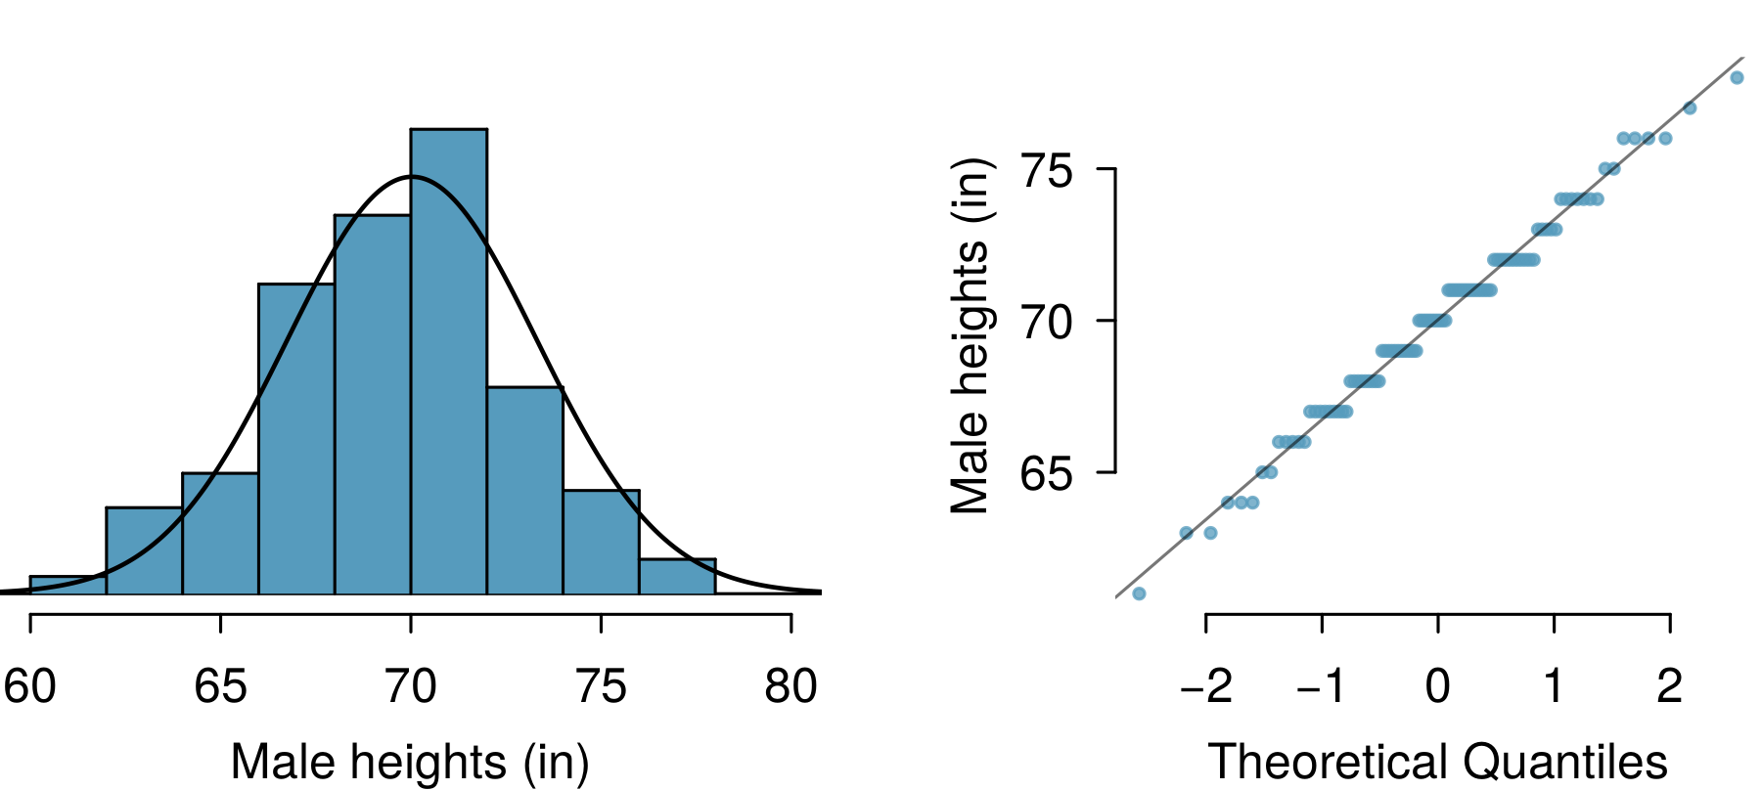

Slide 32
The right hand plot is also called a quantile-quantile plot, or QQ plot for short.

Slide 33
Anatomy of a normal probability plot
Data are plotted on the y-axis of a normal probability plot, and theoretical quantiles (following a normal distribution) on the x-axis.
If there is a linear relationship in the plot, then the data follow a nearly normal distribution.
Constructing a normal probability plot requires calculating percentiles and corresponding z-scores for each observation, which is tedious. Therefore we generally rely on R when making these plots.

Slide 34
NBA Heights, 2008-09
Below is a histogram and normal probability plot for the NBA heights from the 2008-2009 season. Do these data appear to follow a normal distribution?

Slide 35
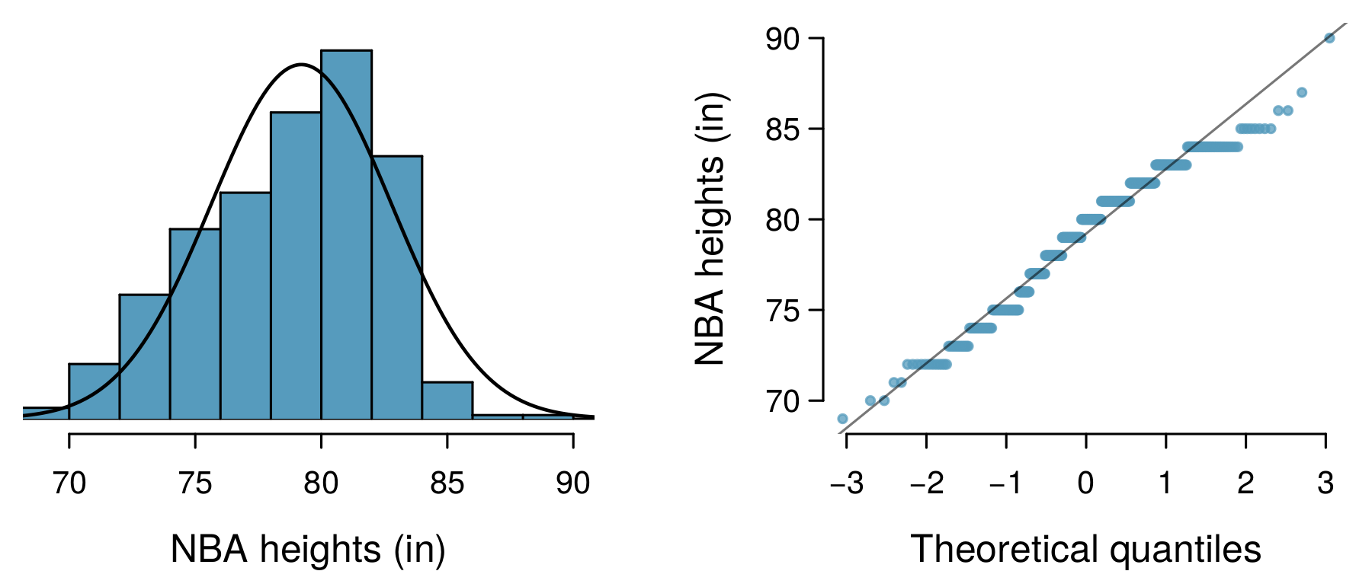

Slide 36
NBA Heights, 2008-09
Below is a histogram and normal probability plot for the NBA heights from the 2008-2009 season. Do these data appear to follow a normal distribution?

Slide 38
Why do the points on the normal probability have jumps?

Slide 39
Normal probability plot and skewness
Left Skew

Slide 40
Normal probability plot and skewness
Right Skew

Slide 41
Normal probability plot and skewness
Long Tails

Slide 42
Normal probability plot and skewness
Short Tails

Slide 43
Binomial Distribution (again)

Slide 44
The Binomial Distribution

Slide 45
Gallup Poll: Obesity in America
A 2012 Gallup survey suggests that 26.2% of Americans are obese. Among a random sample of 10 Americans, what is the probability that exactly 8 are obese?
pretty high?
pretty low?
Gallup: http://www.gallup.com/poll/160061/obesity-rate-stable-2012.aspx , January 23, 2013.

Slide 46
Gallup Poll: Obesity in America
A 2012 Gallup survey suggests that 26.2% of Americans are obese. Among a random sample of 10 Americans, what is the probability that exactly 8 are obese?
${0.262}^{8}×{0.738}^{2}$
$\left({8 \atop 10}\right)×{0.262}^{8}×{0.738}^{2}$
$\left({10 \atop 8}\right)×{0.262}^{8}×{0.738}^{2}$
$\left({10 \atop 8}\right)×{0.262}^{2}×{0.738}^{8}$

Slide 47
Gallup Poll: Obesity in America
A 2012 Gallup survey suggests that 26.2% of Americans are obese. Among a random sample of 10 Americans, what is the probability that exactly 8 are obese?
${0.262}^{8}×{0.738}^{2}$
$\left({8 \atop 10}\right)×{0.262}^{8}×{0.738}^{2}$
$\left({10 \atop 8}\right)×{0.262}^{8}×{0.738}^{2}=45×{0.262}^{8}×{0.738}^{2}=0.0005$
$\left({10 \atop 8}\right)×{0.262}^{2}×{0.738}^{8}$

Slide 48
The birthday problem
What is the probability that 2 randomly chosen people share a birthday?
Pretty low, $\frac{1}{365}≈0.0027$.

Slide 49
The birthday problem
What is the probability that 2 randomly chosen people share a birthday?
Pretty low, $\frac{1}{365}≈0.0027$.
What is the probability that at least 2 people out of 366 people share a birthday?
Exactly 1! (Excluding the possibility of a leap year birthday.)

Slide 50
The birthday problem (cont.)
What is the probability that at least 2 people (1 match) out of 121 people share a birthday?
Somewhat complicated to calculate, but we can think of it as the complement of the probability that there are no matches in 121 people.
$$\begin{matrix}P(no matches) & = & 1×\left(1−\frac{1}{365}\right)×\left(1−\frac{2}{365}\right)×⋯×\left(1−\frac{120}{365}\right)\end{matrix}$$

Slide 51
The birthday problem (cont.)
What is the probability that at least 2 people (1 match) out of 121 people share a birthday?
$$\begin{matrix}P(no matches) & = & \frac{365×364×⋯×245}{{365}^{121}} \\ & = & \frac{365!}{{365}^{121}×(365−121)!} \\ & = & \frac{121!×\left({365 \atop 121}\right)}{{365}^{121}}≈0 \\ P(at least 1 match) & ≈ & 1\end{matrix}$$

Slide 52
Expected value
A 2012 Gallup survey suggests that 26.2% of Americans are obese.
Among a random sample of 100 Americans, how many would you expect to be obese?

Slide 53
Expected value
A 2012 Gallup survey suggests that 26.2% of Americans are obese.
Among a random sample of 100 Americans, how many would you expect to be obese?
Easy enough, $100×0.262=26.2$.
Or more formally, $μ=np=100×0.262=26.2$.
But this doesn’t mean in every random sample of 100 people exactly 26.2 will be obese. In fact, that’s not even possible. In some samples this value will be less, and in others more. How much would we expect this value to vary?

Slide 54
Expected value and its variability
Mean and standard deviation of binomial distribution
$$μ=np σ=\sqrt{np(1−p)}$$
Going back to the obesity rate:
$$σ=\sqrt{np(1−p)}=\sqrt{100×0.262×0.738}≈4.4$$
We would expect 26.2 out of 100 randomly sampled Americans to be obese, with a standard deviation of 4.4.
Note: Mean and standard deviation of a binomial might not always be whole numbers, and that is alright, these values represent what we would expect to see on average.

Slide 55
Unusual observations
Using the notion that observations that are more than 2 standard deviations away from the mean are considered unusual and the mean and the standard deviation we just computed, we can calculate a range for the plausible number of obese Americans in random samples of 100.
$$26.2±(2×4.4)=(17.4,35)$$

Slide 56
Gallup Poll: Home Schooling
An August 2012 Gallup poll suggests that 13% of Americans think home schooling provides an excellent education for children. Would a random sample of 1,000 Americans where only 100 share this opinion be considered unusual?
Yes
No

Slide 57
Gallup Poll: Home Schooling
$$\begin{matrix}μ & =np=1,000×0.13=130 \\ σ & =\sqrt{np(1−p)}=\sqrt{1,000×0.13×0.87}≈10.6\end{matrix}$$
Method 1: Range of usual observations: $130±2×10.6=(108.8,151.2)$ (100 is outside this range, so would be considered unusual)
Method 2: Z-score of observation: $Z=\frac{x−mean}{SD}=\frac{100−130}{10.6}=−2.83$ (100 is more than 2 SD below the mean, so would be considered unusual)
http://www.gallup.com/poll/156974/private-schools-top-marks-educating-children.aspx

Slide 58
Normal approximation to the binomial (Practice)
Go to https://gallery.shinyapps.io/dist_calc/ and choose Binomial coin experiment in the drop down menu on the left.
Set the number of trials to 20 and the probability of success to 0.15. Describe the shape of the distribution of number of successes.
Keeping $p$ constant at 0.15, determine the minimum sample size required to obtain a unimodal and symmetric distribution of number of successes. Please submit only one response per team.
Further considerations:
What happens to the shape of the distribution as $n$ stays constant and $p$ changes?
What happens to the shape of the distribution as $p$ stays constant and $n$ changes?

Slide 59
Distributions of number of successes
Hollow histograms of samples from the binomial model where $p=0.10$ and $n=10$, $30$, $100$, and $300$. What happens as $n$ increases?

Slide 60
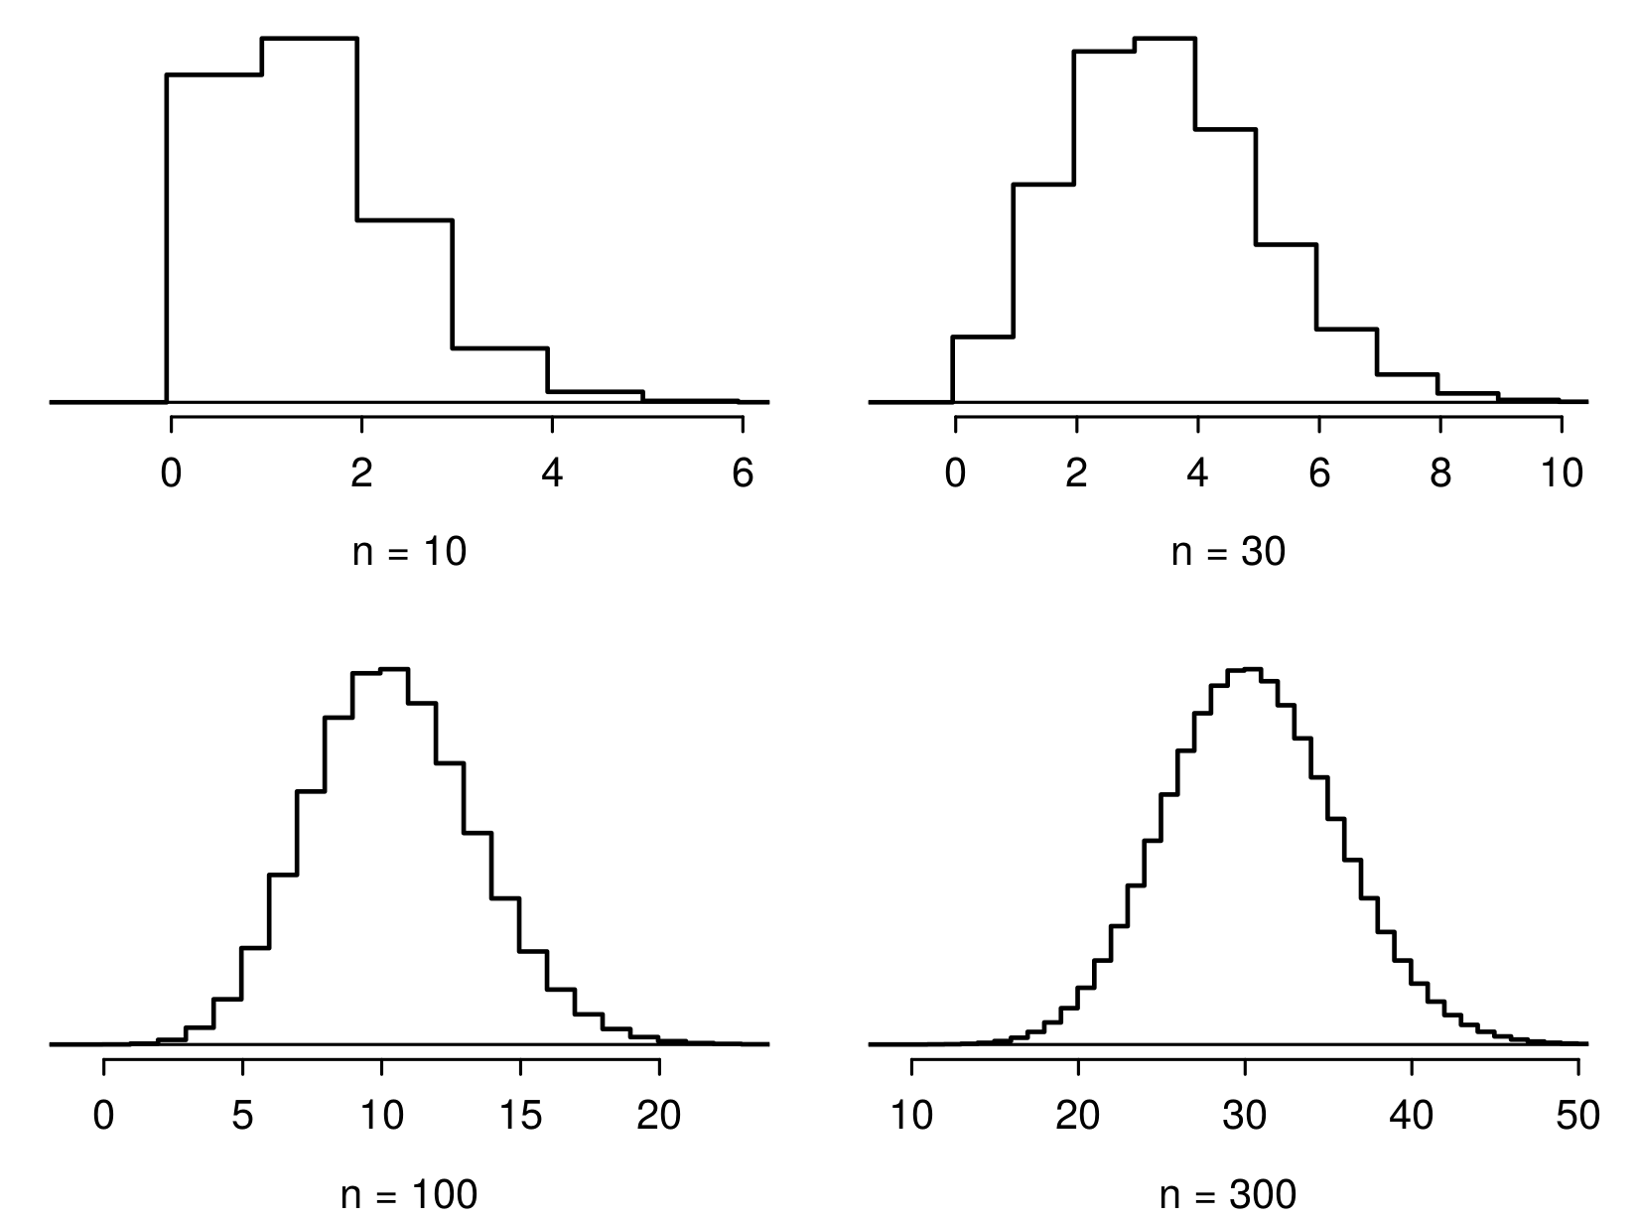

Slide 61
Low large is large enough?
The sample size is considered large enough if the expected number of successes and failures are both at least 10.
$$np≥10 and n(1−p)≥10$$

Slide 62
Practice
Below are four pairs of Binomial distribution parameters. Which distribution can be approximated by the normal distribution?
$n=100,p=0.95$
$n=25,p=0.45$
$n=150,p=0.05$
$n=500,p=0.015$

Slide 63
Practice
Below are four pairs of Binomial distribution parameters. Which distribution can be approximated by the normal distribution?
$n=100,p=0.95$
$n=25,p=0.45→25×0.45=11.25;25×0.55=13.75$
$n=150,p=0.05$
$n=500,p=0.015$

Slide 64
An analysis of Facebook users
A recent study found that “Facebook users get more than they give”. For example:
40% of Facebook users in our sample made a friend request, but 63% received at least one request
Users in our sample pressed the like button next to friends’ content an average of 14 times, but had their content “liked” an average of 20 times
Users sent 9 personal messages, but received 12
12% of users tagged a friend in a photo, but 35% were themselves tagged in a photo
Any guesses for how this pattern can be explained?

Slide 65
An analysis of Facebook users
A recent study found that ``Facebook users get more than they give". For example:
40% of Facebook users in our sample made a friend request, but 63% received at least one request
Users in our sample pressed the like button next to friends’ content an average of 14 times, but had their content “liked” an average of 20 times
Users sent 9 personal messages, but received 12
12% of users tagged a friend in a photo, but 35% were themselves tagged in a photo
Any guesses for how this pattern can be explained?
Power users contribute much more content than the typical user.
http://www.pewinternet.org/Reports/2012/Facebook-users/Summary.aspx

Slide 66
This study also found that approximately 25% of Facebook users are considered power users. The same study found that the average Facebook user has 245 friends. What is the probability that the average Facebook user with 245 friends has 70 or more friends who would be considered power users? Note any assumptions you must make.
We are given that $n=245,p=0.25$, and we are asked for the probability $P(K≥70)$. To proceed, we need independence, which we’ll assume but could check if we had access to more Facebook data.

Slide 67
We are given that $n=245,p=0.25$, and we are asked for the probability $P(K≥70)$. To proceed, we need independence, which we’ll assume but could check if we had access to more Facebook data.
$$\begin{matrix}P(X≥70) & =P(K=70 or K=71 or K=72 or ⋯ or K=245) \\ & =P(K=70)+P(K=71)+P(K=72)+⋯+P(K=245)\end{matrix}$$
This seems like an awful lot of work…

Slide 68
Could Use R …
sum(dbinom(x = 70:245, size = 245, prob = 0.25))
## [1] 0.112763
pbinom(q = 69, size = 245, prob = 0.25, lower.tail = FALSE)
## [1] 0.112763

Slide 69
Normal approximation to the binomial
When the sample size is large enough, the binomial distribution with parameters $n$ and $p$ can be approximated by the normal model with parameters $μ=np$ and $σ=\sqrt{np(1−p)}$.
In the case of the Facebook power users, $n=245$ and $p=0.25$.
$$μ=245×0.25=61.25 σ=\sqrt{245×0.25×0.75}=6.778$$
$Bin(n=245,p=0.25)≈N(μ=61.25,σ=6.778)$.

Slide 70
Normal approximation to the binomial
In the case of the Facebook power users, $n=245$ and $p=0.25$.
$$μ=245×0.25=61.25 σ=\sqrt{245×0.25×0.75}=6.778$$
$Bin(n=245,p=0.25)≈N(μ=61.25,σ=6.778)$.

Slide 71
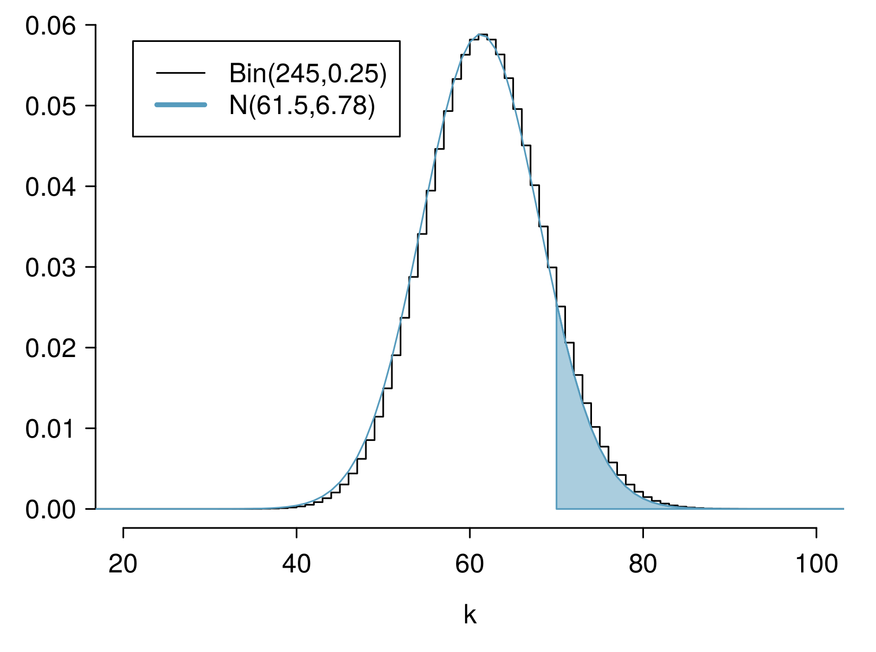

Slide 72
Computing the Approximation
What is the probability that the average Facebook user with 245 friends has 70 or more friends who would be considered power users?
$$\begin{matrix}Z & =\frac{obs−mean}{SD}=\frac{70−61.25}{6.778} \\ & =1.29094 \\ P(Z>1.29094) & =1−0.90164 \\ & =0.09836\end{matrix}$$

Slide 73
Computing the Approximation
What is the probability that the average Facebook user with 245 friends has 70 or more friends who would be considered power users?
But where did this $P(Z>1.29)$ answer come from? R again!
$$\begin{matrix}Z & =\frac{obs−mean}{SD}=\frac{70−61.25}{6.778} \\ & =1.29094 \\ P(Z>1.29094) & =1−0.90164 \\ & =0.09836\end{matrix}$$

Slide 74
Computing Normal Probabilities
Just like we did for pbinom() and dbinom(), we can do for pnorm() and dnorm(). You saw this in workshop last week.
pnorm(1.290964, lower.tail = FALSE)
## [1] 0.09835808

Slide 75
This seems … bad
We know the exact probability, done using pbinom(), is 0.1128. So why is this “approximation” giving an answer of 0.09836?

Slide 76
This seems … bad
We know the exact probability, done using pbinom(), is 0.1128. So why is this “approximation” giving an answer of 0.09836?

Slide 78
“Correction for Continuity”
The normal approximation to the binomial can be a little rough. There is a correction for continuity which can be used instead:
The cutoff values for the lower end of a shaded region should be reduced by 0.5
The cutoff values for the upper end should be increased by 0.5.
Since we are doing a “greater than” probability, the lower end of the shaded region is our relevant object, so we reduce.

Slide 79
Computing Normal Probabilities
$$\begin{matrix}Z & =\frac{obs−mean}{SD}=\frac{(70−0.5)−61.25}{6.778} \\ & =1.217173 \\ P(Z>1.217173) & =1−0.8882308 \\ & =0.1117692\end{matrix}$$
pnorm(1.217173, lower.tail = FALSE)
## [1] 0.1117692
That’s much better!

Slide 80
Inverse Normal Problems

Slide 81
The Inverse Problem
As we’ve seen in the previous, we often need to take $Z$-scores and find probabilities from them. Sometimes this is in a normal problem, sometimes an approximation, and so on.
What if you wanted to go backward? What would this look like?

Slide 82
Inverse Problem Statement
What if I told you “the probability of this event happening is 0.5”. What would the $Z$-score of such a setup be?
$$P(Z≤z_{0})=0.5$$
What’s the unknown here? $z_{0}$!

Slide 83
How do we solve for $z_{0}$?
trial and error?
use R!

Slide 84
Using R to Find $z_{0}$
qnorm(p = 0.5, mean = 0, sd = 1, lower.tail = TRUE)
## [1] 0
Does this make sense? This is saying that $z_{0}=0$ has probability to its left of 0.5.
pnorm(q = 0, mean = 0, sd = 1, lower.tail = TRUE)
## [1] 0.5

Slide 85
Checking Again
x <- seq(from = -3, to = 3, by = 0.01) plot(x, dnorm(x), type = "l", xlab = "Z") abline(h = 0) abline(v = 0, col = "red")

Slide 86
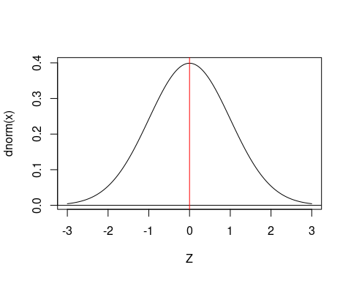

Slide 87
Practice
What value of $z_{0}$ has $P(−z_{0}≤Z≤z_{0})=0.3$?

Slide 88
Practice
What value of $z_{0}$ has $P(−z_{0}≤Z≤z_{0})=0.3$?

Slide 89
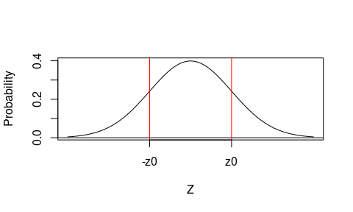

Slide 90
So what do we actually need to run?

Slide 91
Practice
qnorm(p = 0.15, mean = 0, sd = 1, lower.tail = TRUE)
## [1] -1.036433
This is -z0, because we used 0.15 area to the left, and lower.tail = TRUE.
qnorm(p = 0.15, mean = 0, sd = 1, lower.tail = FALSE)
## [1] 1.036433
And this is $z_{0}$, because lower.tail = FALSE.

Slide 92
Extras
Watch for a video in the Extras folder with some additional examples solving these inverse problems: it’s a very important idea!

