Slide 1
MATH 1051H S61: Lecture #03

Slide 2
Examining Numerical Data

Slide 3
Scatterplots
Scatterplots are useful for visualizing the relationship between two numerical variables.
Do life expectancy and total fertility appear to be associated or independent?
They appear to be linearly and negatively associated: as fertility increases, life expectancy decreases.
Was the relationship the same throughout the years, or did it change?
The relationship changed over the years.

Slide 4
Dot Plots
Useful for visualizing one numerical variable. Darker colors represent areas where there are more observations.
How would you describe the distribution of GPAs in this data set?
Make sure to say something about the center, shape, and spread of the distribution.

Slide 5
Dot Plots and Mean
The mean, also called the average (marked with a triangle in the plot), is one way to measure the center of a distribution of data.
The mean GPA is 3.59.

Slide 6
Mean
The sample mean, denoted as $\overline{x}$, can be calculated as
$$\overline{x}=\frac{x_{1}+x_{2}+⋯+x_{n}}{n}=\frac{1}{n}\sum_{i=1}^{n}{x_{i}}$$
where $x_{1},x_{2},⋯,x_{n}$ represent the $n$ observed values.
The population mean is also computed the same way but is denoted as $μ$. It is often not possible to calculate $μ$ since population data are rarely available.
The sample mean is a sample statistic, and serves as a point estimate of the population mean. This estimate may not be perfect, but if the sample is good (representative of the population), it is usually a pretty good estimate.

Slide 7
Calculating
I will never expect you to compute a mean without a calculator. In practice, we do this using R almost always. For example,
x <- c(1, 3, 8, 14, 21) mean(x)
## [1] 9.4

Slide 8
Stacked Dot Plot
Higher bars represent areas where there are more observations, makes it a little easier to judge the center and the shape of the distribution.

Slide 9
Histograms $−$ Extracurricular Hours
Histograms provide a view of the data density. Higher bars represent where the data are relatively more common.
Histograms are especially convenient for describing the shape of the data distribution.
The chosen bin width can alter the story the histogram is telling.

Slide 10
Bin Width
Which one(s) of these histograms are useful? Which reveal too much about the data? Which hide too much?

Slide 12
Shape of a Distribution: Modality
Does the histogram have a single prominent peak (unimodal), several prominent peaks (bimodal/multimodal), or no apparent peaks (uniform)?
Note: In order to determine modality, step back and imagine a smooth curve over the histogram – imagine that the bars are wooden blocks and you drop a limp spaghetti over them, the shape the spaghetti would take could be viewed as a smooth curve.

Slide 13
Shape of a Distribution: Skewness
Is the histogram right skewed, left skewed or symmetric?
Histograms are said to be skewed to the side of the long tail.

Slide 14
Shape of a Distribution: Unusual Observations
Are there any unusual observations or potential outliers?

Slide 15
Commonly observed shapes of distributions
Modality
Skewness

Slide 16
Practice
Which of these variables do you expect to be uniformly distributed?
weights of adult females
salaries of a random sample of people from North Carolina
house prices
birthdays of classmates (day of the month)

Slide 17
Practice
Which of these variables do you expect to be uniformly distributed?
weights of adult females
salaries of a random sample of people from North Carolina
house prices
birthdays of classmates (day of the month)

Slide 18
Application Activity: Shapes of Distributions
Sketch the expected distributions of the following variables:
number of piercings
scores on an exam
IQ scores
Come up with a concise way (1-2 sentences) to teach someone how to determine the expected distribution of any variable.

Slide 19
Are you typical?
How useful are centers alone for conveying the true characteristics of a distribution?

Slide 20
Variance
Variance is roughly the average squared deviation from the mean.
$$s^{2}=\frac{1}{n−1}\sum_{i=1}^{n}{(}x_{i}−\overline{x})^{2}$$
The sample mean is $\overline{x}=6.71$, and the sample size is $n=217$.
The variance of the amount of sleep students get per night can be calculated as:
$$\begin{matrix}s^{2} & =\frac{1}{217−1}\left[(5−6.71)^{2}+(9−6.71)^{2}+⋯+(7−6.71)^{2}\right] \\ & =4.11{ hours}^{2}\end{matrix}$$

Slide 21
Variance (continued)
Why do we use the squared deviation in the calculation of variance?
To get rid of negatives so that observations equally distant from the mean are weighed equally.
To weigh larger deviations more heavily.

Slide 22
Standard Deviation
The standard deviation is the square root of the variance, and has the same units as the data.
$$s=\sqrt{s^{2}}$$
The standard deviation of the amount of sleep students get per night can be calculated as:
$$s=\sqrt{4.11}=2.03 hours$$
We can see that all of the data are within 3 standard deviations of the mean of $\overline{x}=6.17$.

Slide 23
Calculating
I will never expect you to compute a variance or SD without a calculator. In practice, we do this using R almost always. For example,
x <- c(1, 3, 8, 14, 21) var(x)
## [1] 67.3
sd(x)
## [1] 8.203658
sqrt(var(x))
## [1] 8.203658

Slide 24
Median
The median is the value that splits the data in half when ordered in ascending order.

Slide 25


Slide 26
If there are an even number of observations, then the median is the average of the two values in the middle.

Slide 27
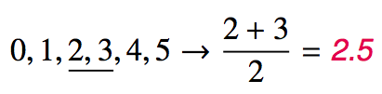

Slide 28
Since the median is the midpoint of the data, 50% of the values are below it. Hence, it is also the 50th percentile.

Slide 29
Calculating
Medians can’t really be computed with calculators, but we’ll use R for this anyway …
x <- c(1, 3, 8, 14, 21) median(x)
## [1] 8

Slide 30
Percentile
A percentile is the the smallest value from an ordered list of numbers which is greater than or equal to that percentage of list elements.
Example: The ${42}^{nd}$ percentile of the numbers $\{1,2,3,⋯,99,100\}$ is 42.
It can become quite complicated when there aren’t an even multiple of 100 items!

Slide 31
Q1, Q3 and IQR
The 25th percentile is also called the first quartile, Q1.
The 50th percentile is also called the median.
The 75th percentile is also called the third quartile, Q3.
Between Q1 and Q3 is the middle 50% of the data. The range these data span is called the interquartile range, or the IQR.
$$IQR=Q3−Q1$$

Slide 32
Calculating
Quantiles are actually hard to do with calculators, but R makes it easy.
x <- sample(1:100, size = 20, replace = TRUE) quantile(x, probs = c(0.4, 0.6))
## 40% 60% ## 41.4 62.2
This computes the 40th and 60th percentiles.

Slide 33
Plotting as Numerical Summary

Slide 34
Box Plot
The box in a box plot represents the middle 50% of the data, and the thick line in the box is the median.

Slide 35
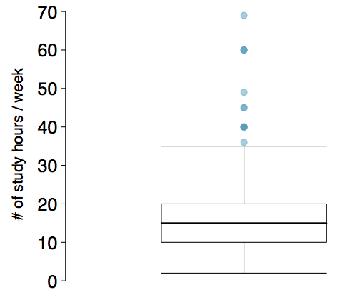

Slide 36
Anatomy of a Box Plot

Slide 37
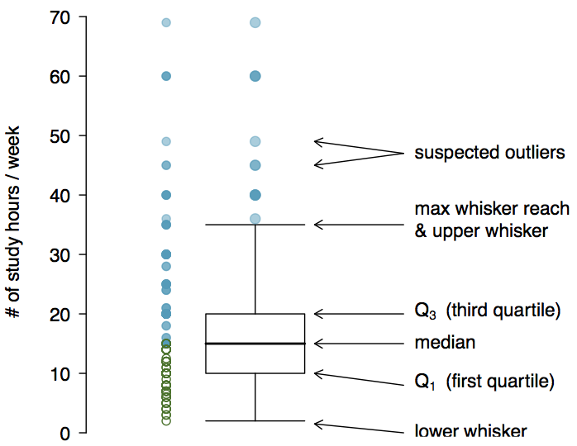

Slide 38
Whiskers and Outliers
The whiskers of a box plot can extend up to $1.5×IQR$ away from the quartiles.
max upper whisker reach = $Q3+1.5×IQR$
max lower whisker reach = $Q1−1.5×IQR$
Example: IQR: 20 - 10 = 10
max upper whisker reach = $20+1.5×10=35$
max lower whisker reach = $10−1.5×10=−5$
A potential outlier is defined as an observation beyond the maximum reach of the whiskers. It is an observation that appears extreme relative to the rest of the data.

Slide 39
Outliers (continued)
Why is it important to look for outliers?
Identify extreme skew in the distribution.
Identify data collection and entry errors.
Provide insight into interesting features of the data.

Slide 40
Extreme Observations
How would sample statistics such as mean, median, SD, and IQR of household income be affected if the largest value was replaced with $10 million? What if the smallest value was replaced with $10 million?

Slide 41
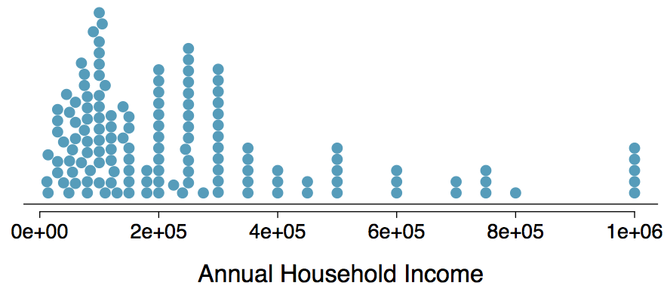

Slide 42
Robust Statistics

Slide 43
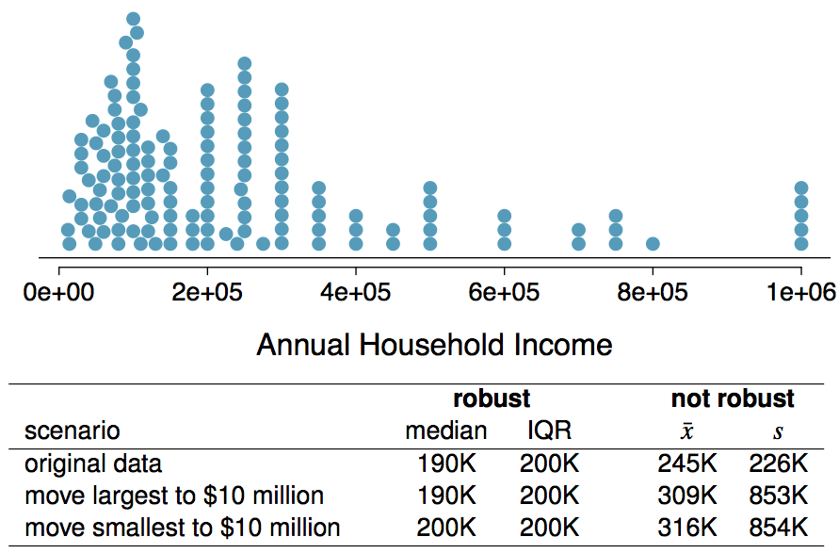

Slide 44
Robust Statistics
Median and IQR are more robust to skewness and outliers than mean and SD. Therefore,
for skewed distributions it is often more helpful to use median and IQR to describe the center and spread
for symmetric distributions it is often more helpful to use the mean and SD to describe the center and spread
If you would like to estimate the typical household income for a student, would you be more interested in the mean or median income?

Slide 45
Robust Statistics
Median and IQR are more robust to skewness and outliers than mean and SD. Therefore,
for skewed distributions it is often more helpful to use median and IQR to describe the center and spread
for symmetric distributions it is often more helpful to use the mean and SD to describe the center and spread
If you would like to estimate the typical household income for a student, would you be more interested in the mean or median income?
Median

Slide 46
Mean versus Median
If the distribution is symmetric, center is often defined as the mean:
mean $≈$ median
If the distribution is skewed or has extreme outliers, center is often defined as the median
Right-skewed: mean > median
Left-skewed: mean < median

Slide 47
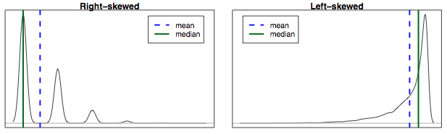

Slide 48
Practice
Which is most likely true for the distribution of percentage of time actually spent taking notes in class versus on Facebook, Twitter, etc.?

Slide 49
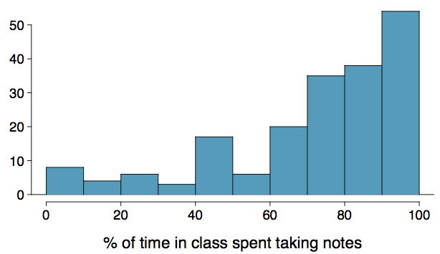

Slide 50
mean > median 3. mean $≈$ median
mean < median 4. impossible to tell

Slide 51
Practice
Which is most likely true for the distribution of percentage of time actually spent taking notes in class versus on Facebook, Twitter, etc.?
If we compute, the mean = 80% and the median = 76%. So …
mean > median 3. mean $≈$ median
mean < median 4. impossible to tell

